Slide 1
ePIC SVT Disk Thermal Study
Nick Payne
npayne@lbl.gov

Slide 2
Objectives
Develop an FEA model that predicts maximum temperatures of detector components.
Perform experiments and compare to FEA model results.
Characterize natural convection coefficient.
Evaluate Nusselt number correlations.
Gain insight into the design variables that influence cooling performance.

Slide 3
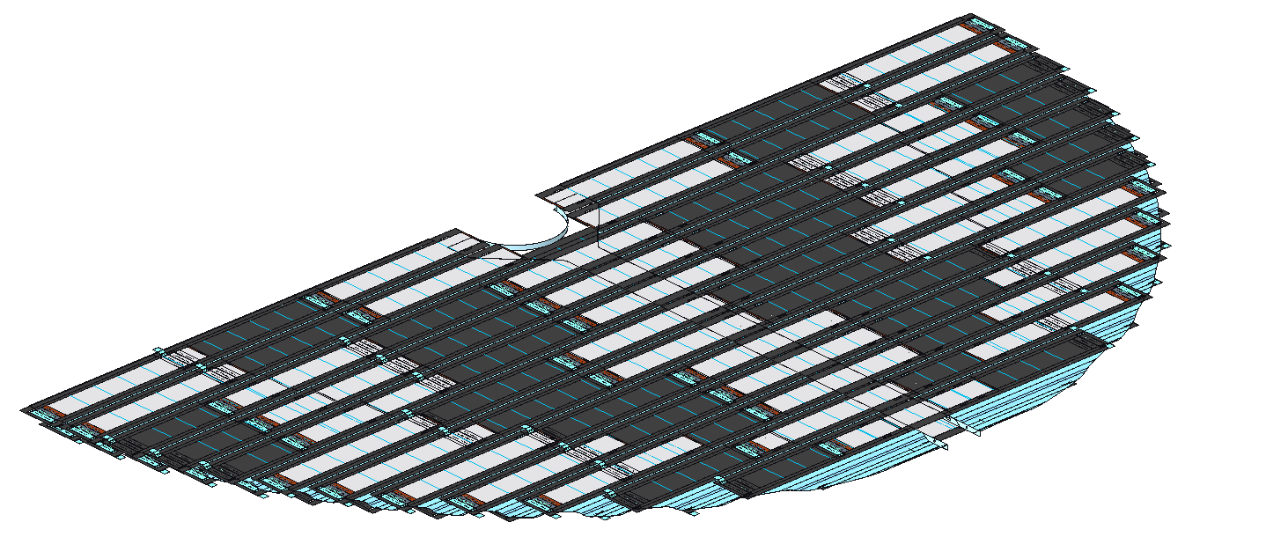
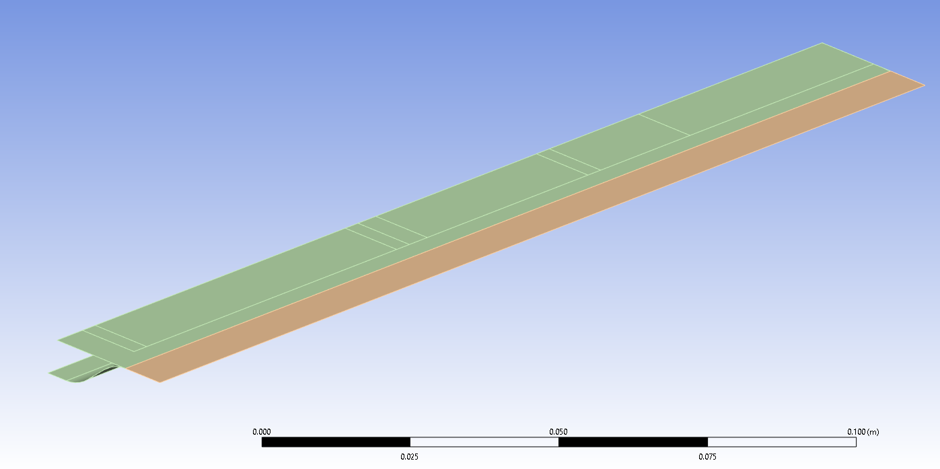
Modeling Approach
Simplest model which captures thermal response.
Shell model (2D) used instead of 3D components.
Composite support and Kapton heaters homogenized into single part.

Slide 4

Homogenization
Thermal conductivity, $κ$.
Composite: $κ_{x}=180\frac{W}{m∙K}$, $κ_{y}=90\frac{W}{m∙K}$, $κ_{z}=1\frac{W}{m∙K}$, $t=0. 07mm$
Heater (Kapton): $κ=0.12\frac{W}{m∙K},t=0. 1mm$
Sequence:
$$\left[0_{h},0_{c},{90}_{c},0_{c}\right];$$
$$h=heater, c=composite$$
h
z
c
x

Slide 5
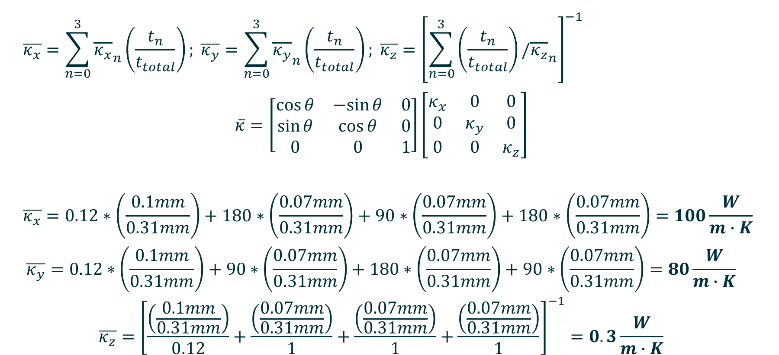
Conductivity Homogenization
$$\overline{κ_{x}}=\sum_{n=0}^{3}{{\overline{κ_{x}}}_{n}\left(\frac{t_{n}}{t_{total}}\right)}; \overline{κ_{y}}=\sum_{n=0}^{3}{{\overline{κ_{y}}}_{n}\left(\frac{t_{n}}{t_{total}}\right)}; \overline{κ_{z}}={\left[\sum_{n=0}^{3}{\left(\frac{t_{n}}{t_{total}}\right)/{\overline{κ_{z}}}_{n}}\right]}^{−1}$$
$$\overline{κ}=\left[\begin{matrix}\cos{θ} & −sin{θ} & 0 \\ \sin{θ} & \cos{θ} & 0 \\ 0 & 0 & 1\end{matrix}\right]\left[\begin{matrix}κ_{x} & 0 & 0 \\ 0 & κ_{y} & 0 \\ 0 & 0 & κ_{z}\end{matrix}\right]$$
$$\overline{κ_{x}}=0.12∗\left(\frac{0.1mm}{0.31mm}\right)+180∗\left(\frac{0.07mm}{0.31mm}\right)+90∗\left(\frac{0.07mm}{0.31mm}\right)+180∗\left(\frac{0.07mm}{0.31mm}\right)=100\frac{W}{m∙K}$$
$$\overline{κ_{y}}=0.12∗\left(\frac{0.1mm}{0.31mm}\right)+90∗\left(\frac{0.07mm}{0.31mm}\right)+180∗\left(\frac{0.07mm}{0.31mm}\right)+90∗\left(\frac{0.07mm}{0.31mm}\right)=80\frac{W}{m∙K}$$
$$\overline{κ_{z}}={\left[\frac{\left(\frac{0.1mm}{0.31mm}\right)}{0.12}+\frac{\left(\frac{0.07mm}{0.31mm}\right)}{1}+\frac{\left(\frac{0.07mm}{0.31mm}\right)}{1}+\frac{\left(\frac{0.07mm}{0.31mm}\right)}{1}\right]}^{−1}=0.3\frac{W}{m∙K}$$

Slide 6
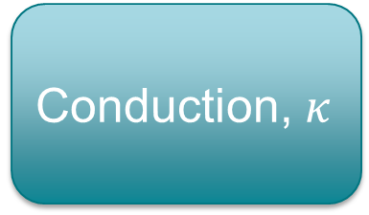
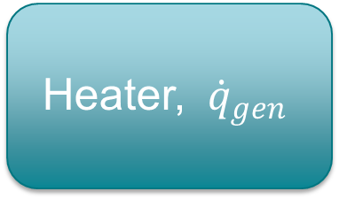
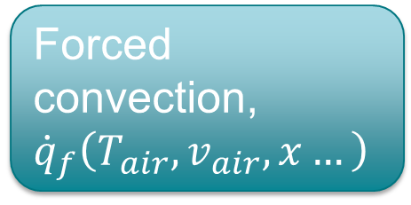
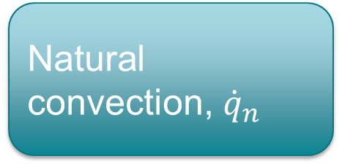
Heat Balance
Natural convection, ${\dot{q}}_{n}$
Heater, ${\dot{q}}_{gen}$
Conduction, $κ$
Forced convection, ${\dot{q}}_{f}\left(T_{air},v_{air}, x…\right)$

Slide 7
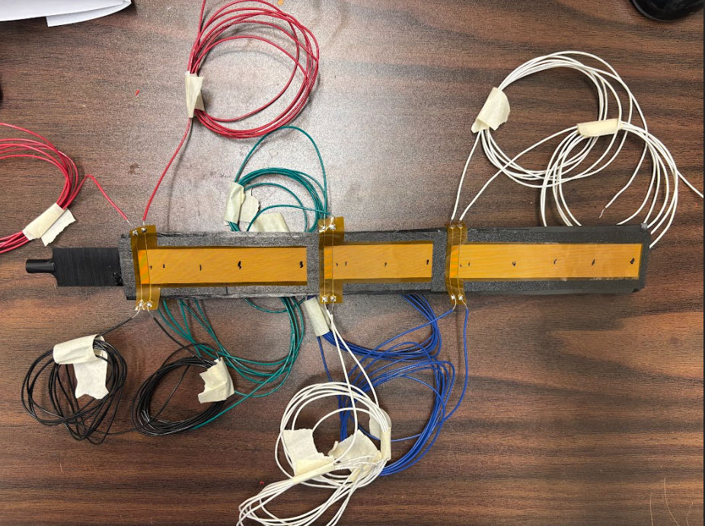
Test Specimen Configuration

Slide 8
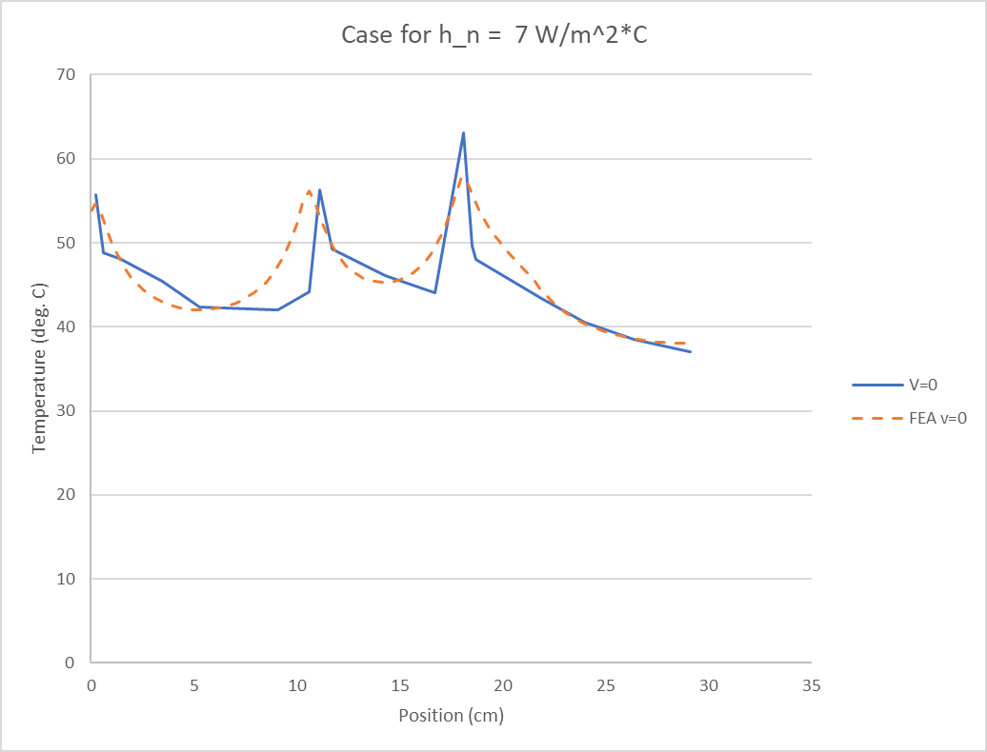
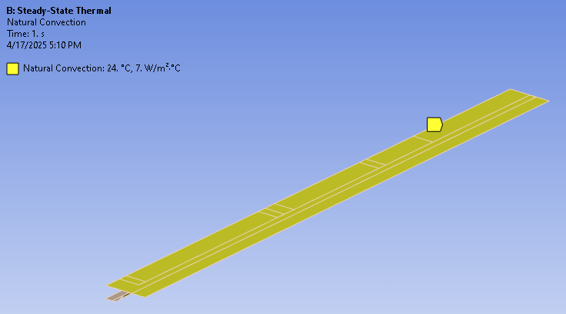
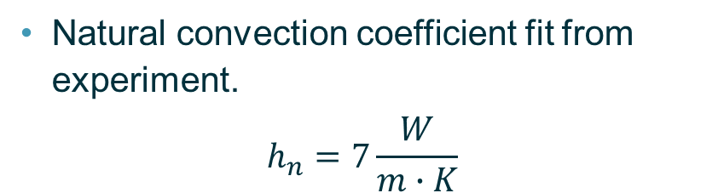
Natural Convection Case
Natural convection coefficient fit from experiment.
$$h_{n}=7\frac{W}{m∙K}$$

Slide 9
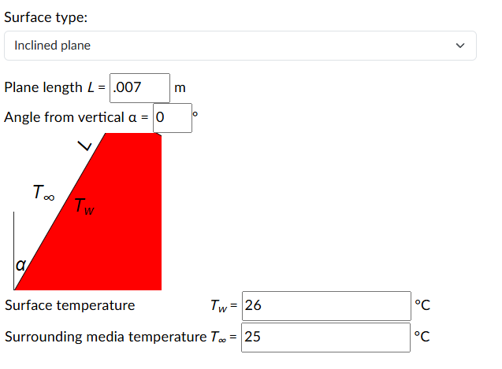
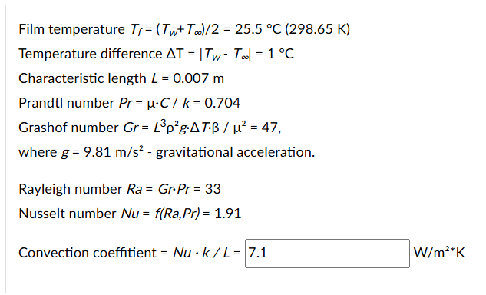
Coefficient Value
$h_{n}=7\frac{W}{m∙K}$ is plausible for a geometry with features of similar size to the corrugation.
https://quickfield.com/natural_convection.htm

Slide 10
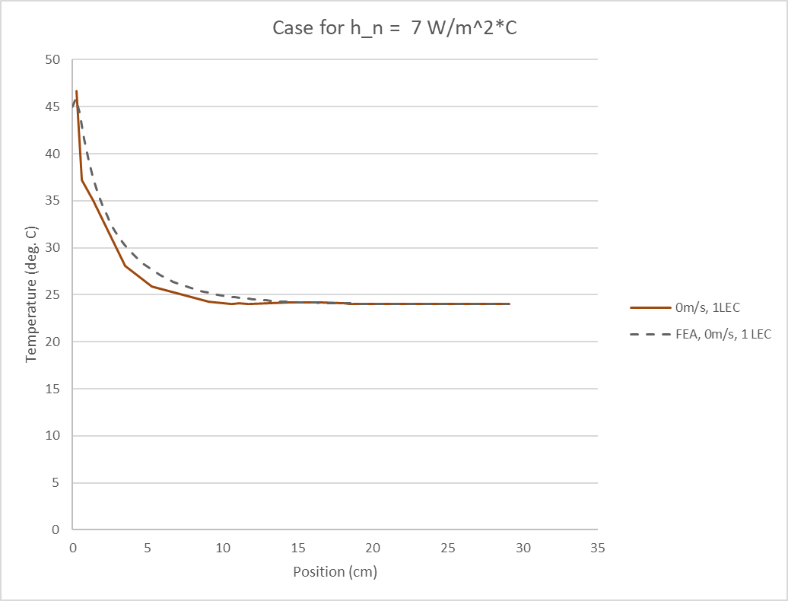
Natural Convection Case with 1 LEC Only
The same natural convection coefficient value matches a 1 LEC heated case fairly well.
Shows that the homogenization of the material is representative.

Slide 11
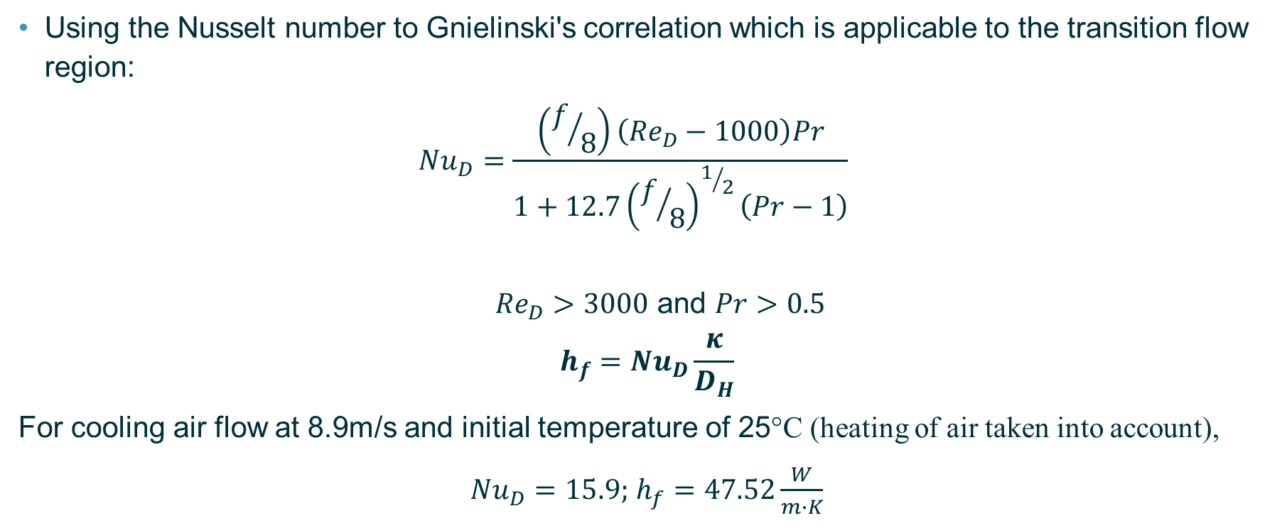
Forced Convection Model
Using the Nusselt number to Gnielinski's correlation which is applicable to the transition flow region:
$${Nu}_{D}=\frac{\left(f/8\right)\left({Re}_{D}−1000\right)Pr}{1+12.7{\left(f/8\right)}^{1/2}\left(Pr−1\right)}$$
${Re}_{D}>3000$ and $Pr>0.5$
$$h_{f}={Nu}_{D}\frac{κ}{D_{H}}$$
For cooling air flow at 8.9m/s and initial temperature of 25°C (heating of air taken into account),
${Nu}_{D}=15.9;$ $h_{f}=47.52\frac{W}{m∙K}$

Slide 12
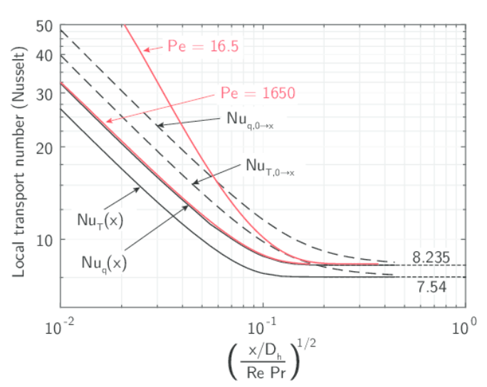
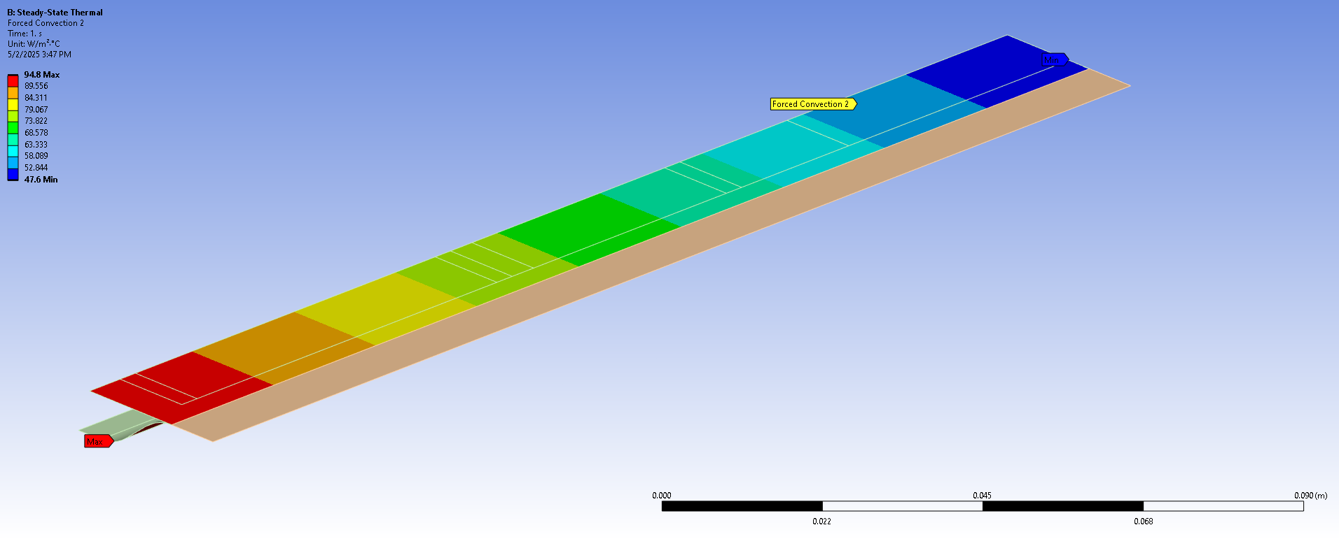

Entrance Region
Nusselt number is inherently higher at the entrance of the duct.
Analysis will use assumption that at inlet ${Nu}_{D}=32$ and then scales to ${Nu}_{D}=15.9$ at exit.
Also temperature of air is at 25°C at inlet and scales to $≈$30°C at outlet due to heating.

Slide 13
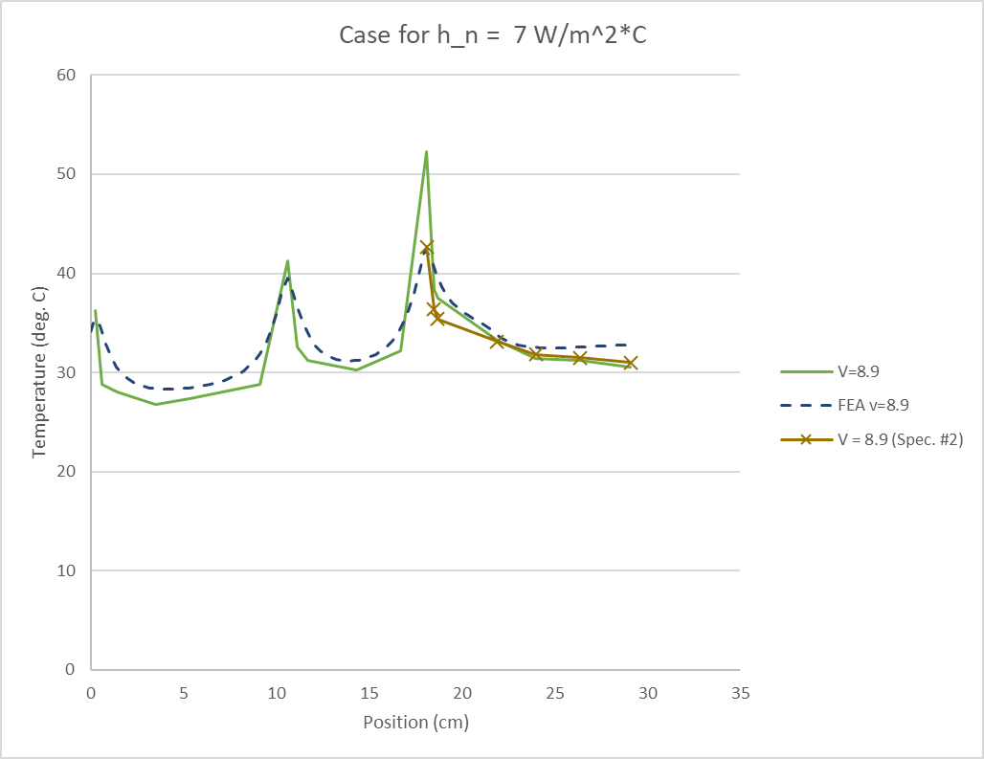
Forced Convection Case, v = 8.9 m/s
The model reproduces the shape of the temperature distribution relatively well in addition to the local maximums at LEC 1 and 2.
In the first experiment, LEC 3 peak temperature was 52.3°C, much higher than the model predication.
Post inspection of the specimen shows that delamination of the heater and larger than normal bonding material between layers was present.
A second test with a new specimen and tighter control of bond thickness resulted in lower peak temperature of 42.7°C.

Slide 14
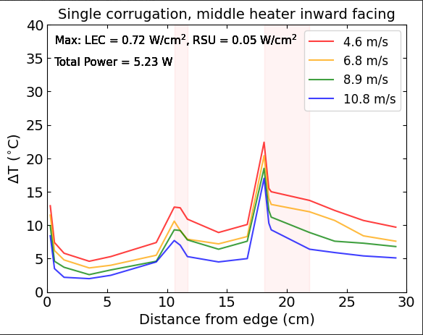
Test Results for LEC/RSU 2 Inward Facing
LEC 2 flipped

Slide 15
Lessons Learned So Far and Future Work
The conduction through the corrugation is an important part of the cooling performance. The heat needs to readily conduct away from the source regions to be efficiently removed.
Entrance region phenomenon is necessary to capture in the modeling approach. Neglecting it will overpredict the temperature near the duct inlet.
The overall modeling approach shows relatively good agreement with the experiment.
Future work needs to be done to evaluate how well the methods represent the actual silicon detector assemblies and air tubing/nozzles.

