Slide 1
Electrical & Optical Services

Slide 2
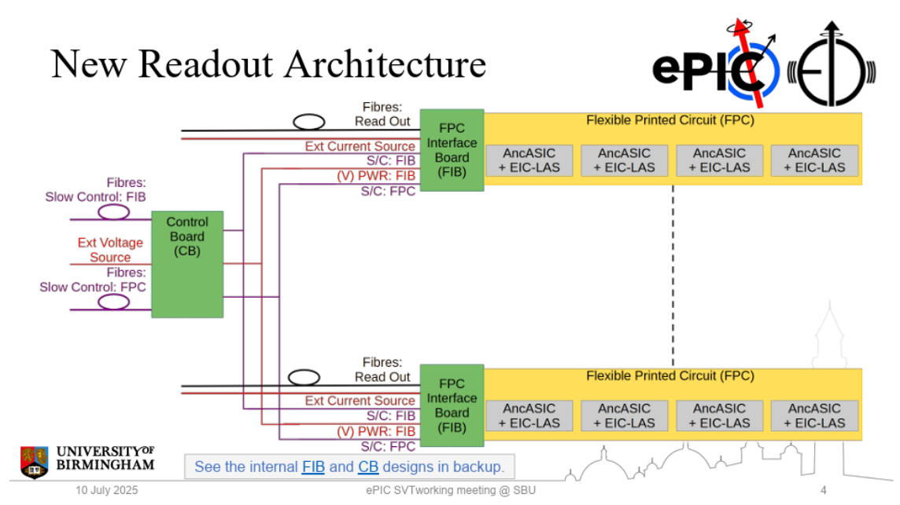
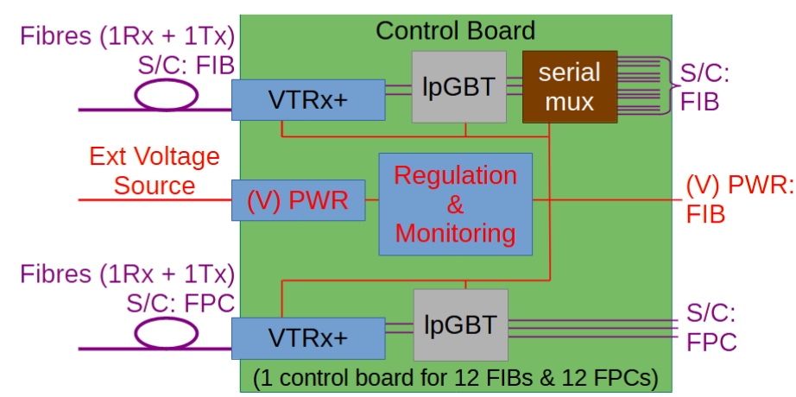
Numbers
I’m trying to understand the numbers
Mostly because I have some time of an electronics engineer at Oxford, who might be able to help identify cable
We are not interested in services inside the SVT, only from SVT volume to patch panels, because this is where space is constrained
From James @ Stony Brook

Slide 3
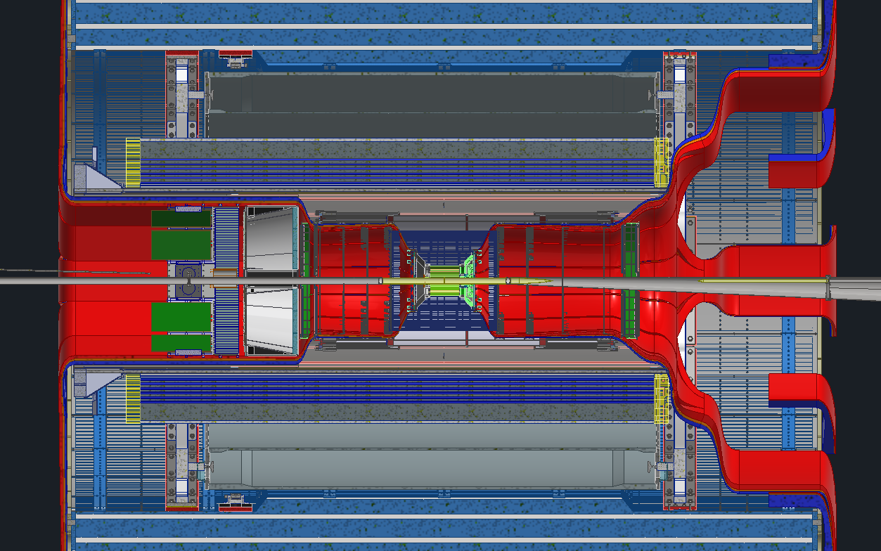
Planned Disconnect Locations
Planning on having 1 disconnect location on each side of the detector
Backward disconnect will be just past the DIRC electronics
Forward disconnect will be between the barrel EMCAL and the dRICH
These are the 2 “earliest” locations with potentially enough space for connectors
Rule of thumb is connectors take twice the amount of space as the cable itself. Finding enough space will be extremely difficult

Slide 4
My preliminary numbers - IB
Sensor power is for max power case
Current estimated based on power in sensor+RDOs, divided by 48 V

Slide 5
My preliminary numbers - OB
Current in serial power chains (FIB) assumed to be 2 A, voltage from P/I
2 A is probably conservative, results from simulations show around 1.7 A for max power case (1.25 A for nominal)
Power in CB derived from previous estimates with CB split into FIB-CB and FPC-CB
Voltage in CB power lines assumed to be 48 V, current from P/V

Slide 6
My (very) preliminary numbers - disks

Slide 7
Cable specification
At Stony Brook we had a discussion about the length of the cables to the power supplies, and the allowed voltage drop
As we do have a break ~4 m (eye-balled) from the FIBs, and the most space-critical region is within that length we should assign a larger voltage drop per length here and a smaller voltage drop per length outside
Inside we probably want aluminium, outside copper should be sufficient
At Stony Brook 5% overall was suggested by James, so maybe 2.5% up to the break, and 2.5% after?
For 6 V, 2.5% is 150 mV, so about 37 mV/m, which for 2 A means 19 mΩ/m. Resistivity of Al is 2.65×10⁻⁸ Ωm, so diameter should be 1.341 mm (AWG15 is 1.450 mm)
There is no hard limit on functionality associated with 5%, only efficiency - could accept a larger number
Ernst has suggested AWG18 (1 mm) in his presentation at Stony Brook, I suggest that we stick to that for now
I don’t know the distance to the power supplies, but for 20 m with Cu, the same calculation (ρ=1.68×10⁻⁸ Ωm) gives 2.388 mm (AWG10 is 2.588 mm)
The electrical connection at the break would need to accommodate the change in diameter and material
Wire diameters for IB and CBs could be smaller, but these are not many anyway
Aluminium wire must be copper-clad (otherwise brittle, and no reliable crimp joints)

Slide 8
Connector specification
We want detachable connectors at both ends
(Assume that FIBs are soldered to FPCs)
Will look for COTS connectors
I am not aware that aluminium crimp connectors exist, so gold plated brass or similar
At the outside end we probably want to have some way to mount connectors to the service support structures
At both ends connectors need to be lockable or securable with a captive screw

Slide 9
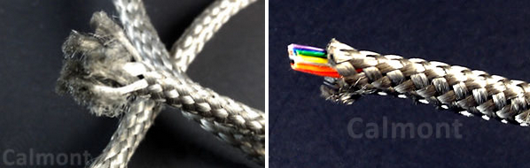
Other things to answer
Redundancy
Number of CBs is very small, so failure of one board/one cable/one connector would knock out large area
James will think about this
Do we need sense lines on IB/CB power?
Not really sure, probably more useful for linear regulators
Will put in for now, possibly can leave out when things get tight
Do we need shield on the power lines? Do we need twisted pairs?
Depends on filtering of the power supplies, and on external excitations
In ATLAS we used metalized Aracon (lower material but not lower volume…)
Do we need to capacitively couple to PST or cable trays?
Do we need separate ground connections? How many? What resistance?
Environmental sensors? Interlocks?
I think there are temperature sensors on the RSU and the AncASIC, that get read out with data stream, do we need anything in addition?
In addition, it would be prudent to add some interlock sensors
Either one per stave/disk cooling channel, or one per internal manifold
Two-fold redundancy would be good
Could get multiplexed in SVT volume

Slide 10
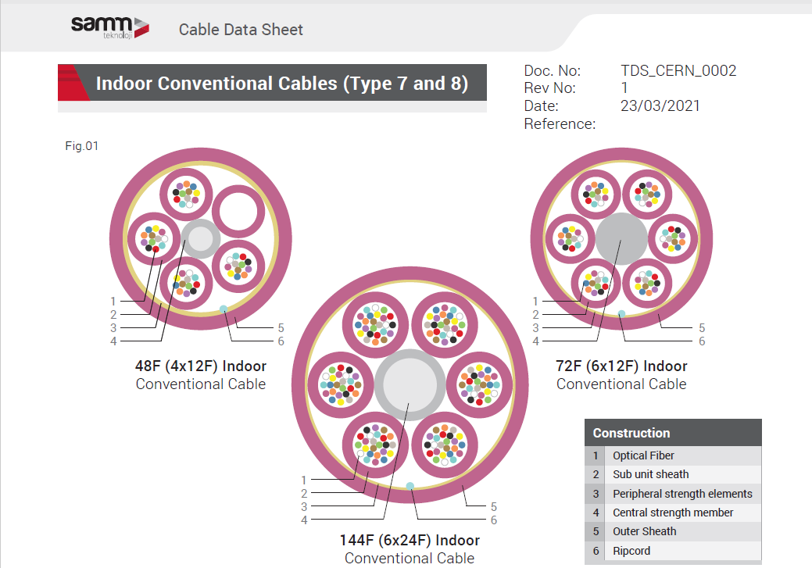
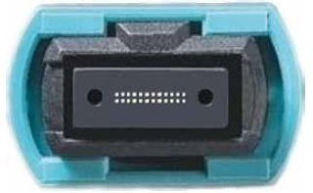
Fibres
Here I suggest a mature solution, from the Versatile Link group at CERN, which is used by SLHC trackers
Available with Draka rad-hard fibre (SLHC compatible)
Benefit of cables over ribbons: flexible in both directions
Space for 144-fibre cable is ½ of estimate in Roland’s table
But the fibres are a minor contribution
144 fibre cable terminates in 6×MPO-24
Will need a harness from RDOs to this cable connector
This harness would include the rearrangement of fibres from SIB/FIB VTRX+ (4 Tx), and CB VTRX+ (1Tx, 1Rx) into 2×12 ribbons
OD 6.85 mm
OD 7.3 mm
OD 8.9 mm
MPO-24

Slide 11
Final thoughts and next steps
We should build a mock-up of the service trays for both ends with realistic dummy services, to see how things fit, and whether bend radii work
BNL was supposed to do this, but we probably need to provide the dummy services, and we probably want to have a good look at this
I will check my table against a table kept by James and Ernst
There are some losses in there, that I still need to include
Include estimates for cooling
Will need help from Nick

