Slide 2
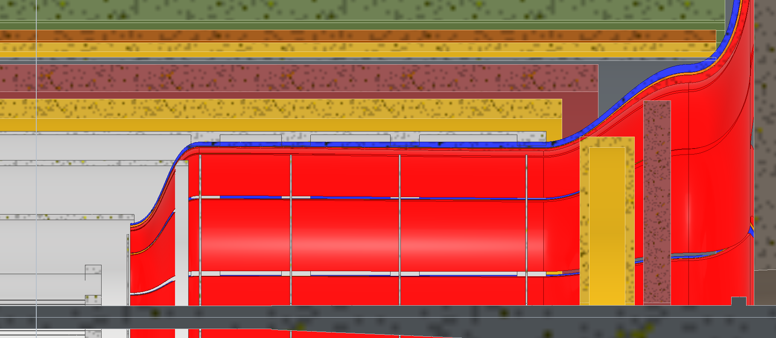
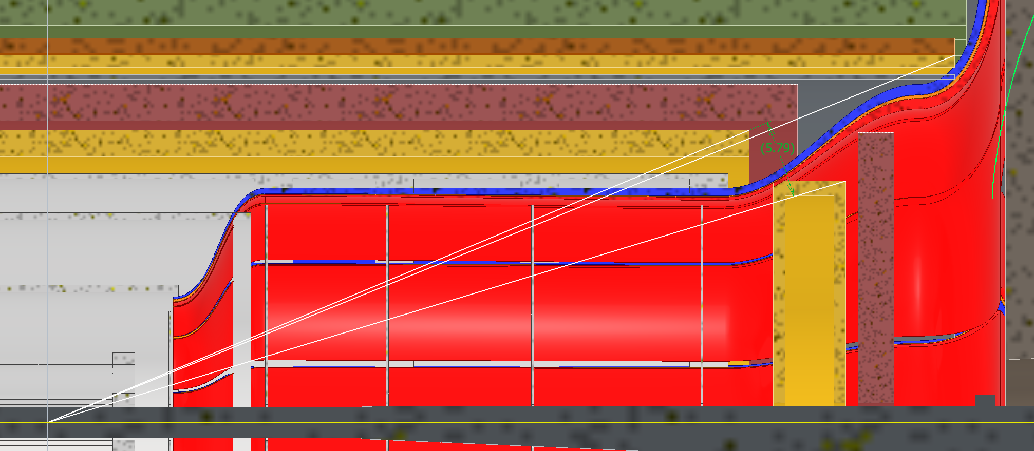
Current Layout
Does not work
5.8 deg MPGD coverage angle
ToF:
Inner Face Z: 1675mm
Thickness Z: 75mm
Outer Radius: 600mm
MPGD:
Inner Face Z: 1500mm
Thickness Z: 150mm
Outer Radius: 500mm

Slide 3
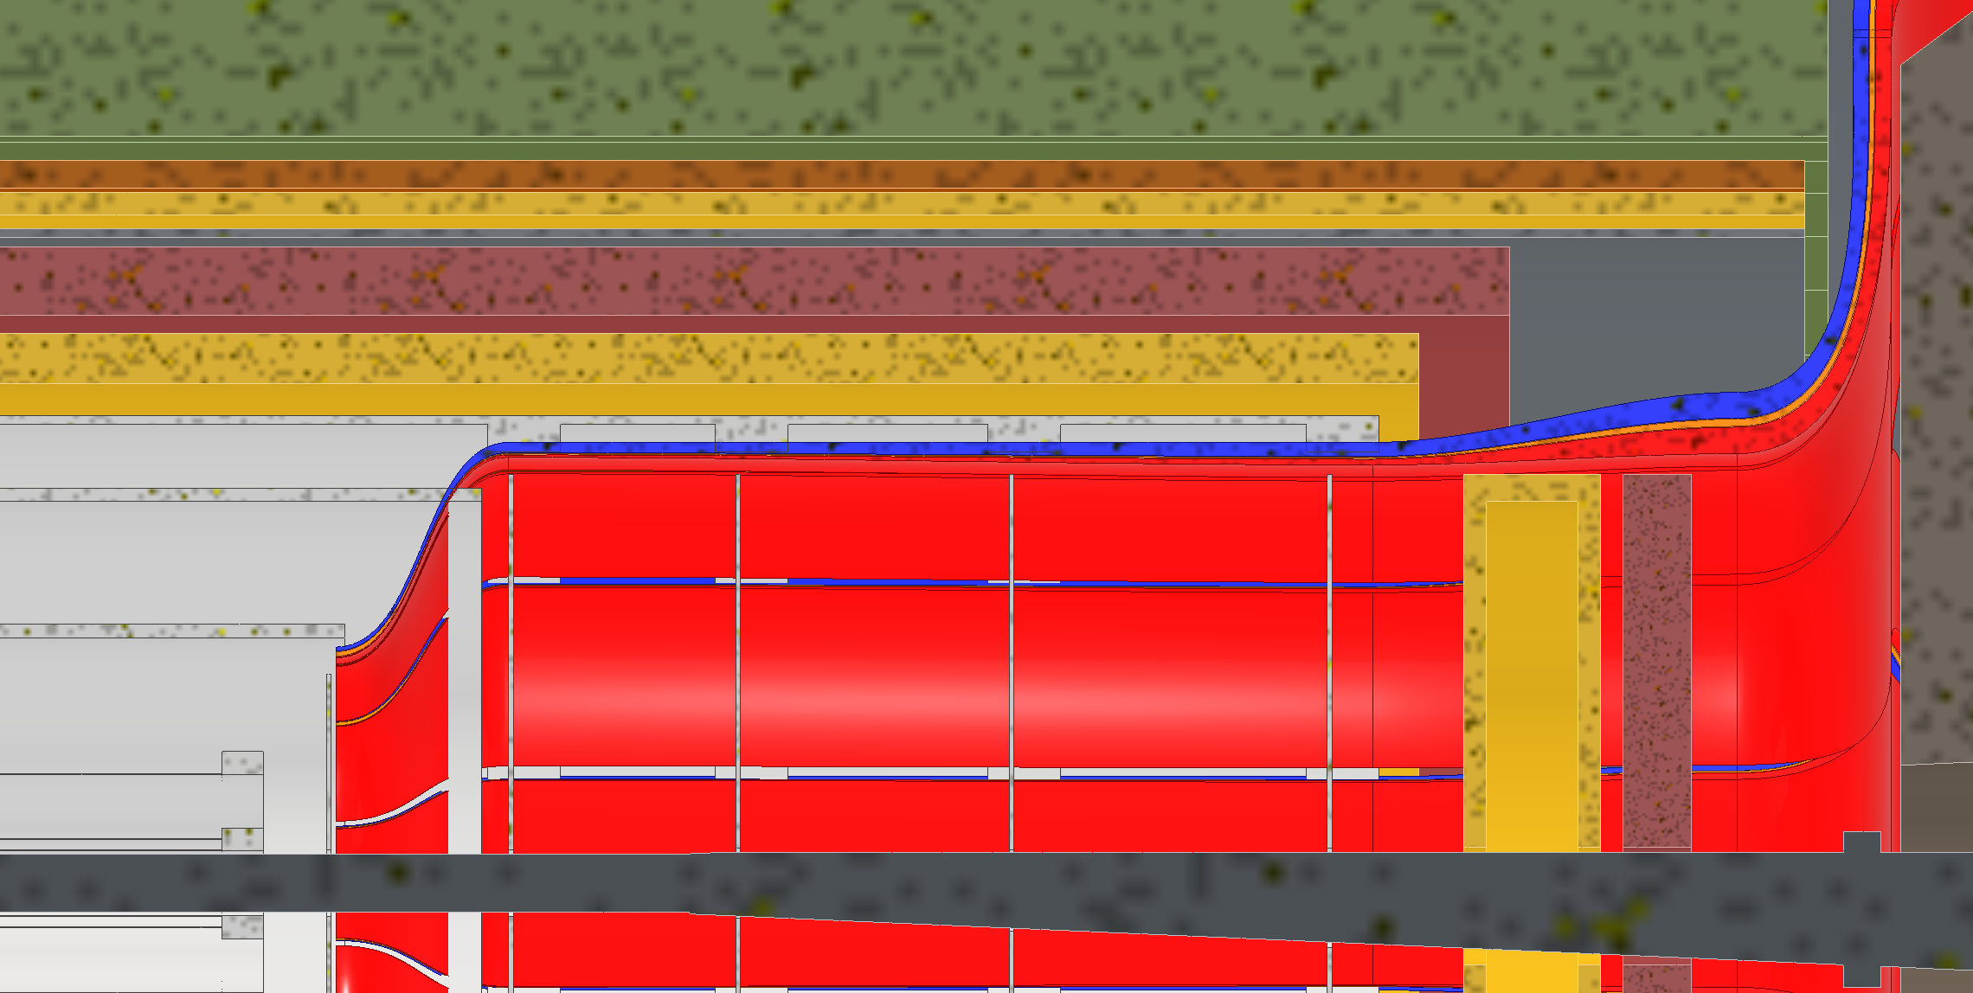
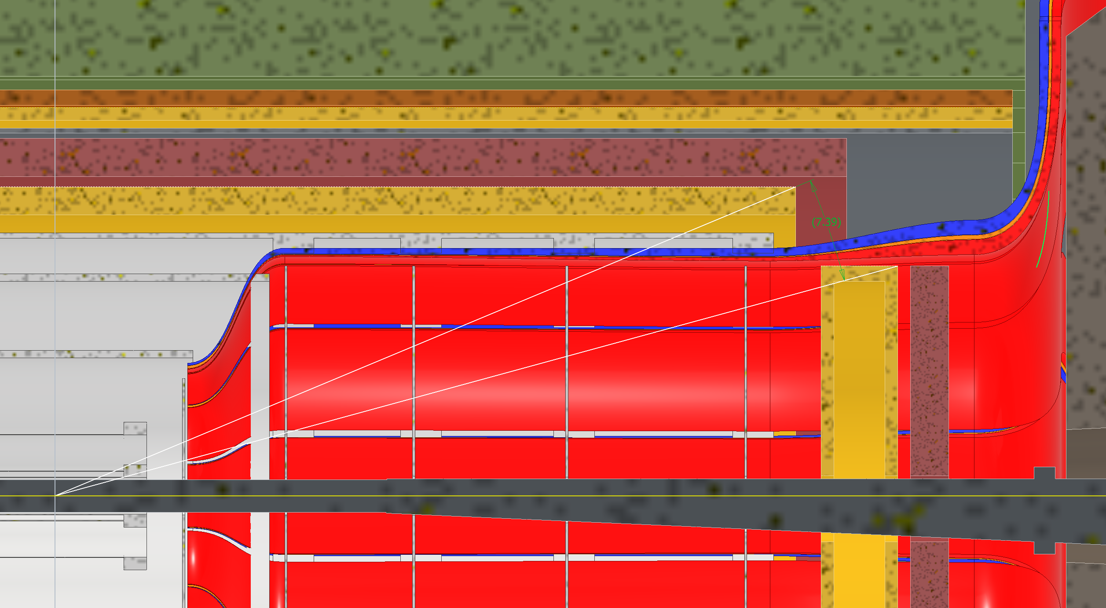
Option 1: Smaller Dia. Disks
Both disks shrink in diameter, MPGD disk would be attached to PST, unsure where ToF would be attached to.
7.4 deg MPGD coverage angle
ToF:
Inner Face Z: 1675mm
Thickness Z: 75mm
Outer Radius: 450mm
MPGD:
Inner Face Z: 1500mm
Thickness Z: 150mm
Outer Radius: 450mm

Slide 4
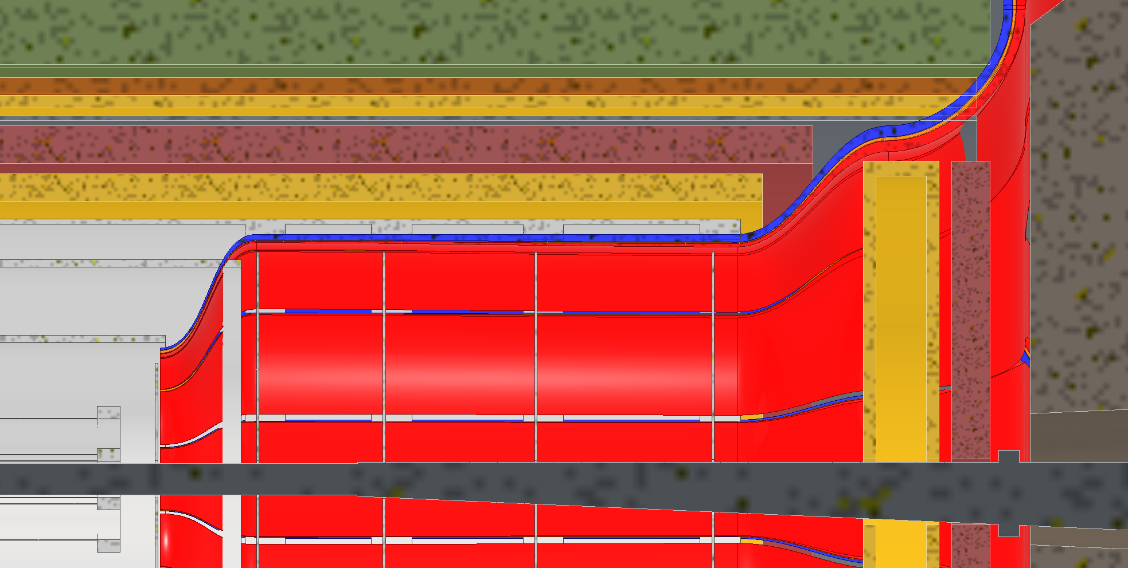
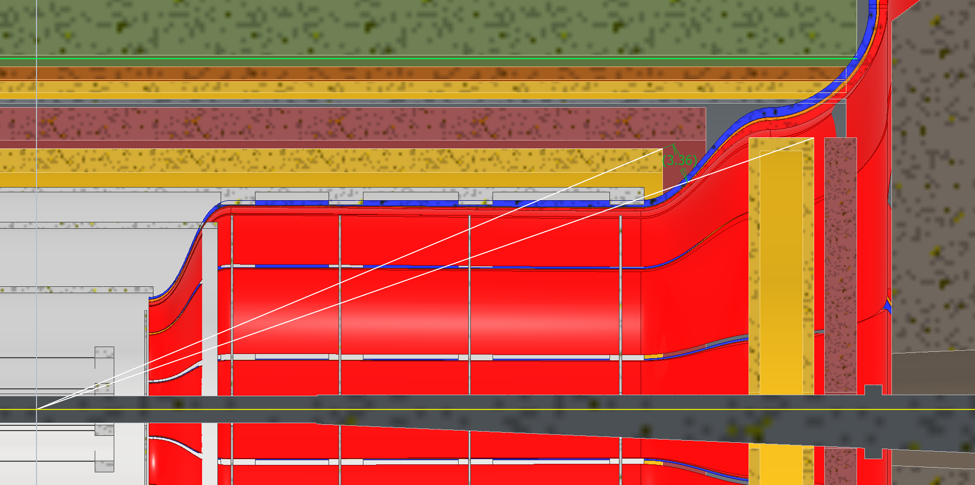
Option 2: Removable Disks
Both disks would be removable, would need to figure out where to support them from. Disks will need wither space in X to move out or larger inner diameters to fit around flange (Flange doesn’t exist yet)
3.4 deg MPGD coverage angle
ToF:
Inner Face Z: 1825mm
Thickness Z: 75mm
Outer Radius: 630mm
MPGD:
Inner Face Z: 1650mm
Thickness Z: 150mm
Outer Radius: 630mm

Slide 5
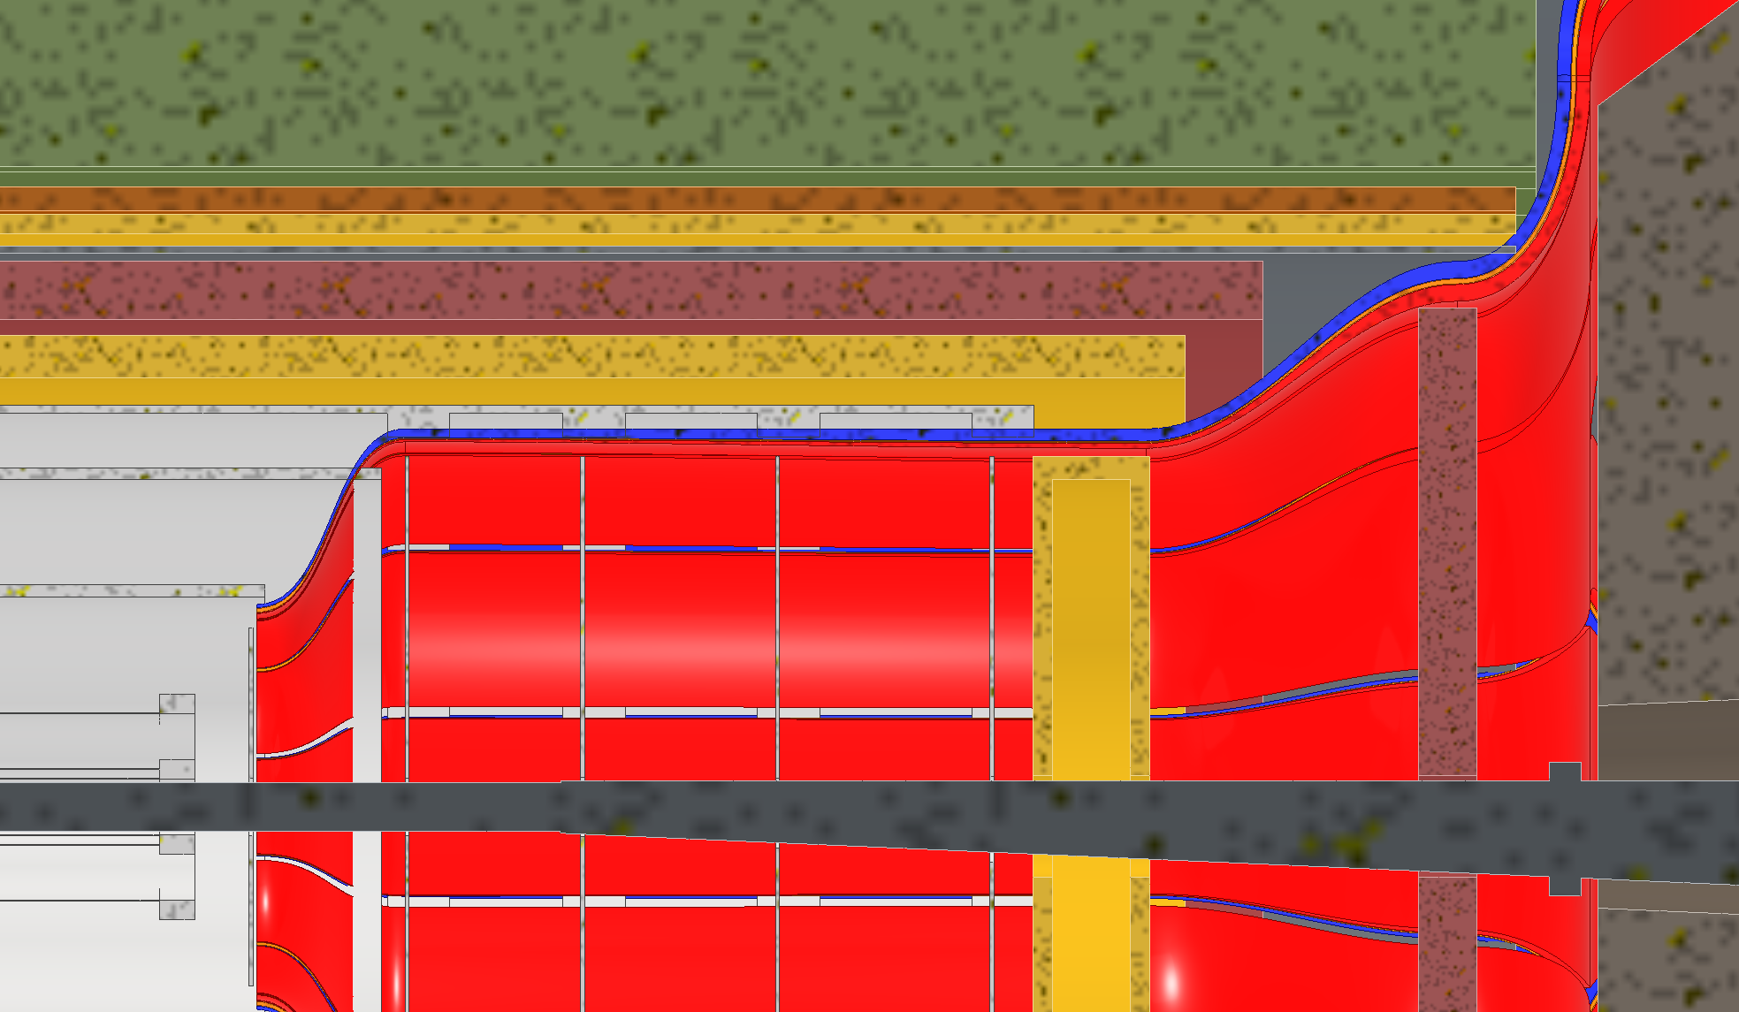
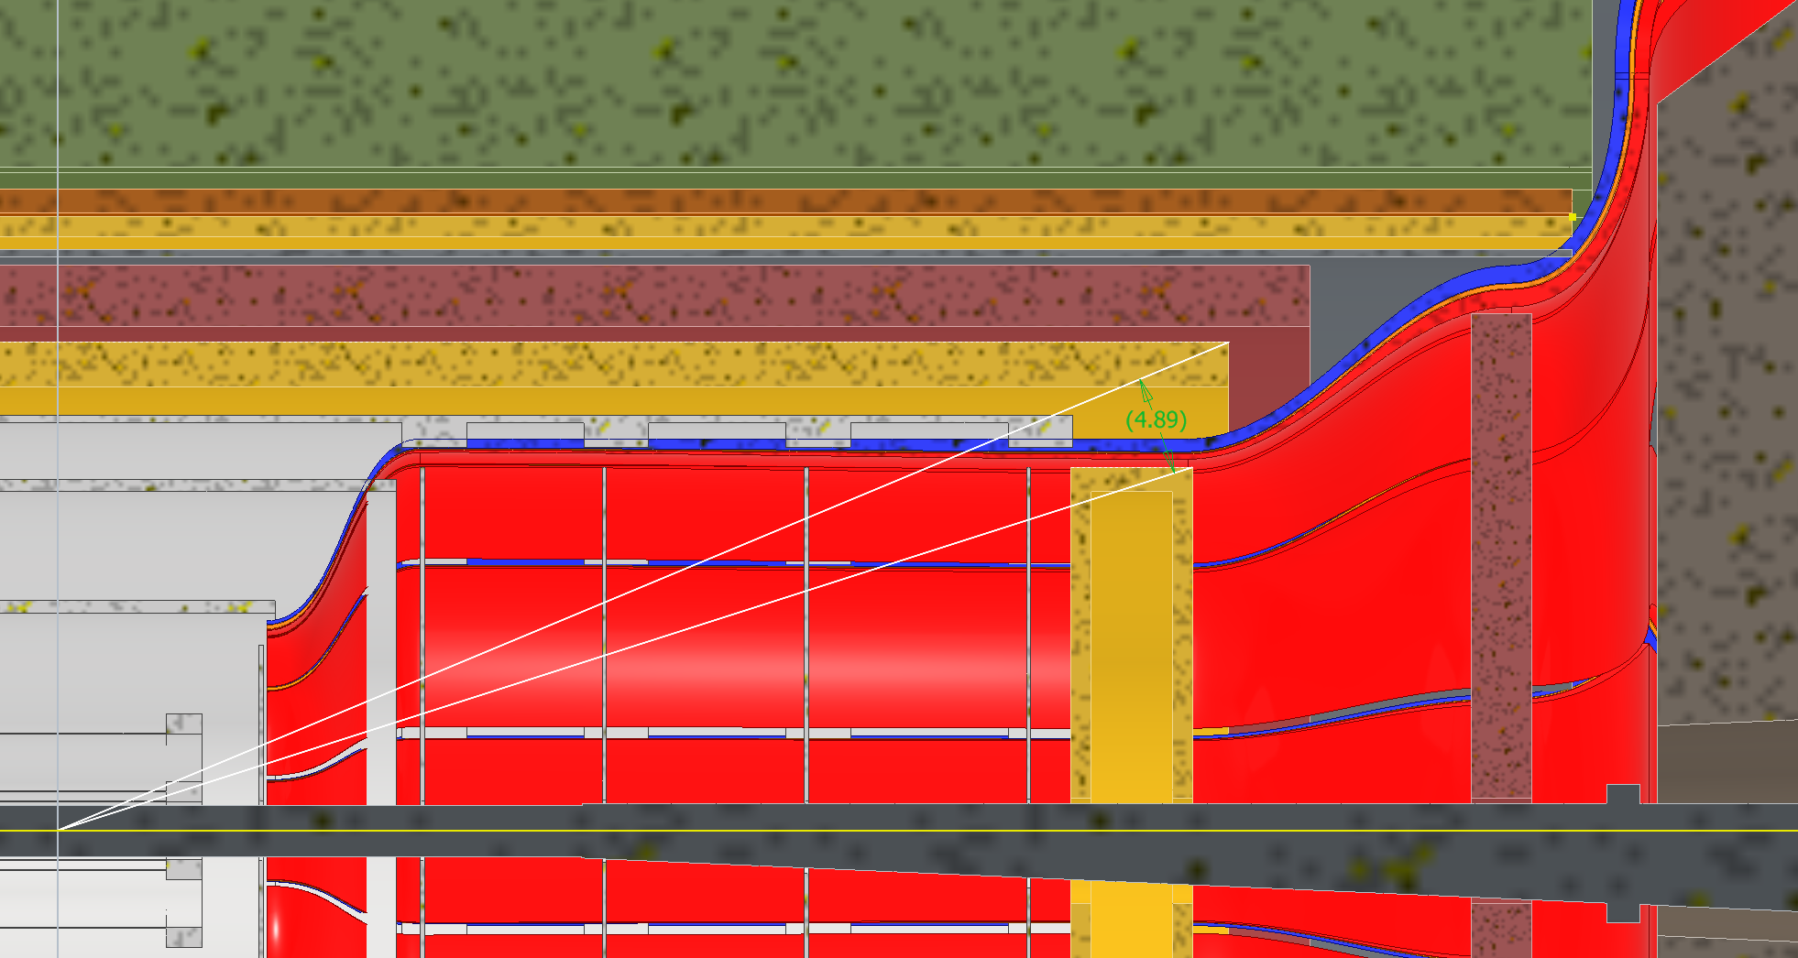
Option 3: MPGD goes Backwards
Requires moving the SVT disks around, need to figure out where we would support ToF from. ToF would still need to be removable.
4.9 deg MPGD coverage angle
ToF:
Inner Face Z: 1750mm
Thickness Z: 75mm
Outer Radius: 630mm
MPGD:
Inner Face Z: 1255mm
Thickness Z: 150mm
Outer Radius: 450mm

Slide 6
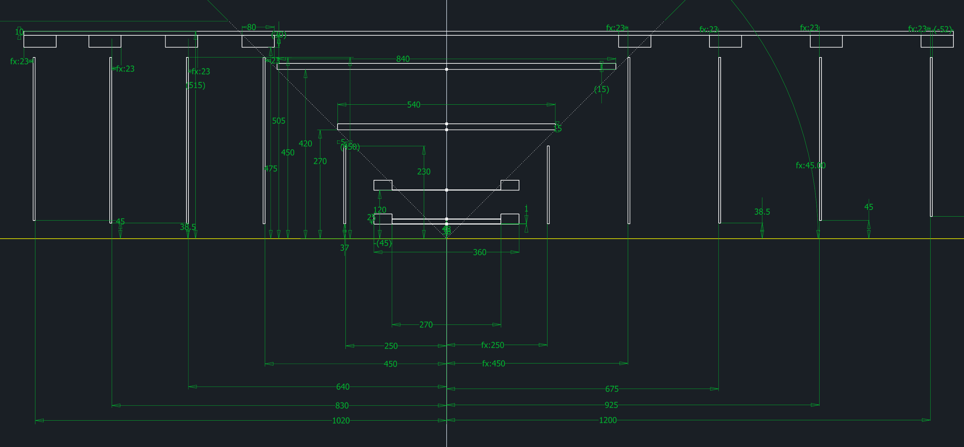
Option 3: MPGD goes Backwards

Slide 7
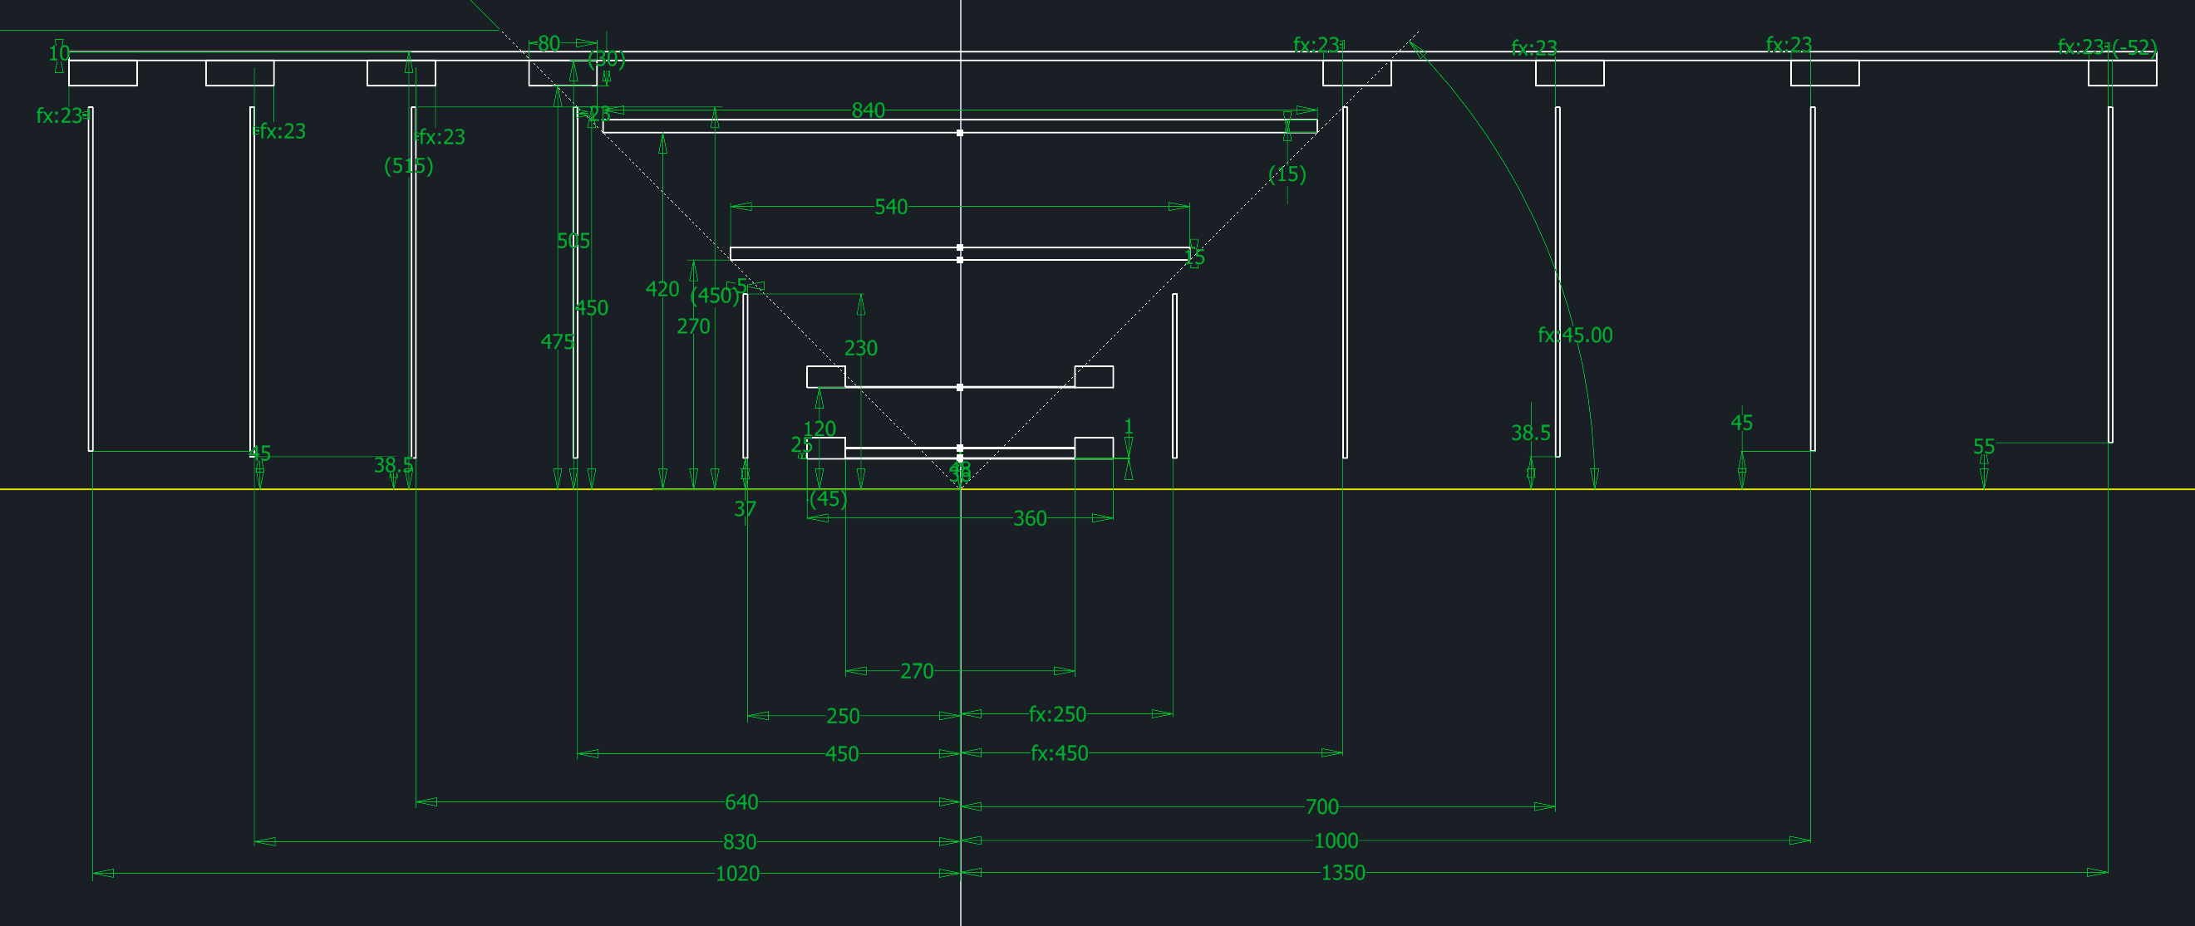
Option 3: MPGD goes Backwards

Slide 8
Backup Slides

