Slide 1
Building the SP(DNN)-Img-Clus workflow
SigProc with DNN-ROI: https://github.com/LArSoft/larsoft/releases/tag/v10_00_03
wire-cell-toolkit
DNNROIFinding: passing through summary/RMS to dnnsp frame
ChannelSelector
larwirecell
CookedFrameSource
Imaging (ICluster):
I had issues running imaging on data, but Ewerton has a working version, incorporating his local devs
wire-cell-toolkit, larwirecell, cfg
using dnn-roi in imaging
synergy with PDHD
Clustering (ITensorSet, PointCloud::Facade):
Configurable clustering_function to run in MultiAlgBlobClustering
json -> c++

Slide 2
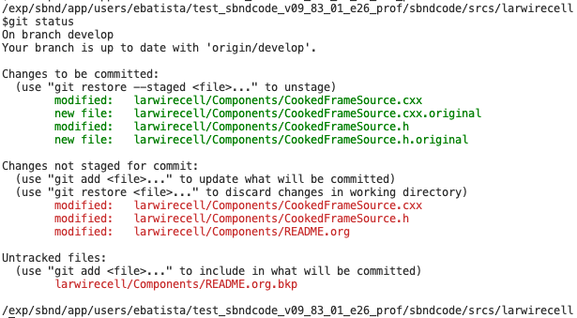

Slide 3
