Slide 1
“2-wire” Splice in PDHD configuration
Wenqiang Gu, Jay Hyun Jo
with Brett’s help

Slide 2
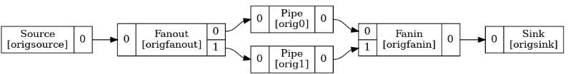
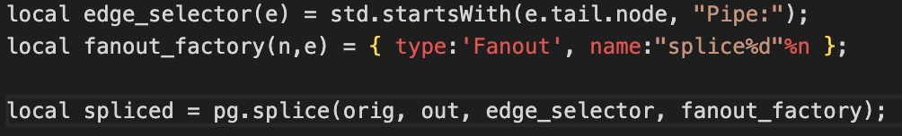

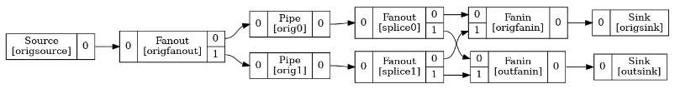
“2-wire” splice in WCT configuration(jsonnet)
https://github.com/WireCell/wire-cell-toolkit/blob/master/cfg/test/test-splice.jsonnet
Brett V.

Slide 3
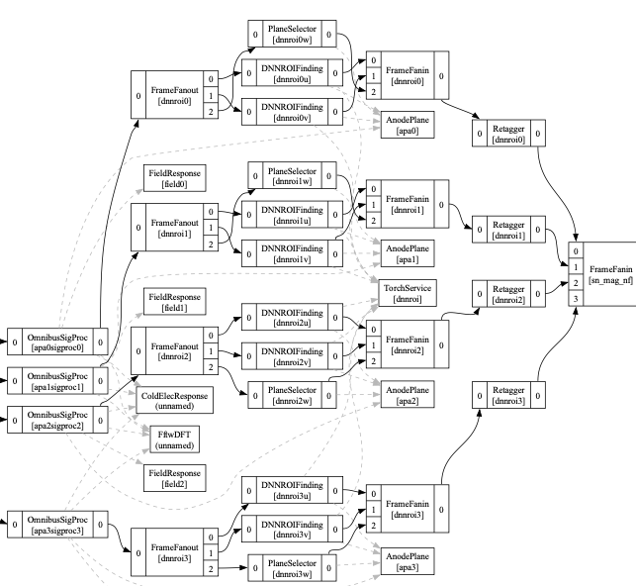
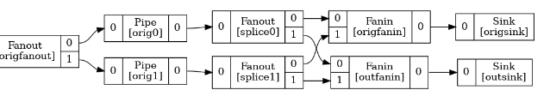
$ wirecell-pgraph dotify --no-params wcls-rawdigit-dnnsp.jsonnet dnnsp.pdf
“2-wire” splice
“Linear” graph for OmnibusSigProc and DNN ROI
Need to save out OmnibusSigProc separately

Slide 4
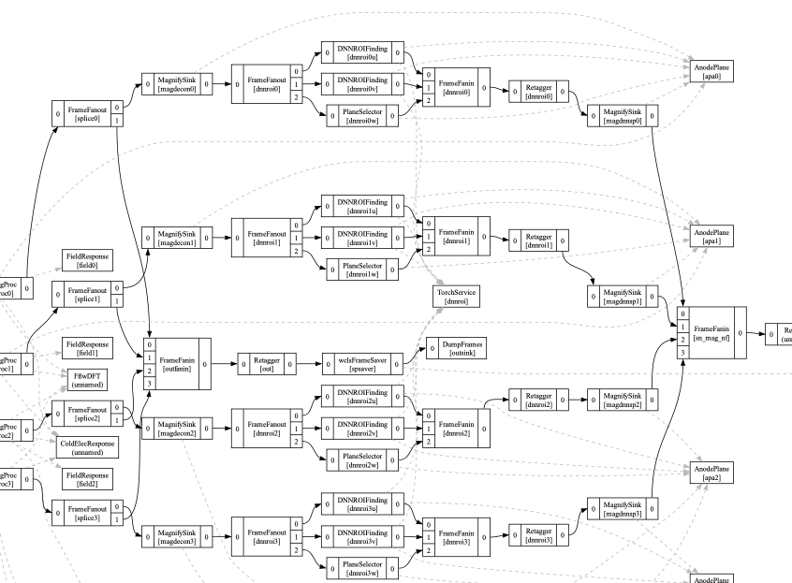
Spliced graph

