Slide 1
Sampling Fraction of the sPHENIX Outer Hadronic Calorimeter (OHCal)
Ghosoun Adawi
Georgia State University

Slide 2
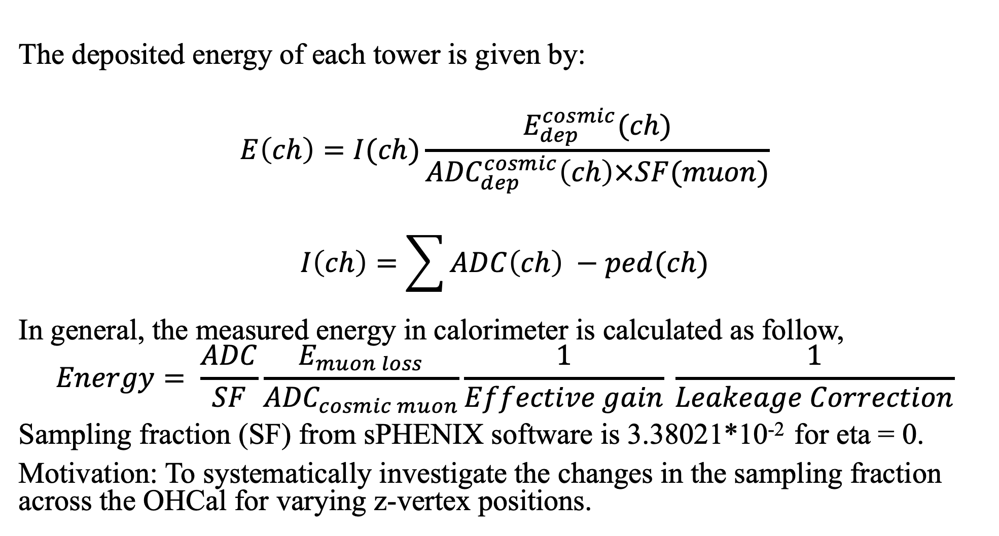
The deposited energy of each tower is given by:
$$E\left(ch\right)=I(ch)\frac{E_{dep}^{cosmic}(ch)}{{ADC}_{dep}^{cosmic}\left(ch\right)×SF(muon)}$$
$$I\left(ch\right)=\sum{ADC\left(ch\right) }−ped(ch)$$
In general, the measured energy in calorimeter is calculated as follow,
$$Energy= \frac{ADC}{SF}\frac{E_{muon loss}}{{ADC}_{cosmic muon}}\frac{1}{Effective gain} \frac{1}{Leakeage Correction}$$
Sampling fraction (SF) from sPHENIX software is 3.38021*10⁻² for eta = 0.
Motivation: To systematically investigate the changes in the sampling fraction across the OHCal for varying z-vertex positions.

Slide 3
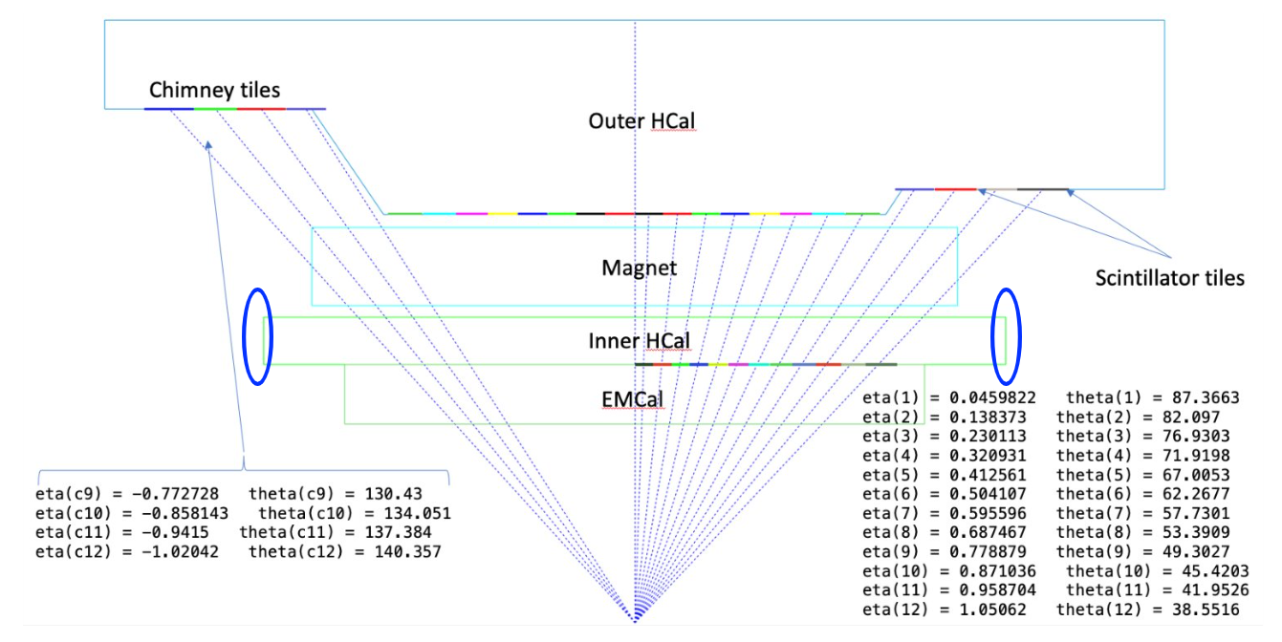
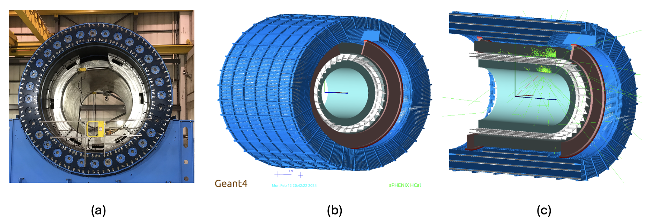
OHCal Geometry
Chimney Sector

Slide 4
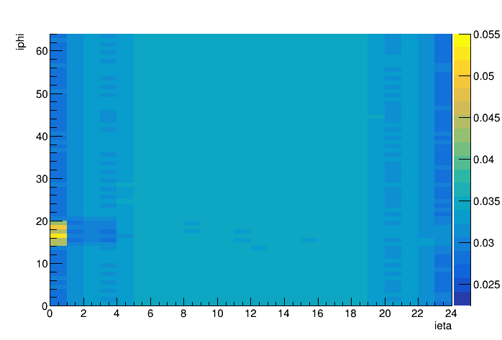
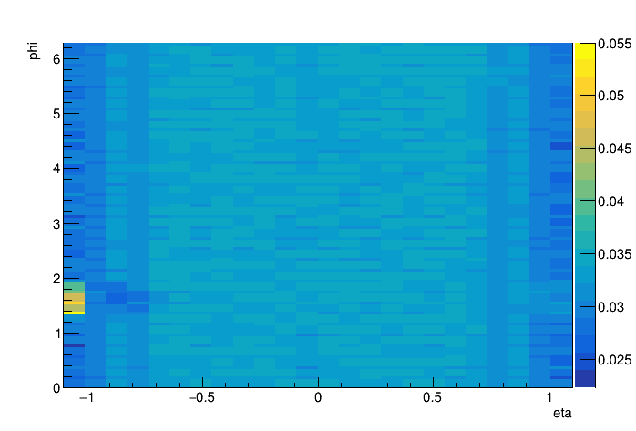
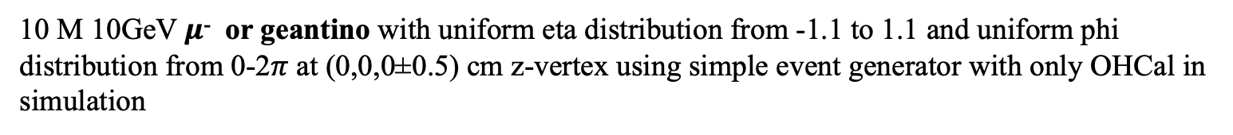
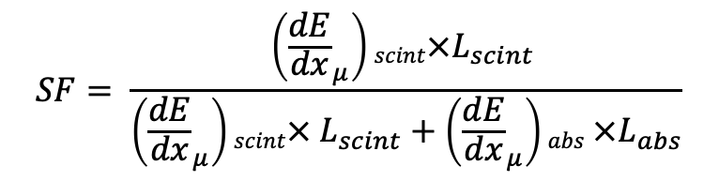
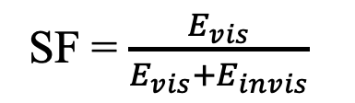
Comparison of Standard Method and Analytical Calculation
10 M 10GeV $μ$⁻ or geantino with uniform eta distribution from -1.1 to 1.1 and uniform phi distribution from 0-2$π$ at (0,0,0±0.5) cm z-vertex using simple event generator with only OHCal in simulation
Standard Method
Analytical calculation
SF = $\frac{E_{vis}}{E_{vis}+E_{invis}}$
$$SF= \frac{\left({\frac{dE}{dx}}_{μ}\right)scint×L_{scint} }{\left({\frac{dE}{dx}}_{μ}\right)scint× L_{scint}+\left({\frac{dE}{dx}}_{μ}\right)abs ×L_{abs}}$$

Slide 5
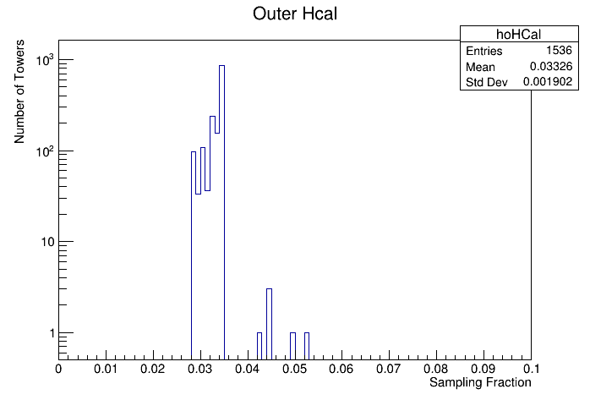

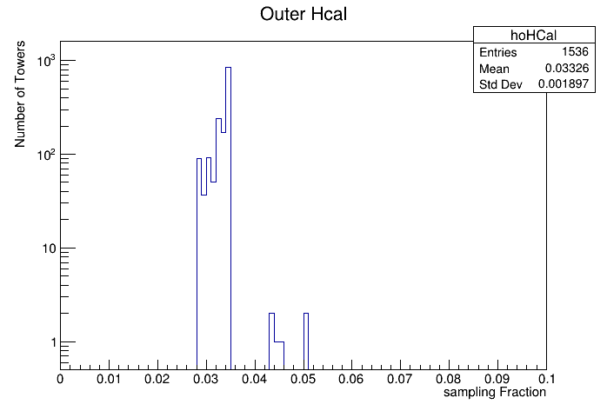
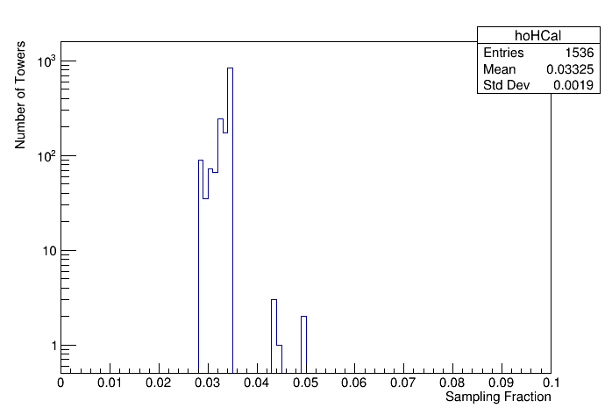
Number of Towers vs Sampling Fraction for Different Z-Vertex Positions
Z-vertex(0,0,0+/- 0.5) cm
Z-vertex(0,0,10+/- 0.5) cm
Z-vertex(0,0,-10+/- 0.5) cm
Z-vertex(0,0,20+/- 0.5) cm
Z-vertex(0,0,-20+/- 0.5) cm

Slide 6
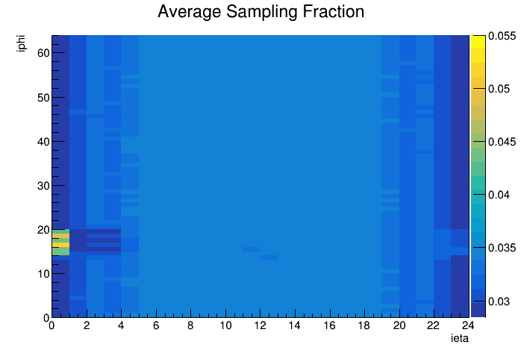
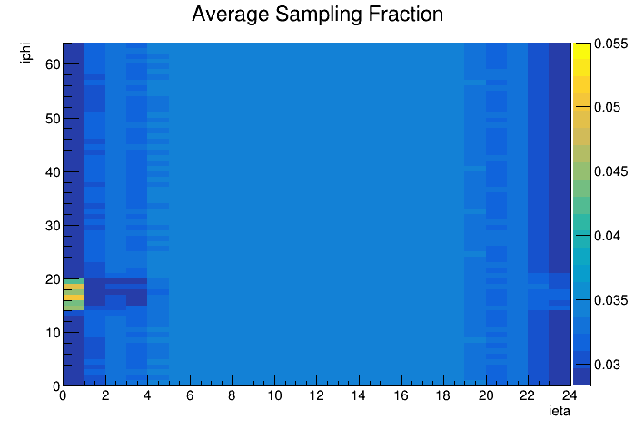
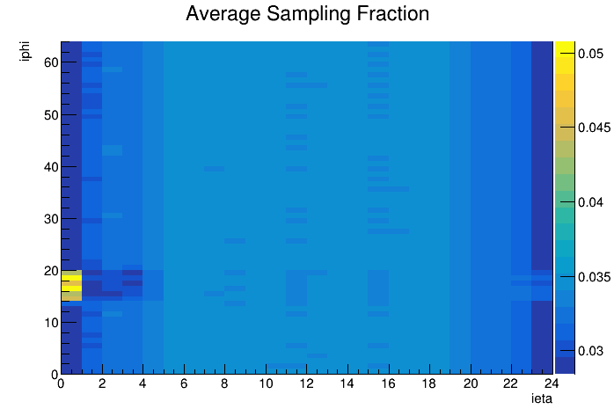
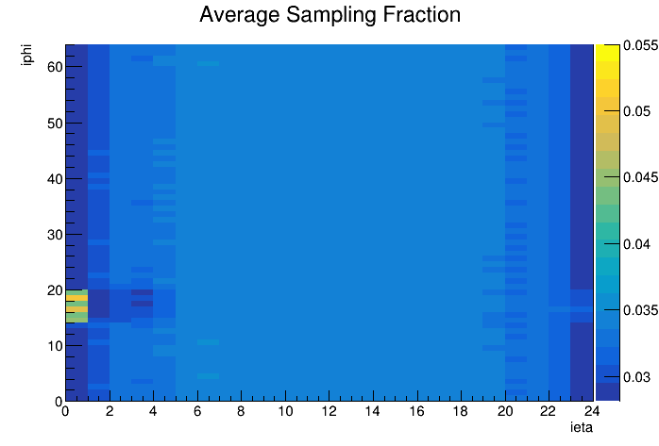
Average Sampling Fraction as a Function of Eta and Phi Bins for Different Z-Vertex Positions
Z-vertex(0,0,0+/- 0.5) cm
Z-vertex(0,0,10+/- 0.5) cm
Z-vertex(0,0,-10+/- 0.5) cm
Z-vertex(0,0,20+/- 0.5) cm
Z-vertex(0,0,-20+/- 0.5) cm

Slide 7
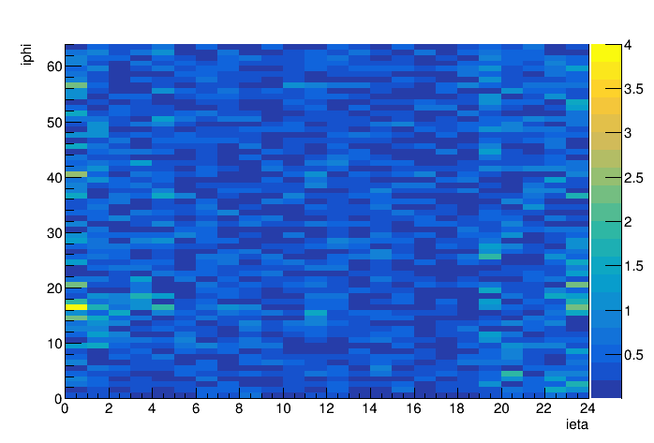
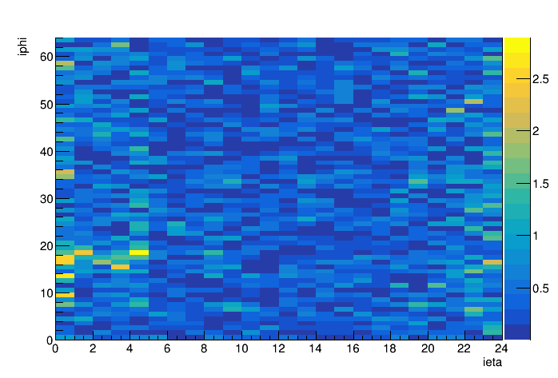
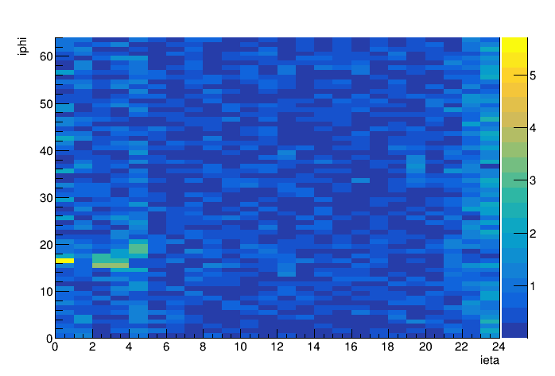
Percent Difference as a Function of Eta and Phi Bins for Different Z-Vertex Positions
Z-vertex(0,0,10+/- 0.5) cm
Z-vertex(0,0,-10+/- 0.5) cm
Z-vertex(0,0,20+/- 0.5) cm
Z-vertex(0,0,-20+/- 0.5) cm

Slide 8
Summary
Estimated the sampling fraction for the OHCal, and the results were consistent with analytical calculations.
There are variations in the sampling fraction throughout the OHCal, particularly at the chimney sector and the left and right edges of the OHCal.
These variations in sampling fraction are due to differences in the material length of the OHCal.
The sampling fraction shows only slight variation across different z-vertex positions within the ±20 cm range.

