Slide 1

Current Status of the CE Calibration Analysis using PDHD Pulser Data
Karla Téllez Girón Flores
Local BNL PD Meeting, 11/04/2024

Slide 2
Dataset
NP04 TPC Electronics Studies Runs.
Pulser Calibration Run 28286.
DAC = 30.
7.8 mV/fC LArASIC gain.
2 µs CE Shaping Time.
LArASIC Output Mode: Single-ended.
Karla Tellez-Giron-Flores

Slide 3
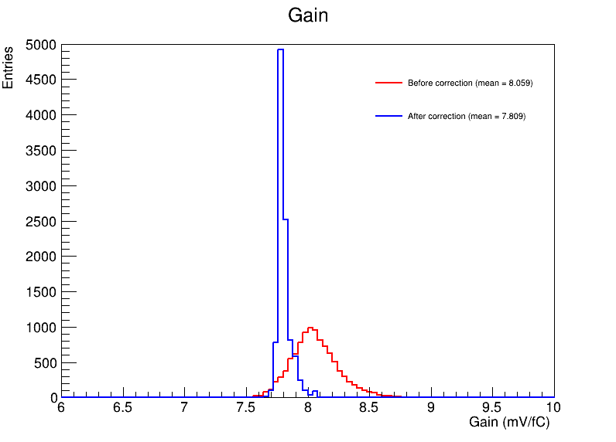
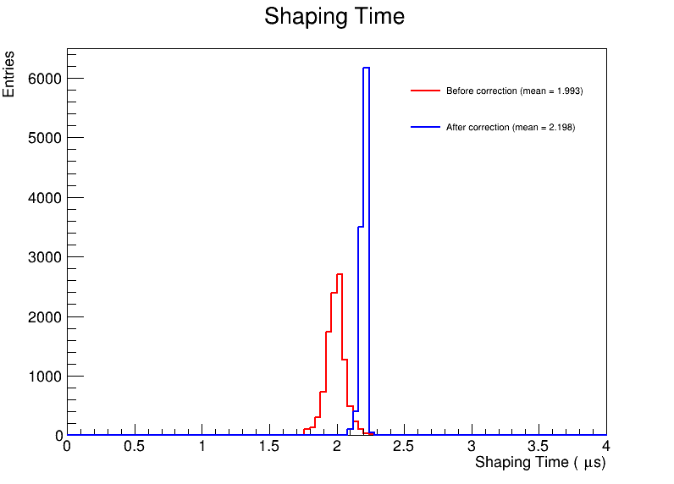
Current Status
Small tail in Fitted Gain distribution.
Karla Tellez-Giron-Flores

Slide 4
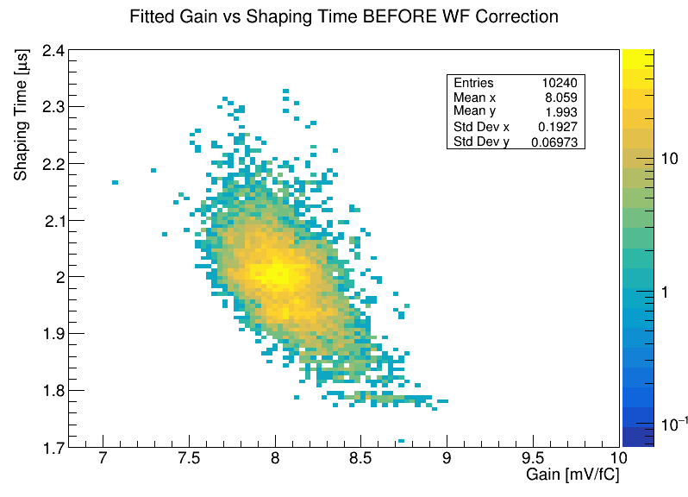
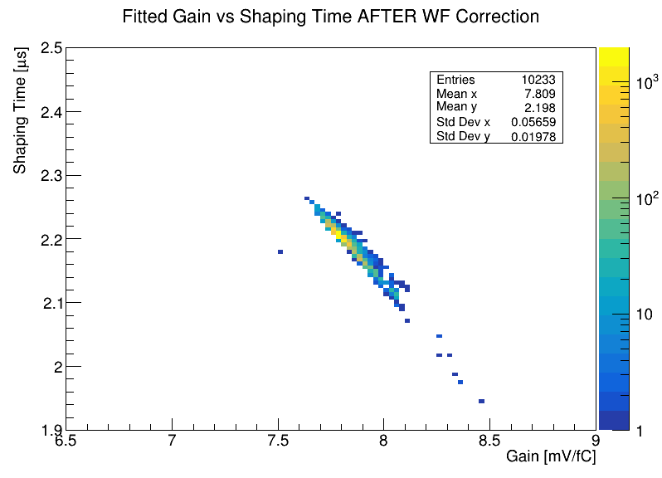
Current Status
Correlation observed after correction.
Where is this coming from?
Karla Tellez-Giron-Flores

Slide 5
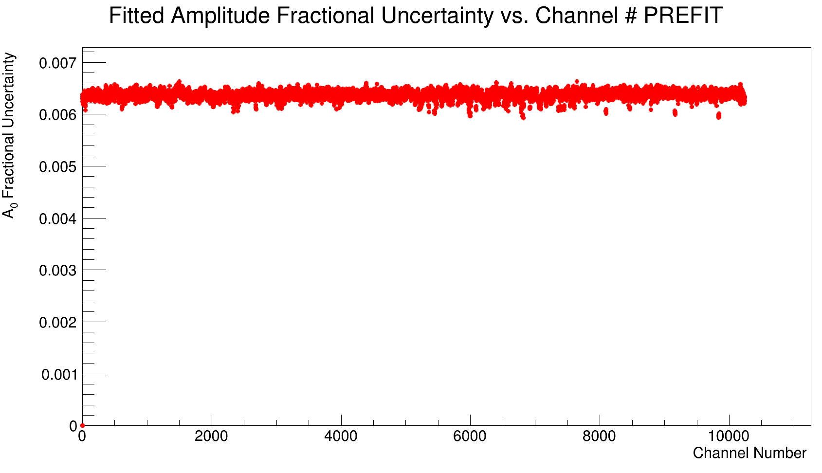
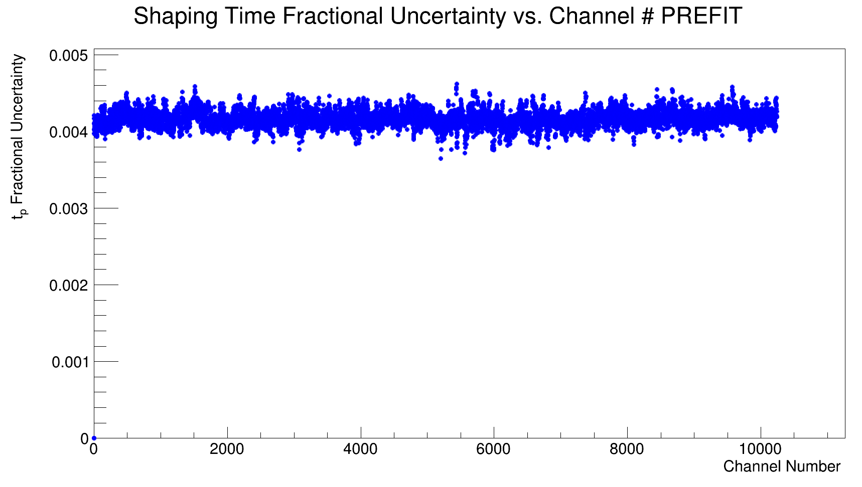
NOW: Debugging
Looking at the uncertainties of the 7-parameter fitter
Pre-Fit seems fine...
Karla Tellez-Giron-Flores

Slide 6
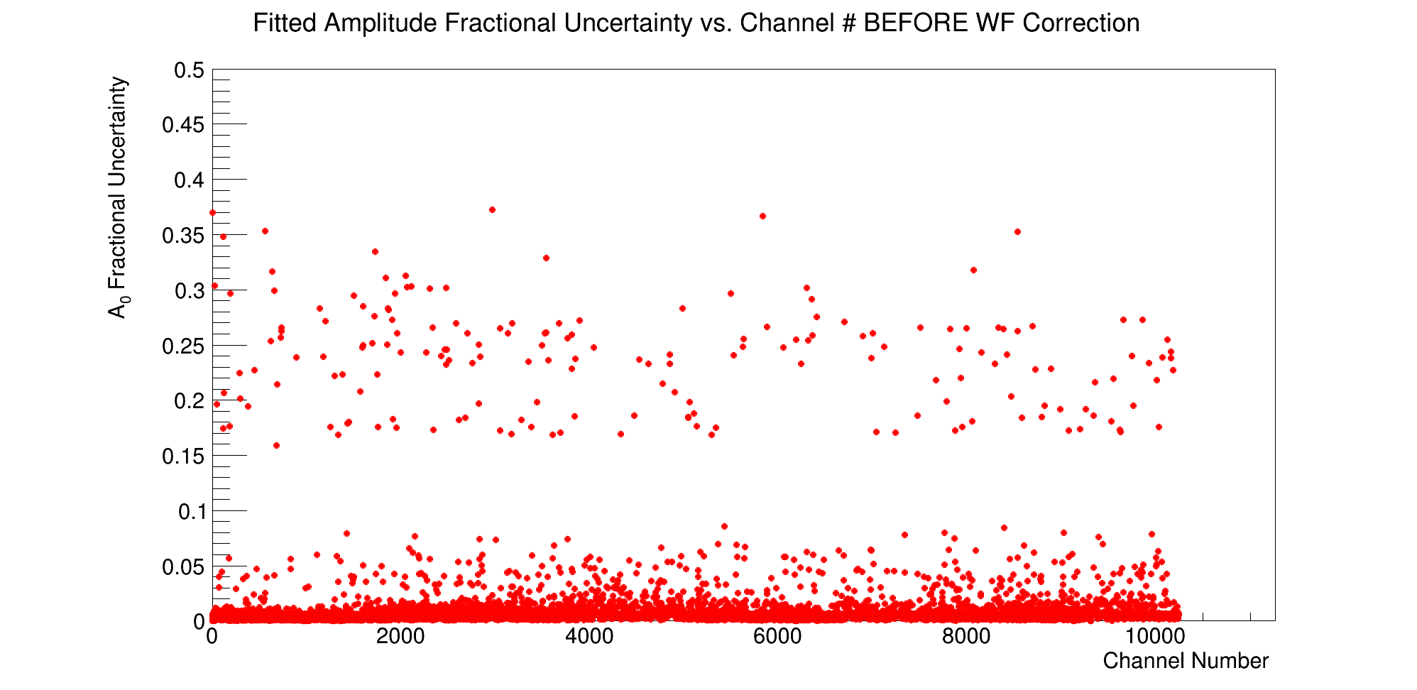
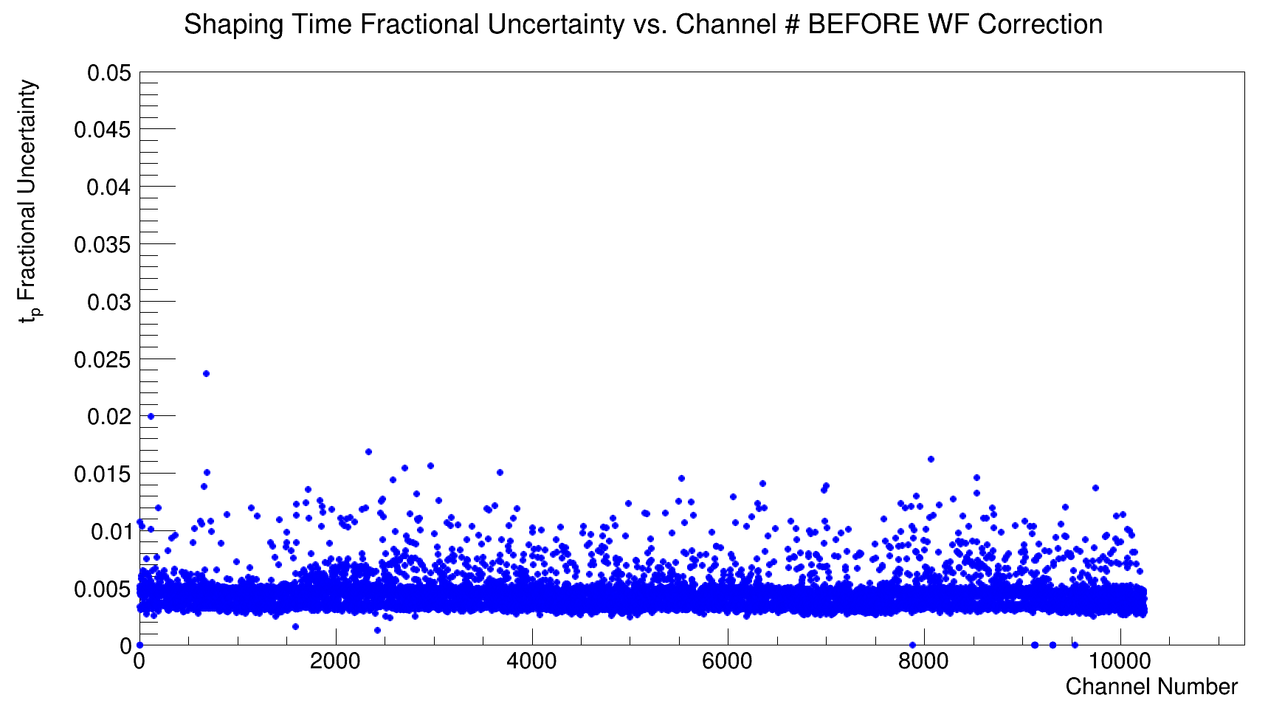
NOW: Debugging
Looking at the uncertainties of the 7-parameter fitter
Vast majority at 0.6% and below.
Vast majority at 0.5% and below.
…fit, not so much?
Karla Tellez-Giron-Flores

Slide 7
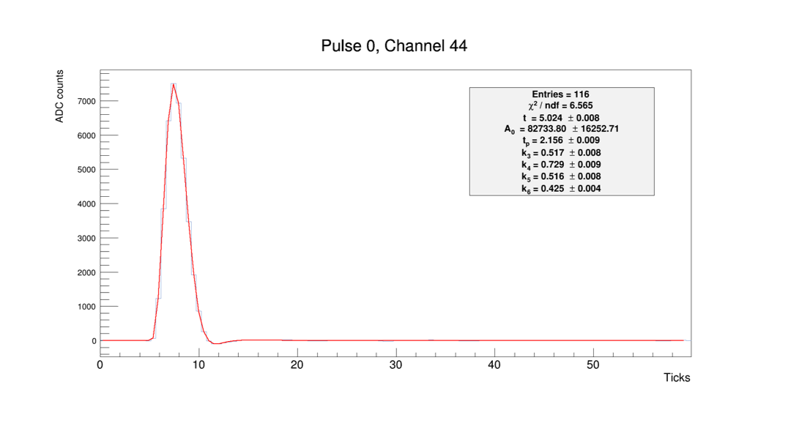
NOW: Debugging
Looking at the uncertainties of the 7-parameter fitter
What is going on with these cases?
t (µs)
Karla Tellez-Giron-Flores

Slide 8
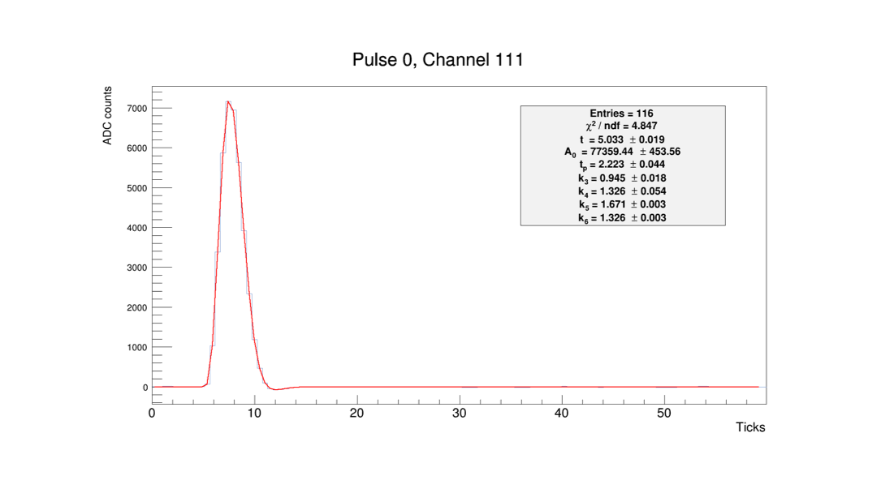
NOW: Debugging
Looking at the uncertainties of the 7-parameter fitter
What is going on with these cases?
t (µs)
Karla Tellez-Giron-Flores

Slide 9
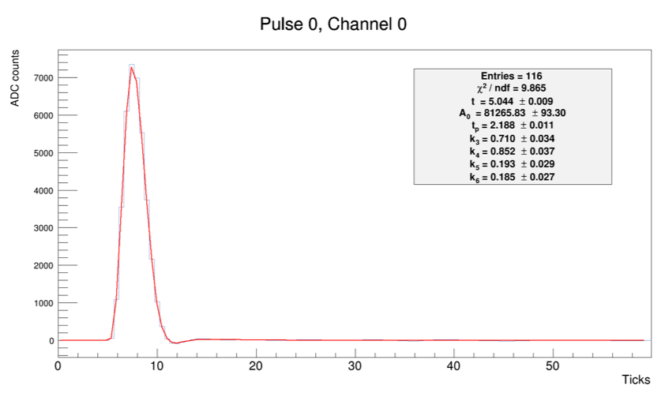
Examples of Good Fits (decent uncertainty)
t (µs)
Karla Tellez-Giron-Flores
Notes:
1400mV corresponding to the maximum voltage that a 14-bit ADC can process.
79.5315 = injected charge = (14.33mV/bit)(30 DAC)(0.185 pF). 0.185 pF is the test capacitance and the 14.33 mV is the DAC-to-voltage conversion factor.
16384 = 14-bit ADC resolution (total number of ADC steps for a 14-bit ADC). PDHD has a 14-bit digitizer (2^14).

Slide 10
Questions to answer…
Does the observed correlation come from a bad fitter?
If not, where does it come from?
Other possible paths: k-value constraints, fit parameters based on pulse area?
If correlation persists, can we live with it?
Please, have a look at the fitter here: https://github.com/KARLATGF/PDHD-wf_fitter
Karla Tellez-Giron-Flores

Slide 11
Backup Slides

Slide 12

Waveform Correction
Run the full fitter on our dataset.
Extract fit parameters.
Run the waveform correction (Wire-Cell).
Fit corrected waveforms with Ideal Electronics Response Function.
Retrieve Amplitude and Shaping Time.
Convert Amplitude to Gain.
$gain= \frac{1400 mV ∗ A0}{79.5315 fC ∗ 16384 ∗ 10}$
1400 mV is the maximum voltage in our voltage range.
79.5315 fC is the injected charge
0.185 pF: test capacitance
14.33 mV/bit : DAC-to-voltage conversion factor for our LArASIC gain setting.
30 DAC: DAC setting.
16384 : 14-bit ADC resolution (2¹⁴)
Karla Tellez-Giron-Flores
Notes:
1400mV corresponding to the maximum voltage that a 14-bit ADC can process.
79.5315 = injected charge = (14.33mV/bit)(30 DAC)(0.185 pF). 0.185 pF is the test capacitance and the 14.33 mV is the DAC-to-voltage conversion factor.
16384 = 14-bit ADC resolution (total number of ADC steps for a 14-bit ADC). PDHD has a 14-bit digitizer (2^14).

