Slide 1
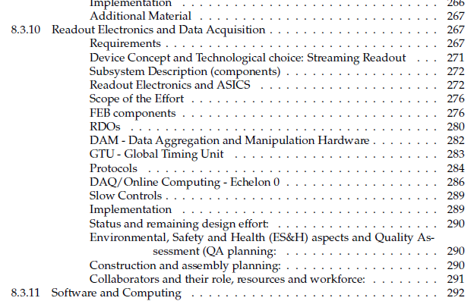
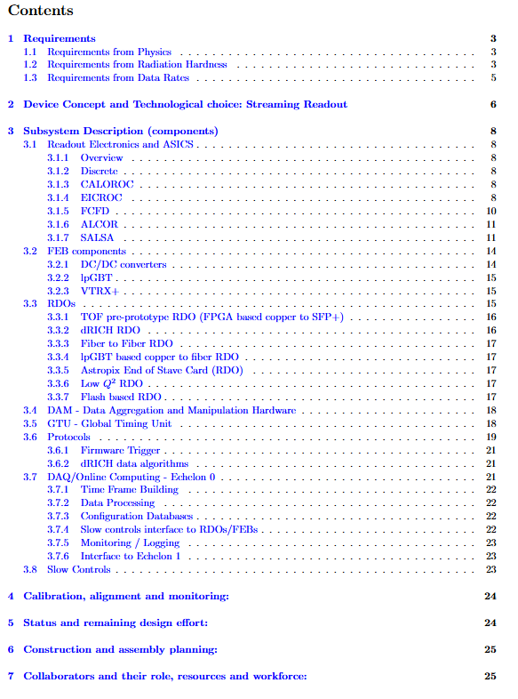
Electronics and DAQ TDR Feedback
High Level Organization:
Email exchange with Doug Higinbotham
Tag sections with numbers 6-deep (8.3.10 + 3 levels)
Table of Contents only 3-deep
General Comments
Figure Captions not currently to standards
Only relevant for 1 (maybe 3) if measured data included of our plots (simulated data volumes)
Figure quality & consistency (mainly used placeholding screen captures from talks…)
Tables quality & consistency (mainly used placeholding screen captures from talks…)
Some tables might be combined (ASIC parameters, schedule, status)
Need to add references (for almost all components)
Missing / broken links to other TDR chapters
Clarity / Typos / Wordsmithing
Reviewers very diligent, many reasonable suggestions for typos/wordsmithing
Fix forward references
Fix naming inconsistencies
Thanks to our three reviewers:
Marco Battaglieri
Pietro Antonioli
Irakli Mandjavidze
Each provided helpful, multi-page comment documents with both high-level and detailed suggestions!
TDR Draft
Add dictionary of abbreviations / terms
Clarify that ASIC/FEB/RDO does not have trigger pipelines
“User commands” for synchronized communication to front ends
DAM board can implement X-detector data selection protocols
Technical Issues / Omissions
5ps timing requirement is very challenging and should be justified
Timing measurements by E&DAQ to date not shown & add reference to community efforts (e.g. CERN TCLink)
FLX-155 info should be expanded given its importance and prominence in report
“RAD HARD” used inconsistently
Specify upper radiation limits
Distinguish SEU / Latchup protection / information redundancy protocols
Run control features (error sensing, component failure sensing, & recovery)
ESH&QA section empty
Risk / Mitigation section not present
Implementation / Status / Construction and assembly planning sections incomplete
VTRX+ / lpGBT usage, and impact on clock / FEB & RDO protocols
Stand Alone Draft

Slide 2
Electronics and DAQ TDR Feedback / Iteration Tasks
High Level Organization:
Email exchange with Doug Higinbotham
Tag sections with numbers 6-deep (8.3.10 + 3 levels)
Table of Contents only 3-deep
General Comments
Figure Captions not currently to standards
Only relevant for 1 (maybe 3) if measured data included of our plots (simulated data volumes)
Figure quality & consistency (mainly used placeholding screen captures from talks…)
Tables quality & consistency (mainly used placeholding screen captures from talks…)
Some tables might be combined (ASIC parameters, schedule, status)
Need to add references (for almost all components)
Missing / broken links to other TDR chapters
Clarity / Typos / Wordsmithing
Reviewers very diligent, many reasonable suggestions for typos/wordsmithing
Fix forward references
Fix naming inconsistencies
TDR Draft
Add dictionary of abbreviations / terms
Clarify that ASIC/FEB/RDO does not have trigger pipelines
“User commands” for synchronized communication to front ends
DAM board can implement X-detector data selection protocols
Technical Issues / Omissions
5ps timing requirement is very challenging and should be justified
Timing measurements by E&DAQ to date not shown & add reference to community efforts (e.g. CERN TCLink)
FLX-155 info should be expanded given its importance and prominence in report
“RAD HARD” used inconsistently
Specify upper radiation limits
Distinguish SEU / Latchup protection / information redundancy protocols
Run control features (error sensing, component failure sensing, & recovery)
ESH&QA section empty
Risk / Mitigation section not present
Implementation / Status / Construction and assembly planning sections incomplete
VTRX+ / lpGBT usage, and impact on clock / FEB & RDO protocols
Stand Alone Draft

