Slide 1
1D scans of HPK17 with Rotating Stage

Slide 2
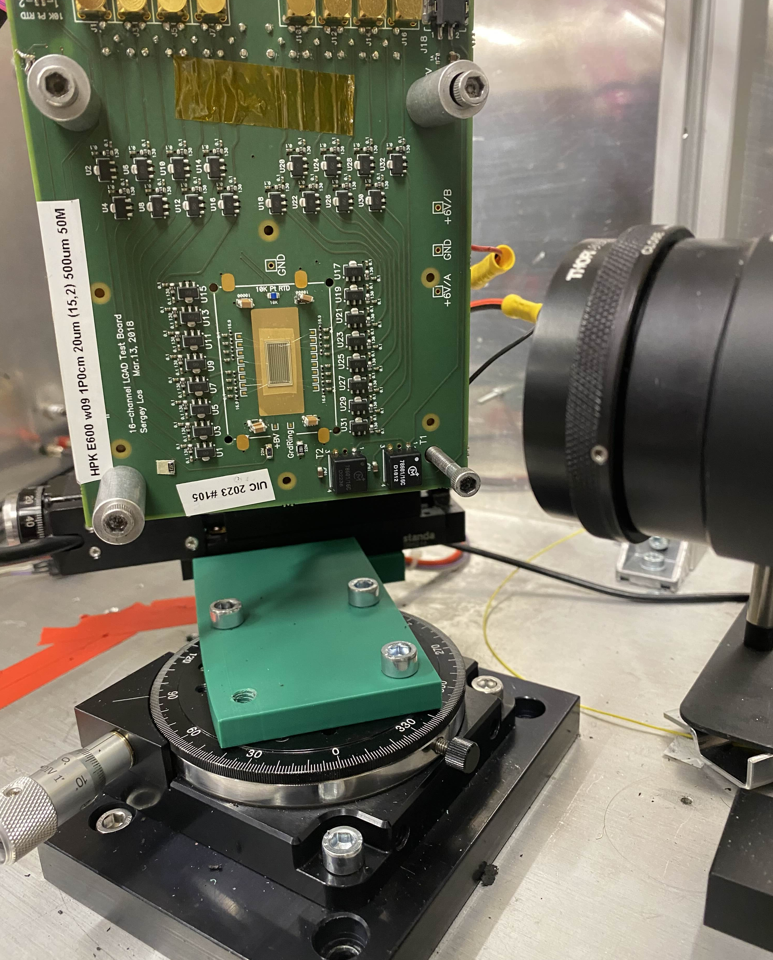
Example of Setup
Rotational stage setup, so we can now test sensors at varying angles to see the effect of the tilt
Took 1D scans across the middle of the sensor at: 0°, 18°, 30° and 45°
Rotating Stage
Setup for taking data at a 45°
tilt (in this case, the angle was at 315°)

Slide 3
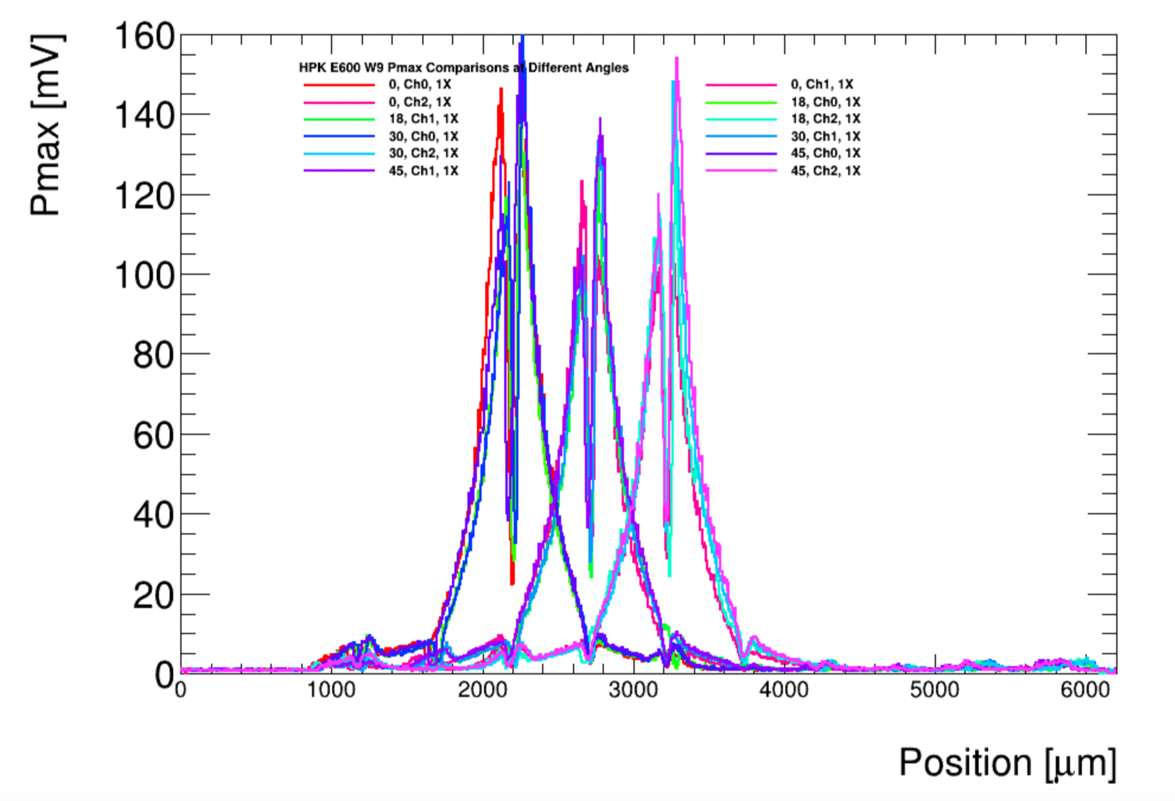
Pmax Comparisons

Slide 4
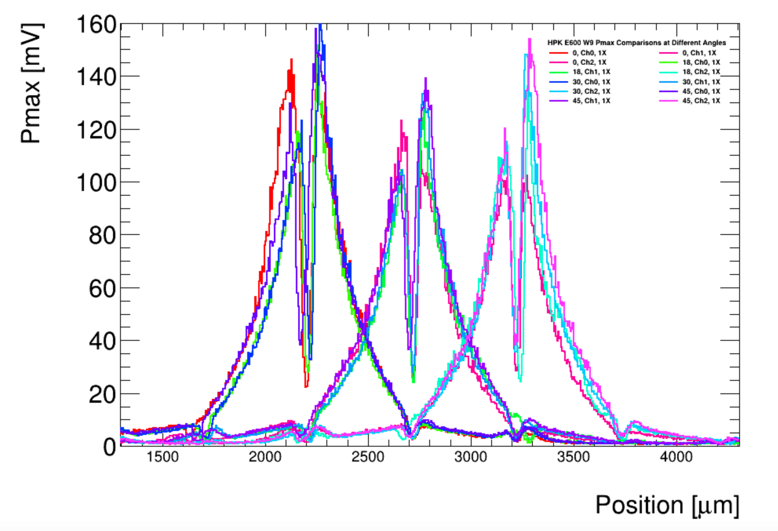
Pmax Comparisons (zoomed in)

Slide 5
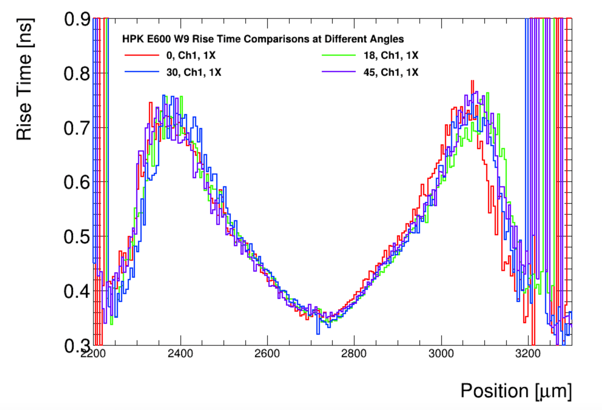
Rise Time Comparisons

Slide 6
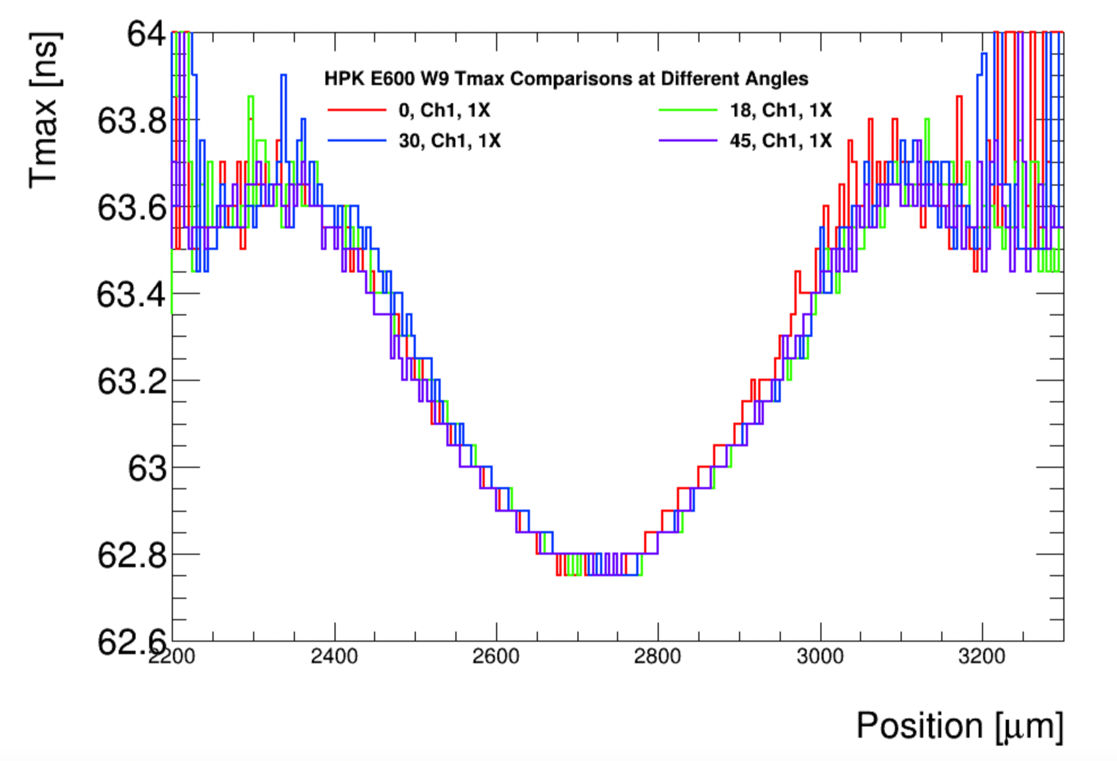
Tmax Comparisons

