Slide 1
BHCal Mechanical and Electronics Integration
Stefan Bathe

Slide 2
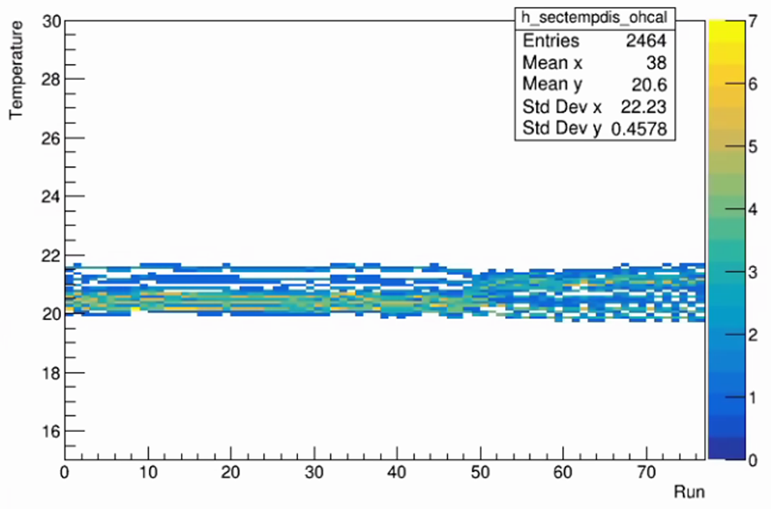
(No) Cooling
We think cooling is not necessary
There’s no cooling of the HCal in sPHENIX
HCal essentially is at ambient temperature
Small T fluctuations can be measured and gain can be corrected
Only caveat: additional steel on outside
Per sector average temperatures of all sectors for all LED runs taken with sPHENIX in Run 2023
All T fall within 20.0 and 21.5 C. So the upper limit of T fluctuations is +/- 0.75 C.
Most of that range comes from a position dependence (top sectors have higher T than bottom sectors).
The actual per sector fluctuations are much smaller than 0.75 C.

Slide 3
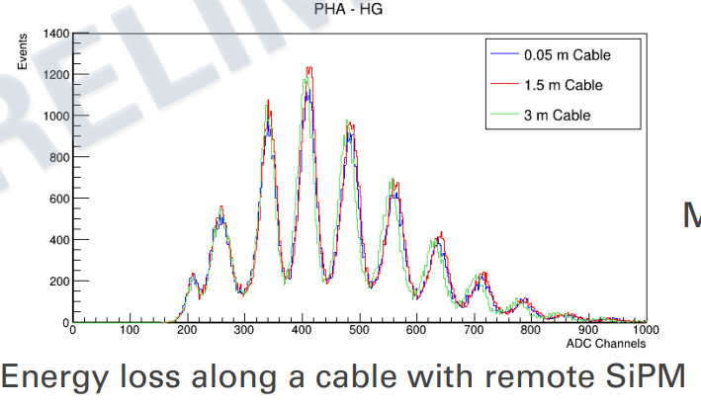
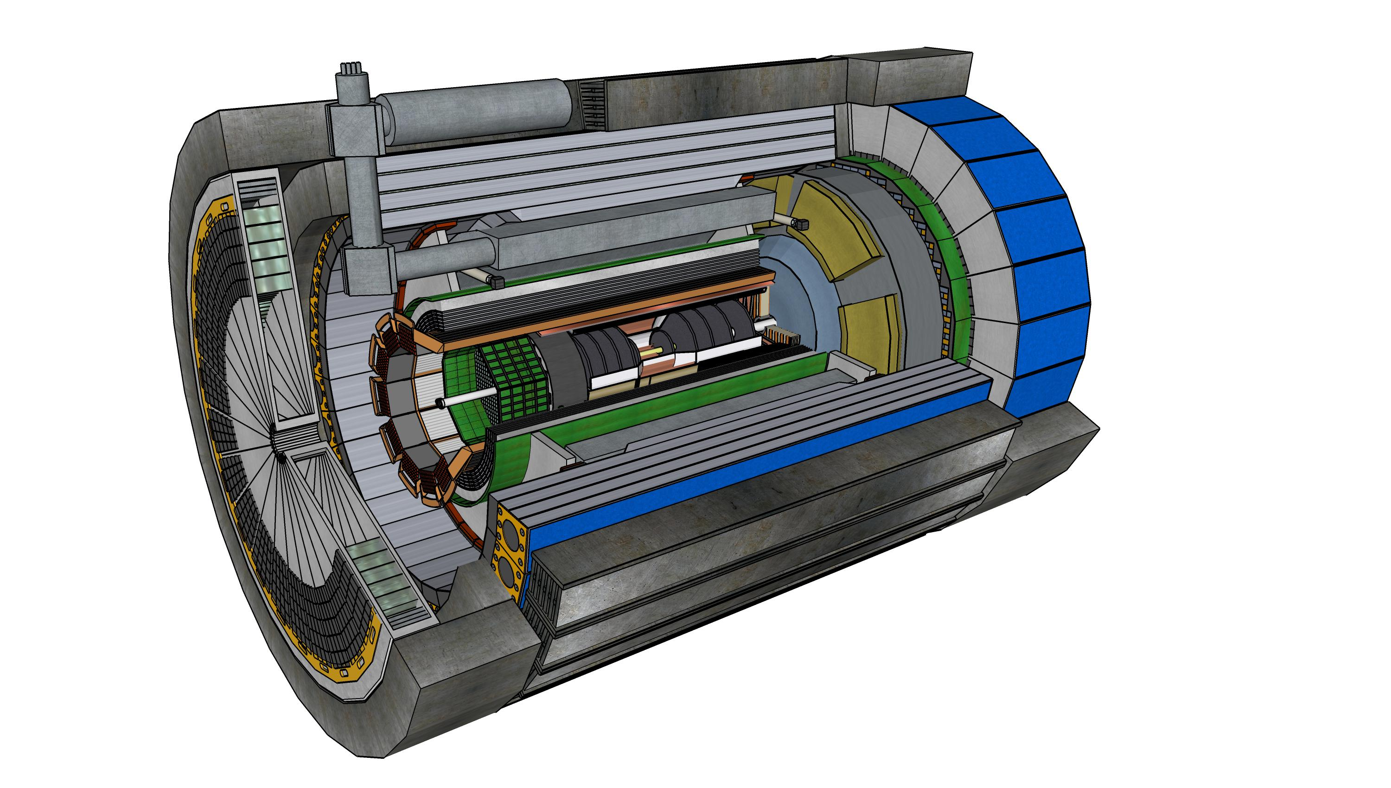
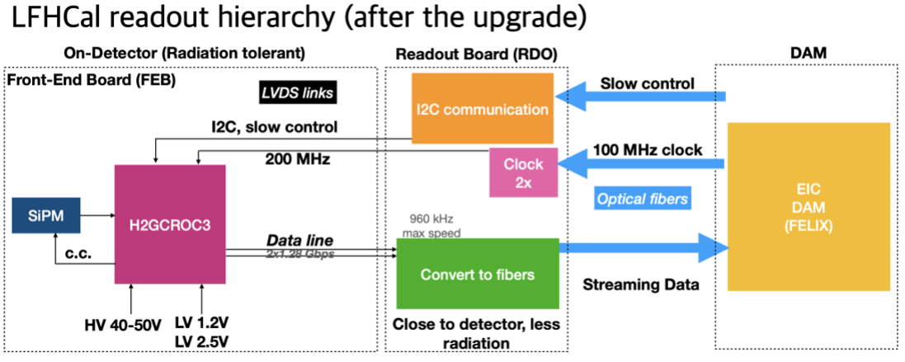
Readout Chain
One half-sector -> 54 H2GCROC3 boards (72 channels each). Cable SiPM’s out to end of barrel HCAL to keep accessible for maintenance.
~3m (μcoax)
120 cables/half-sector
~5m (Cu)
RDO’s
H2GCROC3 (54 per half-barrel) + LED driver boards
Fiber(s) to DAM

Slide 4
More details on electronics to flollow
Slides from Norbert

