Slide 1
Clustering for SBND To build a full SigProc (DNN) – Imaging – Clustering Chain for SBND
Haiwang Yu, Nov. 12

Slide 2
Outline
Xin, Brett and I have finished the initial translation of the uboone clustering to WCT.
runs but not validated yet
Next:
validation – Xin, Haiwang
adaptation to more experiment
SBND – Haiwang, Ewerton

Slide 3
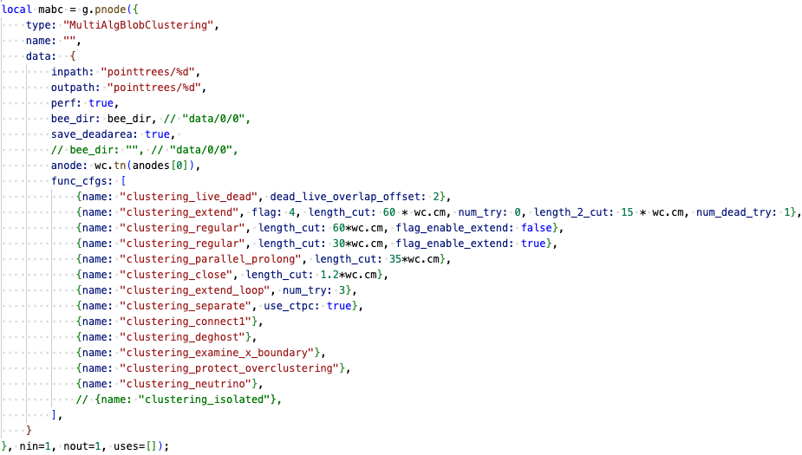
Clustering steps/configuration
Imaging: clustering based on blob overlapping
Clustering:
to combat various failure cases (parallel, prolonged, dead, imaging failure)
specific scenarios (neutrino, small activities, boundaries, over-clustering)
merging:
para, prol, dead, regular
separate, accidental crossing tracks
merging, dotted line
separate, remove ghost
separate
separate
merging, neutrino
merging, merge small to large

Slide 4
Configurable knobs
Parameters already extracted
length_cut – expected gap size to jump
num_try – try and optimize
TPC geom:
wire pitch, angle
boundaries
Many hard-coded numbers on distance, angle cuts
treat them like human-made NN
given the wire LArTPCs are similar in sense of wire pitch, those numbers may be fine?

Slide 5
SigProc (DNN) – Imaging – Clustering for SBND
As part of QL-Matching for SBND
Show some progress at the coming SBND CM (Dec. 10)
DNN – Moon, Avinay
status: production workflow available
WIP: passing though “summary” for imaging
validation - matching the charge – check the uncertainty
Imaging - Ewerton
status: Ewerton has something working locally
WIP: more general purposed coding needed; refactoring on going
validation:
geometry: projection of imaging vs. SigProc result
check some of the equation solving cases
Clustering
status: placeholder available, need to replace with real devs.
make sure the APA boundaries are configured correctly for SBND

Slide 6
Previous development
larwirecell
OpFlashSource
1
QLMatching
(larwirecell)
TensorFileSink (dump)
0
charge-pipe
(SigProc)-Img-Clus
Bee.json
stand-alone python
Bee.json
larwirecell
FrameSource
(ADC/SigProc)
Fanout
Bee.json
larwirecell
OpFlashSource
QLMatching
(larwirecell)
TensorFileSink (dump)
charge-pipe
(SigProc)-Img-Clus

Slide 7
Planned workflow
larwirecell
OpFlashSource
1
QLMatching
(larwirecell)
TensorFileSink (dump)
live
0
charge-pipe
ChSel-Imaging
charge-pipe
Clustering
dead
Bee.json
stand-alone python
Bee.json
larwirecell
CookedFrameSource
Fanout
Bee.json
larwirecell
OpFlashSource
QLMatching
(larwirecell)
TensorFileSink (dump)
live
charge-pipe
ChSel-Imaging
charge-pipe
Clustering
dead

Slide 8
Input/Output
Input: Need to match the staged production: start from recob::wire
all information need to be available: trace; cmm; summary
traces need to be dense after reading in
Output: BEE for now
ITensorSet output available?
Need optional ICluster output?
Future IO for AI/ML

Slide 9
Tasks to make the chain running
wire-cell-toolkit: apply-pointcloud [porting] → master
larwirecell: merge Ewerton and Haiwang’s branches
CookedFrameSouce
QLMatching
jsonnet: merge Ewerton and Haiwang’s branches

Slide 10
Backups

Slide 11
img-active
ChannelSelector
PointTreeBuilding
MABC
dump
img-masked
CookedFrameSource
Fanout
ChannelSelector

Slide 12
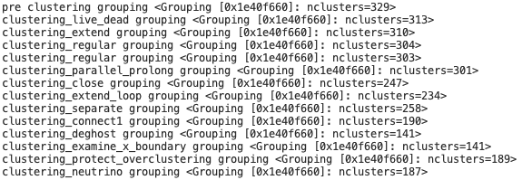
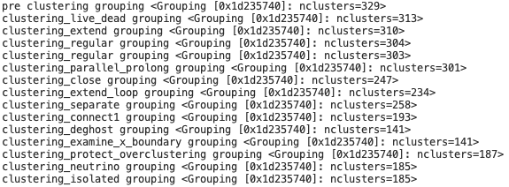
Separate_2 does not break clusters
Separate_2 -> b2id
add function calculate length from list of blobs

Slide 13
Event
wcsimsp_g4_gen_prodgenie_bnb_nu_cosmic_sbnd_nskip6.root

Slide 14
Nov. 7

Slide 15
Deghosting: Projection2D::get_projection
DNNROIFInding: no trace summary

Slide 16
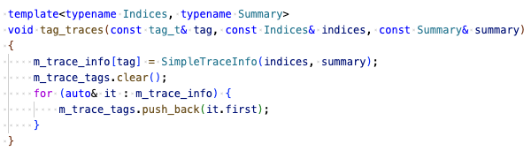
DNNROIFInding: no trace summary
indices, summary: two arrays with same length with indexing corresponding to traces
irow -> index
ch = m_chlist[irow]

Slide 17
Oct. 31

Slide 18
Building the SP(DNN)-Img-Clus workflow
SigProc with DNN-ROI: https://github.com/LArSoft/larsoft/releases/tag/v10_00_03
wire-cell-toolkit
DNNROIFinding: passing through summary/RMS to dnnsp frame
ChannelSelector
larwirecell
CookedFrameSource
Imaging (ICluster):
I had issues running imaging on data, but Ewerton has a working version, incorporating his local devs
wire-cell-toolkit, larwirecell, cfg
using dnn-roi in imaging
synergy with PDHD
Clustering (ITensorSet, PointCloud::Facade):
Configurable clustering_function to run in MultiAlgBlobClustering
json -> c++

Slide 19
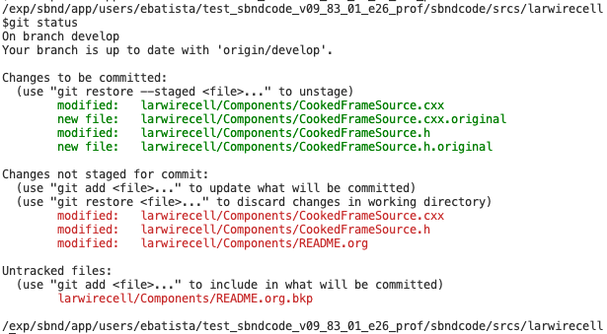

Slide 20
