Slide 1
Jet Algorithm Evaluation
Brian Page

Slide 2



Introduction
Want to compare jet algorithms to see how well they perform in the backward region
Use matching to struck Born-level (no FSR) parton kinematics as a metric
11 million Pythia6 events: 18x275, 10 < Q2 < 100 GeV2, LO DIS process (subprocess ID = 99) only
Compare 4 jet algorithms:
Inclusive Anti_kT with R = 1.0 and jet pT > 1.0 GeV
Inclusive eeGenKT with R = 0.1, p = -1 and jet pT > 1.0 GeV
Inclusive eeGenKT with R = 1.0, p = -1 and jet pT > 1.0 GeV
Exclusive eeKT with jet pT > 1.0 GeV
Next slides: look at properties of jets and how well they match to the partons
Conclusions: Anti_kT and eeKT look ok for general use, including in the backward region. eeGenKT may be ok for backward going partons only but will need more investigation.
Next steps: Look to dijet subprocesses and include Centauro algorithm
$$d_{ij}=min⁡(E_{i}^{2p},E_{j}^{2p})\frac{(1 − \cos{θ_{ij})}}{(1 − \cos{R})}$$
$$d_{iB}= E_{i}^{2p}$$
eeGenKT
$$d_{ij}=min⁡(E_{i}^{2},E_{j}^{2})(1 − \cos{θ_{ij}})$$
eeKT

Slide 3
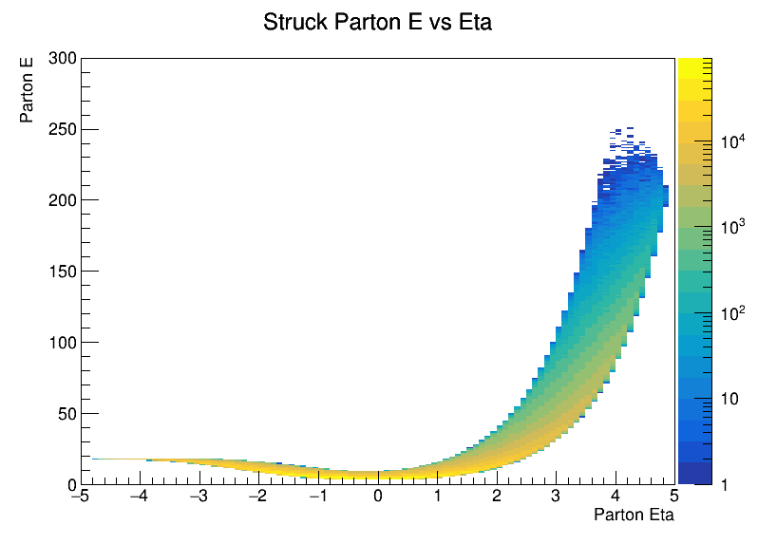
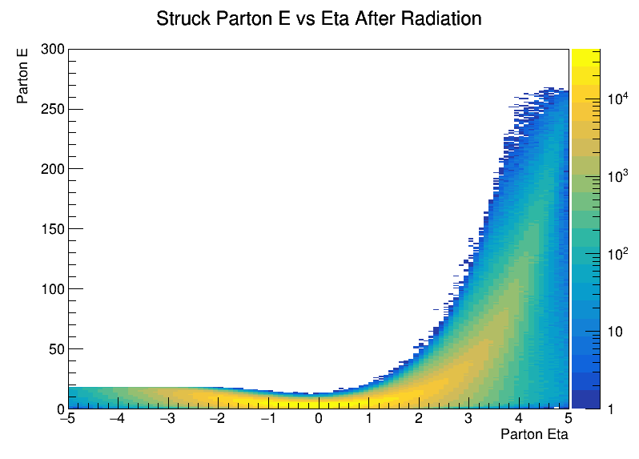
Parton E Vs Eta
Look at energy vs eta distribution for struck parton – defined by Born-level DIS kinematic relations
Also look after the influence of FSR
Match jets with Born-level struck parton

Slide 4
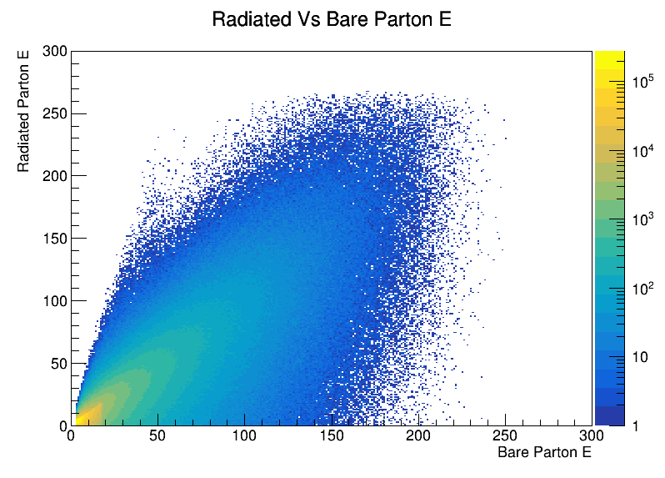
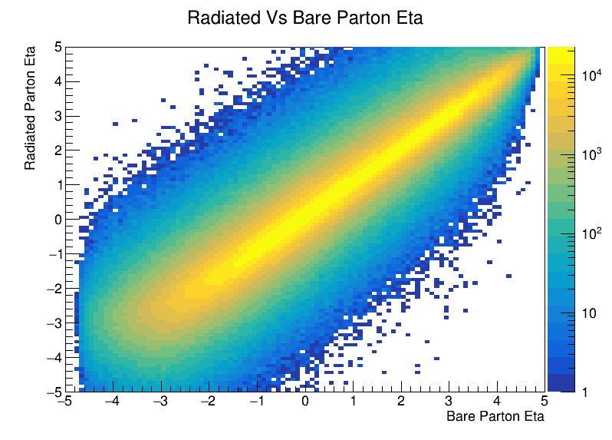
Radiated Vs Born Level Parton
Correlate parton energy and eta before and after FSR

Slide 5
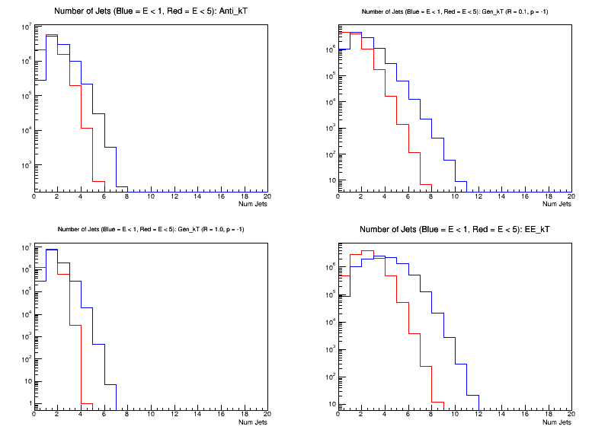
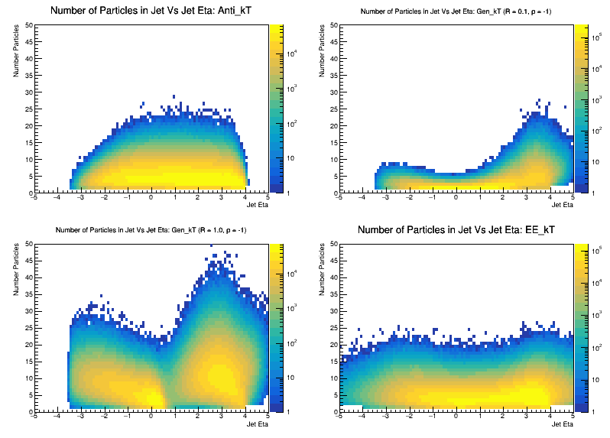
Number of Jets and Particles
Number of jets in event with E > 1 or E > 5 GeV
Number of particles per jet vs jet eta with E > 1 GeV
Clockwise from top left: Anti_kT R = 1.0, eeGenKT R = 0.1, eeGenKT R = 1.0, eeKT

Slide 6
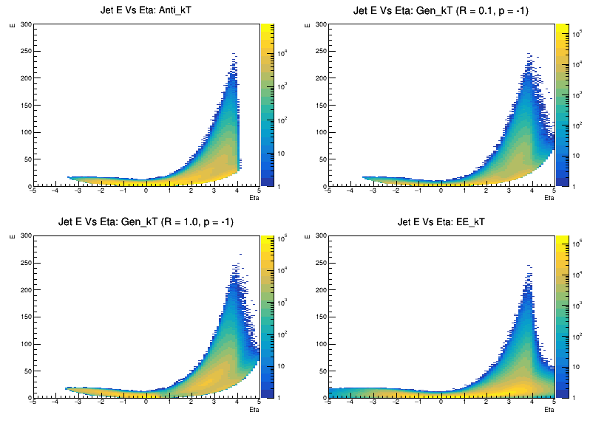
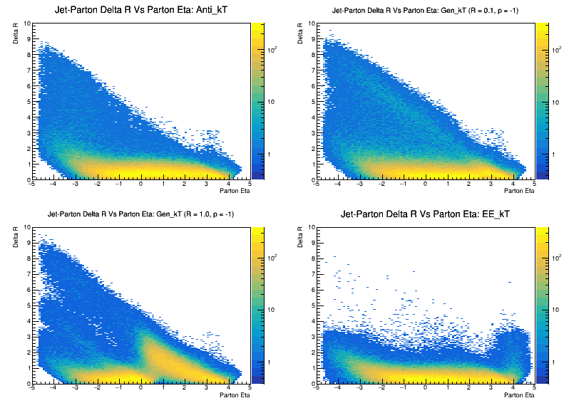
Jet Distribution and Parton Matching
Jet energy vs eta for all jets
Delta R for Born-level parton and closest jet vs parton eta
See prominent lack of jets matching partons at low eta
eeGenKT algo shows odd features with lack of jets at positive mid-rapidity

Slide 7
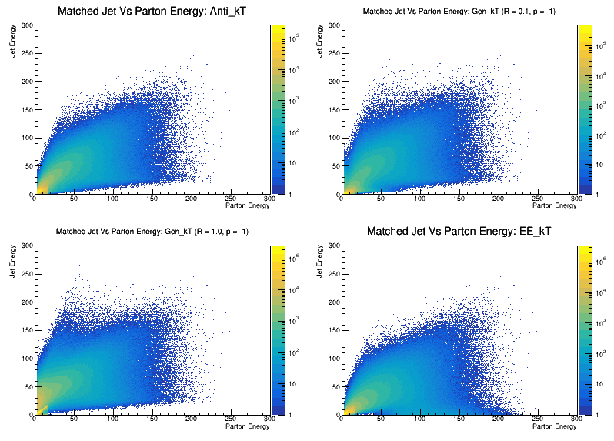
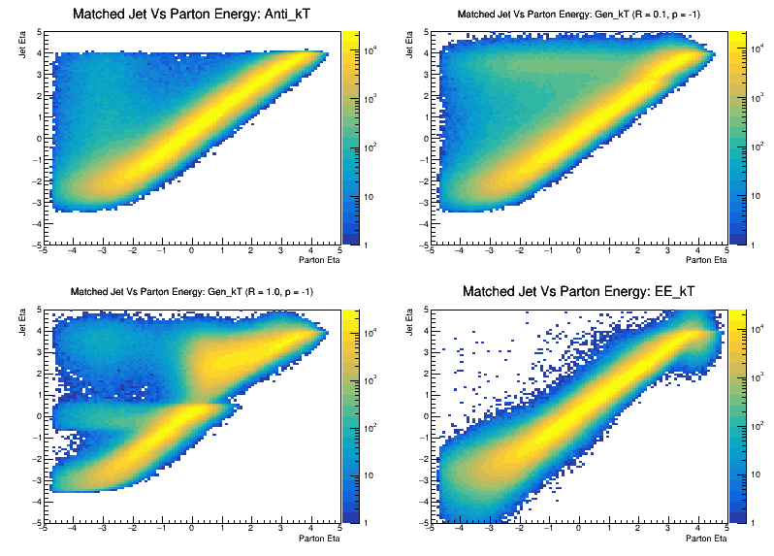
Matched Jet Vs Parton Kinematics
For each parton, find jet that is closest in eta-phi
Plot energy or eta of that jet vs that of the parton
See relatively good correlation in eta and somewhat worse in energy
Again, see odd behavior for eeGenKT with larger radii

Slide 8
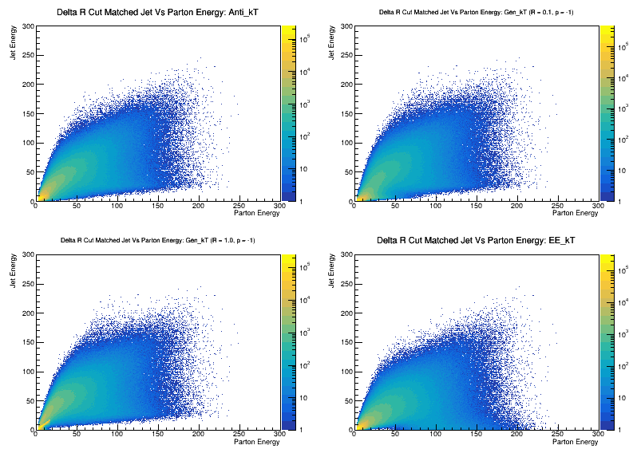
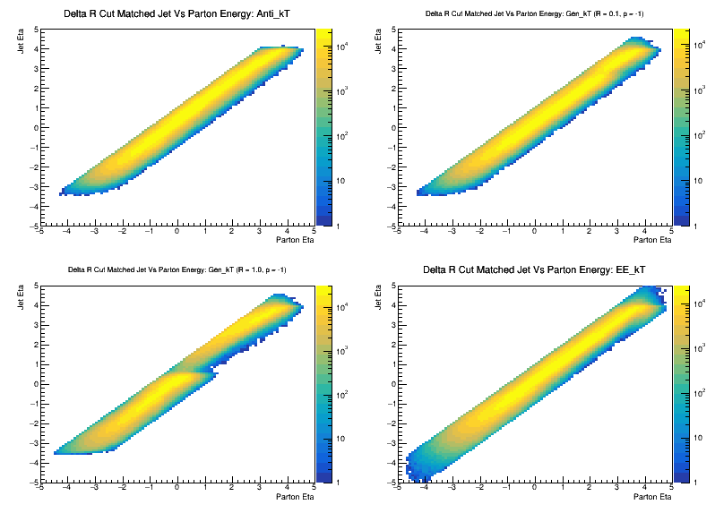
Matched Jet Vs Parton Kinematics: Delta R Cut
For each parton, find jet that is closest in eta-phi
Plot energy or eta of that jet vs that of the parton
Now require the jet be within a Delta R of 1 from parton
Should be able to access Born-level parton kinematics from scattered electron (for DIS)

Slide 9
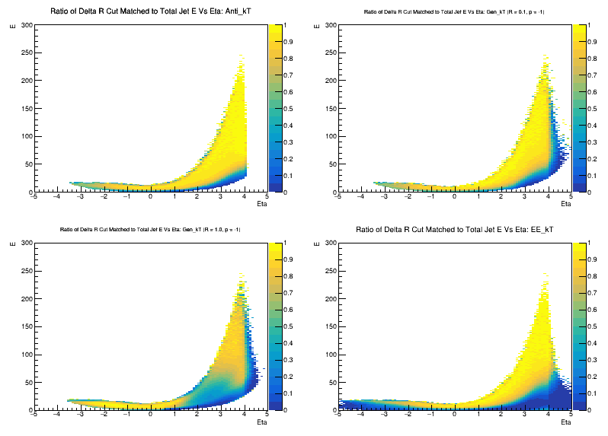
Jets Lost by Delta R Cut
Find jets matched to parton with Delta R < 1.0
Plot E vs Eta for these jets and take ratio to the inclusive sample
This shows the jet phase space where the jets do not represent the parton kinematics well

