Slide 1
BHCal SiPM Cables
Eric J. Mannel
15-Nov-2024

Slide 2
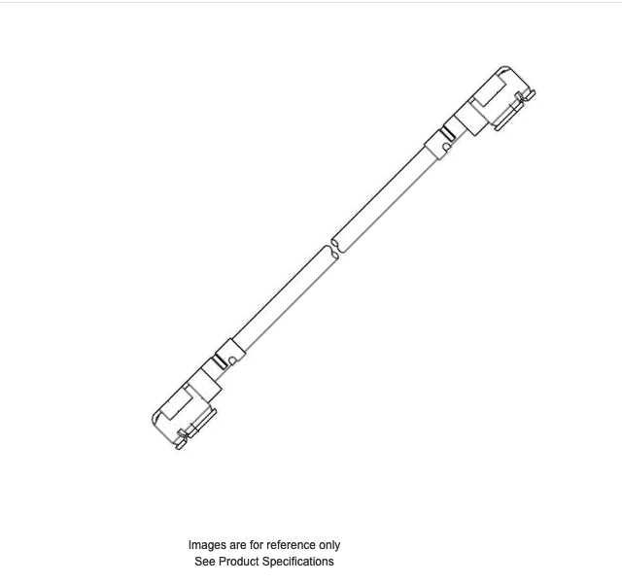
Cable Requirements
Prototype:
  RF coax cable, 1.5m to 2m long
  U.FL female connectors both ends
  80 + spares required.
BHCal
  RF coax cable, maximum length 5m
  U.FL female connectors both ends
  7680 + spares required.
Do we need them all the same length. For prototype, < 5nSec top to bottom, for BHCal < 20nSec from middle to end.

Slide 3
Testing Schedule
Norbert has ordered some pre-fab cables, maximum length 0.5m from Digi-key.
Steve has sent so SiPM boards to ORNL (delivery next week?)
Based on discussions with Norbert, expect results in January (?)
I ordered some sample 1m cables from Mouser, should have them next week.

Slide 4
Cable Ordering
Maximum length pre-fab cables I can find in stock are 1m from Mouser
  $6.89 each, for quantities of 100.
  600 in stock
  Should allow us to cable top 2/3rds of the prototype quickly
Longer length are a custom order.
  Norbert found a Taiwan vendor, 12-16 week lead time
  Requires PO, US Holidays with slow this down
  Taiwan Lunar New Year, 1 week holiday end of January, companies closed
  If we order now, expect them May/June, wait for testing, July/August.

