Slide 1
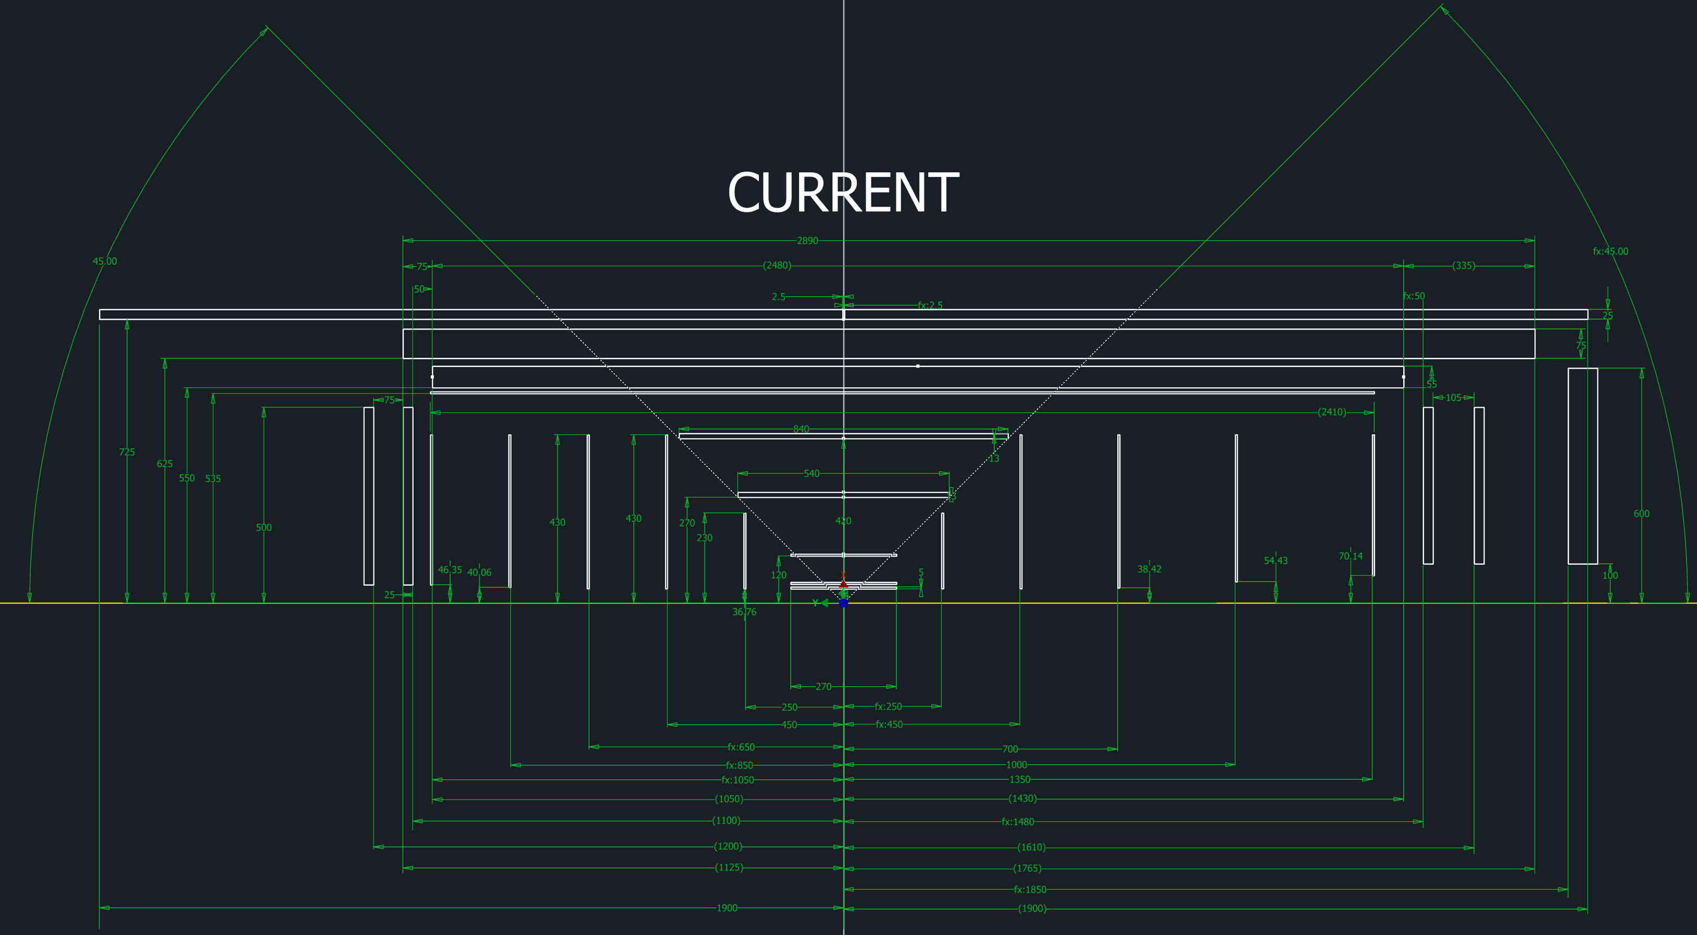
Proposal to resolve the engagement ring problem
Currently we cannot have one engagement ring sitting at the same moment in the middle of the MicroMega layer and the Barrel ToF
Solutions to solve this mechanically are extremely cumbersome and will add additional material
The other solution is to split the Barrel ToF in two non equal length halves, with one half being quite long, so long that there is a potential problem with the flex cable.
μ-Rwell
ToF
Micro Mega
L4 MAPS
L3 MAPS

Slide 2
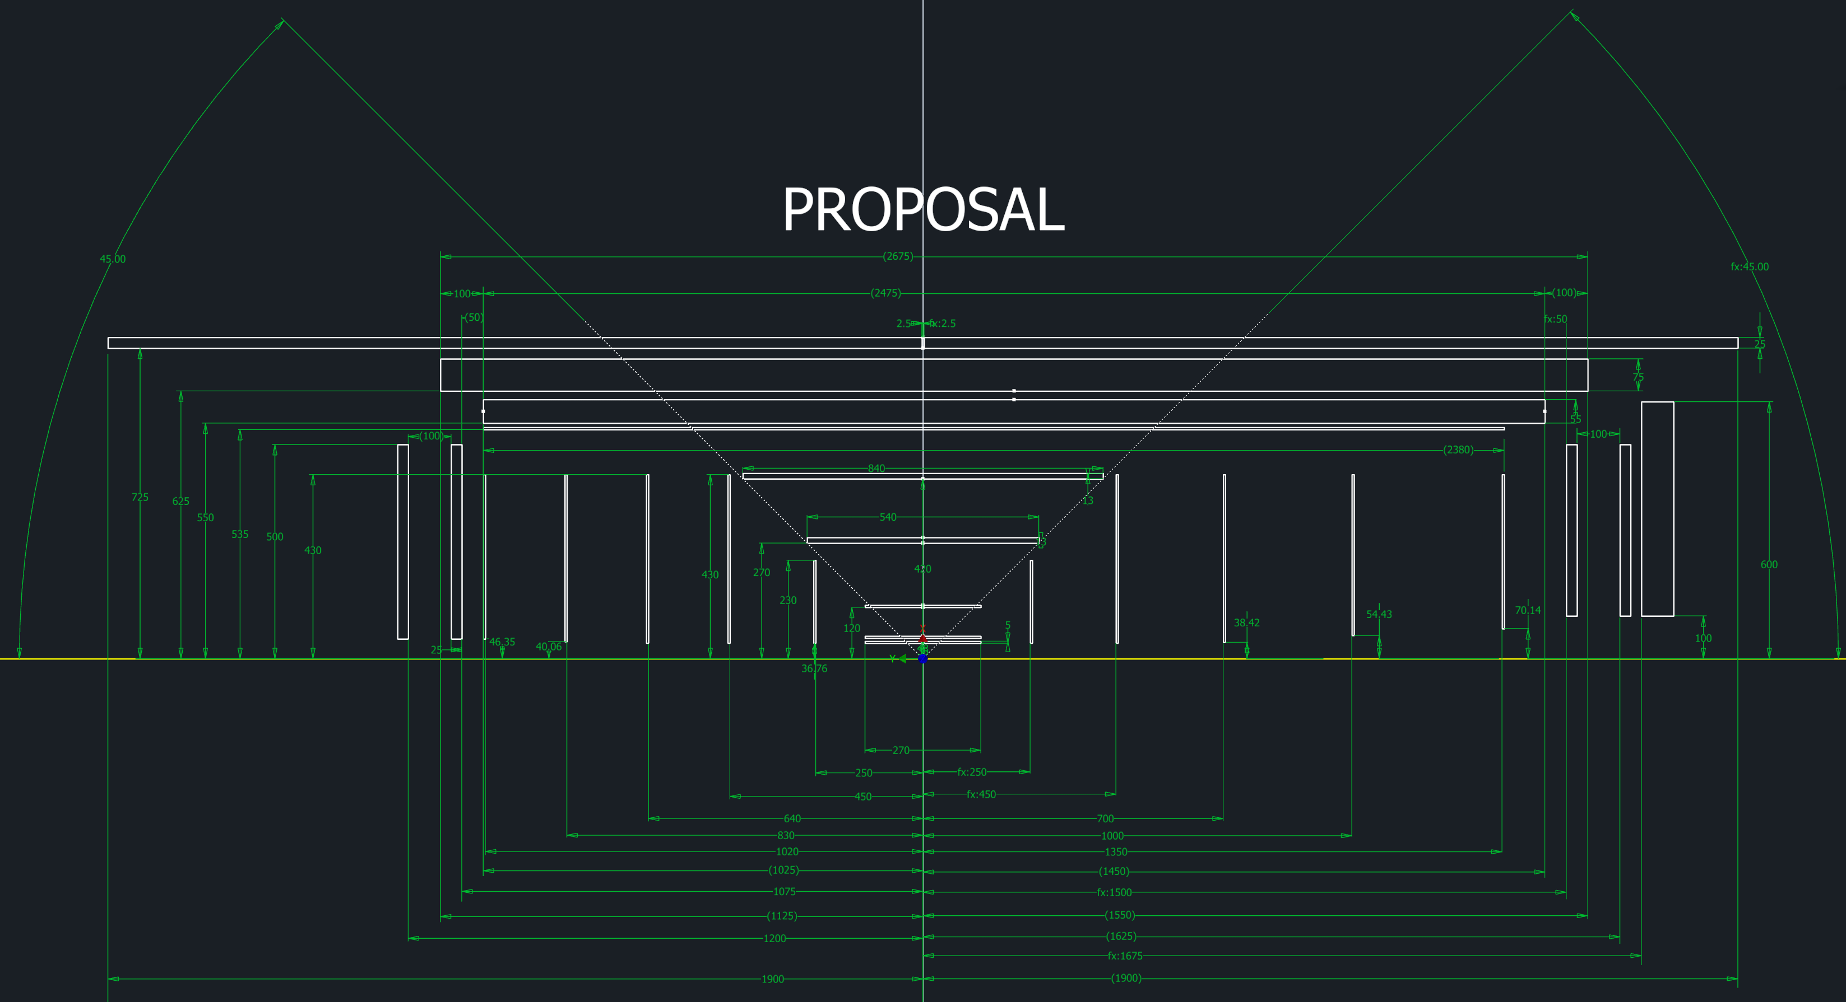
Solution:
Align Barrel ToF and MicroMega detector centers
→ shorten Barrel-ToF by 21.5 cm from the hadron endcap side → total length 2.675 m
this also solves the flex board length issue.
→ me moved the forward ToF closer to the IP by 17.5 cm to keep the gap between barrel and forward ToF minimal
μ-Rwell
ToF
Micro Mega
L4 MAPS
L3 MAPS

