Slide 1
ePIC Common Funds
J. Lajoie, S. Dalla Torre
January 23, 2025

Slide 2
What are “Common Funds”
The purpose of common funds is to create a mechanism to allow international agencies to share the costs associated with operating the ePIC detector.
The following slides summarize the discussions with the Resource Review Board (RRB).
Several exercises were requested by the RRB to envision what common funds might look like for ePIC, informed by experience at the LHC
I would like to emphasize these are just discussions at this point, nothing is set in stone.

Slide 3
EIC RRB Common Fund Working Group
Original Common Fund Working Group
Abhay Deshpande, Rolf Ent, John Lajoie, Rosario Nania
After 3rd RRB meeting Paolo Giubellino replaced Rosario Nania
To add more non-US perspective the WG added Peter Jones
Crucial to have some people that are familiar with the CERN processes

Slide 4
Governance Model
The EIC is a US-based collider. DOE and the host labs promote the EIC as a facility that is fully international in character with the EIC-RRB to provide oversight of resources utilized for detector construction, operations, and planning. To set the stage towards costs, we give here a short description of the key governance principles:
US DOE finances EIC accelerator operations, determines number of operations weeks and schedule.
US DOE supports the host labs’ administrative and technical staff and the infrastructure costs for the experiments.
DOE and non-DOE participate in and finance the governance of the experimental program including construction and upgrades, maintenance and operations (M&O), and distributed software and computing.
BNL and TJNAF (co-hosts for the EIC Experimental Program) convenes the EIC-RRB nominally twice year as international oversight body. The RRB has two co-chairpersons (Abhay Deshpande and Diego Bettoni).

Slide 5
M&O Categories
Category A concerns equipment built and maintained using Common Funds e.g. magnets, or services and operations common to the whole experiment e.g. software licenses.
Category B concerns maintenance of equipment built by a sub-set of the collaboration, mainly sub-detectors.
Category C concerns collaboration support using Common Funds, e.g., support for travel and as-needed time for key Collaboration functions, local co-support of travel for visiting scientists, and general support for a global strategy to allow for underprivileged scientists to participate in EIC science.
Category D concerns items for which the DOE and US host laboratories would naturally assume responsibility for, e.g. costs to run the accelerator which sets the weeks of operations and schedule, infrastructure for the experimental areas and experiments and infrastructure operations costs, survey and alignment, and the overall Environmental, Health, and Safety aspects for detector operation.

Slide 6
Cost Sharing
Category A items:
Sharing by scientists is linked directly to the exploitation of a detector and is perceived to be a fair measure of benefit. To fold in the educational and more transient character of students, ’scientists’ are taken to be fully-qualified PhDs, or the equivalent, appearing as named authors on publications of the collaboration. This implies that a reference is defined annually.
Category B items:
For Category B items a sharing with a different cost-sharing algorithm may be more appropriate. Funding Agencies and Collaborating Institutions can retain responsibility for their own category B costs and sharing can vary with sub-system. Because many ePIC sub-systems have multiple participants, the institutes participating to a given detector sub-system will propose a sharing of the M&O costs as agreed among themselves, and the EIC-RRB will make sure this proposal can be accepted..
Category C items:
Category C items can be handled in the same way as category A items, as a sharing with scientists with a PhD-equivalent level. The cost-sharing mechanism may be chosen to differ from that used for category A items to take into account the special role of the DOE host laboratories to host the ePIC collaboration and visiting scientists, and to encourage participation in ePIC detector operations of underprivileged scientists.

Slide 7
The Process
The initial draft for “Commissioning, Maintenance and Operation of the ePIC Experiment at the EIC” was presented at the 3rd RRB meeting by Rosario Nania.
Follow-up from 3rd RRB Meeting:
"a further iteration of the document for the RRB in late 2024, and provide the seeds that can be used in further agreements between the EIC host labs and the agencies."
"In a future iteration we plan to include preliminary estimates of the total cost of operating the ePIC experiment."
"How should in-kind contributions to computing be treated in this context"
Initial cost estimates for M&O categories A, B and C were made by the US-based members of the Working Group; this was to make a first cut on what is different from CERN in a US-based experiment.
The non-US based members of the Working Group acted as “initial scrutiny board”; they also provided excellent further input from CERN experiments.
Cost estimates were revised and saw a next round of feedback.
Draft document of “Commissioning, Maintenance and Operation of the ePIC Experiment at the EIC” was updated and is shared on Indico.

Slide 8
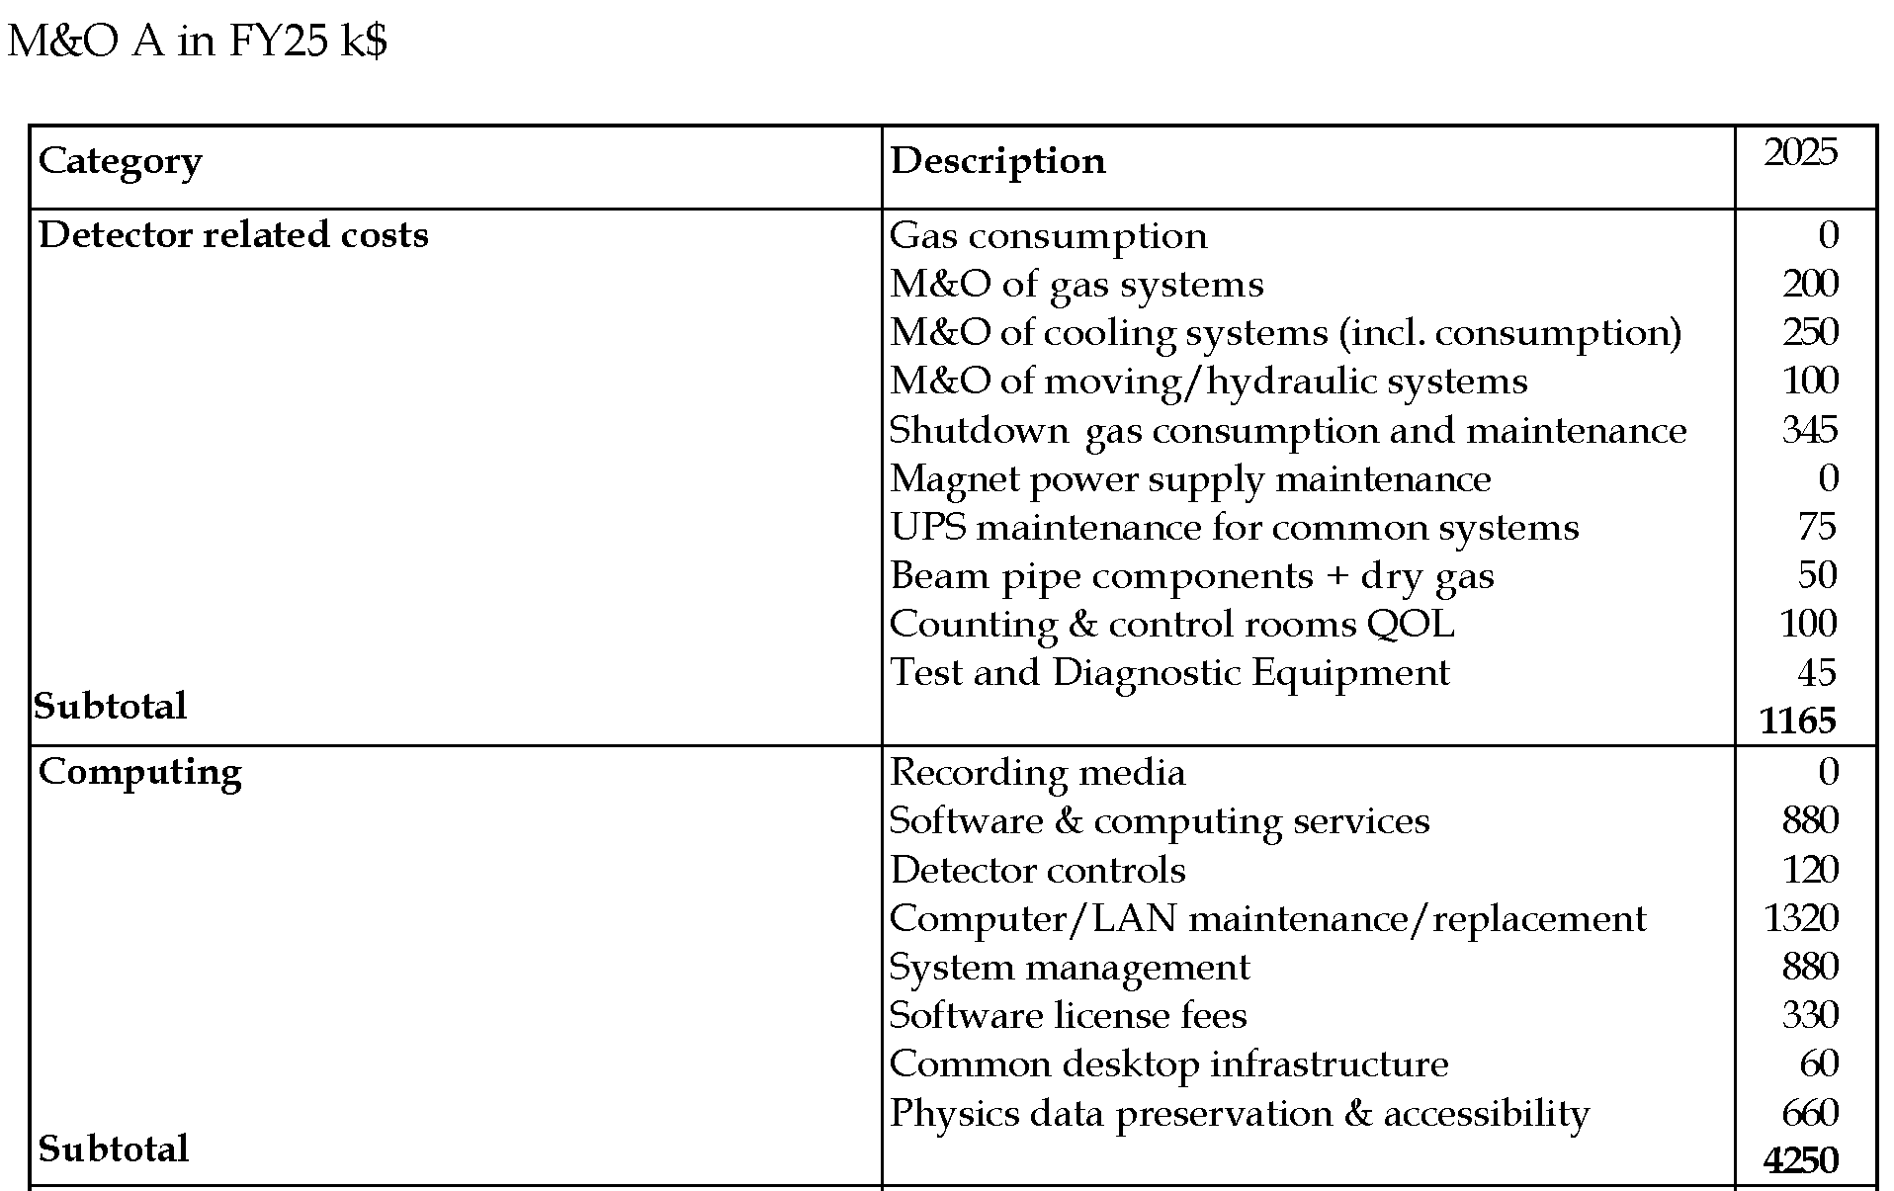
M&O Category A Estimate – Part 1
Will need every maintenance cycle (yearly) to move in/out of the hall
Assume half a year, 1/4 consumables for detector protection + 1/2 M&O
DOE Scope
Assumed ALICE x2
Minimize time to achieve good vacuum
Assume replacement every five years
DOE scope – estimate 201PB for Year-1 data/sim/etc. @$5/TB = $1M
Support for generic physics analysis software & computing (2 FTE service providers)
Hardware replacements; modest but many systems
Hardware repl. & service providers - integration & data flow from echelons 0/1 to 2
Assumed 2 dedicated people
Assumed CLAS12 x 3
Assumed replace 20% per year
Assumed need for additional data science service providers (1.5 FTE) for physics data databases

Slide 9
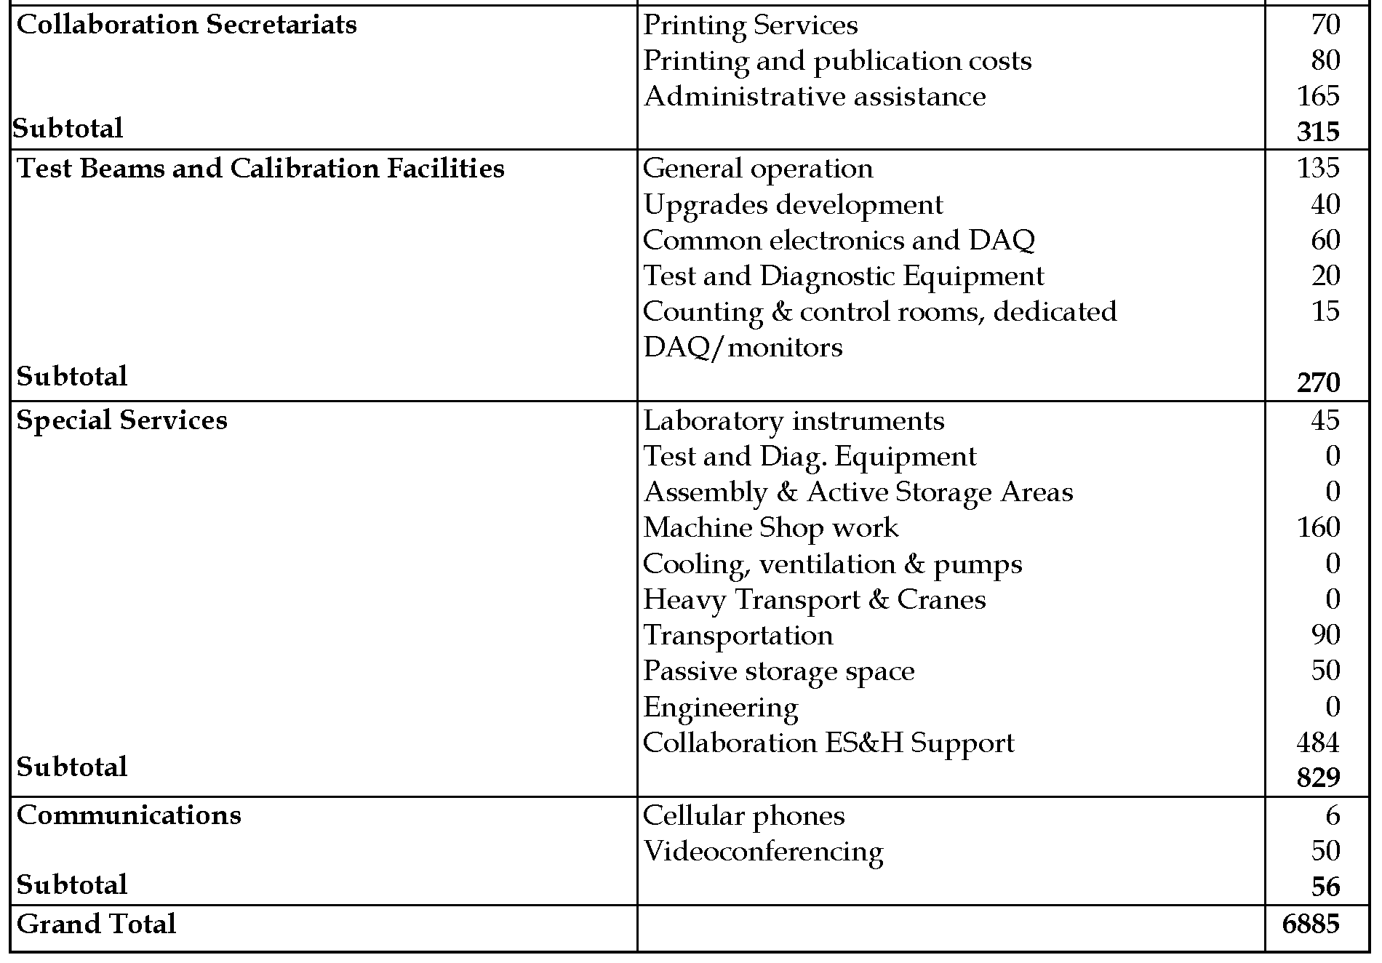
M&O Category A Estimate – Part 2
Estimate based on 4 Halls at Jlab
Phys Rev Lett is ~4k/article in page charges
Assumed one admin staff in addition to host lab support
Includes some support for travel to BNL/JLab tests
To facilitate test setups for parasitic beam use
For DAQ and monitoring
Rare need, assume occasional replacements
Machine shop work account, assume CLAS12 x 2 + 2
Sum of many import tarif and local shipment
Assume temporary lease of space
User support consultancy (1 FTE)
Assumed ~$50 per month per phone, and each subsystem needs one
Zoom license $20/user x 2500 = $50k

Slide 10
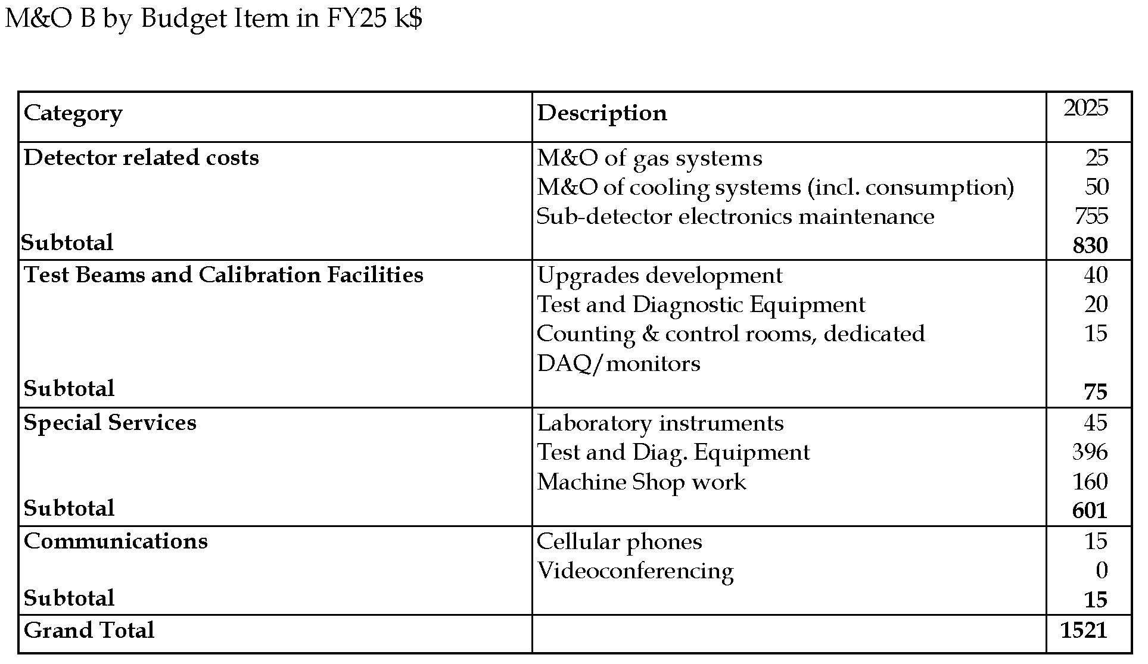
M&O Category B Estimate
Assumed ALICE x 2
To facilitate test setups for parasitic beam use
For DAQ and monitoring
Tech help at EIC from collaborating institutes for user setups
Machine shop work account, assume CLAS12 x 2 + 2
Assumed ~$50 per month per phone, and each subsystem needs one

Slide 11
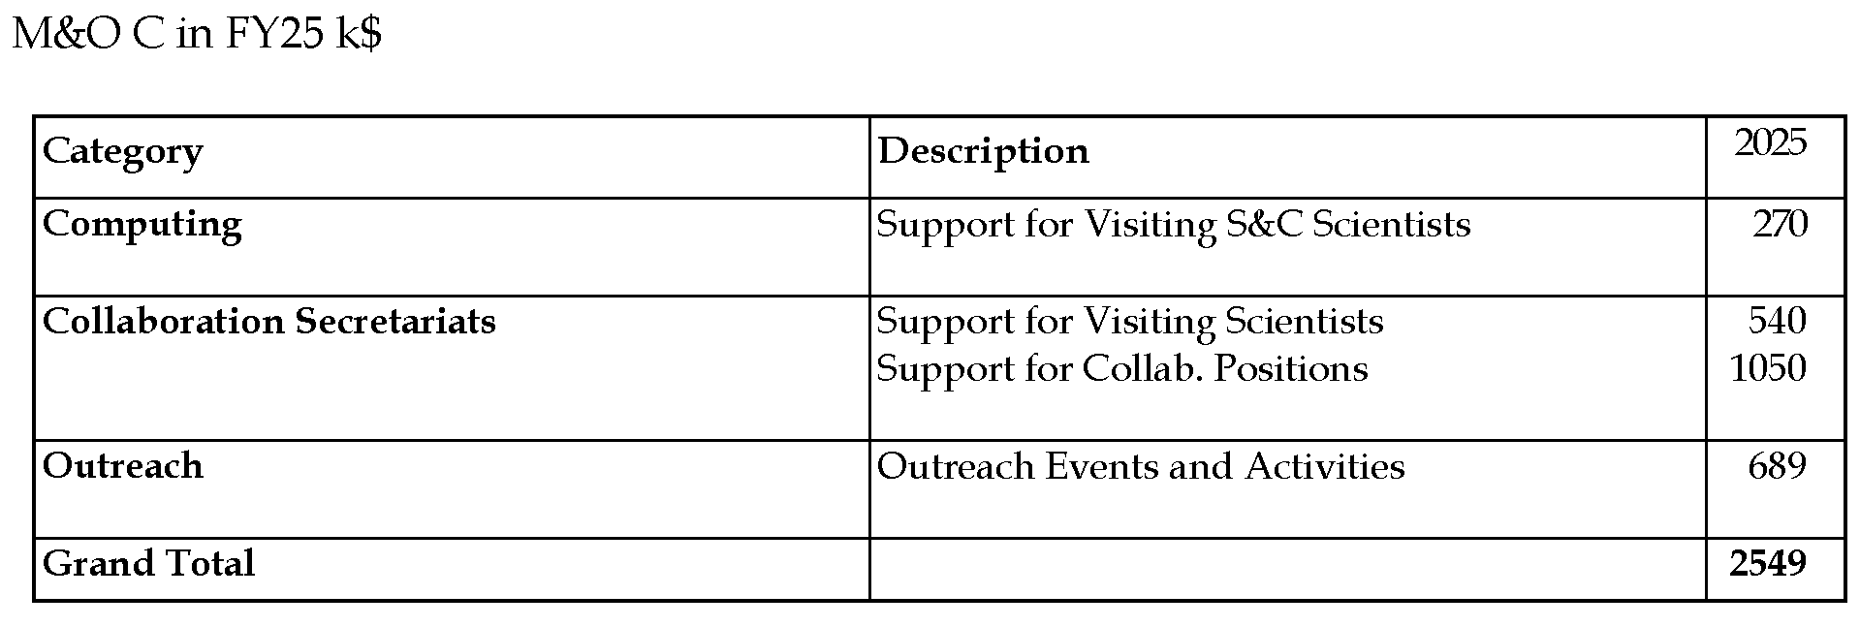
M&O Category C Estimate
Support of lodging and per diem, this support model is successfully used for visiting scientists working on S&C
Assumed CLAS12 x 3
Spokesperson rep, TRC and RRC full time at BNL - this follows more the DESY model
Assumed 10% of M&O Category A only

Slide 12
Key Differences with the CERN Model
We included in Category A the computing-related costs here but (optionally) separated it out in the totals. Note that local co-support of travel for visiting scientists is included in Category C.
Computing M&O amounts to 38% of total M&O (or 45% without M&O-B). For CERN experiments this is (in 2024) 55%, 48%, 41% and 45%, but computing models and data volumes are different. For the CERN experiments this is mostly hardware, while for ePIC this is mostly personnel.
Category B still has large uncertainties as the number of subsystems that should be included here is unclear while we are not baselined and in-kind agreements are in process.
Category C includes “An estimated 10% of the Common Fund money will be dedicated to outreach activities.” (see draft minutes of 3rd RRB meeting). We assumed this to be related to M&O category A.
Category C includes support for onsite ePIC leadership. This follows more the DESY model where onsite presence was required for experiment leadership, which proved very successful. This is different from the CERN model.
All items that are naturally correlated with the weeks of operations are in Category D as the DOE and US host laboratories would assume responsibility for these.
This includes power costs, so a natural comparison with CERN experiments should exclude that.

Slide 13
Draft Profile (Updated with Cost Estimates)
Assumes installation completed around 2030, the exact date may change in future iterations

Slide 14
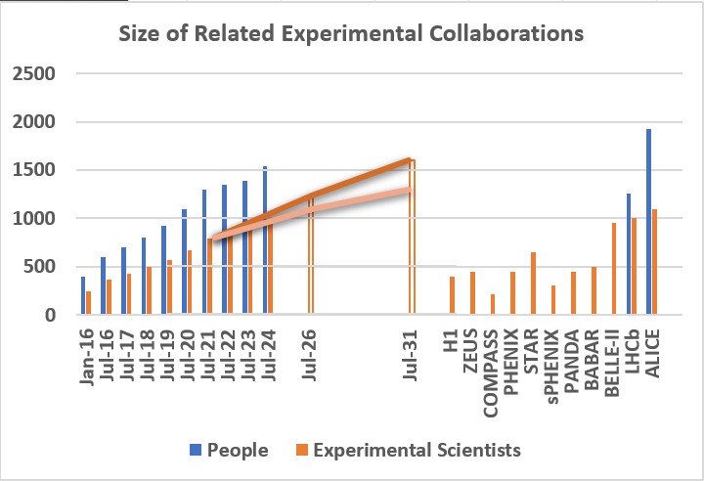
ePIC Collaboration Projections
To project the size of ePIC to the start of EIC data taking, we assume that ePIC’s growth will mirror the EICUG:
ePIC is currently ~900 collaborators
1250-1600 by 2031
ALICE in 2010 was 568 M&O PhD’s and ~1000 collaborators
Use 2024 data to get ratio of physicists, postdocs and students ~0.72
M&O Physicists ratio ~568/(0.72*1000) = 0.79
Combining the two above, we would expect between ~990-1260 M&O PhD’s.
Use the average for M&O/author calculations (1125)
Cost per author (A+B+C): $9.7k
Cost per author (A+B+C excl computing): $6.0k

Slide 15
A Note on Spokesperson’s Discretion
Cost sharing and fair sharing are mentioned in the “Commissioning, Maintenance and Operation of the ePIC Experiment at the EIC” and were discussed at the 3rd RRB meeting.
Flexibilities were also introduced: “It is understood that the financial situation in each member and non-member (observer) country that participates in the EIC-RRB may be different. There should be some means for the EIC-RRB to apply flexibility in contributions to the M&O Common Funds. The EIC-RRB can fold this into their determinations of equitable sharing of M&O costs at their bi-annual meetings.”
The equitable cost sharing is assumed to be by ’scientists’ that are taken to be fully-qualified PhDs, or the equivalent, appearing as named authors on publications of the experiment. It is understood that there may be requests to be “non-paying”. Rather than cause precedents, it is suggested that exceptional cases can be handled by treating Category C M&O costs partly at the spokesperson’s discretion, in periods between the bi-annual EIC-RRB meetings.

Slide 16
What would the M&O process look like?
An approach similar to CERN seems appropriate:
Spring RRB Meeting:
Collaboration presents summary of previous year
Collaboration presents projections for coming year
Summer:
Scrutiny group evaluates projections for coming year
Iteration with Collaboration
Collaboration M&O Authors frozen at fixed date
Sept. 30th in the LHC system
Fall RRB Meeting
Actual budget presented along with scrutiny group evaluation
Funding Agency approval defines billing

Slide 17
Feedback from RRB Meeting
Foreign agencies felt overall cost per PhD was in the right ballpark, but computing costs per PhD was felt to be high
Asked Amber Boehnlein and Alexei Klimentov to look at the computing-related entries and make them more conform to the ePIC computing model.
Better separate control room needs from distributed computing and network
Revise/modernize categories
Suggestion to get further quantitative information on common funds for US-based experiments (BABAR, DUNE/LBNF)
Rolf and I have met with David Hitlin (Babar) Nov. 22nd
Reaching out to DUNE as well
DOE/NP questioned the common funds need, as “what problem are we solving”.
Need to socialize the idea of a common fund both within and without the collaboration.

Slide 19
ePIC Resources
Public Website - https://www.bnl.gov/eic/epic.php
Mailing Lists – https://lists.bnl.gov/mailman/listinfo
Indico Agenda - https://indico.bnl.gov/category/402/
ePIC Software and Computing: https://indico.bnl.gov/category/435/
Wiki - https://wiki.bnl.gov/EPIC
ePIC Software Training:
Landing Page: https://eic.github.io/documentation/landingpage.html
Tutorials: https://eic.github.io/documentation/tutorials.html
Mattermost: https://chat.epic-eic.org
ePIC Zenodo Community: https://zenodo.org/communities/epic

Slide 20
EICUG Membership
The EICUG is a vital organization to promote the interests of the EIC community!
Without the EICUG we would never have gotten far enough to form ePIC!
Please register your institution!
Check with your EICUG IB representative to get registered as a member
https://www.eicug.org/content/join.html

