Slide 1
Vision for the Next Term
J. Lajoie, S. Dalla Torre
January 23, 2025

Slide 2
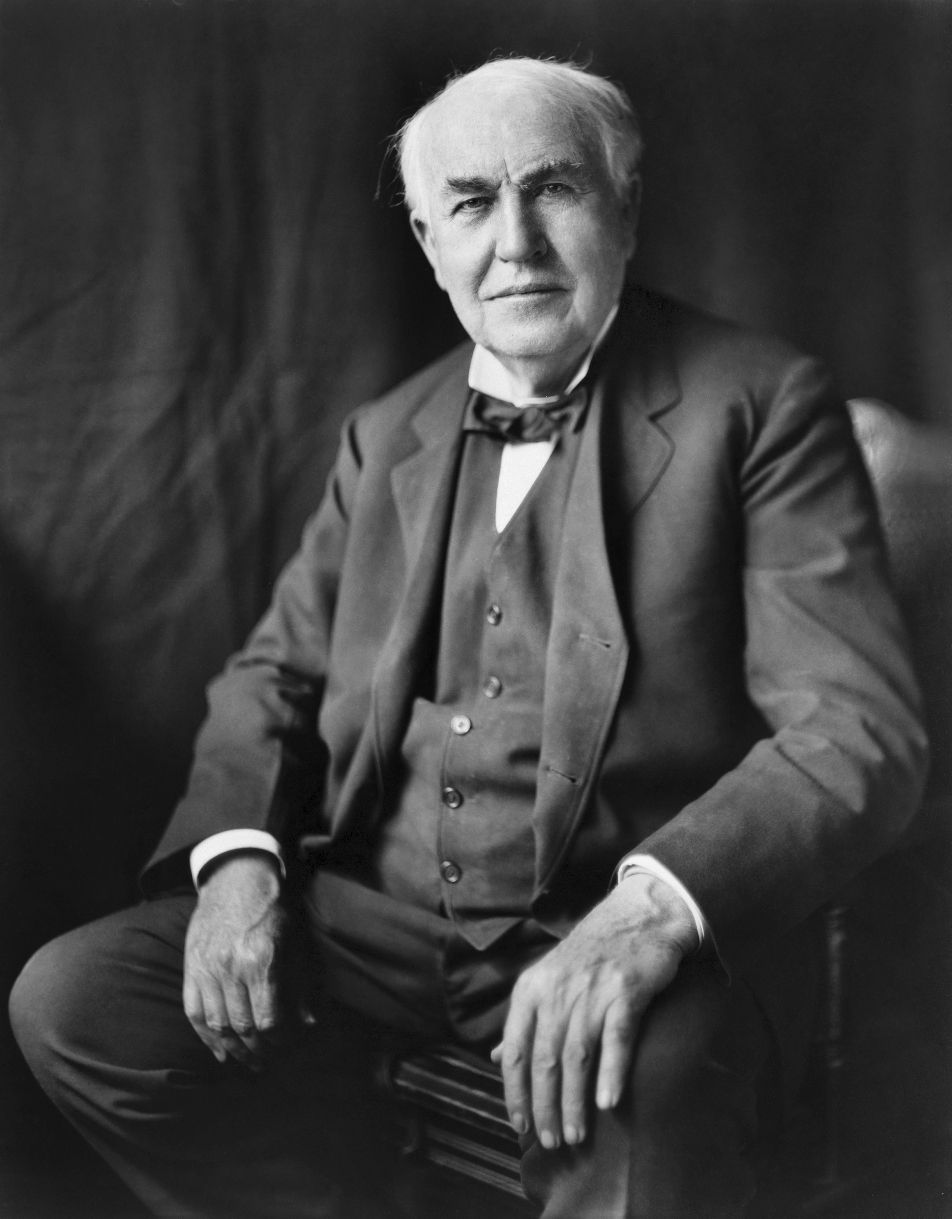
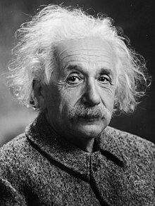
“Vision without execution is hallucination.”
- attributed to Thomas Edison (may also be Einstein or a Japanese proverb)
Notes:
I’m going to tell you our vision on the next slide – but after that I am going to concentrate on how we plan to execute on that vision.

Slide 3
Our Vision for ePIC
ePIC is the primary experiment at the Electron-Ion Collider (EIC). It is a highly integrated, multi-purpose experiment, pushing the precision frontier in Nuclear Physics
We want to put ePIC on a path to becoming one of the most consequential nuclear physics collaborations ever.
Notes:
We really believe that the EIC is one of those foundational efforts in the history of human understanding of the natural world, and we have been honored and humbled to lead the collaboration over the past two years. The ePIC Collaboration is young and just in its infancy, but the collaboration we are building now may last 20-30 years – we have just started laying the foundation. It’s critical to create a foundation that can stand the tests of time and serve the collaboration well into the future.

Slide 4
Looking Forward to 2025+
ePIC faces significant challenges in the coming years:
Internal Challenges:
Engagement and workforce continue to be issues
Detector integration and performance
Still an enormous amount of work to do to reach 90% design maturity
…
External Challenges:
New US Administration with new programs and priorities
Funding and support for groups working in the EIC/ePIC
The EIC project has made design changes for the electron injector complex and is reorganizing the project plan around subprojects – schedule is an issue
…
Notes:
Essentially the same slide as in the opening status talk….

Slide 5
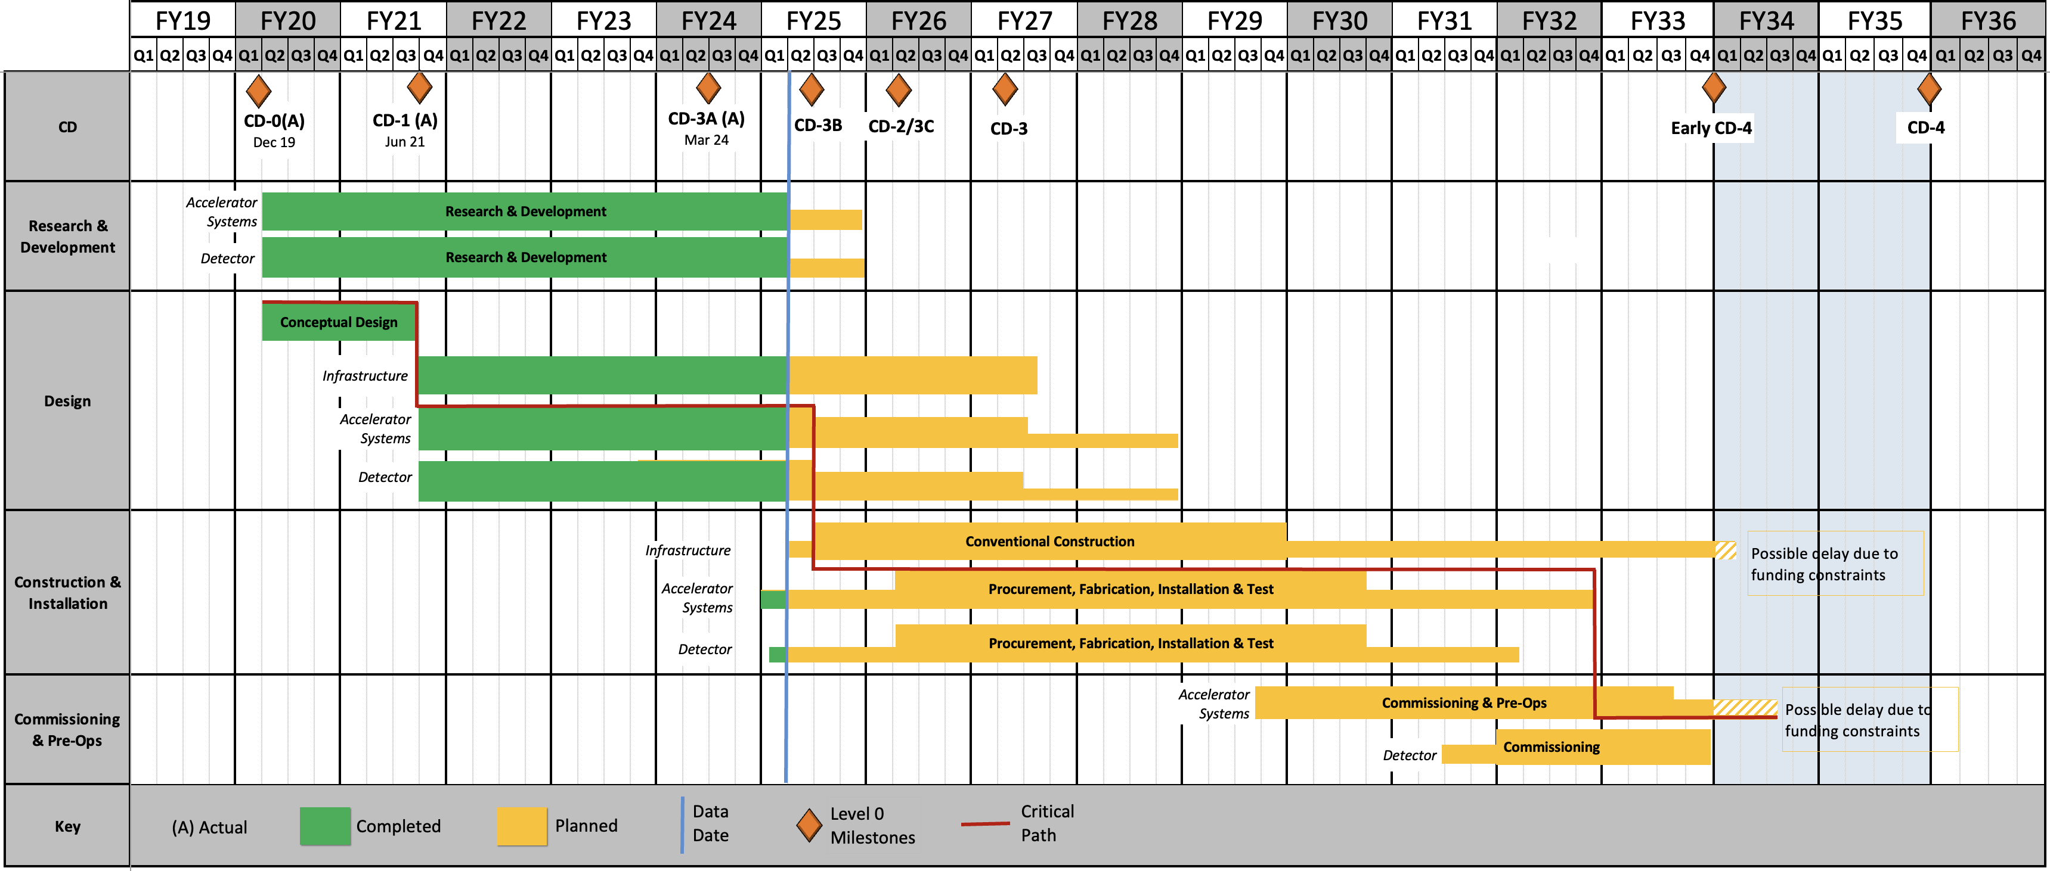
Schedule
From L. Lari CD-3B Plenary Presentation
Notional – project plan to be defined and reviewed in 2025
Under finalization; Mostly Technically Driven after FY2027
CD2/3
SP1
CD2/3
SP2
CD2/3
SP3
The Sub-Projects (SP) delivery strategy is planning to help the start the Early Science program @ Early CD-4 timeframe
Maintaining the momentum of the collaboration at this time is critical to our success. We have been working with the EIC project to communicate to them the importance of a significant project milestone in FY26
RHIC Operations is planned for the end of CY2025
Since CD-1, the critical path is on the Accelerator systems.
Notes:
One of our greatest challenges in the early phase is, quite frankly, the schedule. Maintaining the momentum of the collaboration and the excitement and interest of our international partners is critical at this time. This involves working with the project over the next six months as the subproject plans are finalized and ensuring the technical development of ePIC continues at a pace is not artificially limited.

Slide 6
How do we set priorities?
Collaboration Priorities:
e.g.: TDR, machine backgrounds, track projection resolution, early physics projections, AI integration, streaming computing model, …
A heartfelt “thank you” to everyone for making the Tuesday group exercise successful and productive.
Once we have priorities, it is the responsibility of the SP and Coordination offices to execute on these priorities with concrete action and accountability.
The SP Office needs to build and manage an environment in which the collaboration can be successful.
TC Actions/Goals/ Tasks
SCC Actions/Goals/ Tasks
AC Actions/Goals/ Tasks

Slide 7
Common Themes from Priority Discussion I
There is a need for better communication within the collaboration, across multiple different entities
Not a single problem with a single solution - something that we need to continually work on. Tailor the communication to collaboration needs (newsletter, minutes of meetings, etc.)
Accelerate development of and transition to the website
Evolve technical coordination into less of a reporting body, with a proactive coordinating effort supporting the DSC’s
Organize and coordinate preTDR effort
Increase the direct engagement of the TC-Office with DSCs and CC WGs, TC Office presence in DSC meetings
Set standards/requirements for DSC internal reviews, assist with organization
Facilitate communication with CAMs and EIC Project
Organize common solutions – cooling, grounding, database,…
This list is a synthesis of the Tuesday group exercise by the SP Office the Coordinators.
Sub-bullets are examples that support the priority but are not exhaustive.

Slide 8
Common Themes from Priority Discussion II
Need a better way to grow/onboard analysis efforts
Not just software! Onboard analysis as well
Common reconstruction tools facilitate higher-level analysis efforts
Use Early Science studies as a focus for efforts in analysis and engagement with theory
Need to define a set of 2025 milestones for progress in simulations
This includes simulation framework, fidelity to the mechanical design, inclusion of backgrounds, and reconstruction and common tools
Work with DSC’s to set software goals, SCC to support
Define how we work towards simulation reconstruction in timeframes
Workforce and Engagement
Need to increase workforce and support engagement across all three coordination offices
This list is a synthesis of the Tuesday group exercise by the SP Office the Coordinators.
Sub-bullets are examples that support this priority but are not exhaustive.

Slide 9
Spokesperson Office Focus Items for Next Term
Continue to develop the infrastructure of the collaboration to support communication:
An effective and well-maintained website
Restructure technical coordination to better support the DSC’s
Continue to explore paths that lead to a full-time ePIC TC stationed at BNL
Work with the project to evolve the project plan
A pre-TDR and a project review in 2026 is essential to maintaining momentum in ePIC
Substantially improve engagement in Physics Analysis
Communicate the need for explicit support for EIC research within DOE NP and international funding agencies
Pursue dedicated funding for ePIC Software and Computing
Updates to the ePIC Charter now that policies are in place (working with CC)
Put ePIC Common Funds on a path to starting with ePIC construction
Pursue increased engagement from the JLab community
Actively develop the next generation of ePIC Leadership
Notes:
Of course the primary role of the spokesperson’s office is to support the execution of collaboration priorities. These are the things we think we need to do to best position the collaboration to be successful in executing its priorities. (Is these all too honest? It’s pretty direct….especially the Jlab comment?)

Slide 10
The Three Pillars of ePIC
Technical Coordination
Develop technical design of ePIC
Support the ePIC TDR contributions
Facilitate technical communication with the EIC project
Software & Computing Coordination
Software and simulation productions for TDR and beyond.
Onboarding via landing page and targeted tutorials.
Development of ePIC Streaming Computing Model.
Analysis Coordination
Organizing physics “benchmark” plots for the TDR
Sets priorities for reconstruction development in conjunction with Software and Computing
Silvia Dalla Torre
Prakhar Garg
Oskar Hartbrich
Matt Posik
Markus Diefenthaler
Wouter Deconinck
Dmitry Kalinkin
Torre Wenaus
Rosi Reed
Salvatore Fazio

Slide 11
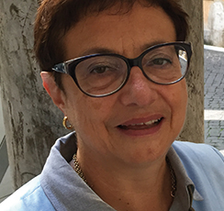
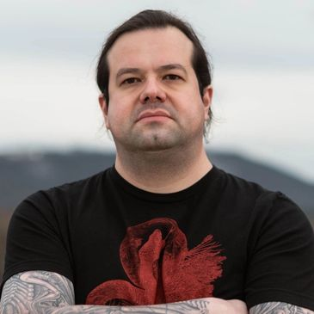
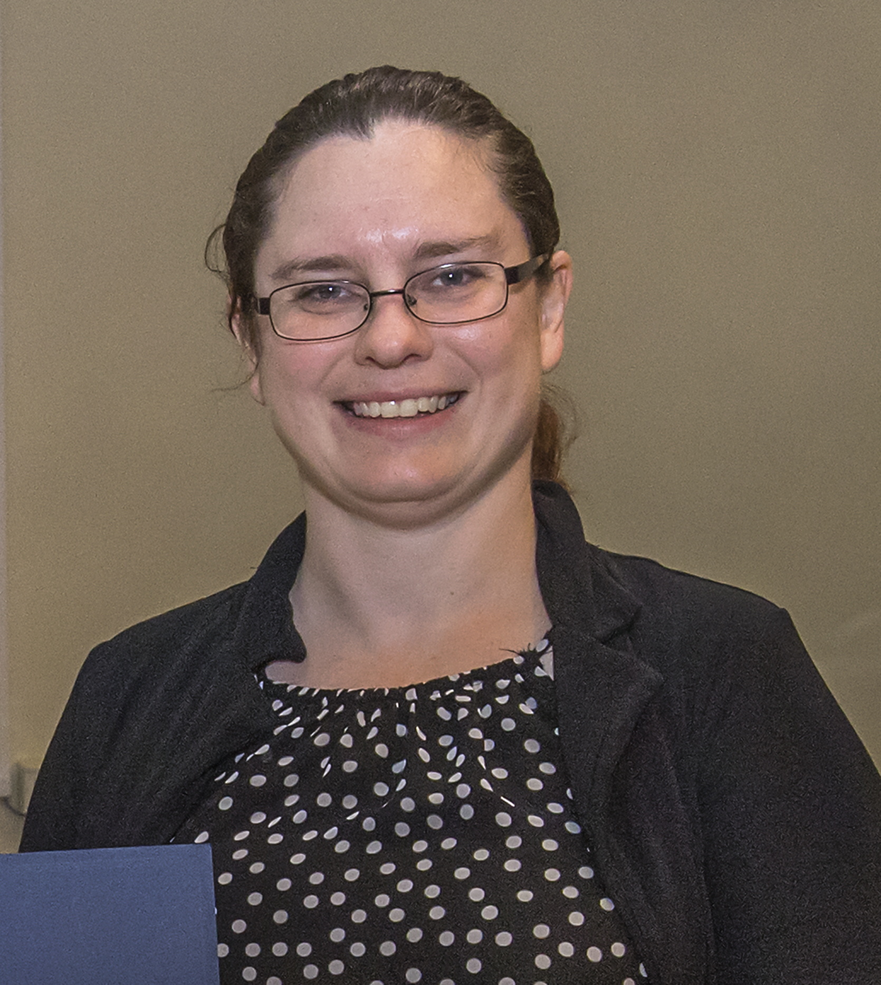
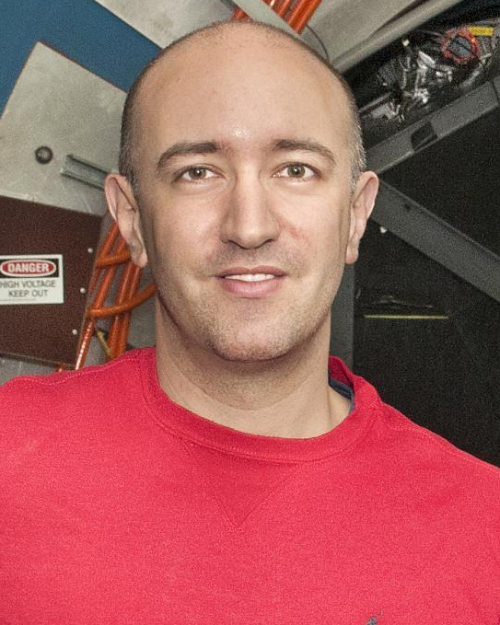
ePIC Collaboration Structure
Collaboration Council
Institutional Representatives
Spokesperson’s Office
Spokesperson (SP)
Deputies
EIC Project
All top-level ePIC coordinators have to agreed to continue to serve for the time being.
We are already aware of some WG conveners and DSC leadership who have asked to step down for their own reasons. We will work on this in the coming weeks but we are not planning to make large scale changes to the convener positions at this time. PWG conveners will rotate this summer as planned.
Executive Board
Standing Committees
DE&I
Conferences and Talks
Membership
Elections
Publications
Ad-Hoc Committees
Technical Coordinator (TC)
Software and Computing Coordinator (SCC)
Analysis Coordinator (AC)
Technical Coordinator (Acting)
• Silvia Dalla Torre (INFN)
Deputy TC’s: Prakhar Garg (Yale) Oskar Hartbrich (ORNL) Matt Posik (Temple)
SCC Coordinator
• Markus Diefenthaler (JLab)
Dmitry Kalinkin
(Kentucky, Deputy SCC for Development)
Torre Wenaus
(BNL, Deputy SCC for Infrastructure)
Wouter Deconinck
(U. Manitoba, Deputy SCC for Operations)
Analysis Co-Coordinators
• Rosi Reed (Lehigh Univ.)
• Salvatore Fazio (Univ. Calabria)
Notes:
Of course in the case of DSC leadership we just facilitate, the DSC leadership is up to the DSC participants.

Slide 12
Summary
We have been humbled by the support of the collaboration over the past two years. ePIC is made up of a fantastic group of people!
We look forward to serving the collaboration as we work to bring ePIC to CD-2/3 approval and into the construction phase.

Slide 16
ePIC Working Group Structure

Slide 17
ePIC DSC Structure

Slide 18
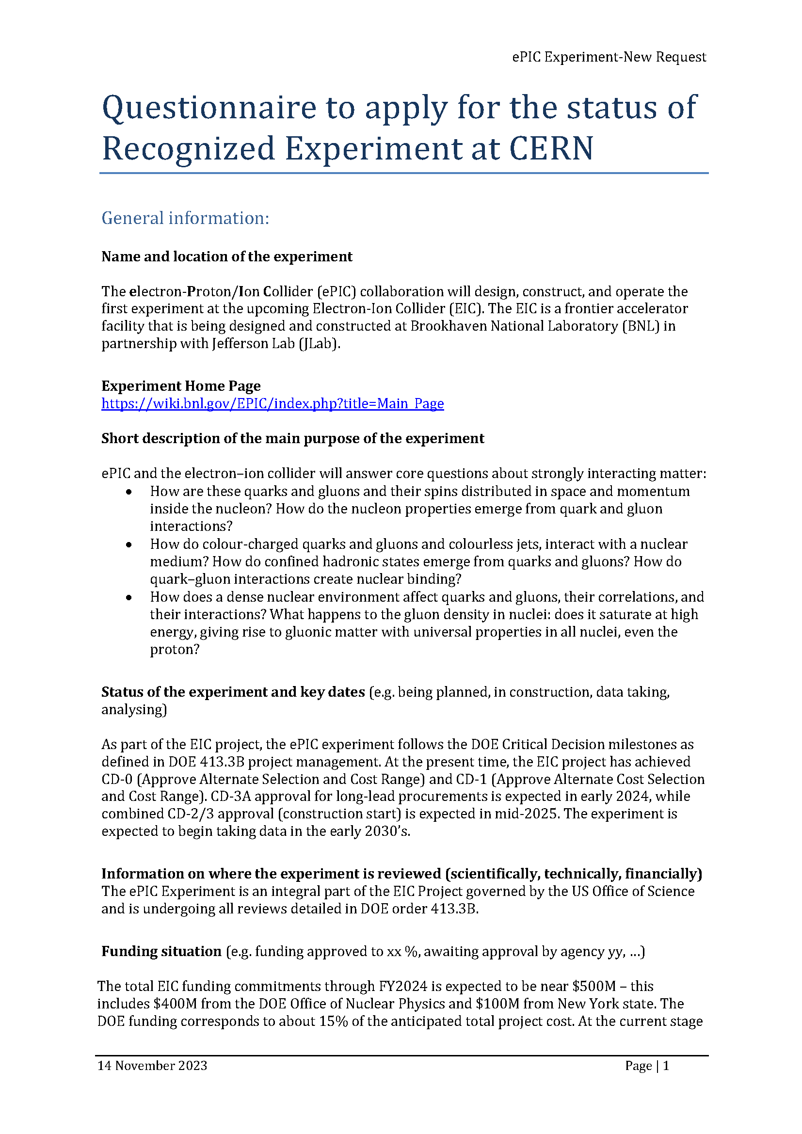
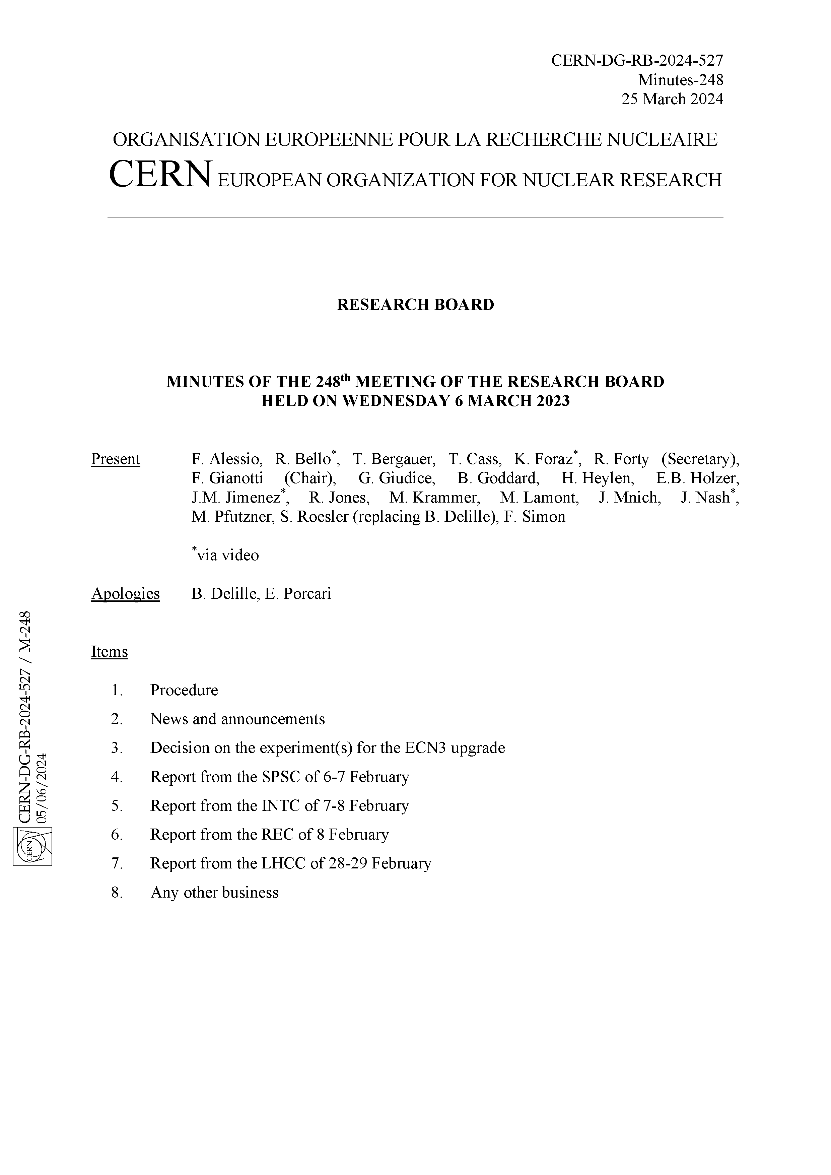
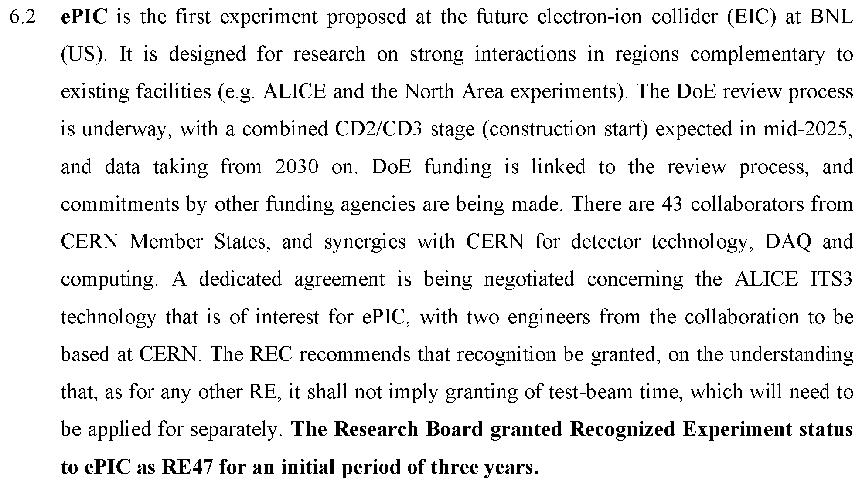
CERN Recognized Experiment
The CERN Recognized Experiment MOU is signed by all parties.
ePIC collaborators are be able to:
Establish team accounts
Register as CERN users
Apply for test beam time as ePIC
SIGNED

Slide 19
ePIC Resources
Public Website - https://www.bnl.gov/eic/epic.php
Mailing Lists – https://lists.bnl.gov/mailman/listinfo
Indico Agenda - https://indico.bnl.gov/category/402/
ePIC Software and Computing: https://indico.bnl.gov/category/435/
Wiki - https://wiki.bnl.gov/EPIC
ePIC Software Training:
Landing Page: https://eic.github.io/documentation/landingpage.html
Tutorials: https://eic.github.io/documentation/tutorials.html
Mattermost: https://chat.epic-eic.org
ePIC Zenodo Community: https://zenodo.org/communities/epic

Slide 20
EICUG Membership
The EICUG is a vital organization to promote the interests of the EIC community!
Without the EICUG we would never have gotten far enough to form ePIC!
Please register your institution!
Check with your EICUG IB representative to get registered as a member
https://www.eicug.org/content/join.html

Slide 21
ePIC Priorities
You will hear a synthesis of Tuesday’s ePIC priority planning exercise from the coordinators in the plenary session on Friday.
ePIC is YOUR collaboration. No one is engaged by being told what to do. People get engaged when they are both a part of defining the problem and finding the solution!
It’s the job of collaboration leadership to execute on the collaboration priorities.
To do that effectively, we need to build and manage an environment in which the collaboration can be successful.
Notes:
Before I talk about what we will focus on next year I have to bring the priorities into the discussion. The spokesperson’s office is responsible for the management plan, which creates the structure that allows the collaboration to pursue its priorities.

