Slide 1
Integration of globus compute with Panda/harvester and its application in Aid2e and ATLAS workflow
Tianle Wang
11/20/2024

Slide 2
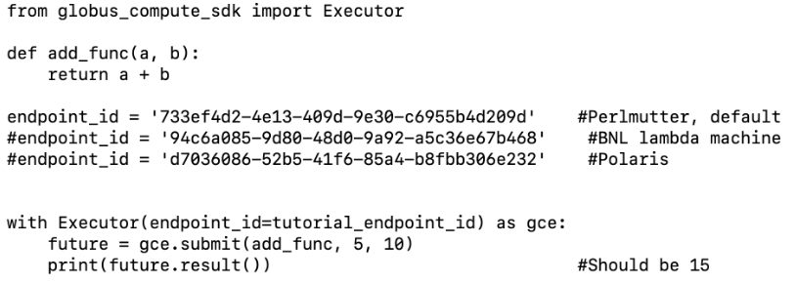
What is globus compute
A distributed Function as a Service (FaaS) platform that enables reliable, scalable, and high performance remote function execution.
Enables execution functions on diverse remote systems, from laptops to campus clusters, clouds, and supercomputers.
To execute functions on compute resources, first setup a globus compute endpoint, and then submit function to that endpoint
All three endpoints execute add_func() successfully by running the script on local machine
Notes:
ing tasks with diverse resource requirements. We discuss conditions for asyn-
chronous execution and offer a quantitative basis and experimental character-
ization of the improvements it can bring in terms of resource utilization and
task throughput, and thus makespan. We focus on the asynchronous execution
of ML-driven heterogeneous HPC workflows, offering four main contributions:
(1) an asynchronous implementation of DeepDriveMD [9, 16]—a framework to
execute ML-driven molecular-dynamics workflows on HPC platforms at scale;
(2) a performance evaluation of asynchronous DeepDriveMD; (3) a model of
asynchronous behavior; and (4) a general performance evaluation of that model
for workflows with a varying degree of asynchronous execution
We investigate asynchronous execution of ML-driven HPC workflows, i.e.,
workflows with heterogeneous tasks. In this context, we define asynchronous
execution as one in which multiple heterogeneous tasks execute independently.
Those independent tasks can execute asynchronously either at the same time
or back-to-back, depending on resource availability. For this reason, we argue
there exist two conditions for workload-level asynchronicity (WLA): (1) inter-
task dependencies, and (2) resource availability.
Thus, we explain the effect of the asynchronous execution
of heterogeneous workflow tasks on the makespan of the entire workflow and its
correlation with resource utilization.

Slide 3
Advantage
Single deploy and just need authentication once.
Easy to config on different platforms with different architecture and job scheduler
  Different number of cores, number of GPU, GPU vendor
  mpiexec, srun, pbspro
  One config (endpoint) can be reused for different task/workflow
Function registration for lower overhead
Both blocking and non-blocking API allows for easy integration with workflow management system to handle workflow with complicated DAG

Slide 4
Issues
Many scientific applications needs MPI support for tasks
  Globus compute and its underlying framework, parsl, only support MPI executor recently and it is still testing
Solution: Walk around the executor. Use a execution wrapper for each task
  This means for different job scheduling system (slrum, pbspro, cobalt, lsf, etc.), we need a different execution wrapper
  Good news: Harvester (and other workflow management system) already has a variety of implementations of that, meaning easy code reuse

Slide 5
Issues
In many scientific workflow (like ATLAS workflow), people need to dynamically choose different type of resources and execution pattern for tasks
  Different type of tasks in a heterogeneous workflow need different resources (number of cores, if and how to use GPU, etc.)
  Resource sweep for optimal configuration of executing task
  Use container or not, which container
  Different executor specification (#SBATCH, #PBS, etc.)
Globus compute earlier only support single-user-endpoint, where every time the configuration changes, need a new UEP
Solution: Recently support multi-user-endpoint
  use it in single user mode to walk around the root privilege
  This allows for dynamic configuration for UEP

Slide 6
Issues
Scientific workflow has different type of dependency
  ATLAS workflow requires container and cvmfs
  MOBO requires conda environment
  Many other workflow requires complicated software stack
  Even simple python function could relies on other files defined in the same directory
Earlier solution by Wen:
  Use panda cache to transfer dependencies
Current solution:
  For cvmfs related, use cvmfsexec (for example, on Polaris)
  For container, MEP natively support that, just need a switch for different container in execution wrapper
  For conda env and software stack
    Install them manually beforehand
    Install them in the pre-exec of each job

Slide 7
Push or Pull
Pull mode is generally easier, as long as we have outbound internet connection
  Perlmutter (NVIDIA GPU) supports that, and we are currently targeting Perlmutter only
  Polaris (NVIDIA GPU) and Aurora (Intel GPU) also support it, but need to enable some proxy
  Frontier (AMD GPU) does not support that, but currently we didn’t heard from anyone targeting Frontier
  We will be focusing on pull mode now
Wen also suggests some design pattern for push mode, will look into that if we met scenario that pull mode fails

Slide 8
General targets of integration
Step 1: People submit multiple tasks using panda, task info are saved in queue at BNL server where a panda server is installed
Step 2: Panda server initiate corresponding harvester, for Grid job that is the harvester at Grid site, for HPC job that is temporarily harvester at BNL
Step 3: Harvester create job submission script, for Grid job it will be submitter of the correspond scheduler, for HPC job that will be globus-compute submitter that I am currently implementing, which target a remote machine
Step 4: Both submitter will specify some resource, and when submitted to the compute resource, will later call some wrapper over pilot
Step 5: (on compute node) Pilot will fetch job from panda queue, and execute it

Slide 9
Plugin progress
Execution wrapper
  Pbspro and Slurm work
A new globus compute submitter
  On top of Wen’s initial implementation, but use execution wrapper and get rid of the source code porting part
  Different template file for parsing
  Implementation finished, need testing
A general wrapper for pilot for GPU on Perlmutter
  Naive version work
A new globus compute monitor
  New multi-user-endpoint introduce problem in locating file info
  Work in progress
Reuse simple worker maker
  Relies on Wen’s panda task decorator

Slide 10
Current issues
Do not have testing environment for all plugins
  Need a test queue and corresponding dev version of harvester
  Panda job submission continue to fail
Workflows progress
  For ATLAS workflow and closure test in Aid2e workflow, the pilot wrapper can not fetch job from queue successfully
  For MOBO, can not set up env correctly on Perlmutter for execution without workflow
Work with globus compute dev team to solve issues rising from the use of MEP
  Dynamic config parsing
  Task info location

