Slide 1
VTRX+ Routing Options:
VTRX+
Feedthrough/Disconnect Panel
If up to 2 m
MT
A)
If longer than to 2 m
B)
Coupler
FEB
C-1)
R
Specify any length
Min ~ 30 mm
Fiber Bend Radius R > 15 mm
VTRX+ Min L ~ 10 cm
Preferred
Min ~ 20 mm
C-2)
Specify any length
Rigid support/PCB.
21 November 2024

Slide 2
VTRX+ Length Options:
Total Length is the length of the fiber pigtail plus the length of the VTRX+ PCB (2 cm) and the length of the MT fiber connector (1 cm): L = fiber length + 3 cm.
Choose Total Length (cm)
5.5
7.7
10
12
15
20
21.5
25
30
32.5
35
40
49
50
65
84
100
200
Extra cost due to “sacrificial” fiber needed.
LLP Order = 5500
Electron side Sub-Detector | Qty | Total Length (cm)
SVT | 790
MPGD EE | 64
MPGD IB | 64
TOF Barrel | 144 | 5.5
pfRICH | 68
Needed Quantities:
Sub-Detector | Qty | Total Length (cm)
SVT | 1579
MPGD EE | 64
MPGD HE | 64
MPGD IB | 128
MPGD OB uRwell | 384
TOF Disk | 212 | 5.5
TOF Barrel | 288 | 5.5
dRICH | 1242
pfRICH | 68
FF – B0 AC-LGAD | 42
FF - RP | 32
FF - OMD | 18
FB – Lumi PS | 64
Hadron side Sub-Detector | Qty | Total Length (cm)
SVT | 790
MPGD HE | 64
MPGD IB | 64
MPGD uRwell | 384
TOF Disk | 212 | 5.5
TOF Barrel | 144 | 5.5
21 November 2024

Slide 3
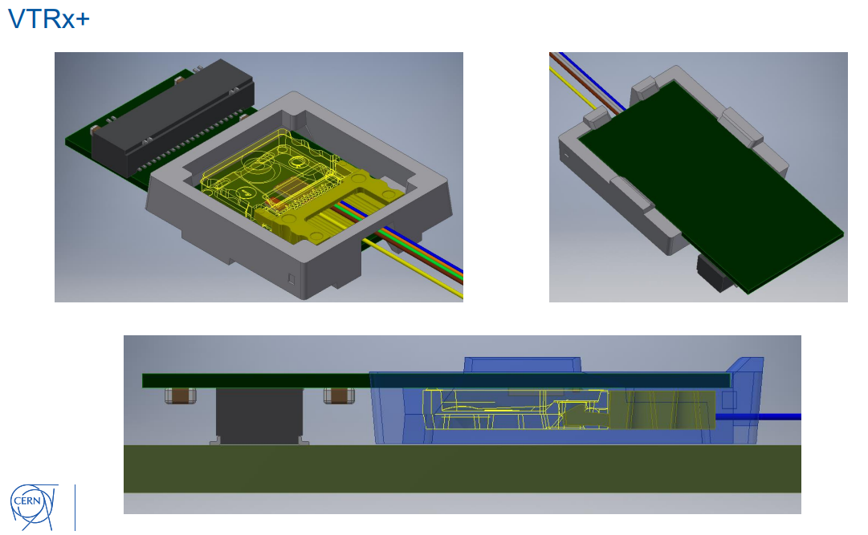
VTRX+ Clip:
Clips to VTRX+ PCB
Support function
A few variants
VTRX+
Clip
FEB
21 November 2024

