Slide 1
Nov. 21

Slide 2
Tasks for SBND clustering
wire-cell-toolkit: apply-pointcloud [porting] → master
  worked on generalizing the clustering to multi-APA/face
  validation:
    randomness after re-compiling
    protect_overclustering seems to have bugs
larwirecell: merge Ewerton and Haiwang’s branches
  CookedFrameSouce
  QLMatching
jsonnet: merge Ewerton and Haiwang’s branches

Slide 3
Generalizing uboone Clustering
Extracting hard-coded numbers
Generalizing to multiple volumes (APA/face)
clus/IClusGeomHelper
per volume WCP style parameter
  jsonnet -> IClusGeomHelper -> WCP style parameter
judge is inside a fiducial volume
  currently simple box boundary checking
provide space charge effect correction
  no actual correction for now

Slide 4
Staged clustering for multi-volume
Potential full procedure
per volume clustering
merge charge/light from all volumes
QL-matching using merged info
  additional information like CRT
correct charge with t0 and SCE
all volume clustering
  need something like jumping dead region
2nd round of QL-matching?
This round for SBND
per volume clustering
per volume QL-matching
correct charge with t0 and SCE
two volume clustering?
  need something like jumping dead region
2nd round of QL-matching?
per volume clustering
from uboone
Tiling
face0
Clustering
face0
SigProc
Slicing
Solving
Tiling
face1
Clustering
face1

Slide 5
per-face clustering for wrapped wires?
APA crossing track
without track t0 correction
APA

Slide 6
Xin’s idea
Hanyu and Haiwang:
the kink could be not in the read-out window
maybe direct matching is easier:
  x = -x
  y = y
  z = z
  angle = angle
CPA
t
t
APA
z
z

Slide 7
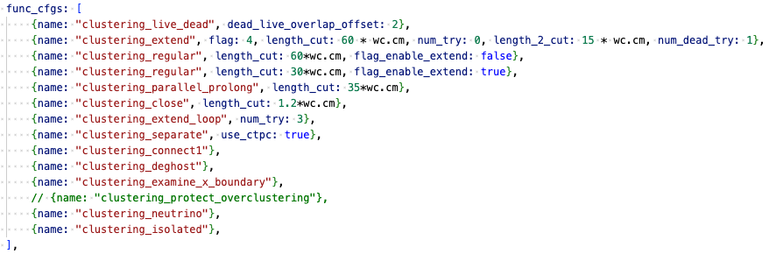
protect_overclustering seems to have bugs

Slide 8
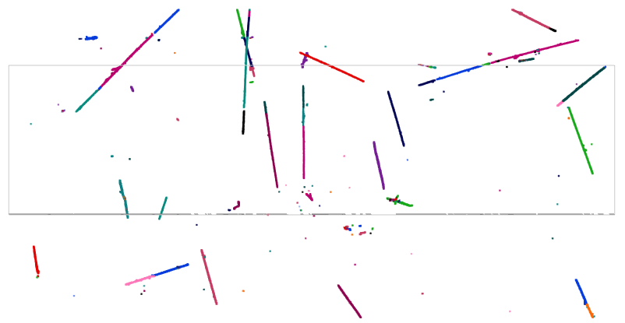
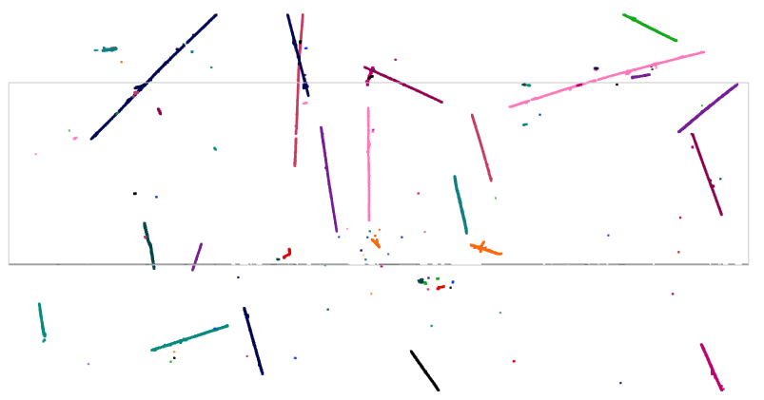
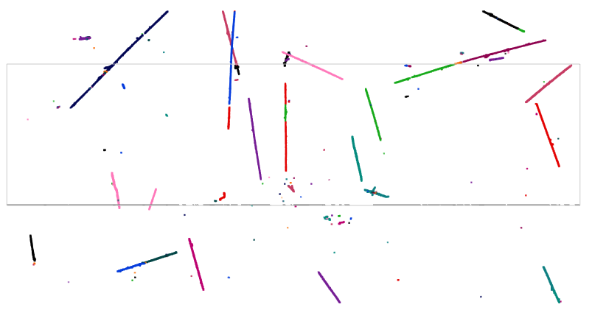
protect_overclustering (POC)
clustering
from imaging
no POC
with POC
https://www.phy.bnl.gov/twister/bee/set/ae58e9ac-df63-4eaf-b13e-3377c5617019/event/0/
https://www.phy.bnl.gov/twister/bee/set/8de66653-8e19-4638-8f9b-3a98d67afe21/event/0/

Slide 9
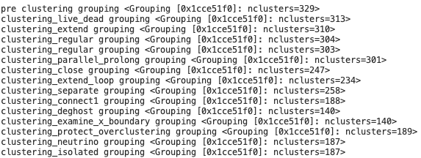
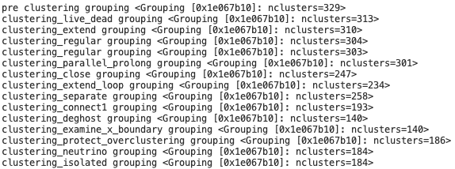
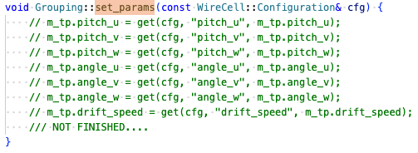
randomness
ref
use GeomHelper, but do nothing

Slide 10
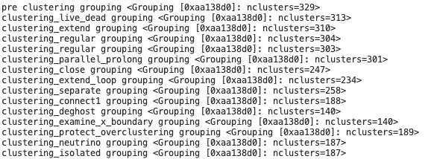
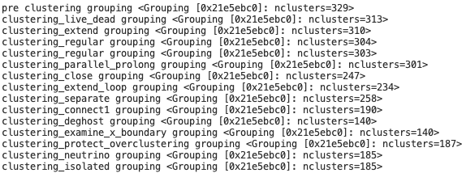
Validate GeomHelper:
randomness from separate or connect1
no GeomHelper
using GeomHelper

Slide 11
ref
using GeomHelper

Slide 12
Nov. 19

Slide 13
Summary, Nov 19
Continue works to make the Clustering code working on SBND and other experiments
Previous status: clustering mostly working and made a draft pull request for reviewing
This week:
residual unfinished tasks
  add summary to DNNROIFinding
  Seperate2: previously breaks clusters; now: return a vector for blob → groupID
    Some temporary operations can be done with blob groups
IGeomService
Next:
Move IGeomService from iface to clus/IClusGeomHelper
add SBND configuration
refactor Ewerton’s CookedFrameSource

Slide 14
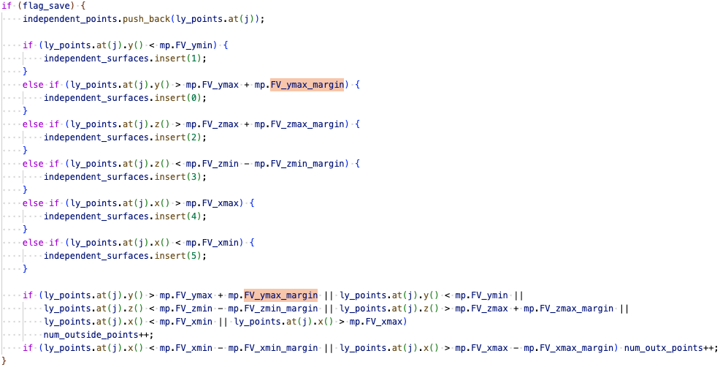
FV/boundaries used in WCP
Used in clustering_separate, clustering_examine_x_boundary, and clustering_neutrino
Deciphered hardcoded numbers to min/max and margin
Are these margins added following some rules?

Slide 15
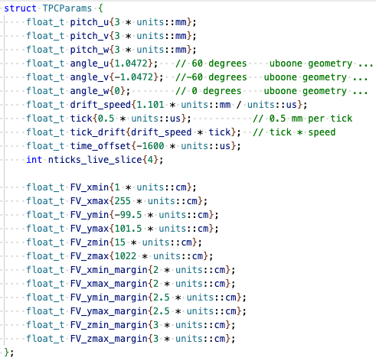
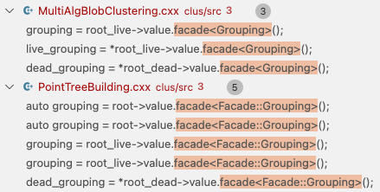
Initial try
Try to hack the TPCParams with FV.
But the

Slide 16
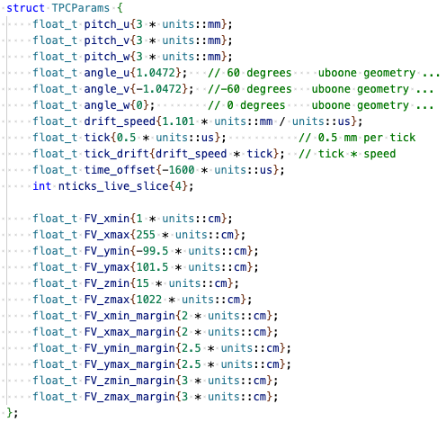
Fiducial Volume
FV + Margin
FV

Slide 17
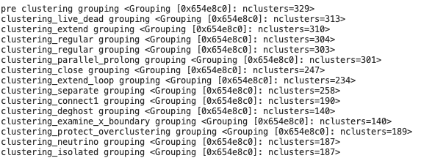
FV, careful replacing
before replacing
after replacing

Slide 18
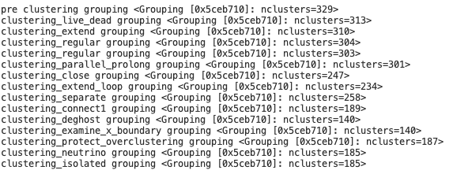
FV, careful replacing
before replacing
if I add one mistake
if I add one mistake

Slide 19
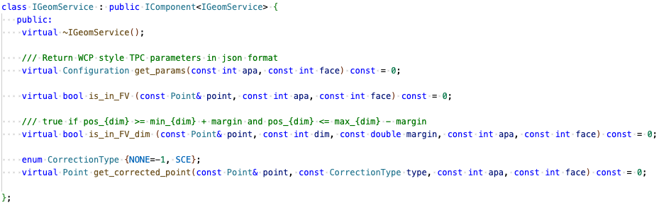
IGeomService

Slide 20
Backups

Slide 21
Construction:
Option 1: jsonnet -> IGeomService
Option 2: jsonnet + IAnodePlane -> IGeomService
Consumption:
Option 1:
  IGeomService -> Grouping -> non-FV params
  many functions can work without IGeomService
Option 2:
  remove TPCParams from Grouping
  replace them with IGeomService

Slide 22
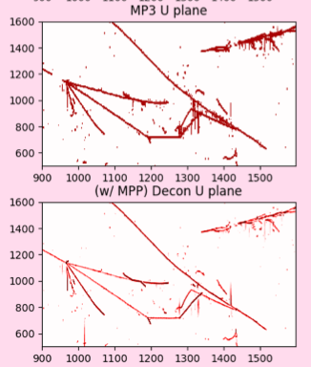

Slide 23
Space Charge
https://indico.fnal.gov/event/19644/contributions/53285/attachments/33181/40704/Space_Charge_Implementation.pdf
https://github.com/LArSoft/larevt/blob/develop/larevt/SpaceCharge/SpaceChargeStandard.cxx#L194
https://github.com/LArSoft/larreco/blob/develop/larreco/SCECorrections/SCECorrection_module.cc#L277

Slide 24
Clustering for SBND
To build a full SigProc (DNN) – Imaging – Clustering Chain for SBND
Haiwang Yu, Nov. 12

Slide 25
Outline
Xin, Brett and I have finished the initial translation of the uboone clustering to WCT.
  runs but not validated yet
Next:
  validation – Xin, Haiwang
  adaptation to more experiment
    SBND – Haiwang, Ewerton

Slide 26
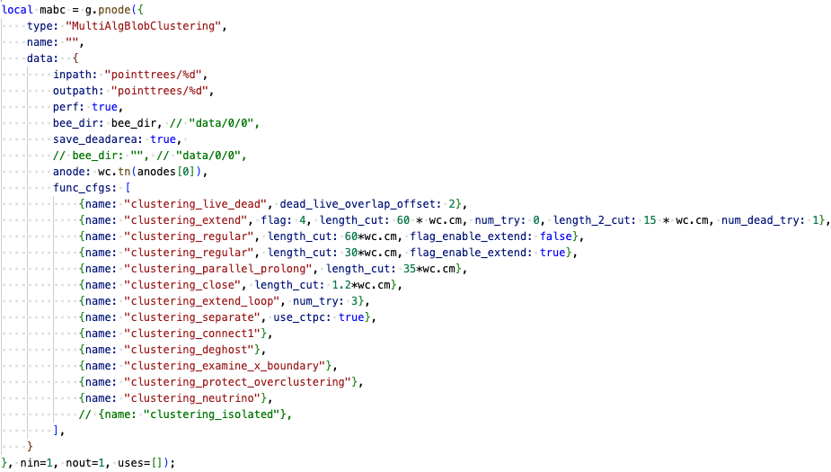
Clustering steps/configuration
Imaging: clustering based on blob overlapping
Clustering:
  to combat various failure cases (parallel, prolonged, dead, imaging failure)
  specific scenarios (neutrino, small activities, boundaries, over-clustering)
merging:
para, prol, dead, regular
separate, accidental crossing tracks
merging, dotted line
separate, remove ghost
separate
separate
merging, neutrino
merging, merge small to large

Slide 27
Configurable knobs
Parameters already extracted
  length_cut – expected gap size to jump
  num_try – try and optimize
TPC geom:
  wire pitch, angle
  boundaries
Many hard-coded numbers on distance, angle cuts
  treat them like human-made NN
    given the wire LArTPCs are similar in sense of wire pitch, those numbers may be fine?

Slide 28
SigProc (DNN) – Imaging – Clustering for SBND
As part of QL-Matching for SBND
  Show some progress at the coming SBND CM (Dec. 10)
DNN – Moon, Avinay
  status: production workflow available
  WIP: passing though “summary” for imaging
  validation - matching the charge – check the uncertainty
Imaging - Ewerton
  status: Ewerton has something working locally
  WIP: more general purposed coding needed; refactoring on going
  validation:
    geometry: projection of imaging vs. SigProc result
    check some of the equation solving cases
Clustering
  status: placeholder available, need to replace with real devs.
  make sure the APA boundaries are configured correctly for SBND

Slide 29
Previous development
larwirecell
OpFlashSource
1
QLMatching
(larwirecell)
TensorFileSink (dump)
0
charge-pipe
(SigProc)-Img-Clus
Bee.json
stand-alone python
Bee.json
larwirecell
FrameSource
(ADC/SigProc)
Fanout
Bee.json
larwirecell
OpFlashSource
QLMatching
(larwirecell)
TensorFileSink (dump)
charge-pipe
(SigProc)-Img-Clus

Slide 30
Planned workflow
larwirecell
OpFlashSource
1
QLMatching
(larwirecell)
TensorFileSink (dump)
live
0
charge-pipe
ChSel-Imaging
charge-pipe
Clustering
dead
Bee.json
stand-alone python
Bee.json
larwirecell
CookedFrameSource
Fanout
Bee.json
larwirecell
OpFlashSource
QLMatching
(larwirecell)
TensorFileSink (dump)
live
charge-pipe
ChSel-Imaging
charge-pipe
Clustering
dead

Slide 31
Input/Output
Input: Need to match the staged production: start from recob::wire
  all information need to be available: trace; cmm; summary
  traces need to be dense after reading in
Output: BEE for now
  ITensorSet output available?
  Need optional ICluster output?
  Future IO for AI/ML

Slide 32
Tasks to make the chain running
wire-cell-toolkit: apply-pointcloud [porting] → master
larwirecell: merge Ewerton and Haiwang’s branches
  CookedFrameSouce
  QLMatching
jsonnet: merge Ewerton and Haiwang’s branches

Slide 33
Backups

Slide 34
img-active
ChannelSelector
PointTreeBuilding
MABC
dump
img-masked
CookedFrameSource
Fanout
ChannelSelector

Slide 35
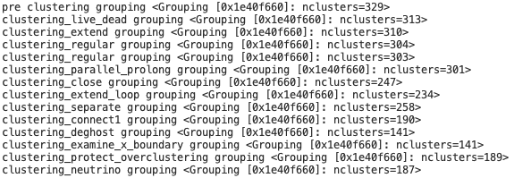
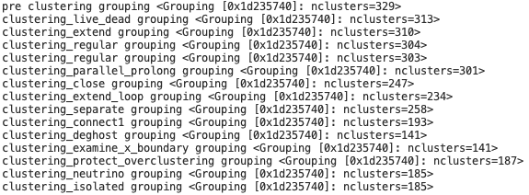
Separate_2 does not break clusters
Separate_2 -> b2id
add function calculate length from list of blobs

Slide 36
Event
wcsimsp_g4_gen_prodgenie_bnb_nu_cosmic_sbnd_nskip6.root

Slide 37
Nov. 7

Slide 38
Deghosting: Projection2D::get_projection
DNNROIFInding: no trace summary

Slide 39
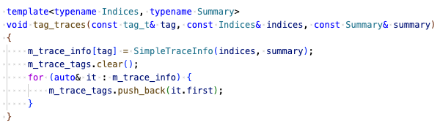
DNNROIFInding: no trace summary
indices, summary: two arrays with same length with indexing corresponding to traces
irow -> index
ch = m_chlist[irow]

Slide 40
Oct. 31

Slide 41
Building the SP(DNN)-Img-Clus workflow
SigProc with DNN-ROI: https://github.com/LArSoft/larsoft/releases/tag/v10_00_03
wire-cell-toolkit
  DNNROIFinding: passing through summary/RMS to dnnsp frame
  ChannelSelector
larwirecell
  CookedFrameSource
Imaging (ICluster):
I had issues running imaging on data, but Ewerton has a working version, incorporating his local devs
  wire-cell-toolkit, larwirecell, cfg
using dnn-roi in imaging
  synergy with PDHD
Clustering (ITensorSet, PointCloud::Facade):
Configurable clustering_function to run in MultiAlgBlobClustering
  json -> c++

Slide 42
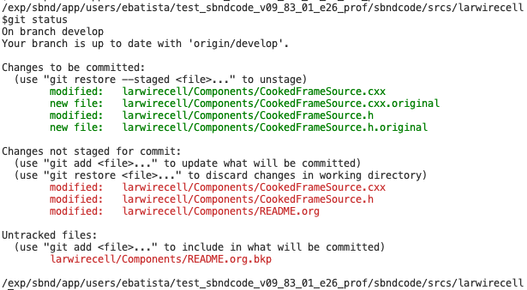

Slide 43
