Slide 1
Read-out update from Martin
Stefan Bathe

Slide 2
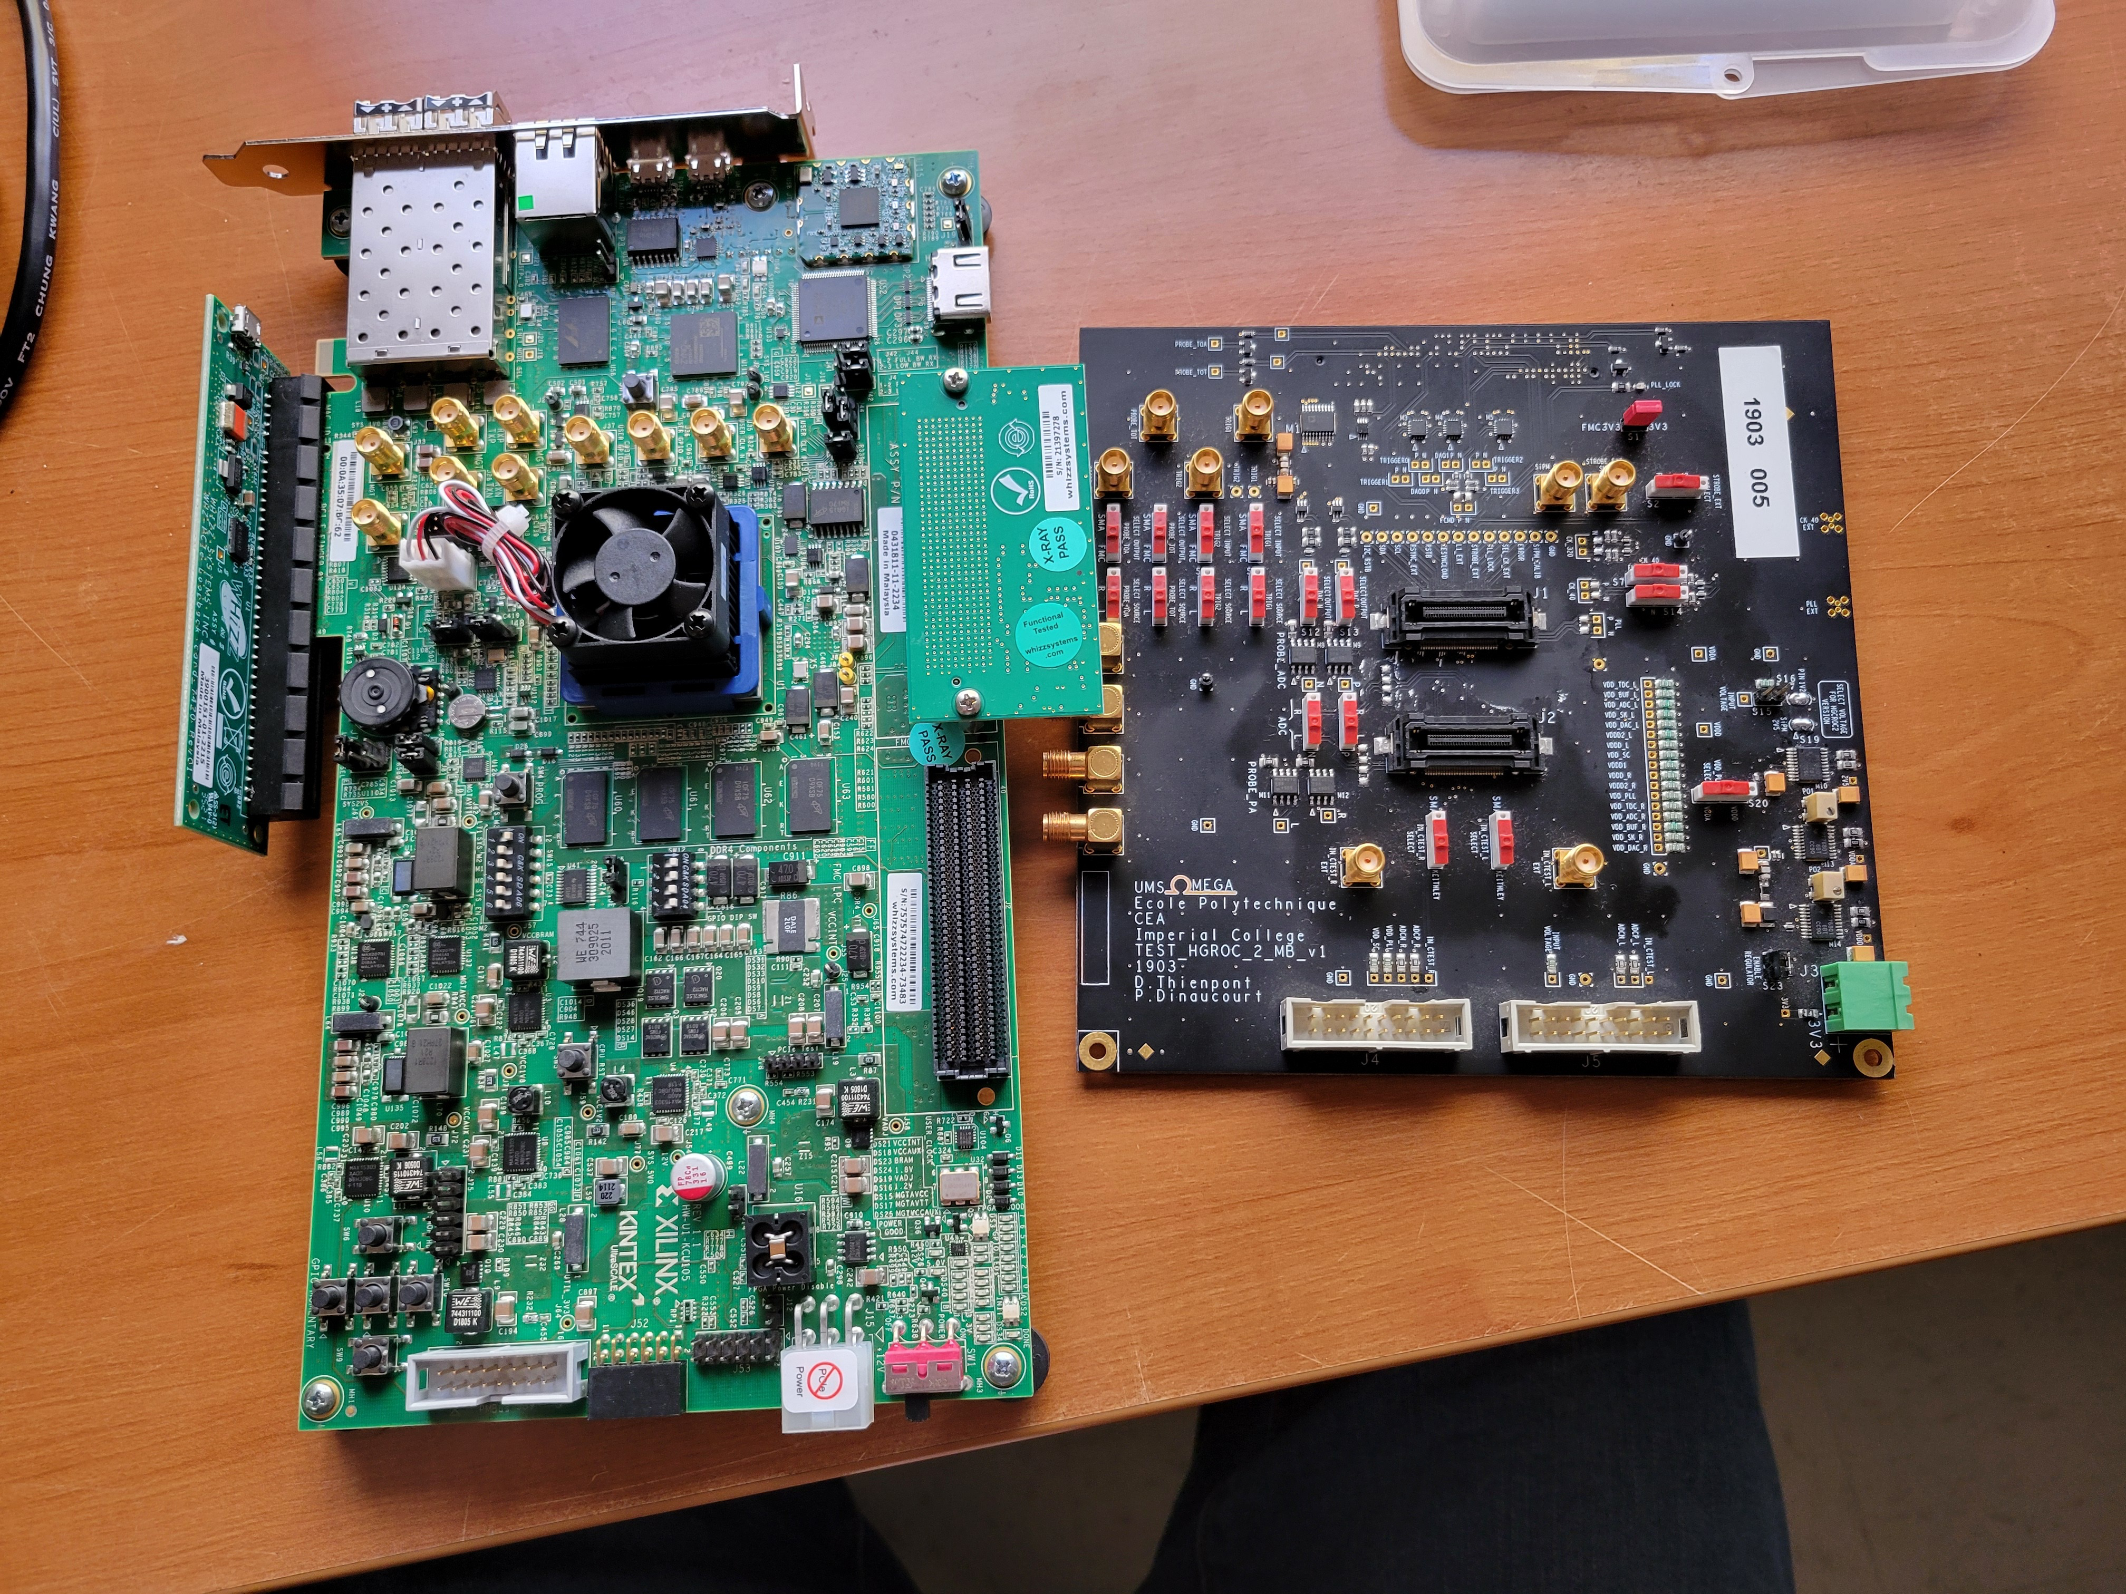
HGROC will arrive at BNL shortly after Thanksgiving
Martin has KCU105 FPGA-board in his possession until March
Picture shows KCU105 with pfRICH ROC from Alexander

