Slide 1
Overview of the ATF’s Facility Plan

Slide 2
ATF Operations

Slide 3
Strategic ATF Operations Thrusts
Operational Goals over the next ~3 years
  Continue operations of Building 820 for at least 2-3 more years
    Maximize user output during period of significant user requests
    Exploit new tools – e.g. x-band deflector cavity
  Provide the best possible CO2 beams for users at Building 820
    Explore the next order of magnitude of power delivered to experiments
    Must work within constraints present in the Bldg 820 location
  Fully integrate the UED Facility (Building 912) into the ATF research portfolio
    Implement next generation of device performance improvements
    Support material science experiments to explore applications of this capability
  Maintain a balance between
    Advanced research needs towards long-term accelerator goals
    Technology demonstrations for near-term capabilities targeted at ongoing accelerator-based science
    Leveraging the unique combinations of capabilities that can be provided by the ATF

Slide 4


Bldg 820 CO2 Development
YAG
Plasma Shutter
CO2
Elements of Building 820
Development Path for Users
In vacuum
full CPA
Direct Amplification (in Amplifier2)
Ti:Al2O3
20 µJ
350 fs
Amplifier 1
20 µJ
350 fs
Amplifier 1
OPA
5 µJ
80 ps
5 µJ
80 ps
30 mJ
60 ps
Ti:Al2O3
OPA
Small Compressor
Stretcher
30 mJ
60 ps
Stretcher
15mJ
2ps
#1
6J*
3-3.5ps
1.7-2TW
Regular gas
20J*
Regular gas
Isotopes
Amplifier 2
#2
Amplifier 2
20J
6J
2ps
3TW
Isotopes
We illustrate here 4 regimes:
#1 DA in C¹⁶O₂
#2 DA in C¹⁶O¹⁸O
#3 CPA in C¹⁶O₂
#4 CPA in C¹⁶O¹⁸O
6-10J**
3-3.5ps
2-3TW
#3
Regular gas
Compressor
#4
* measured
6-10J
~2ps
3-5TW
Isotopes
** compression demonstrated but not at full energy (grating damage)

Slide 5
CO2 Development Thrusts
Bldg 820 Development Targets for Users in FY17-FY18
  Presented 11/8/2016 at ATF-II Cost & Schedule Review
Funding to start this effort received FY17 Q2
Building 820 CO2 Laser Configuration | Pulse Energy (J) | Peak Power (TW) | Pulse Width (ps) | Experimental Transfer (%) | Power to Experiments (TW) | Target Date for Users
Current | 6 | ~2 | 3-3.5 | ~25% | ~0.5 | FY16
Addition of Plasma Shutter | 6 | ~2 | 3-3.5 | 80-90% | ~1.6-1.8 | Mid FY17
CPA Reconfiguration (no Isotopes)* | 6-10 | 2-3 | 3-3.5 | 80-90% | ~1.6-2.4 | Mid FY17
CPA Reconfiguration with Isotopes* | 6-10 | 3-4.5 | 2-2.5 | 80-90% | ~2.4-4 | Early FY18
Non-linear Pulse Compression* | >1 | >1 | <1 ps | 80-90% | ~1 | Late FY18
*Helps address ~100 TW CO2 Laser R&D Issue

Slide 6
4 primary thrusts of the ATF CO₂ laser near-term upgrade
Plasma shutter to eliminate harmful reflection from plasma at the experiment’s IP back into amplifier to allow full-scale operation in the present configuration, which is capable to 2TW, whereas we are limited to 0.5-1TW by this reflection.
CPA: Operating above 1TW in DA regime we see significant distortions in the beam due to nonlinear (high-intensity) effect on the amplifier’s output window. We eliminate it and extract much higher energy from amplifier using a stretched pulse that will be compressed with gratings after the amplifier. Telescopes will be installed to use bigger surface of compressor gratings.
Isotopes to increase the amplifier bandwidth to allow shorter pulses immediately in DA regime or upon compression in CPA regime.
NLPC: We will explore the possibility of productive use of the observed self-modulation of the laser pulse during DA through the second amplifier by selecting a self-focused beamlet, measuring its parameters and attempting to compress. This analysis is essential for designing a full-scale NLPC for 912 and may provide users at 820 with a sub-picosecond pulse.

Slide 7
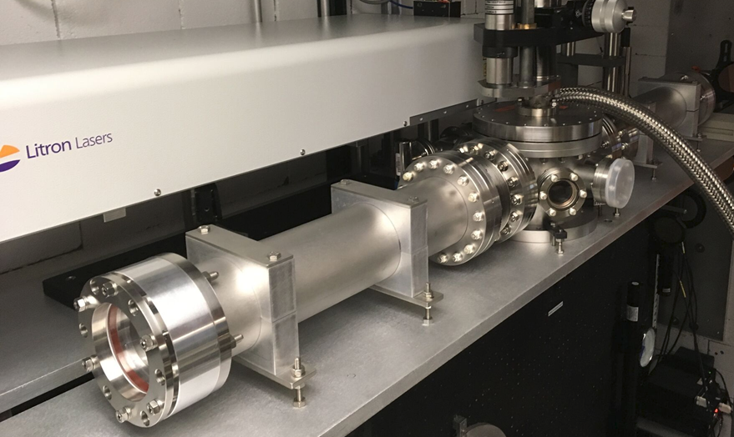
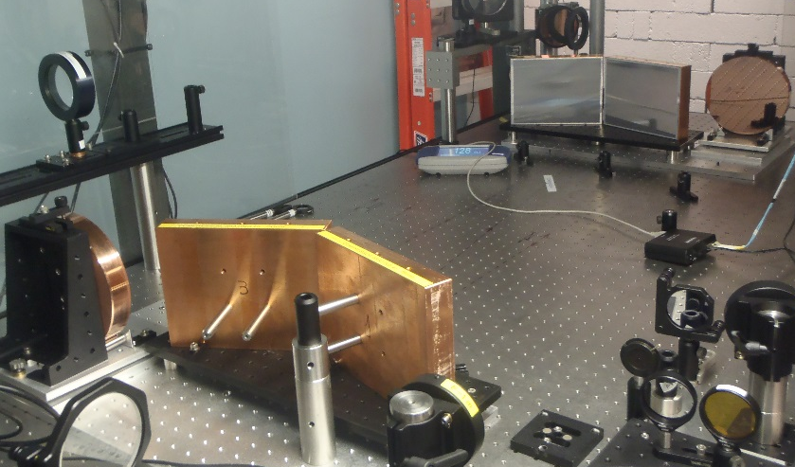
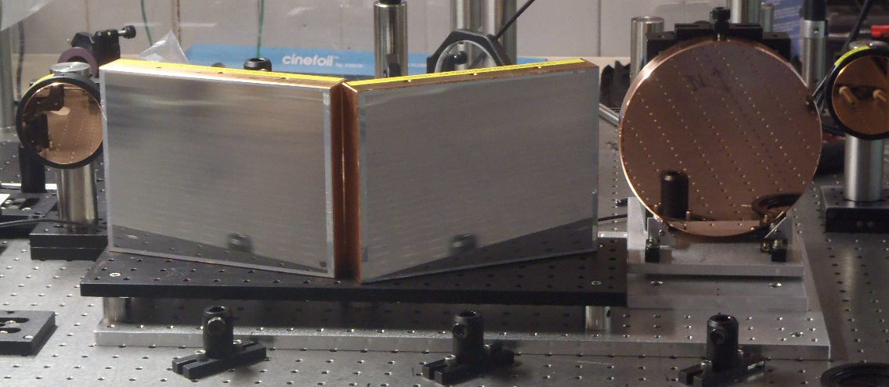
CO₂ Development Thrusts
Table of laser parameters from October 2016 with newest updates marked in the right column
Building 820 CO2 Laser Configuration | Pulse Energy (J) | Peak Power (TW) | Pulse Width (ps) | Transfer to Experiment (%) | Power to Experiment (TW) | Target Date to Implement | May 2017 Status
October 2016 Status | 6 | ~2 | 3-3.5 | ~25% | ~0.5 | FY16
Addition of Plasma Shutter | 6 | ~2 | 3-3.5 | 80-90% | ~1.6-1.8 | Mid FY17 | 20J in stretched pulse at the amplifier. Modified (added telescopes) CPA compressor handles 12J energy. Plasma shutter installed and under debugging. Close to 1 TW at plasma IP. Working to improve.
CPA Reconfiguration (no Isotopes) | 6-10 | 2-3 | 3-3.5 | 80-90% | ~1.6-2.4 | Mid FY17
CPA Reconfiguration (with Isotopes) | 6-10 | 3-4.5 | 2-2.5 | 80-90% | ~2.4-4 | Early FY18 | Amplifier is ready to handle isotopes. Working on isotope recovery system.
Non-linear Pulse Compression | >1 | >1 | <1 ps | 80-90% | ~1 | Late FY18 | To be initiated
Plasma shutter
CPA compressor

Slide 8
ATF-II Upgrade

Slide 9
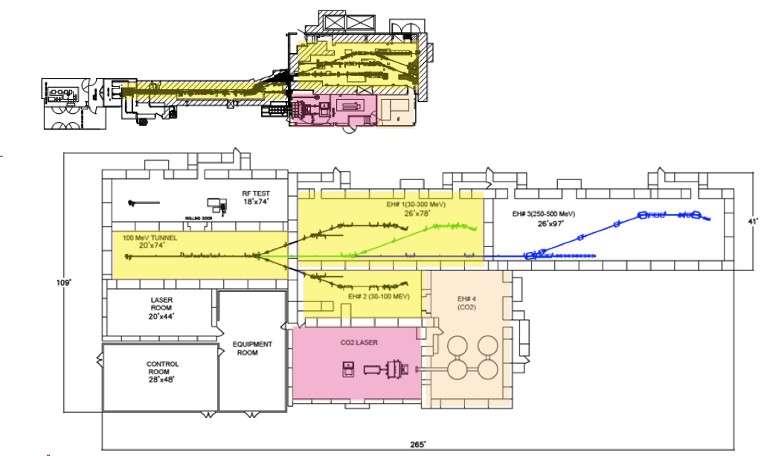
ATF a ATF-II
Towards higher productivity:
ATF (BLDG 820)
Shielded area:
Total floor space:
Exp. Halls:
x4
x7
x3
ATF-II (BLDG 912)
Increased capabilities:
E-BEAM
80 MeV 100 MeV
CO₂ LASER
2 TW 10s TW
[ultimately to 100 TW]

Slide 10
ATF-II Re-Baseline Plan
????

Slide 11
Strategic Thrusts for ATF-II
ATF-II Development Goals
  Leverage BNL Support to deploy the infrastructure to support the next level of CO2 Laser performance for ATF-II
    Building 912 Infrastructure
    Experimental Systems Infrastructure
  Deploy CO2 system components to enable an initial demonstration in the 5-10 TW range
    Achieve next factor of 2 beyond Bldg 820 goal without the use of isotopes in the high pressure amplifier
    Addition of isotopes would then provide
      Better pulse quality
      Factor of ~2 in power (i.e. 10-20 TW facility deliverable)
  Explore cross-fertilization between planned ATF-II capabilities and UED needs
    For example, new pump options for samples

Slide 12
CO₂ Laser System at ATF-II with Potential to Achieve 100 TW
35 µJ
350 fs
Amplifier 1
10 µJ
100 ps
Ti:Al2O3
OPA
Stretcher
100 mJ
Building 912 Demo:
No Isotopes
2 amplifier stages
Output:
15-30 J
~3 ps
5-10 TW
Amplifier 2c
Amplifier 2b
Amplifier 2a
70 J
50 J
2 ps
25 TW
Non-linear compressor (patent)
10 J
100 fs
100 TW
Vacuum grating compressor

Slide 13
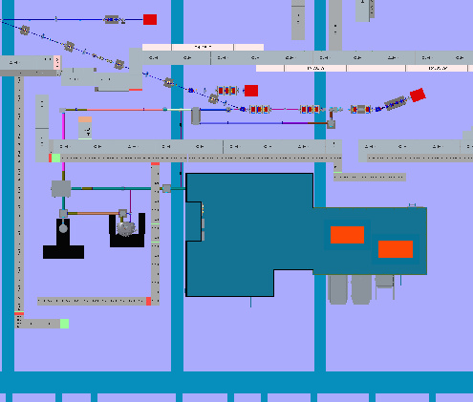
The first steps…
1. Interim Plan – Deploy CO2
and SFL Capabilities
Initial 5-10 TW Demo
(no isotopes)
2. Deliver beams
to users with
>10TW

Slide 14
Key Questions
What balance between ATF-I and ATF-II effort provides the broadest scientific output for the user community?
What is the timescale required for experiments to exploit 3-4 TW capability at Bldg 820? At other stages of deployment (at Bldg 820 and Bldg 912)?
What unique new research opportunities appear along the development paths at Bldg 820 vs Bldg 912?
What is the the most useful balance between Laser-Only versus combined Laser + Electron Beam experiments during a phased deployment of capabilities?
What opportunities exist for collaborative development of these capabilities?

Slide 15
Backups

