Slide 1
ATF response: WG1
Topics in Mid-IR Laser Research
Mikhail Polyanskiy

Slide 2
Working Group 1
Focus primarily on laser R&D and experiments driving “laser-only” research. Consideration should be given to the suitability of currently available facilities for these types of experiments and identify the facility developments required to address the most pressing research needs. Where possible, explicitly comment on: the path for mid-IR laser development required to support future particle accelerator needs; and, the availability and future development of suitable materials needed for high-power mid-IR (9-11 µm) lasers.

Slide 3
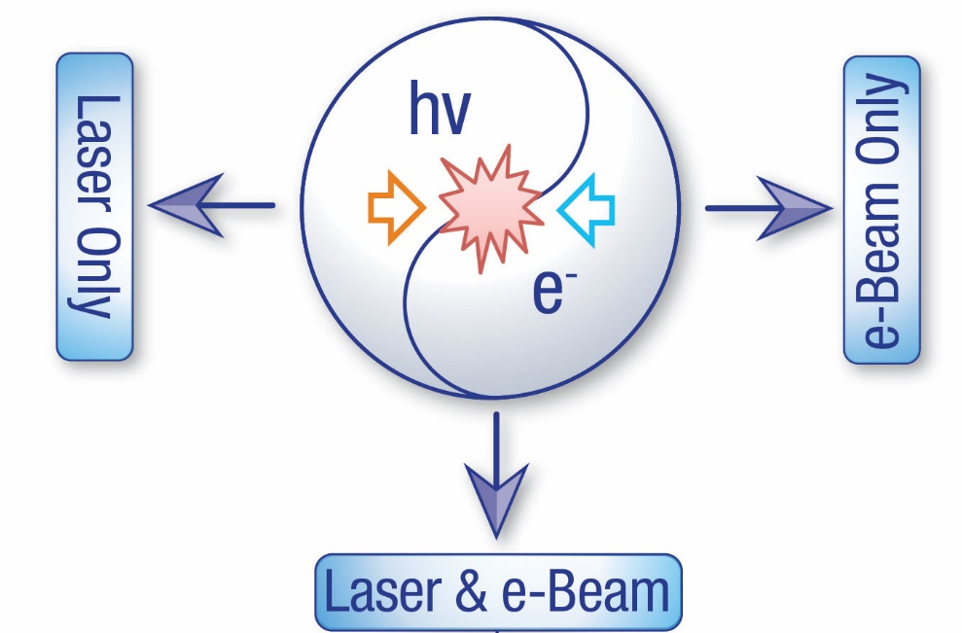
ATF is a user facility…
… Direction of laser development is defined by user needs

Slide 4

User survey: Laser parameters
Peak power
Pulse-to-pulse stability
Pulse width
Pulse format

Slide 5
WG1 requests / questions
Overcome self-focusing in amplifier window
Single pulse
High beam quality, size control, option for non-Gaussian beam
Is high contrast needed?
Circular polarization
Repetition rate?
Efficiency?
CPA
isotopes
working on it
maybe not (?)
???
where are potentials,
not a priority (yet)

Slide 6
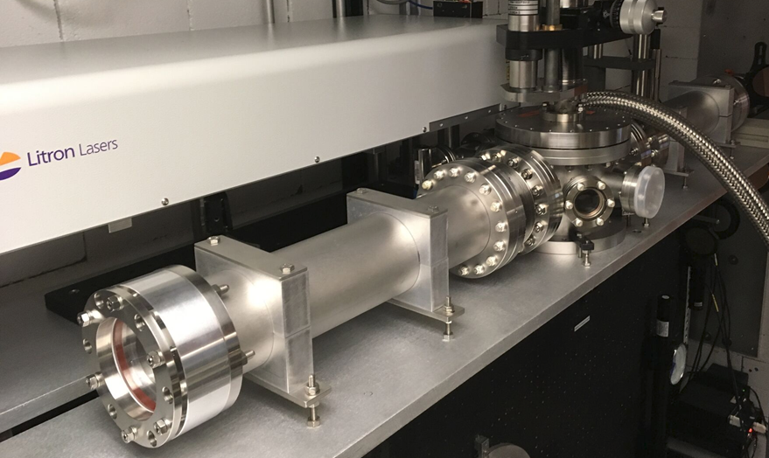


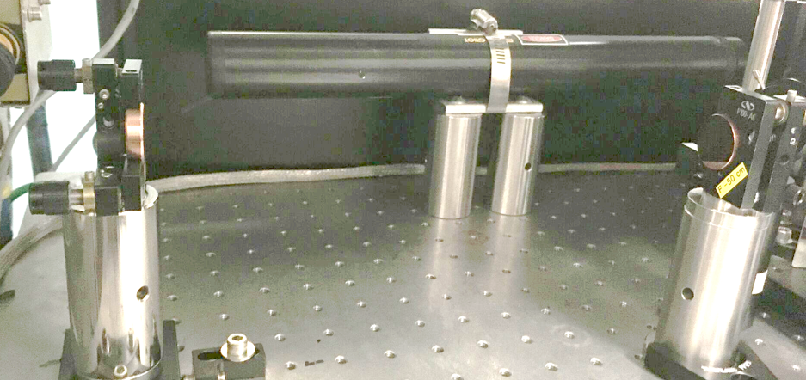
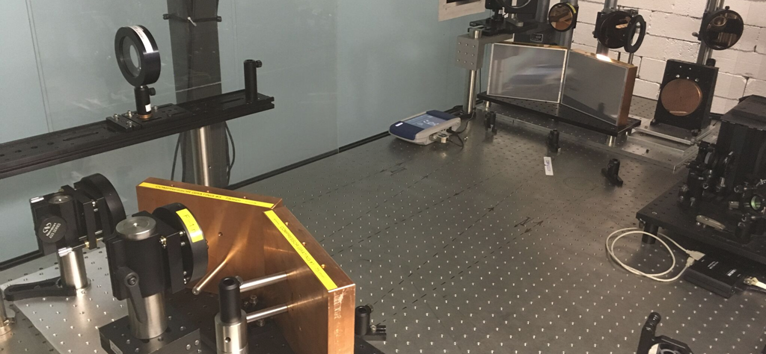
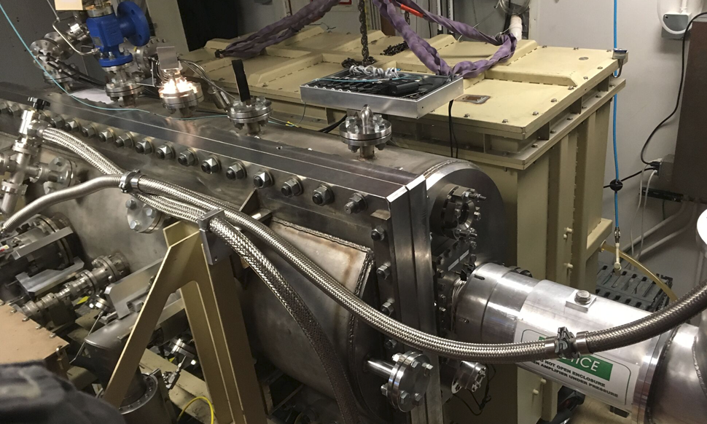
Current status and recent development
Plasma shutter: all-new
1-2 µJ
“50 ps” (*)
Regenerative
amplifier
Osc.
16 µJ
350 fs
Ti:Al₂O₃
OPA
(isotopic gas)
CPA stretcher
20 mJ
50 ps
YAG
Final amplifier
Regen: intracavity telescope
Plasma shutter
20 J
25 ps
(regular gas)
Compressor: telescopes
To be
demonstrated
10 J
3.5 ps
2 TW
Final amplifier:
leak fix, beam expander
CPA compressor
(*) In the usable bandwidth

Slide 7

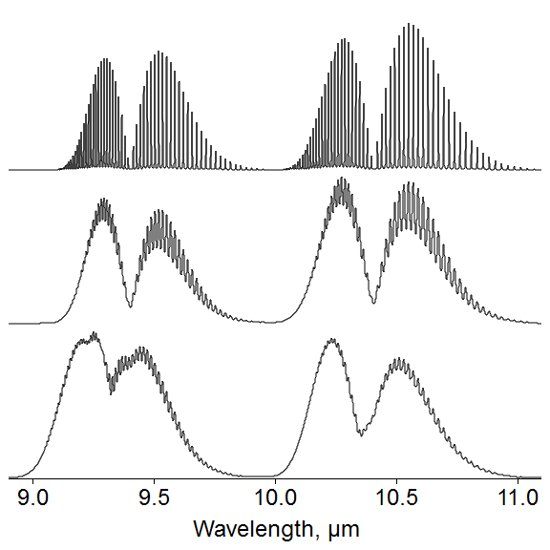
Isotopic active medium
“1 ps”
0.15 µm
1 bar
10 bar
10 bar,
isotopes
3 ps @ 10.2 µm
2 ps @ 9.2 µm

Slide 8
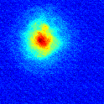
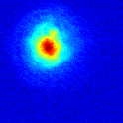
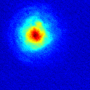
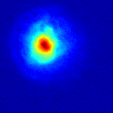
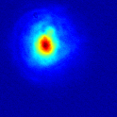
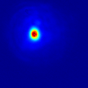
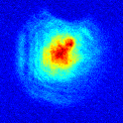
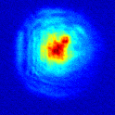
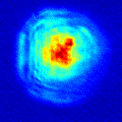
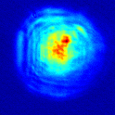
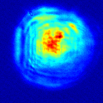
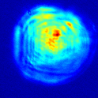
Chirped-pulse amplification
No CPA
75 mm
0.5 J
0.7 J
0.9 J
1.3 J
1.7 J
2.5 J
CPA
0.4 J
0.7 J
0.9 J
1.3 J
1.7 J
2.1 J

Slide 9
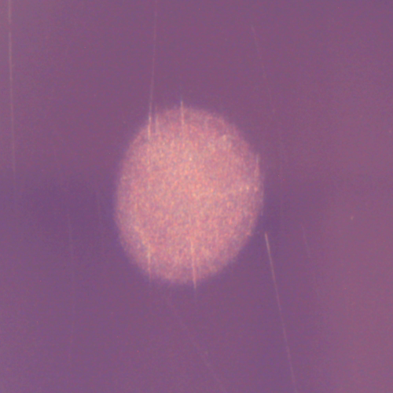
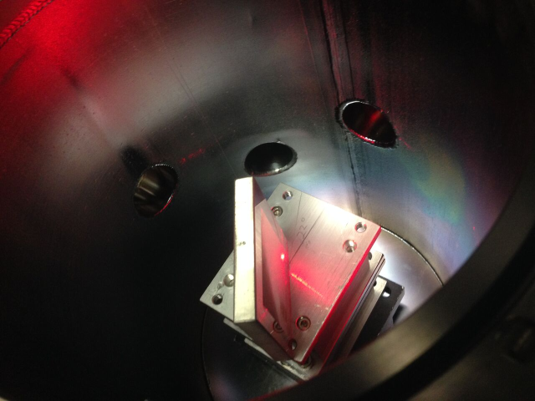
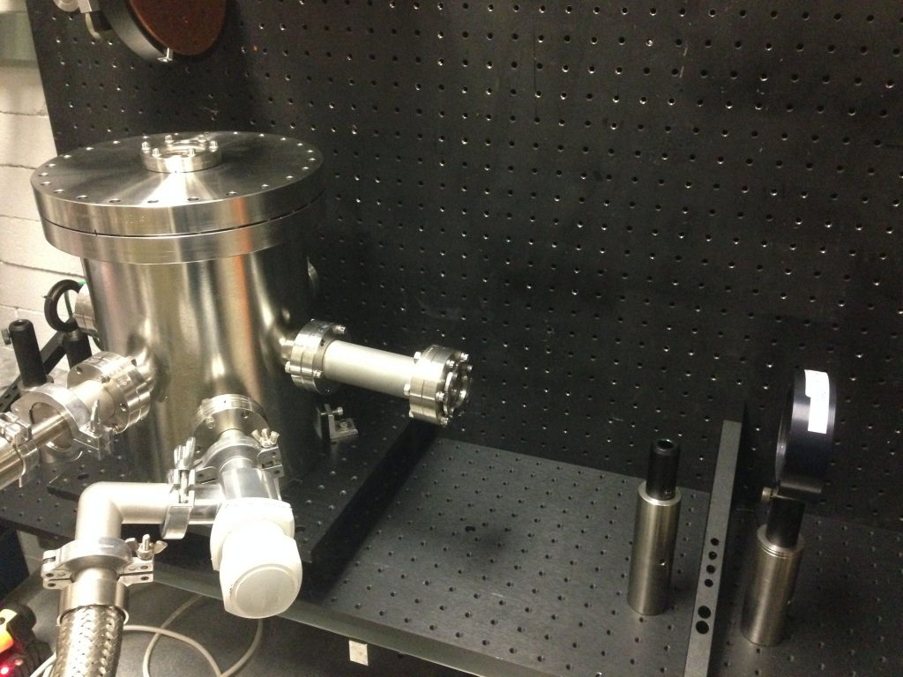
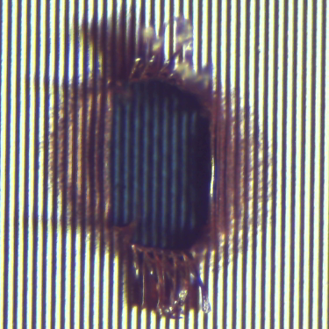
Optical material considerations
Cu mirror
100 µm
I₀ = 8.0 J/cm²
sample
F=50 cm
laser
“Replica” Cu grating
vacuum: <= 0.1 mbar
I₀ = 3.4 J/cm²
Damage threshold (J/cm²) 1.7 ps @ 9.2 µm
 | Bare | Grating (replica) | Grating (master)
Cu | 5 | 1 | 3
Al | 0.5 | 0.5 | 0.5
Mo | 2.5 | - | -
100 µm

Slide 10
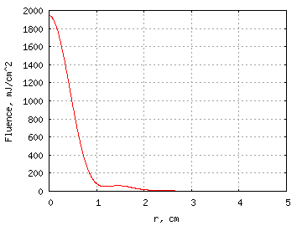
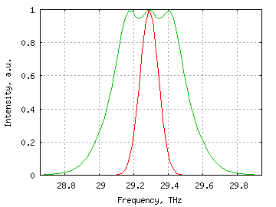
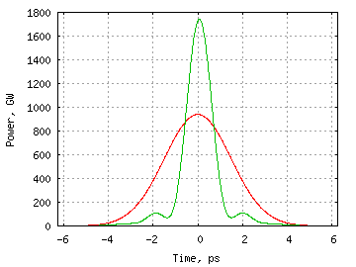
Non-linear pulse compressor
Pair of small-density gratings
(linear compressor)
non-linear material
aperture (spatial filter)
>1 ps
<1 ps
20 mm
Proof-of-principle test simulations (3.5 J)
OUT
2.5 J
IN

Slide 11
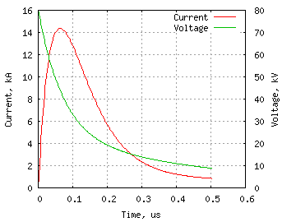
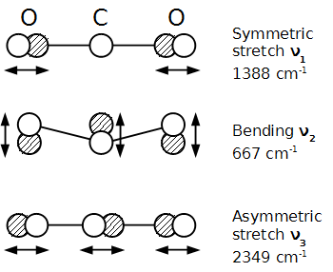

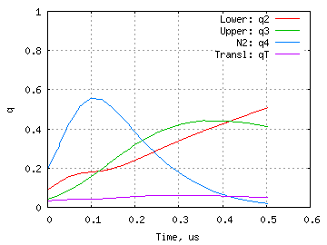
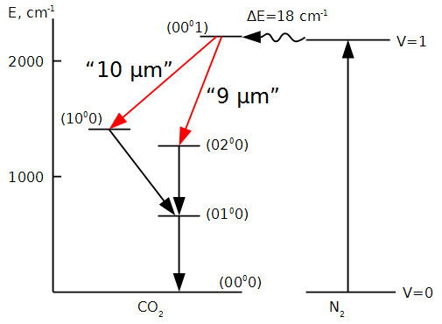
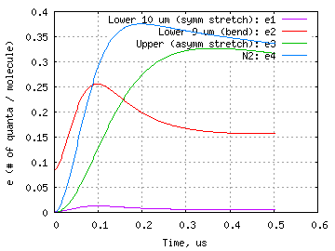
On efficiency…
Discharge
Energy deposition
Discharge pumping of a pulsed 10-bar CO₂ laser
4.2 μm
40% theoretical max
10-20% realistically reachable
Excitation

Slide 12
On repetition rate…
(with pulse compressor)
Can decrease risetime and increase peak current using magnetic pulse compression (MPC)
Five times compression would decrease risetime to 100 ns and increase peak current to 50 kA
Compression factors of >5 times have been demonstrated at STI
Wayne Kimura, SBIR proposal, 2014

Slide 13
On distant future…
Polyanskiy, Early career proposal, 2013
Need diode pump laser @ 4.2 µm
(GaSb…?)

Slide 14
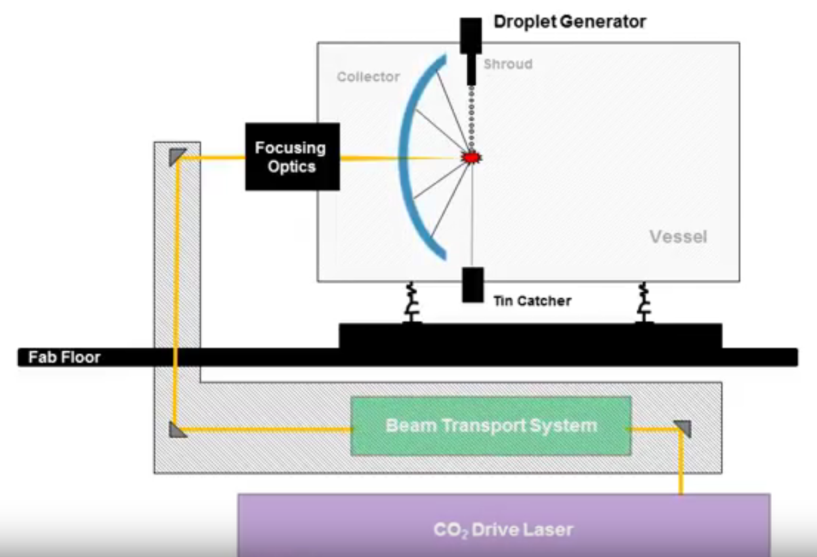
State-of-the art in industrial CO₂ lasers
CYMER: light source for EUV lithography
- 20m long active medium, atmospheric pressure CO2 laser
- 30 kW
- 50 kHz

Slide 15
Summary
Laser development at ATF is driven by user’s needs
Majority of users ask for:
  ~10 TW
  Few picoseconds or less
  Single pulse
  High pulse-to-pulse stability
ATF has developed and keep improving several critical laser components/techniques for satisfying user’s needs
  Isotopic active medium [single pulse, sub-2-ps]
  Chirped-pulse amplification in gas laser [peak power]
  Solid-state seed-pulse generation system [reliability]
  Nonlinear compressor (R&D) [sub-ps]
Possibilities do exist for increasing repetition rates and efficiency (currently not high priority)

