Slide 1
Addressing the Needs of WG#2
Laser-Plasma Interactions
Igor Pogorelsky

Slide 2
Charge to WG#2

Slide 3
Community input
What Mid-IR (10 μm) means for plasma accelerators
  Electron acceleration – larger “bubbles” for external injection, staging, ultra-low emittance
  Ion acceleration – gas targets, monoenergetic regimes such as shock wave, possibility to access energies of cancer therapy interest
Power requirements
  LWFA milestones: self-modulation (2 TW, a₀~1), blow-out (5-10TW a₀~2), bubble (25-30TW, a₀~4)
  Ion acceleration – energy scaling ~a₀², next milestone 20 MeV with 10-20 TW, need a₀~10, ~100 TW for 100 MeV/nu
Pulse duration
  Sub-picoseconds (~500 fs) for LWFA blowout/bubble
  1-3 ps for other applications, including ions
Pulse structuring
  Controlled pre-pulse for ion acceleration

Slide 4
Community input (continues)
Polarization
  Linear
  Circular
Pulse stability, contrast, repetition rate
  <10%
  Important for going forward to applications
High-quality electron beam from RF linac
  10 fs, 10 μm,100 pC, 1 mm.mrad
  Essential for suggested LWFA studies (external injection, staging, emittance preservation, etc.)
  Wake field imaging
NIR lasers
  ~10 TW, ~100 fs
  Ionization injection
  Plasma diagnostics
  Synchronization requirements

Slide 5
Alignment of ATF/ATF-II plans with community needs
Power requirements
  ATF will support near-term needs with up to 4 TW
  ATFII milestones co-aligned with long-term needs (10, 25, 100 TW)
Pulse duration
  2 ps for near-term applications
  Attempt to speed up development of sub-ps regime concentrating on efficient and reproducible ~500 fs pulses
Pulse structuring
  Pre-pulse provided
Polarization
  Linear and circular can be provided with direct amplification (no CPA)
  ATF-II plan does not (presently) include technology development for circular polarization of high power pulses
Pulse stability, contrast, repetition rate
  Work on improving, pulse stability of a high priority
High-quality electron beam from RF linac
  Provide at ATF
  In a core plan for ATF-II
NIR lasers
  Looking for collaborative support to refurbish and put on line to make available at ATF and ATF-II

Slide 6
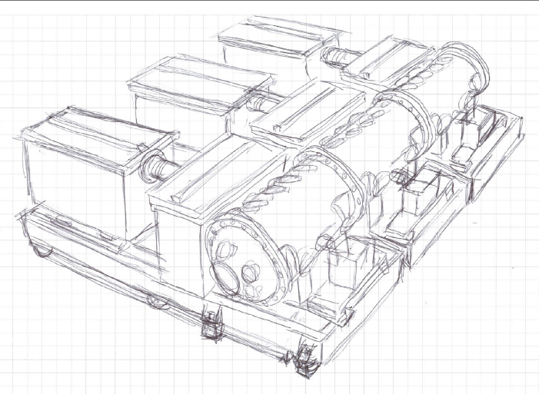
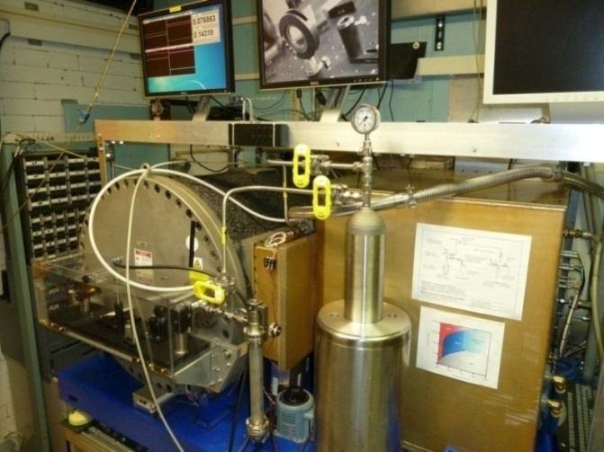
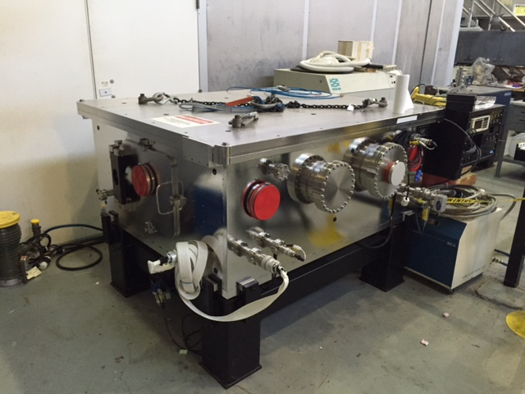
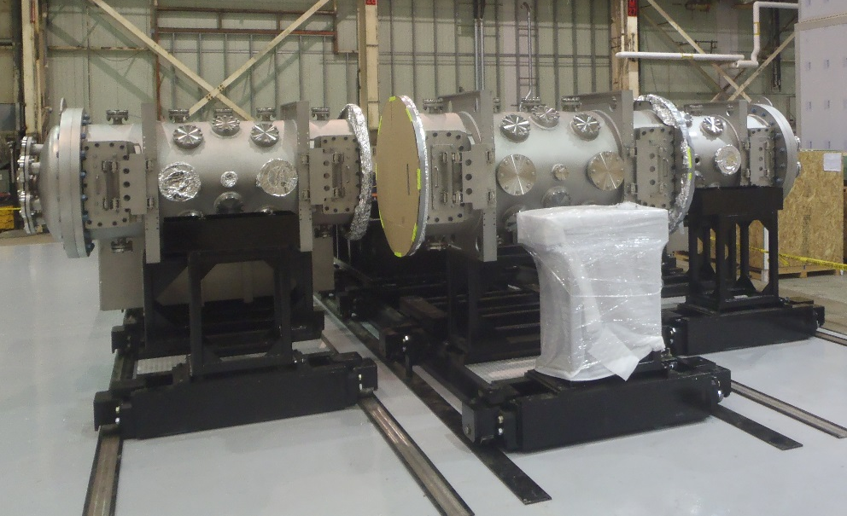
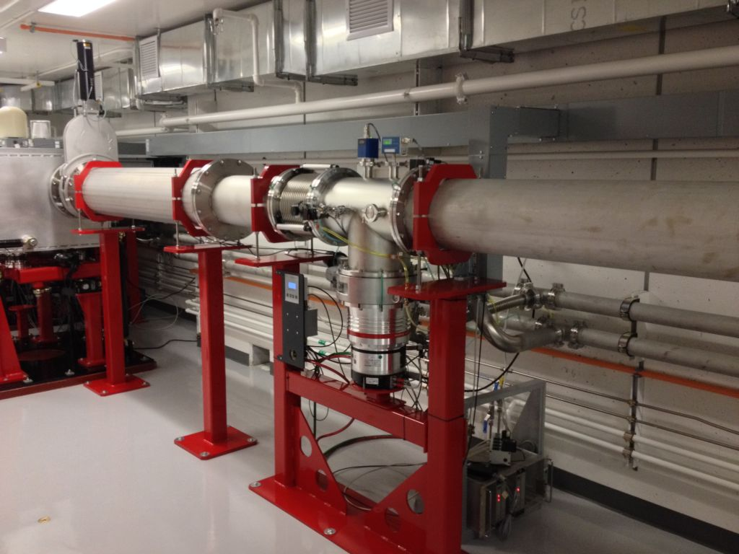
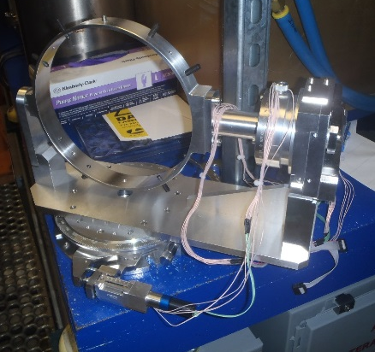
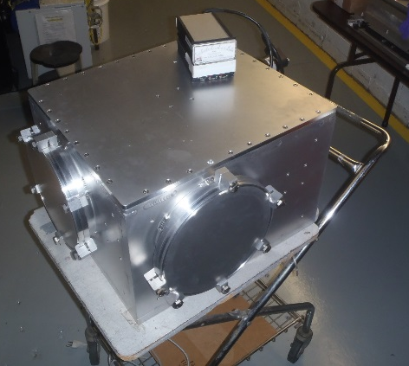
ATF-II laser facility in making
Seed pulse generator
Regenerative amplifier

Slide 7
Impact from ATF-hosted laser/plasma research
Ion Acceleration
  Cancer therapy
  Spin-off to deuteron, neutron, and THz sources
LWFA
  Compact light sources based on combination of a high-charge LWFA and high-yield Compton scattering
  Test bed for R&D towards the next linear collider

Slide 8
Roadmap to plasma colliders
  100 pC ~10 GeV demonstration
  Matched laser guiding in plasma
  Improve stability, reproducibility and tenability, to enable near-term applications as well
  LWFA-based positron source
  Staging with >90% capture and emittance preservation, understanding emittance growth mechanisms and mitigation
  Optimize efficiency from laser to beam, including bunch shaping and wake energy dumping by additional pulses
  New diagnostics development and testing
  Experimental validation of new simulation tools

Slide 9
ATF diversity in addressing community needs
LWFA
Two-color/low ε
all-optical Trojan Horse
Matched guiding
Ion Acceleration
Shock Wave
RPA, BOA, RITA, …
PWFA
LWFA
Seeded LWFA
LWFA stability study
LWFA staging study
Wakefield probing with e-beam
Compton sources
Positron sources
ICS Conversion for γγ colliders

Slide 10
Laser/plasma R&D enabled by CO2 Capabilities
2TW/3ps | 4TW/2ps | 10TW/2ps | 20TW/0.5ps | 40TW/0.25ps | 100TW/0.1ps
Self-modulated LWFA |  | Blowout and Bubble
Seeding
Staging
LWFA
Two-color, low-ε
Laser channeling
5 GeV
Probing, diagnostics, codes benchmarking
Shock wave acceleration
Ions
RPA, BOA
Deuterons, neutrons, THz
Biological tests
Program would benefit from:
Medical application
Large-scale plasma structures
Available well-controlled fs electron linac bunches
Access to low-density SWA technique
3

Slide 11
Thank you for attention

Slide 12
LWFA and Compton R&D Enabled by CO2 Capabilities
2TW/3ps | 4TW/2ps | 10TW/2ps | 20TW/0.5ps | 40TW/0.25ps | 100TW/0.1ps
Self-modulated LWFA |  | Blowout and Bubble
Seeding
Staging
LWFA
Two-color, low-ε
Laser channeling
5 GeV
Probing, diagnostics, codes benchmarking
High-charge regime
+Compton
All-Optical Trojan Horse
All-Optical Compton
All-Optical Compton FEL
Program would benefit from:
Large-scale plasma structures
High-charge LWFA electron bunches
High photon fluxes per laser energy
Available well-controlled fs electron linac bunches
Positron source
3

Slide 13
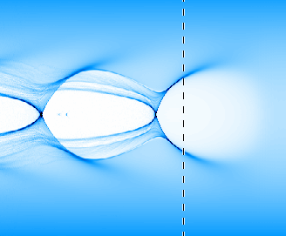
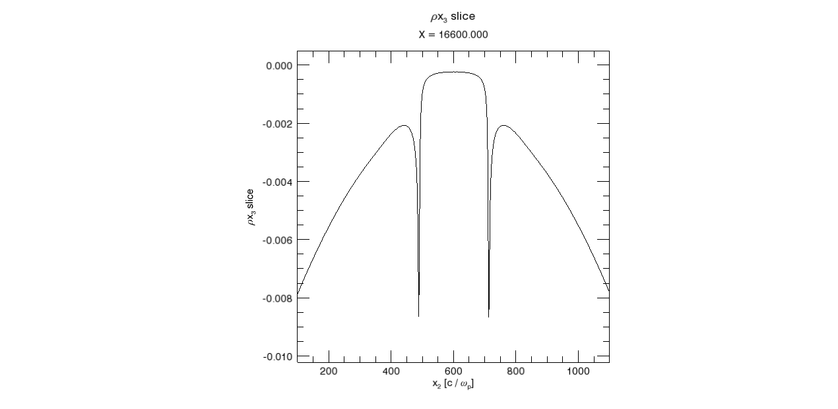
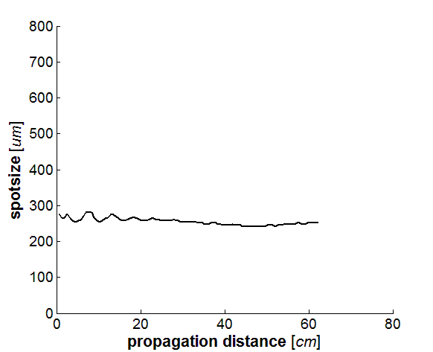
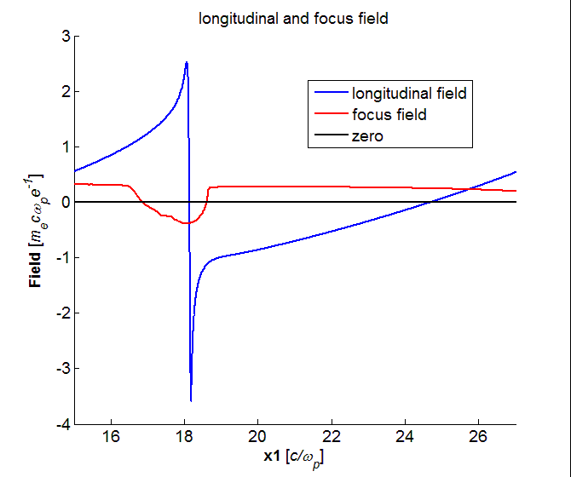
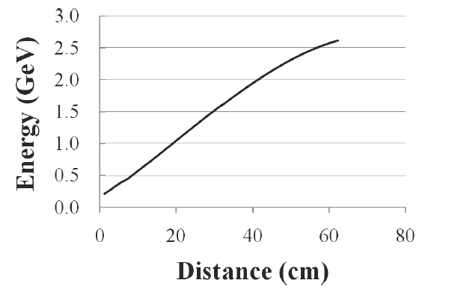
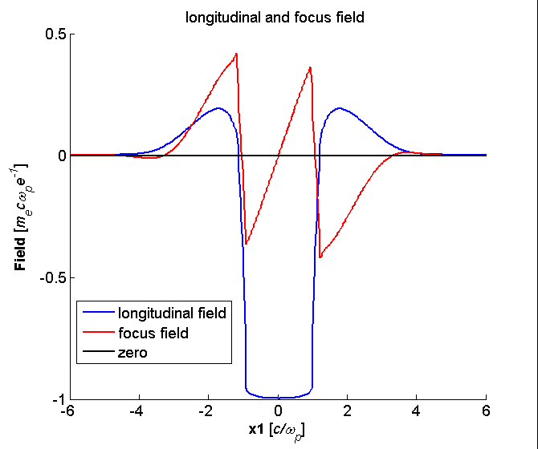

3-D simulations of multi-GeV LWFA stage
Bubble charge
Propagation in
a matched channel
400 fs 60 TW CO₂ laser focused to w₀=262.5 μm at the entrance to a 3.2x10¹⁵cm⁻³ matched parabolic plasma channel.
Courtesy of Wei Lu
Notes:
PIC simulations show that a Cow laser can produce a really nice bubble, several GeV acceleration per stage, considering channeling. But we really need a subpicosecond pulse. Our best result so far was 2 ps. With such a pulse, the bubble conditions is very difficult to satisfy.

Slide 15
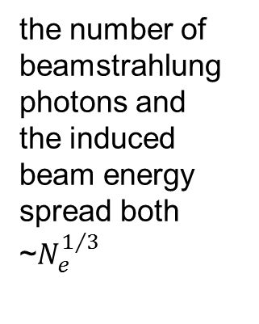
Two optimum regimes for LWFA collider stage
Parameter | Ti:S | CO₂
Laser wavelength (μm) | 0.8 | 9.2
Plasma density (×10¹⁶cm⁻³) | 11 | 0.35
Plasma wavelength (μm) | 99 | 560
Laser pulse duration (fs) | 130 | 700
Laser radius (μm) | 63 | 360
Laser peak power (TW) | 300 | 75
Laser energy per stage (J) | 40 | 52
Number per bunch (×10⁹) | 4 | 23
Single stage interaction length (m) | 0.79 | 1.1
Accelerating field (GeV/m) | 12.6 | 2.2
Energy gain per stage (GeV) | 10 | 2.4
Number of stages | 50 | 208
Collision rate (kHz) | 10 | 0.3
Average laser power per stage (kW) | 400 | 16
Linac length (stages 0.5 m apart) (m) | 65 | 448
Total laser power (MW) | 20 | 2.6
limited by beamstrahlung
e⁻ + e⁺ γ
the number of beamstrahlung photons and
the induced beam energy spread both ~$N_{e}^{1/3}$
Beamstrahlung is irrelevant for gamma colliders

Slide 16
Power milestones? 20 MeV -10TW, neutron production
Pulse duration?
RPA: E~txI, need prepulse, pulse structuring 1 ps, short diagnostic

Slide 17
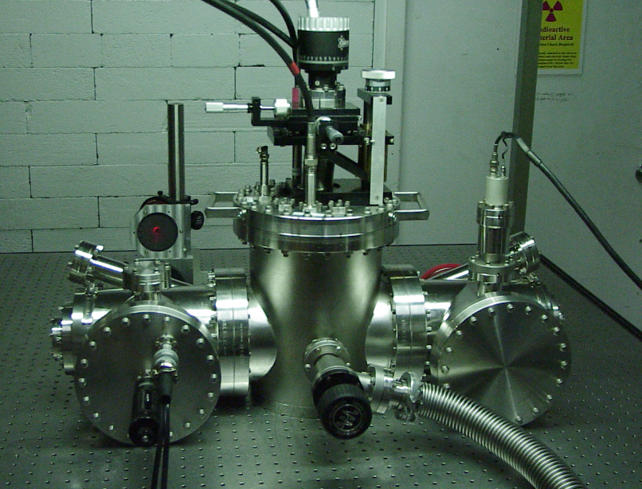
CO₂ laser beam channeling
No discharge
Discharge, no attenuation
Same with attenuation, shows 160 μm FWHM
17

Slide 18
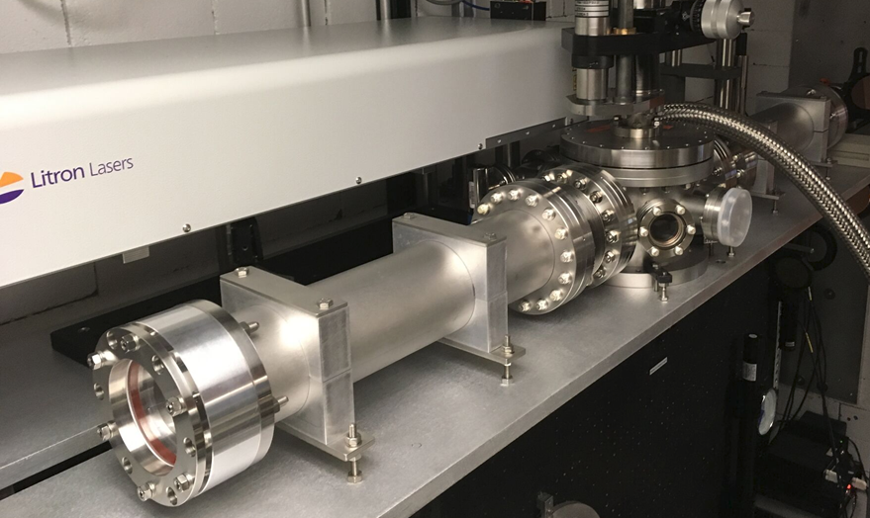
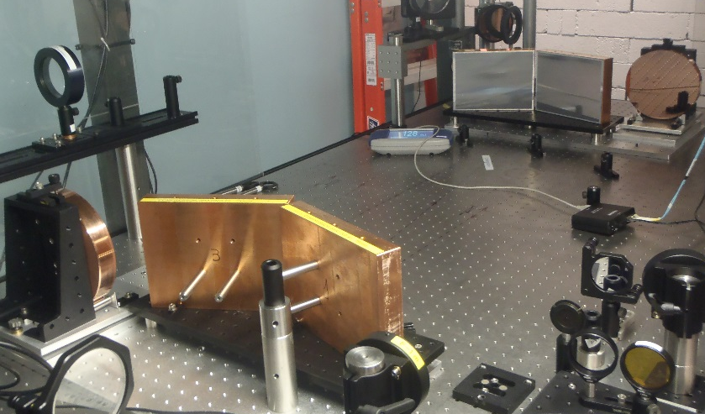
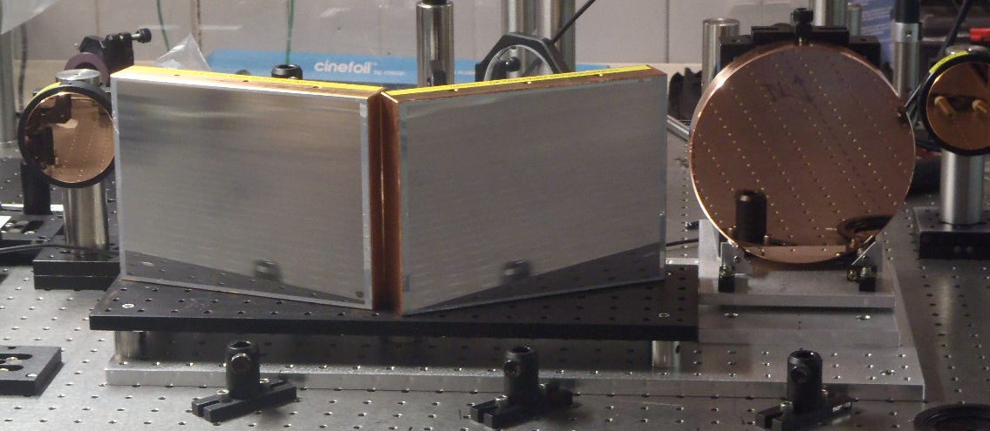
Short-term upgrade plan in progress
Building 820 CO2 Laser Configuration | Pulse Energy (J) | Peak Power (TW) | Pulse Width (ps) | Efficiency of utilization (%) | Power to Experiment (TW) | Target Date for Users
Current status | 6 | ~2 | 3-3.5 | ~25% | ~0.5 | FY16
Addition of Plasma Shutter | 6 | ~2 | 3-3.5 | 80-90% | ~1 | Mid FY17
CPA Reconfiguration (no Isotopes) | 6-10 | 2-3 | 3-3.5 | 80-90% | ~1.6-2.4 | Mid FY17
CPA Reconfiguration with Isotopes | 6-10 | 3-4.5 | 2-2.5 | 80-90% | ~2.4-4 | Early FY18
Non-linear Pulse Compression | >1 | >1 | <1 ps | 80-90% | ~1 | Late FY18
18

Slide 19
Prime thrusts of the ATF CO₂ laser short-term upgrade
Plasma shutter to eliminate harmful reflection from plasma at the experiment’s IP back into amplifier to allow full-scale operation in the present configuration, which is capable to 2TW, whereas we are limited to 0.5-1TW by this reflection.
CPA: Operating above 1TW in DA regime we see significant distortions in the beam due to nonlinear (high-intensity) effect on the amplifier’s output window. We eliminate it and extract much higher energy from amplifier using a stretched pulse that will be compressed with gratings after the amplifier. Telescopes will be installed to use bigger surface of compressor gratings.
Isotopes to increase the amplifier bandwidth to allow shorter pulses immediately in DA regime or upon compression in CPA regime.
NLPC: We will explore the possibility of productive use of the observed self-modulation of the laser pulse during DA through the second amplifier by selecting a self-focused beamlet, measuring its parameters and attempting to compress. This analysis is essential for designing a full-scale NLPC for 912 and may provide users at 820 with a sub-picosecond pulse.

Slide 20
Layout of CO₂ Laser System main components at ATF-II
CO2 Laser Transport
Seed Pulse
Generator
NLPC
CPA
Compressor
IRS
Regenerative
Amplifier
Laser
Experiment.
Systems
Final
Amplifier

