Slide 1
IFEL research needs at ATF & ATF2
P. Musumeci & N. Sudar

Slide 2
IFEL Interaction
In an FEL energy in the e-beam is transferred to a radiation field
In an IFEL the electron beam absorbs energy from a radiation field.
High power laser
Undulator magnetic field to couple high power radiation with relativistic electrons
Significant energy exchange between the particles and the wave happens when the resonance condition is satisfied.

Slide 3
IFEL research directions
IFEL scales ideally well for mid-high energy range (50 MeV – up to few GeV) due to
  high power laser wavelengths available (10 μm, 1 μm, 800 nm)
  permanent magnet undulator technology (cm periods)
Plane wave or far field accelerator : minimal 3D effects.
  Transverse beam dimensions can be mm-size for μm accelerating wavelength!
Vacuum-based accelerator
  Efficient mechanism to transfer energy from laser to electrons
  Simulations show high energy/ high quality beams with gradients ~GeV/m achievable with current technology!
  Preservation of e-beam quality/emittance and high capture.
Microbunching: longitudinal phase space manipulation at optical scale
Viable technology for compact laser-driven 1-2 GeV injector

Slide 4
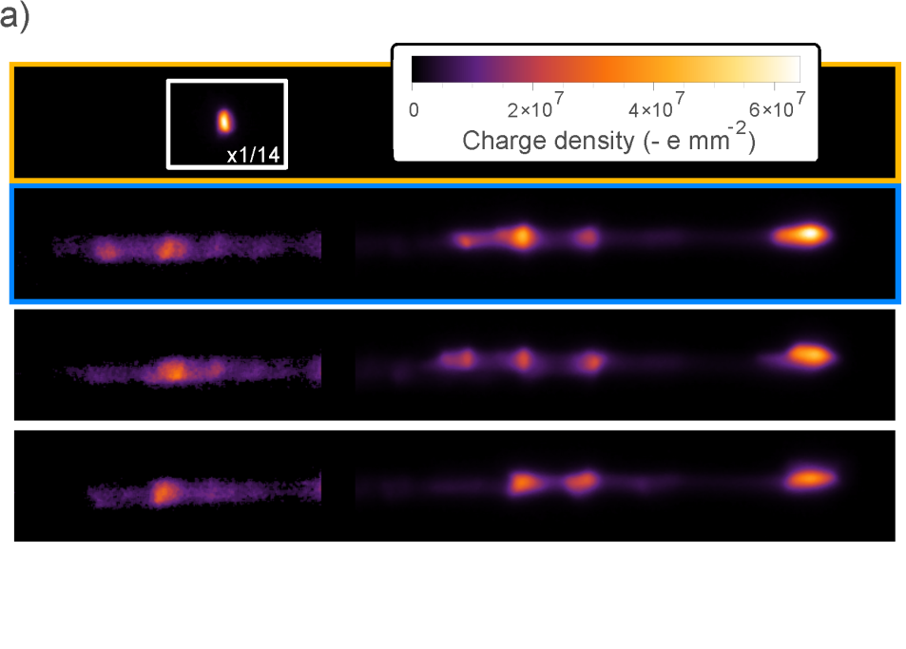
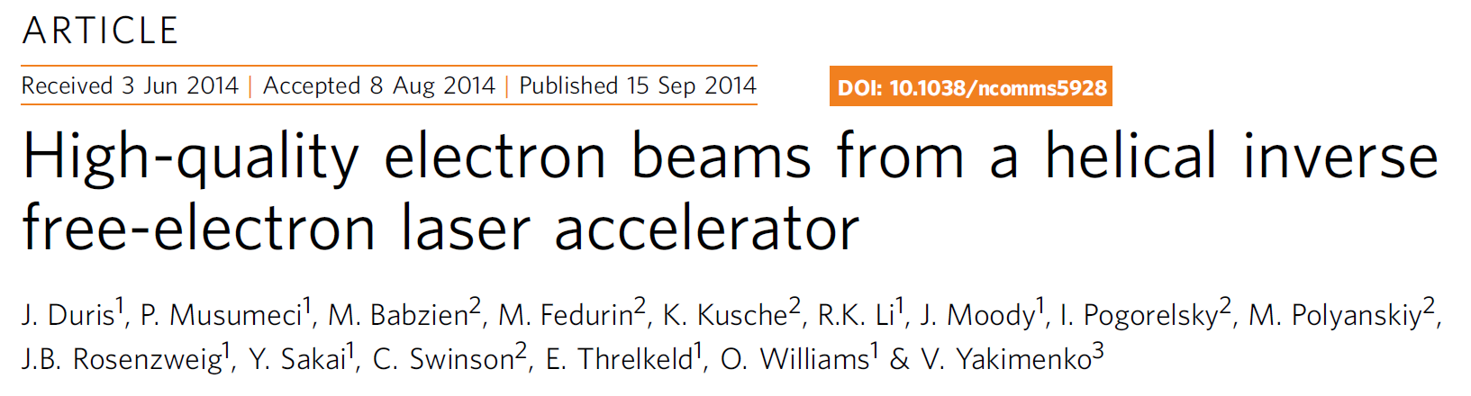

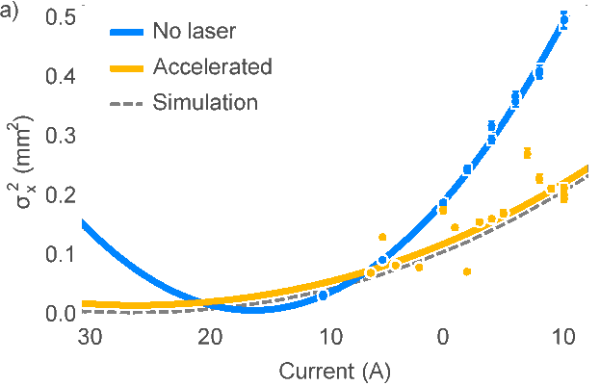
High quality output beams: Rubicon experiment
Input: 50 MeV e-beam, 400 GW CO2 laser, 54 cm long tapered helical undulator
Output: 93 MeV – 1.8 % energy spread
Very reproducible (mean energy std < 1.5 %)
Laser intensity 5 orders of magnitude lower than LWFA
Good agreement with simulation prediction
No laser
Laser on – consecutive shots
Emittance measurement
Quad scan on energy dispersed beam
Emittance growth (from 2 μm -> 3 μm) is due to mismatching in the undulator

Slide 5
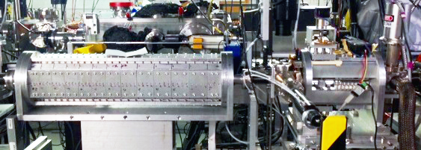
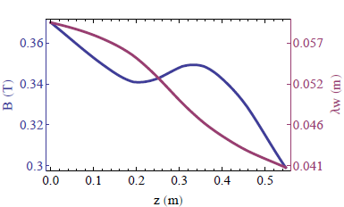
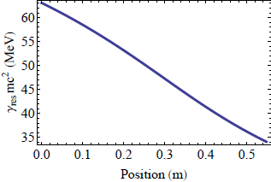
High efficiency interaction: NOCIBUR deceleration
Use RUBICON IFEL set up in reverse at BNL ATF
Reversed and retapered the 0.5 m undulator for high gradient deceleration
Up to 45% of 100 pC beam captured and decelerated
Demonstrated >30% efficiency from a relativistic electron beam in half a meter (2mJ)
Prebuncher
Undulator
Undulator parameters
Resonant energy

Slide 6
Controlling the input phase space: Cascaded buncher
Demonstration of cascade microbunching [Hemsing and Xiang, PRSTAB 2012] using a single laser pulse and only two stage
Use IFEL accelerator as diagnostics
> 90 % captured
Can directly microbunching with RF deflector (Fall 2017)
No laser
No buncher
Single buncher
Double buncher
Acknowledgement of SCGSR support for N. Sudar

Slide 7
Future directions for BNL-ATF based IFEL research
Efficiency
  Recirculated IFEL
  (Recirculated TESSA)
Extend energy reach for applications: Enable MeV photon generation by IFEL accelerated beams or IFEL driven soft-Xray FEL
  High energy second helical tapered undulator@ ATF: AEMILIA
  GeV IFEL demonstration
  Test advanced IFEL concepts such as control of resonant phase along interaction, pump depletion, waveguide IFEL, etc.

Slide 8
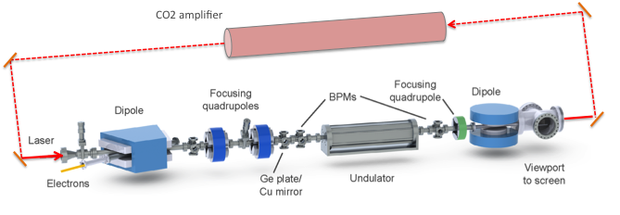
High duty cycle IFEL
E-beam dyamics in a pulse train mode
CO2 recirculated system upgrade
IFEL optimization and integration
Objective: to demonstrate intracavity IFEL operation in a pulse train regime
Phase I: System design (2015-6)
Phase II: Proof of concept demonstration (2017)

Slide 9
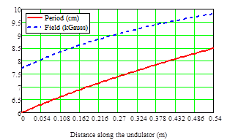
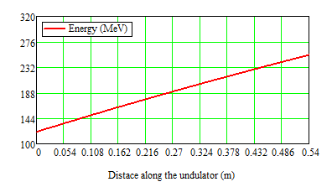
250 MeV IFEL accelerator
Take advantage of 2 TW peak power laser upgrade.
Reuse first half of Rubicon undulator
Build a 54 cm strongly tapered helical booster to get to 250 MeV
Laser power | 2 TW
Rayleigh range | 32 cm
Waist position | 54 cm ( after first undulator half)
Total undulator length | 1.08 m
Input energy | 50 MeV
1st half output energy | 120 MeV
Final output energy | 250 MeV
Undulator period | 4 – 8.5 cm
Undulator magnetic field | 0.5 – 0.9 T

Slide 10
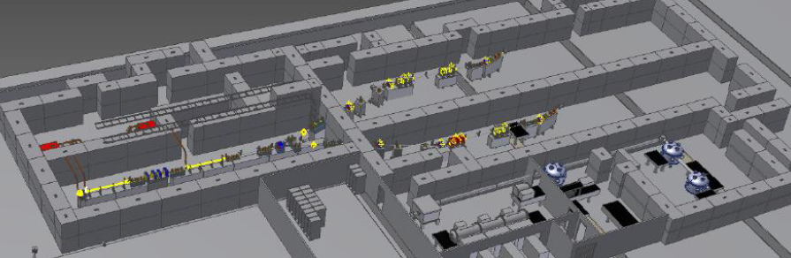
Motivation for high energy IFEL
Demonstrate GeV/m gradients
Demonstrate GeV-class energy gain
Enable IFEL applications :
  Gamma-ray production by Inverse Compton Scattering
  FEL radiation in soft-X ray region
ATF2 is ideal place for next gen IFEL experiment.
  High brightness e-beam
  High power CO2 laser
  Ongoing collaboration
  Leverage on existing experience
ATF2 upgrade parameters
E-beam energy | 50-150 MeV
Laser beam power | 10-100 TW

Slide 11
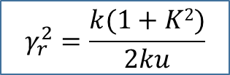
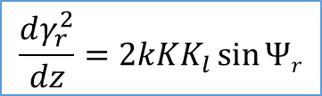
Tapering optimization: Ideal design
Use Halbach undulator scaling laws
Control longitudinal particle dynamics
Ponderomotive potential determines all properties of accelerator
  Area of bucket
  Acceptance
  Gradient
Parameter | Value
Laser power | 100 TW
Pulse length | 0.5 ps
Input energy | 100 MeV
Output energy | 970 MeV
Undulator length | 80 cm
Gradient | 1.1 GeV/m
$$\frac{dγ_{r}^{2}}{dz}=2kKK_{l}\sin{Ψr}$$
$$γ_{r}^{2}=\frac{k(1+K2)}{2ku}$$

Slide 12
More conservative design: 3D sims
Minimize risk associated with aggressive tapering
Undulator can be always retuned
Design aiming at 0.5 GeV
Parameter | Value
Laser power | 25 TW
Laser pulse length | > 0.5 ps
M² | 1.5
Gap | 10 mm
Input energy | 90 MeV
Output energy | 500 MeV
Energy spread | 2 %
Undulator length | 75 cm
Gradient | > 0.5 GeV/m
Can we control the relative energy spread by ponderomotive phase tapering?

Slide 13
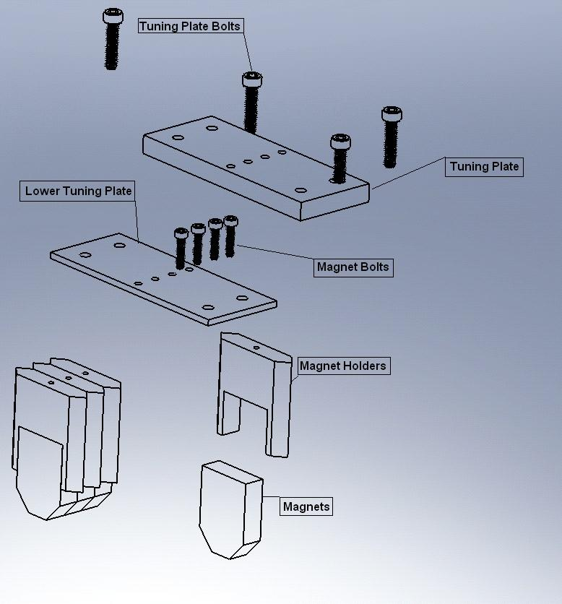
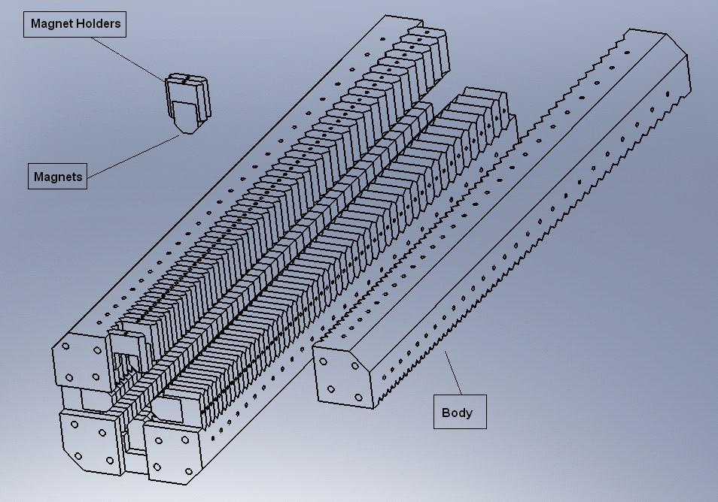
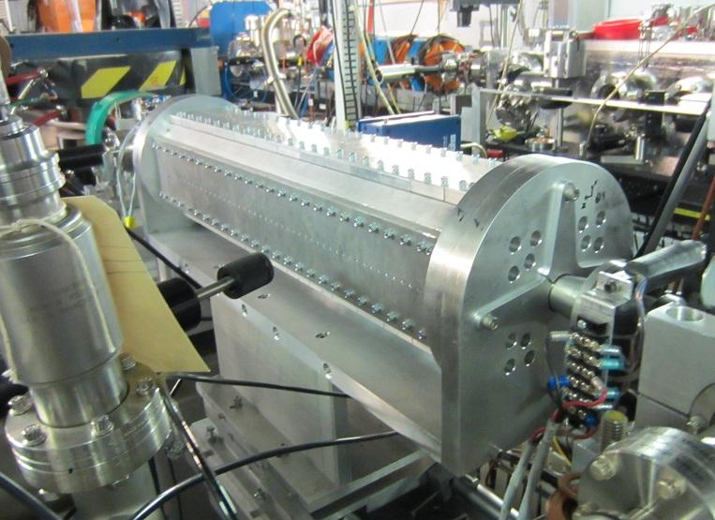
IFEL undulator design
Different options:
  SC undulator
  Cryogenic Pr-based
UCLA Halbach-style undulator: scalable and affordable
  NdFeB magnets
  Orthogonal Halbach undulators with varying period and field strength
  Entrance/exit periods keep particle oscillation about axis
  Beam pipe or vacuum box to allow smaller gap
  Fully tunable
Long period poses some challenges

Slide 14
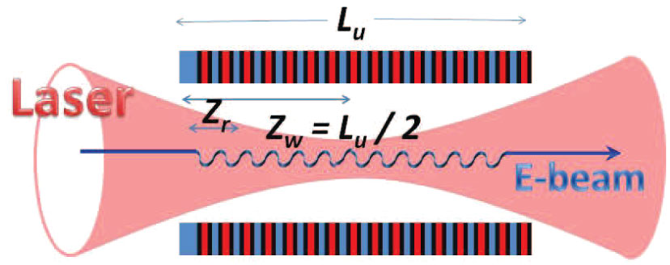
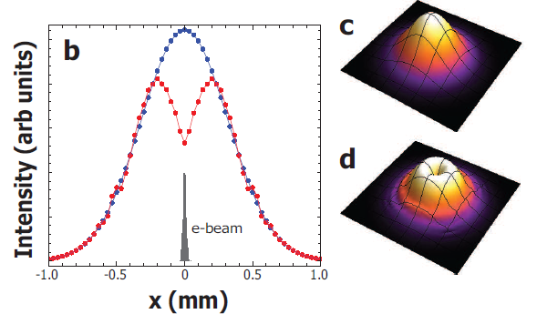
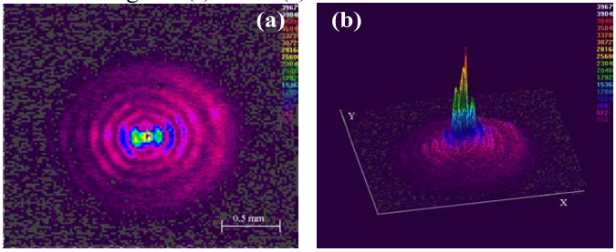
Advanced IFEL concepts
Waveguide IFEL
Diffraction limits gradient
Hollow waveguide can keep high field all along undulator
Increase effective gradient by factor of 2
Need short pulse CO2 to enable efficient coupling of high power pulses( Sung, Tochitsky, Joshi. 2007)
Pump depletion
500 MeV 1 nC = 0.5 J
Need to take into account beam loading
Tapering can be adjusted to compensate
Energy absorption localized in space and in time.

Slide 15
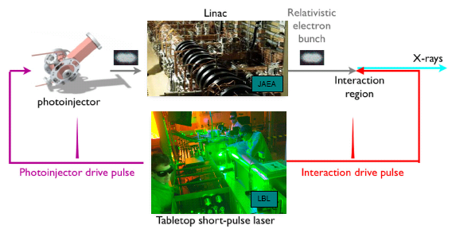
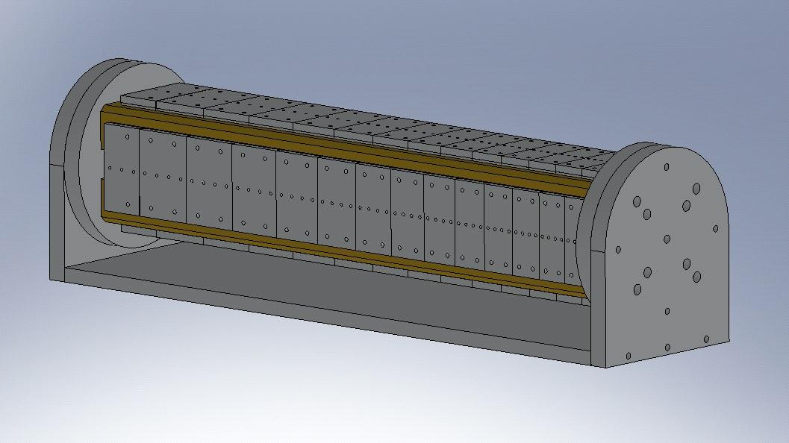
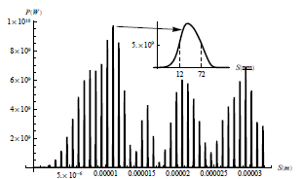
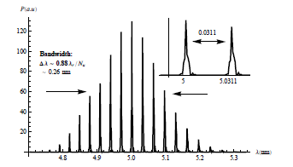
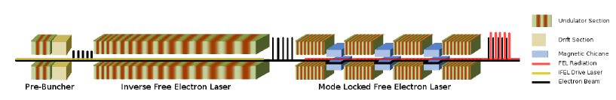
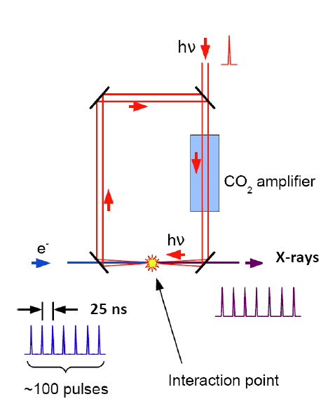
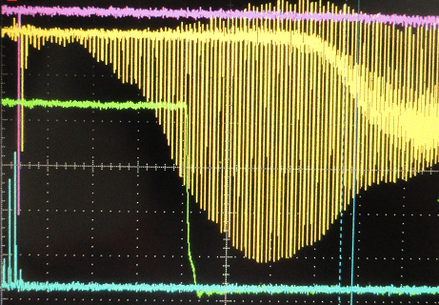
Applications
Inverse Compton Scattering-based compact gamma-ray source
  DNDO – DTRA interest
Compact Modelocked soft-X-ray FEL
  Take advantage of current increase
  Use chicane to realign radiation spikes with e-beam modulation
IFEL
Recirculate drive laser for IFEL to increase repetition rate and average flux of photons

