Slide 1
WG 3 response
Laser – Electron beam Interactions

Slide 2
Expressed needs
Multiple laser wavelengths at e-beam IP
Tunable CO2 laser wavelength
High energy e-beam acceleration after laser power upgrade
Cascade Insertion devices option
Polarization (see comments for WG 2)

Slide 3
Yu.Sakai for ATF SNW

Slide 4
ATF non-linear ICS capability
Present ATF (Bldg 820) facility is capable of providing combined YAG/CO2 laser beams to
e-beam Interaction Point
Required actions: need to design and build YAG beam transport to user experiment
Ti:Sapphire capability will be available after commissioning of the “strong field laser” system

Slide 5
G.Shvets for ATF SNW

Slide 6
Beam bunching by laser at ATF
ATF is capable to use different CO2 isotope mixtures
To shift spectrum above 11 μm is possible but expensive

Slide 7
Future directions for BNL-ATF based IFEL research
P.Musumeci for ATF SNW
Efficiency
  Recirculated IFEL
  (Recirculated TESSA)
Extend energy reach for applications: Enable MeV photon generation by IFEL accelerated beams or IFEL driven soft-Xray FEL
  High energy second helical tapered undulator@ ATF: AEMILIA
  GeV IFEL demonstration
  Test advanced IFEL concepts such as control of resonant phase along interaction, pump depletion, waveguide IFEL, etc.

Slide 8
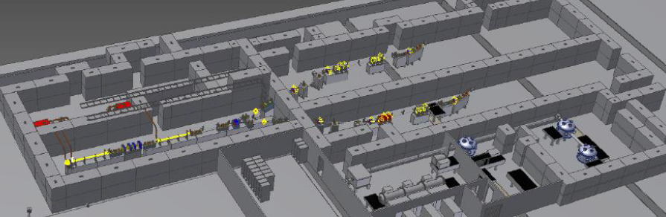
Motivation for high energy IFEL
Demonstrate GeV/m gradients
Demonstrate GeV-class energy gain
Enable IFEL applications :
  Gamma-ray production by Inverse Compton Scattering
  FEL radiation in soft-X ray region
ATF2 is ideal place for next gen IFEL experiment.
  High brightness e-beam
  High power CO2 laser
  Ongoing collaboration
  Leverage on existing experience
P.Musumeci for ATF SNW
ATF2 upgrade parameters
E-beam energy | 50-150 MeV
Laser beam power | 10-100 TW

Slide 9
Response on high energy IFEL
High energy IFEL experiments are possible at present ATF facility
  Requires CO2 laser power increase
  Will have limited repetition rate
Local shielding requirements necessitate special design and radiation safety reviews

Slide 10
Cascade IFEL will be possible at ATF II
Laser transport

Slide 11
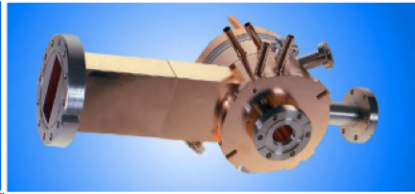
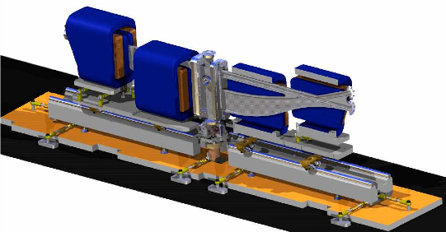
ATF main beam parameters
Parameter | Typical value / range | Best value
Energy | 30-80 MeV | 80 MeV
Charge | 0.1 – 1 nC | 3 nC (at Gun)
Repetition rate | 1.5 Hz | 10 Hz
Electron spot size on cathode | 2.86 mm | 0.2 – 4 mm
Bunch length | 1-8 ps | 100 fs with compression
Average bunch current | 100 A | ~1 kA with compression
Emittance | 1 – 3 mm mrad | 0.8 mm mrad @ 0.5 nC

Slide 12
ATF capability for small beam

