Slide 1


ATF Scientific Needs Workshop,
Brookhaven NL, May 31, 2017
CO₂-Laser-Driven Wakefield
Electron Accelerators¹
Mike Downer, Rafal Zgadzaj,² James Welch³
University of Texas at Austin
M. Babzien, M. Fedurin, I. Pogorelsky, M. Polyanskiy, C. Swinson
Brookhaven National Laboratory – Accelerator Test Facility
V. Litvinenko
SUNY Stonybrook
Chaojie Zhang, W. Lu
Tsinghua University
N. E. Andreev
Moscow State U.
Short-term goal: Self-modulated LWFA
Long-term goal: Bubble-regime LWFA with external injection from linac
→ bigger & better LPAs
¹ Supported by DOE (DE-SC0014043)
² UT Research Associate
³ UT PhD student
Publications: Welch et al., “CO₂-laser-driven self-modulated wakefield experiment
at ATF/BNL”, AIP Conf. Proc. (2017); archival paper in preparation.
1

Slide 3
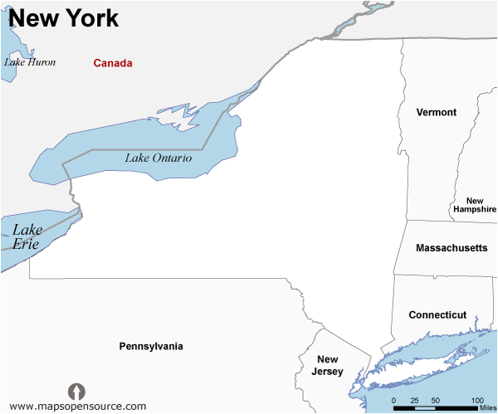
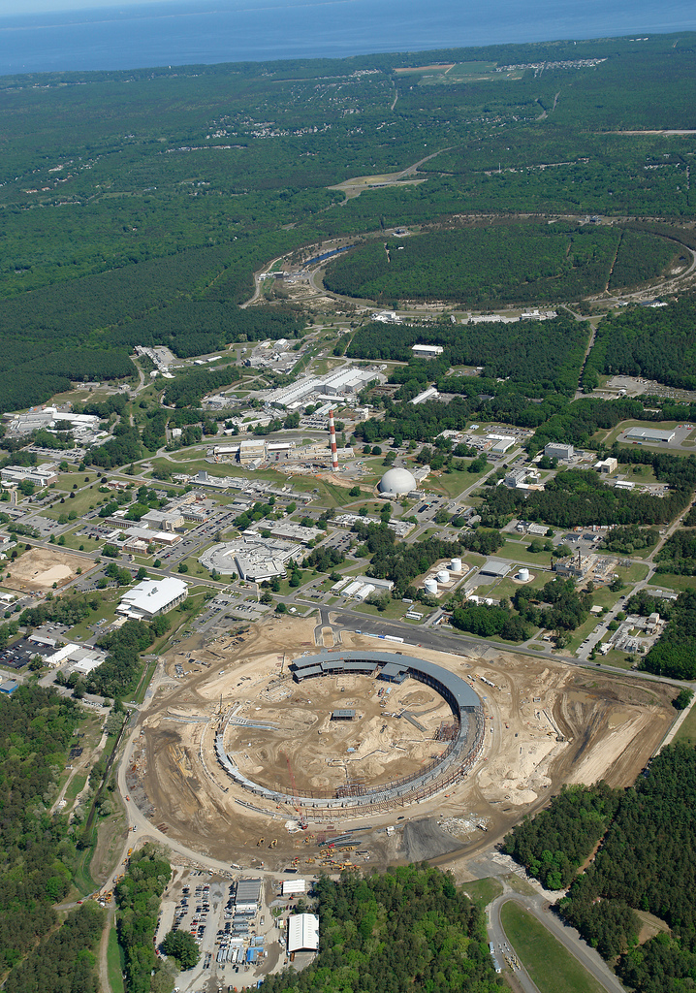
We started CO₂-laser-driven LWFA
experiments at BNL-ATF
New York
RHIC
ATF
Accelerator Test Facility (ATF):
• 70 MeV, sub-ps, 3kA S-band linac
• TW, few-ps CO₂ lasers
• fs synchronization
NSLS
AE-71 Project: “CO₂-laser-driven wakefield
electron acceleration”
• approved by ATF Advisory Committee May 2016
• 3 data runs: May 16-31, Sept 1-15, Oct 1-15, 2016
3

Slide 4
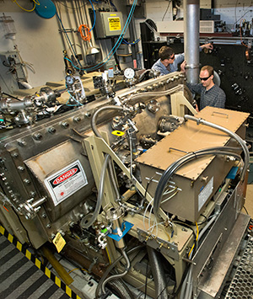
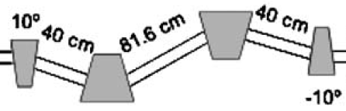
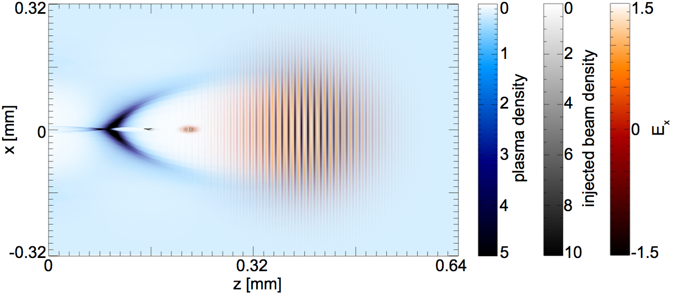
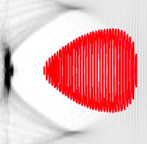
Our experiments use ATF’s TW CO₂ laser, linac,
& e-compression/synchronization capabilities
photo-
cathode
MeV linac (∆E/E ~ 0.1%)
TW CO₂ laser at BNL’s
Accelerator Test Facility
500 fs
10 fs
2) emittance-preserving
zig-zag chicane
compressor²
Ti:S
1) ~10 fs jitter¹
Ti:S
3) CPA at λ = 10µm (Ref. 3)
Large plasma bubbles
easy external injection,
high-resolution diagnostics
300 µm
n_{e} = 1e16 cm⁻³
low-emittance
electron bunch
12.5 J
500 fs
25 TW
¹ Sydlo et al., Proc. FEL 2014
² Litvinenko et al., NIM A 557, 165 (2006).
³ Babzien et al., Optica (2016)
Bubble driven by 1µm, 25 TW
laser in n_{e} = 1e19 cm⁻³ plasma:
4
Notes:
• Could develop a low-emittance positron source & injection stage based on this same idea.

Slide 5

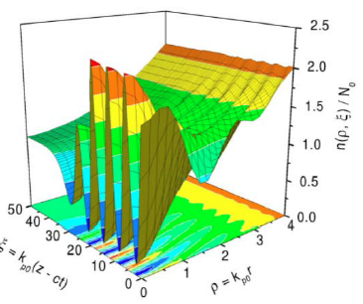
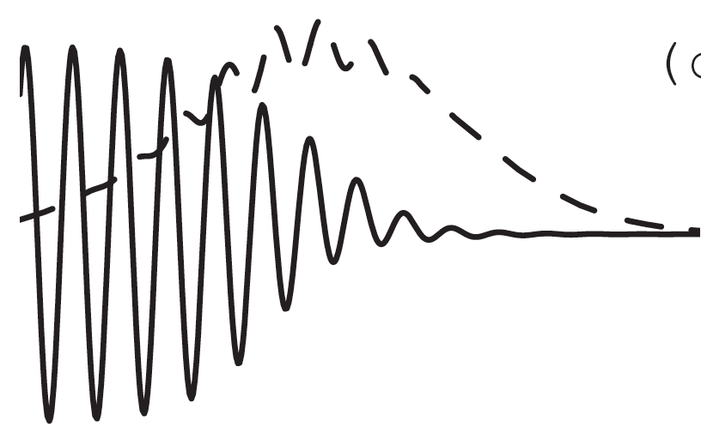
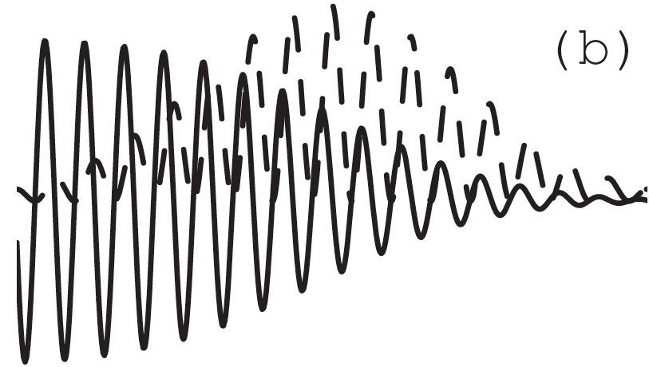
While ATF II is being developed for bubble LWFAs,
we study SM-LWFA with ATF I pulses
3 CO₂ LWFA experiments:
n_{e} (cm⁻³)
τ (ps)
P (TW)
ATF II
pulse
0.3 mm
Bubble
Regime
LWFA
10¹⁶
0.5
25
simulations:
N. E. Andreev et al.,
PR-STAB 6, 041301 (2003)
courtesy W. Lu
laser
probe
ATF I
pulse
Self-
Modulated
LWFA
n_{e}(ρ,ξ)/N₀
~10¹⁸
4
0.5
e⁻
probe
MARS pulse
ξ = k_{p}(z – ct)
CO₂
driver
ρ = k_{p}r
Plasma
Beat-
Wave
Accelerator
λ₁ = 10.59 µm
λ₂ = 10.29 µm
<10¹⁶
300
0.2
Clayton et al.,
PRL 70, 37 (1992)
5

Slide 6

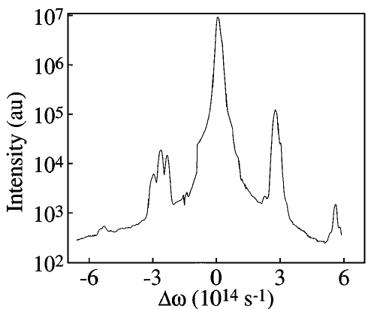
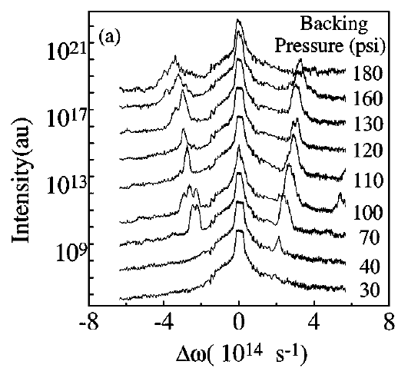
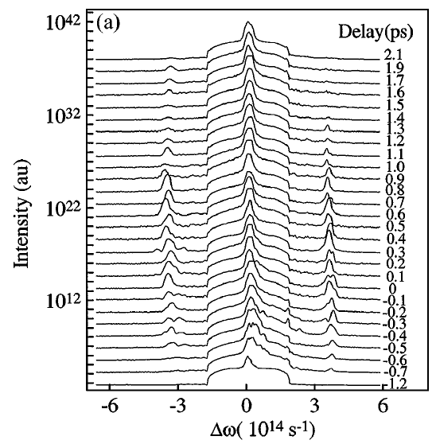
We modeled CO₂ SM-LWFA experiments after prior expts
with λ = 1 µm, 400 fs drive pulses in n_{e} ~ 10¹⁹ cm⁻³ plasma
P ~ 2 TW
LeBlanc, PRL 77, 5381 (1996)
self-focus (P > P_{cr})
PROBE
SPECTRO-
METER
CCD
λ_{pr} = 0.5 µm
WAKE
gas
(6 < λ_{p} < 12 µm)
notch
filter
fixed ∆t ~ 0
n_{e} [10¹⁹ cm⁻³]
P/P_{cr}
fixed n_{e}
(3e19 cm⁻³)
2 ps
2.8
4.7
2.5
4.2
2.0
3.3
Probe Spectral Intensity (arb. u.)
1.9
3.2
Probe Spectral Intensity (arb. u.)
∆t
1.7
2.8
1.6
2.7
1.1
1.8
0.6
1
anti-
Stokes
0.5
0.8
Stokes
-1 ps
probe frequency shift:
critical power for relativistic self-focusing:
∆ω = ± ω_{p} = (n_{e}e²/ε₀m)^{1/2}
P_{cr} [GW] = 17 (n_{cr}/n_{e})
6

Slide 7
We scaled SM-LWFA with a λ = 1µm, 0.4 ps, 2 TW
driver to a λ = 10µm, 4 ps, 0.5 TW drive pulse
Drive Laser (λ, τ_{drive}) | P (TW) | n_{e} (cm⁻³) for P = P_{cr} | ∆ω = ω_{p} (THz) | λ_{p} (µm) | cτ_{driver} (µm) | LWFA regime
YAG (1 µm, 0.4 ps) | 2 | 8 10¹⁸ | 160 | 12 | 120 | SM
CO₂ (10 µm, 4 ps) | 0.5 | 4 10¹⁷ | 36 | 53 | 1200 | SM
CO₂ (10 µm, 0.5 ps) | 25 | 0.8 10¹⁶ | 16 | 350 | 150 | bubble
LeBlanc
expts
(1996)
ATF
I
ATF
II
10× longer λ
10× longer τ_{drive}
4× lower P
20×
lower
density
√20 ×
smaller
shift
cτ_{driver} >> λ_{p} ➔ SM
cτ _{driver} < λ_{p} ➔ bubble
7

Slide 8
We use the “ATF I” CO₂ laser & a synchronized
532 nm probe for 1st generation LWFA expts
Master Clock
Overall timing jitter: ~200 fs
RF reference 2856 MHz
10∝m
350fs
35mJ
10∝m
4ps
2J
CO₂ drive
pulse
Ti:S
OPA/DFG
Stretcher
Regen, Power Amps
Compressor
semiconductor
switch
1.06µm
14ps, 24mJ
0.532µm, 4ps, 1mJ
probe
pulse
Nd:YAG system
Freq. Doubling Compressor¹
25-76MeV, 1nC
e-probe,
injection
Linac Photo Cathode
Linac
266nm, 8ps, 30μJ
chicane
compression
¹ Wang & Luther-Davies, Opt. Lett. 17, 1459 (1992)
8

Slide 9
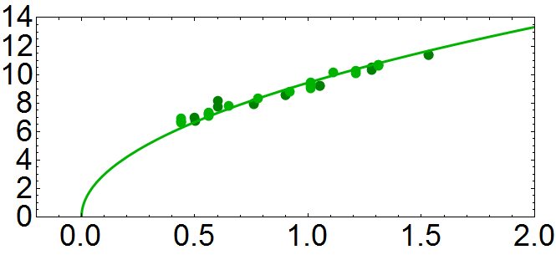

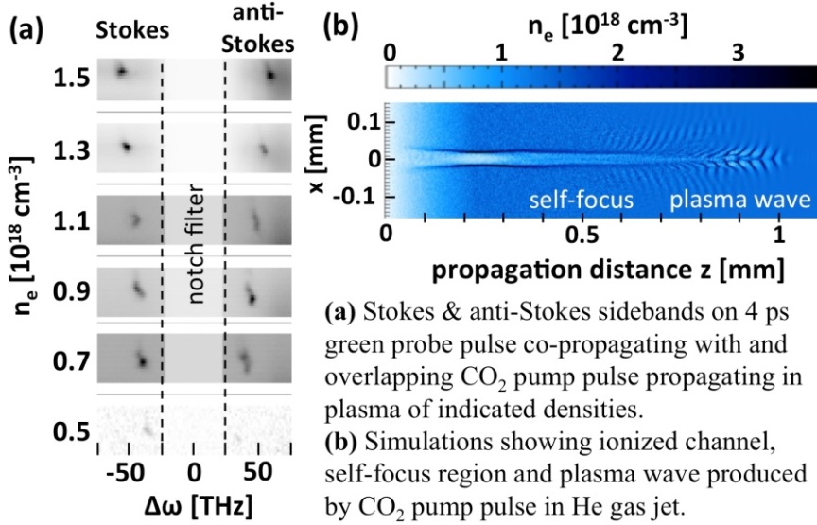
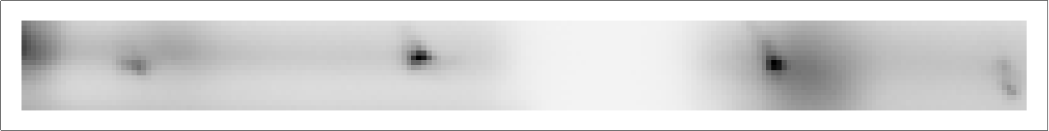


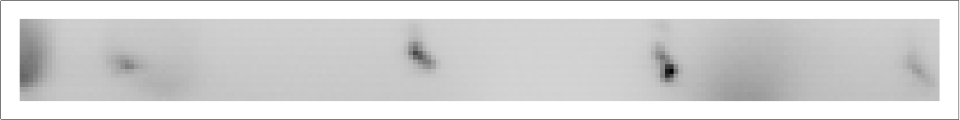

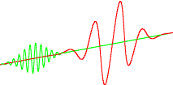

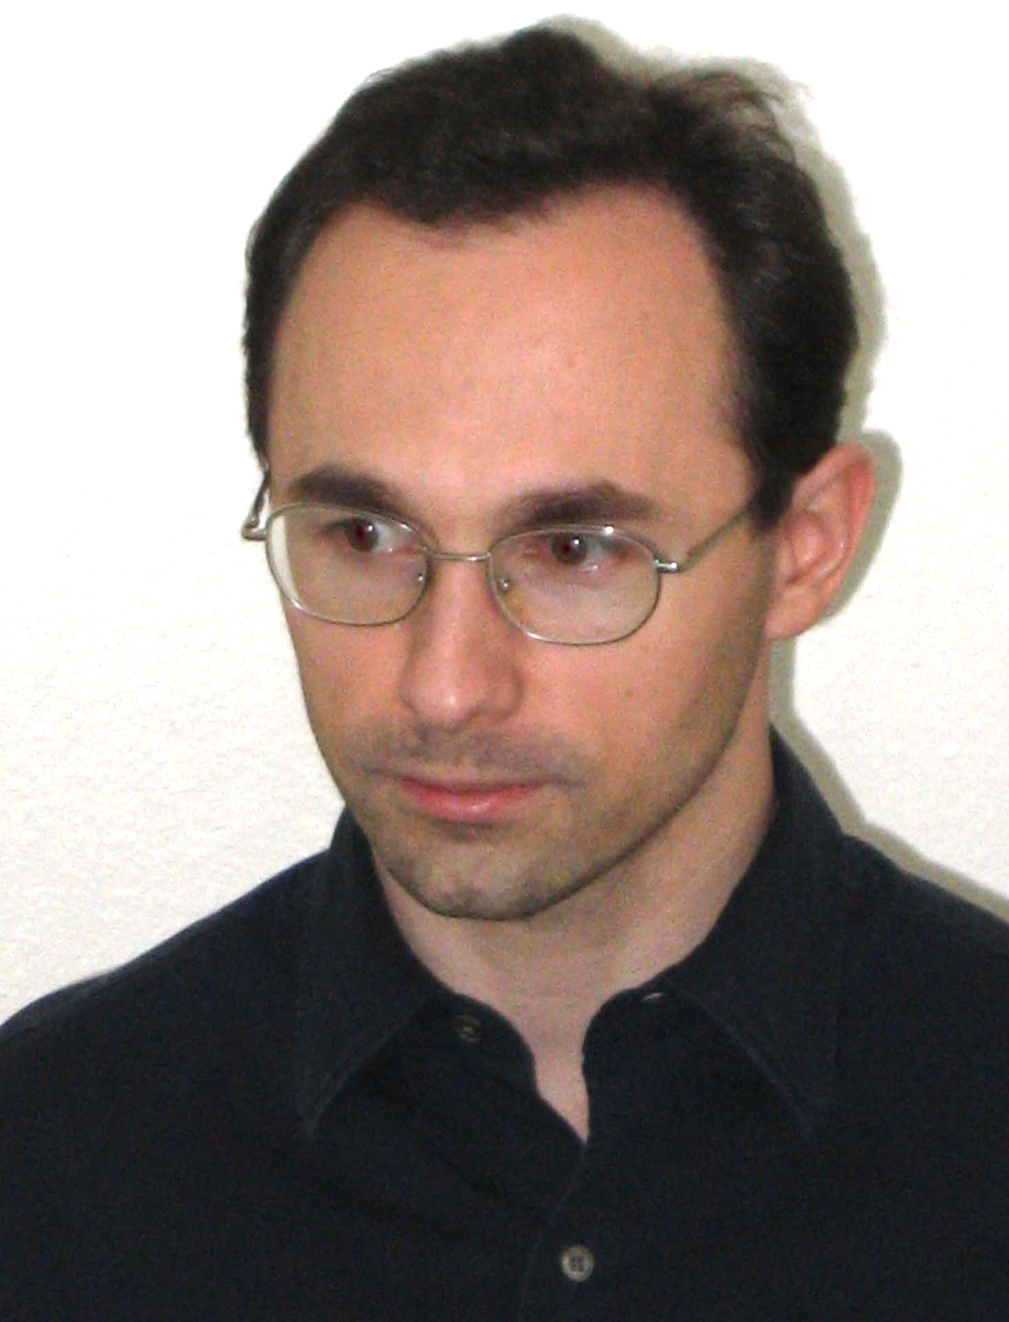
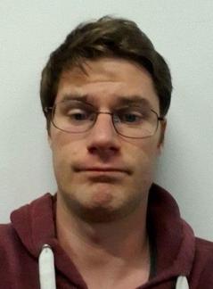
We detected CO₂ laser-driven
wakes via spectral sidebands
of co-propagating probe
∆t ≈ 0
Stokes Shift [nm]
• 0.5 TW, 4 ps (120-cycle) CO₂ laser pulse drives SM-LWFA
• 4 ps, 0.53 µm pulse probes wake via forward collective
Thomson scatter as n_{e} and ∆t vary.
Backing Pressure [Bar]
0
n_{e} [10¹⁸cm⁻³]
10
anti-Stokes
Stokes
0.1
PIC simulation
(courtesy W. Lu)
Probe Spectrum
1.69
0.0
1.45
[mm]
1.11
n_{e} [10¹⁸cm⁻³]
Notch Filter
-0.1
0.98
0
1
0.75
[mm]
0.57
Grating
-50
0
50
Δω[THz]
NOTCH
FILTER
∆t
Blocked by notch filter
PROBE 4ps
λ=0.532 ∝m
PUMP 4ps
λ=10.6∝m,
E = 2 J
H₂ GAS JET
~2 mm diameter
Rafal Zgadzaj
J. Welch
9

Slide 10
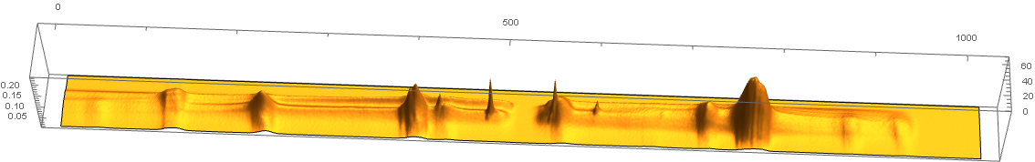
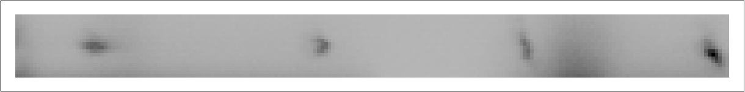
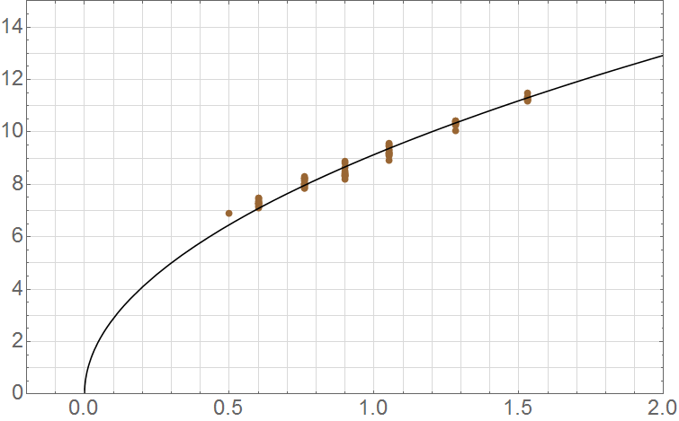
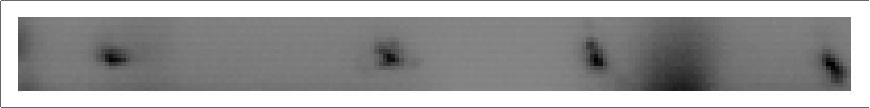
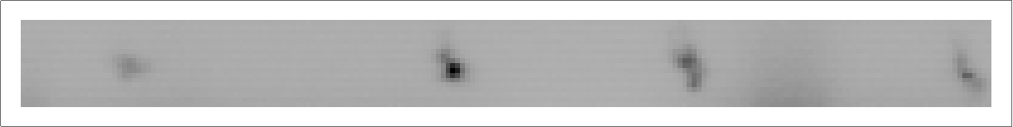
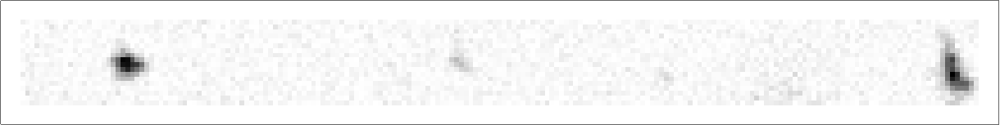
n_{e}-dependent probe spectral shifts
calibrate P_{cr}, λ_{p} and wake amplitude
SRS (ω_{pr}+ ω_{CO2})
anti-Stokes
Stokes
λ [nm]
0
500
SRS (ω_{pr}- ω_{CO2})
*
notch
1000
*
*
*
*
n_{e}=1.8 10¹⁸ cm⁻³
* emission lines
“red
zone”
n_{e} (10¹⁸ cm⁻³)
0
0.5
1.0
1.5
2.0
12
upper n_{e}
limit:
CO₂ laser
reflection
from jet
8
Mean Thomson shift (nm)
nm
4
n_{e}= 5 10¹⁷ cm⁻³
P_{cr} = 0.4 TW
λ_{p} = 47 µm
n_{e} = 1.8 10¹⁸ cm⁻³
P_{cr} = 0.1 TW
λ_{p} = 25 µm
-30
-20
10
20
30
0
0
1
2
-10
0
collective Thomson shift (nm)
Jet backing pressure (atm)
10

Slide 11
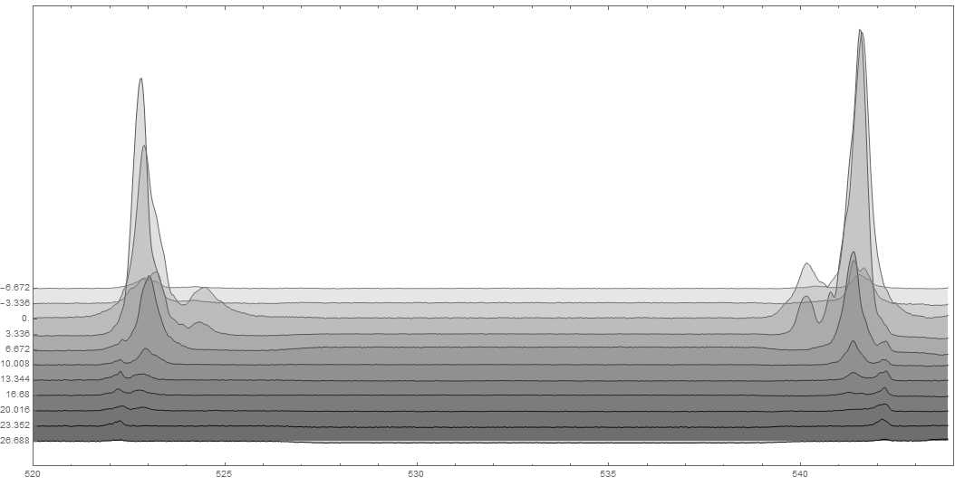
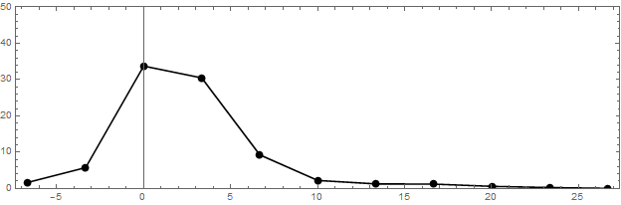
∆t-dependent probe spectral shifts
show wake decays 90% in ~10 ps,
remnants observable at ∆t > 25 ps
notch filter
anti-Stokes
Stokes
Spectral structure
observed around
∆t ≈ 0
n_{e} = 1.5 × 10¹⁸ cm⁻³
sideband
amplitude
(arb. u.)
average Stokes/
anti-Stokes amplitude
-6.67
0
∆t [ps]
6.67
13.33
20
26.67
pu-pr x-correlation
520
525
530
535
540
544
λ_{probe} [nm]
11

Slide 12
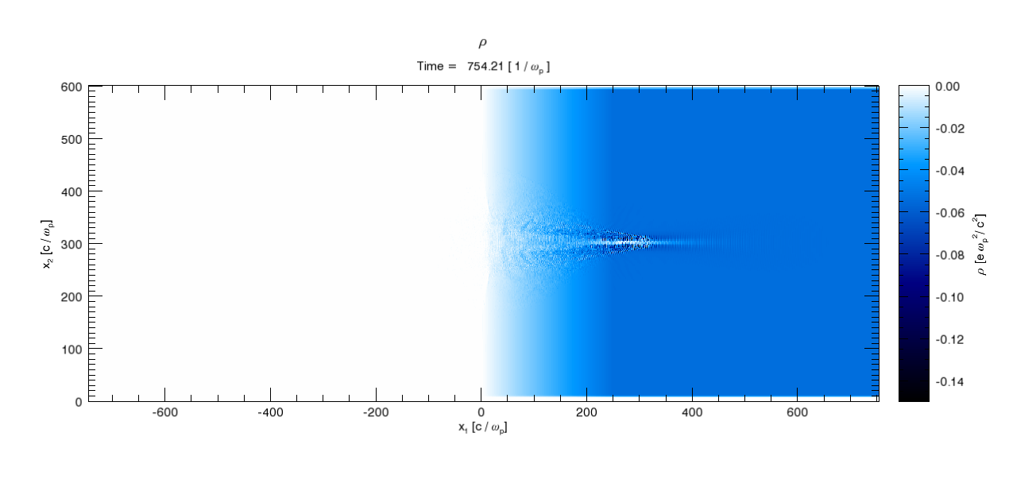
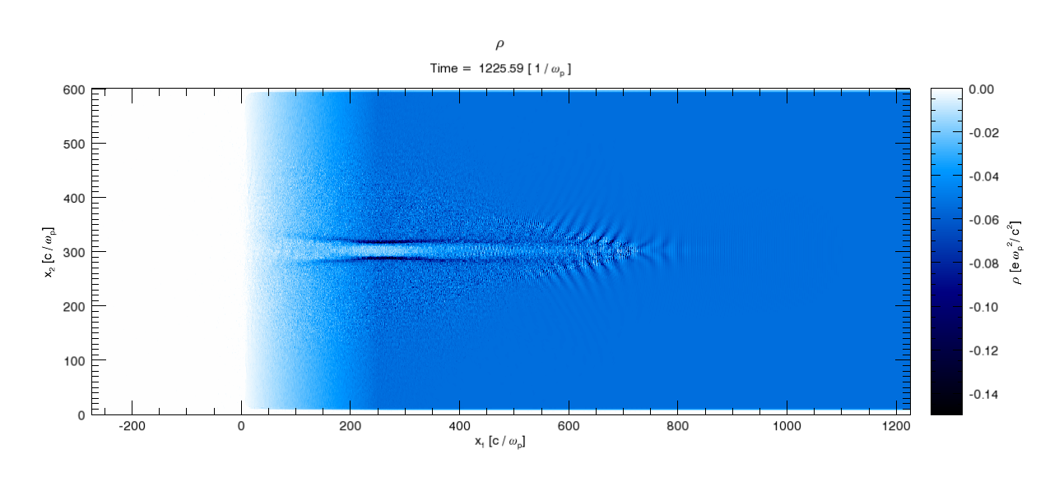
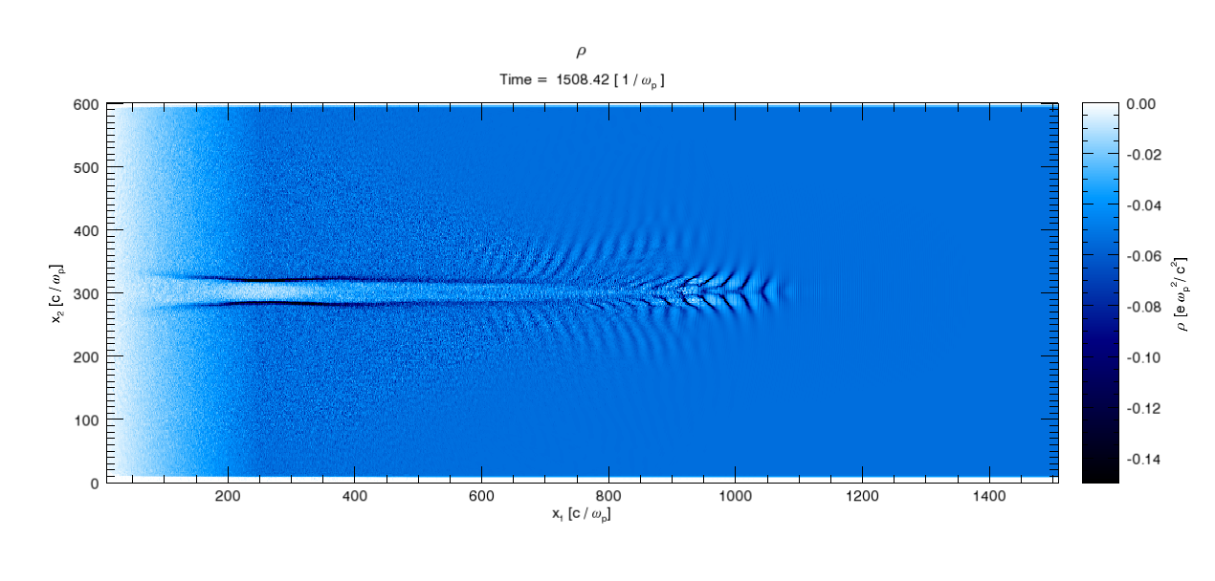
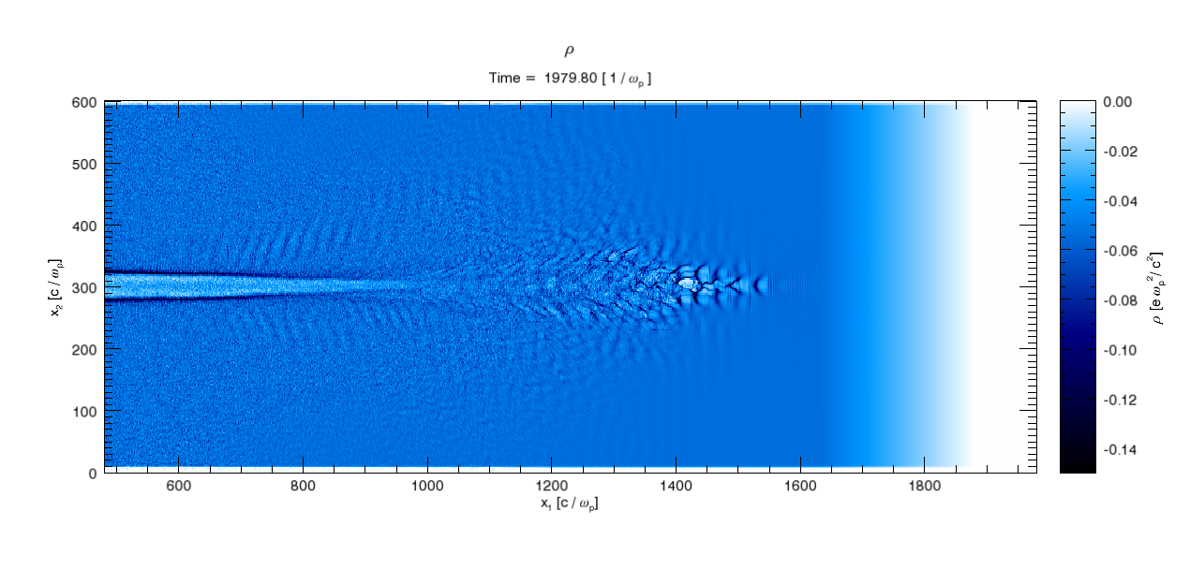
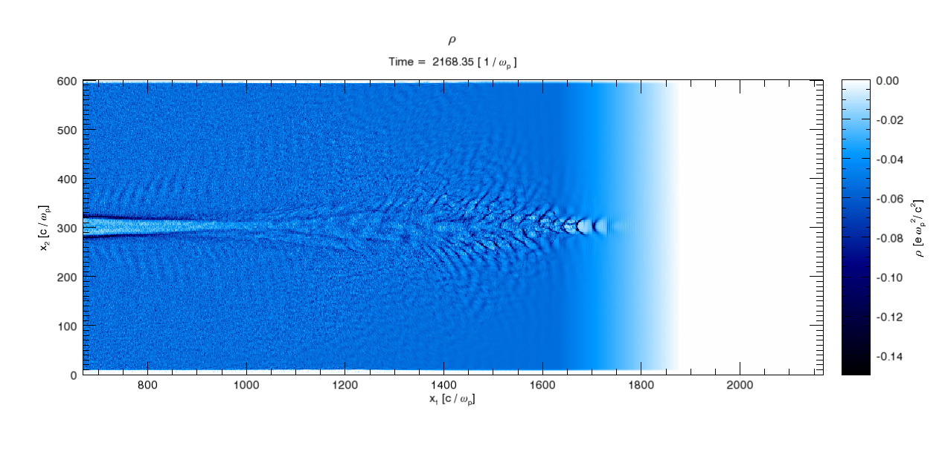
3D PIC simulations confirm 5 principal
experimental observations ...
(1) initial self-focusing
CO₂ pulse:
• 0.5 TW, 2 ps
• w₀ = 25 µm
plasma:
• n_{e} = 6e17 cm⁻³
(2) wake forms ...
(3) ... with few ps lifetime
(4) wake becomes chaotic
(source of spec-
tral structure?)
simulations
courtesy
Chaojie Zhang
& Wei Lu
(5) no e-
produced
1
mm
0
2
... and guide near-term planned experiments
12

Slide 13
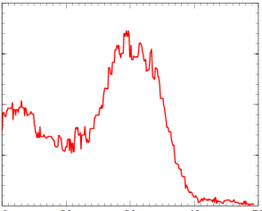
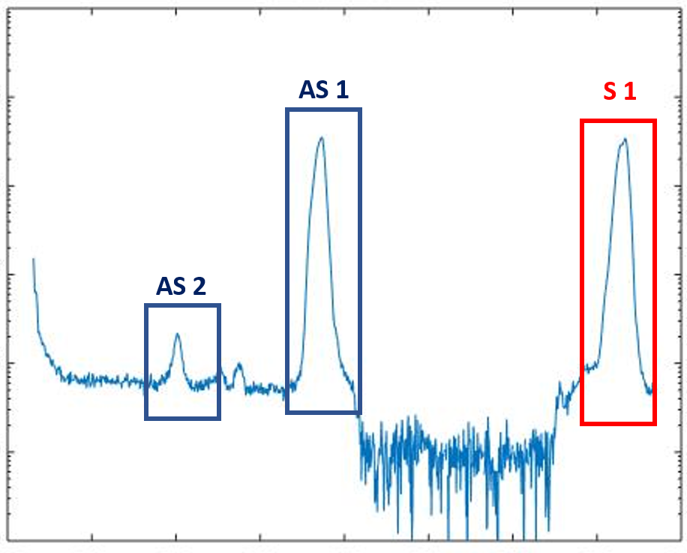
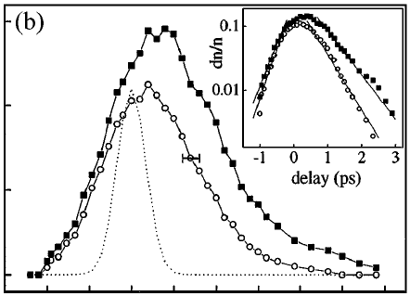
We plan to improve ATF I
SM-LWFA experiments during 2017
n_{e} = 4e17cm⁻³
(a)
P = 2 TW
30
• CO₂ laser power upgraded: 0.5 → 2 TW
3D-PIC
dq/dE (pC/MeV)
z = 4.8mm
(a) electron injection & acceleration should be observable
(b) 2nd order Stokes/anti-Stokes shifts should be observable
→ more accurate wake amplitude determination
10
w₀ = 50 µm
20
40
Energy (MeV)
10⁶
AS 1
S 1
Slusher, Phys. Fluids 23, 472 (1980); Umstadter, PRL 59, 292 (1987)
At P = 0.5 TW, ~10% of our shots yield 2nd order S or AS peaks
10⁴
AS 2
• Pump-probe synch^{n} improved
Intensity (arb. u.)
notch
filter
10²
(c) cleaner measurements of S/AS amplitude vs. ∆t
10⁰
510
520
530
540
→ better understanding of wake decay mechanism
Wavelength (nm)
Decay is ~10x longer than for SM wakes at n_{e} ~ 10¹⁹ cm⁻³
(c)
LeBlanc, PRL
(1996)
• Transverse electron radiographic probe
will be installed this coming year
0.1
dn_{e}/n_{e}
0
-1
0
1
2
3
(d) see next slide
13
∆t (ps)

Slide 14
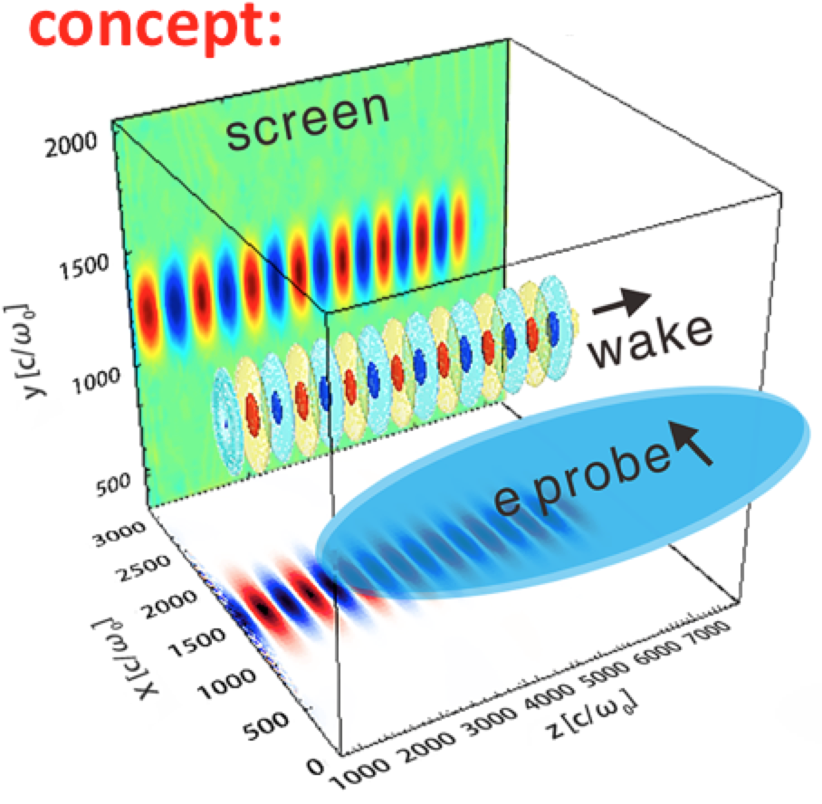
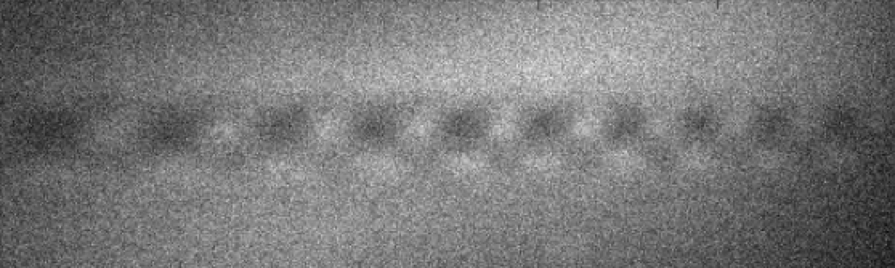
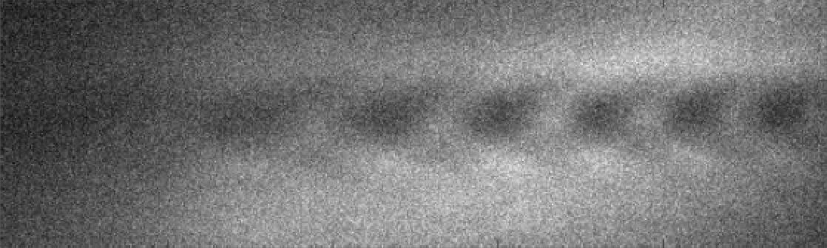
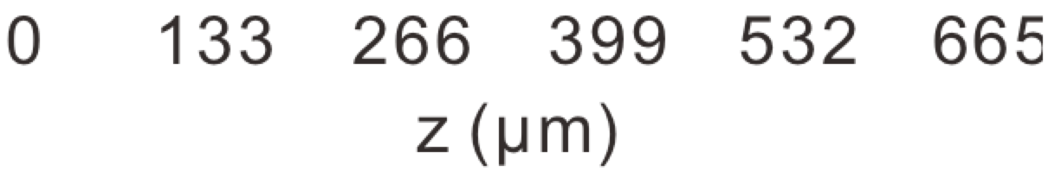
A synchronized transverse ~10 fs e- probe
from the ATF linac & zig-zag chicane
will probe E_{z}-fields in the SM-LWFA ...
Zhang, Sci. Rpts. 6, 29485 (2016)
snapshots of wake using e-bunch
from another synchronized LWFA*
n_{e} = 4 × 10¹⁷ cm⁻³
n_{e} = 2 × 10¹⁷ cm⁻³
* Results from Tsinghua U.
... while providing invaluable experience in compressing
and synchronizing e-bunches at the 10 fs level.
14

Slide 15
Conclusions
• With BNL colleagues, we observed self-modulated LWFA
driven by 0.5 TW CO₂ laser for the first time
- SM wakes generated (S10), characterized (S11-12), simulated (S13)
• We plan ongoing LWFA experiments at ATF
Next Year: (a) Publish Year 1 results.
(b) Improve SM-LWFA experiments at BNL’s ATF (see S14,15)
Following Years: (a) Bubble-regime LWFA at BNL using full ATF-II capabilities (see S5)
Deliverables: (a) Highly-resolved visualization of large plasma bubble physics
(b) Low-emittance e- beams suitable for tabletop XFELs
Work supported by DOE: DE-SC0014043
15

