Slide 1
Community Input Survey Summary
Christina Swinson

Slide 2
Outline
Survey purpose
Survey Structure
Summary of responses
Demographic
Laser Parameters
Other Scientific Needs
Major Challenges
Key Milestones

Slide 3
Survey Purpose
Assess the needs of the scientific community in relation to high peak power mid-IR laser capabilities.
Have a good understanding of the needs of the community to drive the future direction of mid-IR (9-11 µm regime) high-power laser development for strong-field research needs.
Consider 3 main thrusts Thrust 1: Topics in mid-IR laser research Thrust 2: Topics in Laser-Plasma Interactions and Laser Wakefield Acceleration Thrust 3: Topics in laser-electron beam interaction

Slide 4
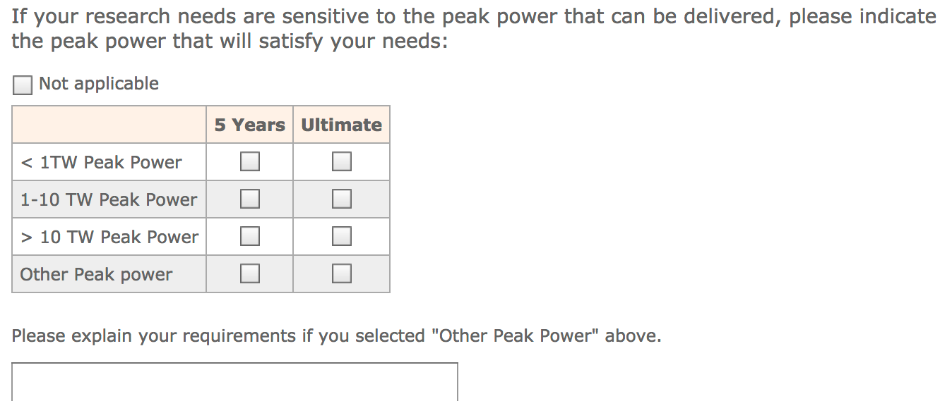
Survey Structure
Combination of multiple choice and text answers
Try to capture most desirable laser parameters and understand how broad a range of parameters is needed to satisfy the whole community.
Gain an understanding of priorities to drive laser R&D.

Slide 5
Demographic

Slide 6
Laser Parameters

Slide 7
Laser Parameters
Linear polarization
Circular polarization
M² < 1.2
Controllable contrast
2 um wavelength
Diffraction limited focusing
< 100 um focus
a₀ = 10
Pulse shaping
Higher-order modes

Slide 8
Other Needs

Slide 9
Major Challenges
Increasing repetition rate
Pushing for higher peak power
Pushing for shorter pulse length
Addressing Efficiency
Increasing Support

Slide 10
Key Milestones
500 fs pulses
a₀ > 1
2 for access to bubble regime in plasma interaction
2 for nonlinear electron beam interaction regime
4 reach ideal blowout regime in plasma interaction
7-10 ion acceleration, accessing relativistic transparency with gas target.

Slide 11
If you have not yet participated …
You may do so here:
https://surveys.external.bnl.gov/n/ATFScientificNeeds.aspx
Also linked from the conference website and indico agenda page

