Slide 1
The ATF Scientific Needs Workshop
Assessing the User Community Needs for Upgraded ATF Capabilities

Slide 2
A Few Words On Safety
*
Orange
Room
Main Entrance
Main Corridor of the Physics Building…

Slide 3
ATF: A National User Facility
Designated a DOE National User Facility in 2015
https://www.bnl.gov/bnlweb/pubaf/fact_sheet/pdf/FS-ATF.pdf
Capabilities in:
  Novel particle acceleration techniques
  R&D for smaller, more cost effective accelerators including:
    Plasma and dielectric wakefield acceleration
    Direct laser acceleration
    Inverse free-electron lasers and more…
  High-brightness radiation sources
  New techniques to produce electromagnetic radiation from THz to X-rays:
    FEL R&D
    Inverse Compton scattering
    THz radiation from dielectric structures and more…
  Beam manipulation and beam instrumentation
  Sophisticated longitudinal and transverse beam manipulation capabilities
    Wide range of beam parameters enabling development and testing of advanced accelerator hardware, beam diagnostics and detectors
  Ion generation and acceleration
    Experimental hardware for producing supersonic hydrogen gas jets provides capabilities for generating mono-energetic multi-MeV proton beams
  Ultrafast Electron Diffraction/Microscopy
  Technique for characterizing materials that is complementary to x-ray sources
    Developmental beam line and experimental station for diffraction and imaging studies with MeV-class electron beams

Slide 4
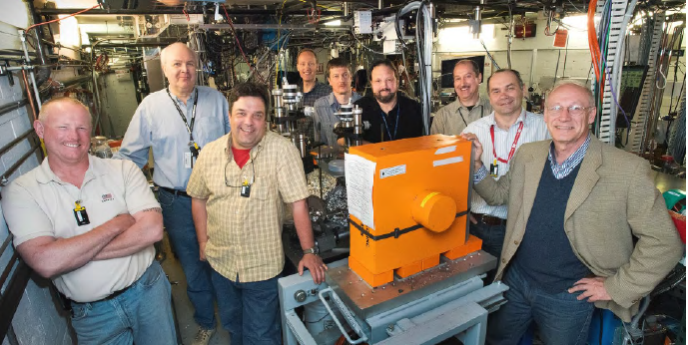
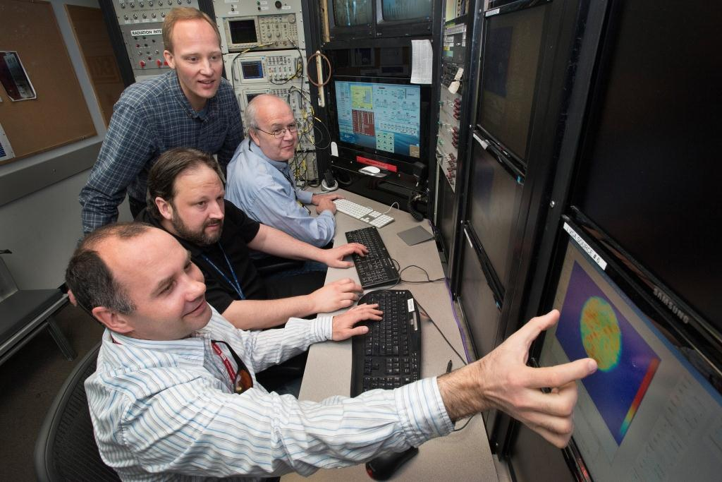
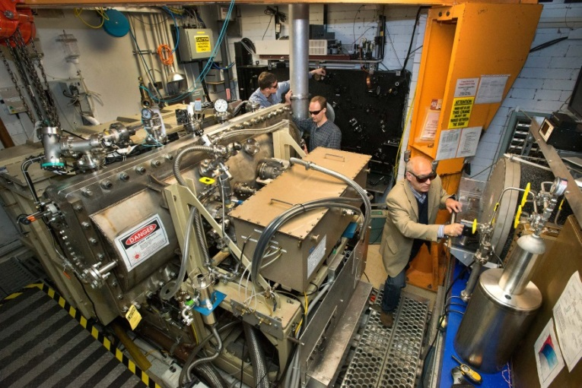
Accelerator Stewardship with the ATF
The ATF pioneered the concept of a user facility for studying new methods of accelerating electrons and ions
One-of-a-kind
combination of e-beams and lasers
Free facility access to qualified
researchers
Well established, proposal-driven, peer-reviewed, serves accelerator community for 25 years
    A highly trained staff to support a broad array of user experiments
High-brightness electron beams
Highly Experienced Staff
Unique powerful lasers

Slide 5
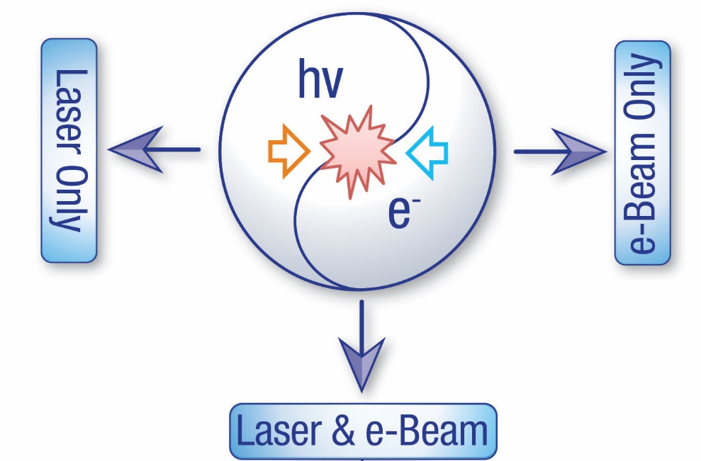
Electron Beam + Laser Capabilities (currently demonstrated)
High-brightness photocathode linac: 80 MeV
Emittance - 1μm
Energy spread - 0.1%
Charge ~ 1.5 nC
Single bunch 10 ps – 200 fs
Multi-bunch trains
CO₂ laser system
λ = 9-11 μm
2 TW peak power
6J @ 3ps pulse width
0.05 Hz repetition rate

Slide 6
ATF Scientific Needs Workshop –
Some Background
At the beginning of FY16, DOE-HEP requested that the ATF-II plan be re-baselined – including:
  A full and complete re-evaluation of all scope that had been presented in the 2013 proposal
    Including scope from all funding sources
  Inclusion of changes in the plans (e.g. the proposed addition of new capabilities to the ATF portfolio)
  General ATF-II construction halted for this process
Re-baseline process was begun in earnest in March 2016
A full cost & schedule review was held in November 2016
Discussions with DOE then targeted a first step of completing construction of a standalone CO₂ laser capability in BNL Building 912 after establishing the Scientific Need for this capability…

Slide 7
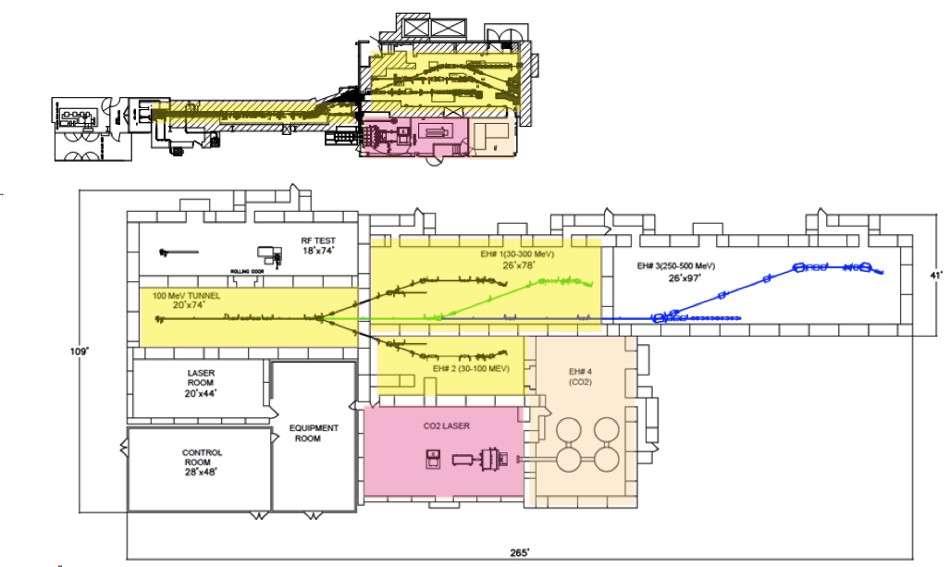
ATF a ATF-II
Towards higher productivity:
ATF (BLDG 820)
Shielded area:
Total floor space:
Exp. Halls:
x4
x7
x3
ATF-II (BLDG 912)
Increased capabilities:
E-BEAM
80 MeV 100 MeV
CO₂ LASER
2 TW 10s TW
[ultimately to 100 TW]

Slide 8
Our Premise
It is the position of BNL and the ATF Team that moving user capabilities for mid-IR lasers into the 10s of Terawatts and sub-ps pulse regime will both:
Enable scientific exploration of the benefits of longer-wavelength laser systems for accelerator applications;
and
Provide a platform for the development of high peak power laser technologies - our own concepts as well as those from the broader user community.
In combination with expanded electron beam capabilities, we believe that the ATF-II plan can provide world-leading user capabilities for decades to come!

Slide 9
The FY18 Budget Landscape
Authorization to resume general ATF-II Construction is contingent on the evaluation of whether our re-baselined ATF-II plan will adequately meet community needs
The ATF has also committed to continue operation of the ATF-I facility through most or all of the FACET down period to ensure the availability of research capabilities for the user community
The language and proposed funding levels in the President’s Budget Request will be a challenge
  Implementation of the budget numbers described there would be devastating to both of the above goals…

Slide 10
Scientific Needs
Our focus in this workshop is to evaluate key scientific needs associated with the proposed development of mid-IR laser capabilities
Workshop will consider 3 target areas:
Topics in Mid-IR Laser Research
Topics in Laser-Plasma Interactions and Laser Wakefield Acceleration
Topics in Laser-Electron Beam Interactions
A 4th session will be devoted to the ATF response to the needs discussed and how the first step of our re-baselined plan can address them.

Slide 11
Our Goals for This Workshop
The overall goal of the workshop is to assess the scientific needs of the community for mid-IR (9-11 μm regime) laser capabilities. This includes reviewing the present experimental efforts, future research directions, and potential paths to achieving the necessary technological infrastructure to enable advanced accelerator research. Thus, the workshop aims to:
Identify priorities in laser development (such as power, pulse duration, repetition rate) and relate them to the experimental landscape;
Identify the major technological barriers to developing laser technology (centered around λ=10 μm) towards satisfying the needs of the accelerator community;
Identify possible conflicts and develop prioritizations for user science paths in the case of conflicting interests;
Provide an assessment of the suitability of currently available facilities and capabilities that are needed to support the user community over the next decade.

Slide 12
Workshop Block Agenda
Day 1
0900-1000 Workshop Introduction
Topic #1: Topics in Long-Wavelength (Mid-IR) Laser Research
1000-1045 User Community Presentations
1045-1100 Coffee Break
1100-1215 User Community Presentations/Discussion
1215-1245 Discussion
1245-1400 Lunch (at Berkner Hall)
Topic #2: Topics in Laser-Plasma Interactions and Laser Wakefield Acceleration
1400-1515 User Community Presentations
1515-1530 Coffee Break
1530-1645 User Community Presentations/Discussion
1645-1715 Discussion
1800-2100 No Host Dinner (Bistro 72 @ Hotel Indigo)
Day 2
0830-0930 Committee Executive Session
Topic #3: Topics in Laser-Electron Beam Interactions
0930-1045 User Community Presentations
1045-1100 Coffee Break
1100-1215 User Community Presentations/Discussion
1215-1245 Discussion
1245-1400 Lunch (at Berkner Hall)
The ATF-II Facility Plan – Response to Community Needs
1430-1500 Overview of the Facility Plan
1500-1515 Addressing the Needs of WG#1
1515-1530 Addressing the Needs of WG#2
1530-1545 Addressing the Needs of WG#3
1545-1600 Coffee Break
1600-1700 User Community Discussion
1700 Workshop Concludes

