Slide 1

Managing Active Directory in a Multi-Platform Environment
Justin Hansen
NLIT 2010

Slide 2

Overview
Active Directory for Linux, Mac, and Windows clients
Effective design for the AD “tree”
Managing Active Directory Group Policy
Delegating rights for workstation and user management
Ongoing work and future projects

Slide 3
The “New” Active Directory
Active Directory has changed over the last 3 years
  Required support for Linux / Mac clients
  Growing importance of Identity Management
  Enforcement of Minimum Security Configuration
  Delegation of duties

Slide 4
Active Directory for Everyone!
Non-Windows Active Directory support provided by Quest Authentication Services
Used for both servers and desktops
Supports Unix / Linux / Mac with same set of tools
Provides management through Group Policy
  Configuration settings
  Startup / Refresh / Shutdown scripts
  Mac specific policies

Slide 5
Active Directory “Design”
Design for Group Policy or Delegation?
  Exponential Group Policy OUs (Organizational Units)

Slide 6
Workstations
Domain
Servers
Users

Slide 7
Workstations

Slide 8
Workstations
Shares

Slide 9
Workstations
Shares
Wireless

Slide 10
Workstations
Shares
Wireless
Wireless

Slide 11
Workstations
Shares
Wireless
Wireless
Scheduled Tasks

Slide 12
Workstations
Shares
Wireless
Wireless
Scheduled Tasks
Wireless
You need 2^{n} OUs for n# of exceptions
  6 exceptions = 64
  8 exceptions = 256

Slide 13
Active Directory “Design”
Design for Group Policy or Delegation?
  Exponential Group Policy OUs (Organizational Units)
  Additional Operating Systems create an even larger problem!

Slide 14
Windows XP
Shares
Wireless
Wireless
Scheduled Tasks
Wireless
RedHat
Shares
Wireless
Wireless
Scheduled Tasks
Wireless
Windows 7
Shares
Wireless
Wireless
Scheduled Tasks
Wireless
Mac
Shares
Wireless
Wireless
Scheduled Tasks
Wireless
Ubuntu
Shares
Wireless
Wireless
Scheduled Tasks
Wireless
SuSE
Shares
Wireless
Wireless
Scheduled Tasks
Wireless

Slide 15
Active Directory “Design”
Design for Group Policy or Delegation?
  Exponential Group Policy OUs (Organizational Units)
  Additional Operating Systems create an even larger problem!
  User OUs have a similar problem
  Delegating rights becomes difficult
    Unlocking user accounts and password resets

Slide 16
Active Directory “Design”
The final design – a combination of Group Policy and Delegation
  Organize computers by OS
  Organize users by privilege level

Slide 17
Workstations
Windows
Mac
XP
Linux
Win7
PPC
Intel
Manage exceptions by Group Membership
  Member of: Shares
  Member of: Wireless
  Member of: Scheduled Tasks

Slide 18
Users
Privileged Accounts
Account Registration
Help Desk
Standard Users
Domain Admins
Group Memberships used for
  Least User Access determination
  Application of specific user policies (Screen Saver Lockout)

Slide 19
Managing Group Policy
Policies are managed in “Apply Everything to Everyone” method
  Exceptions are created by applying an additional policy to “reverse” global setting
Group Policy heavily leverages Security Group Filtering
  Utilizing security groups adds the extra benefit of accounting
  Easier to delegate rights to manage group memberships

Slide 20
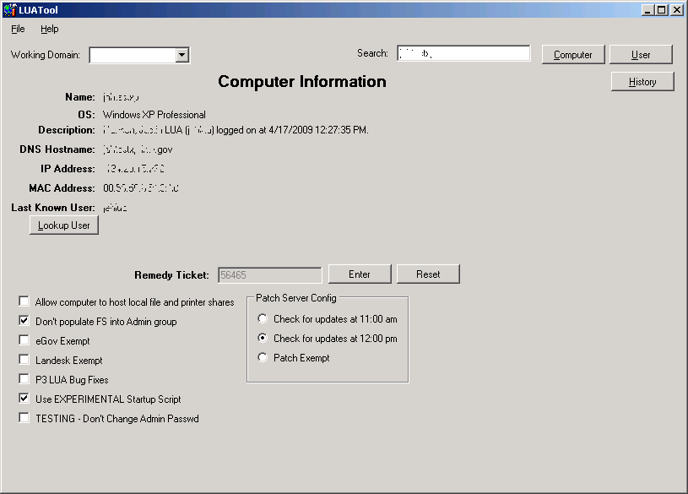
Utility for Group Management

Slide 21
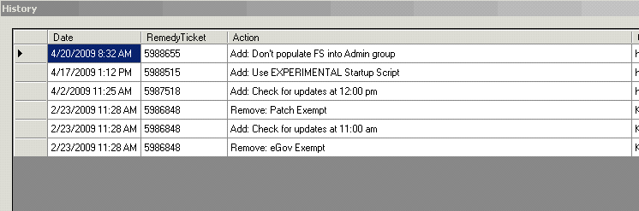
History Log

Slide 22
Ongoing and Future Goals
Complete the restructuring of OUs
Implement more granular policies for Non-Windows systems
Extend these concepts to the management of servers in addition to desktops

Slide 23
Questions
Contact Info
Justin Hansen
(208) 526-6584
Justin.Hansen@inl.gov

Slide 24








