Slide 1



Departmental Computing Services
DCS-4
“Security and Manageability in a Clustered Virtual Environment Using a True Zero Client”
Michael Johnson
Benny Montoya
DCS-4 Information Systems
Virtualization Team
LA-UR 10-02953
Notes:
Thank you for coming today. I am humbled by your interest in our initial testing and pilot work using a zero-client device to implement virtual desktops in the TA-55 Plutonium Facility at Los Alamos National Laboratory.
I am here to introduce to you the technology and hardware/software that we at DCS-4 are pioneering for our customers at TA-55 and have been show-casing to our laboratory community as a whole.
Please get comfortable, relax, and ask questions. We don’t have all the answers, but we have learned a few things that I hope will enhance your understanding of how zero-client devices might be applicable to your environment, in particular, the PanoLogic device.
If everyone is ready – LET’S BEGIN!

Slide 2
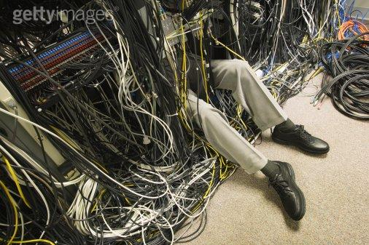
Departmental Computing Services
DCS-4
AVOID…Infrastructure Chaos
Notes:
Thank you for coming today. I am humbled by your interest in our initial testing and pilot work using a zero-client device to implement virtual desktops in the TA-55 Plutonium Facility at Los Alamos National Laboratory.
I am here to introduce to you the technology and hardware/software that we at DCS-4 are pioneering for our customers at TA-55 and have been show-casing to our laboratory community as a whole.
Please get comfortable, relax, and ask questions. We don’t have all the answers, but we have learned a few things that I hope will enhance your understanding of how zero-client devices might be applicable to your environment, in particular, the PanoLogic device.
If everyone is ready – LET’S BEGIN!

Slide 3
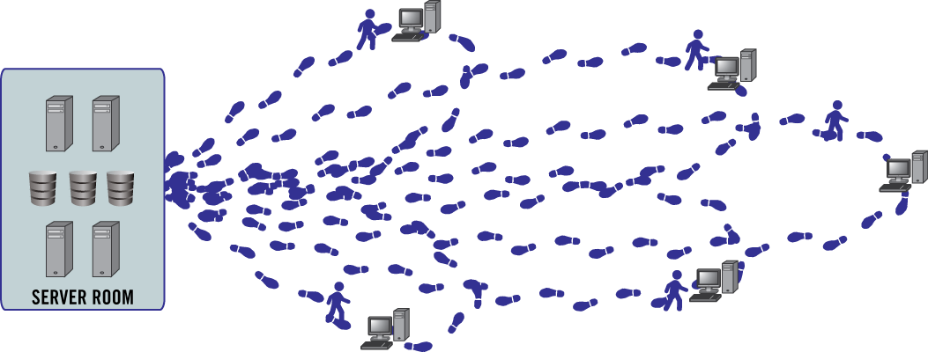

Departmental Computing Services
DCS-4
THE CURRENT IT ENVIRONMENT
Break/Fix
S/W Upgrades
Security Fixes
Corrupted Systems
Downtime
Uniform Control
Notes:
3

Slide 4
Departmental Computing Services
DCS-4
Why Virtual?
Why A VMware Infrastructure?
Notes:
Thank you for coming today. I am humbled by your interest in our initial testing and pilot work using a zero-client device to implement virtual desktops in the TA-55 Plutonium Facility at Los Alamos National Laboratory.
I am here to introduce to you the technology and hardware/software that we at DCS-4 are pioneering for our customers at TA-55 and have been show-casing to our laboratory community as a whole.
Please get comfortable, relax, and ask questions. We don’t have all the answers, but we have learned a few things that I hope will enhance your understanding of how zero-client devices might be applicable to your environment, in particular, the PanoLogic device.
If everyone is ready – LET’S BEGIN!

Slide 5
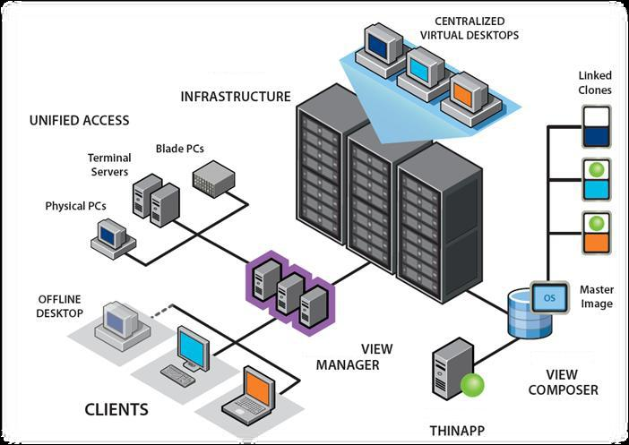
Departmental Computing Services
DCS-4
A New Approach to Infrastructure Management

Slide 6
Departmental Computing Services
DCS-4
Business Requirements
Compliance
Limited User Rights
Standardized Procedures
Notes:
6

Slide 7
Departmental Computing Services
DCS-4
Business Requirements (Cont.)
Security
USB Security – Limited or no connectivity for certain types of devices
Prompt Mitigation of Contamination Incidents
Immediate System Lock-Out
Increased Physical Security
No writeable Media/Flash on User’s Desktop
Notes:
7

Slide 8
TA-55 Client Virtualization
Departmental Computing Services
DCS-4
Business Requirements (Cont.)
Flexibility
Policies
Device-based policies for kiosks
User-based policies for roaming
Infrastructure IT Management
Cost of Ownership
Ease of Operation
Notes:
8

Slide 9
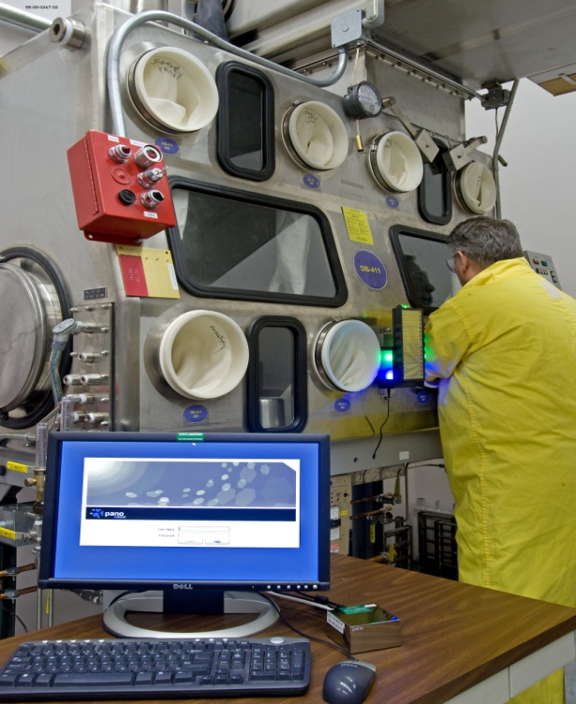
TA-55 Client Virtualization
Departmental Computing Services
DCS-4
Unique Facility Specific Requirements
Reduced Waste/ALARA
Small footprint
RAD Waste Reduction (ALARA)
- Minimize IT staff Exposure
- Remote Setup/Configuration
Low power consumption
No Fan (no internal contamination)
Power and Cooling Issues
No User Data on Local Machines
Notes:
9

Slide 10
Departmental Computing Services
DCS-4
Goals
Compliance
Improve IT Management Control
More Creative Productivity for IT Staff
Changed User Experience
Notes:
Thank you for coming today. I am humbled by your interest in our initial testing and pilot work using a zero-client device to implement virtual desktops in the TA-55 Plutonium Facility at Los Alamos National Laboratory.
I am here to introduce to you the technology and hardware/software that we at DCS-4 are pioneering for our customers at TA-55 and have been show-casing to our laboratory community as a whole.
Please get comfortable, relax, and ask questions. We don’t have all the answers, but we have learned a few things that I hope will enhance your understanding of how zero-client devices might be applicable to your environment, in particular, the PanoLogic device.
If everyone is ready – LET’S BEGIN!

Slide 11
Departmental Computing Services
DCS-4
Zero-Client versus Thin-Client
No operating system
No CPU or non-volatile Memory located at the end point
Local processing capabilities
Operating Systems
A true zero-client device only connects a monitor and peripherals (mouse, keyboard, USB devices) back to a VDI or similar infrastructure in the data center.
VNC- or RDP-equipped PCs (or blades) are deployed in the back room – work along the lines of a Hosted PC solution

Slide 12
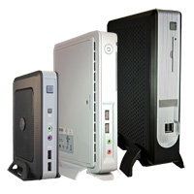
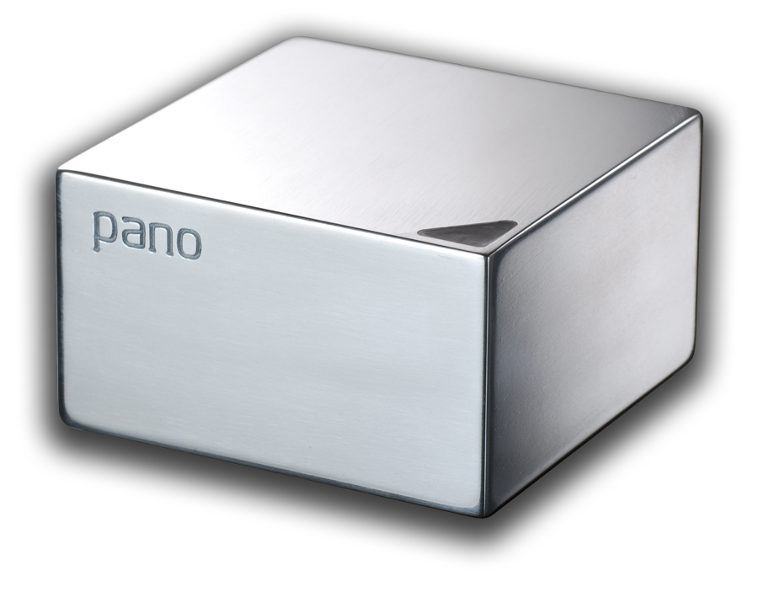
TA-55 Client Virtualization
Departmental Computing Services
DCS-4
Symbio and PanoLogic Devices
Pano Logic Zero-Client
SYM5500 Fiber Thin-Client
Notes:
12

Slide 13
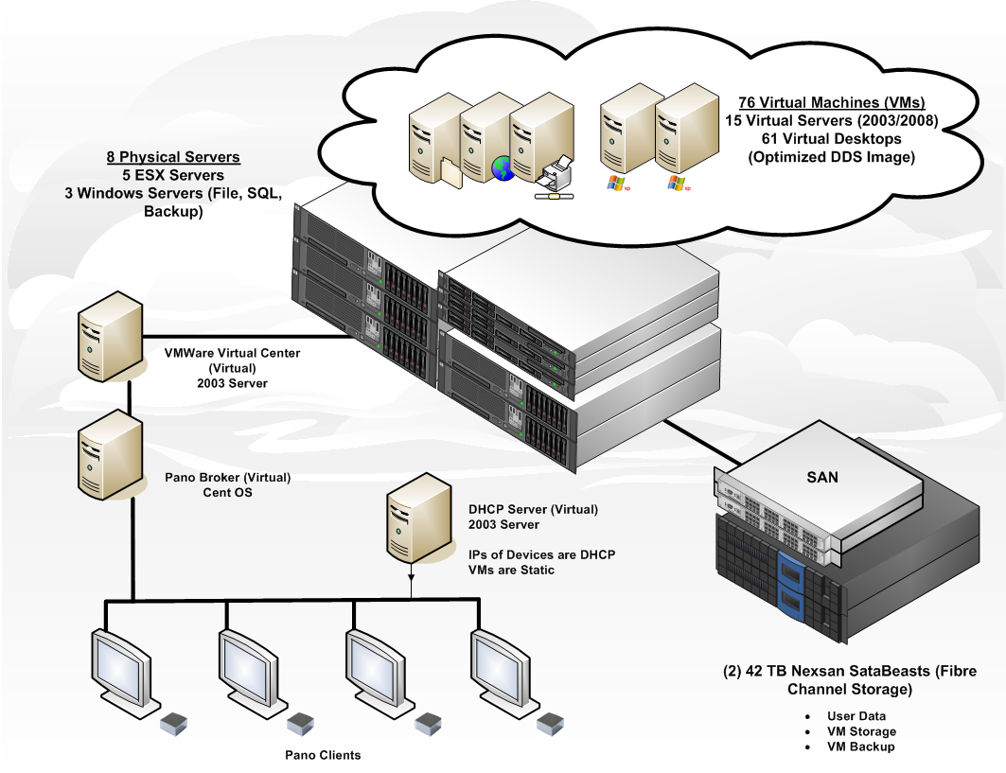
TA-55 Client Virtualization
Departmental Computing Services
DCS-4
Non-Classified (Yellow) Infrastructure
Notes:
13

Slide 14
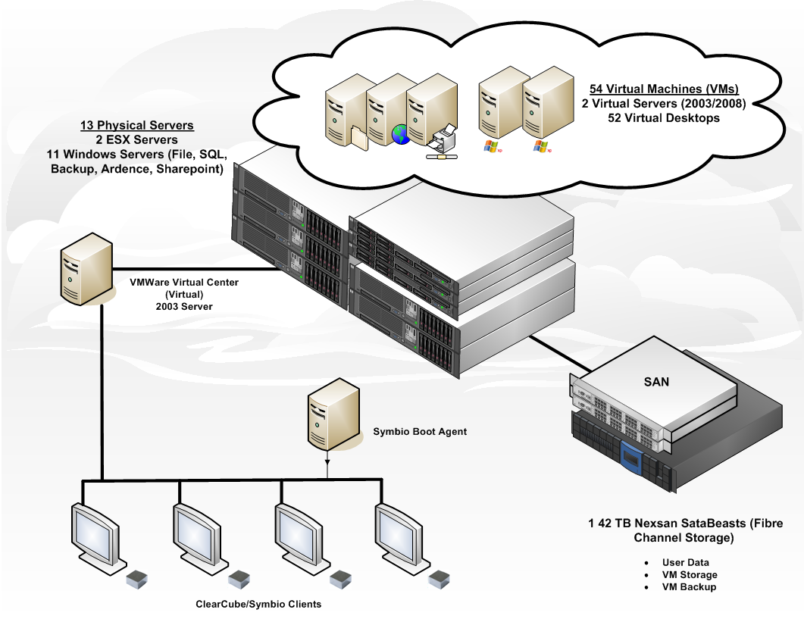
TA-55 Client Virtualization
Departmental Computing Services
DCS-4
Classified (Red) Infrastructure
Notes:
14

Slide 15
Departmental Computing Services
DCS-4
WHAT WE LEARNED…
Consider the whole infrastructure
The Network is a key player
Sprawl is easier than ever
Lessons Learned
Hardware
Software
Applications
Operating System(s)
Best Practices
Issues Confronted
Loss of Connectivity
Network Bandwidth & Hardware
Graphic Limitations
Sound Limitations
Customer Dissatisfaction
Notes:
Thank you for coming today. I am humbled by your interest in our initial testing and pilot work using a zero-client device to implement virtual desktops in the TA-55 Plutonium Facility at Los Alamos National Laboratory.
I am here to introduce to you the technology and hardware/software that we at DCS-4 are pioneering for our customers at TA-55 and have been show-casing to our laboratory community as a whole.
Please get comfortable, relax, and ask questions. We don’t have all the answers, but we have learned a few things that I hope will enhance your understanding of how zero-client devices might be applicable to your environment, in particular, the PanoLogic device.
If everyone is ready – LET’S BEGIN!

Slide 16
TA-55 Client Virtualization
Departmental Computing Services
DCS-4
Future Direction
Complete Virtualized Infrastructure
Dynamic Data Center – Completely Control the Provision of Services
Advanced Technology Testing and Development
PCoIP
Wyse
Symbio
ClearCube
More Efficient User-Experience
Allocate Systems According to User’s Need
Formalized Standards
Notes:
16

