Slide 1


Herding Cats
The Problem with Internal Communication in Dispersed IT Support Organizations
Phyllis Teague, Sandia National Laboratories/Kemtah Group Inc.
Sandia National Laboratories is a multi-program laboratory operated by Sandia Corporation, a wholly owned subsidiary of Lockheed Martin company, for the U.S. Department of Energy’s National Nuclear Security Administration under contract DE-AC04-94AL85000.

Slide 2
My home group
Computing Support Services (CSS) at Sandia
service desk
field techs
tier 3 support
server administrators
back-end developers
IT training
CSS supports people in NM, CA, DC, TX, NV, HI
Notes:
Also administrative functions:
Department management
Communications
Project management
Quality management
Admin support
DOES NOT include networking, telecommunications, corporate applications, high-performance computing, facilities applications, cyber security

Slide 3
The problem
What to communicate & how to do it

Slide 4
What IT should* communicate regularly
New or changed processes or service designs
Metrics (performance reporting)
Changes & exceptions
Routine operational information & technical knowledge
Strategy and design
Policies, processes, and procedures
Emergencies (outages, phishing attacks, viruses)
Project information
*According to ITIL v3 recommendations
Notes:
CSS misses out on a number of these

Slide 5
Problems with HOW to communicate
There often are several or dozens of communication tools to choose from
Every staff member has a personal preference
WHICH do we choose to communicate with a dispersed workforce?
There often is no “single source of truth”
I.e., an “official” information channel
Important information may reside in dozens of places among dozens of teams

Slide 6
Difficulties for IT support orgs
This information must go out to people…
spread out all over the campus
mostly NOT at their desks
may reside in different IT orgs (without common management, even)
work different shifts and/or days
People must be able to find the information again
New hires especially — they need to know where to find current operational information
No matter what you do, staff will complain:
They get too much information
They don’t get enough information

Slide 7

It’s a HUGE problem, and you can’t eat that elephant all at once
It became an urgent problem for CSS when we were rolling out laptop encryption solutions
Notes:
Requirements for encryption changed often (sometimes daily) — it was very hard to get definitive information out to our techs and analysts
No one was ever sure who had the authoritative information on encryption
The bits of information techs and analysts needed (especially to tell customers) existed in many different places, and often the info was conflicting

Slide 8
How CSS is addressing internal communication issues

Slide 9
We started with an internal communication survey
Wanted to understand how people are currently getting information and their opinions of the communication tools
Asked ONLY about communication tools
DID NOT address what should be communicated or communication policies

Slide 10
Main Questions on the Internal Communication Survey
What is the PRIMARY type of work you do?
How many hours are you available (and have the equipment) to check for CSS-related information?
Rate the listed communication channels:
How you receive CSS information
Your opinion of each channel
Of your top choices (4s and 5s), rank them in order of preference
Notes:
Conducted in October 2009
Some of the results follow

Slide 11
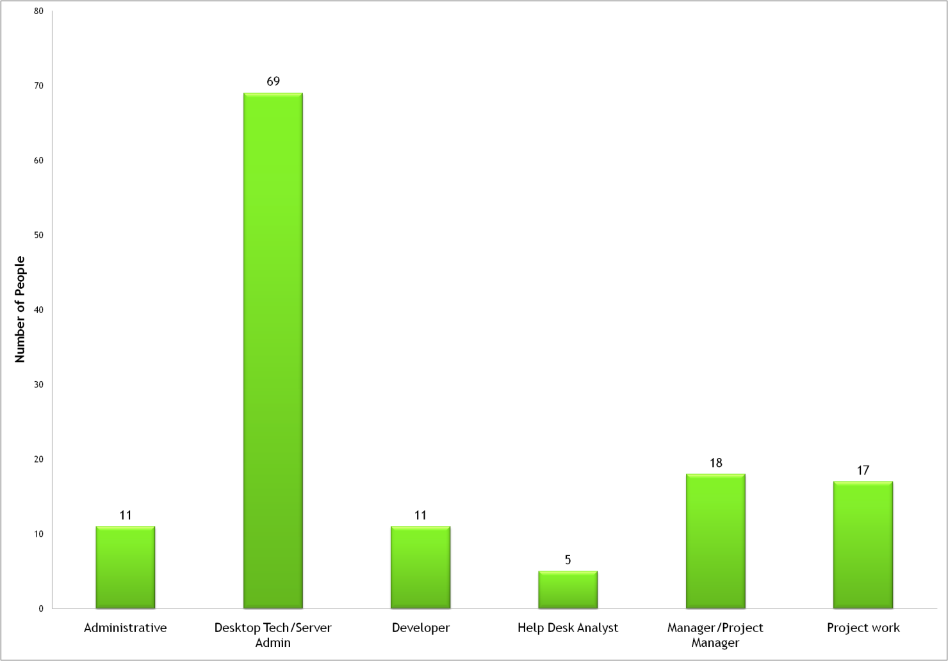
Conducted survey last year — staff participation was good
Notes:
131 respondents overall (almost ½ the staff)
Gives fairly high confidence in results

Slide 12
“How many hours are you available to check for information?”
Notes:
At your desk
At any computer
Have a BlackBerry

Slide 13
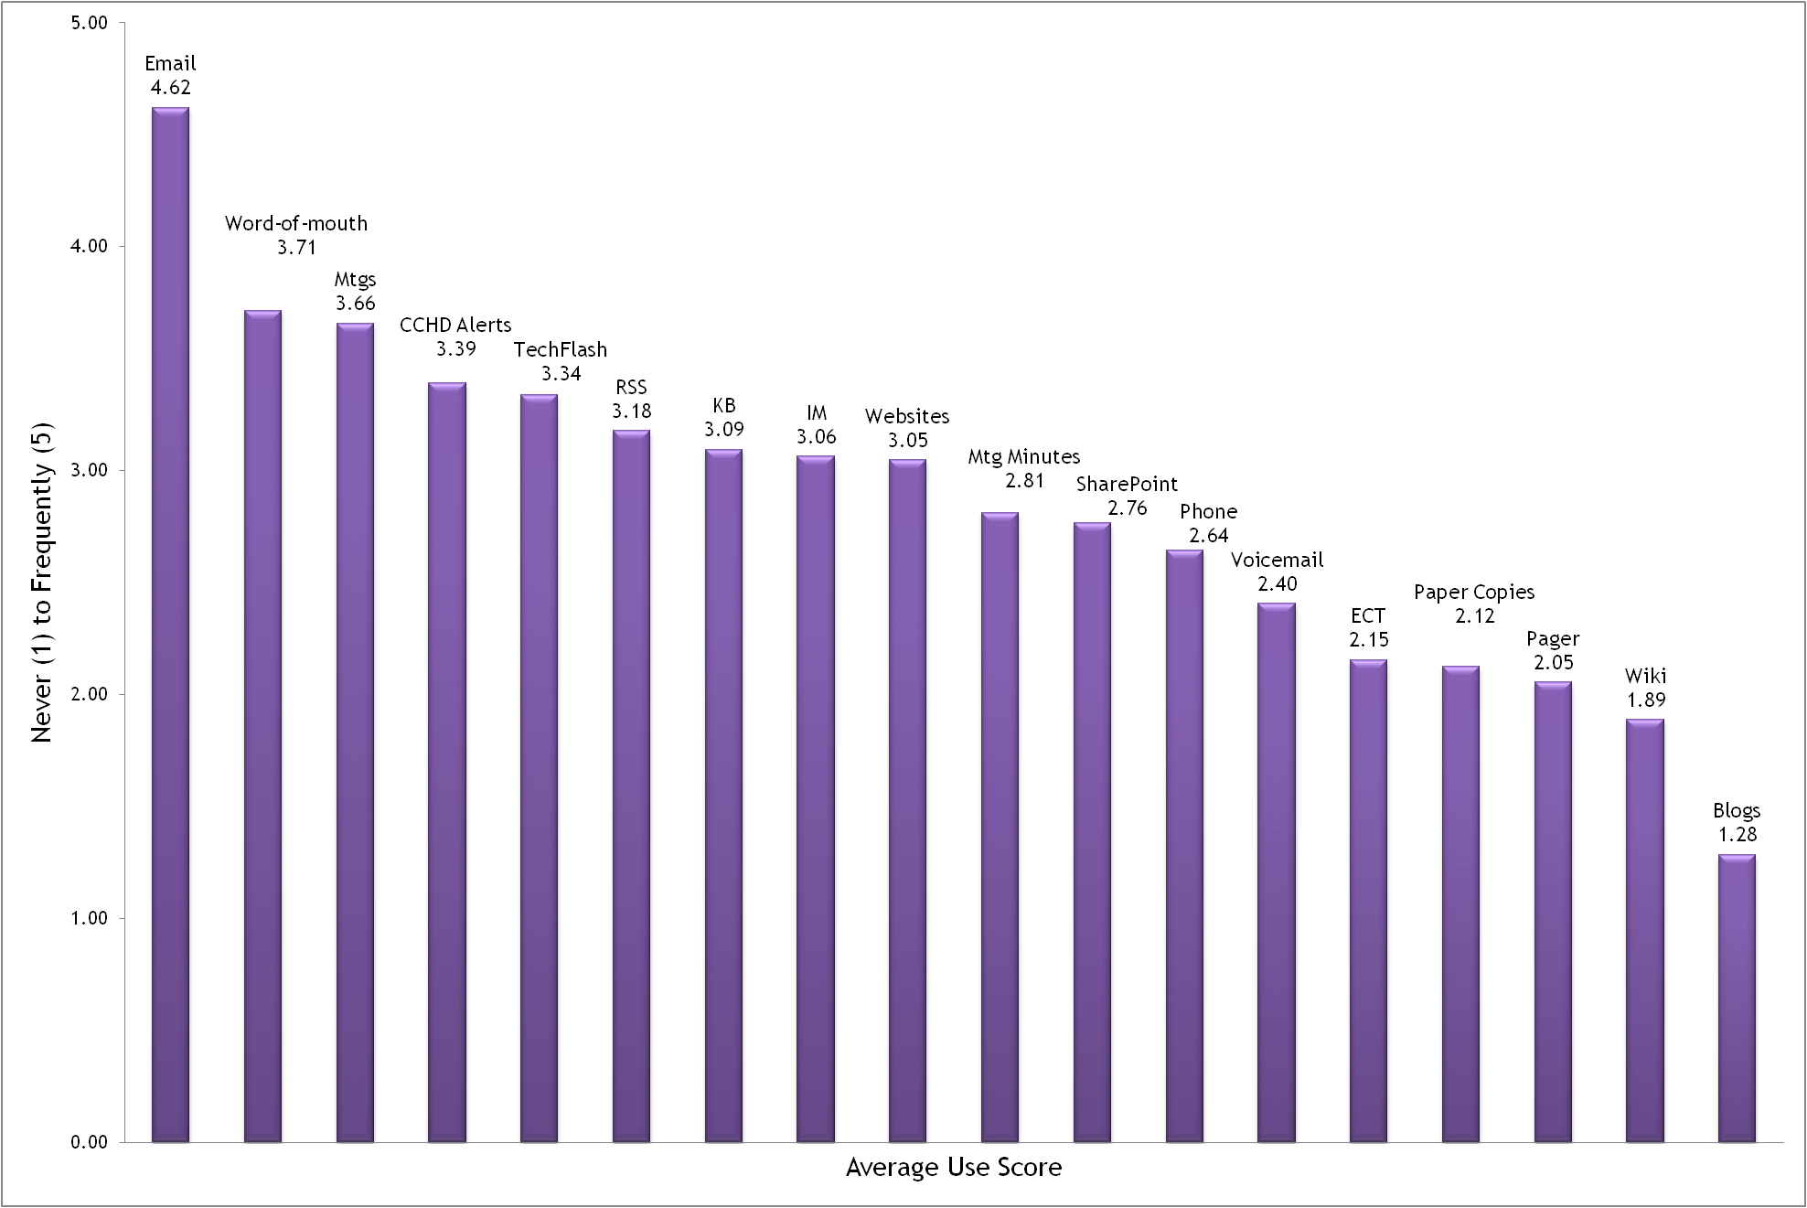
Average staff use of communication tool

Slide 14
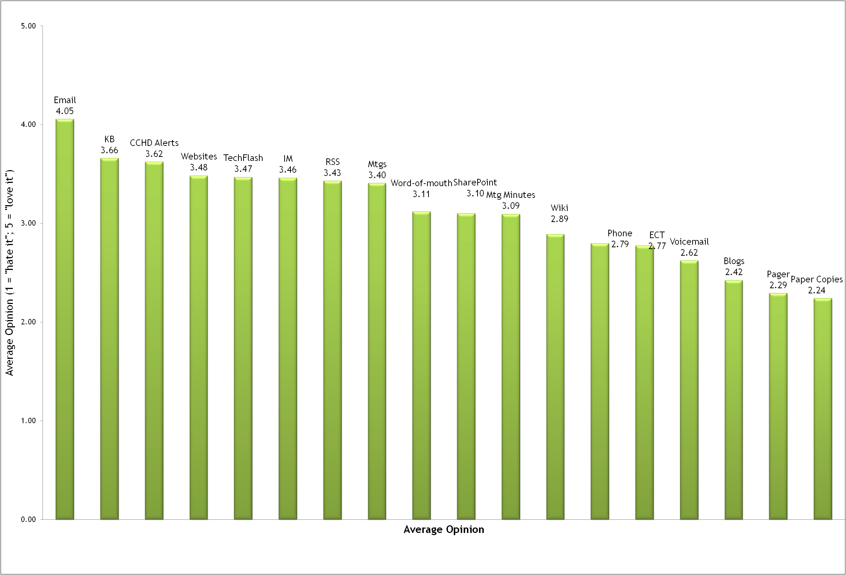
Average staff opinion of communication tool
Notes:
Fewer than 2 points between the lowest and highest
No one either LOVED or HATED anything

Slide 15
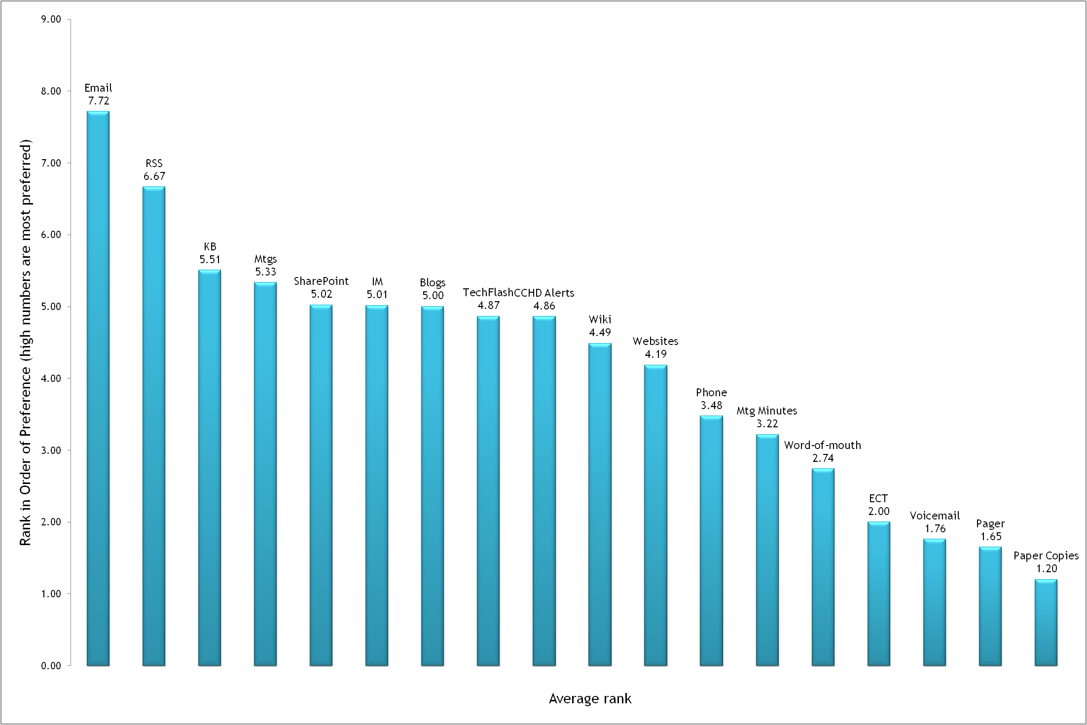
Average staff rank in order of importance

Slide 16
But these results alone were less than definitive
No one set of communication tools rose to the top 10
List changed based on which question we asked
Use
Opinion
Most highly ranked

Slide 17
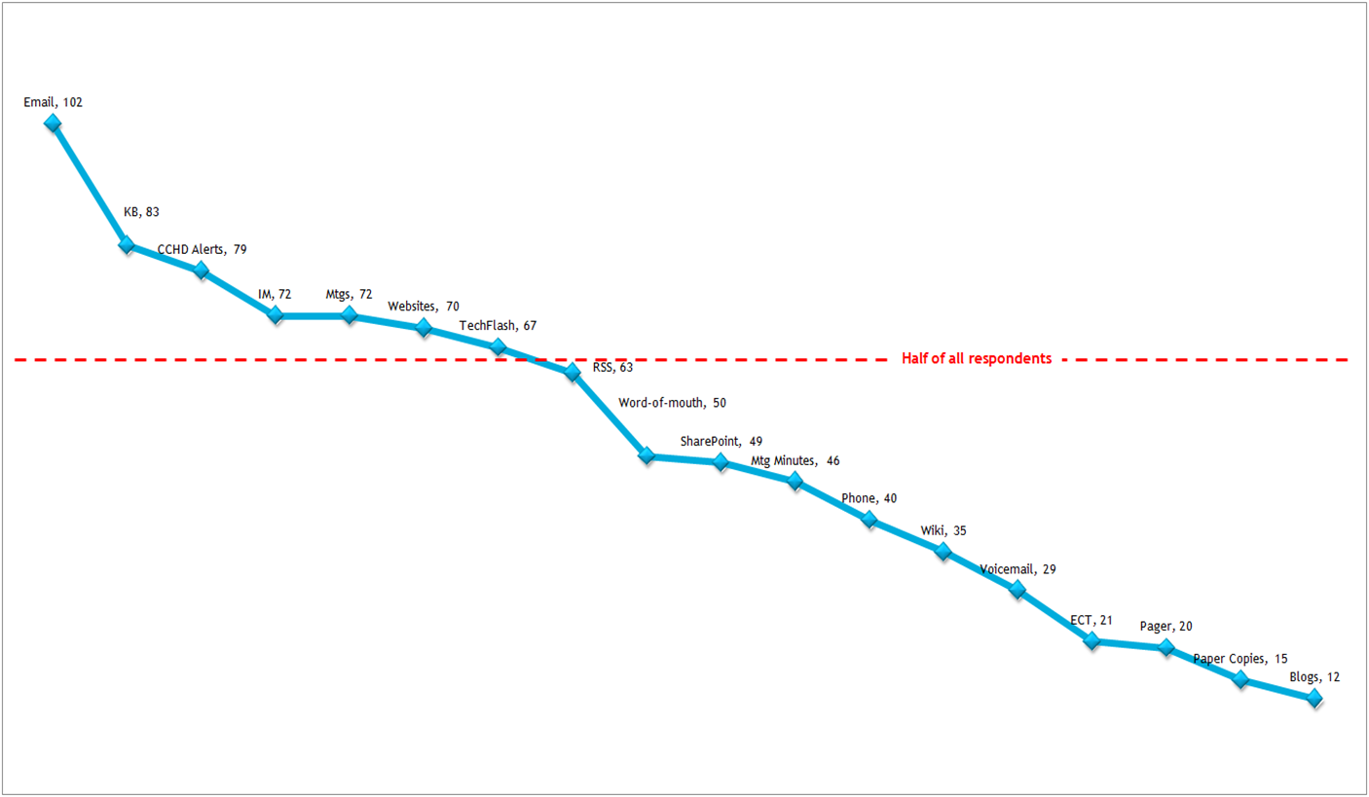
We overlayed THIS result…
Notes:
Number of people who ranked a given communication tool a 4 or 5

Slide 18
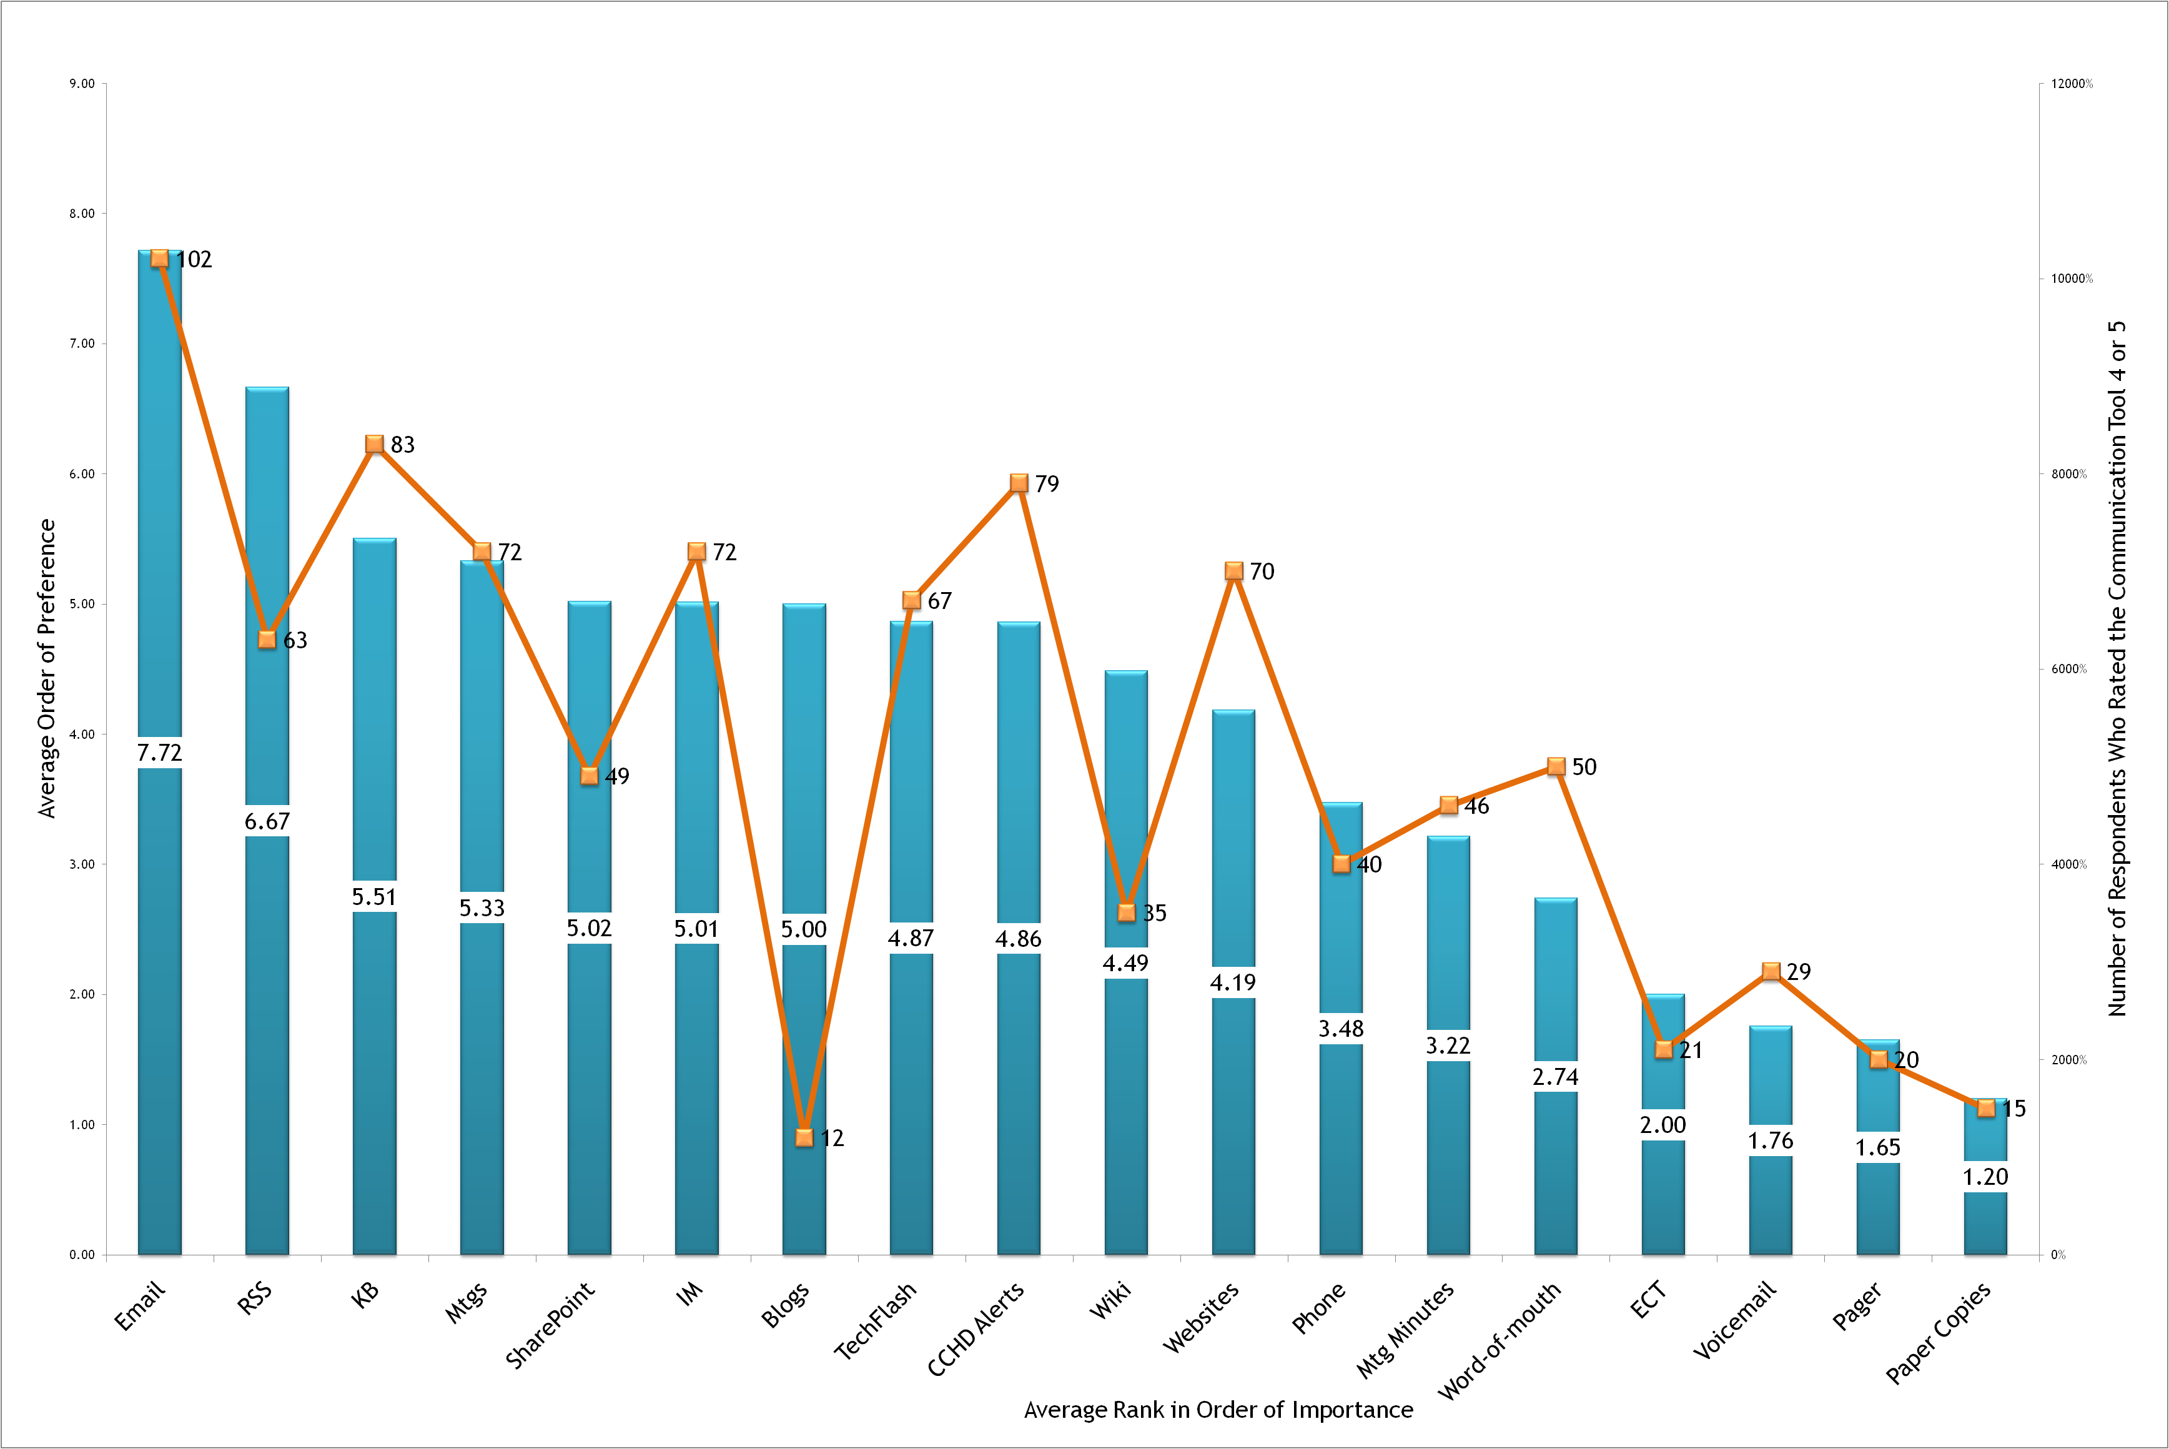
… with the average ranking

Slide 19
Which allowed us to select a “top 10” list of communication tools
Email
RSS Feed
KB
Meetings
SharePoint
Instant Messaging
TechFlash
CCHD Alerts
Websites
Meeting Minutes
Notes:
At least 45 people had to rank the tool a 4 or 5
Descending order of preference

Slide 20
Analysis & implications
… and some surprises

Slide 21
Top 10 list implies several interesting things
People prefer email- or web-based text or face-to-face communications
Meetings are more important than we assumed
(In our case, at least) Comments indicated cross-group communication was less-than-satisfactory
Notes:
None* of the top ten preferred communication tools are “document objects”
Documents (Word, Excel, PDFs) are easy and convenient for senders, but not for recipients (especially when recipients are away from their computers for extended periods)
Meetings and meeting minutes represent 20% of top-10 communication tools
Respondents indicated meetings were highly used and highly valued
Implication: People fall back on face-to-face communication when they can’t find the information they need

Slide 22
Surprises?
Email turns out to be the MOST important communication tool (at least for now)
DOESN’T imply it should be the first choice for all communications
DOES imply it should be used appropriately
Suggests something about how quickly recipients want to get the information and move on to other tasks

Slide 23
Surprises, cont’d
There were no current communication tools that staff rated as failures
There were no potential communication tools (Twitter, e.g.) that staff were wanting to adopt
Web 2.0 tools didn’t rank particularly highly

Slide 24
What’s next for CSS?

Slide 25
Some of the questions to be addressed over time
Internal
communication
Concerns
How do you STOP people from relying on word-of-mouth and START them relying on “official communication channels”
How do you get ACCURATE, APPROPRIATE information to IT staff?
How do you get the information to people WHEN they need it?
Who’s responsible for getting the information out?
How do you ensure staff trusts the information from official channels?
How do you ensure staff have consumed the information?
How do you know they’ve understood what they’ve consumed?
Notes:
We’re starting with the official communication channels

Slide 26
The tasks we’ve set for ourselves
Understand the information channels staff use now (survey)
Architect our information and information gateways
Designate the “official” communication tools & hold staff responsible for the information in them
Help management devise a strategy for tackling the information they should communicate
Devise policies and procedures for internal communication
Notes:
We’ve done the survey.
We’re working on the next two yellow bullets
We’ll take on the white bullets later
Re-architect CSS information
Consolidate existing information
Redesign the structure of our SharePoint site collections
Identify and publicize to CSS staff the “official channels” for CSS information

Slide 27
Address the most urgent communication deficiencies
Re-architect CSS information
Consolidate existing information
Redesign the structure of our SharePoint site collections
Identify and publicize to CSS staff the “official channels” for CSS information
Notes:
These are not necessarily sequential activities.
SharePoint site architecture is highest priority, and we’re already gathering data for this.

Slide 28

Questions

