Slide 1
Data center to cloud
David Leitzel
Senior Consulting Engineer – Juniper Networks
May 24, 2010
Notes:
1

Slide 2
Big Data - Compound Growth of Information
One Exabyte =
1,000 petabytes
1 million terabytes
1 billion gigabytes
Chart Data
Year
Data volume
Data growth
2007
2008
2009
2010
2011
2012
2012
2855
1059
Source: IDC 2007/2008
2011
1796
666
Tenfold growth from 2007 to 2012
Better ways are needed to process, transport and store data.
2010
1130
420
2009
710
264
2008
446
165
2007
281
Notes:
2
2

Slide 3
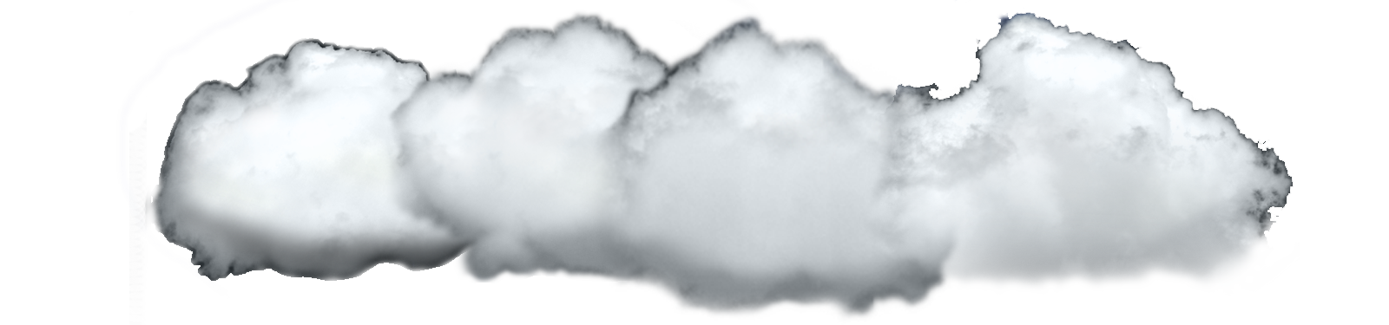
EXPERIENCE
vs
ECONOMICS
Improve Performance and Scale
Drive Out Cost
Can the Cloud help?

Slide 4
Cloud Computing
Cloud Services
Services delivered over the Network
Service Providers
New business opportunity
Pay-as-you-go services
Application Services
Platform Services
Corporate IT
New provisioning model
New infrastructure model
Infrastructure Services

Slide 5
Cloud Infrastructure
Always on, Always responsive
Efficiency
Agility
Economic, Scalable, Secure
Dynamically shared resource pools

Slide 6

Cloud Types
Subscribers
IT End Users
Public
Hybrid
Private

Slide 7

Data Centers are always in flux
Applications constantly introduced, updated, retired
Demand constantly changing
Resource management challenge
Minimize the need for overprovisioning
Reconfigure
Reclaim/Reuse
Adding resources is last resort
Dynamic shared resource pooling addresses these issues
Virtualization + Networks make this possible

Slide 8
Virtualization and Clouds Resource Pooling – Efficiency and Agility
6
Routers/Switches
Access Switch
Access Switch
Server 1
Rack 1
Server 2
Rack 2
3
Hypervisor (VMWare)
Hypervisor
Hypervisor (VMWare)
Hypervisor
App 1
App 1
App 2
App 2
App 3
App 3
App 6
App 1
App 4
App 5
App 2
App 3
O/S
App 3
O/S
O/S
O/S
O/S
O/S
O/S
O/S
O/S
O/S
O/S
O/S
O/S
Unused
Unused
Unused
Unused
Unused
VM 1
VM 1
VM 2
VM 2
VM 6
VM 3
VM 4
VM 5
VM 3

Slide 9


The Cloud Effect
Reconfigure, reclaim, reuse assets to optimize resource allocations
Scale without service interruption to satisfy “always on, always responsive” requirements

Slide 10
The Cloud Effect
Reconfigure, reclaim, reuse assets to optimize resource allocations
Scale without service interruption to satisfy “always on, always responsive” requirements
Economies of Scale –
Larger pools are more efficient and elastic

Slide 11
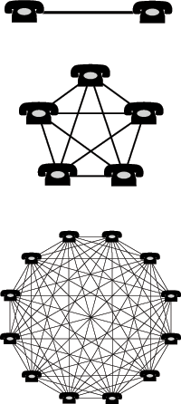
Larger pools are more efficient but also add complexity
Two telephones can make only one connection, five can make 10 connections, and twelve can make 66 connections.
However, the number of “device interactions” and (thus the complexity) also grows as:
n(n-1)/2
Complexity
Scale

Slide 12
Challenges of Scale
SCALABILITY:
The ability to add capacity while minimizing complexity
Today’s Real Complexity
Limits of Scale
Capacity
Capacity
Complexity
Complexity
Ideal Complexity
Scale

Slide 13


Traffic Flows in the Data Center
Client Server - Tree
Data moves in and out of data center
N
Web 2.0/Virtualization - Flat
Data moves across data center
SOA, Mashups
Increase in application peer-to-peer traffic
Increased storage traffic
Real-time resource management
S
Network topologies should mirror the nature of the traffic they transport
Up to 70%
E
W

Slide 14






Data Center Networks are Complex and Inefficient
L2/L3 Switch
L2/L3 Switch
SSL VPN
Firewall
IPSec VPN
IPS
L2/L3 Switch
L2/L3 Switch
L2 Switch
A
B
Notes:
14
14

Slide 15





Today’s Data Center Networks are NOT cloud ready
Complex, inefficient
High Latency
Spanning Tree
Appliance sprawl
Multiple networks
Limited scalability
Poor economics
Sub-optimal performance
L2/L3 Switch
L2/L3 Switch
SSL VPN
Firewall
IPSec VPN
IPS
L2/L3 Switch
L2/L3 Switch
L2 Switch
SERVERS
NAS
STORAGE
Cluster Network
FC SAN

Slide 16



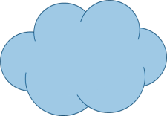



3 steps to a cloud ready data center
Share
Secure
Policies
Infrastructure
Simplify

Slide 17
Values of Simplicity
Improved Application Performance
Greater Scalability
Lower Cost
Performance & Scale
Cost

Slide 18

Flatten the Network
Core
Consolidated Core
Aggregation
Access
Access
Eliminate the Aggregation Layer
Simplify the Consolidated Core
Juniper Confidential
Notes:
18
18

Slide 19

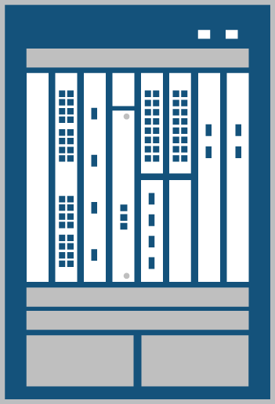
Consolidate & virtualize security appliances
1
Dynamic services gateway
Offers high capacity
Consolidate multiple service devices into one
Simpler
One hop-lower latency
Rapid provisioning
Lower power, cooling, and space
L2/L3 Switch
L2/L3 Switch
SSL VPN
Firewall
IPSec VPN
IPS
L2/L3 Switch
L2/L3 Switch
SERVICES
L2 Switch
SERVERS
STORAGE
FC SAN

Slide 20


Virtualize the access layer
2
Create a single fabric from up to ten switches improving performance and efficiency
1/10th switches to manage
Reduces uplinks
EoR chassis features at ToR economics
Deployment flexibility— EoR or ToR
L2/L3 Switch
L2/L3 Switch
L2/L3 Switch
L2/L3 Switch
SERVICES
ACCESS
L2 Switch
SERVERS
STORAGE
FC SAN

Slide 21
Improving Application Performance
×
Routers/Switches
up to 160µs
Access Switch
Access Switch
~2.6 – 36µs
Server 1
Rack 1
Server 2
Rack 2
3
Hypervisor (VMWare)
Hypervisor
Hypervisor (VMWare)
Hypervisor
App 1
App 1
App 2
App 2
App 1
App 4
App 5
App 2
App 3
O/S
App 3
O/S
O/S
O/S
O/S
O/S
O/S
O/S
O/S
O/S
Unused
Unused
Unused
Unused
Unused
VM 1
VM 1
VM 2
VM 2
VM 3
VM 4
VM 5
VM 3

Slide 22

collapse core & aggregation layers
3
Eliminates the aggregation layer
Simplifies the architecture
Reduces space, power, and cooling requirements
L2/L3 Switch
L2/L3 Switch
CORE
L2/L3 Switch
L2/L3 Switch
SERVICES
ACCESS
SERVERS
STORAGE
FC SAN

Slide 23
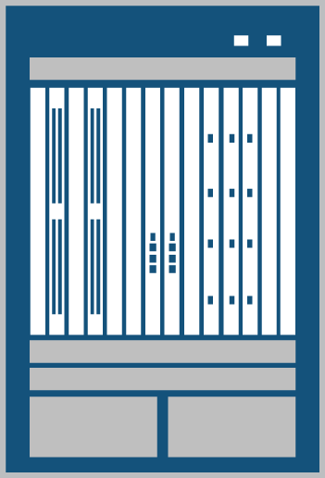
Connect data centers
4
Powerful, reliable routers for the edge
Powerful multicast
For inter-data center mobility
MPLS, VPLS extend VLANs enabling mobility
WAN
CORE
SERVICES
ACCESS
SERVERS
STORAGE
FC SAN

Slide 24

Legacy Network Management

Slide 25

Simplify management
5
Simplify Management
Single pane of glass
Centralized automation
Open API for 3rd-party integration
Support of full network lifecycle
WAN
CORE
SERVICES
ACCESS
SERVERS
STORAGE
FC SAN

Slide 26
3 Steps to Cloud-Ready Data Center Network
Share
Secure
Policies
Infrastructure
Simplify

Slide 27


Share—Virtual Partitioning
VLANs
Physical or virtual server instance

Slide 28
Share—Virtual Partitioning
Zone 1
Zone 2
MPLS - VPN
VPLS - VPN
Zone 4
Zone 3
DATA CENTER
DATA CENTER
VLANs
Zones
VPNs

Slide 29
3 Steps to Cloud-Ready Data Center Network
Share
Secure
Policies
Infrastructure
Simplify

Slide 30


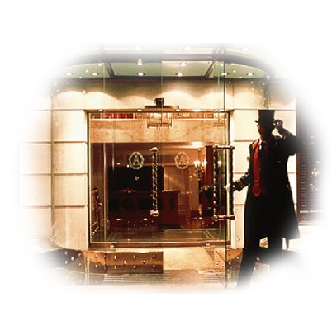


Secure – new model for the cloud
Keep Out!
Hotel Model
Castle Model

Slide 31



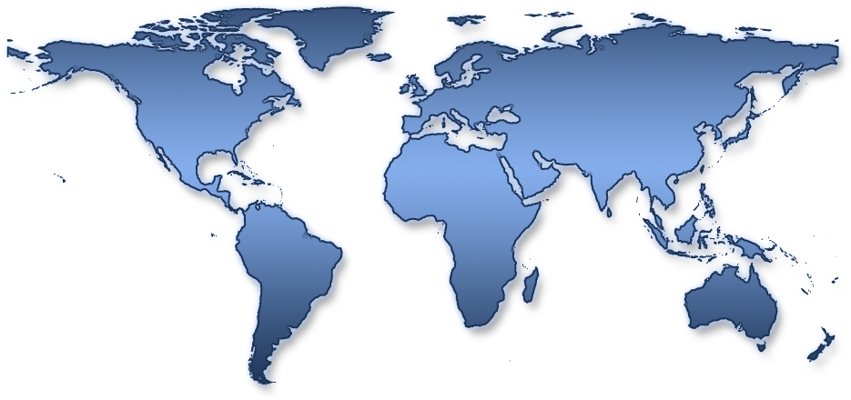

Secure – cloud enabled security
Clients
Global High-Performance Network
Data Centers
Client to DC
Server to Server
DC to DC

Slide 32






Secure—Cloud Enabled Security
User
App
VM 1
VM 2
VM 3
VM 4
Clients
Hypervisor
IDENTITY
Virtual Machines
Internet
SSL VPN
Virtualized
Security
Services
Hr Zone
DMZ
Finance zone
Services
Management & Compliance
Application DoS Protection
Firewall
Authentication
Encryption
NAT
Intrusion prevention
Real-time visibility
Traffic prioritization

Slide 33
Today’s Reality
Two Tier Networks
One Data Center Network
Three Tier Networks
Economies of Scale
Greater Efficiency, Elasticity
The Limits of Scale

Slide 34
Really flatten the Network
Core
Core
Access
Aggregation
Access
Access
Eliminate the aggregation layer
Flat Data Center Fabric
Juniper Confidential
Notes:
34
34

Slide 35
Simplify – Juniper’s Vision
DATA CENTER FABRIC
WAN
Virtualized
Security &
Application
Services
SRX5800
SERVERS
STORAGE
Notes:
35
35

Slide 36
EXPERIENCE
vs
ECONOMICS
Improve Performance and Scale
Drive Out Cost
Can the Cloud help?
Yes

Slide 37
Notes:
37

