Slide 1


Versatile Virtual Desktops
This work performed under the auspices of the U.S. Department of Energy by Lawrence Livermore National
Laboratory under Contract DE-AC52-07NA27344.
Lawrence Livermore National Laboratory
Don Mendonsa
LLNL-PRES-431832

Slide 2
Table of Context
Introduction
Objective
Challenges
Examples
Conclusion
Next Year
Questions
LLNL-PRES-431832

Slide 3
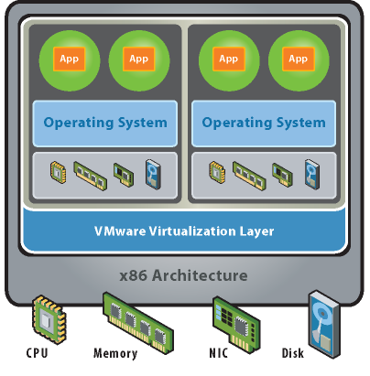
Introduction
Virtualization, What is it?
LLNL-PRES-431832

Slide 4
Introduction
Virtualization widely used in the data center
Previous Presentations
  A Measured Approach to Virtualization
  Moving Towards a Virtual World
  Versatile Virtual Desktops
LLNL-PRES-431832

Slide 5
Objective
Computing diversity exists on the End System
Types of End Systems
  User Desktops
  Kiosks
  Training Centers
  Machine Controllers
  Machine Measurement Systems
  Points of Sale
  Single use Systems – only one use for systems
LLNL-PRES-431832

Slide 6
Challenges
Challenges to managing End Systems
  OS Patches
  OS Upgrades
  Application Patches
  Application Upgrades
  Hardware Upgrades
  Hardware Maintenance - mostly moving parts
Each one can be huge projects, often with limited staff
LLNL-PRES-431832

Slide 7
Overview of Examples
Laboratory Training Center
Material Tracking Infrastructure
Safe Desktop – Institutional Web Browsing
User Desktops
Measurement / Machine Controller
My Mac
LLNL-PRES-431832

Slide 8
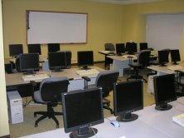
Training center
Problem
  Diverse class schedule requires multiple configurations to classroom systems
Components
  Dell R900 Server 128 Gigs RAM 16 Cores
  HP Thin Clients
  Mac Mini’s 4 Gigs RAM
Solution
  Classes are provisioned from a read only image
LLNL-PRES-431832

Slide 9
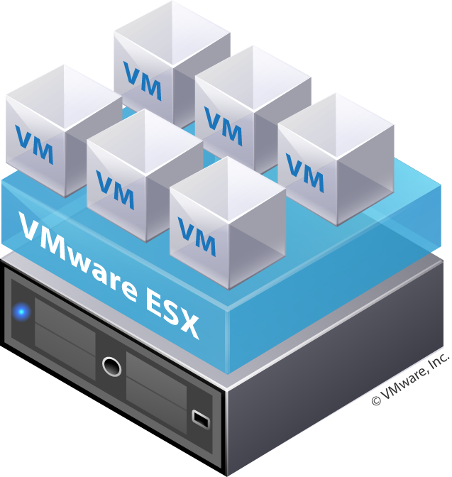
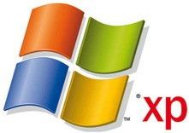

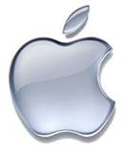
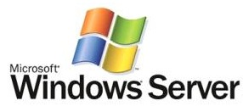
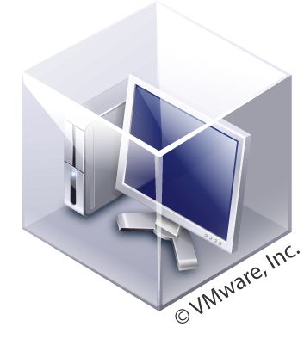
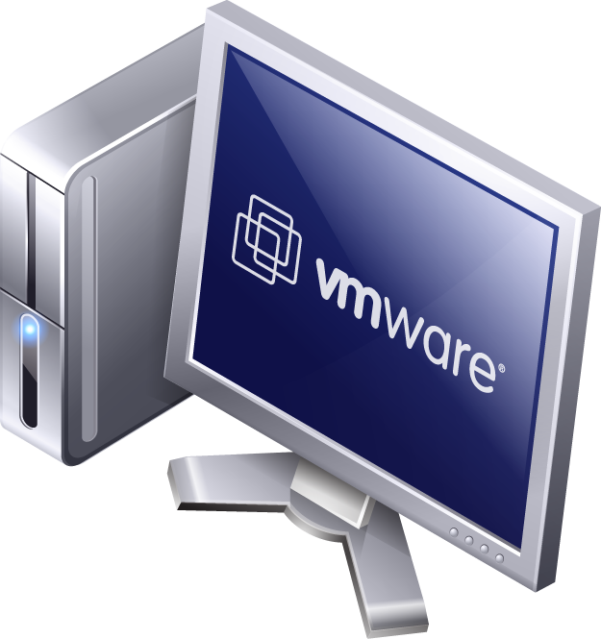
Training center
ESX Server hosts all server OS instances and Windows, Apple and Linux desktop instances
Class with new systems have Mac minis and Windows Thin clients for running virtual desktops
Class with older systems will convert older pc’s to run virtual desktops
Class with new systems
Class with older systems
Mac Netboot Desktop
Mac Netboot Desktop
Windows Thin Desktop
Windows Thin Desktop
Old PXE boot Win Desktop
Old PXE boot Win Desktop
LLNL-PRES-431832

Slide 10
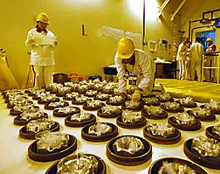
Material Tracking
Problem
  Systems require static image
Components
  Dell R900 Server 128 Gigs RAM 16 Cores
  HP Thin Clients
  USB Printers, Hand Scanners and Cameras
Solution
  Static image using VMWare View to support USB peripherals
LLNL-PRES-431832

Slide 11
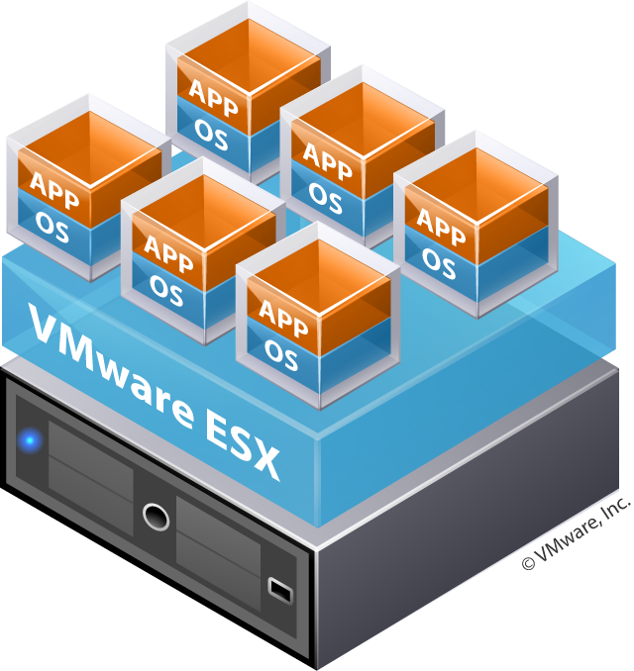
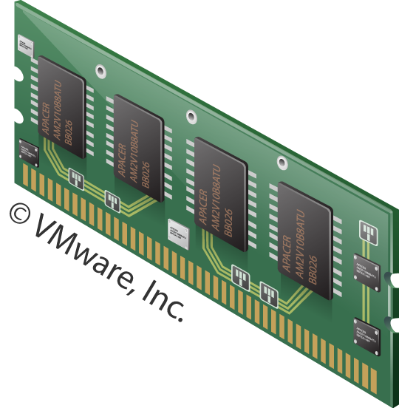
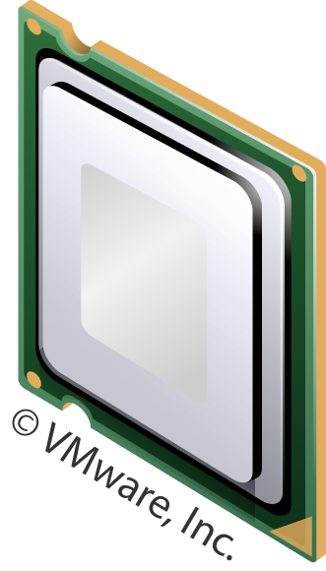
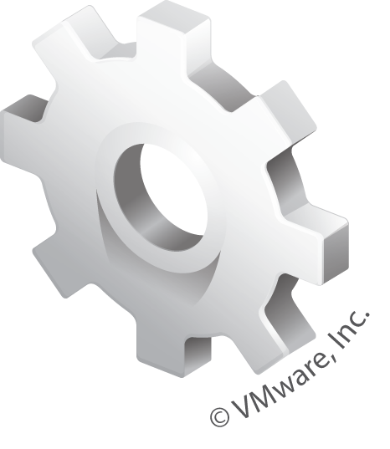
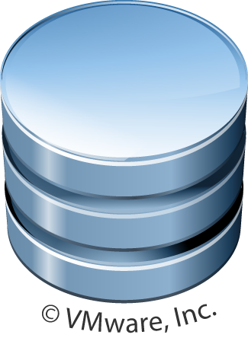
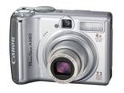


Material Tracking
View Clients with Peripherals
The ESX server serves a shared desktop image with peripheral support enabling the individual end clients to utilize local, printers, cameras and hand scanners
Thin client running embedded OS with peripheral support
LLNL-PRES-431832

Slide 12
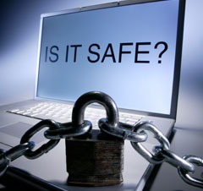
Safe Desktop
Problem
  LLNL end users unable to access web based mail and social networking sites
Components
  Dell R900 Server 128 Gigs RAM 16 Cores
  VMWare ESXi, Composer, View
Solution
  Automated pool of provisioned virtual desktops available for web browsing
LLNL-PRES-431832

Slide 13
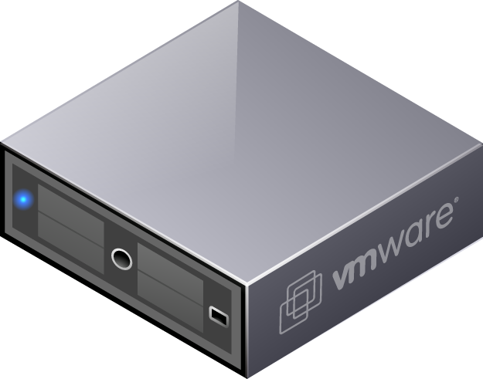
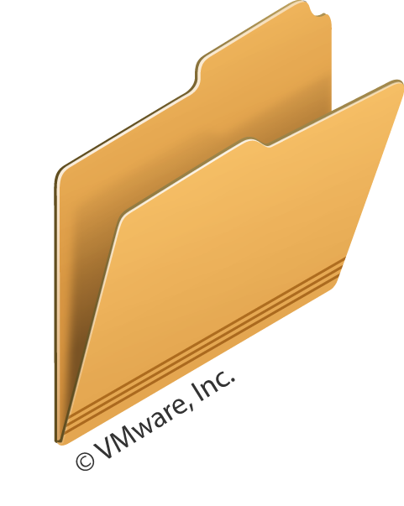
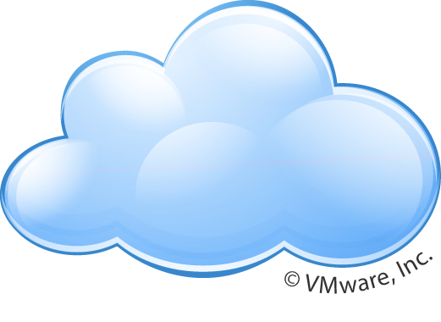

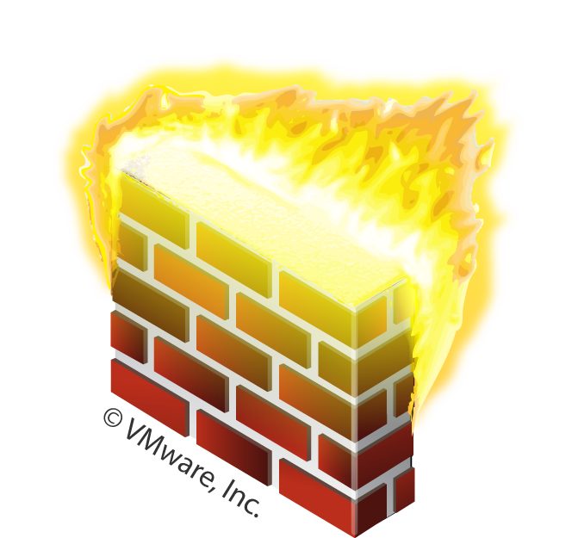

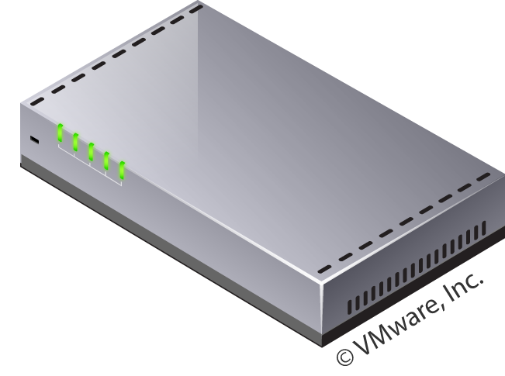



Safe Desktop
Active Directory
Internet
Step 2
Step 3
Step 7
Virtual Desktop
Router
Step 4
Step 5
Step 6
Step 1
Steps in using a secure desktop
Step 1 - Request via http a secure desktop
Step 2 – Obtain authorization from Active Directory
Step 3 – Authorization gained
Step 4 – Obtain virtual desktop from available pool
Step 5 – Obtain an IP address in a defined range
Step 6 – Access Internet with minimized Bluecoat restrictions
Step 7 – Terminate session and desktop destroyed
LLNL Desktops
LLNL-PRES-431832

Slide 14

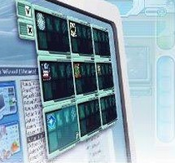
User Desktops
Problem
  1000’s of end users system each requiring individual full system support
Components
  Dell R900 Server
  HP Thin Clients
Solution
  VMWare View
  Linked Clones
  Single Image Systems
LLNL-PRES-431832

Slide 15
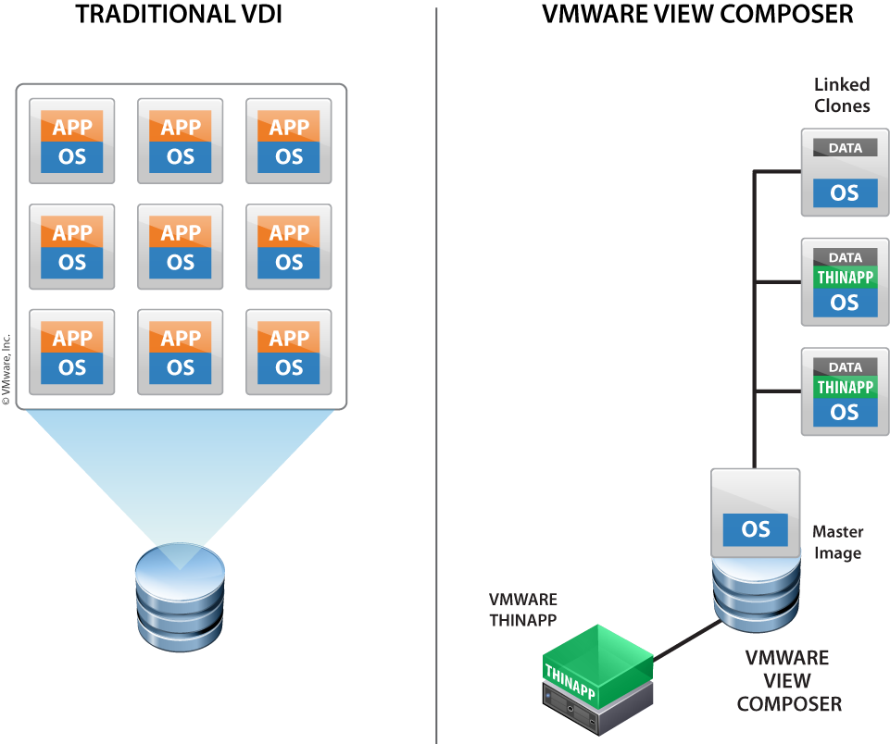
User Desktops
LLNL-PRES-431832

Slide 16
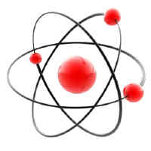
Measurement Systems
Problem
  Laboratory measurement systems run on old PC hardware that runs older, un-supported, un-patched operating systems with software certified for a specific purpose of instrument systems
      Calorimeter
      Gamma Counter
      Neutron Multiplexor
LLNL-PRES-431832

Slide 17
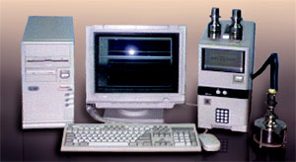
Measurement Systems
Solution
  Virtualize existing OS instance onto redundant hardware and run certified software under exact operating environment
  Due to proprietary hardware three separate implementations have to occur
Benefit
  OS image sustainable indefinitely
LLNL-PRES-431832

Slide 18
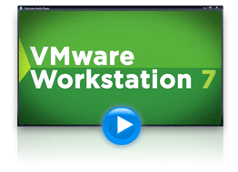
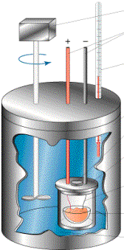

Measurement Systems
Solution 1
  Server 2008 running VMWare Workstation7 using serial or usb ports
LLNL-PRES-431832

Slide 19
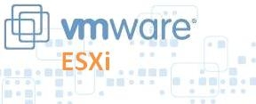

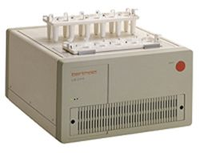
Measurement Systems
Solution 2
  ESXi with pass-through for National Instrument GBIC Card
LLNL-PRES-431832

Slide 20
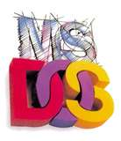
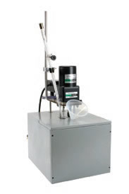
Measurement Systems
Solution 3
  ESXi with pass-through for ISA bus expansion card to connect to a ISA chassis
ESXi Server
ISA BUS
LLNL-PRES-431832

Slide 21
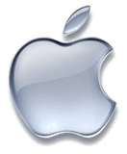
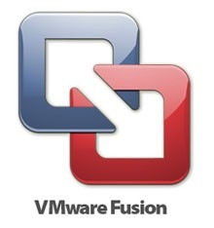
My Mac
Problem
  Testing OS’s, software packages, policies, upgrades
Components
  Apple MacPro 32 Gig RAM 3 Monitors
  3 TB storage
Solution
  Vmware fusion
LLNL-PRES-431832

Slide 22
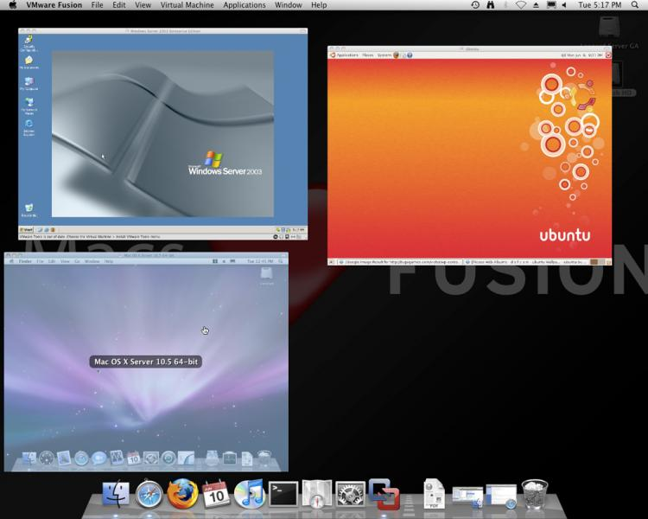
My Mac
Multiple iterations of each OS
Windows XP
Windows 2003
Windows 2008
Windows 2008 no UI
Windows Vista
Windows 7
RedHat 5
Ubuntu
OSX 10.5 Server
LLNL-PRES-431832

Slide 23
Conclusion
Virtualization isn’t just for servers anymore!
Challenges revisited
      OS Patches
      OS Upgrades
      Application Patches
      Application Upgrades
      Hardware Upgrades
      Hardware Maintenance - mostly moving parts
Wielding a virtual image solves most of these challenges
LLNL-PRES-431832

Slide 24



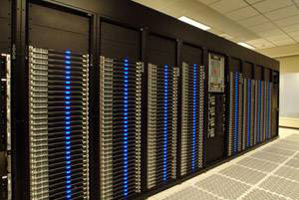
Next Year…
High Performance Computing
LLNL-PRES-431832

Slide 25
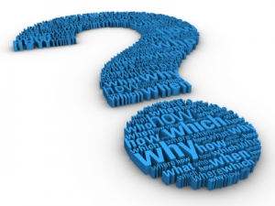
Questions
LLNL-PRES-431832

Slide 26
Contact Information
Don Mendonsa
Lawrence Livermore National Laboratory
mendonsa2@llnl.gov
925-423-2224
LLNL-PRES-431832

