Slide 1

Sandia National Laboratories BlackBerry Enterprise Server 5.0
Sean McGovern
BlackBerry Operations
K. Jarrod Collins
Infrastructure Computing Services
Sandia National Laboratories is a multi-program laboratory operated by Sandia Corporation, a wholly owned
subsidiary of Lockheed Martin company, for the U.S. Department of Energy’s National Nuclear Security Administration
under contract DE-AC04-94AL85000.

Slide 2
Why BES 5.0?
New features:
  Support side:
    Web based administration and new API’s
    Build in High Availability
    Enhanced application deployment
  End user side:
    Remote file access
    Flag messages for follow up
  Implementation with other products:
    Boxtone, MVS, Wallace wireless

Slide 3
What Is The BAS
BlackBerry Administration Service is a software component in version 5.0 of the Blackberry Enterprise System
  Centralized, browser-based management interface
  Dynamic web user interface based on users role
  Multi-Level & Multi-Tiered Group support

Slide 4
Using The BAS at SNL
We can Activate and Support Users Wirelessly
  Set Activation Passwords
  Device Password changes
  Policy Changes
  Wipe and Disable Devices

Slide 5
Customizable Roles
Tier 1
    Help desk
      Can view user information
      Resend service books, Device password changes, Device wipes
Tier 2
    BlackBerry Operations
      Set activation passwords
      Add and delete users
Tier 3 – delegated authorities
    BES Admin, Policy Admin, Applications Admin
      Manages HA, Server configuration, Admin accounts
      Manages Polices
      Manages Software Configurations

Slide 6
Lessons Learned / Things to Know
Device activations are faster through the web console
      Activation key is pushed directly to the device and the slow sync process begins
Upgrades on the 9550 device with OS 5.0.0.607
      Has caused corruption in the calendar, work around has been to complete the upgrade with the user in the default policy with content protection turned off
8800 series with 4.2 OS and .wav file compatibility
      Devices must be upgraded to OS 4.5

Slide 7
Migration Overview
Evaluated migration options
Planning and testing
Designed architecture
Performed migration

Slide 8
Migration Options
New BlackBerry Domain
  Requirements:
    New servers
    New policies, software configurations, etc…
  Benefits:
    Least user impact, ability to move users back
    Administrator / Support teams moved first
    Pilot Group testing
    New BlackBerry Configuration Database
    New Virtual Machines
Notes:
Guides:
http://docs.blackberry.com/en/admin/deliverables/12057/BlackBerry_Enterprise_Server-Planning_Guide--820441-1029090714-001-5.0.1-US.pdf
http://docs.blackberry.com/en/admin/deliverables/12052/BlackBerry_Enterprise_Server-Upgrade_Planning_Guide-T577232-820366-1021033702-001-5.0.1-US.pdf
http://docs.blackberry.com/en/admin/deliverables/12164/BlackBerry_Enterprise_Server_for_Microsoft_Exchange-Upgrade_Guide-T561574-819646-1029041635-001-5.0.1-US.pdf

Slide 9
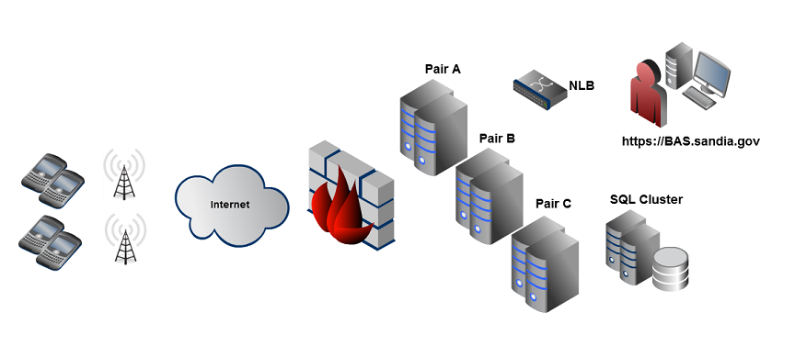
BES 5.0 Architecture
Notes:
3 x Two Node BES pairs
Each BES node is a Virtual Machine running on ESX 4.0, Server 2008 R2 64 bit, 1cpu, 2GB ram
Node A, All components, without BAS
Node B, All components, with BAS
1 x Two node SQL 2005 cluster
Physical server 2003 R2, 4 CPU, 4 GB RAM
2 x Foundry NLB’s

Slide 10
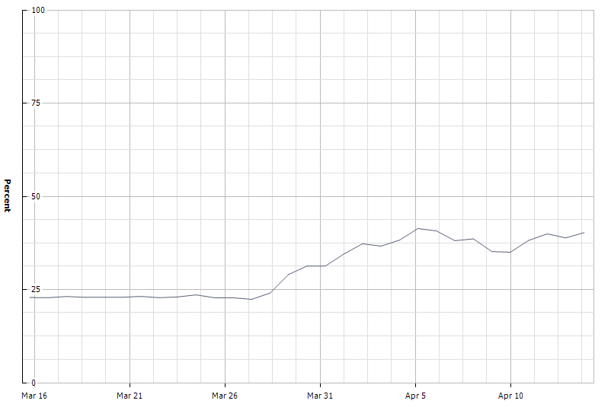
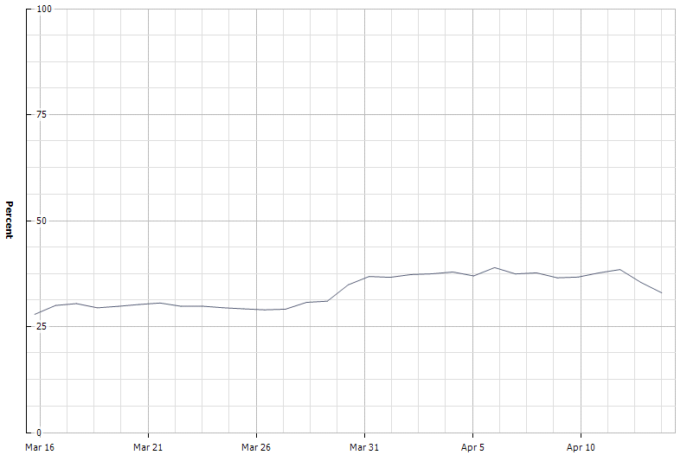
BES 5.0 Performance
Notes:
Top Chart - Node A
~17% Memory usage before migration
~35% Peak Memory usage after moving 600+ users
Bottom Chart - Node B
~24% Memory usage before migration
~33% Peak Memory usage after migration

Slide 11
How was the migration performed?
BES configuration - November through December
  Testing, testing, testing…
    HA features
    Software Deployment
    Email / PIM synchronization
    New 5.0 device capabilities
    Enterprise Transporter
  Migrated Policies and Roles
  Developed custom programs using new BAS API’s
    Limited Area Credentialing
    Policy Enforcement
Pilot testing conducted January through March
  New tools distributed to support staff

Slide 12
How was the migration performed? Cont..
User notification sent 03/22
  Requested users to have their BlackBerry turned on
    Notification targeted to all users
    Notification targeted to all 4.3 users
Migration started 03/29 using the Transporter
  Ran a SQL query to identify recent contact time and supported OS
  Imported email addresses into the transporter tool
  Performed test migration
  Removed problematic users
  Migrated users
  Wait for updated contact time
  Set policy

Slide 13
Migration Stats
Started on 03/29
88% of users moved within first week
200 to 600 users migrated per day
Completed 06/01 - All remaining users will be migrated

Slide 14
Lessons Learned / Things To Know
BAS does not fully integrate with AD
Policies do not migrate
2 or more pooled instances of BAS causes job delays
Some users cannot be managed via the BAS
Moving users without the device turned on

Slide 15
Questions?
Sean McGovern
  5058440494
  smmcgov@sandia.gov
K. Jarrod Collins
  5052842918
  kjcolli@sandia.gov

