Slide 1
Blackberry Pilot and Planned Production Roll Out at
LLNL
NLIT 2010
Jean Shuler
Computer Systems and Support Deputy Division Leader
Lee Neely
CISSP & LLNL Cyber Security Program
Auspices Statement
This work performed under the auspices of the U.S. Department of Energy by Lawrence Livermore National Laboratory under Contract DE-AC52-07NA27344.

Slide 2
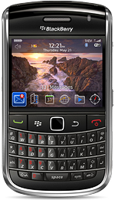
Overview
Abstract
Steps from Pilot to Production in three years
Project Objectives and Assumptions
Entrust a BIG issue!
Review of Milestones and Accomplishments
Roll out announced on April 14!
What Next?
  BlackBerrys in Limited Areas
  Development of LLNL Apps
  ……

Slide 3
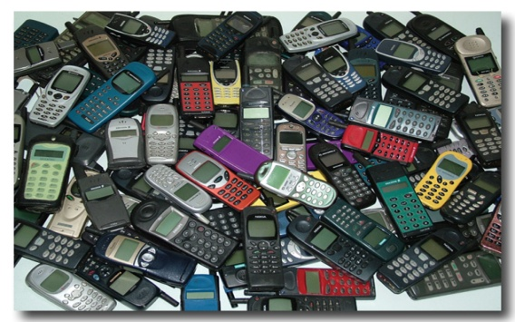
Abstract
LLNL initiated the Blackberry Pilot program over 3 years ago to determine the feasibility of issuing LLNL purchased and managed Blackberry mobile devices to Lab employees
The possibility of allowing Blackberrys in Limited Areas in the future was a desired outcome based on Sandia National Lab and Y-12 efforts
Pros and Cons of the results of allowing the use of Blackberrys on-site in Property Protected Areas at LLNL will be presented along with issues and problems encountered and how they were addressed
Initially, 50 Blackberrys were issued to IT and Computer Security managers on a case-by-case request based on business need
Demand for iPhones and BBs grew because of their convenience, popularity, and use by other organizations, so policies and procedures needed to be written to address who was eligible, how they were managed, and who would support them
A major issue was getting encryption set up on the BBs. Entrust is the encryption solution provided at LLNL and an effort was started to develop documentation and train IT staff to install and activate Entrust on the BB mobile devices. This process will be presented along with the problems and solutions

Slide 4
Steps from Pilot to Production
Steps
  Business case developed in late 2006
  Evaluation of mobile devices
  $$ funding issues
  Deploy managed BlackBerry Service
    Exchange migration and pitfalls
  Process Refinement
    Funding, Apps determination, Governance Board interactions
  Future
    Limited Area access
    Develop/Port LLNL applications
    Ongoing support

Slide 5
The Six Step Plan
Business case
1– Develop Business Case
2 – Evaluation of devices– PALM, Windows Mobile, BBs
BlackBerry smart phone device chosen
Conduct Pilot
Get Entrust working
3 – Identify funding sources
4 - Deploy the managed BlackBerry Service providing managed BlackBerry devices to LLNL customers
5 - Process Refinement
6 – Local application development and ongoing funding and support.
Security
Funding
Migration & Pitfalls
Maximize Return
Notes:
1 – Develop Business Case Collaboration with : Telcom, Email staff, desktop techs ,and CSP
2 - What to evaluate – PALM, Windows Mobile, BBs – BBS were # 1 candidate because of encryption and configuration management with BES – strong integration
- Conduct a pilot of BlackBerry devices to identify the benefits that smart phone devices and determine the infrastructure required to provide a production service. Get Entrust working! Move to exchange server– decision on who would be initial pilot testers – managers or techs?? - Initial order- 30 BBs and gave to techs - set up on exchange and decided on settings and what apps. Had to set Passwords and firewall.
3 – Identify funding sources– to go production we need a LLNL wide exchange - which meant H/W for Exchange and migration plans – on the order of $1M – and this at a time of belt tightening and layoffs so no money
4 - Deploy the managed BlackBerry Service providing managed BlackBerry devices to LLNL customers that are integrated with LLNL’s Exchange Email and Calendar system by April 1, 2010. Exchange migration and pitfalls ( Google Maps, OCS client) -Whole lab is migrating to Exchange and having problems with Mac and Entrust
5 Process Refinement –
who pays in the long term for devices and monthly service fees – we need to refine the process about loading APPS we are part way through step 4 – the MIGRATION
Governance Board and communication for approving APPS – Texting removed because of support issues
current funding and support issues (4HELP, telecom, CSP, – determine applications (Front Range, Lite, Ltrain)
6 – Local application development and ongoing funding and support.
Develop institutional Apps like Epay, Lite and change the web portal for mobile devises (U-Learn already there)
Issues in the limited area – it because apparent that it is not productive to POP batteries whenever you went in limited areas – techs wanted apps (front range and access to email all the time – Sr. managers want to be able to use phones everywhere

Slide 6
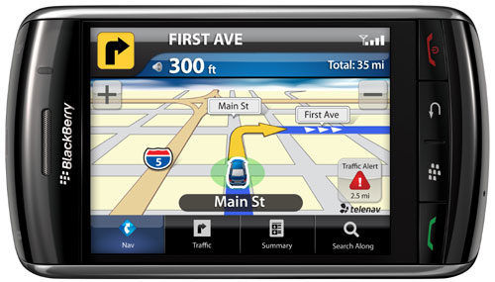
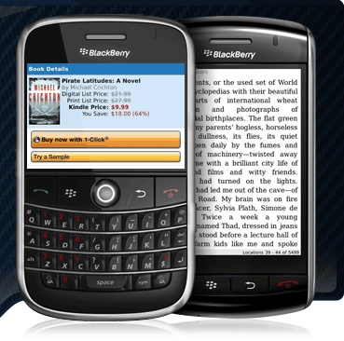
Step 1 - Business need
Recommend deploying BlackBerrys to enable immediate mobile collaboration
Pilot identified these key benefits
  Immediate, 24x7, Exchange email access, calendaring, Instant Messaging, phone, web browsing, paging, cellular modem service, applications, collaboration tools.
  Remediation of security risks –(If lost, can be remotely wiped)
  Competitive cost versus existing LLNL cell phones
  Conversion of number of hrs/person/yr in downtime into productive time per industry ROI analysis
    15 min/day=1/32nd of workday=1/32nd of annual labor=1/32nd of $1B = ~ $30M savings
  Allows users to keep working when out of office
  Study to determine use of phones in Limited Areas
  Attract new hires because of up-to-date technology
  Executives/managers require rapid, secure communications regardless of location and increased productivity

Slide 7

Step 2 Evaluation
Evaluation of mobile devices:
  Palm/Treo
  Windows mobile
  Other devices based on Gartner Magic Quadrant
  Blackberry – BlackBerry # 1 choice
    Dominant leader rated by Gartner, commercially and at Bechtel, DOE/NNSA complex
    Exchange coming soon
    Tightly manages security settings
    Settings and Applications needed
    Most complete solution
      End-to-End from single vendor
    Best integrated with cell phone vendors

Slide 8
Pilot
In late 2006 fifty BlackBerrys were purchased – who should get them? Managers or “techies”
  Techies won out! Concern that Managers would have expectations of 24x7 support before they were ready for production. Techies could troubleshoot issues and report them
From 2007 through 2010 LLNL conducted a pilot of Blackberry devices with the goal of identifying the benefits smart-phones provide and determine the infrastructure required to provide a production service
  Initial offering was by IT manager selection based on requests
  Most capabilities were tested
  Stable, performed well, and secure (but Entrust difficult to install)
  Identified strong dependency on robust Exchange infrastructure
  Easy to use
  Tested by all levels of management (not all techies!)
The pilot resulted in the initiation of this project to deploy the managed BlackBerry Service providing managed BlackBerry devices to LLNL customers that are integrated with LLNL’s Exchange and Calendar system

Slide 9



Step 3 – Identify funding source
Initially 50 BlackBerrys were purchased
  Cost of devices and support person determined
  Started due to cost of Exchange deployment and not necessarily BlackBerry devices themselves
Support structure determined for the pilot
  Collaboration with Telecom, CSP, Desktop Support, Email staff
  Texting was originally installed but removed because of support issues.

Slide 10
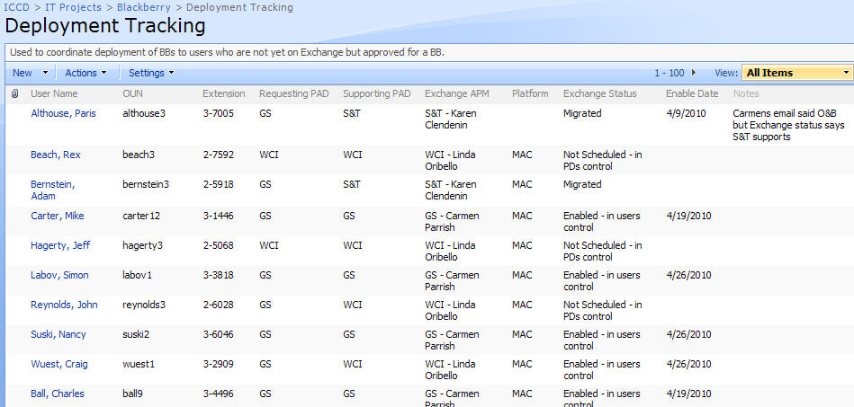
Initial Deployment
Late 2006 - Initial Deployment to 50 “techies” and some managers
  Mid 2009 - Second deployment of ~100 devices to High Level Managers Based on limited requests to IT managers
    Process was done manually. Input of information and personal interaction required
      Telcom, CSP, email staff, and desktop support all involved
    Not scalable for mass deployment but issues uncovered and resolved

Slide 11
Step 4 – Current Status of BlackBerry Deployment
Project run by IT Solutions Project Management Office
  A PMI based project methodology used to document and track projects
  Monthly status meetings and in-depth project reviews conducted
  Issues and risks will be managed and communicated to stakeholders

Slide 12

Project Objectives and Assumptions- as refined in 2010
The objective is to perform work required to develop and deploy a service to provide BlackBerry service to the LLNL User community by 4/1/2010
  Provide an institutional service for managed BlackBerry devices with connectivity to Exchange email, calendaring
  Define and implement BlackBerry configurations that meet security requirements while providing the necessary applications for customer productivity
  Define and implement support procedures for on-going provisioning, wiping, upgrading and troubleshooting of BlackBerry issues
CIO Program pay for the infrastructure and the Programs/Users pay for the BlackBerry device and usage

Slide 13

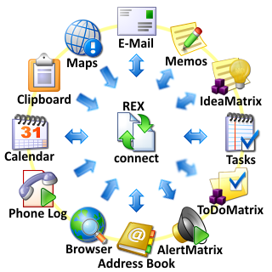
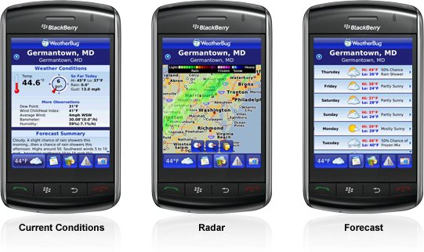
Step 5 – Process refinement
Develop ongoing funding and support model
  Two parts:
    Behind the scenes infrastructure (FTEs, Exchange, BES)
    Device + Cell carrier fees
Establish Governance Board policy
Determine process for reviewing and approving applications
  (Social Networking apps?)
Development of new LLNL apps
  Who will develop
  Who will support (U-Learn mobile available)

Slide 14
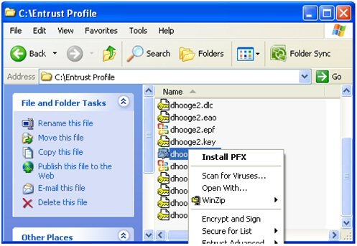
Entrust Issues
Getting Entrust (encrypted email) to work on the BlackBerrys was a big effort!
  Expertise was developed
  No actual Entrust Client on the BlackBerry
  Steps taken to go from Entrust to S/MIME
  Many people got together to test the process and refine documentation
  Staff was trained (both managers and techs)
  Instructions went through several iterations
January 2010 - Started with a 36 page document of instructions that began with explaining how to Export your Entrust credentials in P12 format and install them on your local system.

Slide 15
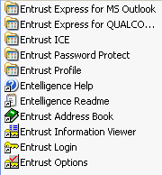
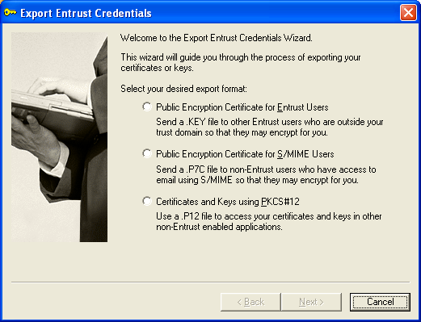
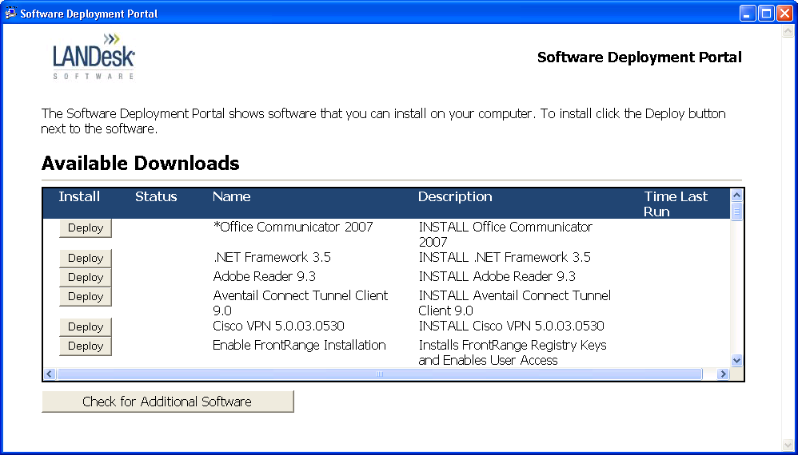
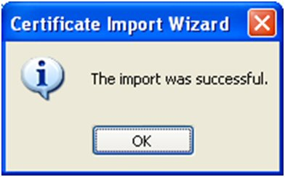
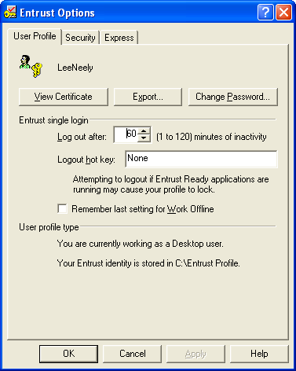
Documentation to install Entrust
Jan 2010 document was 36 pages!
Export your credentials in PCKS#12 format
  Go to Entrust Options – either via the Entrust program group or right-click on the entrust key in the task bar and select “Entrust Options…”
  ………and 36 pages later -
  Your certificates are now synchronized with your device and S/MIME is installed.
March 2010 document was only 24 pages long
  Verify S/MIME software is installed on your BlackBerry
  On your device, go to Options->Advanced Options->Applications and validate “BlackBerry S/MIME Support Package” is listed
  If it is not installed, contact The Cellular Administration Team x3-1815
  Download and install BlackBerry Desktop Software on your desktop
  ……..and 24 pages later
April 2010 documentation was an email with links to Right Answers

Slide 16
Email to new BB users – March 31, 2010
Hello,
Your Blackberry phone is almost ready for pick up. To complete the process and pick up your new Blackberry you must complete the following five tasks:
Log on to the CSP web-site (enter web-site) and update your authentication questions. This must be done so we can authenticate your identity should you call to get your password reset or have your device wiped. We will need to validate the completion of this prior to distribution of your Blackberry.
  https://cspservices.llnl.gov/
  Select Q&A from the left side under Identity Management
  Click on Security Questions & Answers
  Enter OUN
  Action allows you to delete or change your answers if you don’t have five questions you can additional questions.
Read and sign the attached Cell Phone/Blackberry Security Rules and Cellular Information Acknowledgement Sheet
Print and sign your Property Record Change Form. VALIDATE the property number when you pick up your device. A copy of this email is being sent to your Property Representative to let them know you are about to receive a new property tagged item.
To complete your Entrust certification - AFTER you have picked up your Blackberry visit How to: Configure your BlackBerry device to work with encrypted e-mail. Also visit How to: Get help with my BlackBerry for other general information.
Take a look at a great link to help you with frequently asked questions. Type “Answers” in your browser bar and visit the RightAnswers home page.
Once these items have been completed you may pick up your Blackberry in the Phone Store, Bldg 571 room 1231. The Phone Store hours are 9:00am to 11:30am and 1:00pm to 3:30pm.
If someone other than the custodian is planning on picking up the device they must have the signed copies of the Acknowledgement Sheet and the Property Record Change Form with them AND the custodian must have completed the authentication questions.
If the attached documents are not signed and the authentication through CSP has not been completed by the custodian, the phone will not be available for pickup.

Slide 17
Review Milestones and Accomplishments
Pre-Project Technical Investigation and Business Case Development
8/15/08 Project Proposal and Approval
10/1/09 Funding Received
3/23/10 Documentation
  Operational documents
  Help Desk documents
  Knowledgebase entries
  Roles and Responsibilities document
3/25/10 Application and Policies Complete
  Google Maps, OCS client complete for installation
  Policies for operational roles created and tested
3/26/10 Entrust Support Complete and Production Infrastructure Complete
  Hardware and software in place and configured
  Monitoring and alerting configured
  Redundancy / Failover tested
  Procedure to import Entrust Certificates documented and tested for Windows and Macs
  Blackberry Desktop Manager for Windows and Macs packaged and available in the LANDesk software portal
3/31/10 Training
  Training for LC Operations, 4Help and Telecom
4/1/10 Service Overview Complete and approved by Computer Security
4/1/10 – Communication Service in Production Project Conclusion!
New phone deployments begin as prioritized and approved
  Migration from pre-production to production for pilot users complete
  Communication to stakeholders and support organizations complete
5/31/10 Migration from Pre-production to production for pilot users complete
  Prioritize and bin users for migration
  Schedule and migrate users to new environment

Slide 18
BlackBerrys to be made available to Laboratory users!
April 14, 2010 – Announcement in LLNL NewsOnLine
The CIO program will soon offer managed BlackBerry “SmartPhones” to Laboratory users. These phones offer users access to their LLNL e-mail from the Exchange server and will offer access to the Exchange Calendar when LLNL converts from Meeting Maker this summer.
SmartPhones offer increased security of information and, if lost or stolen, the phone can be completely erased from a central console ensuring the security of LLNL information. While BlackBerry devices cost more than standard cellular phones, they offer greater productivity features and, in many cases, can replace pagers and cellular data cards.
How do I get a BlackBerry?
To request a BlackBerry, users will be asked to complete a cellular order form and send it to the principal directorate-designated approver listed on the form. Contact information will be provided when the phones become generally available.
Principal directorate representatives have already submitted an initial list of priority requests. This initial deployment is expected to take several months to complete. Additional individual user requests will be addressed after the principal directorate priority requests have been fulfilled. All users are required to migrate to Exchange prior to receiving a BlackBerry.
Security rules
BlackBerry devices are to be handled the same as Laboratory cell phones when entering limited areas. They are not allowed in classified areas unless the battery is removed, or BlackBerrys should be left in “cell garages” outside limited area buildings.
The CIO program is aware of the demand for various other devices and, as a result, will explore options for a managed iPhone service and other possible devices. The delivery timeframe will depend upon the Laboratory’s budget, IT priorities and security considerations.

Slide 19
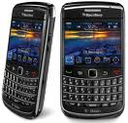
Step 6 – Future development
BBs in Limited areas
  Risks and mitigations
Training
Upgrades to new models
User support
New application porting, development, installation and support

Slide 20
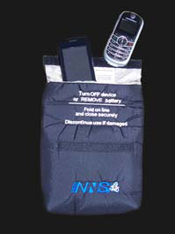
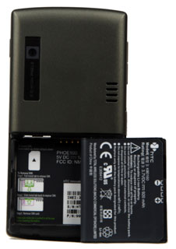
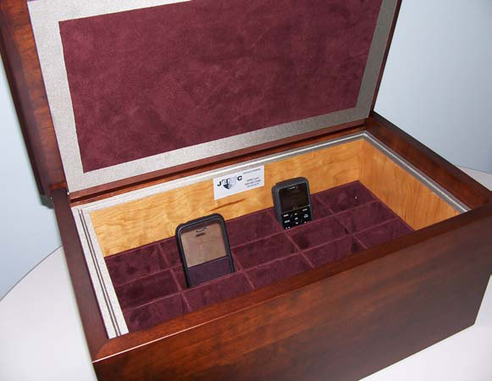
BlackBerrys in Limited areas – determination to be made
Where we are now
Three hurdles to get across:
Technical Security and Countermeasures approval
Computer Security Program approval
Sr. Managers want to ensure safe IT environment
  Concern over increased infractions if users not thoughtful on new rules
  Having BlackBerrys in Limited Areas means retraining users on “any cell phone in classified area = bad”
  Managers concerned about data and cell phones left on. Need to protect classified data and discussions
  Additional user training required–
  How do we accept these risks and manage End User behavior??
Working group reviewed current BES configuration policies based on NSA and DISA guidelines, and Sandia’s policy for allowing BlackBerrys in limited areas.
LLNL experts were solicited for input on the risk assessment and a report will be presented describing possible threats, impact, likelihood, mitigation, and residual risks.
  Simple Mitigations
    Signage
    User training
      Battery “pop”
      RF Shielded Pouch
      Conference RF Cell Phone /PDA Box

Slide 21
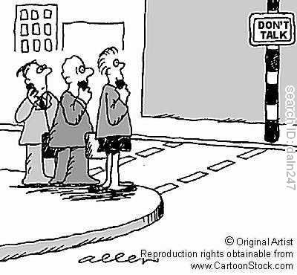
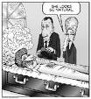


Possibility of BlackBerrys in Limited areas
From this:
To this:

Slide 22
Thanks for your time!
Questions?

