Slide 1


Automated Document Control System for Science and Engineering Using SharePoint
Ted Shab
May 24, 2010

Slide 2
Part 1 - Functional
Controlled Documents for Accelerator Systems and Research Facilities

Slide 3
Why SharePoint?
Comprehensive solution already in production.
Based on a cost effective and widely supported commercial off-the-shelf (COTS) technology.
Allows different access methods on one platform: No login read, SLAC Windows accounts, Extranet accounts.
Users build and maintain sites without time-consuming and costly overhead. A built-in approval process is available.
Consistent navigation and valid searches allow quick access to information.
Well-architected structure helps eliminate duplication of effort thus saving time and resources.
Color coded sites allow easy navigation and help protect content.
Effective document management system in production. The process is based on 20 years of document management experience. Successfully used to prepare for ARRs and thoroughly peer reviewed by representatives from several labs including Sandia, Oak Ridge, PNNL. See final report Operational Readiness Review: Accelerator Controlled Document System in SharePoint.

Slide 4
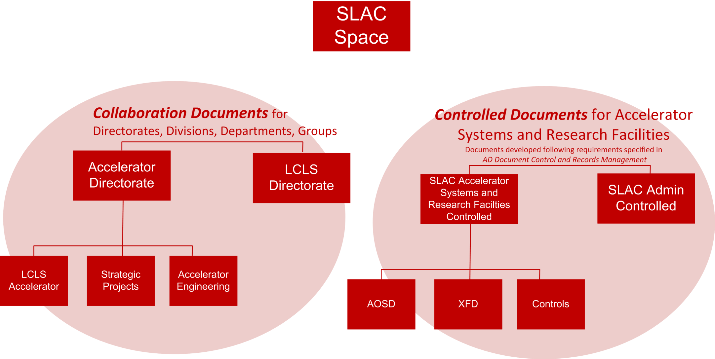
Controlled Documents for Accelerator Systems and Research Facilities

Slide 5

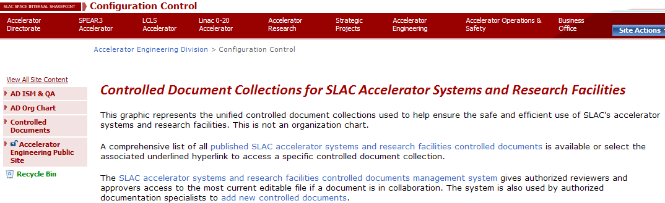
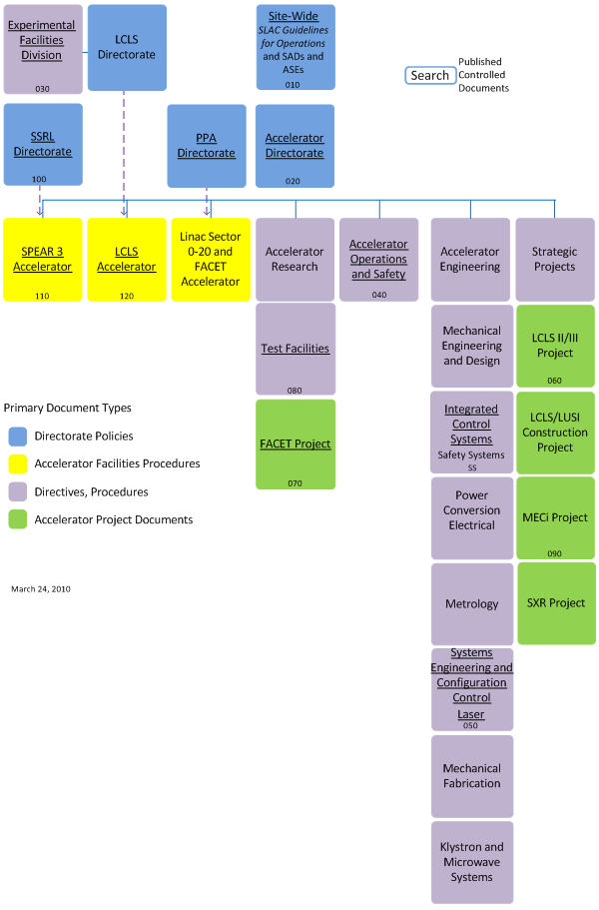
Search Published Controlled Documents Collections
Important first step:
Identify what documents need to be controlled. See AD Document Control and Records Management.
Hyperlinks to Controlled Document Collections

Slide 6

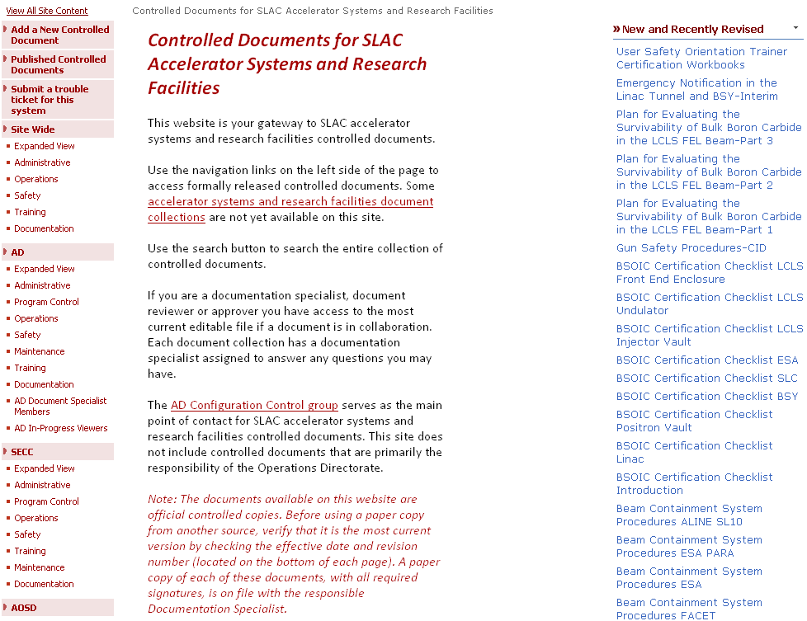
Automated System for Controlled Documents for Accelerator Systems and Research Facilities
Documentation
Specialists
Users
Users

Slide 7
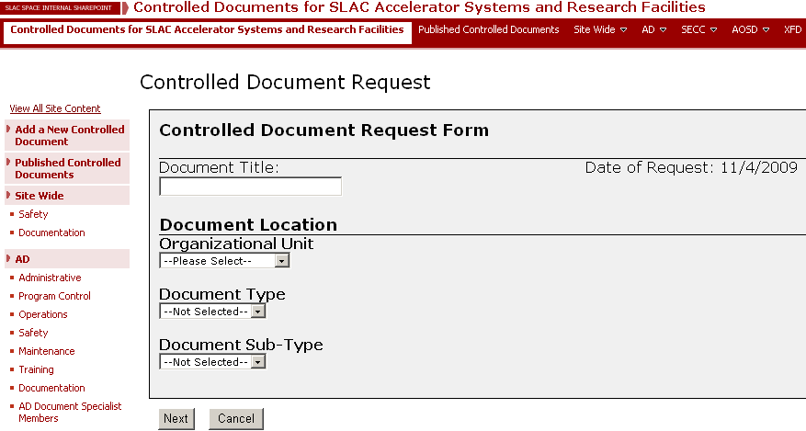
The documentation specialist adds a new controlled document
https://slacspace.slac.stanford.edu/sites/slac_sci_controlled/Pages/

Slide 8
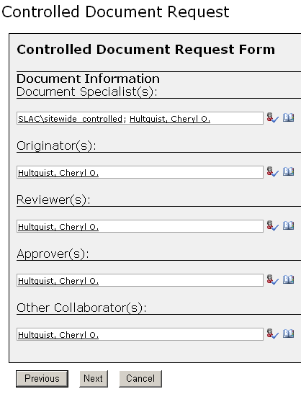
The documentation specialist identifies the authorized collaborators (permissions are automatically set)
Active Directory

Slide 9
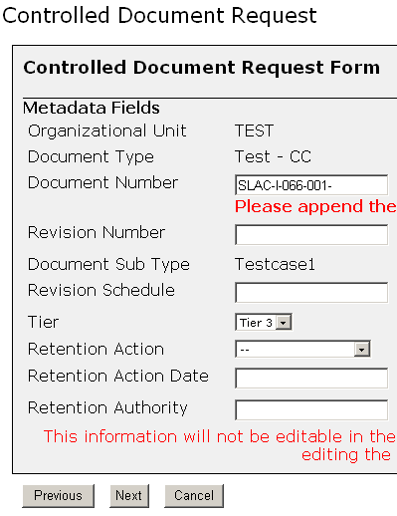
The documentation specialist completes the metadata

Slide 10
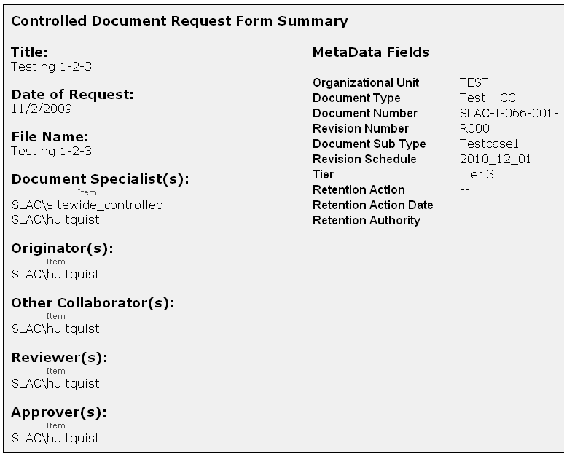
The documentation specialist reviews the controlled document request

Slide 11
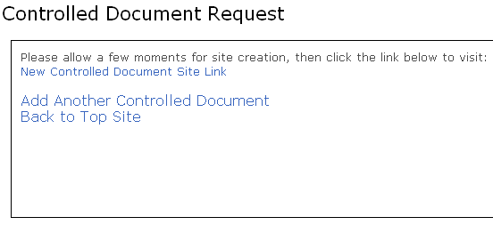
A controlled document site is created for the initial release and all subsequent revisions

Slide 12
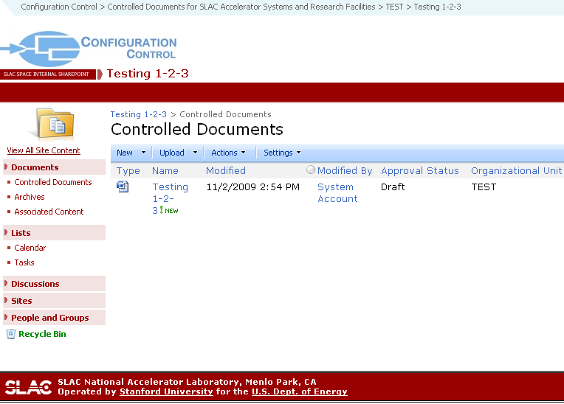
The document is available for collaboration
Sub sites for associated content, archives, discussion
Metadata

Slide 13
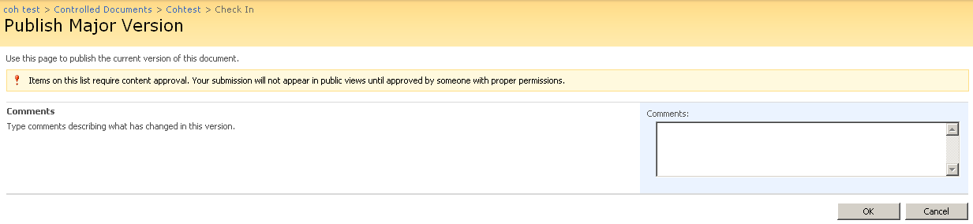
Approve the document
Upon approval a PDF is automatically created and published to the appropriate published controlled document site.

Slide 14

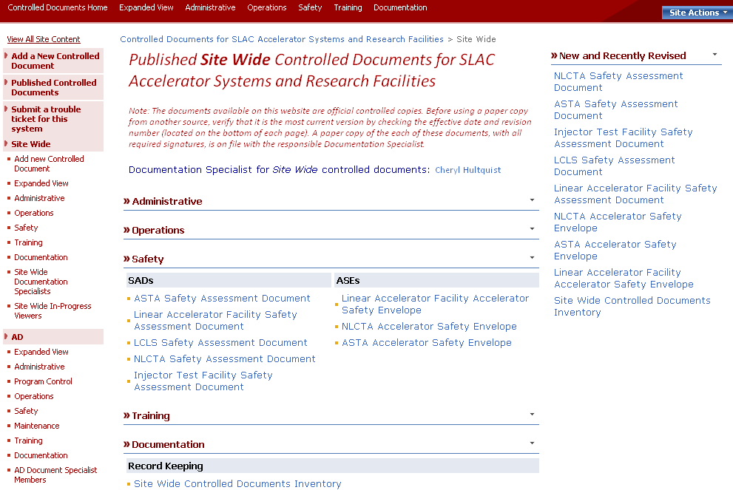
The result
A PDF of the approved document is available for use. Only the most current approved version is accessible. The entire document lifecycle is captured within one system to allow relevant searching and auditing.

Slide 15
Part 2 - Technical
Controlled Documents for Accelerator Systems and Research Facilities

Slide 16
Design Parameters
Minimize customizations to OTB (Out of the Box) SharePoint
2010 coming soon
Don’t want to have to maintain an extensive set of customizations
Allow any good SharePoint tech to be able to pick it up
Very large delta in security granularity – simple roles wouldn’t work
Usable right away – could be stood up in stages
Design for flexibility
Site templates
Metadata
Document Templates
Navigation
Views
Permissions
Workflow

Slide 17
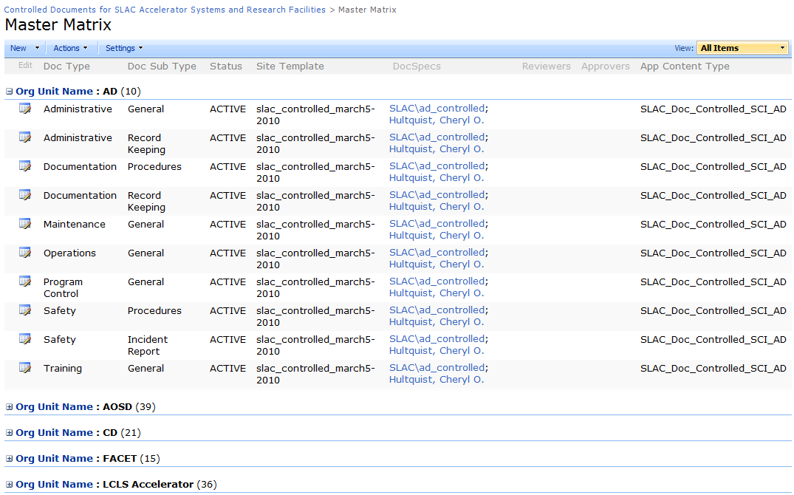
Configuration
Master Matrix
Configures key templating at the level of a subtype:
Drives metadata (Content type), Security, site and document templates at a reasonably low level (i.e. Accelerator Directorate,Safety, Incident Report)

Slide 18
Configuration
Master Matrix
Configures key templating at the level of a subtype:
Drives metadata (Content type), Security, site and document templates at a reasonably low level (i.e. Accelerator Directorate,Safety, Incident Report)

Slide 19
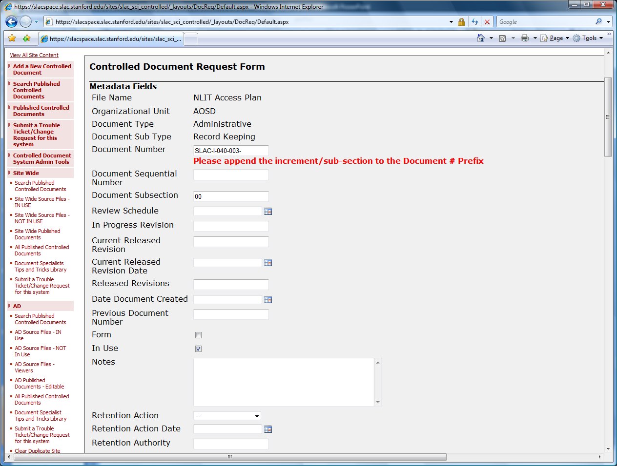
Provisioning “Wizard”
Here lies custom code, C#, uses Windows Workflow Foundation. Dynamically configured based on Master Matrix, Administrative Permissions and Content Types.

Slide 20
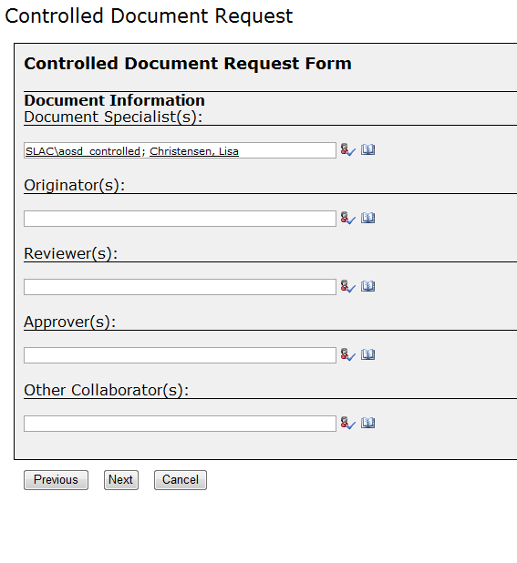
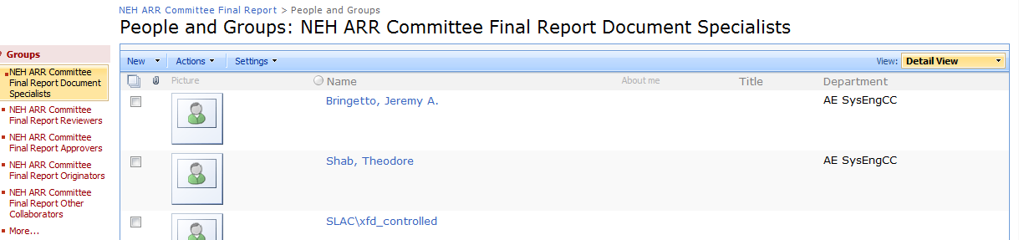
Security assigned during provisioning or afterwards through standard SharePoint security groups

Slide 21
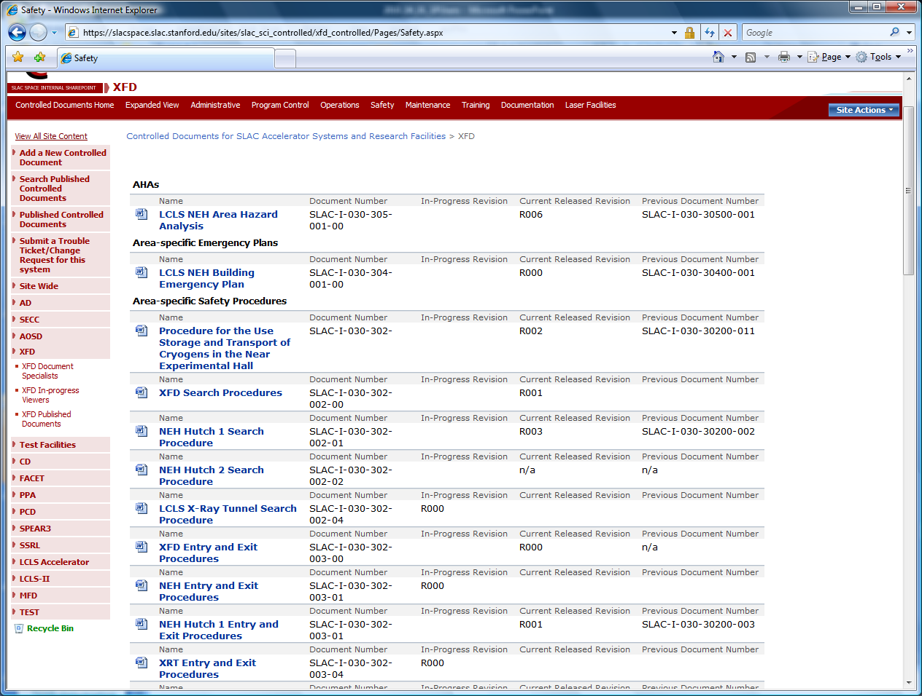
Multiple Views to underlying documents using the Content Query web part
Source Views (by Document Collection and Type)

Slide 22
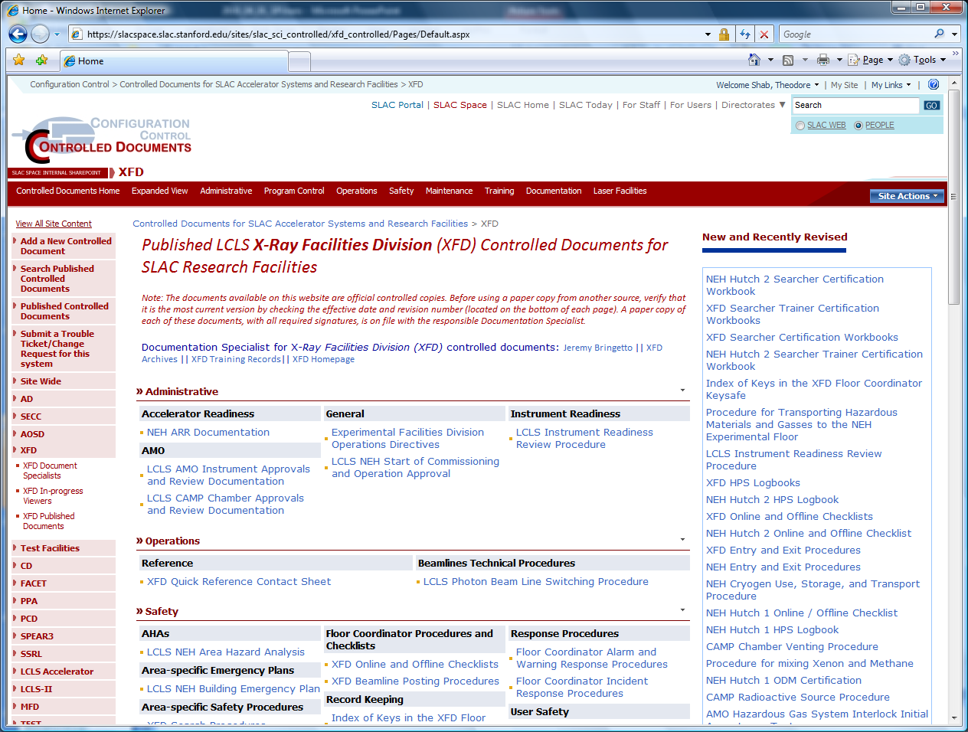
Multiple Views to underlying documents using the Content Query web part
Public View (Published Documents)

Slide 23
Part 3 - Organizational
Controlled Documents for Accelerator Systems and Research Facilities

Slide 24
In it to win it
Design Review
Internal 5/13/2009
External (committee of DOE SharePoint experts) 7/2/2009 (THANKS!)
Sam Mashburn and Mark Gabriel, Oak Ridge Operations
Connie Begovich, ORNL
Erin Brown and Jason Meaden, PNNL
Phyllis Teague, Sandia
SharePoint acceptance at SLAC is a mixed bag, so user interface has to be likable by all
Flexibility is king
Metadata should be standardize top-down, but those efforts wouldn’t feed the wolves this year
Get buy-in from key customers
Do real work with it right away
Configuration phase critical with new document libraries, although typically only requires about two person days total per document collection (includes metadata and templating changes)

Slide 25
Part 4 – Future Plans
Controlled Documents for Accelerator Systems and Research Facilities

Slide 26
Enhancements, Rollouts and Additions
Enhancements
Views, using Jquery (more dynamic)
Workflow (investigating K2)
Rollouts
Expect to rollout another 10-15 site collections (Document Collections) this year, but that could triple under certain circumstances
Additions
Looking at drawings
That other thing
Looking at migrating to 2010 asap, most likely 1st Quarter FY2011

Slide 27
Resources
Group Lead: Cheryl Hultquist
Systems Analysts and Project Managers
Andrea Chan - AD and LCLS SLACSpace and SLACPortal
Ted Shab - Controlled Documents for Accelerator Systems and Research Facilities
Core Documentation Specialists
Cheryl Hultquist - Site Wide, AD, Systems Engineering and Configuration Control
Jeremy Bringetto - LCLS Directorate Experimental Facilities Division
Lisa Christensen - Accelerator Operations and Safety Division
AD Document Control and Records Management
Service Level Agreement by Computing Division for SharePoint at SLAC
May 24, 2010

