Slide 1
Implement Workspace Virtualization while Reducing OpEx
Department of Energy (DOE)
National Laboratories Information Technology (NLIT) Summit
Ken Cline, Systems Consultant
Quest Software, Desktop Virtualization Group

Slide 2
Agenda
Virtual Workspace Challenges
Virtualization Value Proposition
Costs of Delivering a Virtual Workspace
Options for Delivering a Virtual Workspace
Make it Make Cents
Quest vWorkspace: An Introduction

Slide 3
Workspace Challenges
Workspace Management
Installation, Patches, Upgrades
Short useful life of endpoint devices
End User Support
High-touch requirement
Security
Data at rest on endpoint devices
User Mobility
Telecommute, remote office/branch office, anywhere access from any device
Data Protection
Enterprise data lives on unmanaged endpoint devices
Energy Efficiency
Current workspace devices are power hungry
Generate significant heat that must be dissipated
Business Continuity
Users need access to systems when they can’t get to work
Natural disasters (hurricane, flood, snow storm, etc.)
Pandemic (bird flu, swine flu, etc.)
Terrorist incident (9/11, etc.)

Slide 4
Virtualization Value Proposition
User mobility
Enabling technology for telework solutions
Client independence
Bring your own PC
Mobile devices (smart phones, etc.)
Data protection
Information housed on enterprise managed storage
Redundancy, fault tolerance
Enterprise backup policy
Enhanced regulatory compliance
Business continuity
Users can work, even if they can’t get to work
Data is centralized, can be replicated to DR site
Centrally managed workspaces
Updates can be delivered to the user across a logout/login
Consistent virtual hardware platform reduces complexity
End user device has longer useful life
End user support
Delivered remotely
Significantly fewer desk-side visits
Most handled by first-level help desk staff
Security
Data lives in the data center, not on the end user device
Centrally managed access to removable media devices
Energy efficiency
Highly efficient endpoint devices
Power, heat & cooling managed in data center

Slide 5
Delivery Options
Remote Desktop Session Host (RDSH)
More commonly known as Terminal Services
Most cost-effective solution
Virtual machine based delivery (VDI)
Gets the most attention today
Highly flexible solution
Still have many OS instances to manage
Physical system remoting
Allow users to remotely access physical systems (personal desktop systems, blade PCs in the data center)
Application virtualization
Can be coupled with any of the above
Simplifies application lifecycle management

Slide 6
Delivery Costs
Infrastructure
Servers
Networking
Storage
Data protection
Licenses
Virtualization
Data protection
Desktop operating systems
Access licenses
Management
Full lifecycle
Image management
Provisioning, allocation, user state management
Patch, upgrade, decommission

Slide 7
Making it Make Cents

Slide 8
Servers are the Foundation
Use modern, high-performance servers as the basis for your workspace virtualization effort
Desktop usage is “bursty”, need to have reserve capacity
Don’t be afraid of density – but have enough redundancy
Build a balanced configuration
There are four core resources: CPU, RAM, network, & storage
Make sure to have adequate I/O (network & storage) bandwidth
Consider 10GbE and converged networks
Consider “scale-out” redundancy
Think of the server, rather than the I/O interface, as the failover unit

Slide 9
Networking is the Glue
Core networking services must be robust and reliable
10GbE allows for better performance with fewer connections
Improves data center reliability and maintainability
Converged storage and “regular” network traffic on high performance network infrastructure
Simplifies overall data center environment
Fewer technologies to manage

Slide 10
Storage is a Key Component
Boot storms / logon storms can kill performance (and user acceptance)
Steady state operations use ~10 IOPs/user
Logon can use 20+ IOPs/user
Boot-up can use 30+ IOPs/user
Consider solid state disks to meet the IOPs requirements
Consider standalone hosts with local storage to minimize infrastructure costs
Consider IP-based storage (CIFS / NFS) for persona persistence
Deploy “Single Image” VMs using base image with snapshot technology to reduce storage consumption & improve storage cache hit rates

Slide 11
Management Brings it Together
Operating systems, applications, group policies, ACLs, permissions, and more!
Stateless virtual machines
Centralize workspace management to the maximum extent possible
Provisioning
Configuration
Allocation to users
Persona management
Patch / upgrade management
Decommissioning

Slide 12
Quest vWorkspace
An Introduction

Slide 13
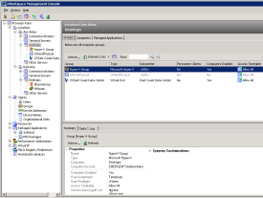

Quest vWorkspace
Broker
VDI: Multiple Options
Terminal Services/RDSH
Blade PCs
User Experience
Optimized Performance
Range of Access Devices
Universal USB and Print
Management
Automation
Flexibility
Security

Slide 14




Simplify Management of Application and Desktop Delivery Multiple User Types – Multiple Deployment Options – Single Console
Task Workers
Terminal Server
Knowledge Workers
VDI
Power Users
Blade PCs
Shared OS
Shared Apps
Server OS
Fast and Personal
Can be user-customized
Provisioned on-demand
Fully isolated and secure
Standard desktop OS
Fast, Powerful and Consistent
Demanding users/applications
Fully isolated and secure
Standard desktop OS
Deploy and Manage the Most Cost-Effective Solution
Management Console

Slide 15
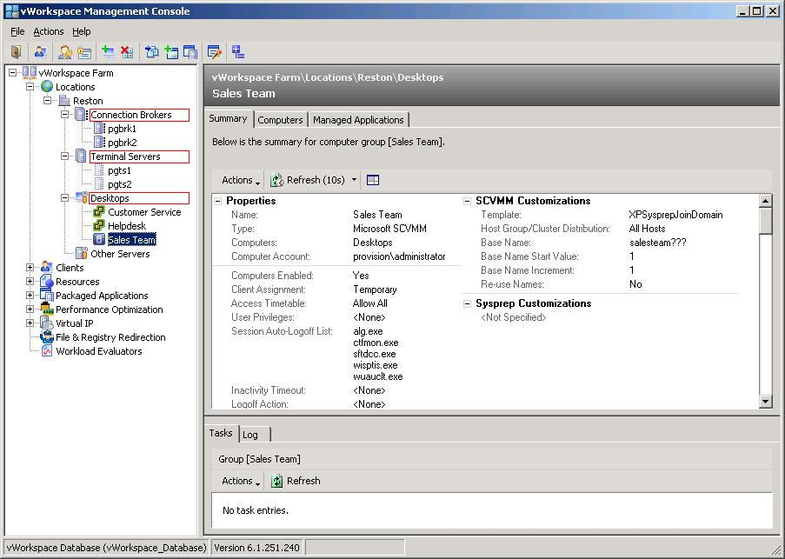
Single Management Console – RDS, VDI and PCs

Slide 16
The Smarter Way to Desktop Virtualization
Simplified – Consolidation Reduces Complexity
Efficient – Schedule and Automate Operations
Flexible – Adapt to Changing Needs and Platforms
Scalable – Built for Full-Scale Deployments, Not just POC
Cost-Effective – Best Price/Performance Available
Work Smarter, Not Harder.

Slide 17
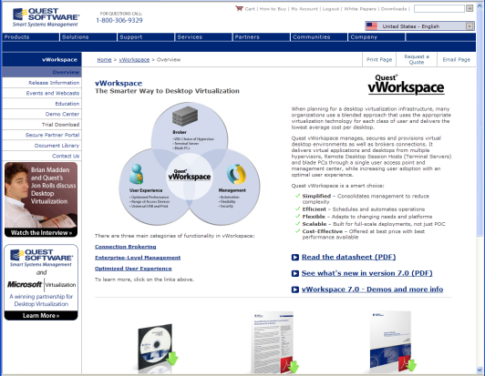
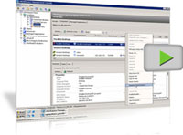
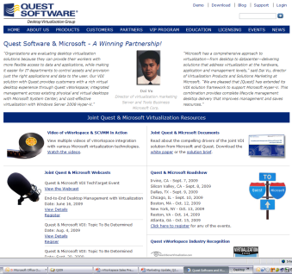
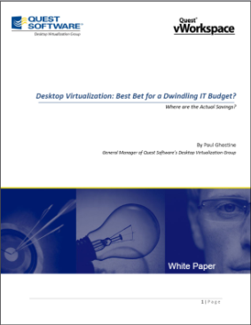
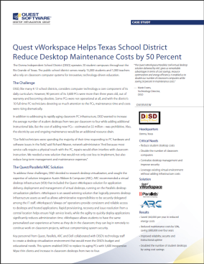
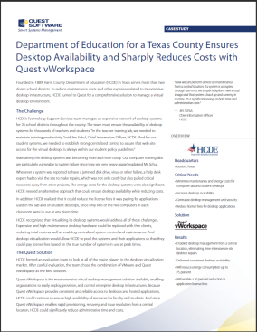
Questions and Answers
vWorkspace Web pages & General Information
www.quest.com/vworkspace/
vWorkspace Demos
www.quest.com/vworkspace/demo.aspx
vWorkspace Evaluation Software
www2.provisionnetworks.com/downloadreg.aspx
vWorkspace & Microsoft VDI Solution
www.vworkspace.com/aWinningPartnership/
vWorkspace Webcasts and Events
www.quest.com/vworkspace/events-webcasts.aspx
ROI White Paper
Desktop Virtualization: Best Bet for a Dwindling IT Budget? Where are the Actual Savings?
www.quest.com/documents/landing.aspx?id=10685&technology=&prod=389&prodfamily=&loc=
Case Studies
www.quest.com/documents/list.aspx?contenttypeid=13&technology=&prod=389&prodfamily=&loc=

