Slide 1




Migration to System Center Configuration Manager at LANL
Departmental Computing Services
DCS-1
Mark Wingard
LA-UR 10-03089

Slide 2
Agenda
Departmental Computing Services
DCS-1
LANL migrated from SMS 2003 to System Center Configuration Manager 2007 in April, 2010
LANL Environment
  General
  Technical
  Political

Slide 3
Environment
Departmental Computing Services
DCS-1
LANL has been using SMS for 13 years
  Supporting 14,000 unclassified PCs
    Team of 5 FTEs for 7000 PCs, Team of 2 as of Jan
  Collections based on 90 top-level OUs
    Over 150 collection admins
      Remote support & queries but no SW distribution
  100% user acceptance of ITMU patching
    No patching of servers
  Extensive use of software distribution
    Adobe patching, Office, utilities, etc
  Heavy reliance on SMS by cyber-security

Slide 4
Why Not Upgrade SMS?
Departmental Computing Services
DCS-1
Mainstream support ended January 12th
SCCM had been out for over 2 years
SCCM had desirable features
SCCM client is more stable
SMS 2003 site server was 6 years old
Desire to integrate OS deployment
Lack of resources!

Slide 5
Migration Plan – General
Departmental Computing Services
DCS-1
Get DAA approval
Arrange for PSS consultant on-site
Test migration on development network
Install SCCM in production
Conduct extensive communication about upgrade
Upgrade SMS 2003 clients
Moratorium on CPAT blocking
Patch systems using new software update mechanism
Live happily ever after

Slide 6
Oversight Environment
Departmental Computing Services
DCS-1
DOE Designated Approving Authority (DAA) must approve all security significant changes
Request to upgrade to SCCM made in early December
Permission granted in late March
  Could not extend AD schema until DAA approved
  Did not want to install SCCM until schema was extended
  Needed to stage upgrade around Microsoft patching schedule
Microsoft consultant could not come on site due to legal issues
  Off-site consultant fell through due to unpredictability of schedule

Slide 7
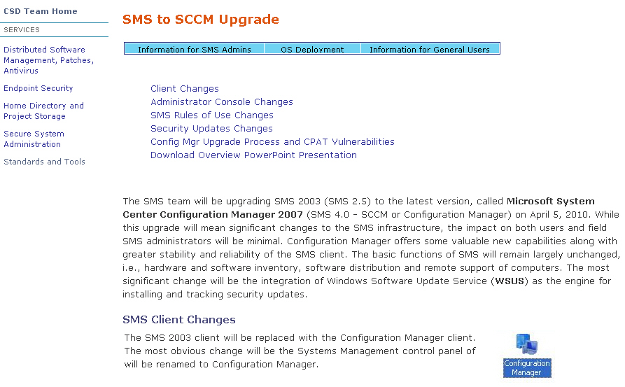
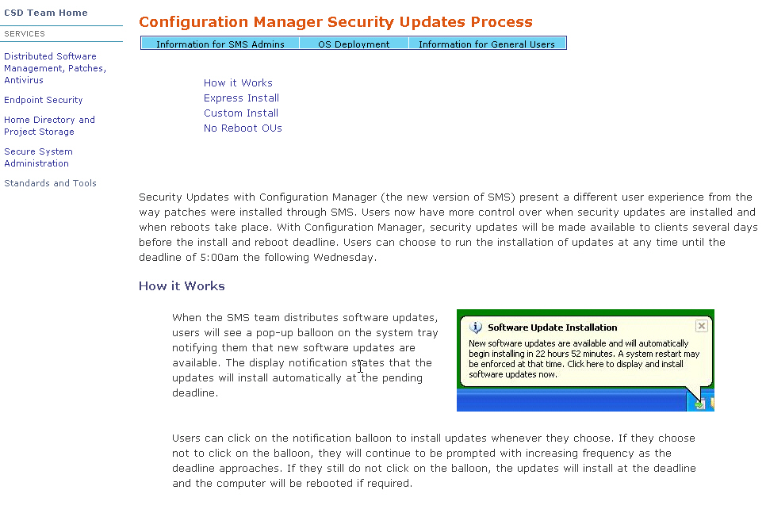
Migration Plan – Political Environment
Departmental Computing Services
DCS-1
Communications
  Developed web pages announcing upcoming client changes
    More web pages explaining change in patching behavior
  Sent e-mails to various mailing lists
  Attended computer support team meetings

Slide 8
Migration Plan – Political Environment
Departmental Computing Services
DCS-1
Server Patching
  SMS traditionally avoided patching or installing software on servers
  Some organizations maintained their own WSUS
  Institutional WSUS linked to by many OUs
  SCCM software update agent cancels WSUS group policy
  Obtained Information Architecture approval for server patching
  Held Change Control Board for server patching
    Allowed orgs with complex WSUS setup to use SCCM admin console to do their own patching
    Established No Reboot, No Patch and Patch w/ Reboot strategies based on OU placement

Slide 9
Migration Plan – Technical Environment
Departmental Computing Services
DCS-1
Original Plan
  Side-by-Side migration
    Install SCCM site as parent to SMS 2003
    Move site boundaries from AD-based SMS 2003 site to AD-based SCCM site
    Extend AD schema and update AD
    SMS 2003 clients auto-magically assign themselves to SCCM site
    SCCM client can be pushed out incrementally via software distribution
  That’s the way it was supposed to work…

Slide 10
Migration Plan Tech Environment Cont’
Departmental Computing Services
DCS-1
Tested plan on development network
  SMS 2003 Clients would not discover SCCM site
  Microsoft Premier Support provided WMI script to change site assignment
  Catch-22 in deploying WMI script
    If deployed via SMS 2003, no SCCM site to discover
    Could not be deployed via SCCM site
    If WMI script deployed via Group Policy, why not just deploy SCCM client instead?

Slide 11
Migration Plan Tech Environment Cont’
Departmental Computing Services
DCS-1
Actual Plan
  Side-by-Side migration
    Install SCCM site in parallel to SMS 2003
    Push Out-of-band IE patch as final act of SMS 20003
    Extend AD schema and update AD
    Move site boundaries from AD-based SMS 2003 site to AD-based SCCM site
    Create domain level GPO start-up script to install SCCM client
      Allowed inheritance blocking to prevent server client installs
    When SMS 2003 clients reboot from IE patch, they run script and auto-magically become SCCM clients
  It should have worked…

Slide 12
Migration Plan – What happened
Departmental Computing Services
DCS-1
Active Directory brought to its knees
  Domain controllers not authenticating
    90+ % CPU usage
    Windows 2008 DC memory leak
    Patch on DC lost DNS connection
  Client unable to process GPOs
    “Cannot bind to domain”
  Cached credentials allowed logons anyway
  Only 1/3 of SCCM clients were installed
  Tried changing startup script to run from Management Point instead of downloading 120 Mb files
    No appreciable improvement in SCCM client installs

Slide 13
Migration Plan – What happened Cont’
Departmental Computing Services
DCS-1
Patched DCs to fix memory leak
  CPU usage dropped
Added more DCs
  Client still not installing
Replaced startup script with SW installation GPO
  Client still not installing
2000+ SMS 2003 clients still talking to old site
  Tried pushing SCCM client install package from SMS 2003
    Source files did not copy properly
    Client would not install because “prerequisite files are not MS signed”

Slide 14
Migration Plan – What happened Cont’
Departmental Computing Services
DCS-1
Pushed site re-assignment WMI script to SMS 2003 clients
Pushed SCCM install to newly assigned 800+ SMS 2003 on SCCM site
  Clients would not run package if they had attempted to run it from SMS 2003 site
  Other bizarre errors
Reached 12,750 clients after 1 month
  Avoided targeting servers due to WSUS considerations
800 SMS 2003 clients would not upgrade no matter what
  Sent list to OU admins/field teams to address manually
  Often required running CCMClean

Slide 15
Migration Plan – What happened Cont’
Departmental Computing Services
DCS-1
Other issues
  Changed paper-based Rules of Use access to on-line
    Permission tweaking for departmental admins
  Reporting problems with IIS7 on W2K08 servers
  Help Desk frustration with no more CTRL-ALT-DEL in Remote Tools
  Labor intensive desktop visits to upgrade clients manually
Good News
  Software update process came off without a hitch in April

Slide 16
Lessons Learned
Departmental Computing Services
DCS-1
Group Policy troubleshooting is a black hole
  Without an effective tool, determining if and when GPOs run is nearly impossible
    Relying on anecdotal data
    Application event log entries
  Cached credentials prevented users from noticing they were not being authenticated and not applying GPOs
Don’t believe everything your read on Technet
  No documentation on clients not discovering new site
Always assume it will take twice as long to get DAA approval than you plan for
  It actually took 3 times as long
Have enough staff to do the job
  Hiring freeze still in place
  2-year limited term openings
    Did you bring your resume to NLIT?

Slide 17

Questions
Departmental Computing Services
DCS-1

