Slide 1
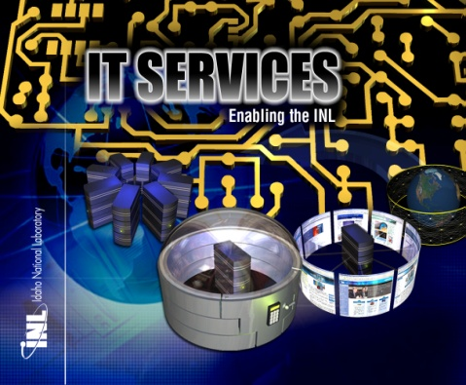

INL Service Management
Demonstrating Progress in Moving
to an External Business Focus
from an Internal Technology Focus
May 24-26
Jeanette L Cook

Slide 2
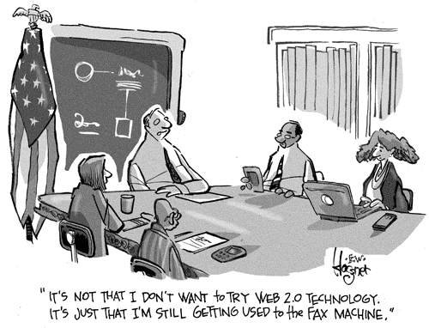
Information Technology: Hindrance?

Slide 3
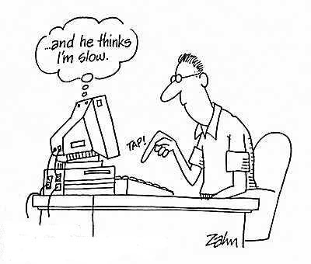
Information Technology: Hindrance?

Slide 4
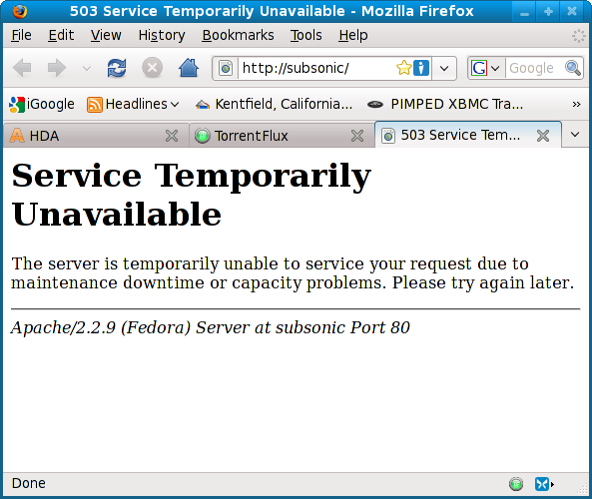
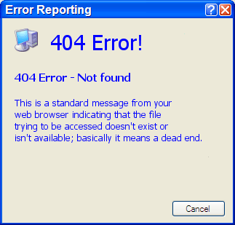


Information Technology: Hindrance?

Slide 5


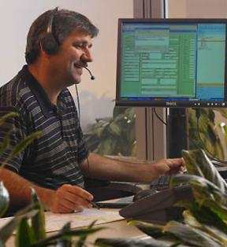
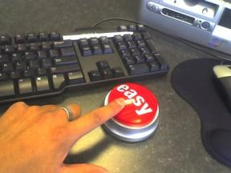

Information Technology: Or Help?

Slide 6
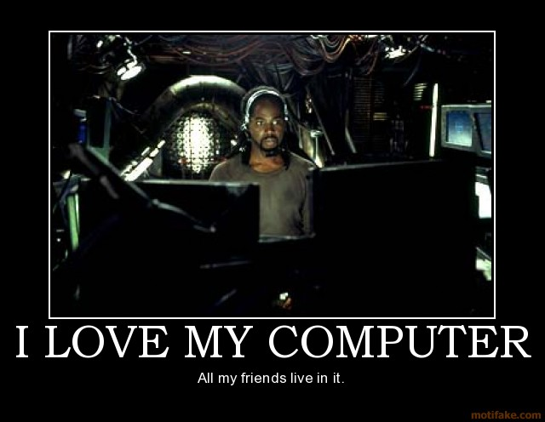
Information Technology: Or Help?

Slide 7
Agenda
What is Service Management?
Why Service Management?
How did INL implement Service Management?
What’s Next?
What are INL’s Lessons Learned?
Questions?

Slide 8


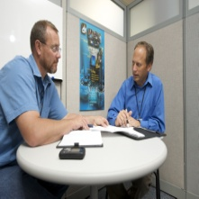

Service Management: Focus is the Customer
Providing value to the customer through delivery of services
Applying discipline to managing IT services in a way to continuously improve
Bringing maturity, consistency, predictability to IT service delivery
Achieving common understanding between the customer and provider through managing service-level expectations and delivering and supporting desired results

Slide 9
IT Organization Maturity Scale
Outward-Focused IT
Potential Economic Value
Step 4
IT Exploitation
Step 3
Inward-Focused IT
Customer- Driven
Step 2
Process Maturity
Step 1
Process Implementation
IT Credibility
Adapted from Gartner Group’s IT Management Maturity Model

Slide 10
Why Service Management?
Transform from “managing technology” to delivering end-to-end results
Drive INL innovation and growth
Gain efficiencies
Improve IM service delivery consistency
Allows to right-size services (dial up or down)

Slide 11

Service Management Process
Roadmap
Revise
Implement
Vision
Feedback
Monitor
Assess
Measure
Best practice framework – ITIL  Iterative approach  Driven by customer needs

Slide 12
Service Management Roadmap
FY 2010
FY 2010
FY 2010
Incident Mgmt
Problem Management
Mature Financial Management
Capacity Mgmt
OLA Development
Knowledge Management
Remedy Upgrade
Demand Mgmt
Program Definition
Event Management
Configuration Mgmt Database
ITIL Foundations Training
SLA Revisions
Automate SLAs
CAES SLA
Vulnerability Management
Variance Tracking
Revisit HPC SLA
Service Asset & Config.
Change Mgmt
Firewall Rule Request Proc
iFACTS Integration
Process specific ITIL training
SM people consolidation
Continuity Mgmt
Service Portfolio
Standardize SLA reporting
In-house ITIL training
SM budget/tool consolidation
Release & Deploy Mgmt
INL eServices
Cyber SLAs
IM Professional Services SLA
Revise SLAs
Financial Management
INL Request Management – Service Catalog Implementation Phase II
Enterprise SLAs
Visit Process Ownership
Develop Performance Goals
Revise OLAs
ITIL Foundations Training
Develop Process Maturity assessment
Availability Mgmt
Upgrade Remedy to 7.6

Slide 13

Define Services

Slide 14
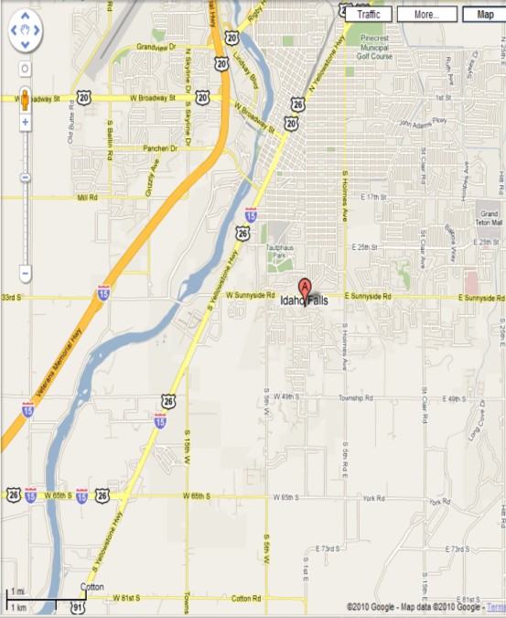
Determine where you are
External assessment
Apollo 13 training
Incident management
Change management
Service delivery principles
ITIL Foundation Training

Slide 15
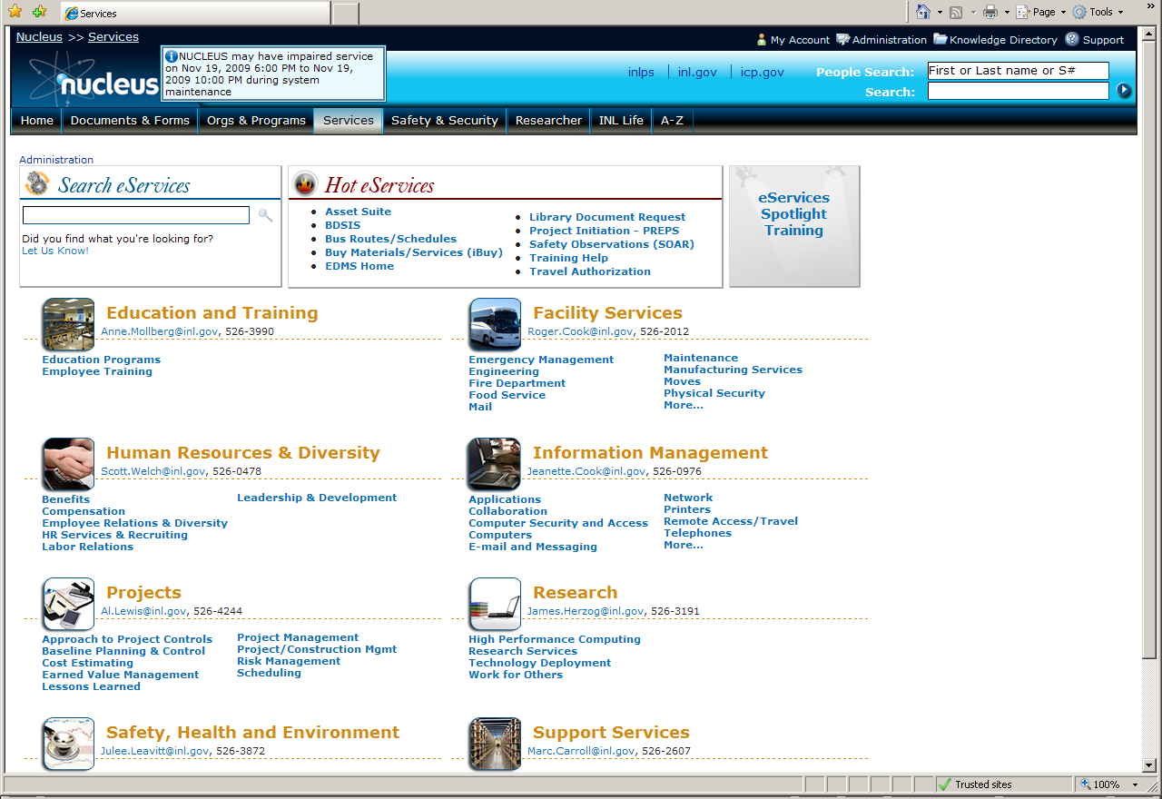
Make Services Available: INL’s eServices

Slide 16

Service Level Agreements
Create framework
SLA written at service portfolio level
Manage customer expectations
Use standard SLA process

Slide 17
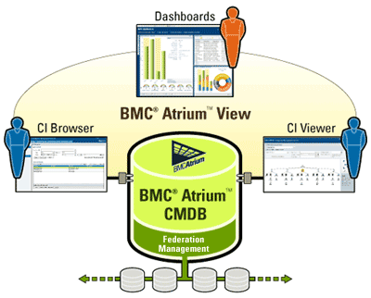
CMDB and Change Management
Gartner research reveals that 80% of all application downtime is caused by change (planned and unplanned).

Slide 18
Budget By Service
IT Services | Budget
Workplace Support | $ 5,000,000
Business Process Automation | $15,000,000
Virtual Collaboration | $15,000,000
High Performance Computing | $20,000,000
Cyber Security Services | $10,000,000
Professional Services | $ 5,000,000
Sample

Slide 19
What’s Next?
eServices Phase II
Asset management
Operational level agreements
Self-assessments
Problem, knowledge, event

Slide 20

Service Management Makes IT Help!
Customers know what to expect
Customers know how to obtain services
Services are restored more quickly
IM operates on facts
Creates foundation for service improvement
Focused on the right services for the laboratory
Greater Customer Satisfaction!

Slide 21

Tips for Success
Start where you are
Develop a roadmap with incremental steps toward vision
Train staff early
Create quick wins
Focus on low-hanging fruit
Remember, it is an iterative process
Obtain and retain top-level commitment
Be patient – culture change takes a long time – but it’s worth it
It’s not tidy

Slide 22

Questions?
Contact Information:
Jeanette L Cook, Idaho National Laboratory, jeanette.cook@inl.gov
208-526-0976 or 208-569-1580 (cell)

