Slide 1

Securing Virtual Directories
May 25, 2010
Bill Claycomb
Member of Technical Staff
Sandia National Laboratories
Albuquerque, New Mexico, USA
Sandia is a multiprogram laboratory operated by Sandia Corporation, a Lockheed Martin Company,
for the United States Department of Energy’s National Nuclear Security Administration
under contract DE-AC04-94AL85000.

Slide 2
Agenda
Directory services and virtual directories
Threats to directory services
Attacks on virtual directory services
  Protecting Virtual Directories
  Risk Analysis Framework for VDS
Next steps

Slide 3
Directory Services
Localized data store containing information about objects
  Users
  Computers
  Contacts, etc.
Provide information to applications
  Authentication and access control
  Contact information
  Group membership
Use LDAP Communication Protocol
  Lightweight Directory Access Protocol

Slide 4
Directory Services Data
  dn: cn=Joe User,dc=somedomain,dc=com
  cn: Joe User
  givenName: Joe
  sn: User
  telephoneNumber: 1 505 555 1212
  postalAddress: 123 Main St.
  mail: juser@somedomain.com
  objectClass: inetOrgPerson
  objectClass: organizationalPerson
  objectClass: person
  objectClass: top
Object
Attribute

Slide 5




Directory Services
Popular Directory Services Implementations
  Windows Server Active Directory
  IBM Tivoli
  Apple Open Directory
  OpenLDAP
  Fedora Directory Server
  Sun JAVA System Directory Server

Slide 6
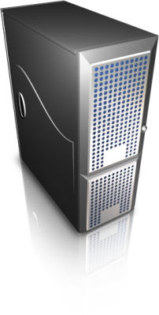
Virtual Directories
Virtual Directory Server
Client
Directory Servers

Slide 7
Virtual Directories
Synchronization
Virtual Directory Server
Data Stores
Directory Servers

Slide 8

Threats to Sensitive Directory Information
“Insider Threat Study: Illicit Cyber Activity in the Government Sector”, a study conducted by U.S. Secret Service and CERT (2008) found:
  Most of the insiders had authorized access at the time of their malicious activities
  Access control gaps facilitated most of the insider incidents, including:
    The ability of an insider to use technical methods to override access controls without detection
    System vulnerabilities that allowed technical insiders to use their specialized skills to override access controls without detection

Slide 9
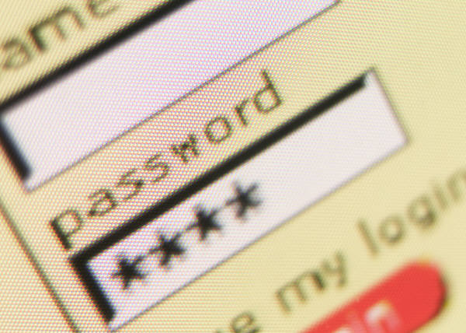
Attacks on Virtual Directories
Authentication attack
Cache attack
Data transformation attack
Network disruption attack
Source data redirection attack
Destination data redirection attack
Covert channel attack
Synchronization attack
Exposed data attack
Data combination attack

Slide 10
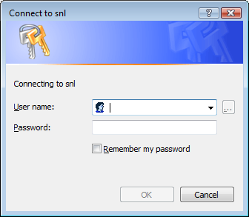
Authentication Attacks
Stored Credentials
User
Credentials
Stored
Credentials
Virtual Directory Server
Stored
Credentials
Destination Servers

Slide 11

Cache Attacks
High
Speed
Cache
Client
Virtual Directory Server
Directory Servers

Slide 12
Data Transformation Attacks
(505) 555-1212
505-555-1212
US Citizen: Y
US Citizen: N
Data Transformation
Virtual Directory Server
Client
Directory Servers

Slide 13
Network Disruption Attack
Accounts:
X
Y
Z
Change Detected:
Disable Account X
Virtual Directory Server
Directory Server

Slide 14

Network Attacks
Accounts:
X
Y
Z
Change Detected:
Disable Account X
Virtual Directory Server
Directory Server

Slide 15
Source Data Redirection Attack
Attacker’s
Directory Server
Virtual Directory Server
Directory Server
Client

Slide 16
Destination Data Redirection Attack
Attacker’s
Client
Virtual Directory Server
Directory Server
Client

Slide 17
Covert Channel Attack
Virtual Directory Server
Directory Server
Client
Attacker’s Data Store

Slide 18
Synchronization Attack
Stored Credentials
Directory Server
Virtual Directory Server
HR SQL Server
Stored Credentials
Virtual Directory Server
HR SQL Server
Directory Server
Attacker’s Data Store

Slide 19
Exposed Data Attack
Name
Email Address
SSN
Salary
Name
Email Address
Client
Stored Credentials
Virtual Directory Server
Directory Server
Name
SSN
Salary
Attacker’s Data Store

Slide 20
Data Combination Attack
Clearance: Y
Clearance: N
Clearance: Y
Directory Server 1
Synchronization
Virtual Directory Server
Access Control System
Clearance: N
Directory Server 2
Authoritative Source: Directory Server 2
Authoritative Source: Directory Server 1

Slide 21
Protecting Virtual Directories
Threats depend on level of access
Administrator Access
User Access
Network Access

Slide 22
Addressing Threats Requiring Network Access Only
Use encryption for all inter-server communication (SSL, LDAPS, etc.)
  Prevents eavesdropping
  Prevents password capture (LDAP simple bind)
  Prevents manipulation of network messages
Verify transaction success, notify administrators if transactions fail

Slide 23
Addressing Threats Requiring User
Access Only
Limit user access to the virtual directory server
Require authentication for interaction with the virtual directory server
  Eliminate anonymous connections
Ensure virtual directory encrypts stored credentials
Configure access controls on virtual directory files
  Cache
  Transformation scripts
  Topology configuration

Slide 24
Addressing Threats Requiring User
Access Only
When stored credentials are required, use restricted accounts
Only gather necessary data from back-end data sources
Do not use persistent cache for sensitive data
Do not allow transformation of sensitive data

Slide 25
Addressing Threats Requiring
Administrator Access
Use networking rules to enforce allowed connections to/from the virtual directory server
  IPSec, firewall, etc.
Perform consistency checking of sensitive data
  Use another system
Limit access to synchronization topologies
Monitor network activity to/from the server for unexpected traffic
Encrypt directory data

Slide 26
 | Authentication attack | Cache attack | Data trans-formation attack | Network disrup-tion attack | Source data re-direction attack | Destination data redirection attack | Covert channel attack | Synchronization attack | Exposed data attack | Data combination attack
Use SSL | X |  |  | X
Verify transaction success |  |  |  | X
Require authentication | X
Encrypt stored credentials | X
Protect cache |  | X
Protect transformation scripts |  |  | X |  |  |  |  |  |  | X
With stored credentials, use restricted accounts | X
Limit data gathered to relevant data only |  |  |  |  |  |  |  |  | X
Network Access
User Access
Administrator Access

Slide 27
 | Authentication attack | Cache attack | Data trans-formation attack | Network disrup-tion attack | Source data re-direction attack | Destination data redirection attack | Covert channel attack | Synchronization attack | Exposed data attack | Data combination attack
Limit access to the virtual directory server | X | X | X | X | X | X | X | X | X | X
Do not use cache for sensitive data |  | X
Do not allow transfor-mations of sensitive data |  |  | X |  |  |  |  |  |  | X
Use IPSec, firewall, etc. |  |  |  |  | X | X | X | X
Perform consistency checking of sensitive data |  | X | X | X | X | X |  |  |  | X
Protect topologies |  |  |  |  |  |  |  | X |  | X
Monitor network traffic |  |  |  |  | X | X | X | X
Encrypt directory data | X |  |  |  | X | X | X | X | X | X
Network Access
User Access
Administrator Access

Slide 28

Understanding Threat Risk
Important to determine which attacks are most serious for an individual organization
  Consider what threats are most serious to your group
If threats and risks could be quantified, it would be easier to focus protection efforts on the most critical areas

Slide 29

Risk Analysis Framework
Risks
  Data Confidentiality
  and Integrity
  Business Logic
  Compromised Credentials
  Availability
Attack Anatomy
  Required Access
  Likelihood of Detection
Generate an Risk Vector using these components

Slide 30
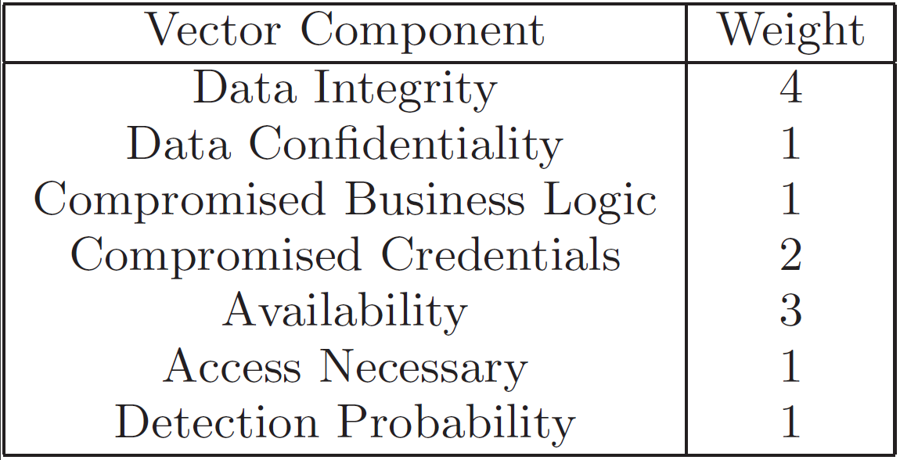
Weighting Risk Factors

Slide 31
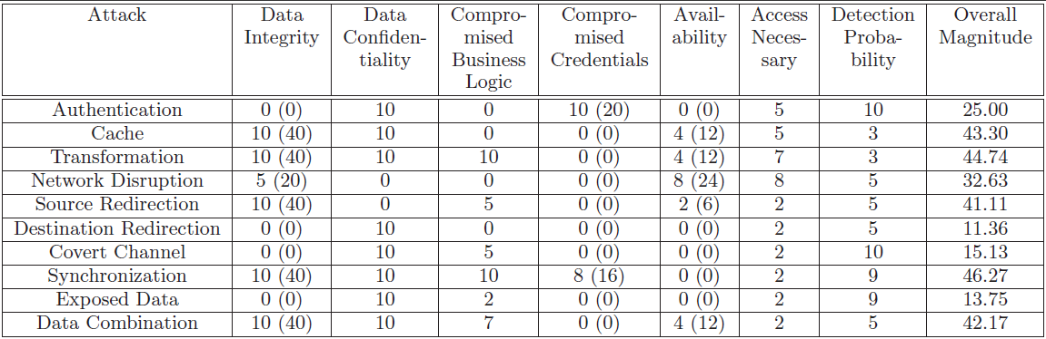
Risk Vector Example

Slide 32
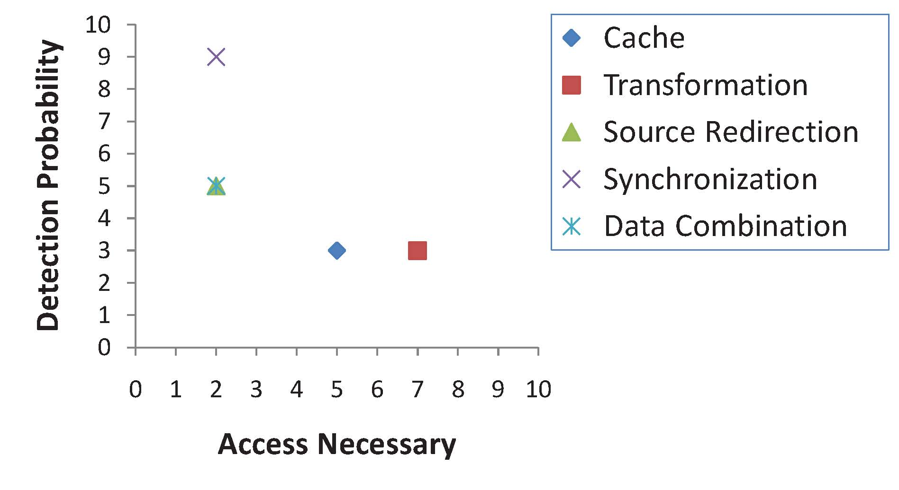
Attack Analysis
Analysis of risk vectors enables attack grouping

Slide 33

Future Directions
Implement advanced attack models to determine feasibility
Explore attacks on various VDS implementations
Automation of modeling and analysis process
  Tool development

Slide 34

Questions
http://www.sandia.gov
wrclayc@sandia.gov

