Slide 1
“Cloud Computing”
Gary Rodgers
Public Sector Consultant

Slide 2
Outline of Presentation
Cloud Context
Cloud Definition
HP’s Viewpoint of Cloud Computing
HP’s Cloud Strategy
HP’s ePrint Mobile Printing Solution
Questions

Slide 3

Questions forming around cloud
Is Cloud hype or real?
What is cloud computing?
What are cloud services?
What will a cloud do for you?
Do you buy, build and/or use a cloud?
When would you buy vs. build vs. use?
When should you buy vs. build vs. use?
How do you know if a cloud is in use in my business?
How to get started?
What workload should/would you move to the cloud?
What is a cloud?
….……

Slide 4
Cloud Computing...Everything as a Service Why the Confusion ?
Historic Meaning with many IT Professionals
The ‘Cloud’ often used by IT Professional to simply mean the Internet
Definitions have various and/or multiple scopes
Infrastructure, Software, Business Models, Software Platforms, Architecture Design Principles, App Infrastructure
Multitude of related Terms and Trends
Software as a Service, Platform as a Service, Everything as a Service, Web Oriented Architecture, Web 2.0, etc.

Slide 5







Many years in the making
Utility Computing
Cloud Computing
Dark Matter
Data Fabric
Co Location
Internet Service
Providers
Managed Hosting
Managed Service
1994

Slide 6
What is Cloud Computing
Excerpted from U.S. National Institute of Standards & Technology Draft Definition1
Cloud computing is a model for enabling convenient, on-demand network access to a shared pool of configurable computing resources (e.g., networks, servers, storage, applications, and services) that can be rapidly provisioned and released with minimal management effort or service provider interaction.
Essential Characteristics:
On-demand self-service.
Ubiquitous network access.
Location independent resource pooling.
Rapid elasticity.
Measured Service.
Delivery Models:
Infrastructure as a Service (IaaS).
Platform as a Service (PaaS).
Software as a Service (SaaS)
1 http://csrc.nist.gov/groups/SNS/cloud-computing/
Notes:
6

Slide 7
What do we mean by or expect from the Cloud?
Pay-per-use business model
As-needed consumption model
Over the Internet consumption model
Over the Internet delivery model
Elastic services
Highly scalable
Global class

Slide 8
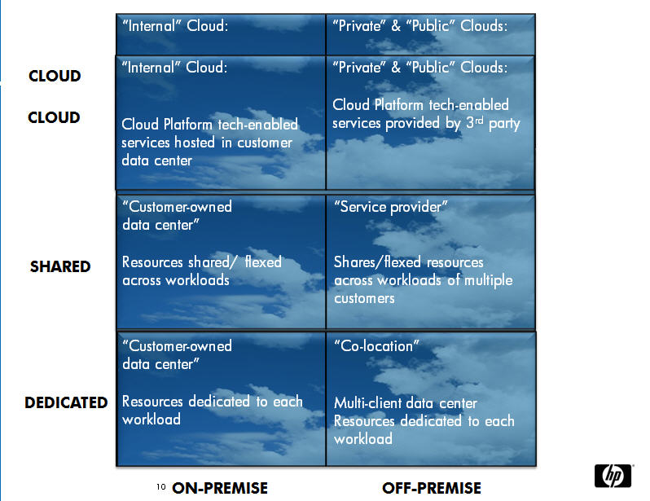

Slide 9
The cloud (r)evolution: solving problems that current technology models can’t solve
Service providers
Service consumers
New connections
Decoupling services and data
Information relevance
New capabilities
Massively scalable applications
Flexible consumption
New access
Existing apps and infrastructure
Technology over the internet
Contract-based consumption

Slide 10
HP’s Viewpoint on CLOUD COMPUTING

Slide 11
“Everything as a Service”
A world of information, opportunities and experiences — from computing power to business processes to personal interactions —
delivered wherever, however and whenever you need it

Slide 12
The cloud hype is around cost; the cloud reality is about new value
Cost
Value
?

Slide 13
IT’s job is to source printing services that result in the right business outcome
Internal
IT Organization
Better business outcomes
Service portfolio
(ie. printing)
Accelerate growth
Hosted or Outsourced
Value Sourced
Value Delivered
Lower costs
Cloud
Mitigate risk

Slide 14

“External” cloud computing is revolutionary and will ultimately change the world… but not overnight
The future of Enterprise IT is a hybrid environment.
“Internal Clouds” are a continuation of the IT Transformation that has been happening for years…

Slide 15
HP’s CLOUD Strategy

Slide 16
HP’s cloud strategy
Enable cloud providers
Massive scale-out servers, storage, network , e.g. HP Bladesystem Matrix
Software for Infrastructure and management, e.g. Cloud Assure
Data center infrastructure: design and optimization, e.g. Cloud consulting services
Data center services: in-house and outsourced, (printing as a service)
Cloud Consulting Services cloud roadmap service, cloud discovery workshop
Help customers secure, source, and govern cloud services
Provide cloud services

Slide 17
HP’s cloud strategy
Enable cloud providers
Cloud Assure
Service Portfolio Management solutions
ITIL v3 authorship; COBIT, ISO, and other industry standards and practices
Founding member of itSMF
Print Security
Help customers secure, source, and govern cloud services
Provide cloud services

Slide 18
HP’s cloud strategy
Enable cloud providers
NetSuite partnership
SnapFish
CloudPrint
MagCloud
Gabble
Cloud Assure
ePrinting
Help customers secure, source, and govern cloud services
Provide cloud services

Slide 19
HP ePrint mobile printing solution Printing wherever business happens

Slide 20

Business is mobile; printing should be too.
Senior executives are demanding more Smartphone capabilities.¹
Mobile worker population will surpass 1 billion in 2010 and reach 1.2 billion by 2013.²
“By 2012, all physicians will walk around with a stethoscope and a smart mobile device.”³
Until now, printing from a smartphone has been the missing link in the enterprise mobile workflow.
1. www.informationweek.com, October 2009.
2. Gap Intelligence, 2010.
3. Monique Levy, Senior Director of Research, Manhattan Research, www.fiercehealthcare.com, October 2009.

Slide 21



HP ePrint
Making printing as mobile as you are
Empower enterprise employees to be more productive and innovative
Secure printing between any of your company offices
Convenient printing to public printer hotspots
Printing to your company’s networked printers around the globe with the HP ePrint Enterprise solution¹
Print on the go at HP ePrint-enabled locations²
1. Requires BlackBerry Enterprise Server deployment and BlackBerry OS 4.5 or newer.
2. Requires HP ePrint app and BlackBerry OS 4.5 or newer.

Slide 22
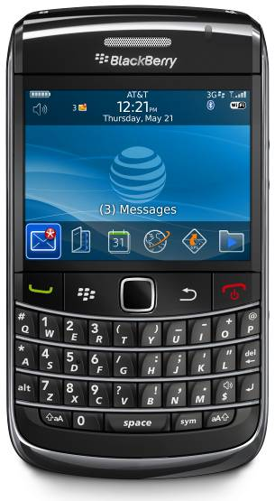
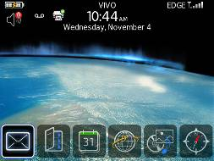
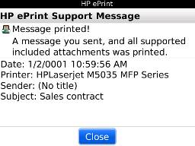
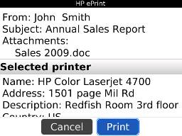
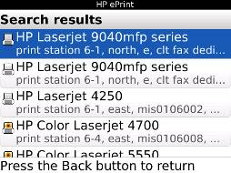
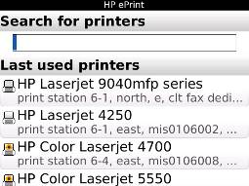
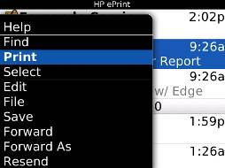
Simple print experience for mobile professionals
Three clicks to print
1. Select e-mail/attachment to print.
2. Search for and select a printer.
3. Hit Print.
Receive confirmation of print
No need for printer drivers or software on the smartphone
22
5/18/2010

Slide 23


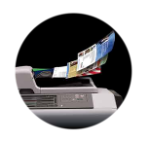


Seamless integration with your business
HP ePrint app on your server processes e-mail and attachments
Easy to implement
Manageable
Scalable to your secure network
BlackBerry® Enterprise Server receives e-mail
Enterprise printer delivers documents
Mobile professional sends e-mail to print
HP ePrint Enterprise solution
Confirmation sent to mobile device

Slide 24
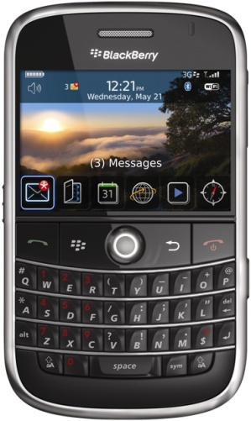

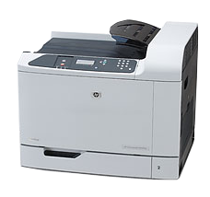
CloudPrint Enterprise Edition Architecture
Client App
RIM BES + E-Mail
Enterprise
1
No modification required
MDS (RIM API)
Forward E-Mail + HTTPS
CloudPrint
Enterprise SERVER
End user initiates print from email application. Transactions traverse through secure BES/Mobile Data Service (MDS) tunnel to CP Enterprise Server.
Documents are transported from corporate E-Mail infra to CloudPrint Enterprise Server. Documents are processed and rendered.
Document is printed on the selected printer
End user receives notification.
2
1
Status
4
MS Queue, Loose coupling
E-Mail notification
Text, PDF, MS Office, XML, JPG, PNG, GIF, BMP
2
3
PCL5/6, PCL3, PCL3GUI
3
Enterprise PRINTER
4
HP Restricted

Slide 25
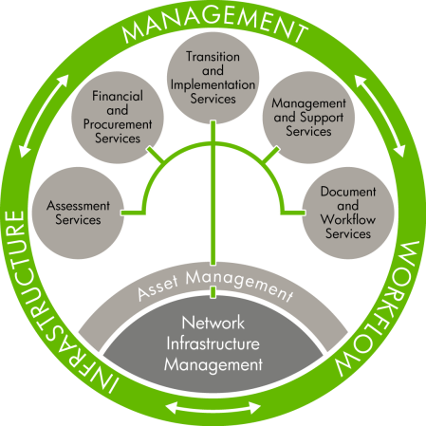
HP ePrint Enterprise solution offered through HP Managed Print Services
HP Managed Print Services helps you achieve business goals. With the HP ePrint Enterprise solution, you get:
HP ePrint Enterprise solution
HP ePrint Enterprise software
Services including installation, configuration and setup of an intuitive directory of printers
Dedicated support, updates and maintenance
Document
and
Workflow
Services

Slide 26
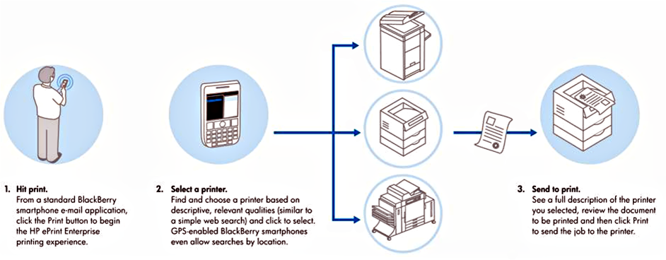
HP ePrint Enterprise solution diagram

Slide 27
It’s time to make printing as mobile as you are
“Cloud printing will transform traditional industries and redefine the way we use technology in business, classrooms, the home and on the road.”
—Sridhar Solur, Director of Mobile Printing, HP
• For more information, visit www.hp.com/go/ePrintEnterprise
• From your BlackBerry Smartphone, visit www.hp.com/go/eprintmobile

Slide 28
Questions

