Slide 1
Brookhaven Site Report
NLIT 2010
Thomas J. Schlagel
Director, Information Technology Division
May 25, 2010

Slide 2
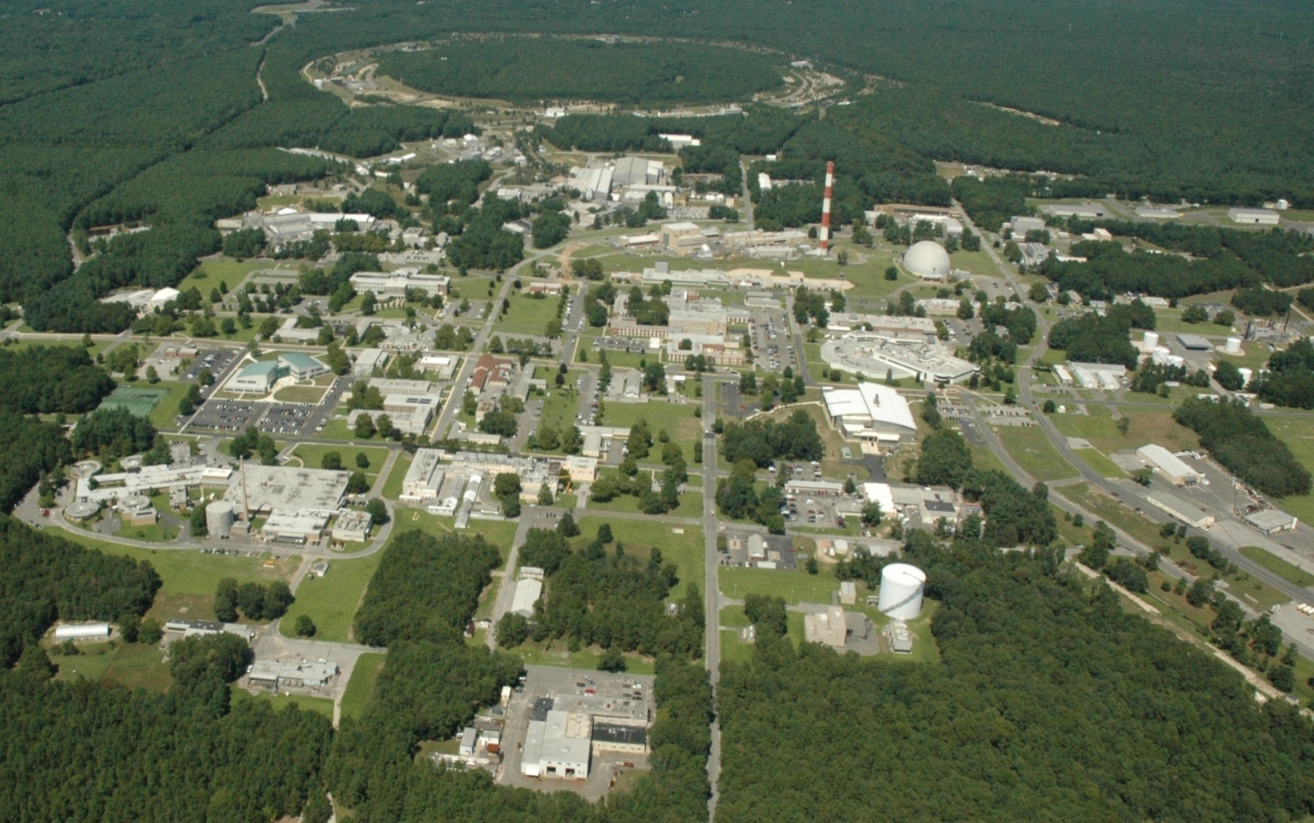

Slide 3
Brookhaven at a glance
BNL founded in 1947
~2750 employees
>4000 scientific facility users annually
S&T Portfolio
  Photon Sciences
  Nuclear & Particle Physics
  Energy & Climate Sciences
    Physical Science
    Applied Science
    Nanoscience
    Life Sciences
    Environmental Science
  National Security
Seven Nobel Prizes garnered
  12 Scientists honored (users & staff)
  First in 1957, latest in 2009
Work for
Others 12%
High Energy
Physics 9%
Other DOE
3%
National Nuclear Security
Administration 8%
Nuclear
Physics
31%
Environmental
Management 3%
Other Office of
Science 2%
Safeguards &
Security 2%
Basic Energy
Sciences 26%
Biological &
Environmental Research
4%
  FY09 New Funding
  $610M (Ops & Constr.)
  $231M (ARRA Ops & Constr.)
  $841M (Total)
  ~3/4 from Department of Energy (DOE) Office of Science
Notes:
3
3

Slide 4
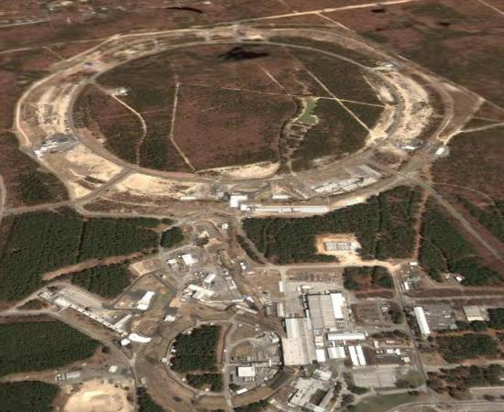
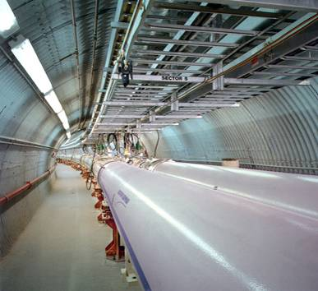
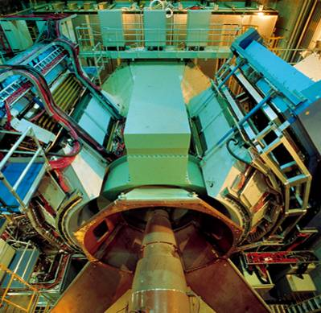
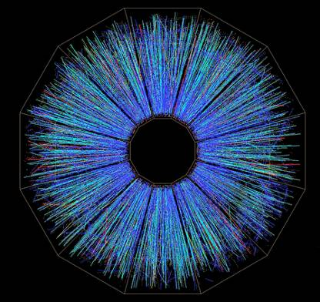
Relativistic Heavy Ion
Collider (RHIC)
Since 2000, the world’s highest energy machine for fundamental nuclear physics
  World-wide collaboration of more than 1000 scientists, engineers and students
The nature of the Universe at the birth of protons and neutrons
  0.00001 sec after the Big Bang
  It’s a “Perfect Liquid”! with a temperature of 4 Trillion degrees C
Future upgrades: RHIC II (now), eRHIC
Notes:
4
Understand the origin of the universe a microsecond after the big bang

Slide 5
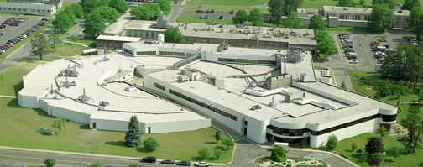
National Synchrotron Light Source (NSLS)
Crucial resource for the Northeast
  2100 Users in FY 2006
  400 institutions
    academic, industrial, government
  > 900 publications in FY 2006 (a record)
  ~ 25% in premier journals
Vital for diversity of programs:
  Chemistry, Physics, Nanoscience, Energy Science, Structural Biology, Environment and other BNL facilities
What’s next: NSLS-II
  NSLS ~25 years old
(14%)
Northeast
States
Foreign
Other US
(65%)
(21%)
NSLS-II & CFN
User Institutions
Macromolecular
Crystallography
Nanoscience
Notes:
5
5

Slide 6
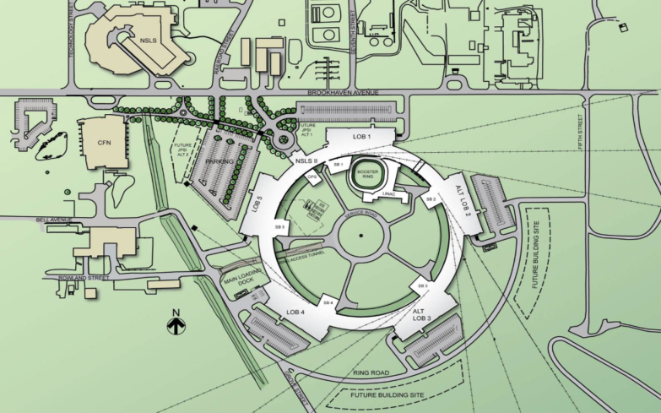
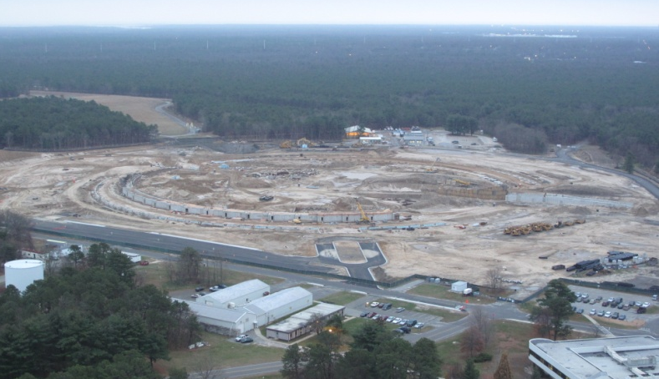
NSLS-II: Enable the Nanoscience Revolution
World-leading performance
  10,000 brighter than NSLS
  1 nm spatial resolution
  0.1 meV energy resolution
  Synergy with the Center for Functional Nanomaterials
    Dynamical characterization of new materials, reactions, processes
Ground breaking June, 2009
  $925M Total Project Cost
  Full operations in FY2015
    Comparable in scope to
    RHIC operations
Notes:
6
6

Slide 7
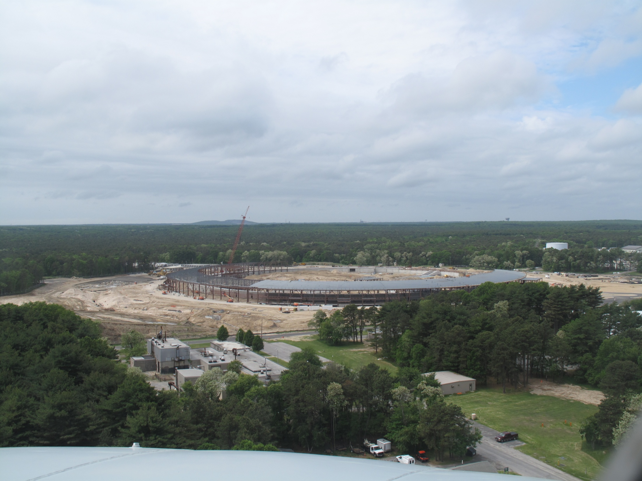
Notes:
Picture of NSLS-II construction site May 23, 2010

Slide 8
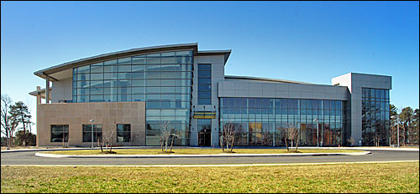
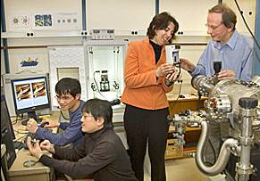
Center for Functional Nanomaterials (CFN)
Mission: To develop and share materials and processes at the nano-scale to address the nation’s critical needs
  User-oriented Facility
  Focused on Energy
  Offer materials preparation, characterization, theory and develop new techniques
Science Themes
  Electronic Nanomaterials
  Soft/Bio Nanomaterials
  Nano-catalysis/Interfaces
Facts
  Full operations: May `08
  50-60 Staff
  Expect hundreds of Users each year

Slide 9
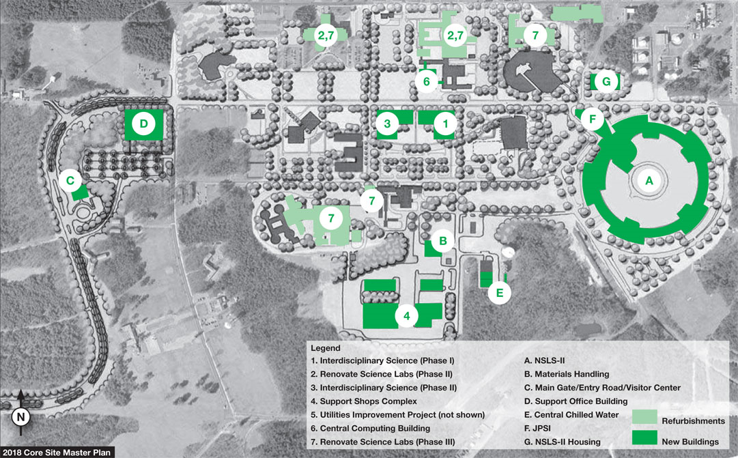
BNL 2018 Core Site Master Plan

Slide 10
BNL Blueprint
The Blueprint is a set of projects to help realize the laboratories 10-year strategic plan, expanding our basic and applied science impact while fixing our problems and identifying new capabilities.
Major tasks include leadership improvement; reorganization; performance management; and laboratory process improvements
The Blueprint includes a project to restructure IT infrastructure and services organizations to improve coordination and delivery of IT services across all research and operations efforts, reduce operational risk and improve our ability to control the cost of doing business.
  Project completion targeted for 9/30/11.

Slide 11
Site-Wide Telephone System Replacement
Prospective growth in buildings and people, along with the age of our current PBX and lack of modern feature-set is prompting our replacement of the site-wide telephone system
RFP being issued in June, 2010 for VoIP system that can also handle some analog nodes
In tandem, upgrade network switch infrastructure to support Power over Ethernet, Quality of Service and extended uptime in the event of a power outage.
The new phone system will be phased in over 4 years

Slide 12
Green IT
Server Virtualization
  Replacing stacks of 1U servers with blade centers
  Managing virtual images with VMWare
  Physical server footprint and power usage will substantially decline by the end of FY10
  Using RHEV for infrastructure server (DNS, DHCP, …) for better reliability and manageability
Desktop Virtualization
  Piloting a small number of systems using WYSE terminals to understand impacts on network and desktop management
Desktop Power Management
  GPO’s enforcing power settings, with opt-out mechanism

Slide 13
Cyber Security
Certification completed for Classified Computing
ATO for Unclassified Computing extended until June 2011 (pending BHSO approval)
Started a Phishing Awareness campaign in April which generated a lot of buzz – additional campaigns to be rolled out later this year
Laptop encryption – BHSO would not accept the residual risk of unencrypted laptops. New project to identify FDE solution and deploy on new laptops

Slide 14
BNL NLIT 2010 Presentations
Monday
  “Configuration Auditing on Unix-based OS” - Rich Casella
  “Wireless at BNL” – Phil Zeo
  “KB, KW and QOS” – Bob Healy
  “Desktop Security – Assessing Application Vulnerabilities” – Joshua Federmann
  “Networking Your Security” – Michael Ojeda
  “Enforcement through Denial of Networked Services” – David Cortijo
  “Big Science Networking” – John Bigrow
Tuesday
  “Brookhaven National Laboratory Telephone System Replacement: Technical Challenges and Operational Pitfalls” - Scott Bradley
Wednesday
  "Can you See me Now?“ - Chris Masullo
  “Email Archiving at BNL” - Kevin O'Brien
  “Active Directory authentication in a mixed architecture environment using Centrify” - John Reddy
  “Backup & Recovery of workstations” - Theresa Cutrone
  “BNL HPC Networking” - Frank Burstein

