Slide 1
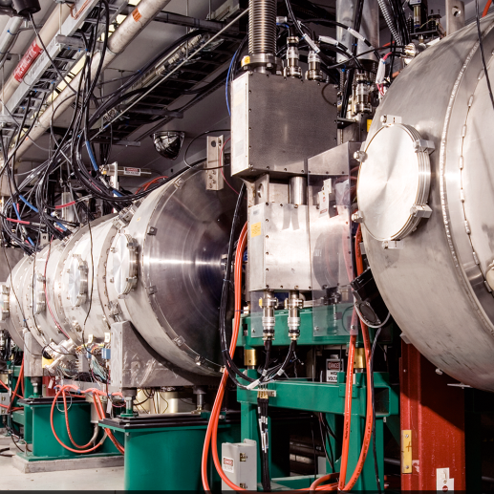
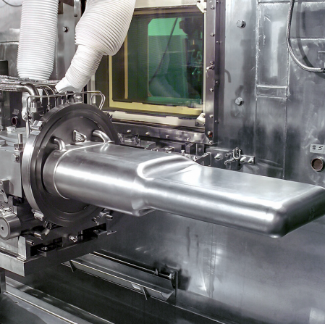
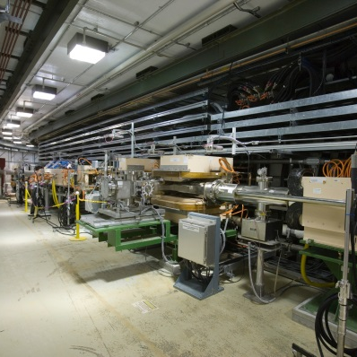

ePIC
Forward Hadronic Calorimeter
8M Tower Mechanical Design Update
Eliott Fountain
December 18, 2024

Slide 2
Presentation Overview
Top Level FHCal Design
Stacking (spacing and shimming)
Fabrication Progress (8M Tower)
Structural Testing (8M Tower)
Next Steps
Tower Designs (8M, 4M, Left Insert, Right Insert)
Scintillator Integration

Slide 3
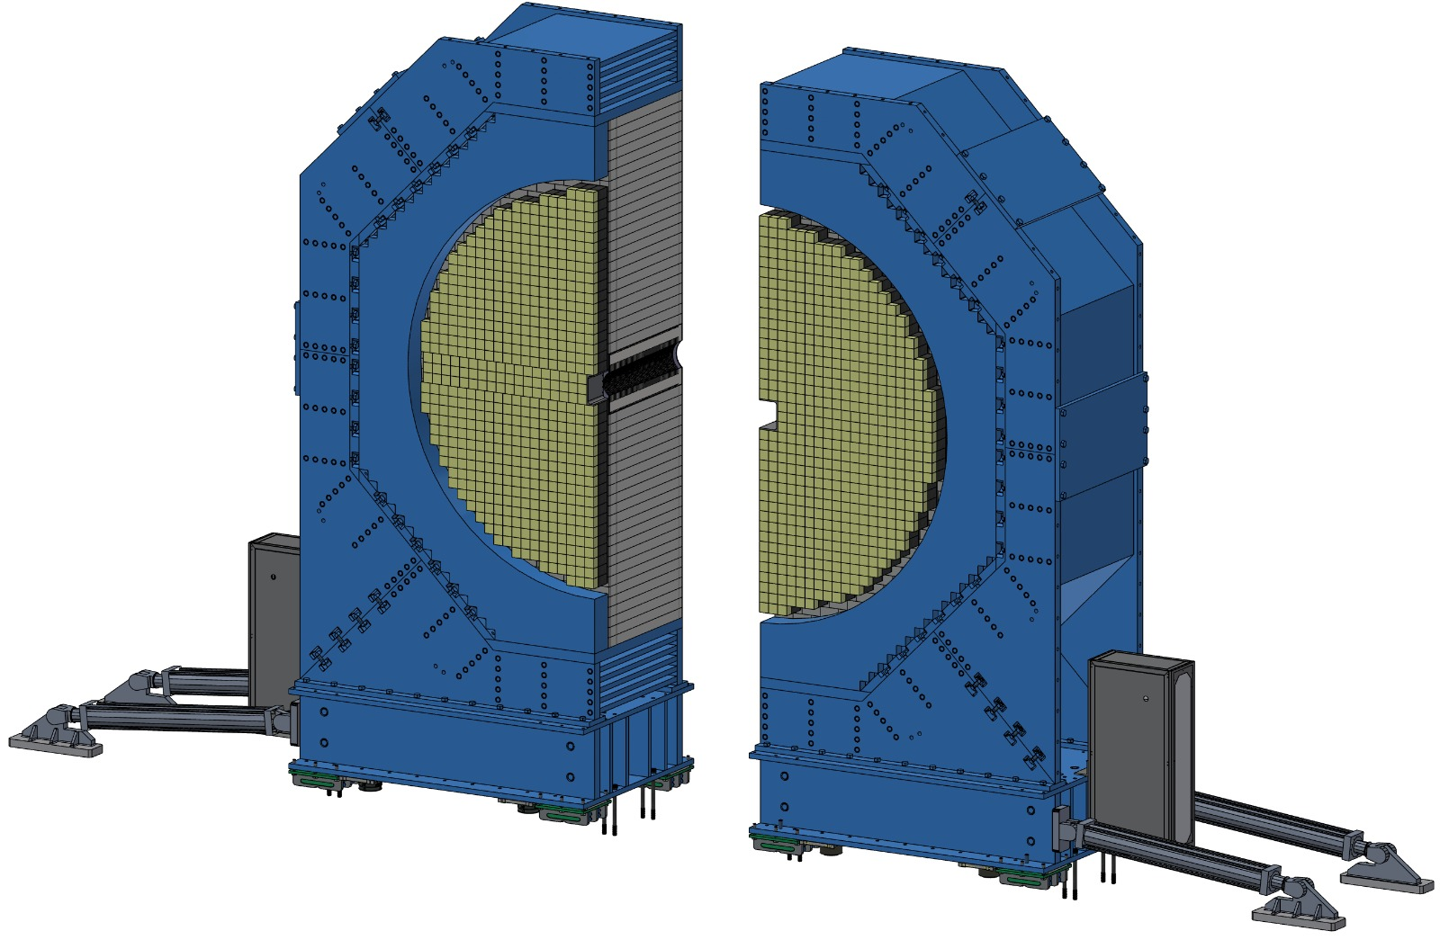
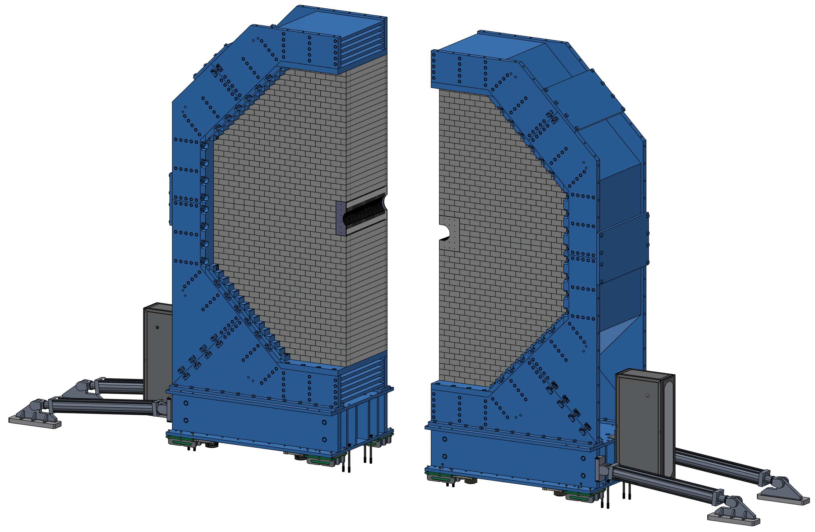
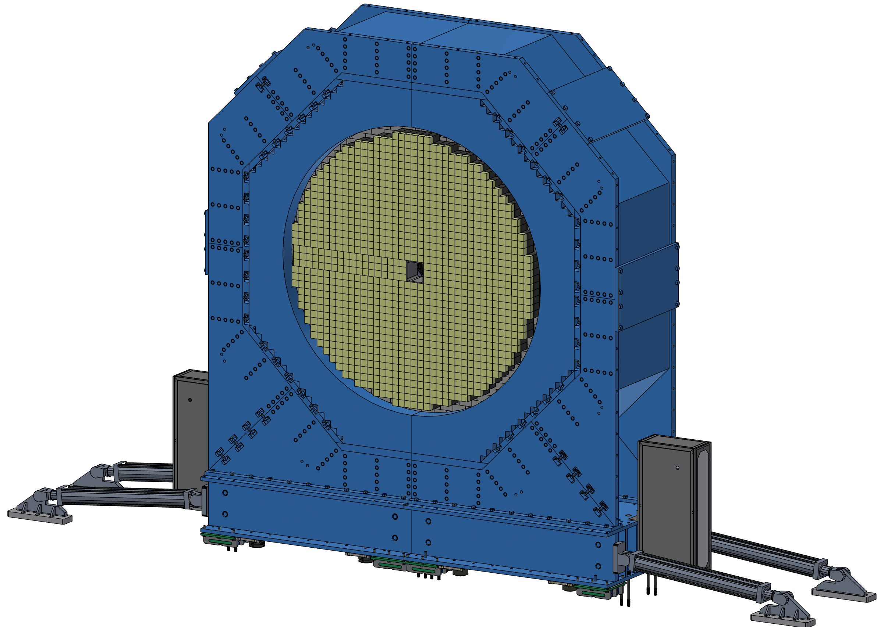
Top Level FHCal Structure (BNL)
Detector Features / Highlights:
Ø 5.2 meters, 1.32 meters thick, Vertical Split Design.
Contains 162,000 kg of Steel.
1,058x 8M Towers, 72x 4M Towers.
2x asymmetric “Insert” Towers for beampipe passage.
60x Scintillator assembly layers.
≈ 530,000x Scintillator Tiles, 47 x 47 mm with individual readouts.
EMCal Detector Assembly
Support structure
FHCal Detector Assembly

Slide 4
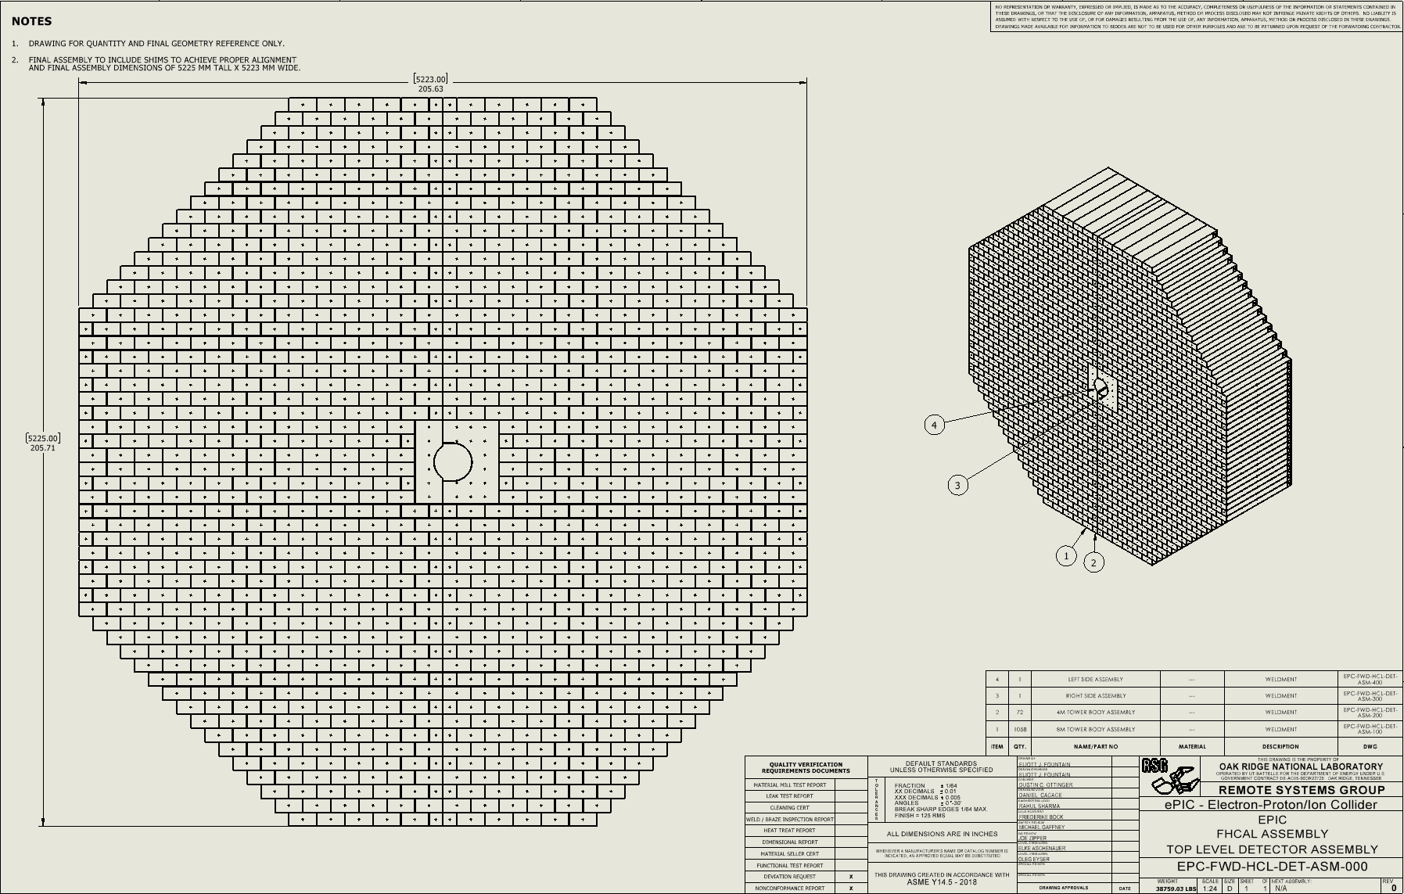
Top Level FHCal Structure
Drawing of the FHCal Stack
SolidWorks model adapted based on BNL Top Level Design.

Slide 5
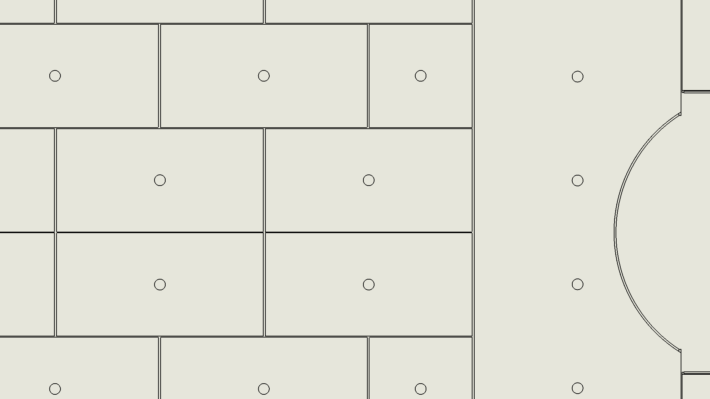
FHCal Stacking (spacing and shimming)
Collaborated Idea between ORNL and BNL.
Prescribed Typical gap between modules to ensure proper assembly and alignment.
Prescribed gaps only add ~25 mm to overall detector height and width.
Gaps and shimming allow for slightly more variation in module manufacturing, thereby reducing cost and manufacturing time.
Vertical gaps will be filled with full length shims to fully support the wight of each module and allow for correction of small height variation from unit to unit. Vertical shims will vary in thickness from ~0.1mm to 1mm, and can be cut to length if variation from front to rear of the module needs correction.
Horizontal shims may be either temporary or permanent, and need not be full length. Horizontal shims will vary in thickness from ~ 0.1mm to 2mm.
Vertical Shim areas (1mm TYP)
Horizontal Shim areas (2mm TYP)

Slide 6
Fabrication Progress (8M Tower)

Slide 7
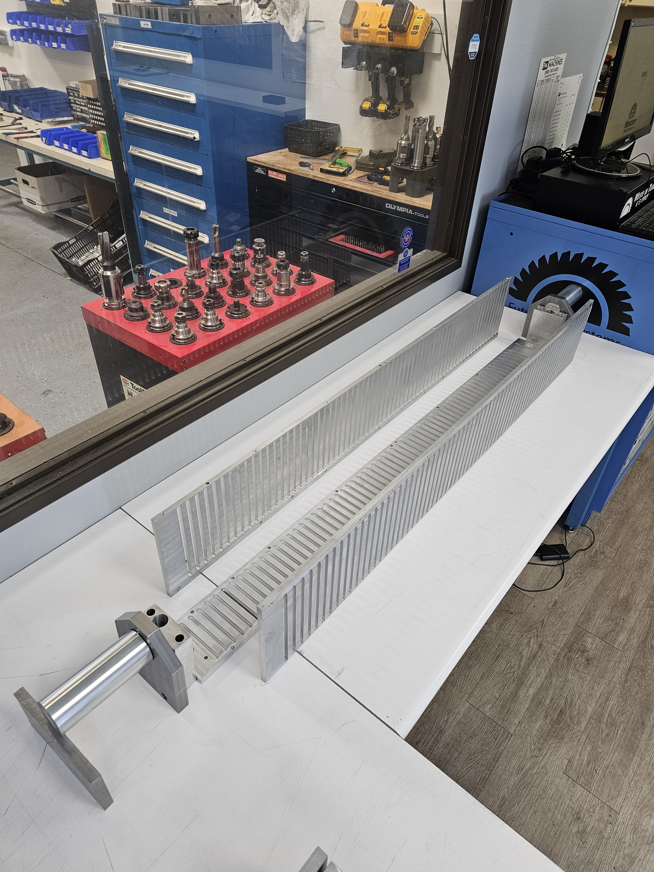
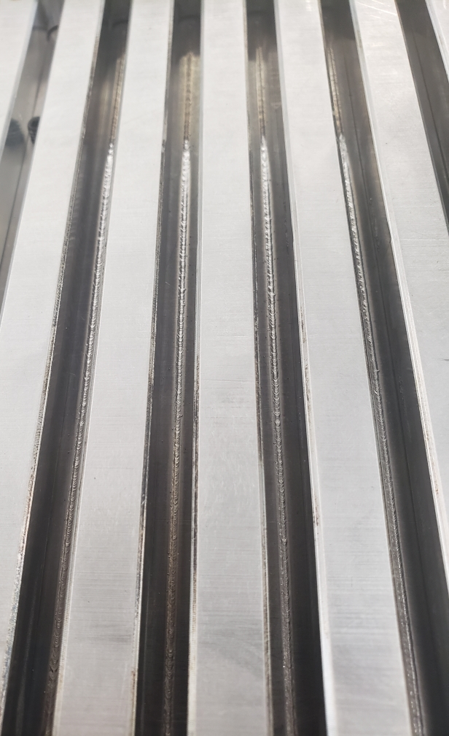
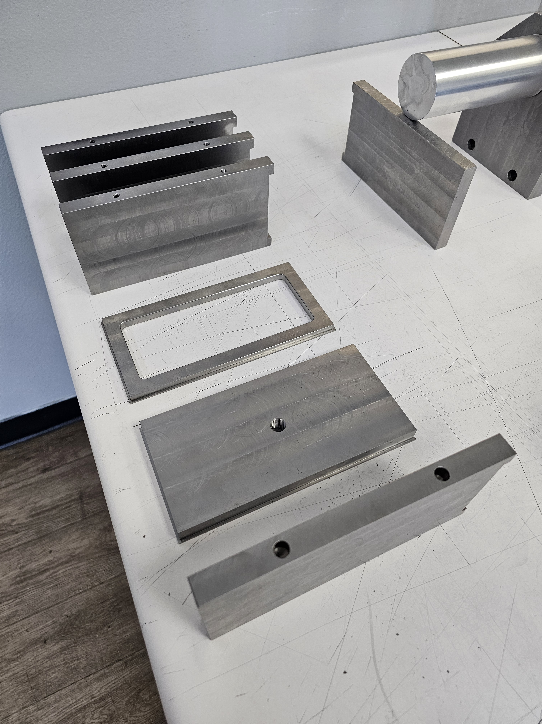
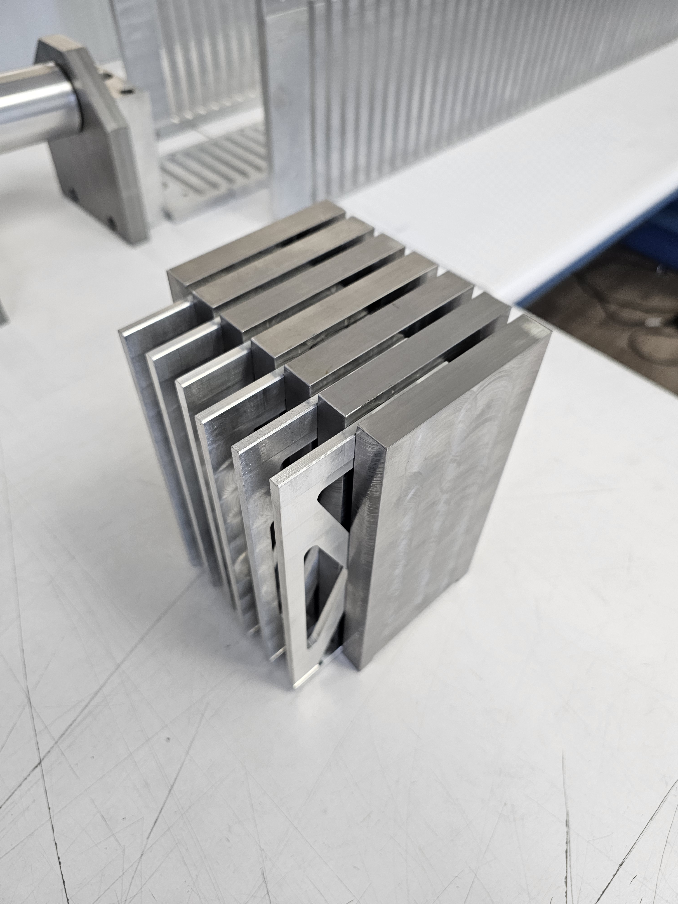
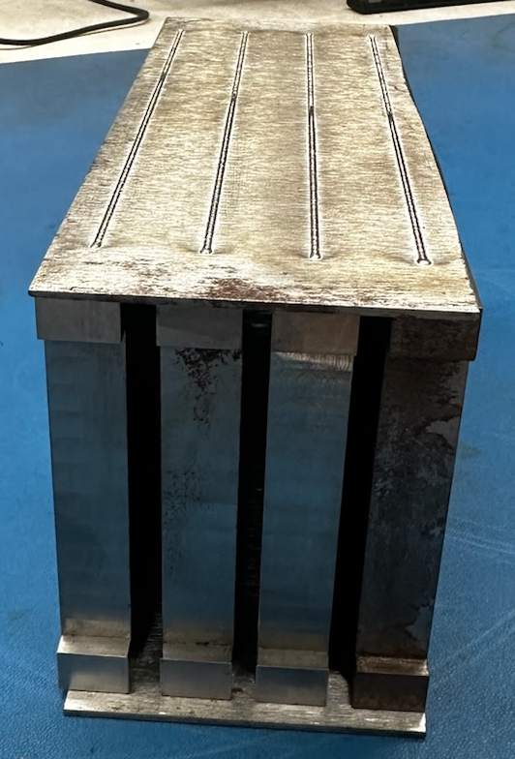
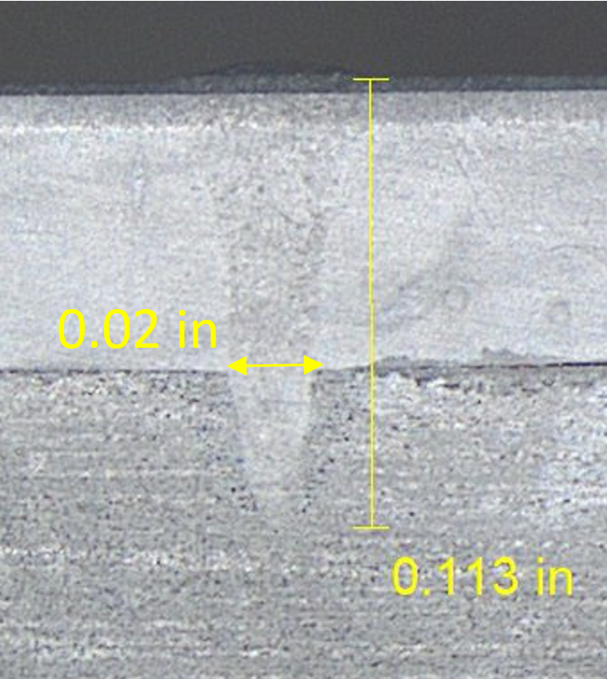
E-Beam Welding
8M Tower Welding Jig
E-Beam Welding of first 8M Tower Assembly
Manufactured Parts
Absorber plate Spacers
E-Beam Weld Testing

Slide 8
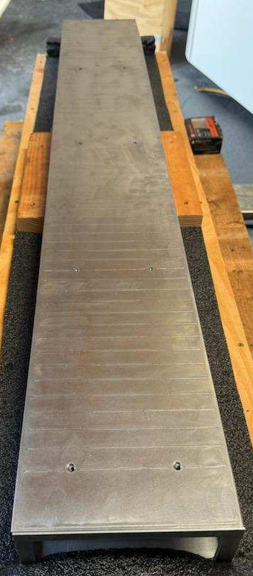
Prototype #0 (1400mm) (June)
Prototype Details:
  Full weld path for top, bottom, and one side (maximum length).
  Designed for alignment pins at rear.
  65x inner plates.
  Datum A is Front Face of Front Plate.
  1045 Carbon steel material.
Identified Issues:
  GD&T not achieved for critical dimensions of final assembly, including flatness of front face (0.028” > 0.010”) , total height of module (too large by 0.012”), perpendicularity of bottom and sides (0.018” > 0.010”). Some absorber plate gaps were tight for the go-gage (0.200”).
  Absorber plate pockets are blind, and jig spacers were stuck after welding, requiring forced removal.
  Welding only one side likely caused the perpendicularity issues as the unit “drew” to that side.
  Absorber plate spacing tolerance stack-up resulted in poor strongback hole alignment in the final assembly and some tight slots.
Identified Wins:
  Solid, monolithic structure. Strong and robust, can pickup from one end without permanent deformation of tower.
  All piece parts comply with GD&T tolerances.
  Most GD&T issues could be corrected with post machining (not ideal).

Slide 9
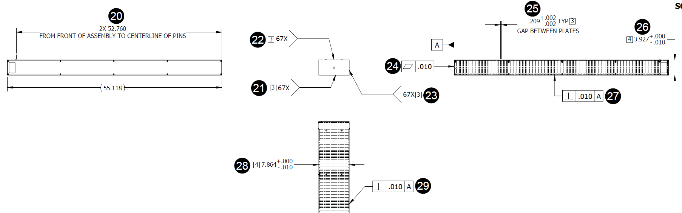
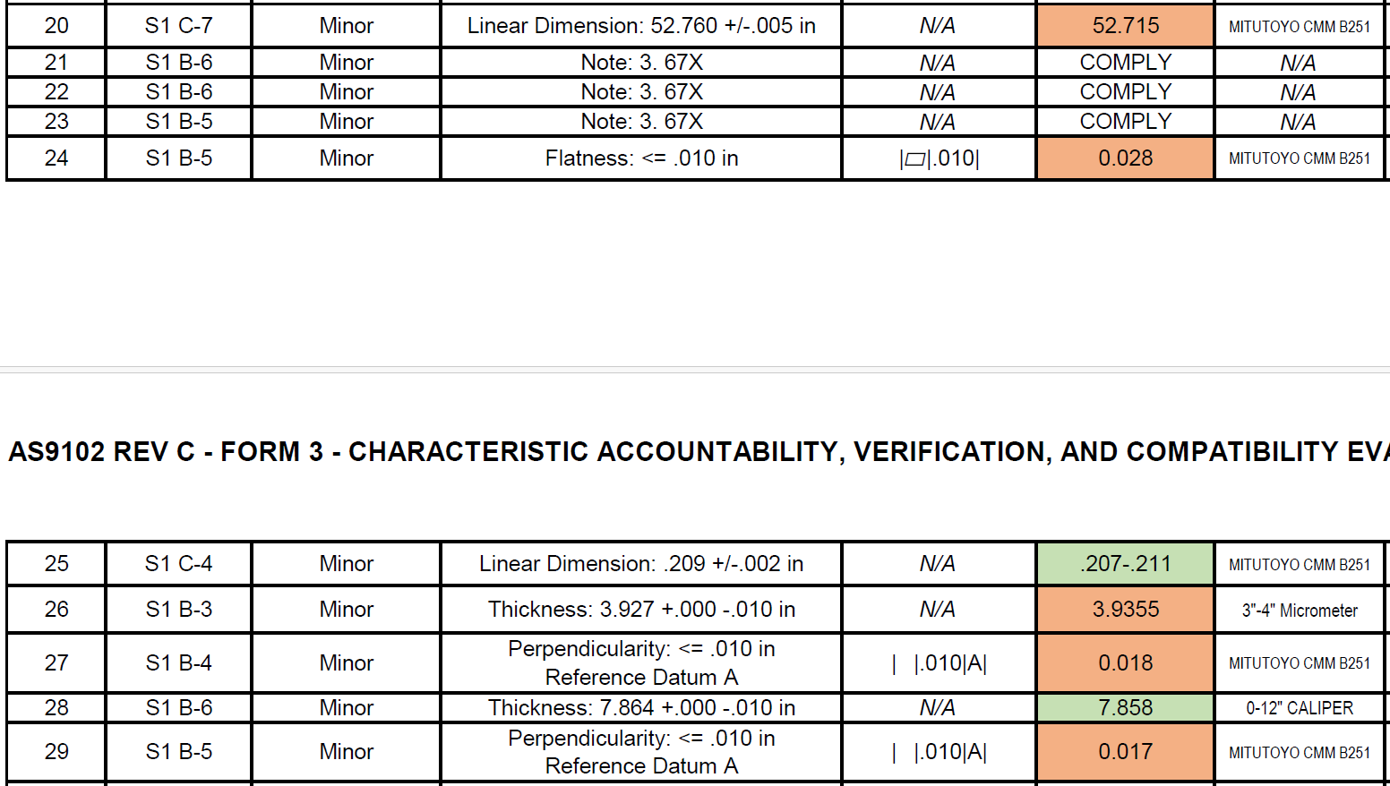
Prototype #0 (1400mm) (June)

Slide 10
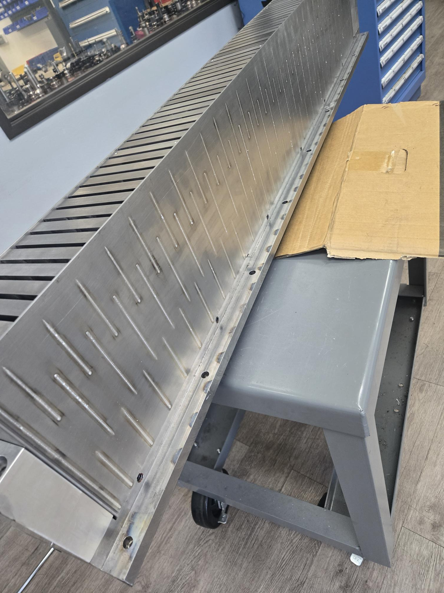
Prototype #1 (1320mm) (October)
ORNL and BNL Visited Fabrication and Welding Companies and witnessed this prototype being welded. Currently at ORNL (Crush Tested)
Prototype Details (changes):
  Staggered stitch weld path for top, bottom plates (both sides bolt on).
  No alignment pins at rear (replaced with bolt plate on back face).
  Module width reduced 0.75mm
  60x inner plates.
  Datum A is bottom face of final weldment.
  1020 Carbon steel material.
Identified Issues:
  GD&T not achieved for critical dimensions of final assembly, including total height of module (too large by 0.030”), perpendicularity of bottom and sides (0.035” > 0.010”).
  Welding jig was reworked to weld the 2nd prototype, and after welding the bottom plate was found to be out of flat by 1mm (0.039”), other issues could have existed to make GD&T worse for certain tolerances because of the repurposed jig.
Identified Wins:
  Staggered weld did not noticeable diminish rigidity of the unit.
  All piece parts comply with GD&T tolerances.
  New welding procedure reduced welding time and warping.
  Most GD&T issues could be corrected with post machining (not ideal).

Slide 11
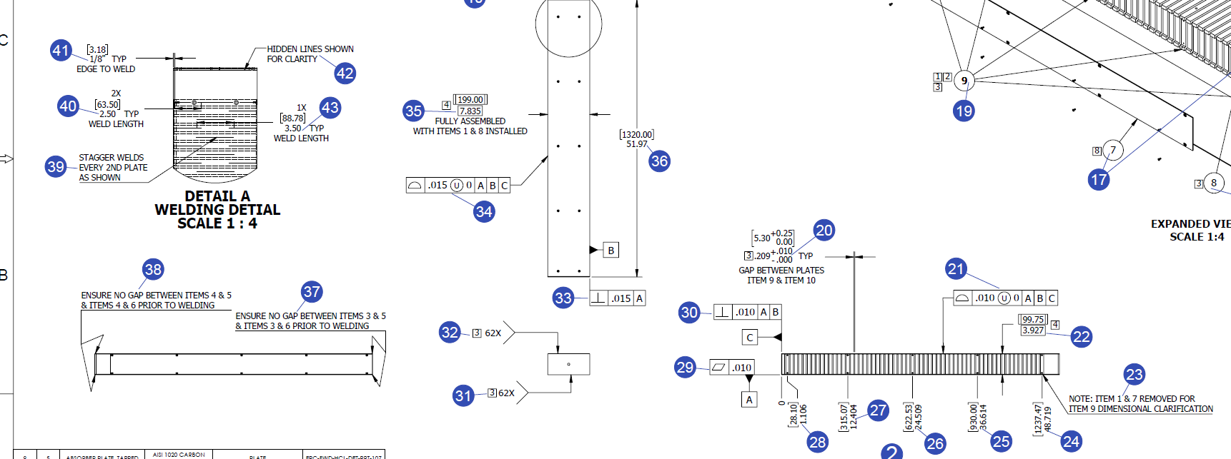
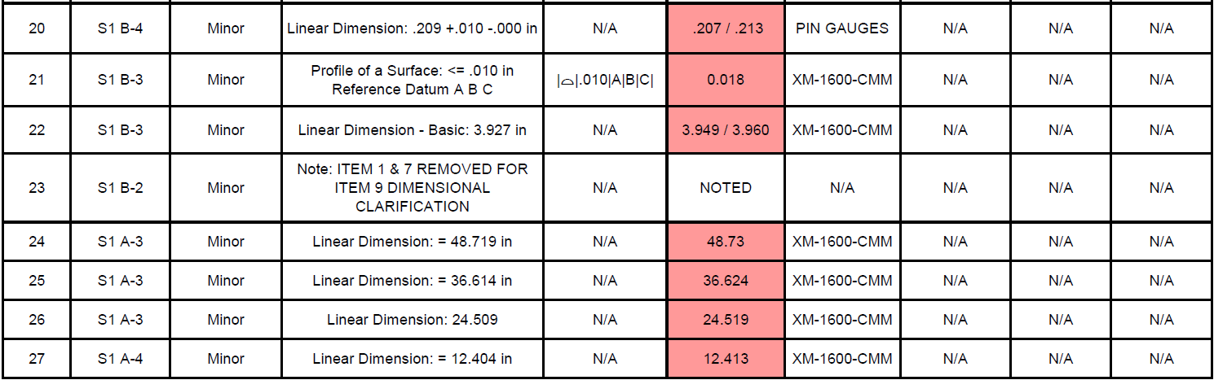
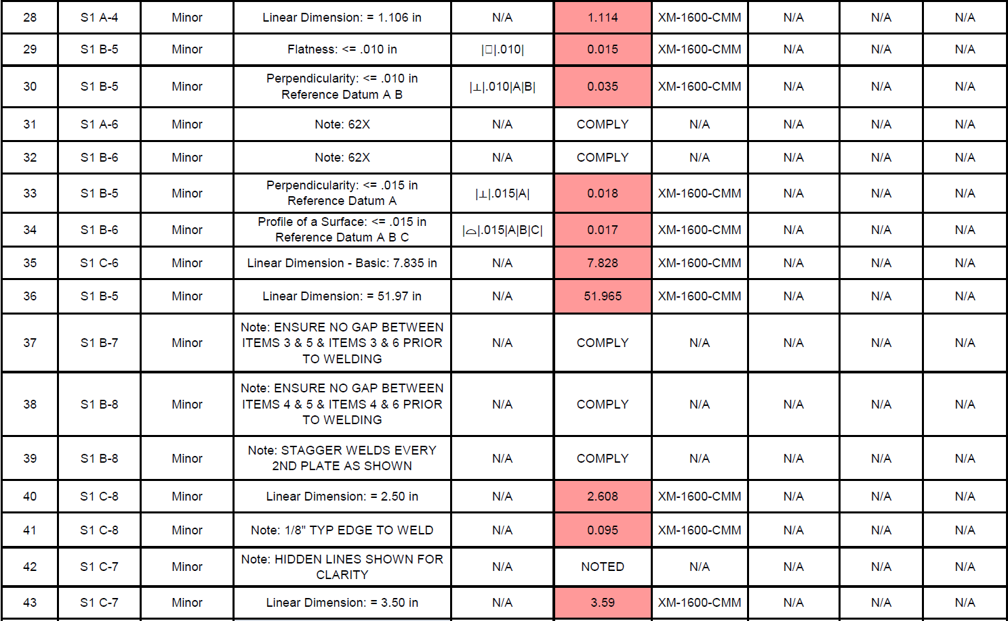
Prototype #1 (1320mm) (October)

Slide 12
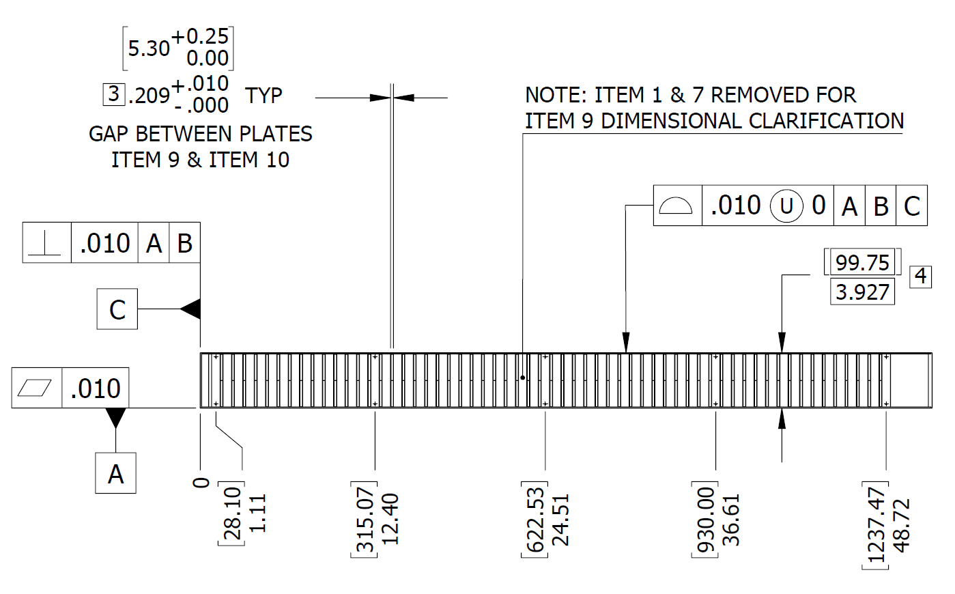
Prototype #2 (1320mm) (November)
Currently at ORNL (Lift Tested)
Prototype Details (changes):
  Plate spacing GD&T areas were re-evaluated and relaxed to help achieve our end functional goal and promote a more manufacture-friendly item.
  Small rework on Jig to achieve better perpendicularity on front plate.
Identified Issues:
  GD&T not achieved for critical dimensions of final assembly, including total height of module (too large by 0.030”), perpendicularity of bottom and sides (0.035” > 0.010”).
  Welding jig was reworked to weld the 2nd prototype, and after welding the bottom plate was found to be out of flat by 1mm (0.039”), other issues could have existed to make GD&T worse for certain tolerances because of the repurposed jig.
  Handling of pre-welded (jigged) assembly needs to be done with more care to prevent shifting of components prior to welding.
Identified Wins:
  Staggered weld did not noticeable diminish rigidity of the unit.
  All piece parts comply with GD&T tolerances.
  New welding procedure reduced welding time and warping.
  Most GD&T issues could be corrected with post machining (not ideal).

Slide 13
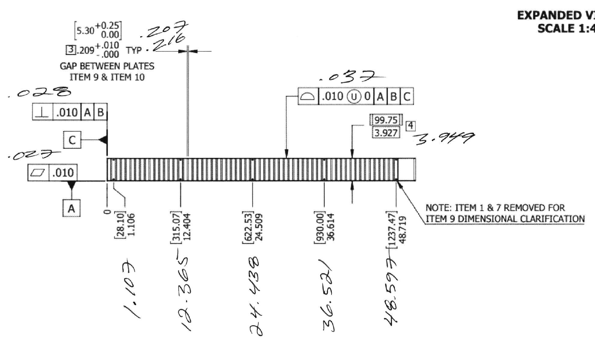
Prototype #2 (1320mm) (November)

Slide 14
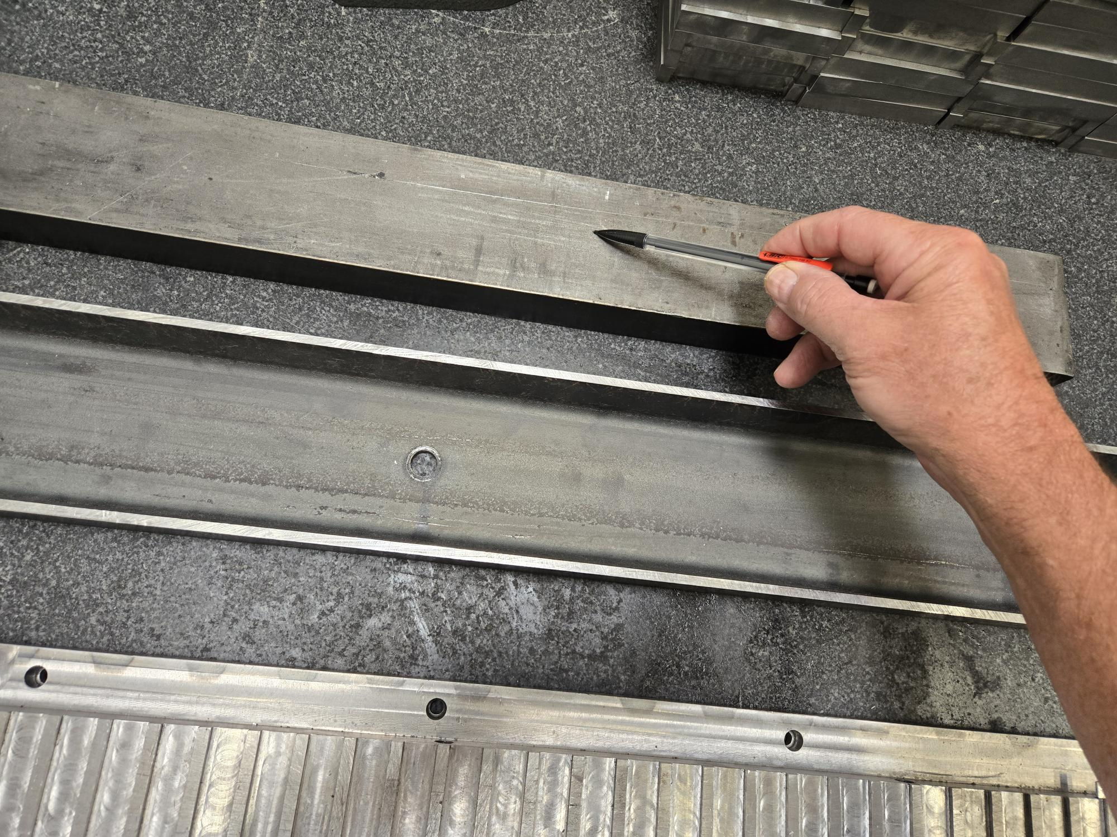
Prototype #3 (1320mm) (December)
On route to ORNL
Prototype Details (changes):
  Staggered stitch weld path further optimized (by welder).
  Completely reworked Jig to better support (reinforced bottom plate) the new 1320mm module geometry and prevent shifting during transport.
Identified Issues:
  GD&T not achieved for critical dimensions of final assembly, including total height of module (too large by 0.013”), perpendicularity of sides (0.040” > 0.015”), and absorber plate spacing *(0.167-0.238 > 0.209-0.219).
  Miscommunication between fabricators and welding shop. Welding procedure accidentally edited to weld front and back plates before absorber plates, instead of welding from one side (back to front). After post analysis, the welding shop agreed that this error likely cause the plate spacing issues (which were not a problem in earlier prototypes) and likely added to lateral warping of the module, otherwise only the height of the module may have fallen outside of the GD&T.
Identified Wins:
  Welding issue identified and will be corrected on Prototype #4.
  Most GD&T issues could be corrected with post machining (not ideal).
Reinforcement Plate
*Note: It is unclear how many plates (assuming more than 1) fell below the 0.209” spacing. GD&T only required that the total range of spacing be reported. It could be that one plate shifted and cause one large gap and one small gap adjacent to it. ORNL will evaluate this when the unit arrives.

Slide 15
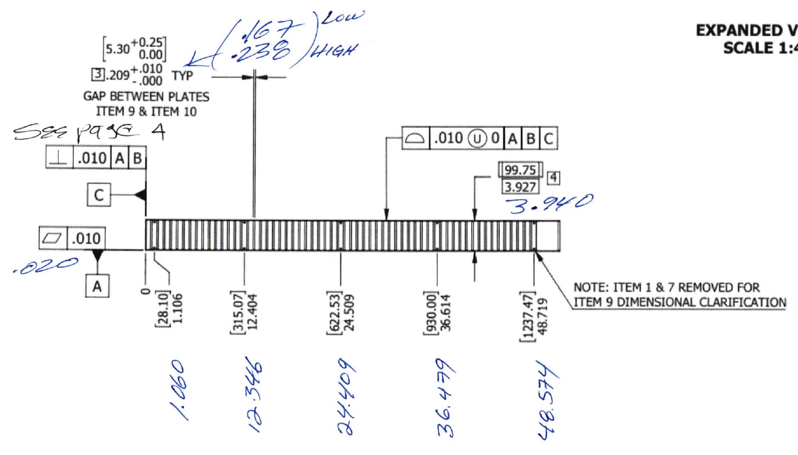
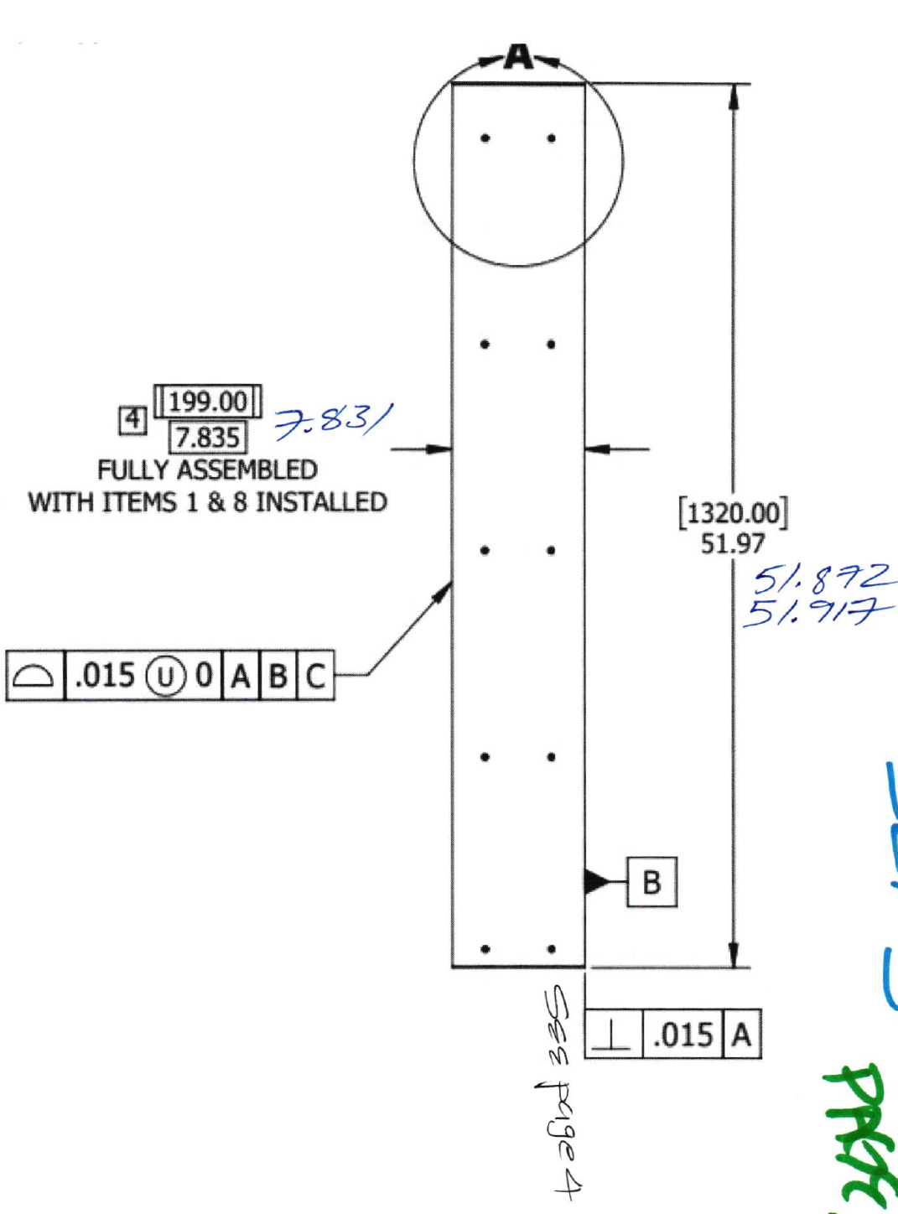
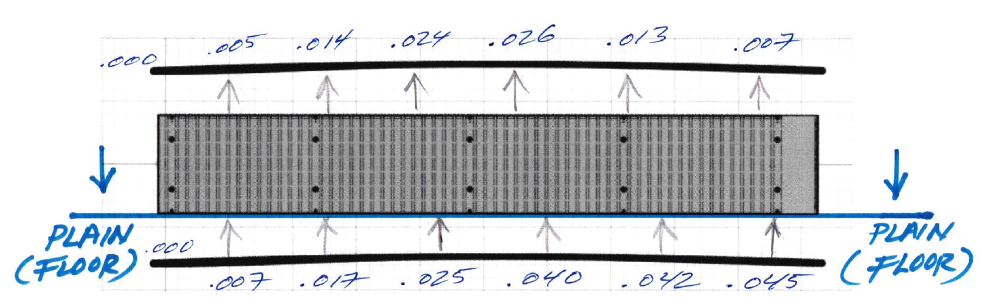
Prototype #3 (1320mm) (December)

Slide 16
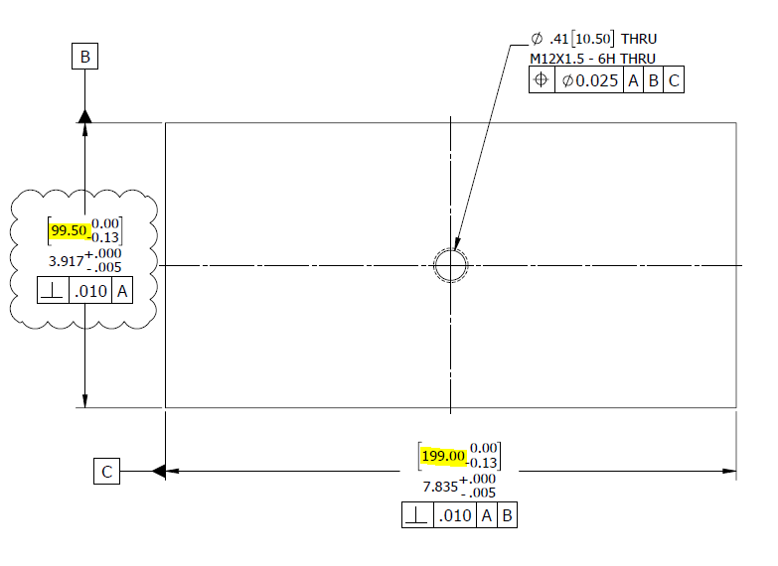
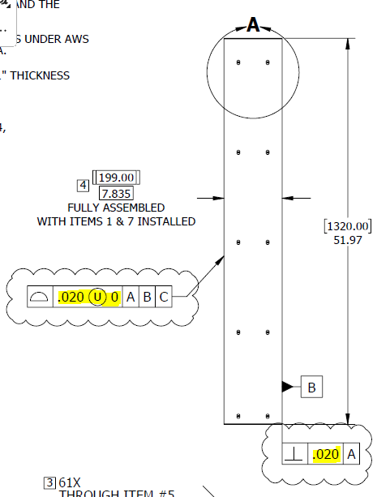
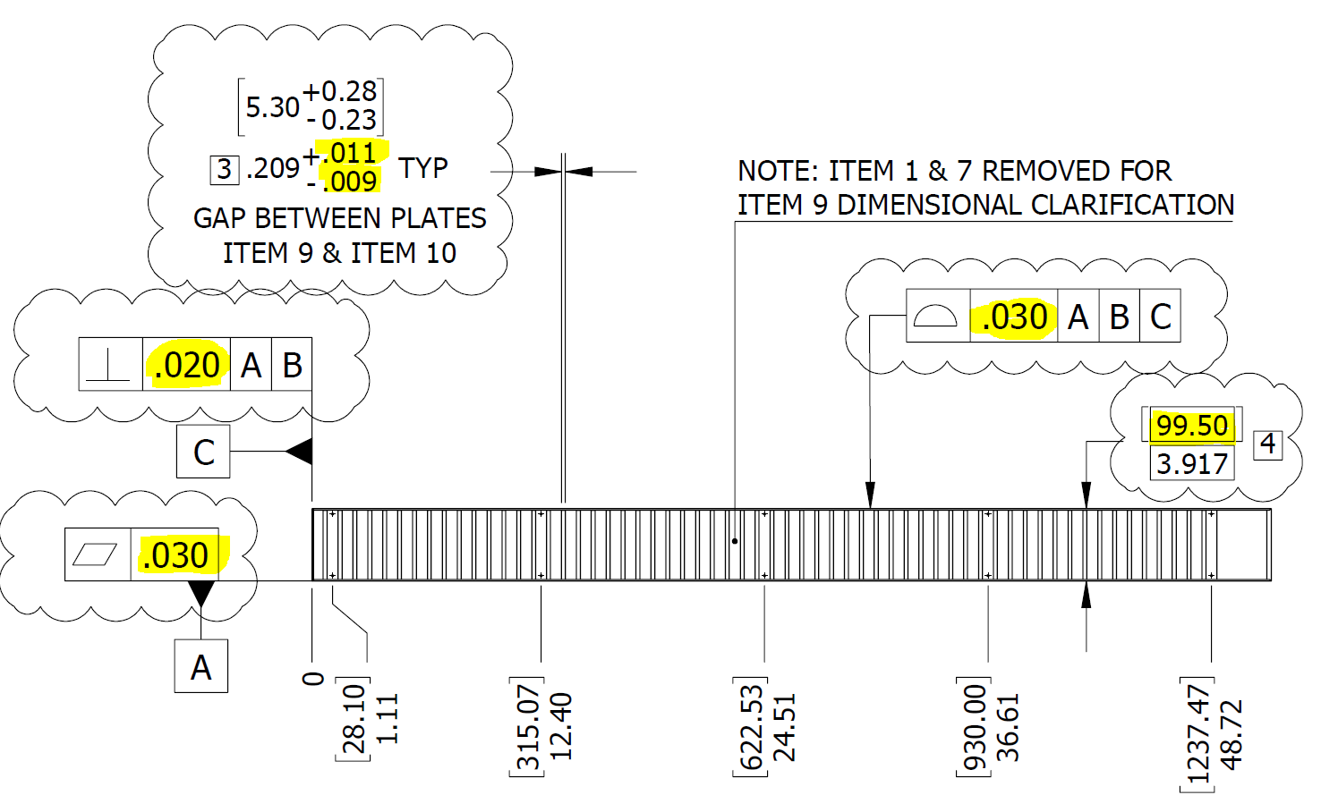
Prototype #4 (1320mm) – In Progress (in review by Fab)
Prototype Proposed Changes:
  Welding procedure solidified to prevent error.
  Module geometry was reduced (0.25mm height) to allow more tolerance on top and bottom for shimming (final assembly). Welds are sitting proud of the surface and causing difficulty hitting this tolerance.
  Reduced height only requires machining ~0.010” of material off one side of absorber plates and front and back plates. No parts will be wasted.
  Some GD&T areas re-evaluated and relaxed since shimming will be incorporated.
    Bottom plate flatness: 0.015” → 0.030”
    Front plate perpendicularity: 0.010” → 0.020”
    Top plate profile surface: 0.015 U0 → 0.030”
    Side plate perpendicularity: 0.015” → 0.020”
    Side plate (other) profile surface: 0.015” U0 → 0.020” U0
    Plate Spacing: +0.010” → + 0.011 – 0.009”
  Further evaluation of support jig and measurement of the pre-welded module to be done prior to welding to isolate any remaining issues that may be found after welding and inspection.

Slide 17
Structural Testing

Slide 18
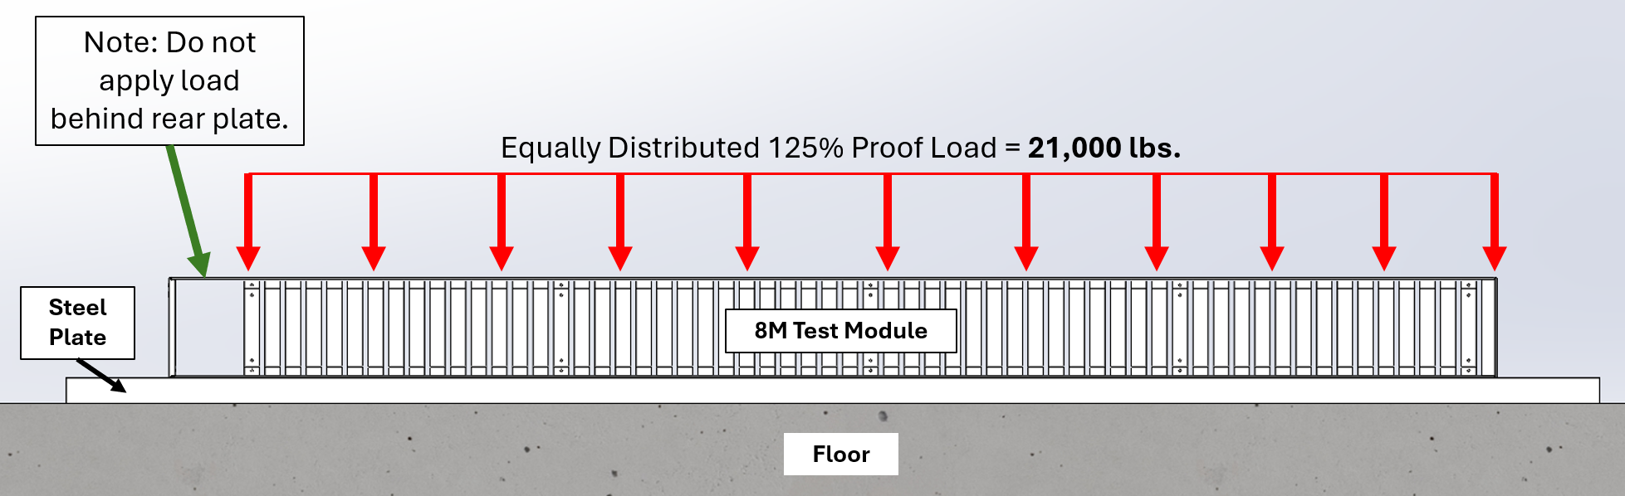
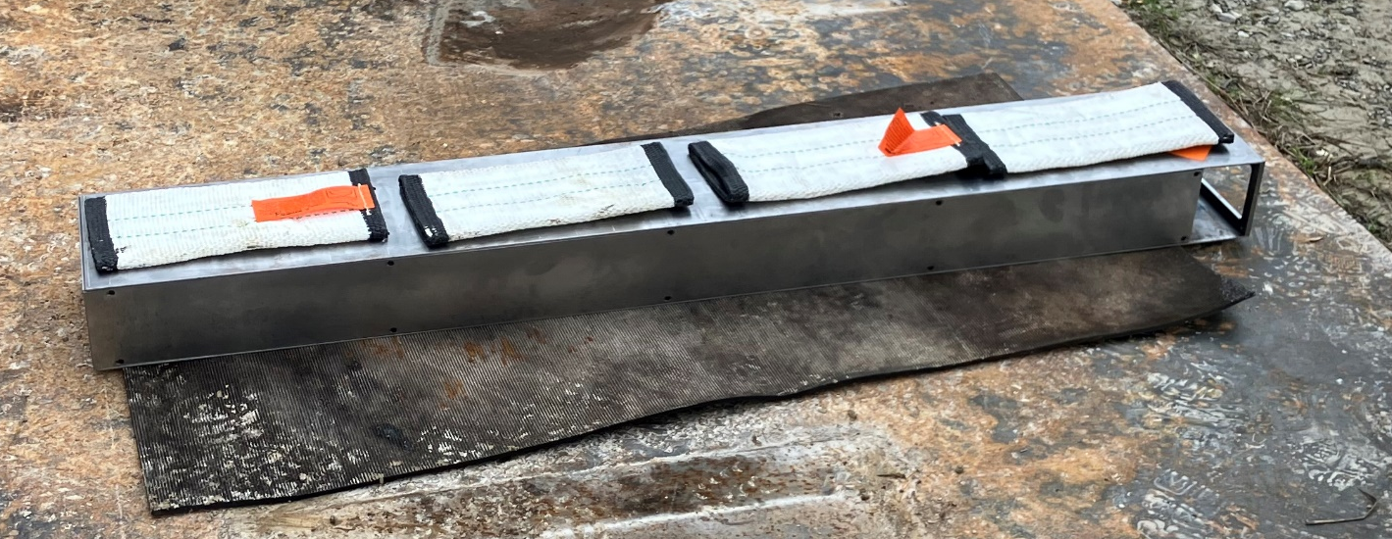
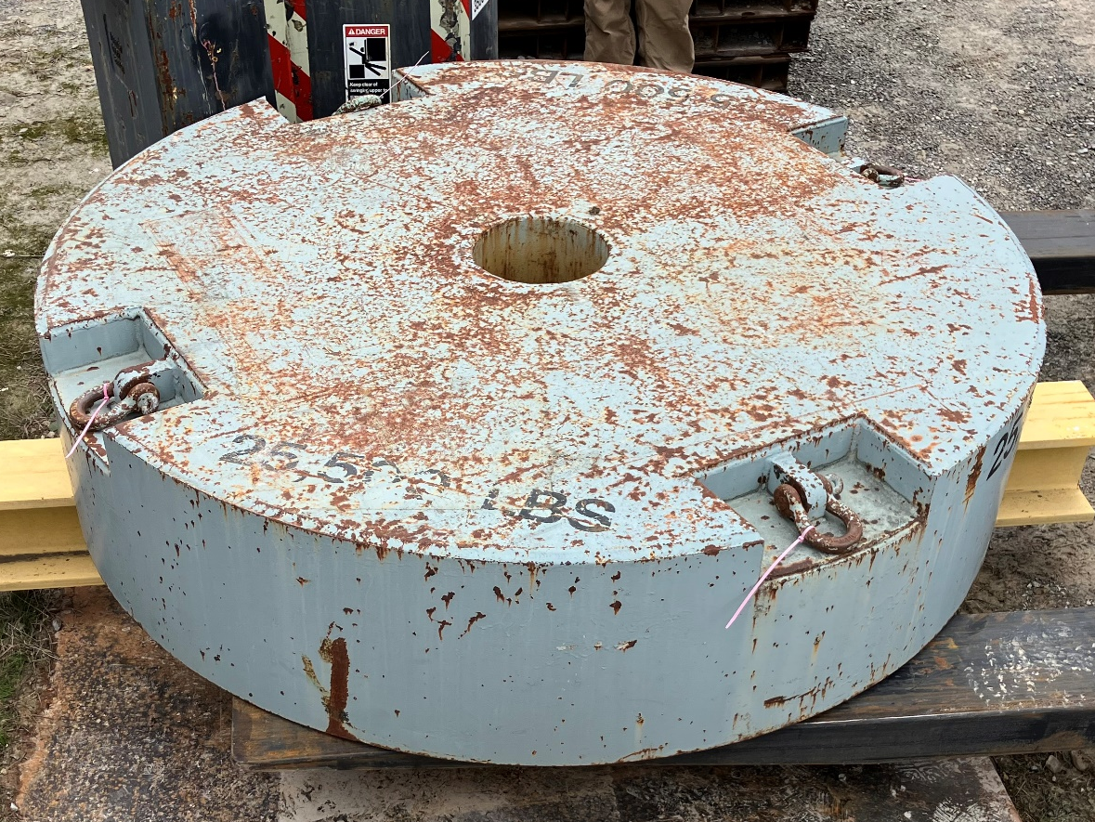
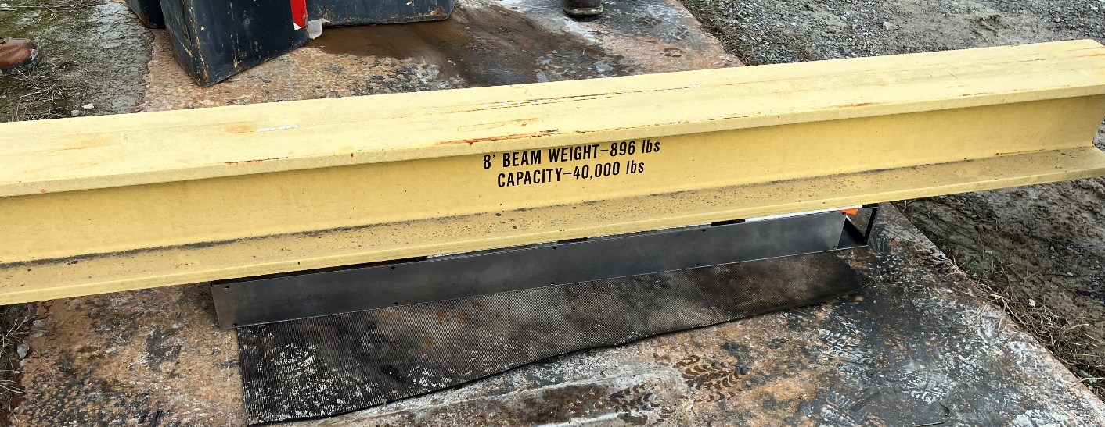
Load (Stacking) Test (Proto #1)
Identified Tower for consideration: 8M Tower with highest vertical loading identified in image to right, on bottom row. Test to verify structural integrity of the 8M Tower weldment.
Test Setup:
Target Load (125% Proof): 330 lbs. x 51 layers x 125% = 21,000 lbs.
Foundation: Flat Steel Plate with thin mat for surface protection.
Applied Load: 8’ x 8” I-beam used to equally distribute load (896 lbs.), crane spindle weight centered on top of I-beam and 8M Tower (25,500 lbs.).
Total test loading: 26,500 lbs. (157% Proof Load)
Test Results:
No visual damage or deformation. Measurements to be performed before end of year.
51x Layers
8M Tower with highest bearing load.

Slide 19
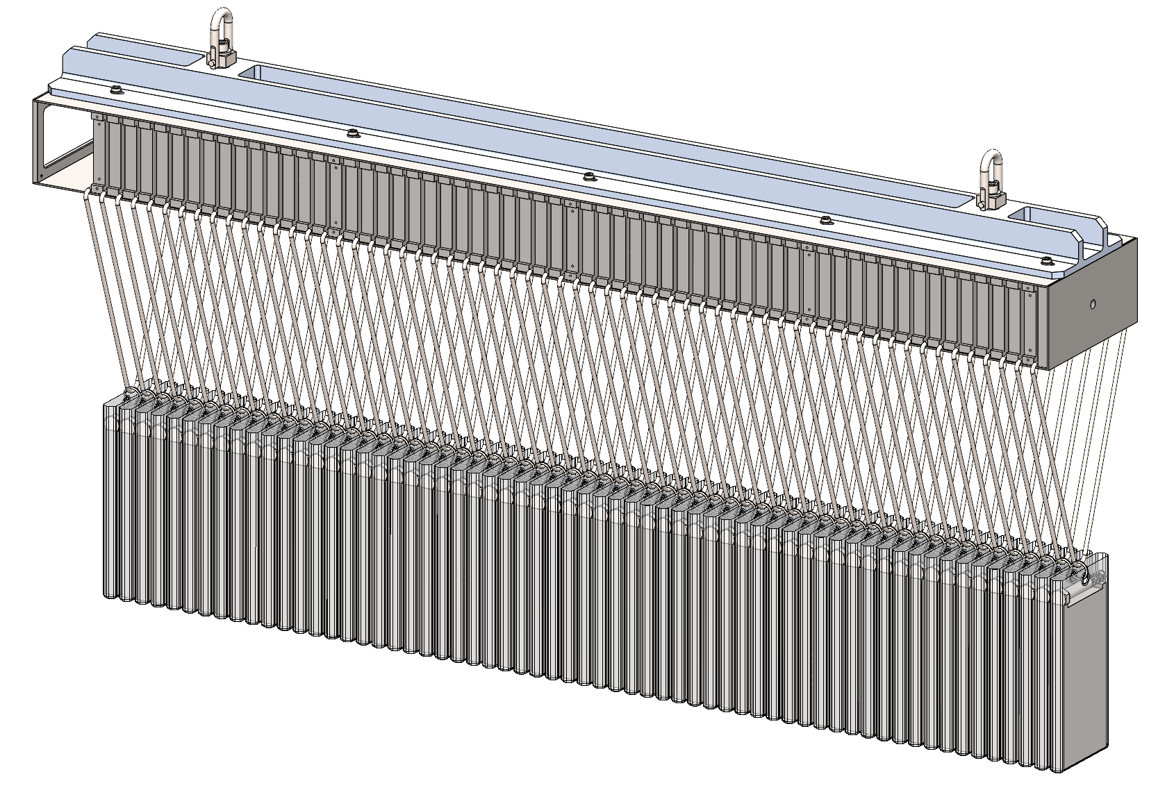
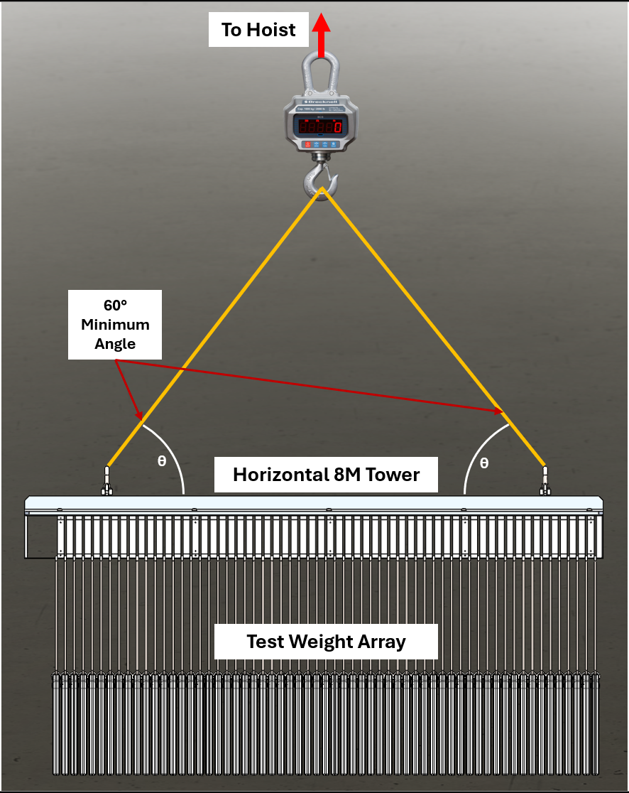
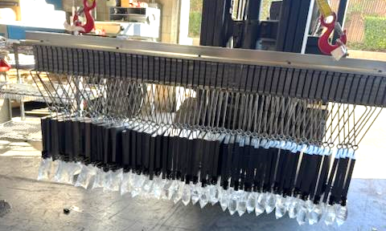
Lifting (Assembly) Test (Proto #2)
Test to verify structural integrity of the 8M Tower weldment while being manipulated with the strongback during fabrication, electro-plating, final assembly, and detector stacking.
Test Setup:
Target Load (200% Proof): 330 lbs. x 200% = 660 lbs.
Support: Attached to strongback by two swivel hoist rings and to load cell.
Applied Load: Loaded with extra absorber plates (for next assembly) by individual hangers in-between welded plates to equally distribute load.
Test Results:
No visual damage or deformation. Measurements were performed and showed no variation greater than the inherent accuracy variation of the measuring tools.

Slide 20
Next Steps
ASAP Tasks:
Finish and evaluate 4th 1320mm Prototype (5th prototype to follow for process verification).
After 5th Prototype evaluation, 3x Prototypes to be manufactured and electroless nickel plated (Ohio).
Ensure proper fitment in Tower stacking and installation of scintillator assemblies, can be performed with delivery of current batch of 5x units (expected at beginning of January 2025).
Create Design Specification document for fabrication methods / testing procedures, acceptance criteria, and shipment instructions.
Procurement Bid for LLP of 8M Tower Assemblies.
FY25 Tasks:
Repeat for 4M tower.
Finalize design of Left and Right Insert assemblies, (tile positioning and geometry still being optimized).
Design Scintillator Tile wrapping device and Scintillator package assembly device to allow for fast, repeatable operation for ≈530,000 wrapped scintillator tiles, ≈70,000 scintillator packages.

Slide 21
Tower / Insert Design

Slide 22
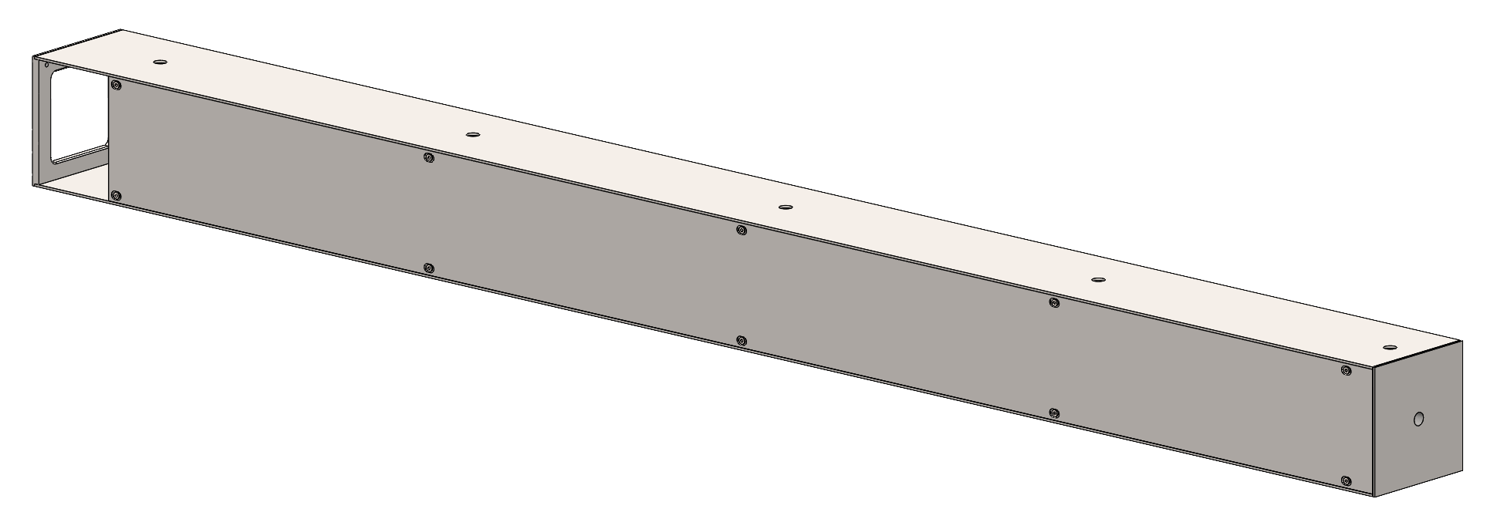
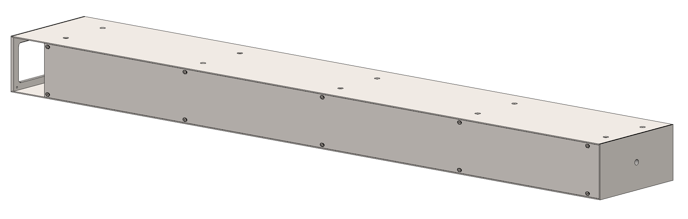
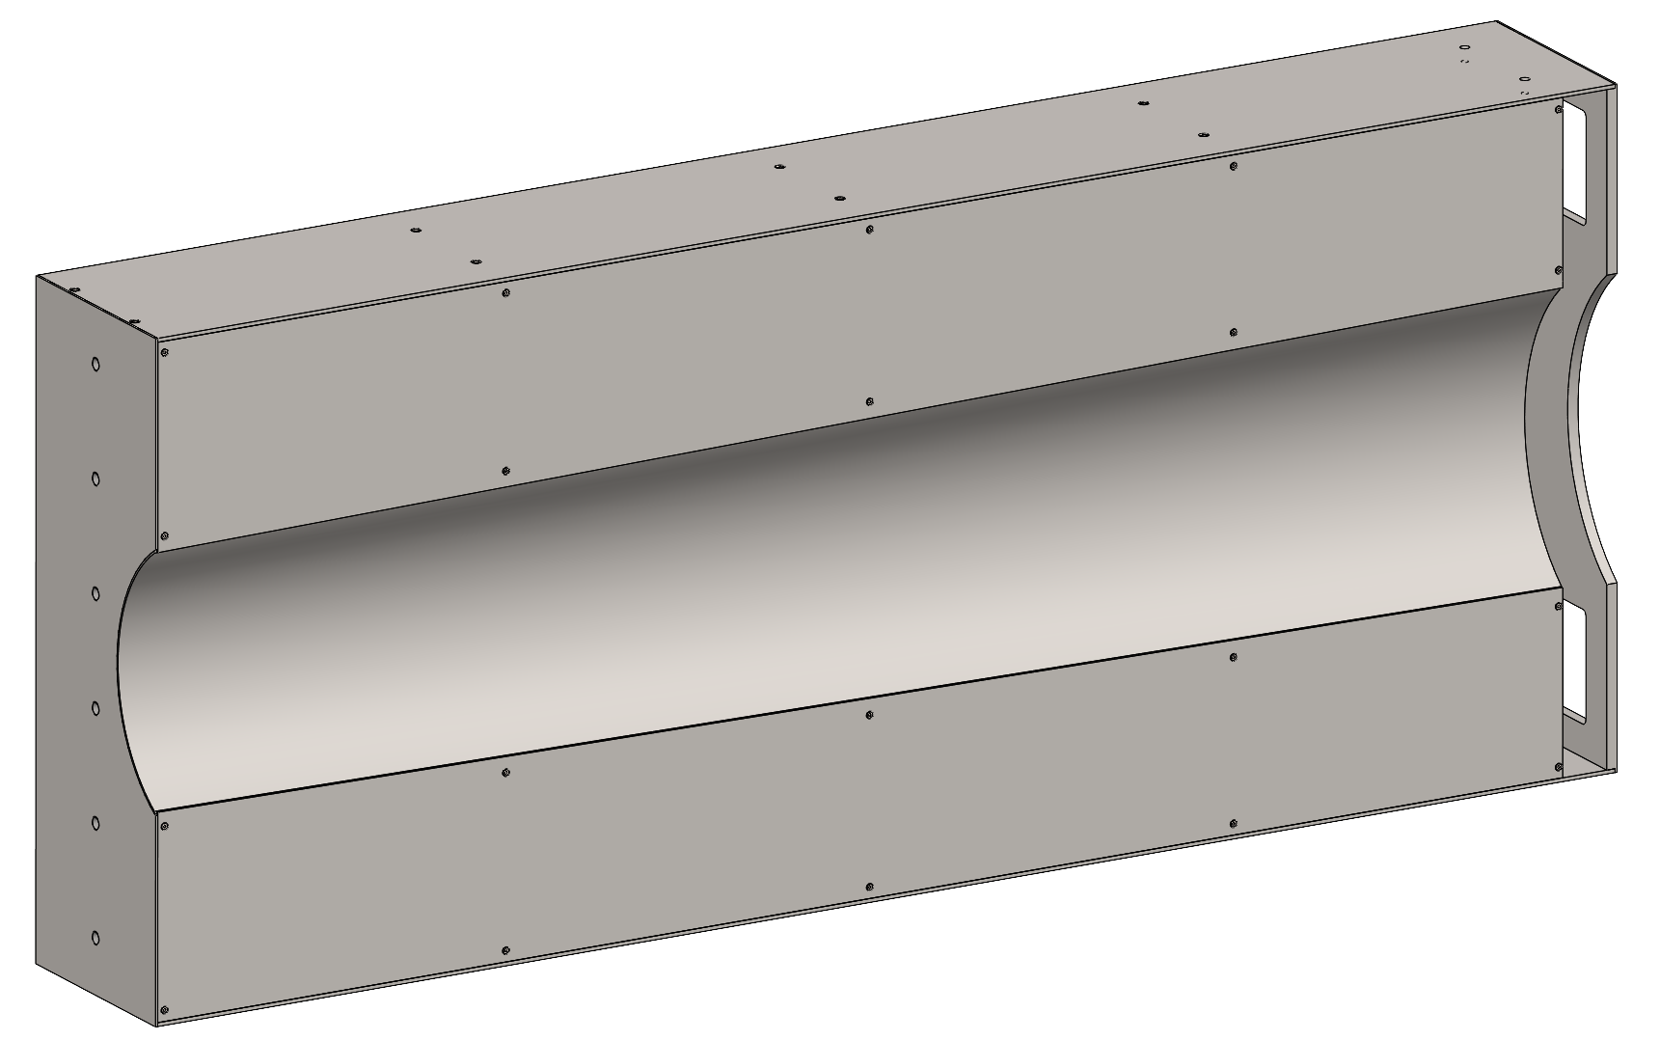
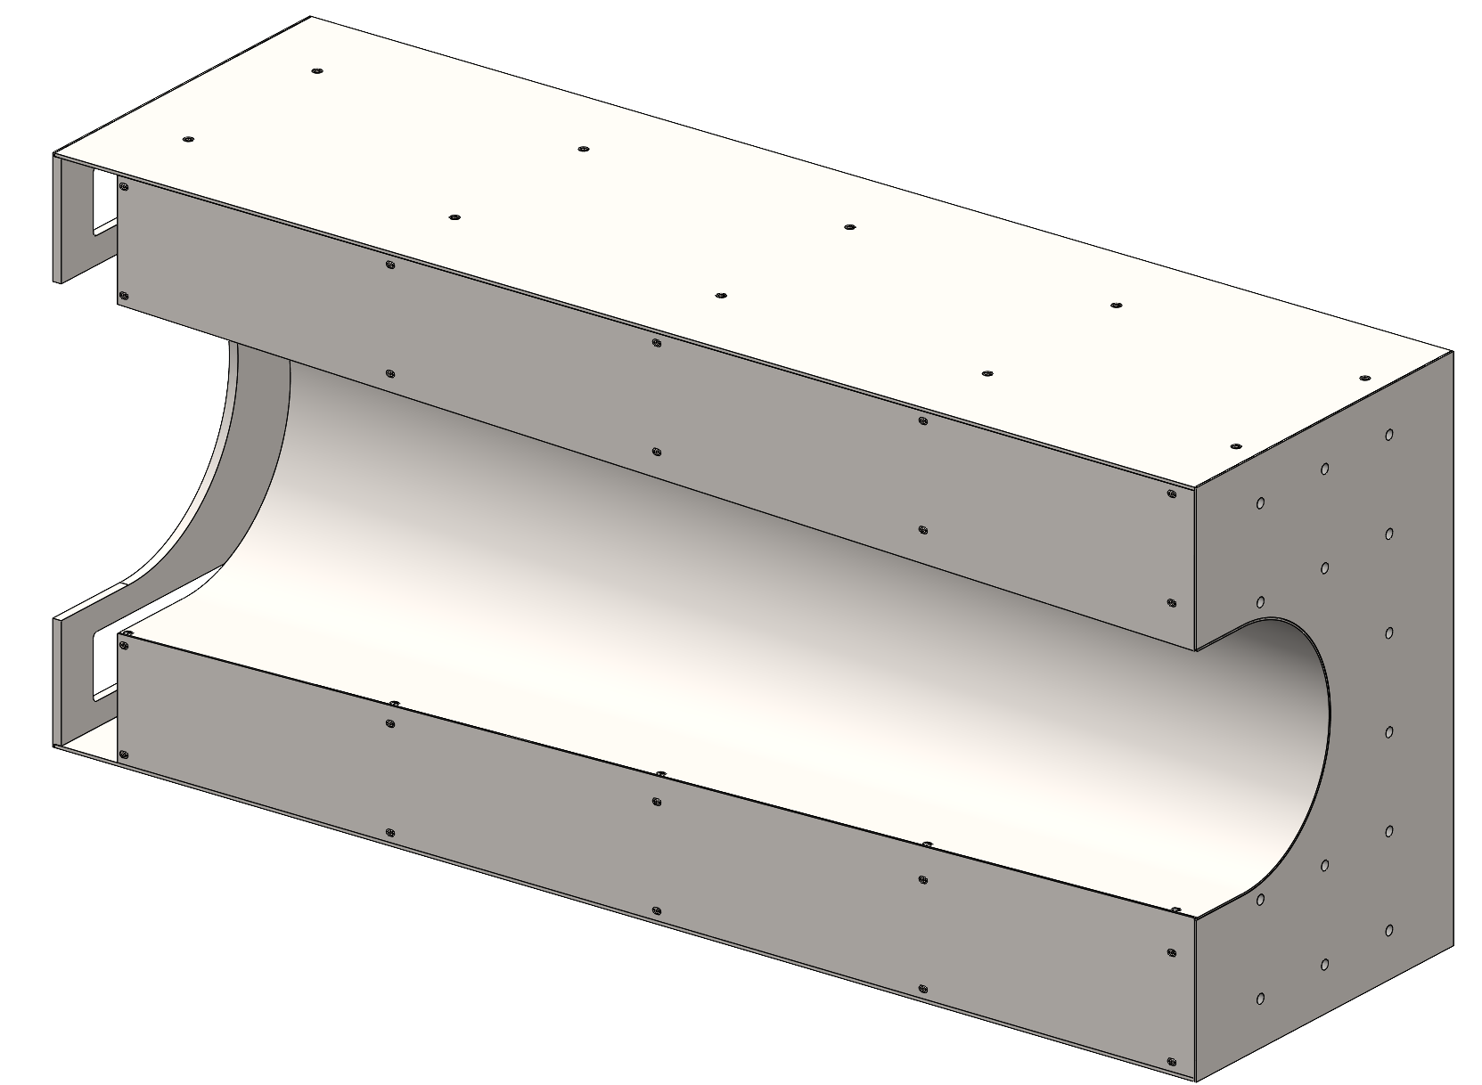
Unique Detector Geometries
4M Tower Assembly
- Dimensions: 10 x 10 x 132 cm
- Quantity: 72
- Mass: ≈ 70 kg
Common design and manufacturing processes for all geometries.
Constructed of 15.2 mm thick solid absorber plates, 1020 Carbon Steel
1020 Carbon steel sheet metal top and bottom.
Electron-Beam welding of all steel components for a monolithic structure.
Electroless Nickel plating for corrosion resistance.
Removable side panels for scintillator assembly and maintenance.
M12 tapped hole in front plate (For EMCal mounting).
M6 tapped holes for hoisting (strongback).
Generous windows at rear for PCB access / electrical connections.
8M Tower Assembly
- Dimensions: 10 x 20 x 132 cm
- Quantity: 1058
- Mass: ≈ 150 kg
Left Insert Assembly
- Dimensions: 60 x 20 x 132 cm
- Quantity: 1
- Mass: ≈ 820 kg
Right Insert Assembly
- Dimensions: 60 x 40 x 132 cm
- Quantity: 1
- Mass: ≈ 1,320 kg

Slide 23
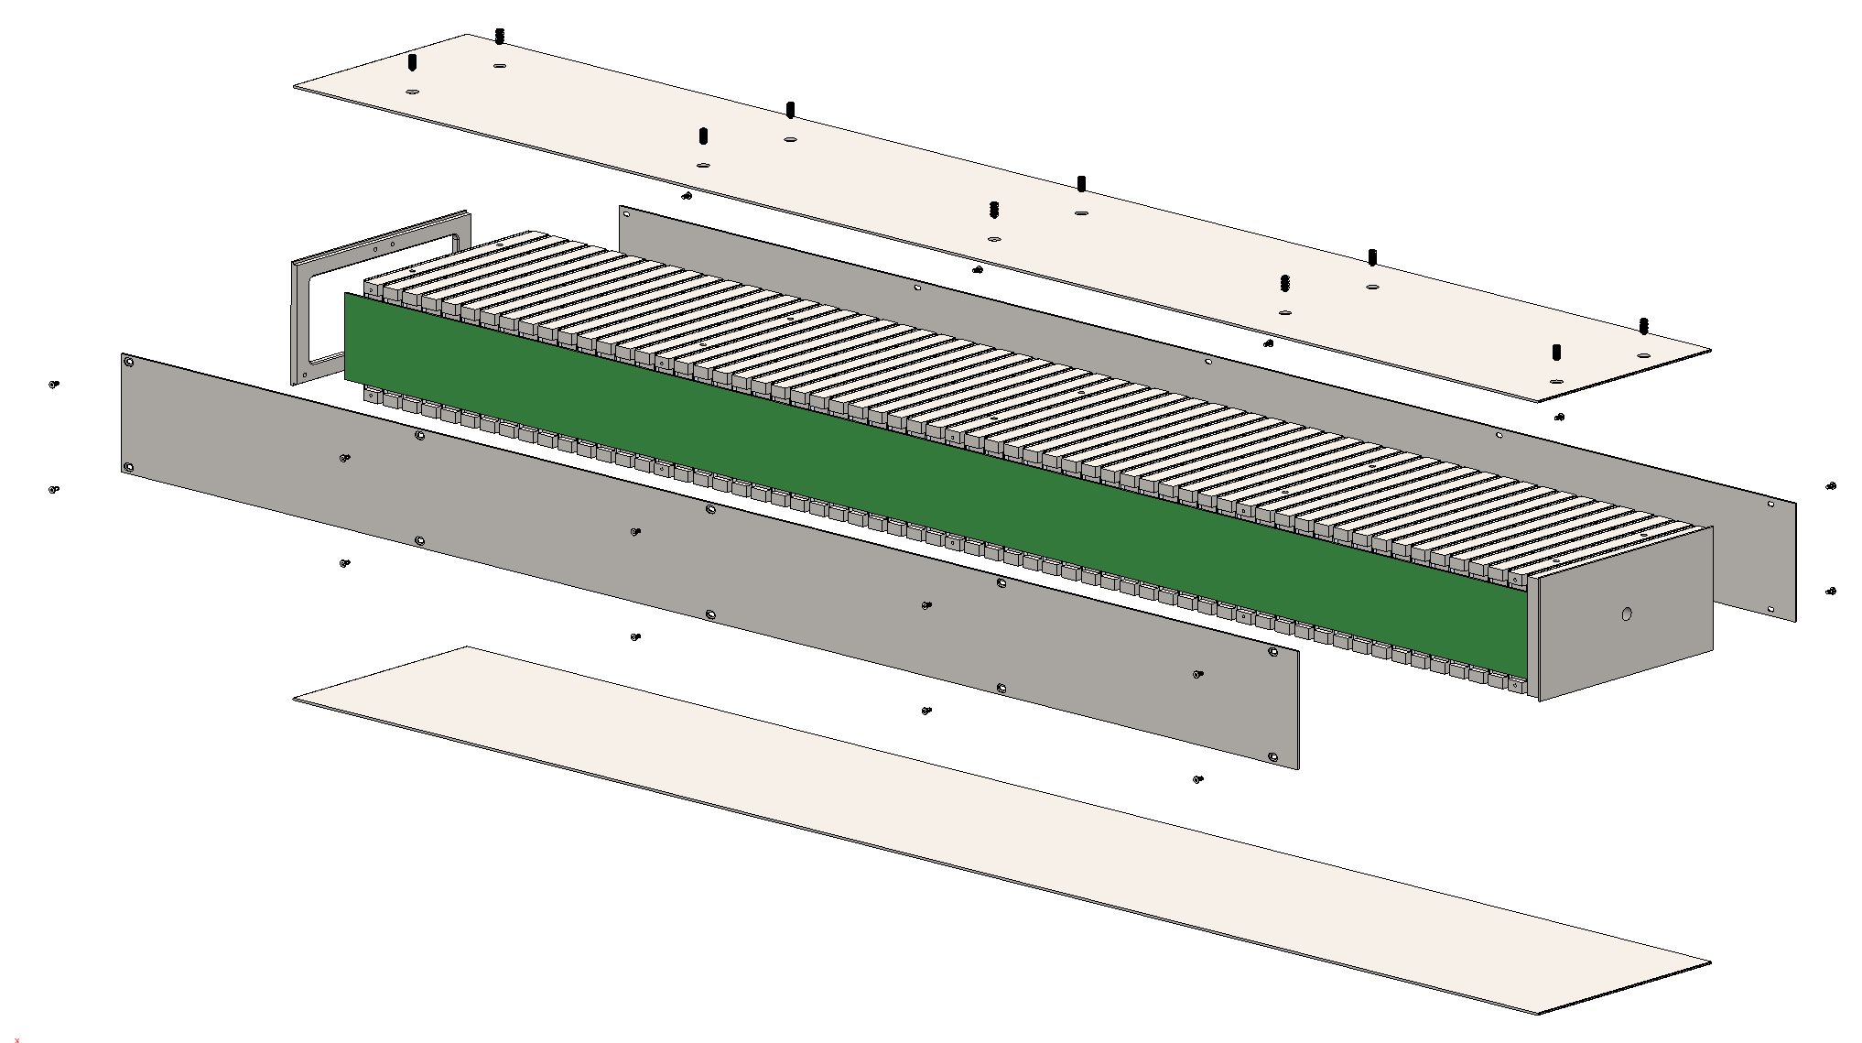
8M Tower Design
8M Tower Assembly
Main detector module shape.
61x absorber plate layers, 1020 Carbon Steel.
Top, bottom, and side panels made from 14 GA sheet metal.
Steel Plates
Removable Side Plate
Removable Side Plate
Expanded View
Side PCB connection
Front Plate
Side View with side panel removed

Slide 24
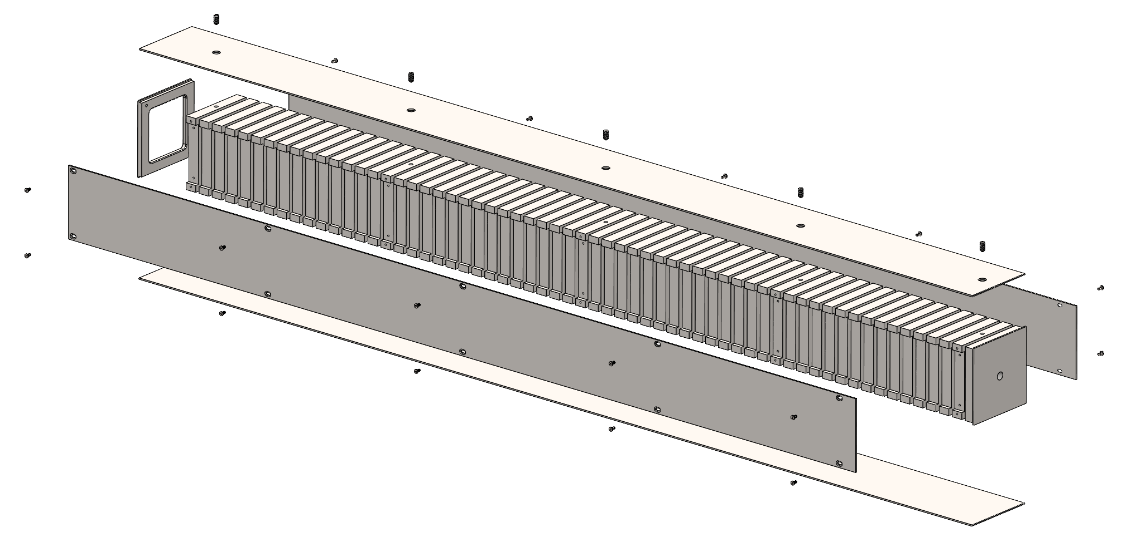
4M Tower Design
8M Tower Assembly
Fills voids left by 8M Tower stacking arrangement.
61x absorber plate layers, 1020 Carbon Steel.
Top, bottom, and side panels made from 14 GA sheet metal.
Steel Plates
Removable Side Plate
Expanded View
Front Plate
Side View with side panel removed

Slide 25
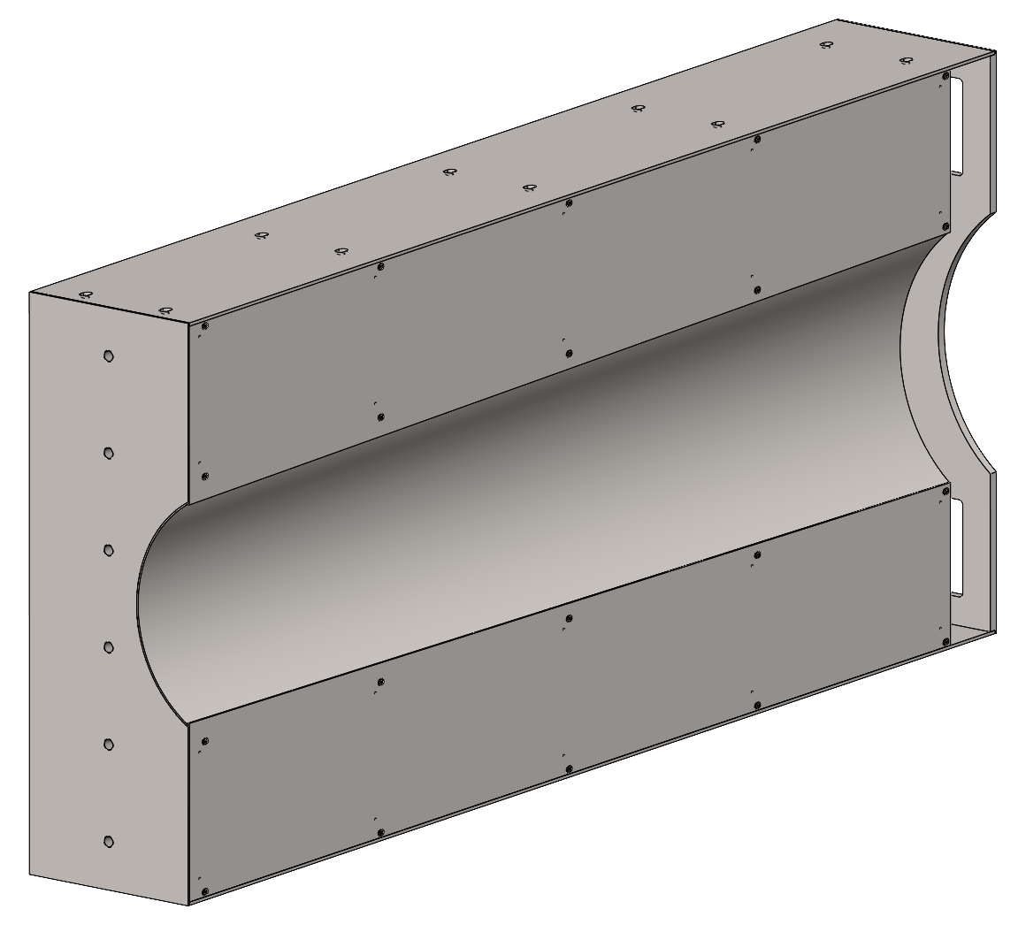
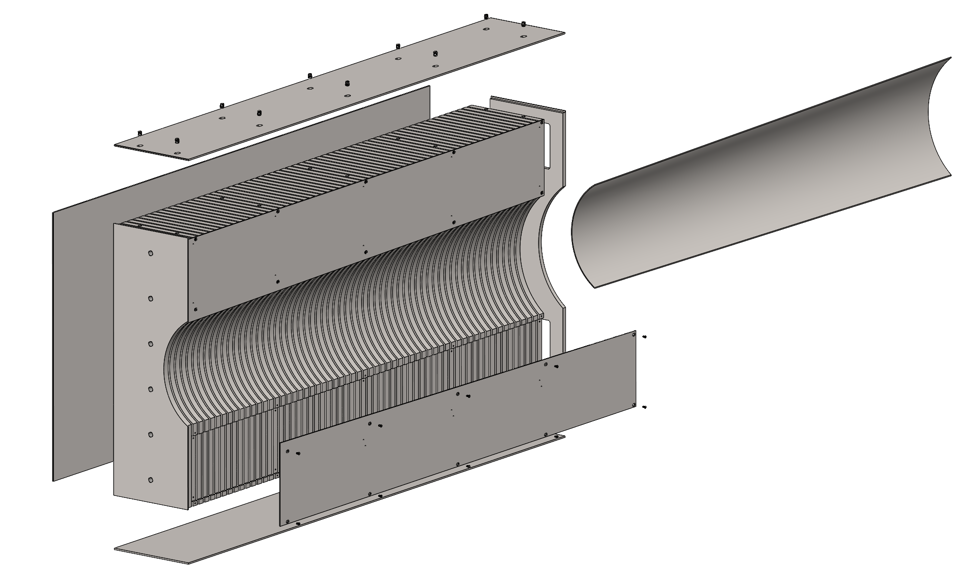
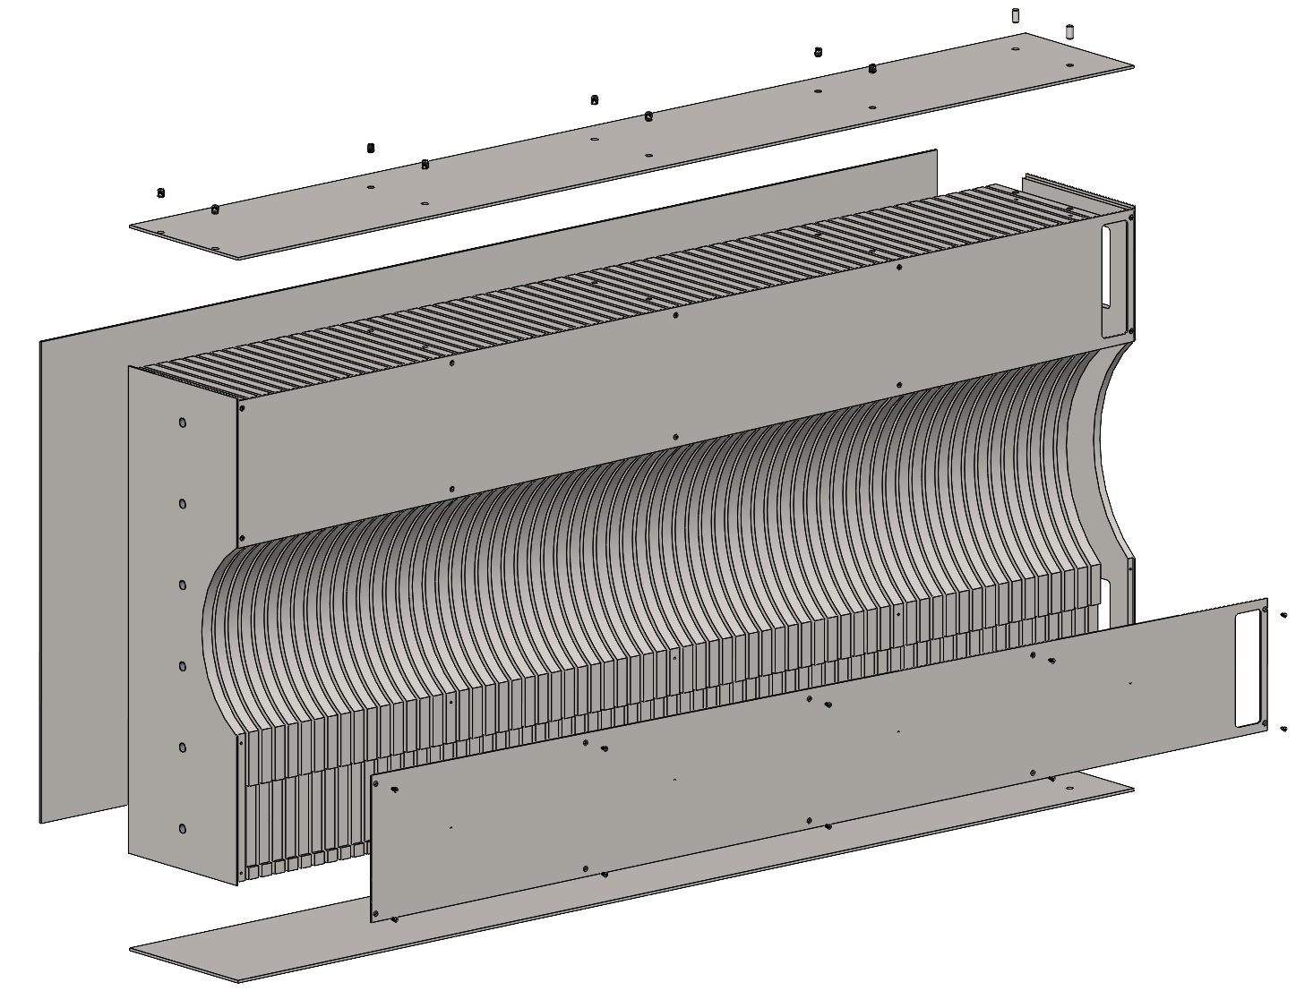
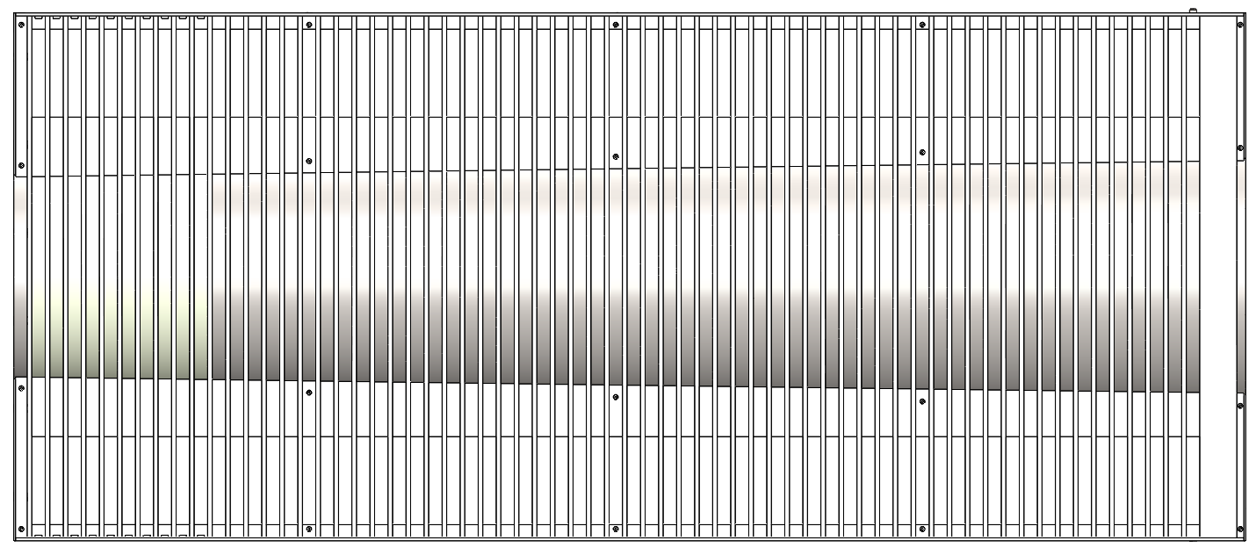
Insert Assembly Design (Left Side)
Left Insert Assembly
61x absorber plate layers, 1020 Carbon Steel.
Continuously expanding circular cut for constant beampipe clearance.
Top, bottom, and side panels made from 10 GA sheet metal.
Expanded View
Unique Geometry Steel Plates
Conical Inner Plate
Removable Side Plate
Side View with side panels removed
Removable Side Plate
Front Plate

Slide 26
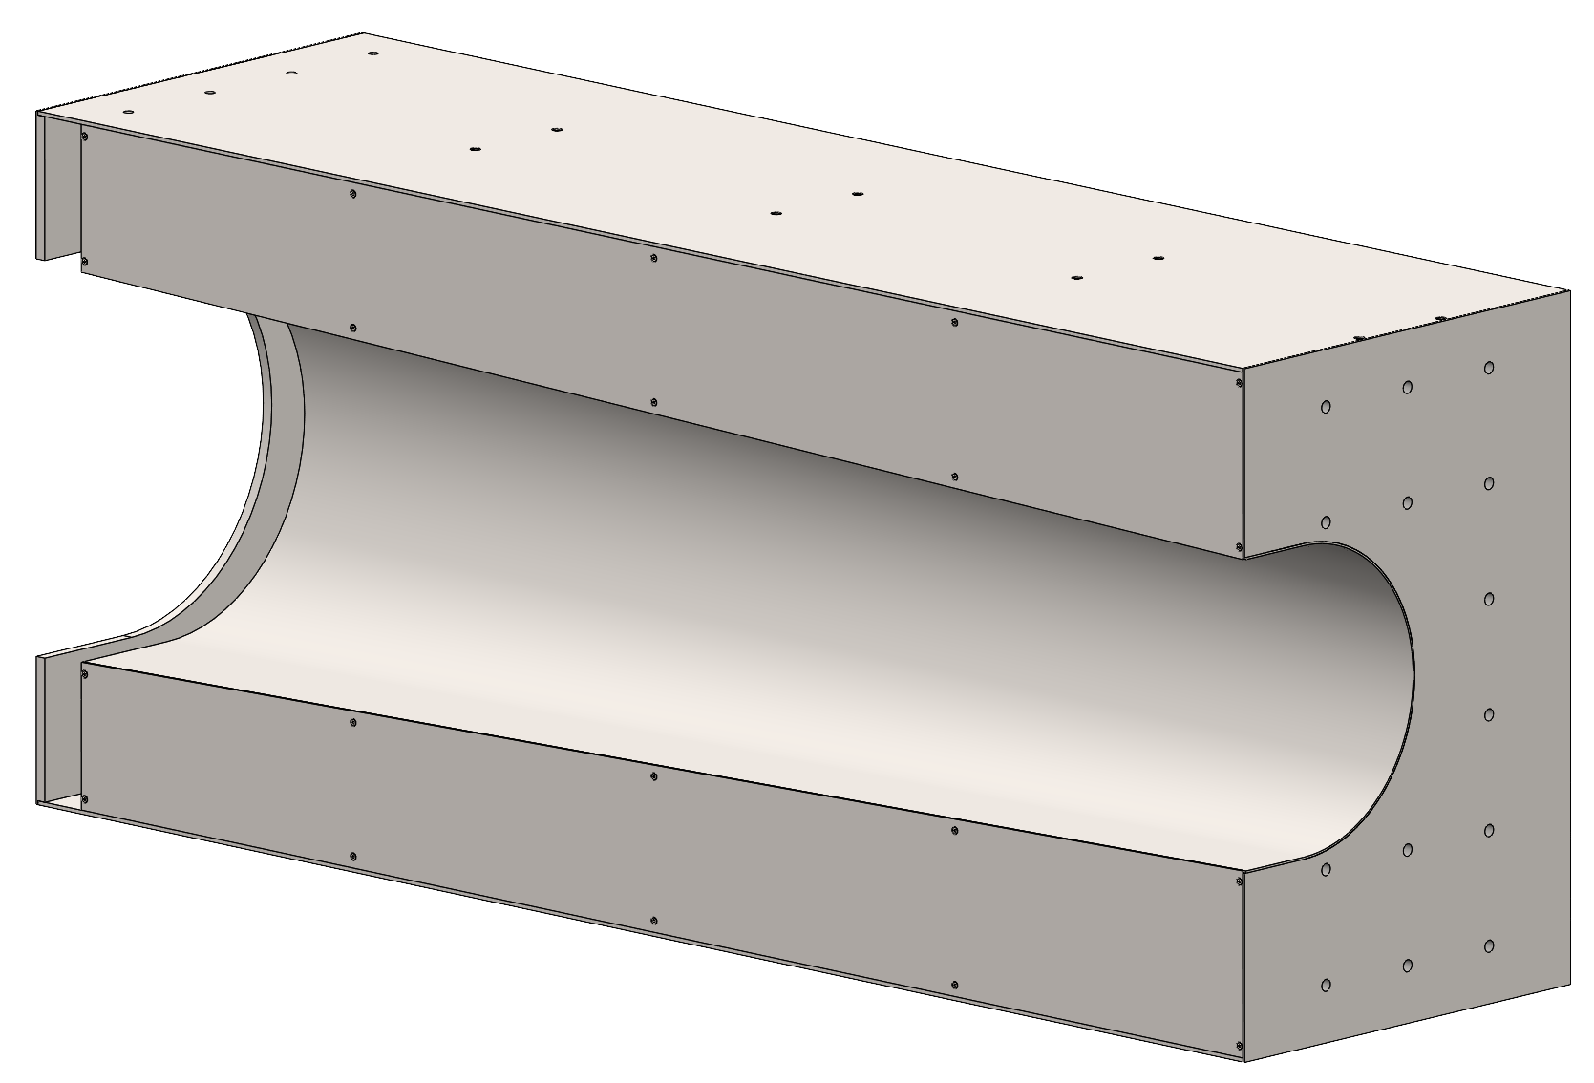
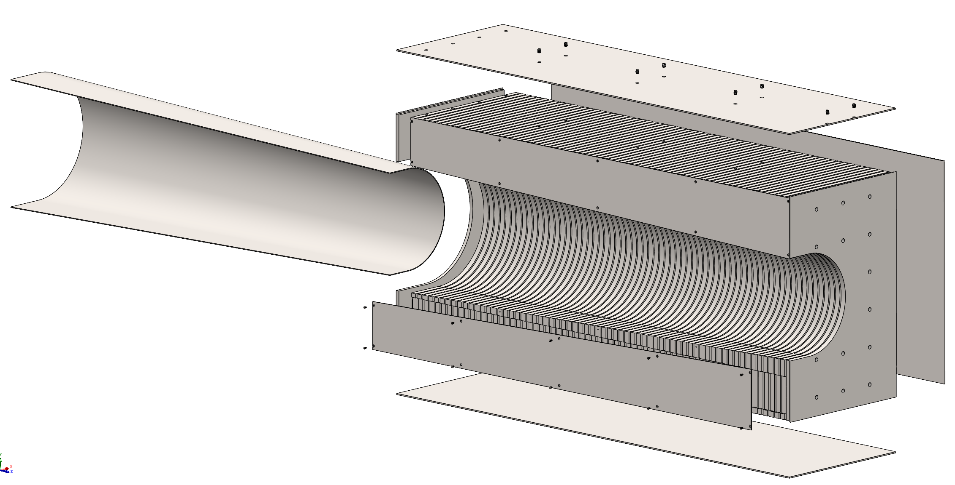
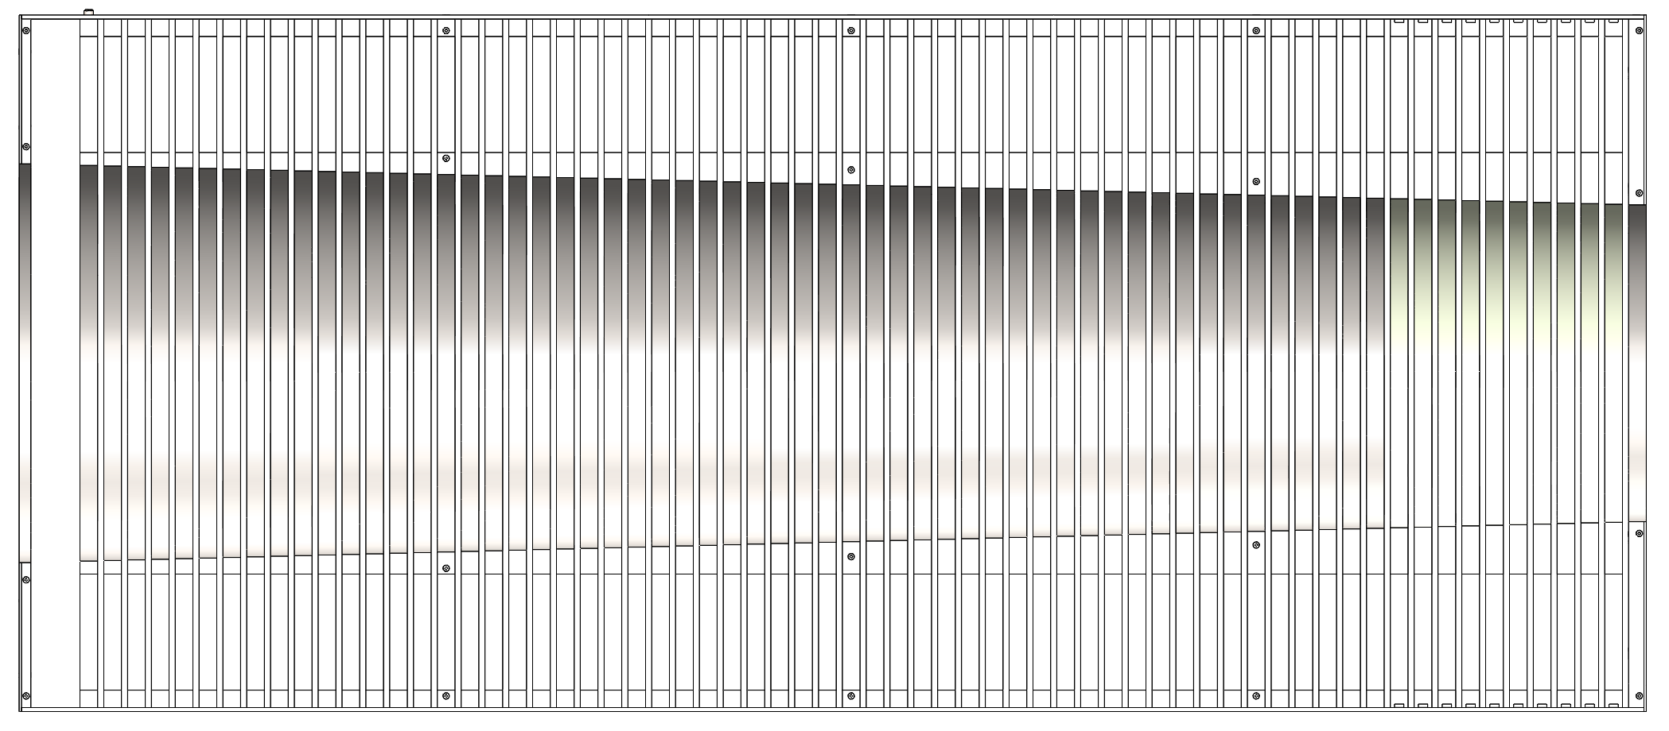
Insert Assembly Design (Right Side)
Right Insert Assembly
61x absorber plate layers, 1020 Carbon Steel.
Continuously expanding circular cut for constant beampipe clearance.
Top, bottom, and side panels made from 10 GA sheet metal.
Expanded View
Conical Inner Plate
Removable Side Plate
Front Plate
Side View with side panels removed
Unique Geometry Steel Plates
Removable Side Plate

Slide 27


Insert Assembly Design (Beam Pipe)
3 cm annular clearance around beampipe

Slide 28
Scintillator Integration

Slide 29




Common Scintillator Assembly Features (8M shown)
Material / Manufacturing:
  Injection molded polystyrene scintillating tile (bulk fabrication)
Dimensions:
  Raw Tile: 47 x 47 x 4 mm (sets the resolution)
  Wrapped tile: 47.2 x 47.2 x 4.6 mm (not including SiPM board thickness)
Envelope Assembly:
  Approximate weight: 100 grams / envelope
  Total weight per Tower Assembly:
  4M Tower – 4 kg / 8M Tower – 7 kg
  Left Insert – 40 kg / Right Insert – 57 kg
Flexible PCB with Silicon Photomultipliers (SiPM) connects to the common PCB running along the tower to the rear of the assembly.
The flex PCB then connects to the readout board at the rear of the Tower.
Scintillating Tile
Wrapped Tiles
Kapton Sheet
Kapton Sheet
3M Reflective Foil
SiPM Flex PCB

Slide 30




Assembly Methods (8M Tower / Scintillator Envelopes)
Scintillator Envelope:
  Tiles are wrapped in 3M Foil.
  SiPM Boards attached to wrapped tiles.
  Kapton sheet attached to front and back of envelope assembly.
Assembling Tower:
  Side panel is removed from tower (10x screws).
  Each Scintillator Envelope is slid into the slot between absorber plates (60x).
  The side flex PCB is connected to each of the SiPM board connectors.
  The flex PCB is connected to the readout board at the rear of the tower.
  The side panel is re-attached.
Flex PCB Connections
(90 degree bend)
*NOTE: Final design to have a seamless 60 connection circuit. Preliminary 8x8 connection circuit board shown was used in test beam.*
Side PCBs
Readout Board
(not used for test beam)
Scintillator Envelope

Slide 31

CERN Testing Assembly (8M Tower)
Side PCBs

