Slide 1
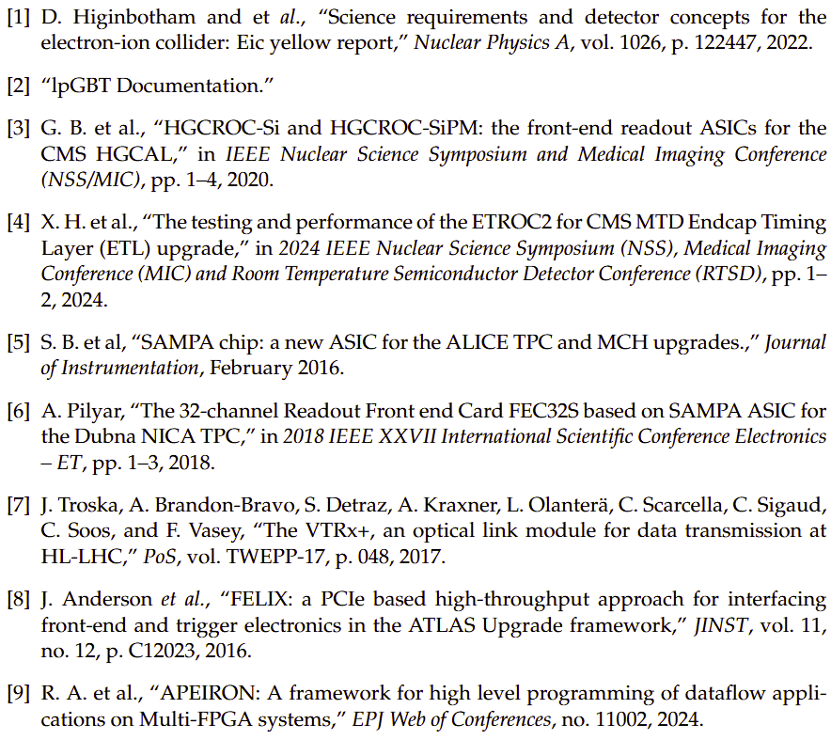
TDR V1 References:
Some effort, but not yet complete
Need experts to suggest appropriate references…
Please email conveners:
jml@bnl.gov, barbosa@jlab.org, jhuang@bnl.gov
TOPIC | Reference(s)
Yellow Report | Yellow Report, 2022
CALOROC | HGCROC-SiPM, 2020
EICROC | HGCROC-Si, 2020
FCFD | ETROC (as possible mode for backend) , 2024
SALSA | SAMPA, 2016, 2018
ALCOR | (none yet)
lpGBT | Web documentation
VTRX+ | VTRX+, 2017
FELIX-155 | FELIX, 2016
bPOL12V | None
bPOL48V | None
LTC36xx | None
Astropix end of stave card | None
Spyder 3 (Low Q2) RDO | none
JLAB ADC250 (Direct photon) | none
?TCLINK? | none (should it be referenced in regard to timing dev)
?CODA, RCDAQ, NESTDAQ? | none (should these be referenced?)
SRO I…XII | none (should its impact be referenced?)
SPADI | none (should it be referenced in workforce plans)
dRICH FPGA Processing | APEIRON, 2024
Others?
(More detail in bibtex entry, but format??)

Slide 2
Need to move towards baseline definition for the detector and need counts & final ASIC interfaces
PDR3 Summer 2025
CD2 Early 2026
Fast commands (downlink)
Bit Rate
Frame Rate
Fast commands synchronized at 50.75ns (5x EIC clock, 2x 40MHz)
Data links
Data Rate per link
Number of links
Logic of links
Must all links be used or is this configurable by data rate needs?
If so, how is configuration done (register settings, or hardcoding)
Are link speeds configurable?
If so, how is configuration done
Moving towards understanding of interfaces
What happens when hit rate is too high
Dead times?
Truncation of digital data?
Marking of Truncation?
Fast commands
Data formats

