Slide 1

ePIC Collaboration News
J. Lajoie, S. Dalla Torre
March 7, 2025

Slide 2
Hey John, start the recording….

Slide 3
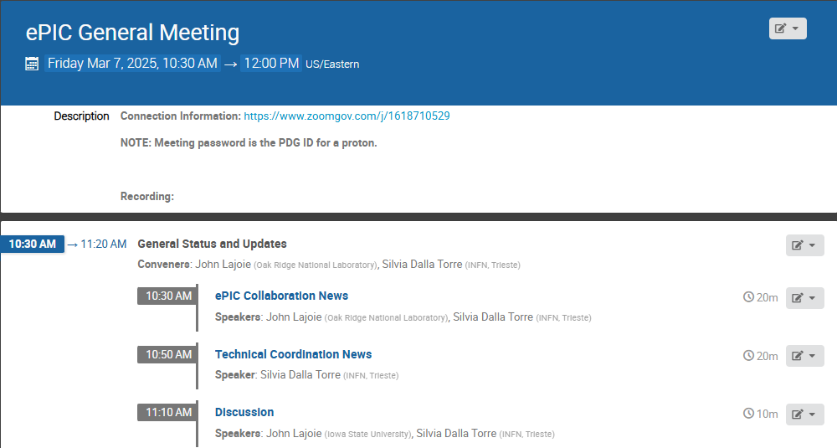
Agenda
The usual news updates from the SP and TC Offices.

Slide 4

ePIC Collaboration News
Lots of few-slide news items to go-through today. There’s a lot happening in the collaboration!

Slide 5
ePIC preTDR Timeline

Slide 6
preTDR in 2025 Timeline
More in Silvia’s TC News Talk
Version 1 (chapter 8) to be reviewed by TC Office, specific criticisms and suggestions to DSC’s by end of March
Version 1 (chapter 2) to be reviewed by SP Office, specific criticisms and suggestions to PWG’s by end of March
Version 2 due mid-July (Collaboration Meeting)
  Version 2 internal/external review Aug-Oct.
  Comments tracked and feedback given to reviewers
Editorial Board formed by end of July
  Silvia to co-chair, 3-5 additional people
  Board is responsible for overseeing Version 2 review process
  Board is responsible for final editing pass (typos, language, consistency)
preTDR Version 2.1 by early December 2025

Slide 7
Analysis/Technical Notes

Slide 8
Analysis/Technical Notes
Within ePIC we need a mechanism to document ongoing work so that it doesn’t get lost/forgotten.
  Within collaborations this is typically an analysis or technical note
What do I mean by an “analysis or technical note” ?
  Written document that preserves some work/study/information
  The content of these notes can vary widely:
    It can be a note by a summer student on the outcome of a simulation study
    It can be a comprehensive note supporting a preliminary result or a publication
    It can be the results of a test beam
    It can be a technical note on a reconstruction algorithm
    …
Notes like this are for the collaboration only, and encompass any effort within the collaboration (TC, S&C, AC)
There should be a low bar to creating analysis/technical notes
  We want to encourage people to document important work!
  Should become an expectation that work is preserved in a note, not in slides

Slide 9
Proposed Procedure for
Analysis/Technical Notes
Procedure discussed in coordinator meeting, as well as TC/S&C/AC meetings.
https://www.epic-eic.org/documents/note_process.html
Step 1: Collaborator contacts the Analysis/Technical/Software and Computing Coordination Office with title to receive note number
  Analysis/Technical/Software and Computing Coordination Offices maintain note numbers and list of notes
Step 2: DSC/WG leadership signs off on note
  Work with DSC/WG leadership to identify the most appropriate DSC/WG
  Review should ensure the content of the note follows the standards of the collaboration and the results are accurate.
  DSC/WG leadership sends an email to the Analysis/Technical/Software and Computing Coordinators to confirm
Step 3: Collaborator submits to Zenodo
  Use keywords “ana_note” and “tech_note”, along with any other keywords that will make it easy to find the note efficiently. A list of official keywords is available here.
Step 4: Analysis/Technical/Software and Computing Coordinators approve publishing to ePIC
  Analysis and Technical notes will be made available to ePIC Community members

Slide 10
Notes in Publication Policy:
Analysis notes are explicitly mentioned in draft publication policy:
No conflict. Pub. Committee Chairs notified of draft procedures.

Slide 11
ePIC Publication Plan

Slide 12
ePIC Publication Plan
Completing
preTDR
process design phase
structuring the
effort
draft ePIC pre-TDR
ePIC pre-TDR (CD-2)
writing
(TDR/notes)
Preparing papers for
publication
Mid Jan.24
Late 2025
Mid Mar.24
End Oct. 24
Late 2024
It is still our intent to publish a super-set of the material prepared for the preTDR.
  Longer articles on subsystems, physics performance, etc.
  Important for collaborators to have a published product for all their hard work!
According to the projections shown at the Frascati meeting, we should be at ~70% design maturity by end of 2025, ~90% after July 2026
Need a publication plan that is flexible to accommodate these timescales

Slide 13

Possibility: NIM Special Issue I
JGL Discussed the possibility of a NIM-A special issue with William Barletta (Editor), Christian Joram (NIM-A Editor in Chief), Tanur Sinha (Publisher):
Q: What ePIC is thinking of …
  NIM special issue would be a set of more detailed articles that the TDR would allow on the detector subsystems in ePIC, their design and performance.
  Physics Working Groups would like to include articles on the performance of ePIC for various parts of the EIC science program.
  Combined, this would make a comprehensive overview of the design and performance of ePIC.
  The timescale would be such that articles would start to be available in fall of 2025 and we should be able to complete the set in early-mid 2026.
A: “That sounds like an excellent approach and also makes the refereeing much more tractable. We can certainly keep the submission portal open for the length of time that you envision. We will be most pleased to be a part of this exciting project for nuclear physics.”
  NIM editors/publisher are enthusiastic and supportive

Slide 14
Special Issue Considerations:
Plan discussed in coordination meetings
NIM Publication Policy:
  No article charges for subscription access
  $2-3k per article for Open Access
Do we need Open Access?
  US DOE Labs do not require Open Access
  DOE requires articles be submitted “as accepted” to DOE PAGES
    Typical embargo 12 months then publicly available
  Agreement between journals and DOE regarding arXiv
    As accepted can get posted, but before and editors changes
  Conclusion: Open Access covered by existing agreements/procedures
Impact:
  NIM: 1.5, JINST 1.3

Slide 15
NIM Special Issue
Next Steps:
  Present to the collaboration and get feedback (today)
  Expect follow-up discussions in TIC, S&C and AC meetings
Assuming we go forward with NIM-A Special Issue:
  Fill out and send in Special Issue Information Form
  Discussion on format of special issue:
    Multiple subsystem articles? Combined articles (tracking, calorimetry, PID)?
    Settle a list of contributions, put together teams to write the articles
  Select Guest Editors from within ePIC:
    Guest Editors will shepherd the review process
    Should be selected from amongst us, but this means work
    Final decision rests with Editor-In-Chief

Slide 16
DSL/Convener Changes

Slide 17
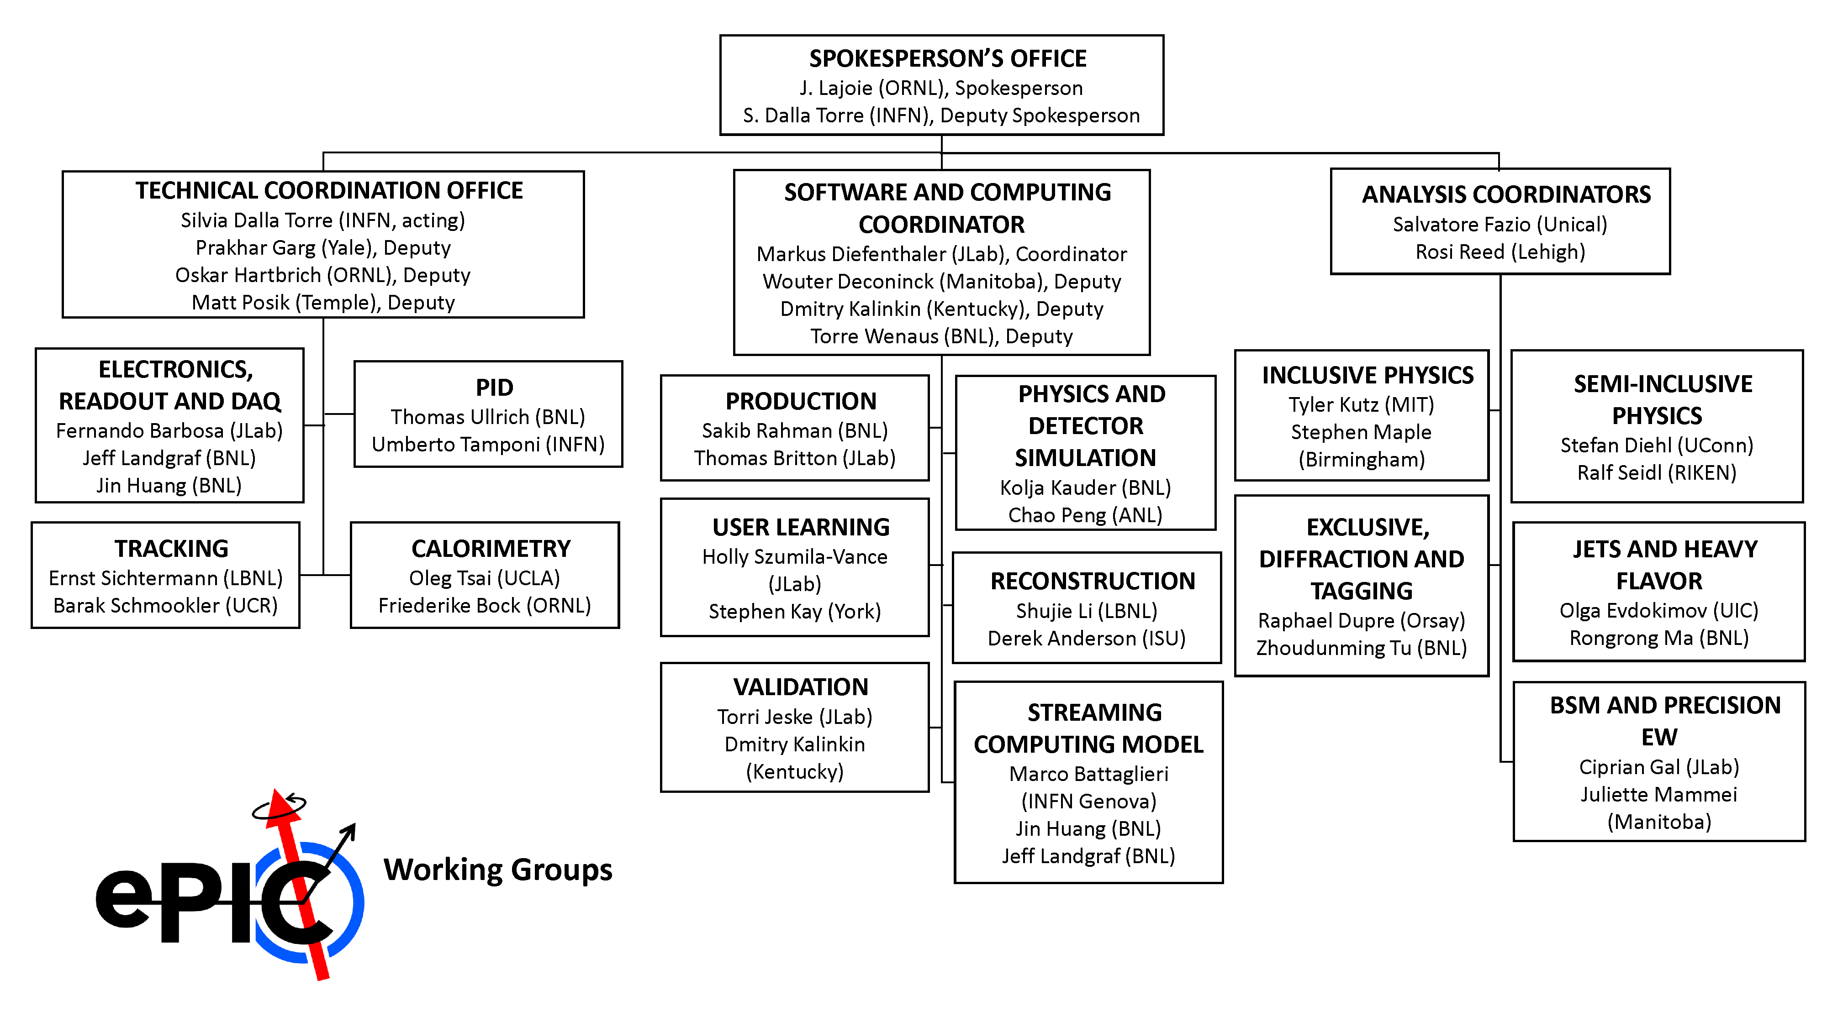
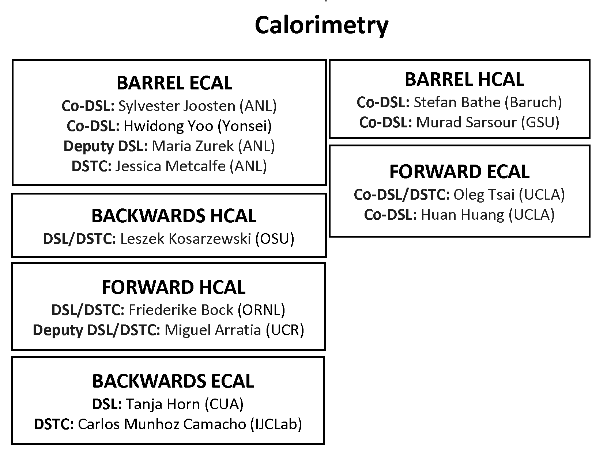
Changes
Jin Huang and Megan Connors have been elected as co-spokespersons of sPHENIX – congratulations!
Murad Sarsour will take over for Megan as Barrel HCal Co-DSL.
Software & Computing in discussions with a candidate for Streaming Computing Model WG convener (pending CC endorsement).

Slide 18
Other Items

Slide 19
Next Early Science Workshop
The next ePIC Early Science Workshop is scheduled for April 24-25th at Stony Brook University
  This will be a hybrid meeting
  Indico: https://indico.cfnssbu.physics.sunysb.edu/event/410/
  Early Career Support: https://forms.gle/CoC64dM4B8koduwm9
    Deadline for requesting support is March 14th
Talks in the morning/early afternoon to facilitate online participation
Agenda developing – contact Rosi and Sal with contributions
Many thanks to Abhay and CFNS for support!

Slide 20

Welcome Seoul National University!
Following their presentation at the January 23rd Collaboration Council meeting in Frascati, the CC has voted to admit Seoul National University to the ePIC Collaboration!

Slide 21

ORCID
Long email to collaboration sent Feb 24th
TLDR: ORCID is not required by ePIC, but for CC members it will allow them to update the information for their institution members in the collaboration database.
Required for BNL registration starting March 31st, 2025
https://orcid.org/

Slide 22
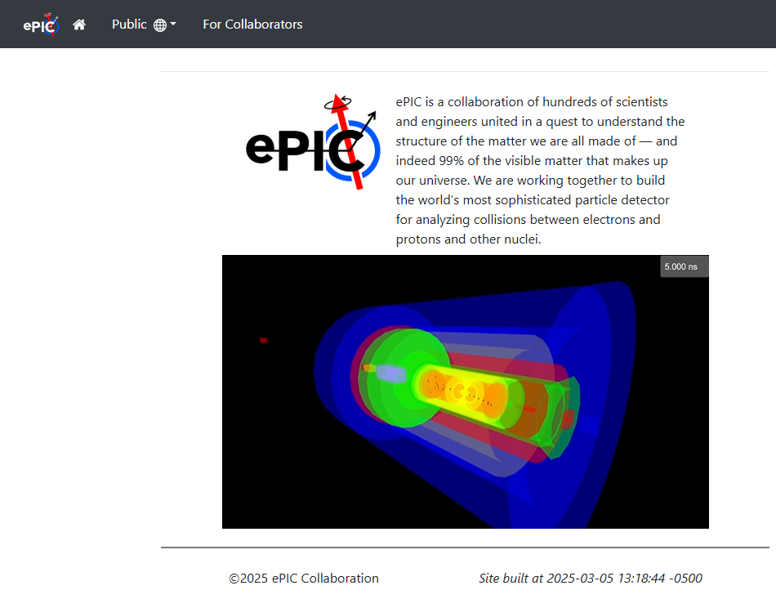
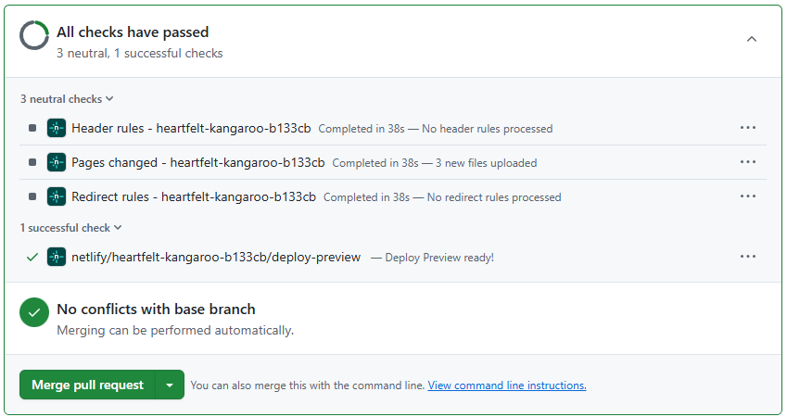
ePIC Website
Lots of changes – check it out!
  Information updated/kept up to date
New event display video from Sean Preins:
  https://youtu.be/H8Mqj3K66cU
New preview feature for pull requests – no need to install/maintain Jekyll.
  Easy to edit in Markup, commit
  and pull request to view
  Contact Maxim
  (potekhin@bnl.gov)
  for assistance

Slide 23
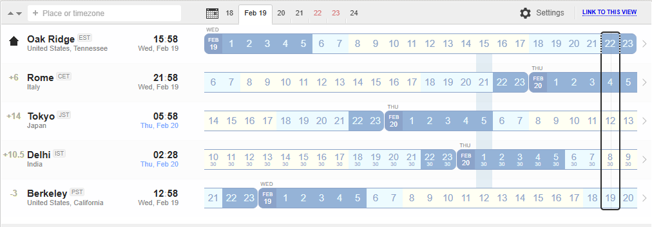
New Time for Evening General Meetings
Current Meeting Times:
Fridays:
10:30 AM ET
Thursdays:
7:30 PM ET
Current evening meeting time is not serving its purpose
NOTE: It is not expected that everyone attend all General Meetings!
New Evening Meeting Time:
Thursdays:
10 PM ET

Slide 24
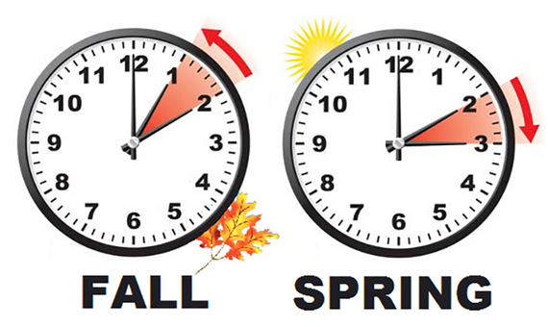
Daylight Savings Time
The U.S. will “spring forward” at 2AM ET on March 9th
Europe will “spring forward” at 2AM CET on March 30th
China, India, Japan, Taiwan, and Saskatchewan, do not observe DST
This transition will cause some confusion during March
I don’t trust myself to do the conversion:
  https://www.worldtimebuddy.com/

Slide 25
Next CC Meeting
Next CC meeting April 4th, 2025 at 10:30AM ET
Two new institutions will petition to join ePIC
Further discussions on the Publication Policy
Analysis of Membership Survey data
Agenda coming soon at https://indico.bnl.gov/event/26907/

Slide 26
Coming Soon
2025 Statements of Service frozen as of Feb 10th
  Analysis of 2025 FTE commitments and projections underway
  Look for more information at next CC Meeting
Next collaboration meeting – Week of July 14th @ JLab
REMINDER: Call for Jan. 2026 Collab. Meeting Host due March 31st
  So far one expression of interest…
At future GM’s: Reports from Coordination Offices
  TC Office Today – AC, S&C in near future
EIC RRB Meeting Announced – June 5-6 in Prague
  https://www.bnl.gov/eic-rrbmeeting/index.php

Slide 27
Detector and Project Reviews planned for 2025:
From Elke and Rolf
Preliminary Design Reviews (60% design maturity equivalent, called PDR, PDR2 or PDR3, pending the subsystem)
  PDR2: MPGD Tracking Detectors (6.10.03.02) – Summer 2025 – exact timing linked to progress on first engineering test articles
  PDR2: Silicon Tracking Detectors (6.10.03.01) – Fall 2025 – After early results of ITS3 ER2
  PDR2: Cherenkov-based Particle Identification Detectors (6.10.04; pfRICH, hpDIRC, dRICH) – April 1-2, 2025
  PDR2: AC-LGAD-based Particle Identification Detectors (6.10.04; BTOF, FTOF, common systems) – Fall 2025
  PDR3: Barrel EM Cal (6.10.05.02) – ~August 2025
  PDR2: Backward HCAL (6.10.06.01) – ~September 2025
  PDR: Magnet Cryogenics and infrastructure (6.10.07) – September/October 2025
  PDR3: Electronics/DAQ-computing (6.10.08. 6.10.09.01) – Late August 2025 – this does not include slow controls
  PDR: DAQ-Slow Controls (6.10.09.02) – November/December 2025 – Later to ensure integration DAQ in the collider common platform
  PDR: Integration, Infrastructure and Installation (6.10.10) – September/October – everything outside GST, includes cradle, HCAL, etc.
  PDR: Integration, Infrastructure and Installation (6.10.10) – November/December 2025 – everything inside GST
  PDR3: IR Integration and Auxiliary Detectors (6.10.11) – November/December 2025 – includes 6.10.14 lumi detector
  PDR2: Polarimetry (6.10.014) – September/October 2025
Final Design Reviews (FDR):
  FDR: Backward & Forward EM Calorimetry, Barrel & Forward HCAL (6.10.05.01; 6.10.05.03; 6.10.06.02; 6.10.06.03) – May 2025
Project Reviews:
  OPA CD-3B Review – January 7-9, 2025
  DAC Meeting – Comprehensive look to design status and readiness for CD-2: 3 days to split topics. June 11-13 @ BNL.
  DOE IPR focused on SP Status – 29th & 30th of July
  Collider Subproject and Status Director's Review – October 21st – 23rd, 2025
  DOE IPR and ICR – January 13th – 16th, 2026
Other Meetings:
  Detector R&D Day hosted by ePIC and EIC Project: 16-17April 2025
  5th RRB Meeting: June 5-6, 2025 – Prague, Czech
  6th RRB Meeting: November 4th & 5th 2025, BNL

Slide 28



2025 -2026
PDR2: Polarimetry
Sept./Oct 2025
PDR: DAQ - Slow
Controls
Nov./Dec. 2025
ePIC Early Physics Workshop
April 24-25, 2025
DOE IPR: SP Status 29-30th July, 2025
PDR2: Backwards HCal
~Sept. 2025
ePIC pre-TDR
V2.1
PDR3: Barrel EMCal
~August 2025
5th EIC RRB Meeting
June 5-6th 2025
ePIC Software and
Computing Review
~Oct 2025
ePIC Software and
Computing Review Check-in
~May 2025
DOE IPR and ICR, 13-16th Jan., 2026
PDR2: Cerenkov PID
April 1-2, 2025
PDR3: IR Integ. & Aux. Det
Nov./Dec. 2025
PDR3: Elec./DAQ
August 2025 (late)
PDR: Magnet/Cryo Infrastructure
Sept./Oct. 2025
2025
2026
Frascati
Jan 20-24,2025
Collider Subproject and Status Director's Review
21-23 Oct., 2025
CD-2/3 Review
~ mid 2026
EICUG/ePIC Collab. Mtg. July 14-18
FDR: Backward & Forward EM Calorimetry, Barrel & Forward HCAL
May 2025
PDR: Integ. + Installation
(outside GST)
Nov/Dec 2025
PDR2: Si Tracking Detectors
Fall 2025
10th Detector Advisory Committee
June 11-13th 2025
PDR2: MPGD Detectors
Summer 2025
Detector R&D Day (ePIC/Project)
16-17th April 2025
PDR2: AC-LGAD Detectors
Fall 2025
PDR: Integ. + Installation
(inside GST)
Nov/Dec 2025
6th EIC RRB Meeting
Nov. 4-5th 2025

Slide 29
Parting Words
Moving forward on a number of collaboration priorities
A busy 2025 is already underway!
Next ePIC General Meeting Friday, Mar. 20th, 2025 @ 10:00PM ET

Slide 30


Slide 31
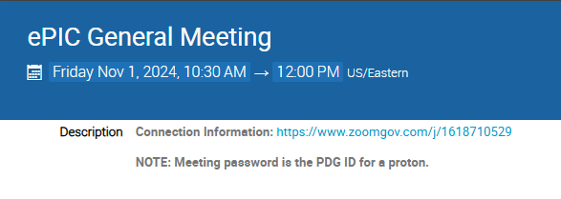
New Zoom Link
The Zoom link for the General Meeting now requires a password
We decided to do this after a TIC meeting was Zoom-bombed
  All our Indico pages are public, so this offers another hurdle for a would-be
  bomber (not a guarantee)
    Old link had password embedded to allow one-click access
  Hopefully this is not
  overly cumbersome for
  our collaborators

Slide 32
ePIC Resources
Public Website - https://www.bnl.gov/eic/epic.php
Mailing Lists – https://lists.bnl.gov/mailman/listinfo
Indico Agenda - https://indico.bnl.gov/category/402/
  ePIC Software and Computing: https://indico.bnl.gov/category/435/
Wiki - https://wiki.bnl.gov/EPIC
ePIC Software Training:
  Landing Page: https://eic.github.io/documentation/landingpage.html
  Tutorials: https://eic.github.io/documentation/tutorials.html
Mattermost: https://chat.epic-eic.org
ePIC Zenodo Community: https://zenodo.org/communities/epic

Slide 33


EICUG Membership
The EICUG is a vital organization to promote the interests of the EIC community!
  Without the EICUG we would never have gotten far enough to form ePIC!
Please register your institution!
Check with your EICUG IB representative to get registered as a member
https://www.eicug.org/content/join.html

Slide 34
NIM Special Issue III
Role of a guest editor | Editors | Elsevier
Guide for guest editors | Editors | Elsevier
Declaration of Interests
Special issues – frequently asked questions
A short guide to guest editing a journal special issue - YouTube

Slide 35
Common Themes from Priority Discussion
There is a need for better communication within the
collaboration, across multiple different entities
  Not a single problem with a single solution - something
  that we need to continually work on. Tailor the
  communication to collaboration needs
  (newsletter, minutes of meetings, etc.)
  Accelerate development of and transition to the website
Actions Underway:
  Discussions underway on future development of ePIC website:
    Current version functional not very visually appealing or engaging
    Public face of ePIC needs to be dynamic
    Need to seek collaboration feedback
  Coordinators discussion meeting “best practices”
    S&C has meeting minutes for all WG’s
  Proposing new time for evening GM (next slide)
Sub-bullets are examples that support the priority but are not exhaustive.
Actions listed not exhaustive.

Slide 36
Common Themes from Priority Discussion
Evolve technical coordination into less of a reporting body, with a proactive coordinating effort supporting the DSC’s
  Organize and coordinate preTDR effort
  Increase the direct engagement of the TC-Office with DSCs and CC WGs,
  TC Office presence in DSC meetings
  Set standards/requirements for DSC internal reviews, assist with organization
  Facilitate communication with CAMs and EIC Project
  Organize common solutions – cooling, grounding, database,…
Actions Underway:
  Increased TC presence in DSC meetings
  Individual meetings with DSC leadership (through mid-March)
  Coordination effort for CERN test beams in 2025
Sub-bullets are examples that support the priority but are not exhaustive.
Actions listed not exhaustive.

Slide 37
Common Themes from Priority Discussion
Need a better way to grow/onboard analysis efforts
  Not just software! Onboard analysis as well
  Common reconstruction tools facilitate higher-level
  analysis efforts
  Use Early Science studies as a focus for efforts in analysis
  and engagement with theory
Actions Underway:
  PWG’s working to implement analysis tutorials
  AC working with TC Office on performance studies
  S&C will be reaching out to DSCs on software plans.
  Planning Early Science workshop in late April
Sub-bullets are examples that support this priority but are not exhaustive.
Actions listed not exhaustive.

Slide 38
Common Themes from Priority Discussion
Need to define a set of 2025 milestones for progress in simulations
  This includes simulation framework, fidelity to the mechanical design, inclusion of backgrounds, and reconstruction and common tools
  Work with DSC’s to set software goals, SCC to support
  Define how we work towards simulation reconstruction in timeframes
Actions Underway:
  S&C/AC agreed on priorities and people identified
    Report at next General Meeting
Workforce and Engagement
  Need to increase workforce and support engagement across all three coordination offices
Actions Underway:
  Analysis tutorials in preparation ahead of summer
  students
  Analysis of membership survey underway
Actions listed not exhaustive.
Sub-bullets are examples that support this priority but are not exhaustive.

