Slide 1
EIC Project News
E.C. Aschenauer (BNL), R. Ent (JLab)
Co-Associate Directors for the EIC Experimental Program
ePIC Bi-Weekly General Meeting
May 2nd, 2025

Slide 2
Outline
CD-3A Progress
Upcoming Reviews and Meetings
April 1-2 Cherenkov-Based Particle Identification Detectors Review(s)
Charge for the June 11-13 Detector Advisory Committee (it will be REMOTE)
Charge for the August 5-7 DOE OPA Focused Status Review
EIC Sub-Projects – present planning
EIC Detector High-Level Priorities for CY2025

Slide 3
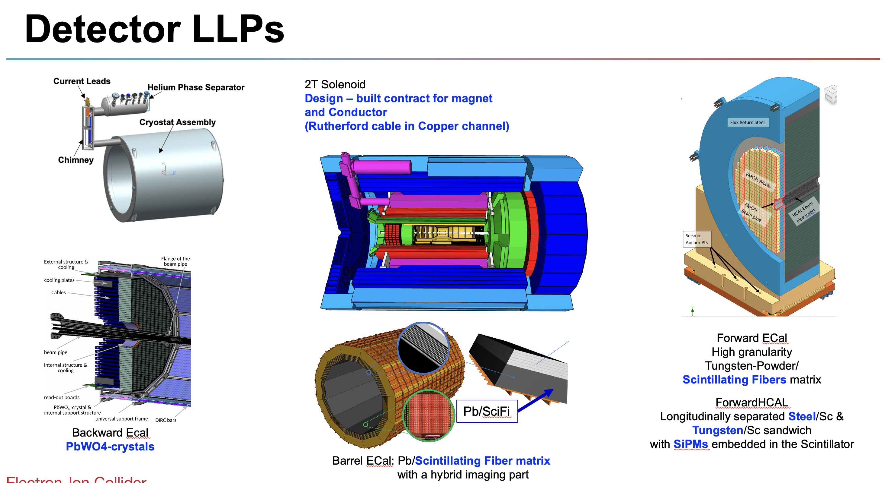
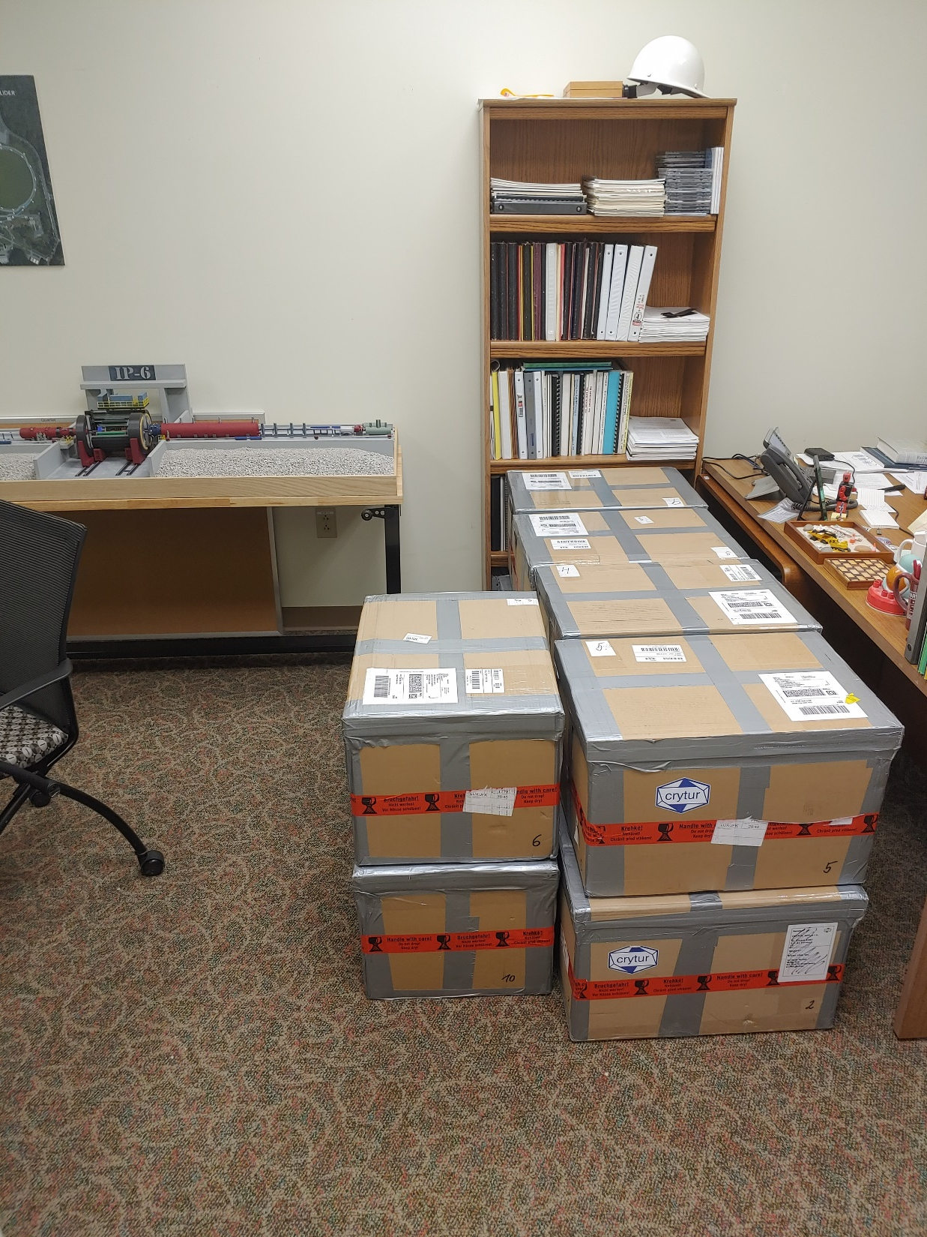
Construction has started! (CD-3A)
Lead Tungstate Crystals for the Detector Backward Electro-Magnetic (EM) Calorimeter
Scintillating Fibers for the Detector Barrel and Forward EM Calorimeters
Silicon Photomultipliers for the Detector Forward Hadronic Calorimeter
Steel and Tungsten for the Detector Forward Hadronic Calorimeter
Detector Solenoid Magnet Design and Fabrication and Conductor
140 PbWO4 crystals in – quality tests completed, all crystals (CRYTUR) passed specifications.
Forward ECal: first batch of 100 scintillating fibers in – quality tests show fibers do not pass specifications; discussions with vendor (Luxium) ongoing who is investigating issue;
Final evaluation barrel EMCal scintillating fiber contract completed – two vendors Luxium and Kuraray – one of the two vendors does not meet specifications. Vendor who meets the specs is more expensive ~30%, price negotiations ongoing → increased cost will a “Programmatic Change Request” and approval of contingency use.
Contract signed --> expect first SiPM delivery by end of the year
All engineering test articles are finalized → contract going through different stages of approval
Procurement working on submitting conductor contract documents to Thomas Jefferson (DOE) Site Office; INFN working on magnet tender with JLab and CEA engineers reviewing documents
My office on Tuesday April 1, 2025
The first shipment of PbWO4 crystals arrived at Jefferson Lab, consisting of 11 boxes of 10 crystals each. This CD-3A Long-Lead Procurement is done through BNL, but the crystals first are delivered to Jefferson Lab for their Quality Control tests.

Slide 4
Detector Reviews planned for 2025 (all Reviews for 2024 completed)
Preliminary Design Reviews (60% design maturity equivalent, called PDR, PDR2 or PDR3, pending the subsystem)
PDR: MPGD Tracking Detectors (6.10.03.02) – Summer/Fall 2025 – Note: FDR only after completion of first engineering test articles
PDR2: Silicon Tracking Detectors (6.10.03.01) – Fall 2025 – TBD, pending early results of ITS3 ER2
PDR2: Cherenkov-based Particle Identification Detectors (6.10.04; pfRICH, hpDIRC, dRICH) – April 1-2, 2025
PDR2: AC-LGAD-based Particle Identification Detectors (6.10.04; BTOF, FTOF, common systems) – Fall 2025
PDR3: Barrel EM Cal (6.10.05.02) – ~August 2025
PDR2: Backward HCAL (6.10.06.01) – ~September 2025
PDR: Magnet Cryogenics and infrastructure (6.10.07) – September/October 2025
PDR3: Electronics/DAQ-computing (6.10.08. 6.10.09.01) – Late August 2025 – this does not include slow controls
PDR: DAQ-Slow Controls (6.10.09.02) – November/December 2025 – Later to ensure integration DAQ in the collider common platform
PDR: Integration, Infrastructure and Installation (6.10.10) – September/October – everything outside GST, includes cradle, HCAL, etc.
PDR: Integration, Infrastructure and Installation (6.10.10) – November/December 2025 – everything inside GST
PDR3: IR Integration and Auxiliary Detectors (6.10.11) – November/December 2025 – includes 6.10.14 lumi detector
PDR2: Polarimetry (6.10.014) – September/October 2025 → January/February 2025
Final Design Reviews (FDR):
FDR: Final Design Review of the BABAR DIRC Bar Refurbishment for the High Performance DIRC Particle Identification Detector – April 1, 2025
FDR: Backward & Forward EM Calorimetry, Barrel & Forward HCAL (6.10.05.01; 6.10.05.03; 6.10.06.02; 6.10.06.03) – ~July 2025
Project Reviews:
DOE OPA CD-3B Review – January 7-9, 2025
“Red Team” Review (acts as Director’s Review for DOE OPA Focused Status Review) – May 20-21, 2025
DOE OPA Focused Status Review – August 5-7, 2025
Other Meetings:
Detector R&D Day hosted by ePIC and EIC Project – April 16-17, 2025
DAC Meeting – Comprehensive look to design status and readiness for CD-2. June 11-13, 2025.
5th RRB Meeting: June 5-6, 2025 – Prague, Czech
EIC International Computing Organization (EICO) – April 2–4, 2025 @BNL
Technical interchange meeting with EIC Computing and Software Advisory Committee (ECSAC) – May 12, 2025 - https://indico.bnl.gov/event/27425/
6th RRB Meeting: November 4-5, 2025 - BNL

Slide 5
Past 2025 Reviews/Meetings and Upcoming Meetings
Past:
DOE/OPA CD-3B and Status Review – January 7-9, 2025
Jan 2025 ePIC Collaboration Meeting – January 20-24, 2025
Magnet In-Kind Follow-Up w/ INFN and CEA – January 31
EIC, RIKEN, U-Tokyo Collaboration Meeting – February 3
PDR2: Cherenkov-based Particle Identification Detectors (6.10.04; pfRICH, hpDIRC, dRICH) – April 1-2
Includes FDR of the BABAR DIRC Bar Refurbishment for the High Performance DIRC Particle Identification Detector
EIC International Computing Organization (EICO) meeting – April 2-4 @ BNL
ePIC/EIC Project Detector R&D Day – April 16-17 (two half days, from 10 am to 1 pm)
Indico link: https://indico.bnl.gov/event/27200/
Upcoming:
Technical interchange meeting with EIC Computing and Software Advisory Committee (ECSAC) – May 12 (remote) - https://indico.bnl.gov/event/27425/
“Red Team” Review (acts as Director’s Review for OPA Focused Status Review) – May 20-21 @ BNL
5th Resource Review Board meeting – June 5-6 in Prague, Czech – see https://www.bnl.gov/eic-rrbmeeting/
10th Detector Advisory Committee meeting – June 11-13 (remote) - https://indico.bnl.gov/event/26584/
MC4EIC workshop – July 9–11 @ Jefferson Lab – https://indico.jlab.org/event/930/
Joint EIC User Group and ePIC Collaboration Meeting – July 14-18 @ Jefferson Lab
DOE OPA Focused Status Review – August 5-7 @ BNL

Slide 6
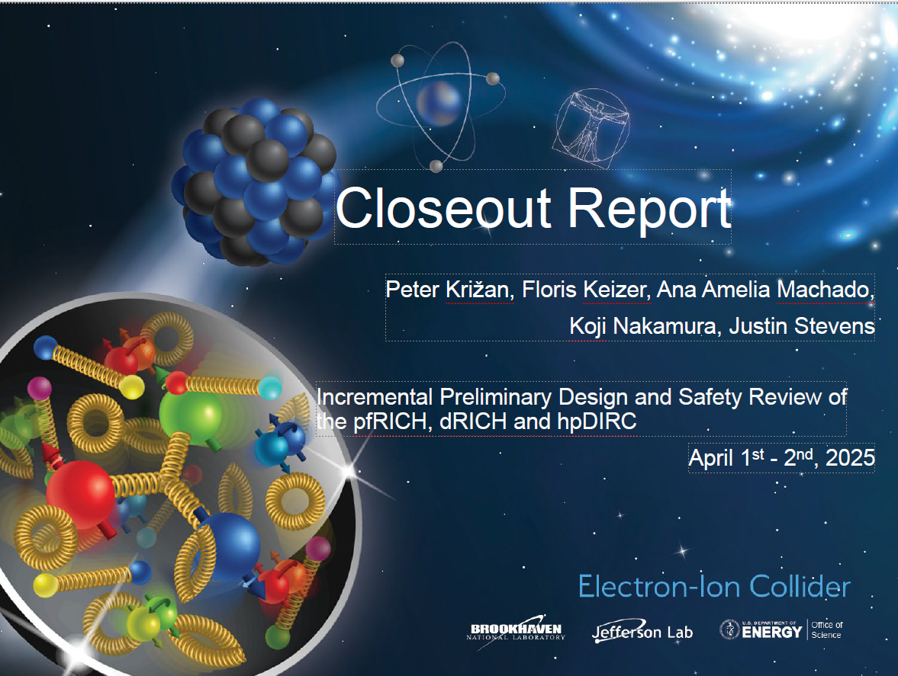
PDR of the Cherenkov-based PID detectors (pfRICH, dRICH, hpDIRC)

Slide 7
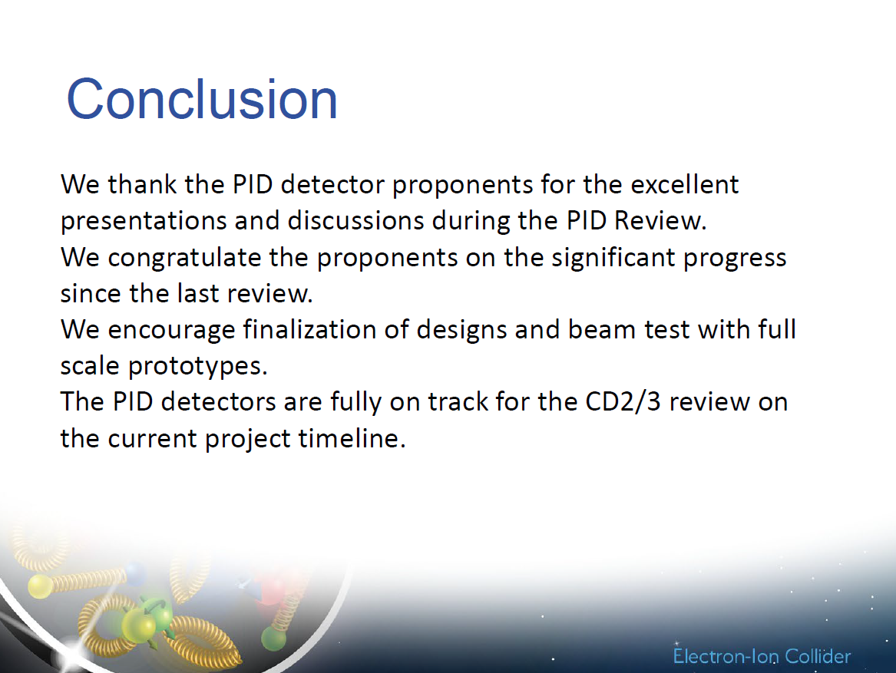
PDR of the Cherenkov-based PID detectors (pfRICH, dRICH, hpDIRC)

Slide 8
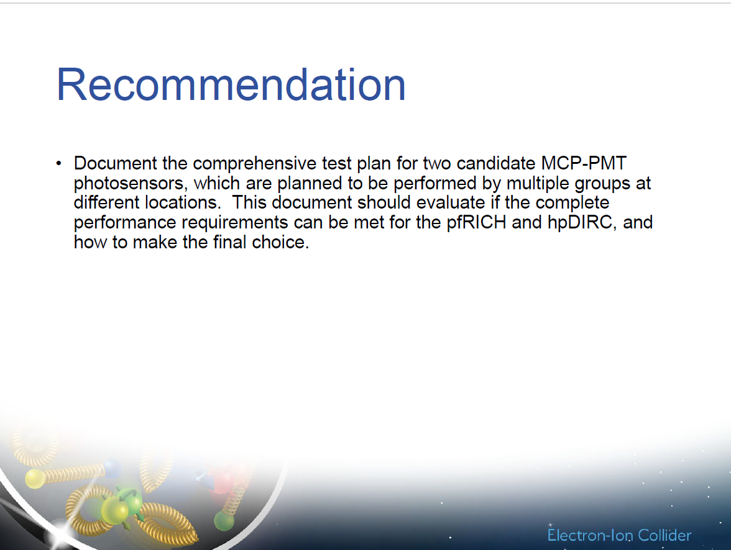
PDR of the Cherenkov-based PID detectors (pfRICH, dRICH, hpDIRC)
PDR:
All charge questions answered with yes
Many excellent comments
One recommendation

Slide 9
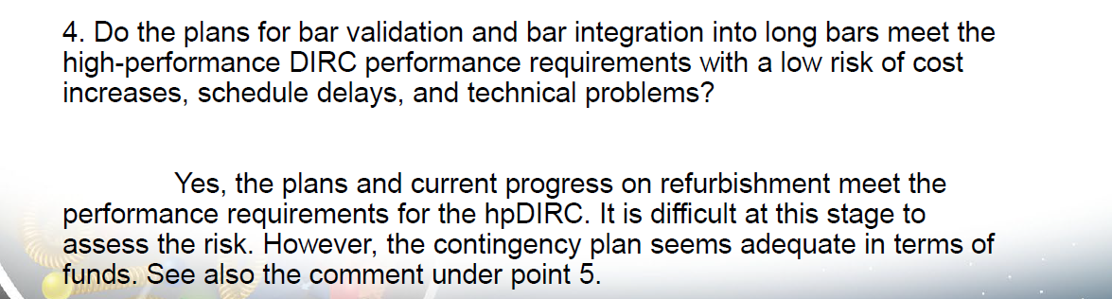
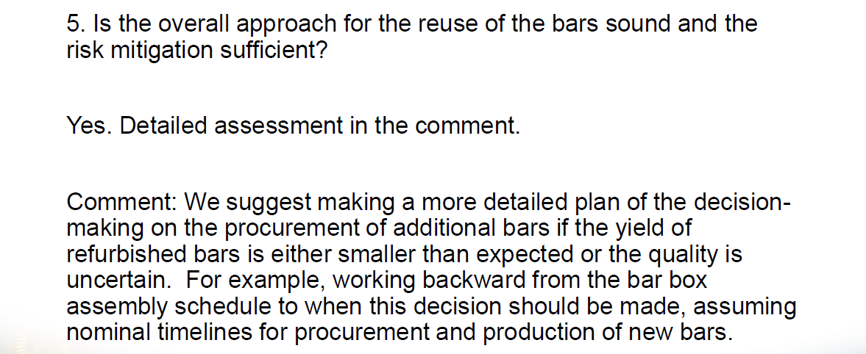
FDR of the BABAR DIRC Bar Refurbishment
FDR:
All charge questions answered with “yes”
Recommendation: “We support the refurbishment of the BaBar DIRC bars is included in the CD-3B scope.”

Slide 10
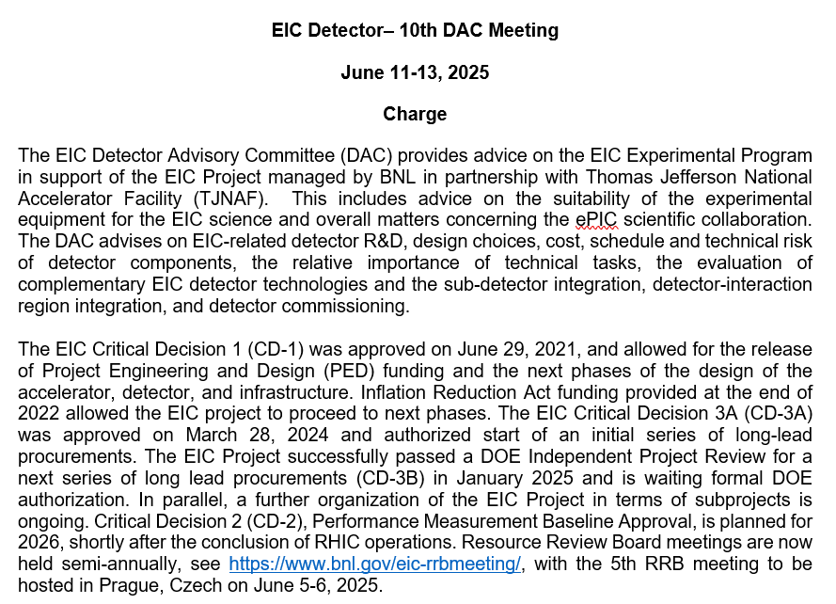
10th DAC Meeting Charge

Slide 11
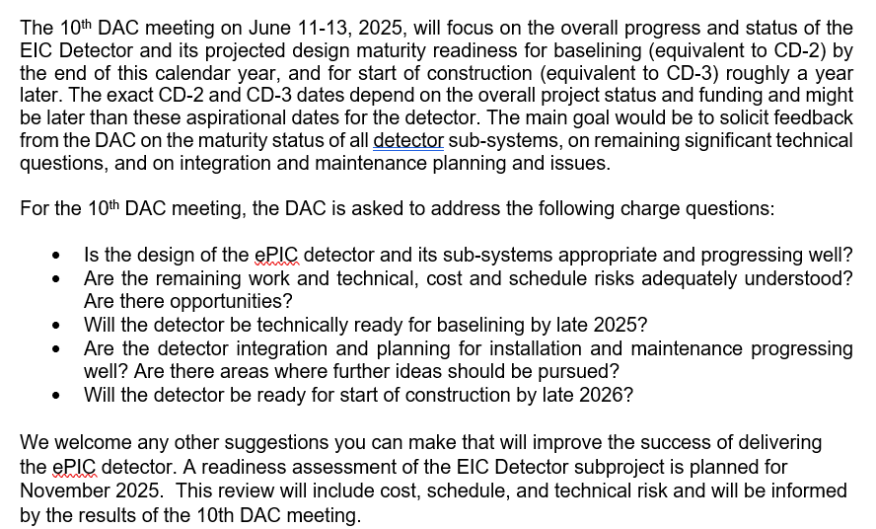
10th DAC Meeting Charge

Slide 12
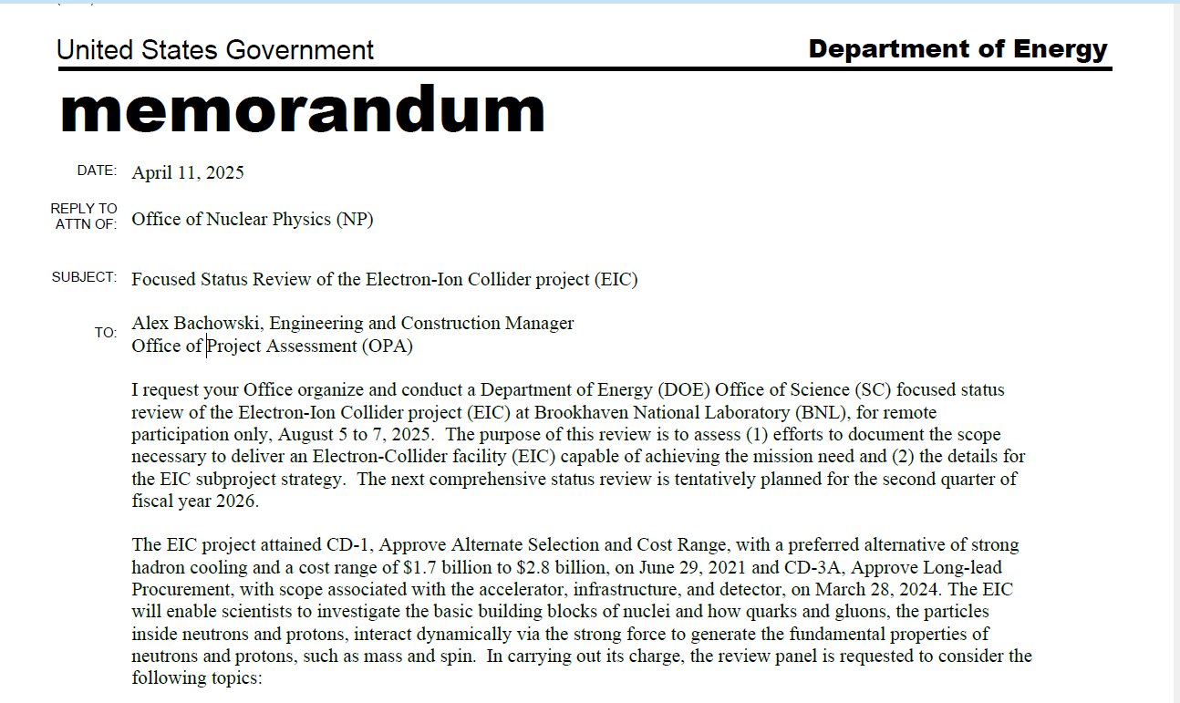

Slide 13
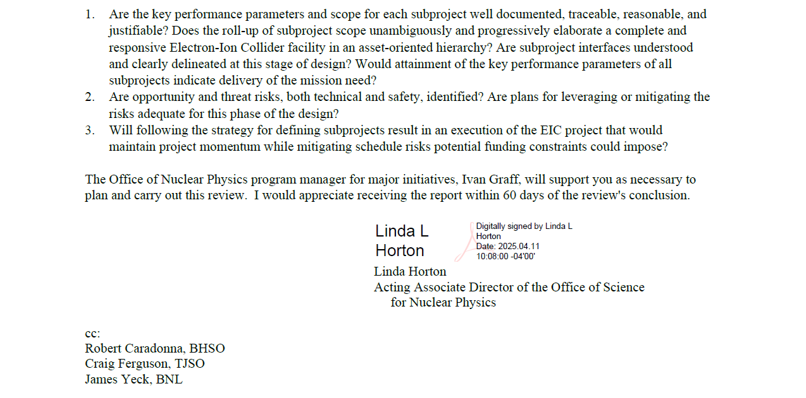

Slide 14
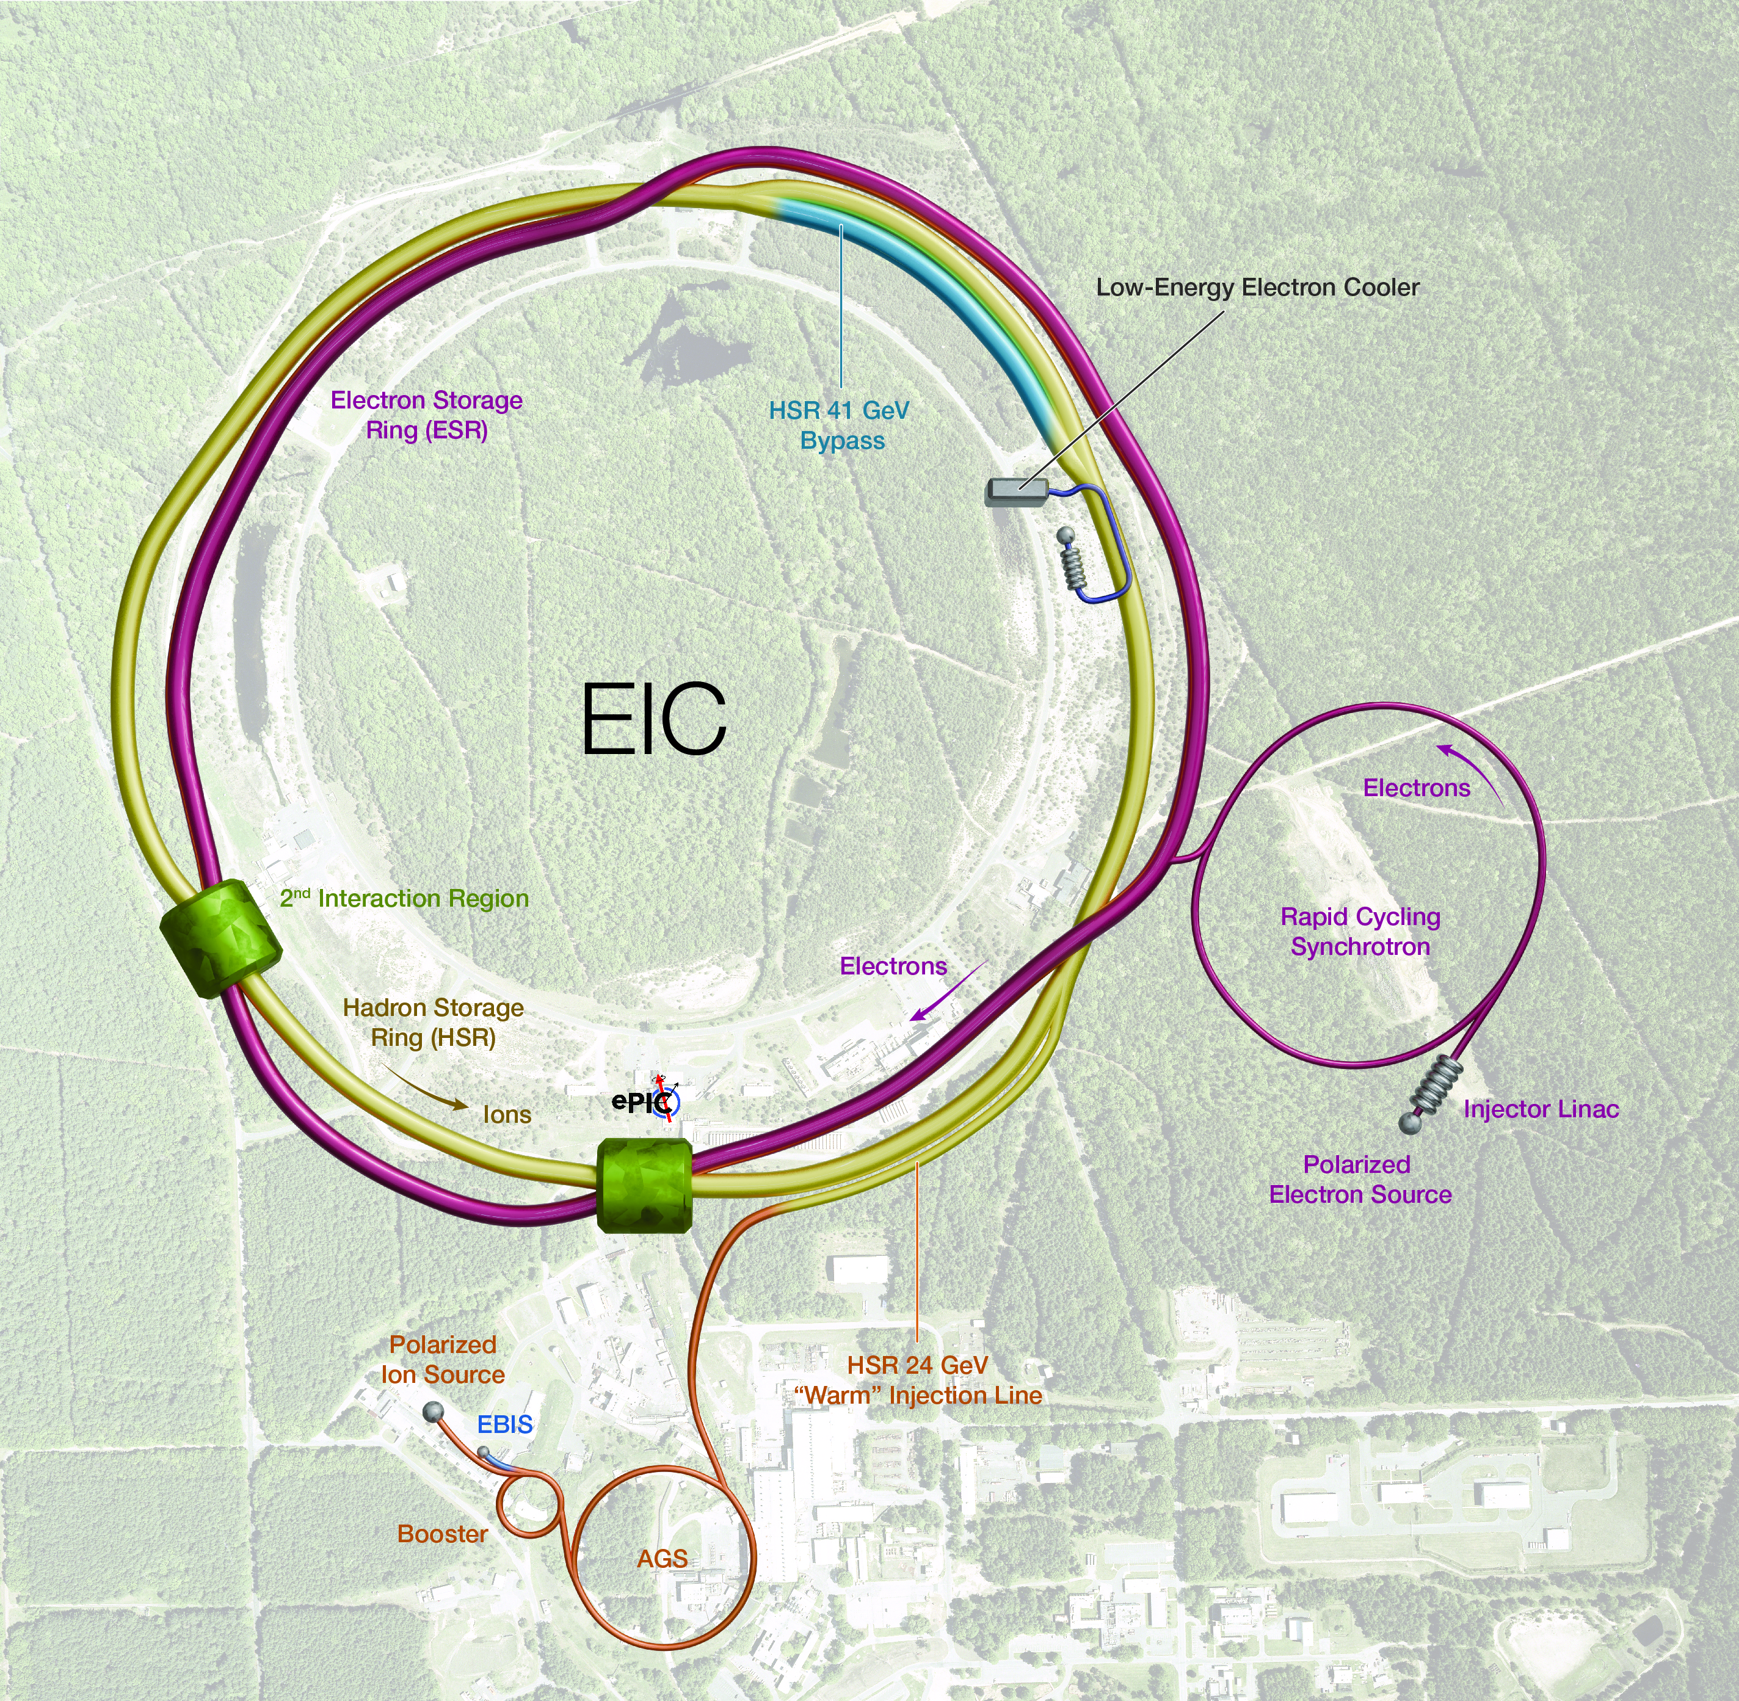
Asset-Oriented Hierarchy of Subprojects – Elevator Speech
SP0: global – work performed to date, CD-3A, CD-3B, Project Office, etc. (also includes pre-ops)
SP1: accelerator rings – all scope that if one adds an interaction region insert provides hadron beams and if one also adds an electron injector allows collisions.
SP2: integrated interaction region section – scope that includes section with IR magnets (SP2A) and the ePIC detector (SP2B).
SP3: electron injector – scope that delivers 5-10 GeV electron beams to the electron storage ring and allows a non-invasive 18 GeV enhancement; completion allows start of EIC science during commissioning.
SP4: full capability – scope that delivers mission need and allows full execution of the NSAC/NAS science.
RF modules (18 GeV, E_{CM} ~ 140 GeV), RF power (18 GeV, lumi), 41 GeV bypass (E_{CM} ~ 30 GeV), etc.
EIC scope interface

Slide 15
Slide from Jim Yeck: EIC Project Priorities for 2025 and 2026
Priorities for 2025 include:
Execute the CD-3A and CD-3B procurements.
Prepare plans for addressing the “portfolio” of project dependencies including the Removal and Repurposing (R&R) of RHIC facilities (IP6 prepared for ePIC).
Define subprojects and prepare a CD-2 quality performance baseline for the entire project (all subprojects).
Conduct reviews to assess status of CD-2 preparation for each subproject and prepare the collider subproject for DOE approvals in 2026.
RHIC will run through December 2025 and the R&R work will immediately proceed.
Complete the DOE reviews needed to start EIC construction in 2026 with the approval of the collider subproject. Detector should be baseline ready.

Slide 16
ePIC Priorities CY2025
Flow of Requirements from Science Requirements to sub-detectors to technical requirements to design and component specifications known and documented.
Services (cabling, LV, HV, cooling) and serviceability of sub-detectors known and documented.
Mechanical and Electrical Design of sub-detectors in sufficiently mature state
It is understood that some sub-detectors will be ahead of others, we do need to be on average in a state we can baseline
Inspection and Test Plans for all components that are prone to quality control are documented – aerogel test plan as example
ePIC pre-Technical Design Report completed
Has to include (some) realistic performance projections with all materials and backgrounds included in simulations
Concepts of all sub-detector assembly and installation plan known.
Also:
Cost Basis of Estimates vetted and documented
(Some) In-Kind Agreements signed, and we must-have a CERN agreement…

Slide 17
Project Information in other meetings
TIC: Every first Monday of the month
Monthly update about mechanics and integration by Roland Wimmer
TIC: May 12th
EIC Detector Quality Control Plan by Walt Akers
Common scenarios for preTDR: Luminosity, doses, background – ECA
Later TIC – Meetings
Flow down of requirements into specifications ECA
The details on Vault - Can it replace EDMS - CERN's Engineering Data Management Service – Dan Cacace

Slide 18


