Slide 1

ePIC Collaboration News
J. Lajoie, S. Dalla Torre
May 2nd, 2025

Slide 2
Hey John, start the recording….

Slide 3
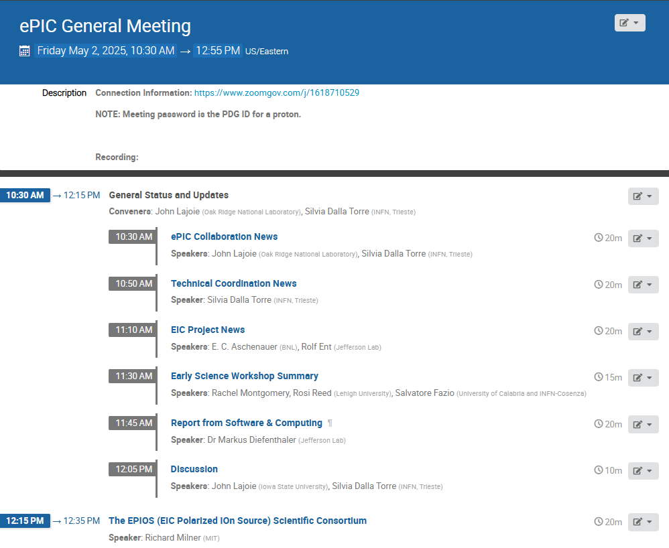
Agenda
News and updates from the collaboration and project.
Presentation from the new EPIOS collaboration.

Slide 4




2025 -2026
DOE IPR: SP Status 29-30th July, 2025
PDR2: Polarimetry
Sept./Oct 2025
ePIC Early Physics Workshop
April 24-25, 2025
10th Detector Advisory Committee
June 11-13th 2025
PDR: DAQ - Slow
Controls
Nov./Dec. 2025
PDR2: Backwards HCal
~Sept. 2025
ePIC pre-TDR
V2.1
PDR3: Barrel EMCal
~August 2025
PDR2: Cerenkov PID
April 1-2, 2025
FDR: BABAR DIRC Bar Refurbishment
ePIC Software and
Computing Review
~Oct 2025
ePIC Software and
Computing Review Check-in
~May 2025
DOE IPR and ICR, 13-16th Jan., 2026
PDR3: IR Integ. & Aux. Det
Nov./Dec. 2025
PDR3: Elec./DAQ
August 2025 (late)
PDR: Magnet/Cryo Infrastructure
Sept./Oct. 2025
2025
2026
Frascati
Jan 20-24,2025
Collider Subproject and Status Director's Review
21-23 Oct., 2025
CD-2/3 Review
~ mid 2026
EICUG/ePIC Collab. Mtg. July 14-18
EICO
2-4th April 2025
FDR: Backward & Forward EM Calorimetry, Barrel & Forward HCAL
May 2025
PDR: Integ. + Installation
(outside GST)
Nov/Dec 2025
PDR2: Si Tracking Detectors
Fall 2025
5th EIC RRB Meeting
June 5-6th 2025
PDR2: MPGD Detectors
Summer 2025
Detector R&D Day (ePIC/Project)
16-17th April 2025
PDR2: AC-LGAD Detectors
Fall 2025
PDR: Integ. + Installation
(inside GST)
Nov/Dec 2025
6th EIC RRB Meeting
Nov. 4-5th 2025

Slide 5
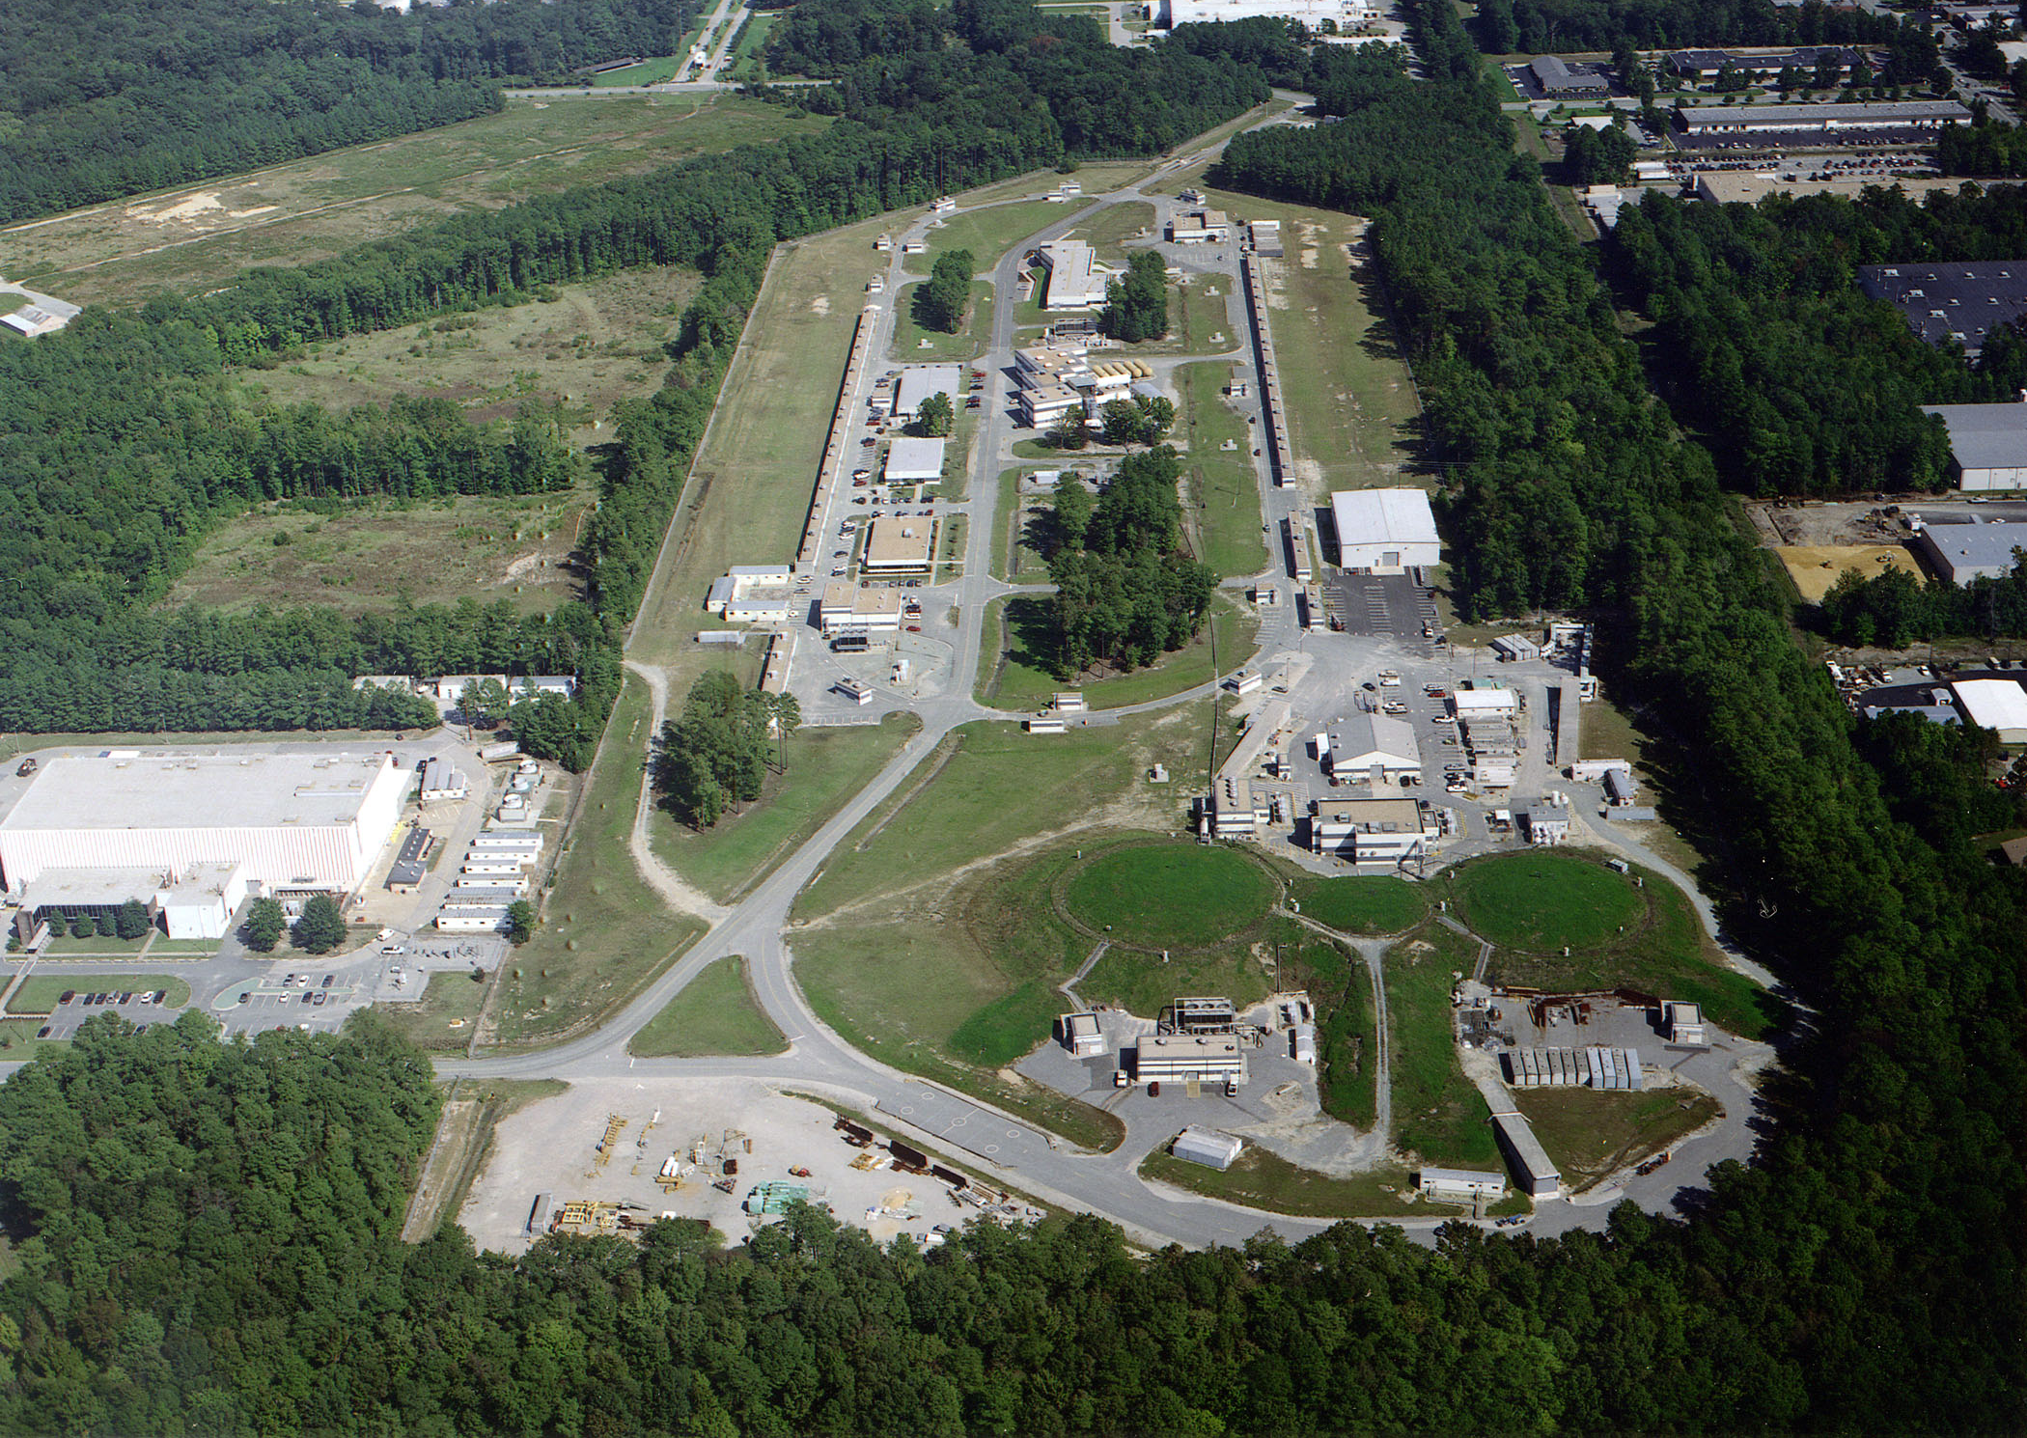
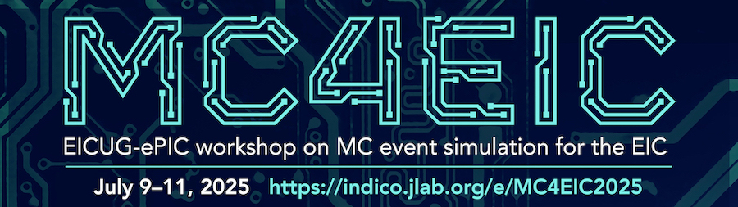
Summer 2025 EICUG/ePIC Collaboration Meeting
July 14-18th at JLab
  $350 in-person (includes lunches)
EICUG Early Career Workshop
July 11-13th
Registration is now open:
https://indico.jlab.org/event/934/
Detailed agenda and call work workfests coming soon
NOTE: Collaboration Meeting follows
MC4EIC July 9-11th
https://indico.jlab.org/event/930/

Slide 6
DRAFT Block Schedule
This is a very early draft and may change somewhat with further input from the EICUG and collaboration.
Early Career Workshop
Summer 2025 Joint EICUG/ePIC Collaboration Meeting
 | F July 11th | S | S | M July 14th | T | W | Th | F
Morning Sessions | Last part of MC4EIC | 2nd Session | 4th Session | Joint ePIC/ EICUG Plenary | Parallel/ Workfests | Parallel/ Workfests | ePIC CC Meeting | ePIC Closing Plenary
Lunch | Not Provided | Provided | Not Provided | Provided | Provided | Provided | Provided | Not Provided
Afternoon Sessions | 1st Session | 3rd Session | ( free ) | Accelerator/ Early Science | EICUG | EICUG Awards | Parallel/ Workfests | ( free )
Goal is to integrate the EICUG/ePIC sessions as much as makes sense, make the agenda accessible to JLab users.

Slide 7
Collaboration Meeting Notes:
Govt. rate ($110/day) at the nearby Marriot for all conference attendees:
  Accommodations
There are some rooms at the JLab residence facility blocked that people can share (approx. half Marriot rate).
  Residence Facility
This meeting at a national lab - please note a REAL ID or passport will be required for visiting the lab.
Apply for site access at least 7 days prior to arrival:
  Apply for Site Access
Many thanks to Doug Higinbotham!

Slide 8
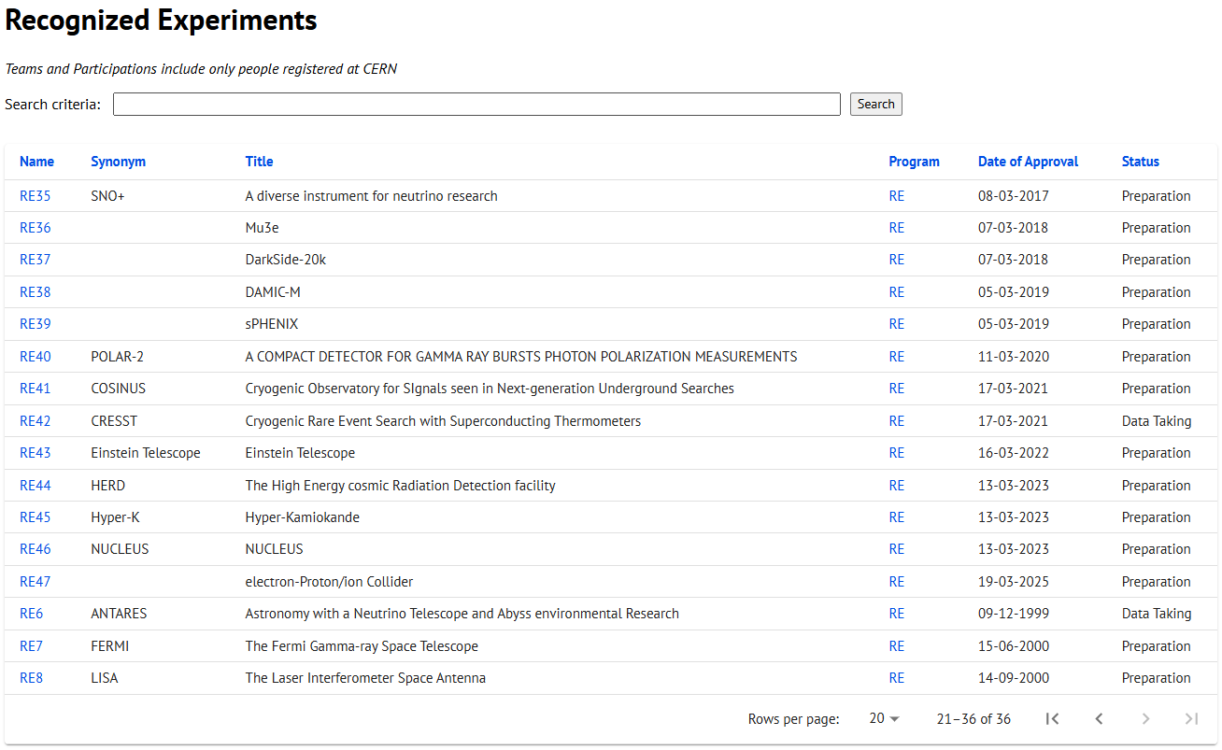
CERN Recognized Experiment Status: RE47
ePIC now appears in the CERN Grey Book database as RE47:
https://greybook.cern.ch/experiment/recognized
Two steps to get ePIC Collaborators registered at CERN:
CC Representative needs to register as team leader with
CERN Users Office:
  https://usersoffice.web.cern.ch/
  https://usersoffice.web.cern.ch/team-leaders-corner
  info@recognized-experiments.cern.ch
CC member can then certify registrations of team members
Contact us if you run into problems!

Slide 9
Results from 2025 Survey
Working with Peter Steinberg to convert commitments to an Excel spreadsheet/pivot table
  Name/Institution/Interest (no FTE)
  Useful to identify workforce in the collaboration that is not optimally engaged
Working out some last kinks, but will make available to DSL’s, Conveners and Coordinators very soon

Slide 10
Projections from 2025 Survey
GUIDANCE FOR INFORMATION TO BE FILLED IN THE TABLE
Fill the table with total workforce that you plan to dedicate to ePIC - expressed in FTE - of the nine different personnel types. Do not include personnel paid by EIC/ePIC R&D, PED or construction funds. The information requested is for any effort on behalf of the ePIC Collaboration, not just construction of ePIC.
Also please identify the two main areas of efforts of your group contributing to ePIC for each year. We expect this will evolve year to year, and we also understand that most groups do not have firm plans past the next few years.
For the purposes of this survey, please assume a constant total level of effort for your group, across all activities (both ePIC and non-ePIC), for the time period of the projection. Assume that there are no increases in students, postdocs or faculty working on ePIC due to new positions, but only redirection of effort from other group activities that may be winding down. In this way the overall effort on ePIC may increase over time, as workforce is redirected from other projects.
For purposes of this survey assume that the first physics run of ePIC is in 2034.
In addition to commitments for 2025, also requested projections for how collaborations might see the evolution of their engagement in ePIC
~70% of institutions responded
  Same fraction US/international

Slide 11
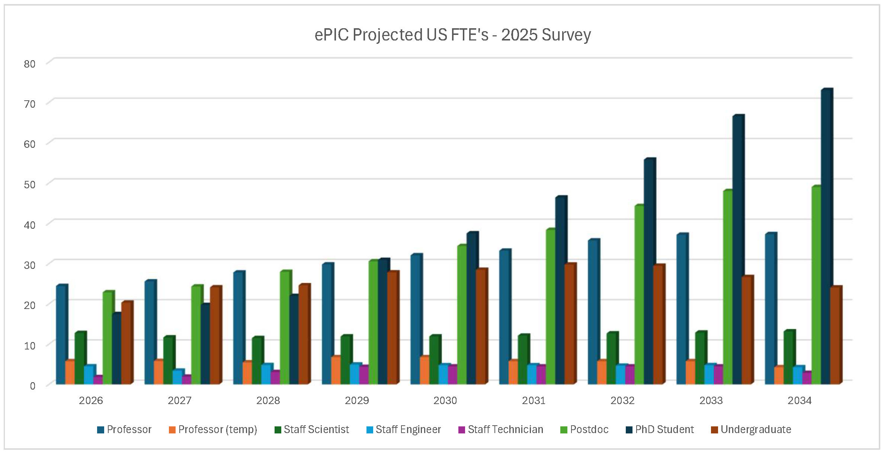
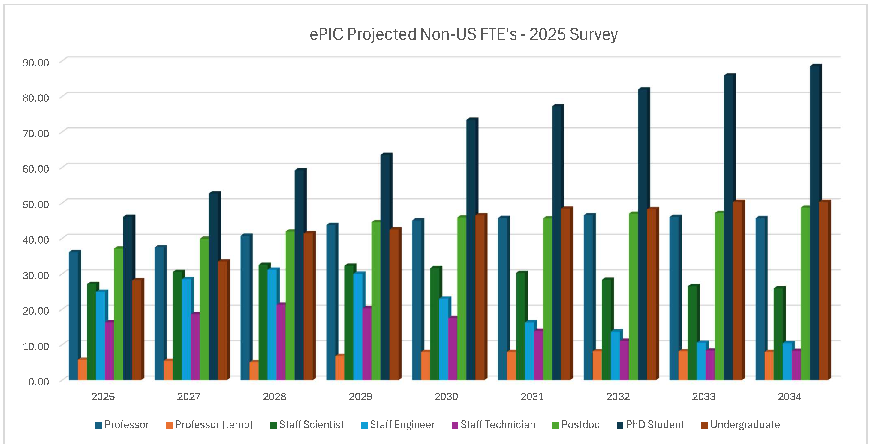
Projections Results from 2025 Survey
Both US and international institutions project the effort will scale up as we move into construction, especially students and postdocs, although there are differences in details.
This information can be useful as we discuss ramping up support for the collaboration.

Slide 12
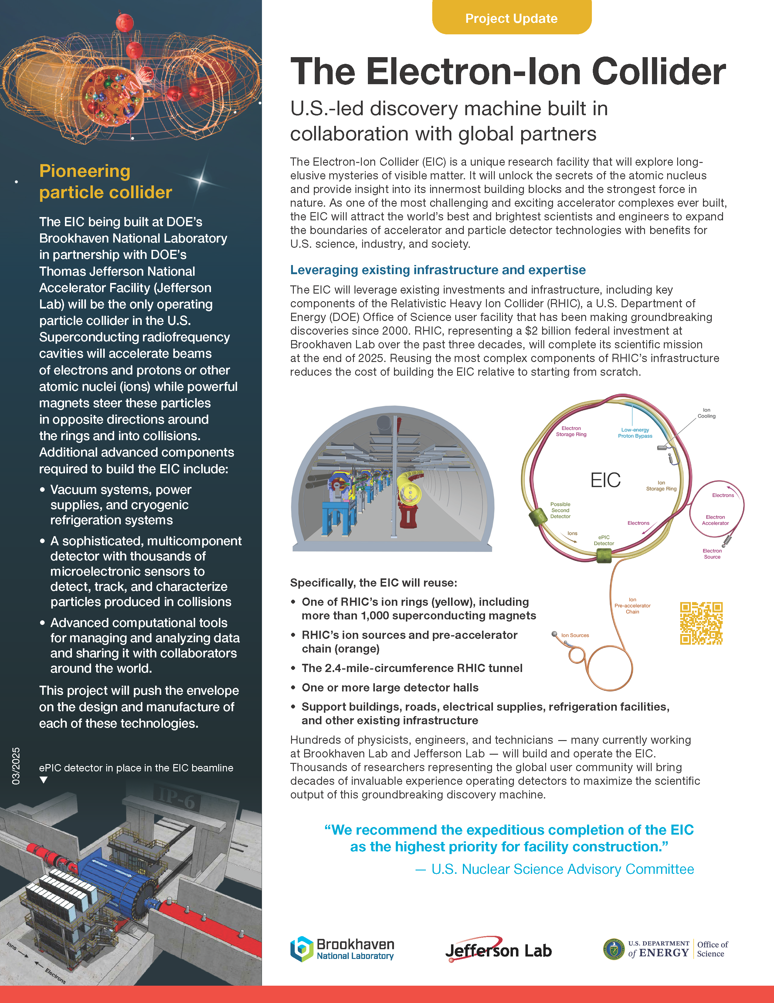
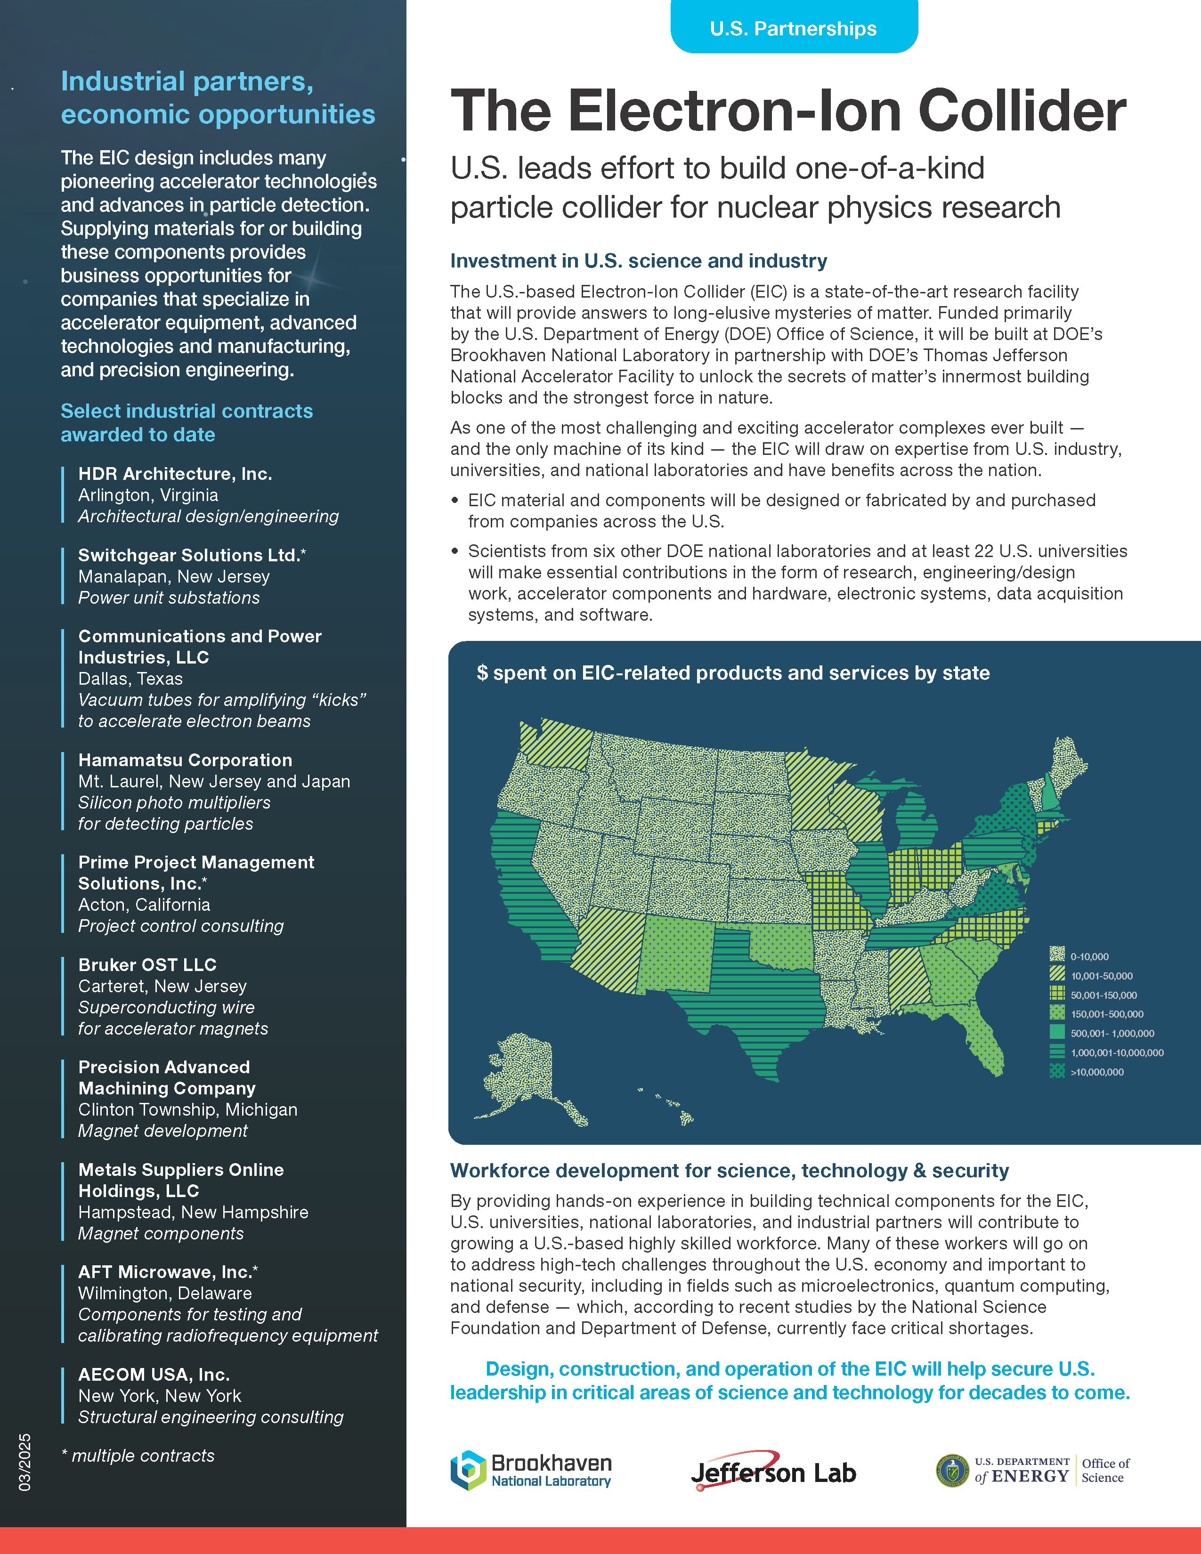
Communicating about the EIC
New material available from EIC project and BNL Public Affairs
https://www.bnl.gov/eic/science.php
Very useful when
discussing EIC/ePIC

Slide 13
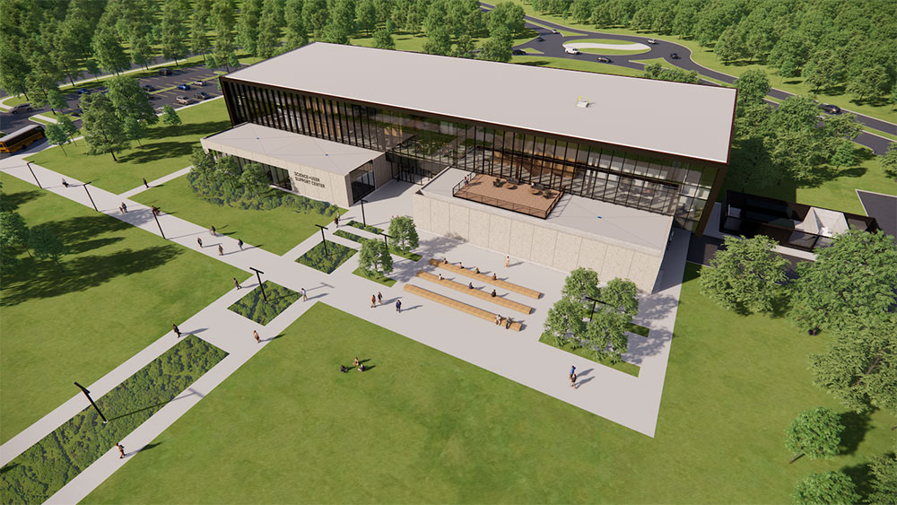
BNL SUSC Now Open!
New Science and User Support Center (SUSC, Bldg. 101) opened on Thursday, May 1.
Staff in Badging, Housing, and the Guest, User & Visitor Center are now working in SUSC.

Slide 14

Parting Messages
Ongoing CC votes:
  Result Release Policy
  Admission of four new institutions
  Not yet at quorum
Next General Meeting – May 15th 10PM ET
CC Meeting end of May / beginning of June
EIC RRB June 5-6th Prague

Slide 15


Slide 16
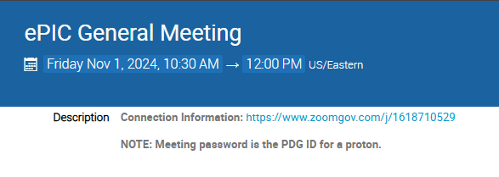
New Zoom Link
The Zoom link for the General Meeting now requires a password
We decided to do this after a TIC meeting was Zoom-bombed
  All our Indico pages are public, so this offers another hurdle for a would-be
  bomber (not a guarantee)
    Old link had password embedded to allow one-click access
  Hopefully this is not
  overly cumbersome for
  our collaborators

Slide 17
ePIC Resources
Public Website - https://www.bnl.gov/eic/epic.php
Mailing Lists – https://lists.bnl.gov/mailman/listinfo
Indico Agenda - https://indico.bnl.gov/category/402/
  ePIC Software and Computing: https://indico.bnl.gov/category/435/
Wiki - https://wiki.bnl.gov/EPIC
ePIC Software Training:
  Landing Page: https://eic.github.io/documentation/landingpage.html
  Tutorials: https://eic.github.io/documentation/tutorials.html
Mattermost: https://chat.epic-eic.org
ePIC Zenodo Community: https://zenodo.org/communities/epic

Slide 18


EICUG Membership
The EICUG is a vital organization to promote the interests of the EIC community!
  Without the EICUG we would never have gotten far enough to form ePIC!
Please register your institution!
Check with your EICUG IB representative to get registered as a member
https://www.eicug.org/content/join.html

