Slide 1

ePIC Collaboration News
J. Lajoie, S. Dalla Torre
June 20th, 2025

Slide 2
Hey John, start the recording….

Slide 3
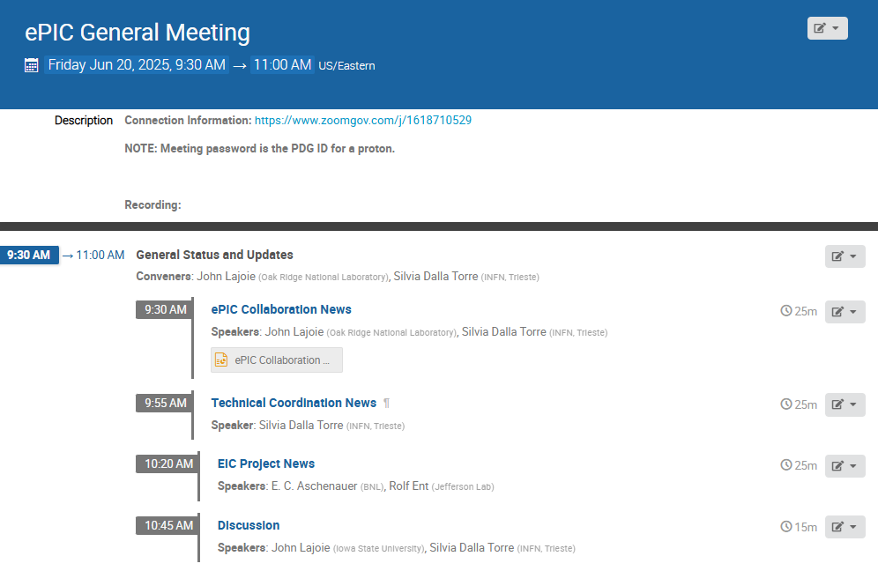
Agenda
News and updates from the collaboration and project.
Last GM in this (approximate) time slot was May 2nd!

Slide 4





Welcome New Institutions!
Texas Southern University
  Presented by Nissem Abdelrahman
Johannes Gutenberg University Mainz
  Presented by Tyler Kutz
Mount Allison University
  Presented by David Hornidge
University of Hawaii at Manoa
  Presented by Jennifer Ott

Slide 5
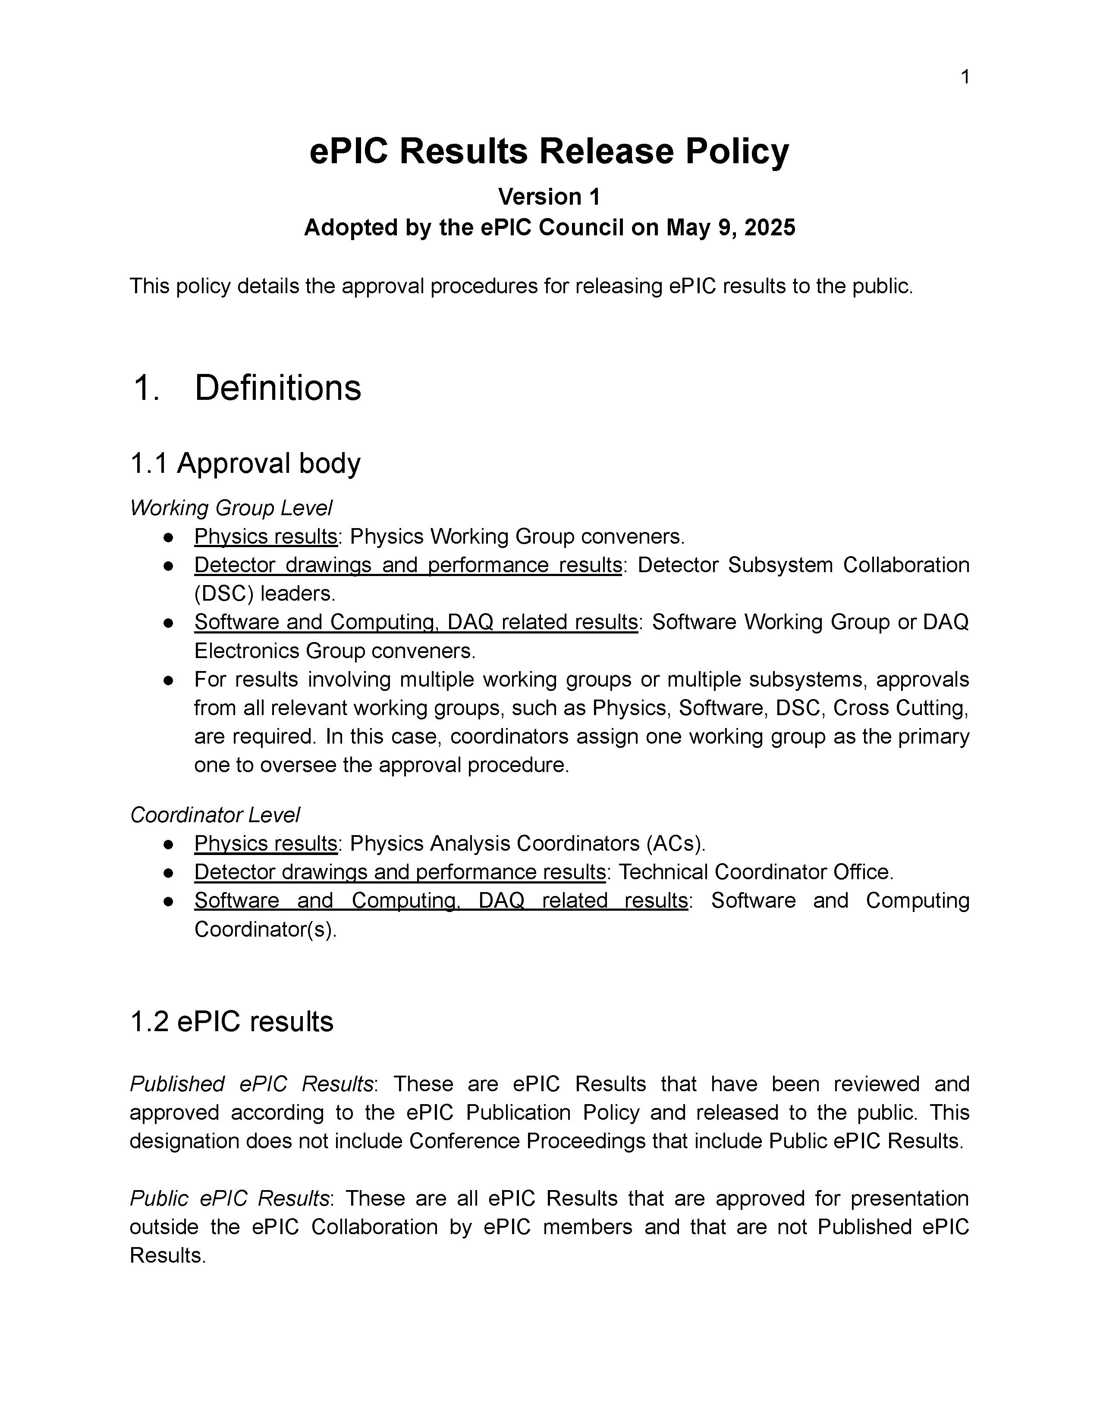
ePIC Results Policy Passed by CC Vote
Last discussed at April 4th CC Meeting:
  https://indico.bnl.gov/event/26907/
Available in Zenodo:
  https://zenodo.org/records/15390156
Don’t have a Zenodo account?
  Create one at zenodo.org
  Email SP Office or a coordinator to be invited to ePIC community

Slide 6
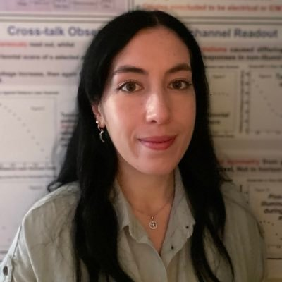
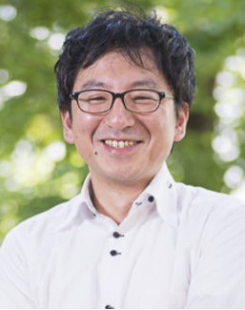
New PAC/Streaming WG Convener Endorsed
Congratulations to Rachel Montgomery (Physics Analysis Coordinator) and Taku Gunji (Streaming WG Convener) on their endorsement by the Collaboration Council.

Slide 7
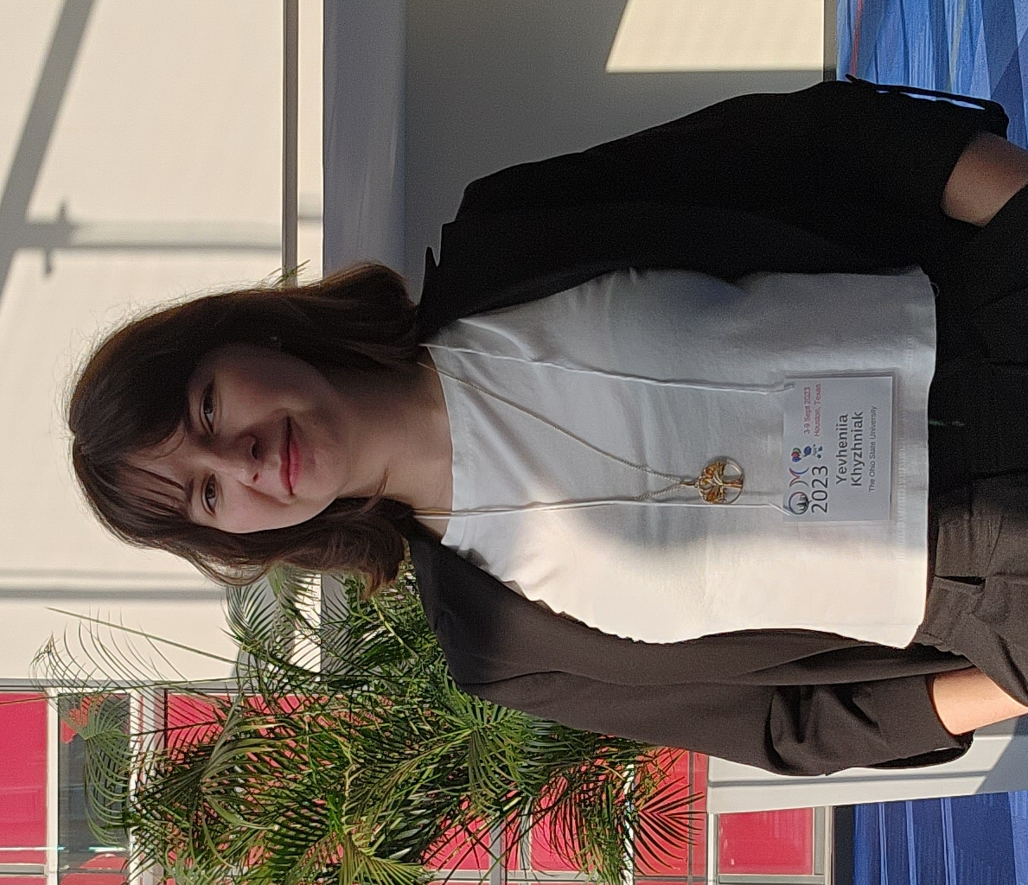
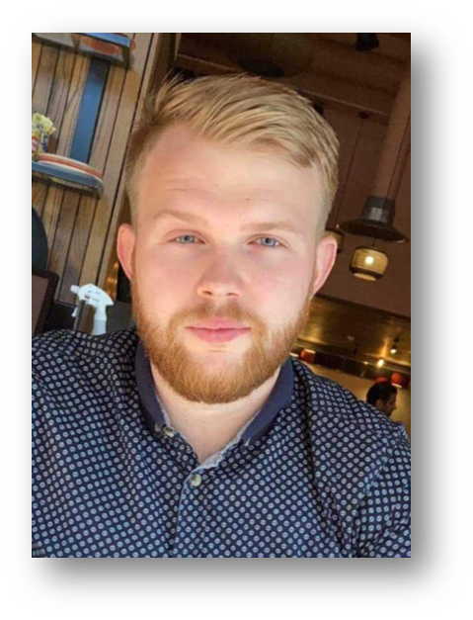
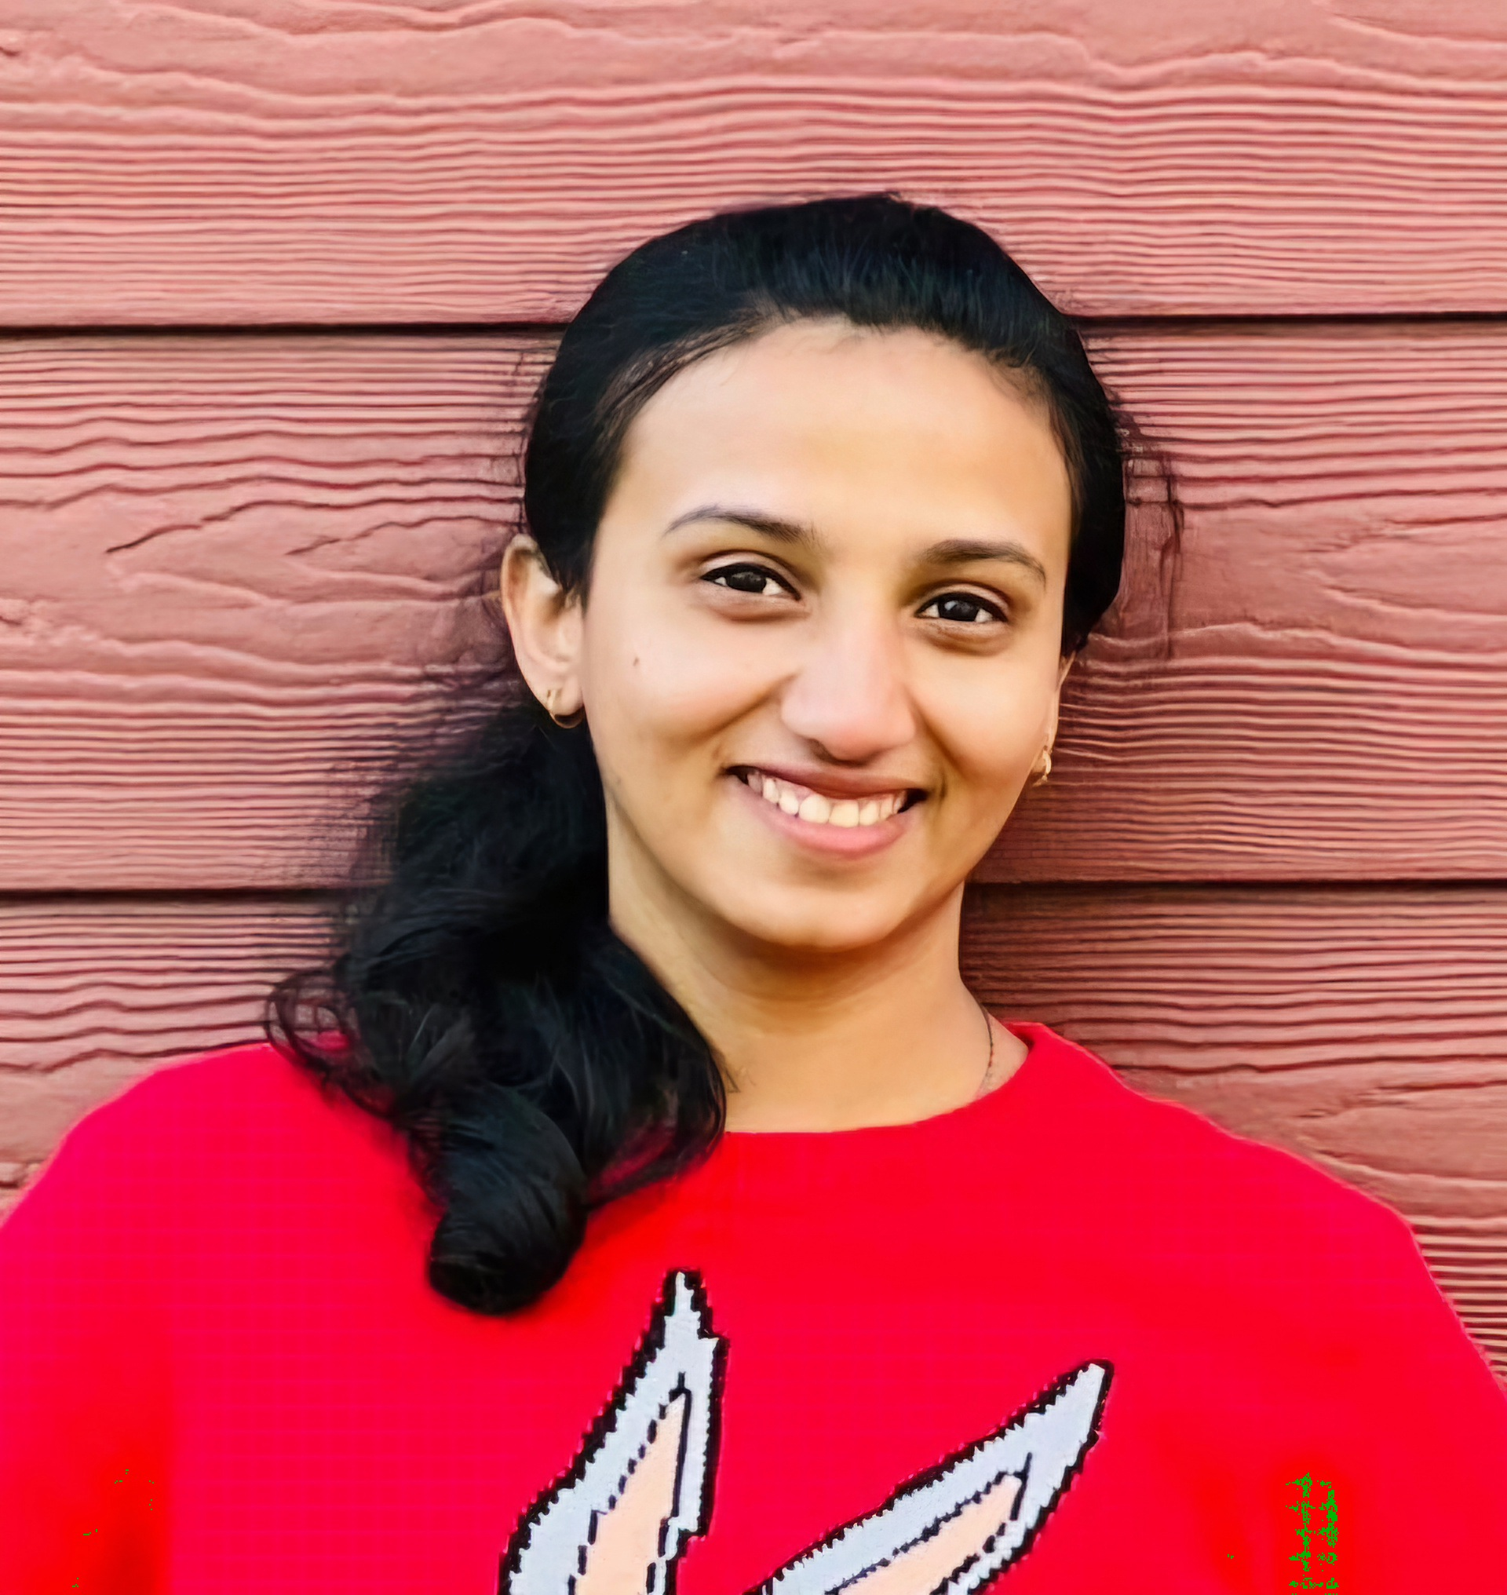
New Early-Career Members!
Many thanks to our outgoing EC representatives – Maria Stefaniak, Nicholas Schmidt, and Aranya Giri.
Yevheniia Khyzhniak
The Ohio State University
khyzhniak.1@buckeyemail.osu.edu
Gary Penman
University of Glasgow
g.penman.1@research.gla.ac.uk
Akshaya Vijay
University of Manitoba
vijaya2@myumanitoba.ca

Slide 8



2025 -2026
DOE OPA Status
5-7th August, 2025
PDR2: Polarimetry
Sept./Oct 2025
10th Detector Advisory Committee
June 11-13th 2025
PDR: DAQ - Slow
Controls
Nov./Dec. 2025
PDR2: Cerenkov PID
April 1-2, 2025
FDR: BABAR DIRC Bar Refurbishment
ePIC Early Physics Workshop
April 24-25, 2025
PDR2: Backwards HCal
~Sept. 2025
ePIC pre-TDR
V2.1
PDR3: Barrel EMCal
~August 2025
ePIC Software and
Computing Review
~Oct 2025
ePIC Software and
Computing Technical Interchange – May 12th
SVT Working Meeting
July 9-11,
2025
BIC In-Person Workshop
April 9-11,
2025
DOE IPR and ICR, 13-16th Jan. 2026
PDR: Magnet/Cryo Infrastructure
Sept./Oct. 2025
PDR3: IR Integ.
& Aux. Det
Nov./Dec. 2025
PDR3: Elec./DAQ
August 2025 (late)
Frascati
Jan 20-24,2025
EICUG/ePIC Collab. Mtg. July 14-18
CD-2
Mid 2026
Detector R&D Day (ePIC/Project)
16-17th April 2025
6th EIC RRB Meeting
Nov. 4-5th 2025
EICO
2-4th April 2025
Calorimetry
Workshop
June 5-9th, 2025
FDR: Backward & Forward EM Calorimetry, Barrel & Forward HCAL
July 2025
PDR: Integ. + Installation
(outside GST)
Nov/Dec 2025
hpDIRC Annual Meeting Jun 26th - July 2nd
PDR2: Si Tracking Detectors
Fall 2025
HSF-India/ePIC Workshop
May 13-17th, 2025
PDR2: MPGD Detectors
Summer 2025
PDR2: AC-LGAD Detectors
Fall 2025
Detector Subproject Baseline Readiness Director's Review
12-14 Nov. 2025
PDR: Integ. + Installation
(inside GST)
Nov/Dec 2025
5th EIC RRB Meeting
June 5-6th 2025
ePIC Italy Meeting
16-18 June 2025

Slide 9

Software and Computing Technical Interchange Meeting
Purpose:
Discuss the ePIC (Streaming) Computing Model paper, as presented at the ECSAC Reviews in 2023 and 2024,
Gather feedback and comments from ECSAC.
Outcome:
Documented ECSAC questions, ePIC responses, and comments made during the meeting (13 pages).
Meeting helped improve the manuscript by clarifying key points and addressing inconsistencies.
Also supported preparation for the upcoming review, likely in October.
Key Discussion Points:
ECSAC Role: Scope of the ECSAC review begins with data at the output buffer of E0.
Interface Between E0 and E1: Discussion focused on data aggregation, transfer, and low-level processing.
Echelon 2: Discussed role of E2 in the distributed computing model.
Analysis Infrastructure: Discussed analysis model involving E1, E2, E3 sites.
https://doi.org/10.5281/zenodo.14675920

Slide 10

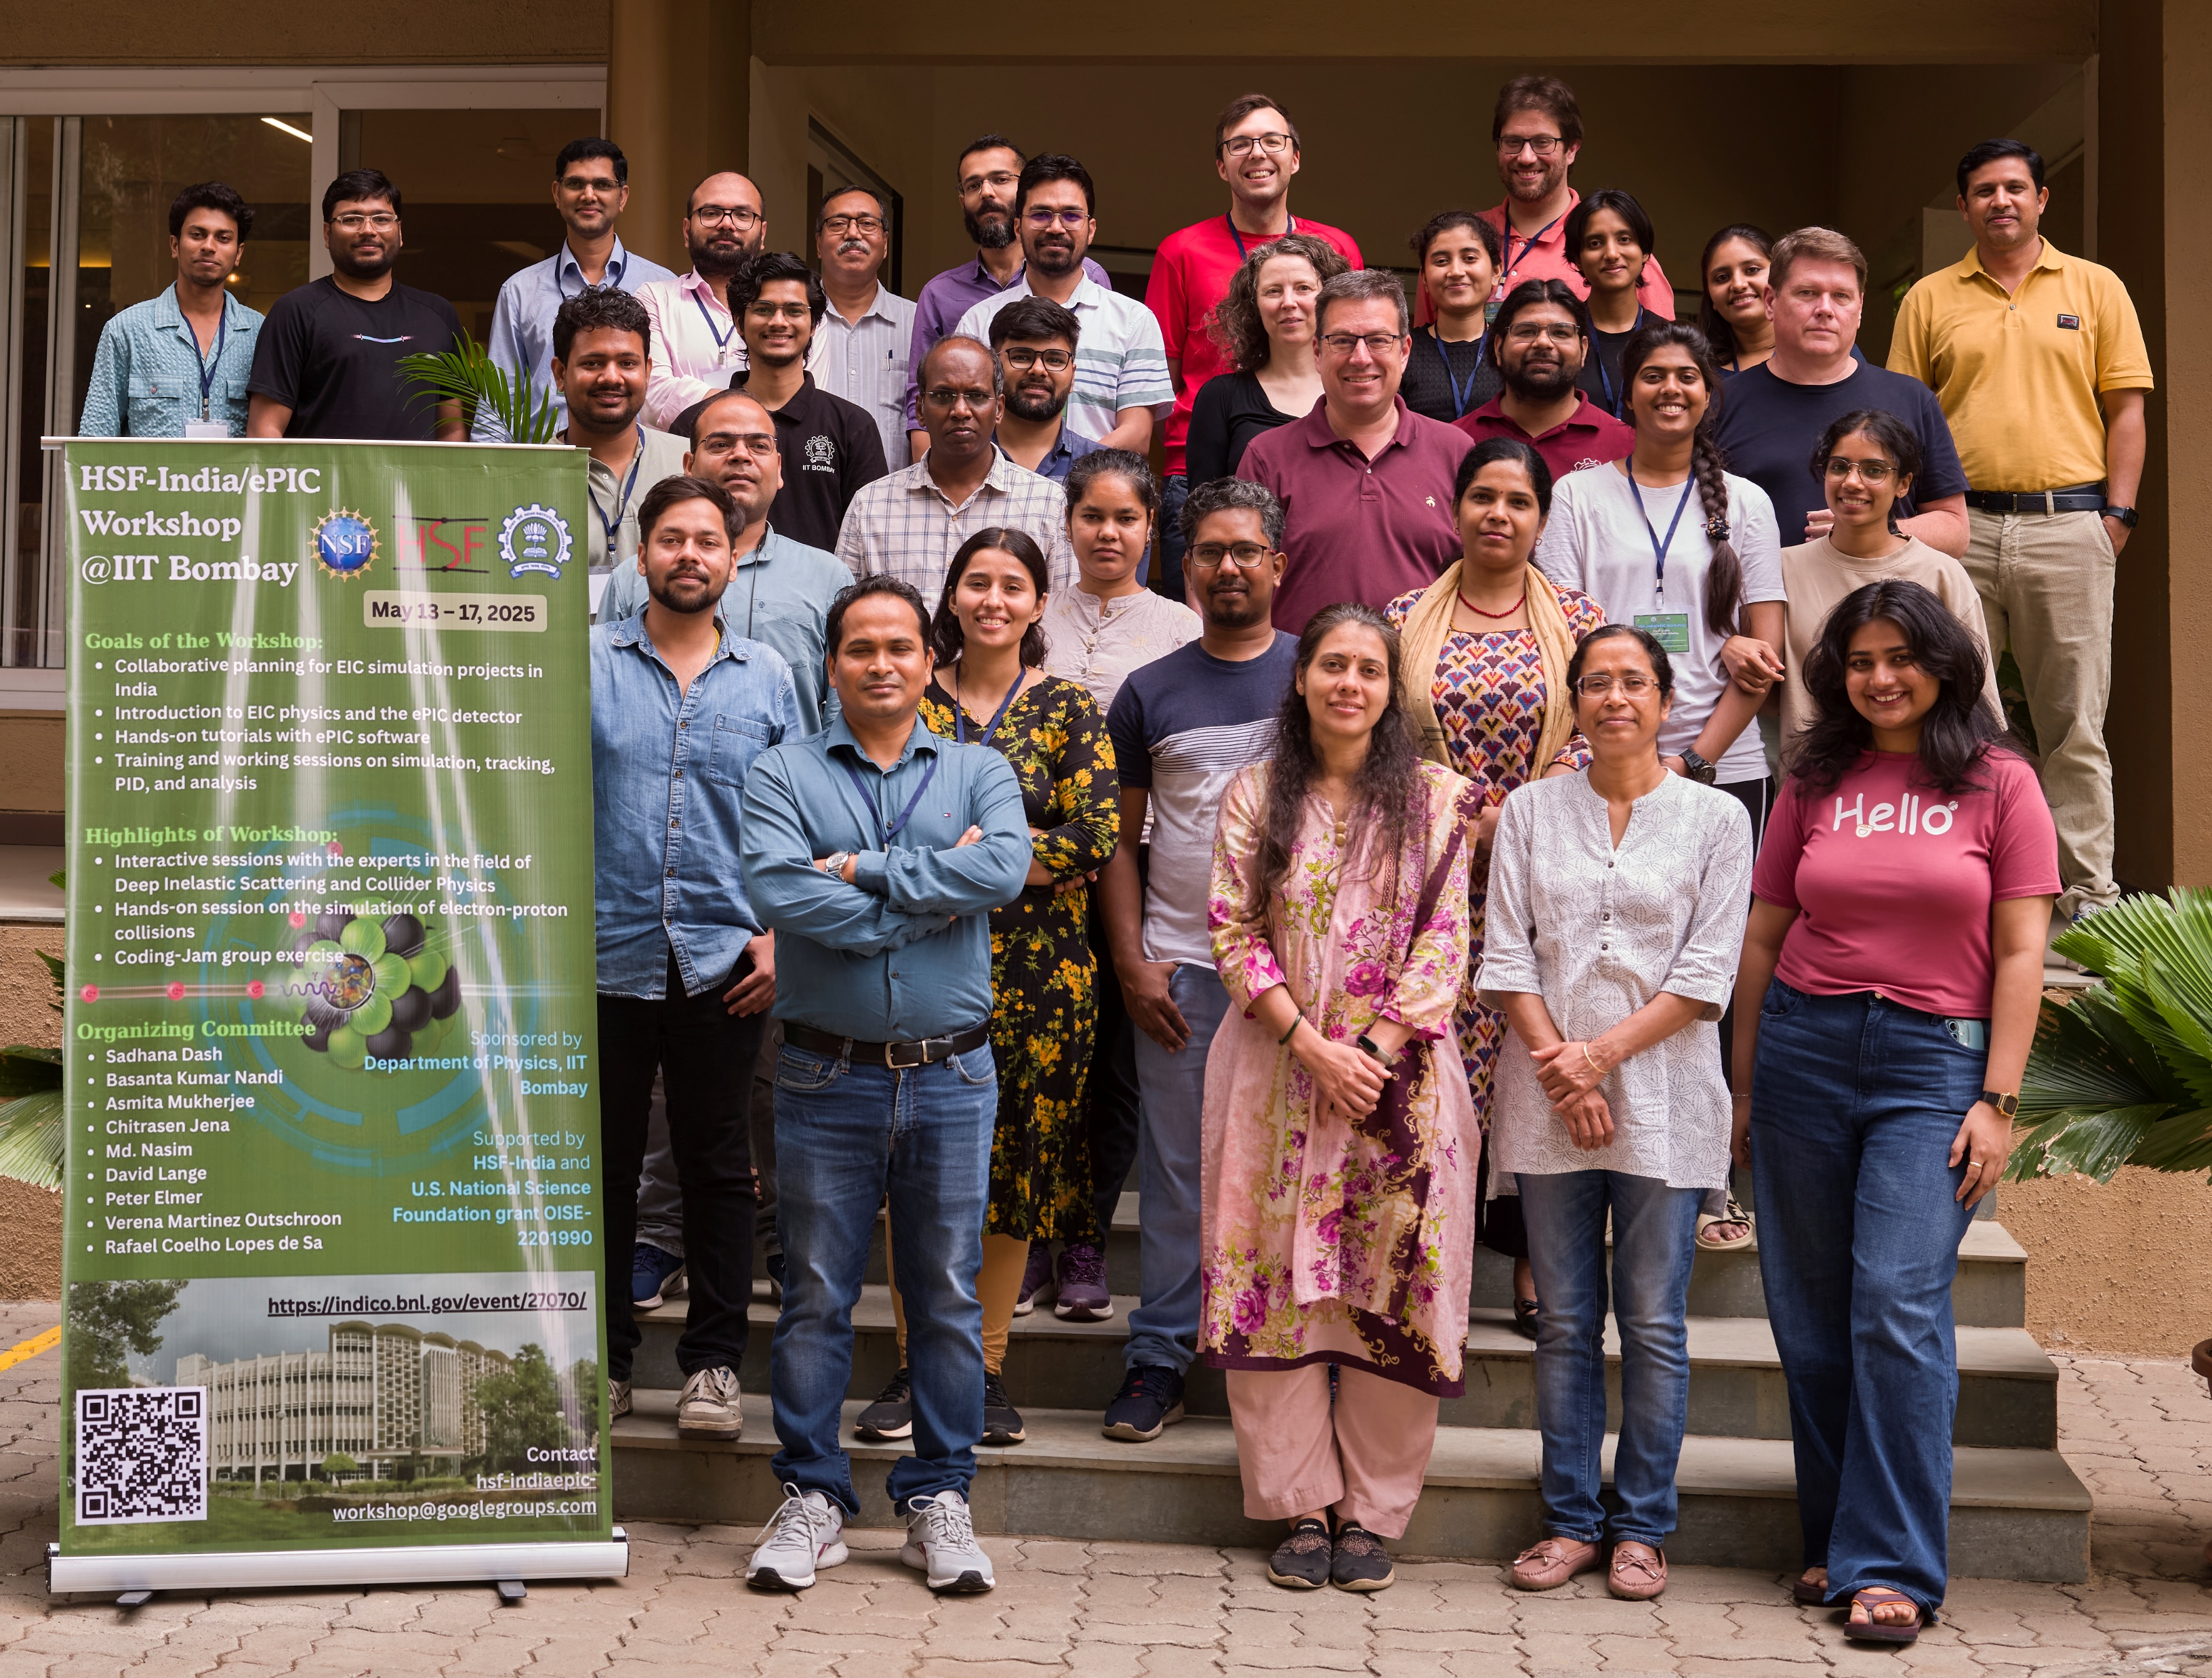



Community Building in
The HSF-India project aims to join networks in India to networks in the U.S. and Europe in order to build international research software collaborations.
HSF-India/ePIC Meeting
Five introductory talks covering the EIC and the science it will enable, a theory perspective on spin physics, EIC/ePIC in India, research software collaborations, and contributing to ePIC.
Several long-format tutorials by:
  Chandradoy Chatterjee (INFN Trieste)
  Stephen Kay (University of York)
  Charlotte Van Hulse (University of Alcalá)
Meeting Survey: Students found the workshop content very useful and appropriately paced.
Planning a hackathon-style follow-up later this year to encourage students to initiate their own projects.
44 registered participants, including 33 master’s and doctoral students
Students from: Central University of Karnataka, Central University of Tamil Nadu, IIT Bombay, IIT Indore, IIT Madras, IIT Mandi, Malaviya National Institute of Technology, Ramaiah University of Applied Sciences

Slide 11
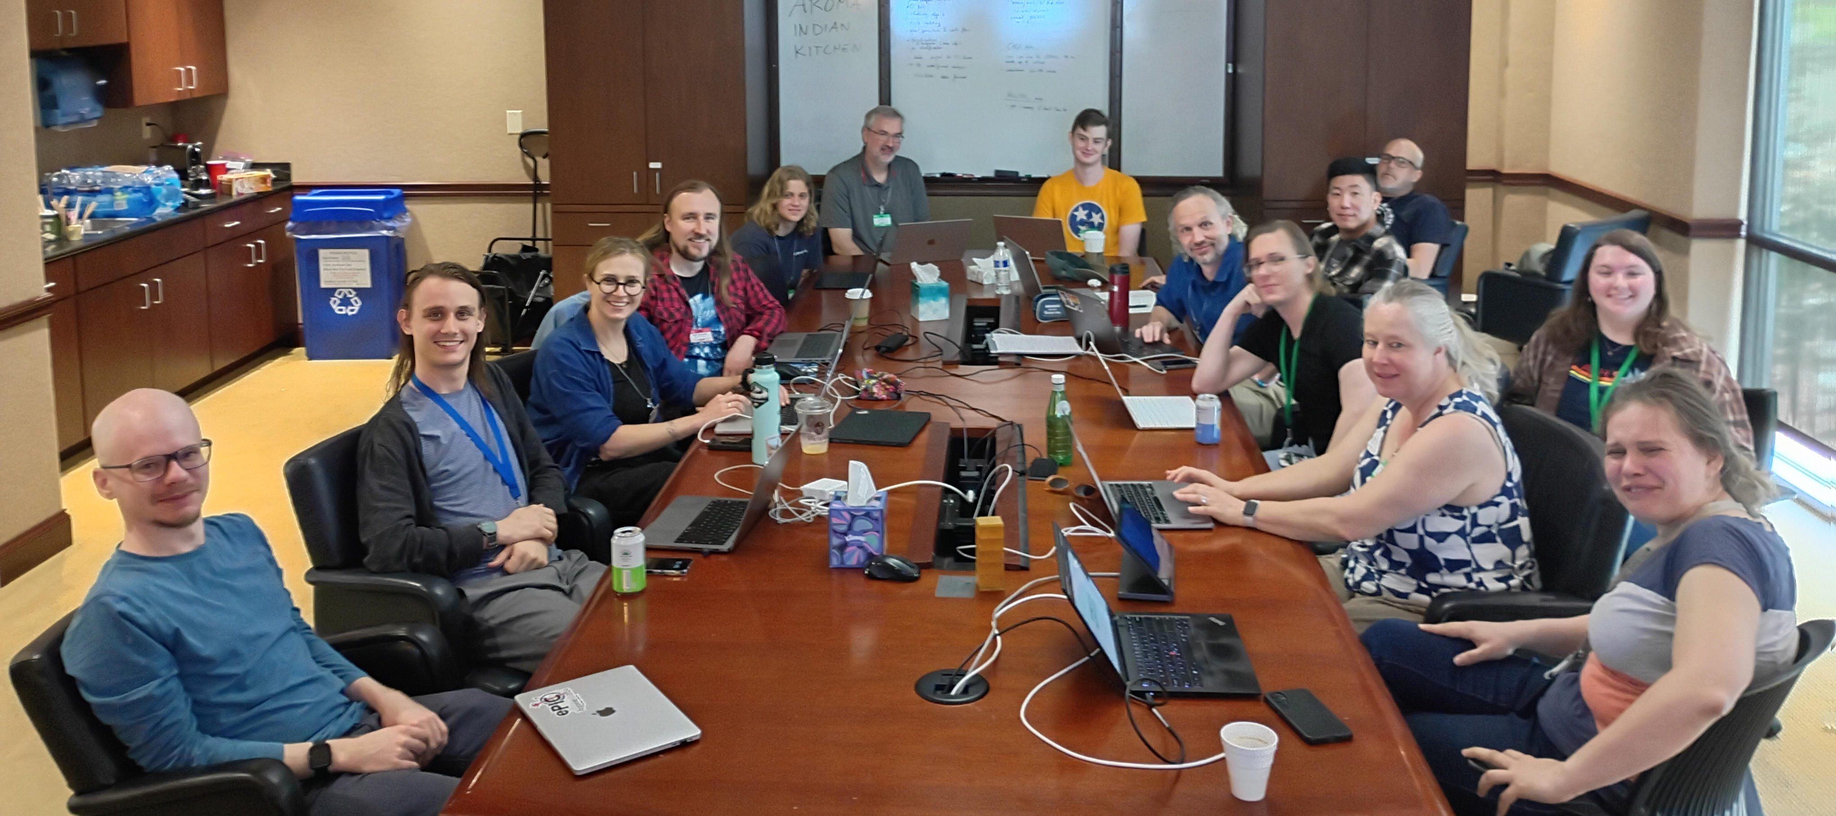
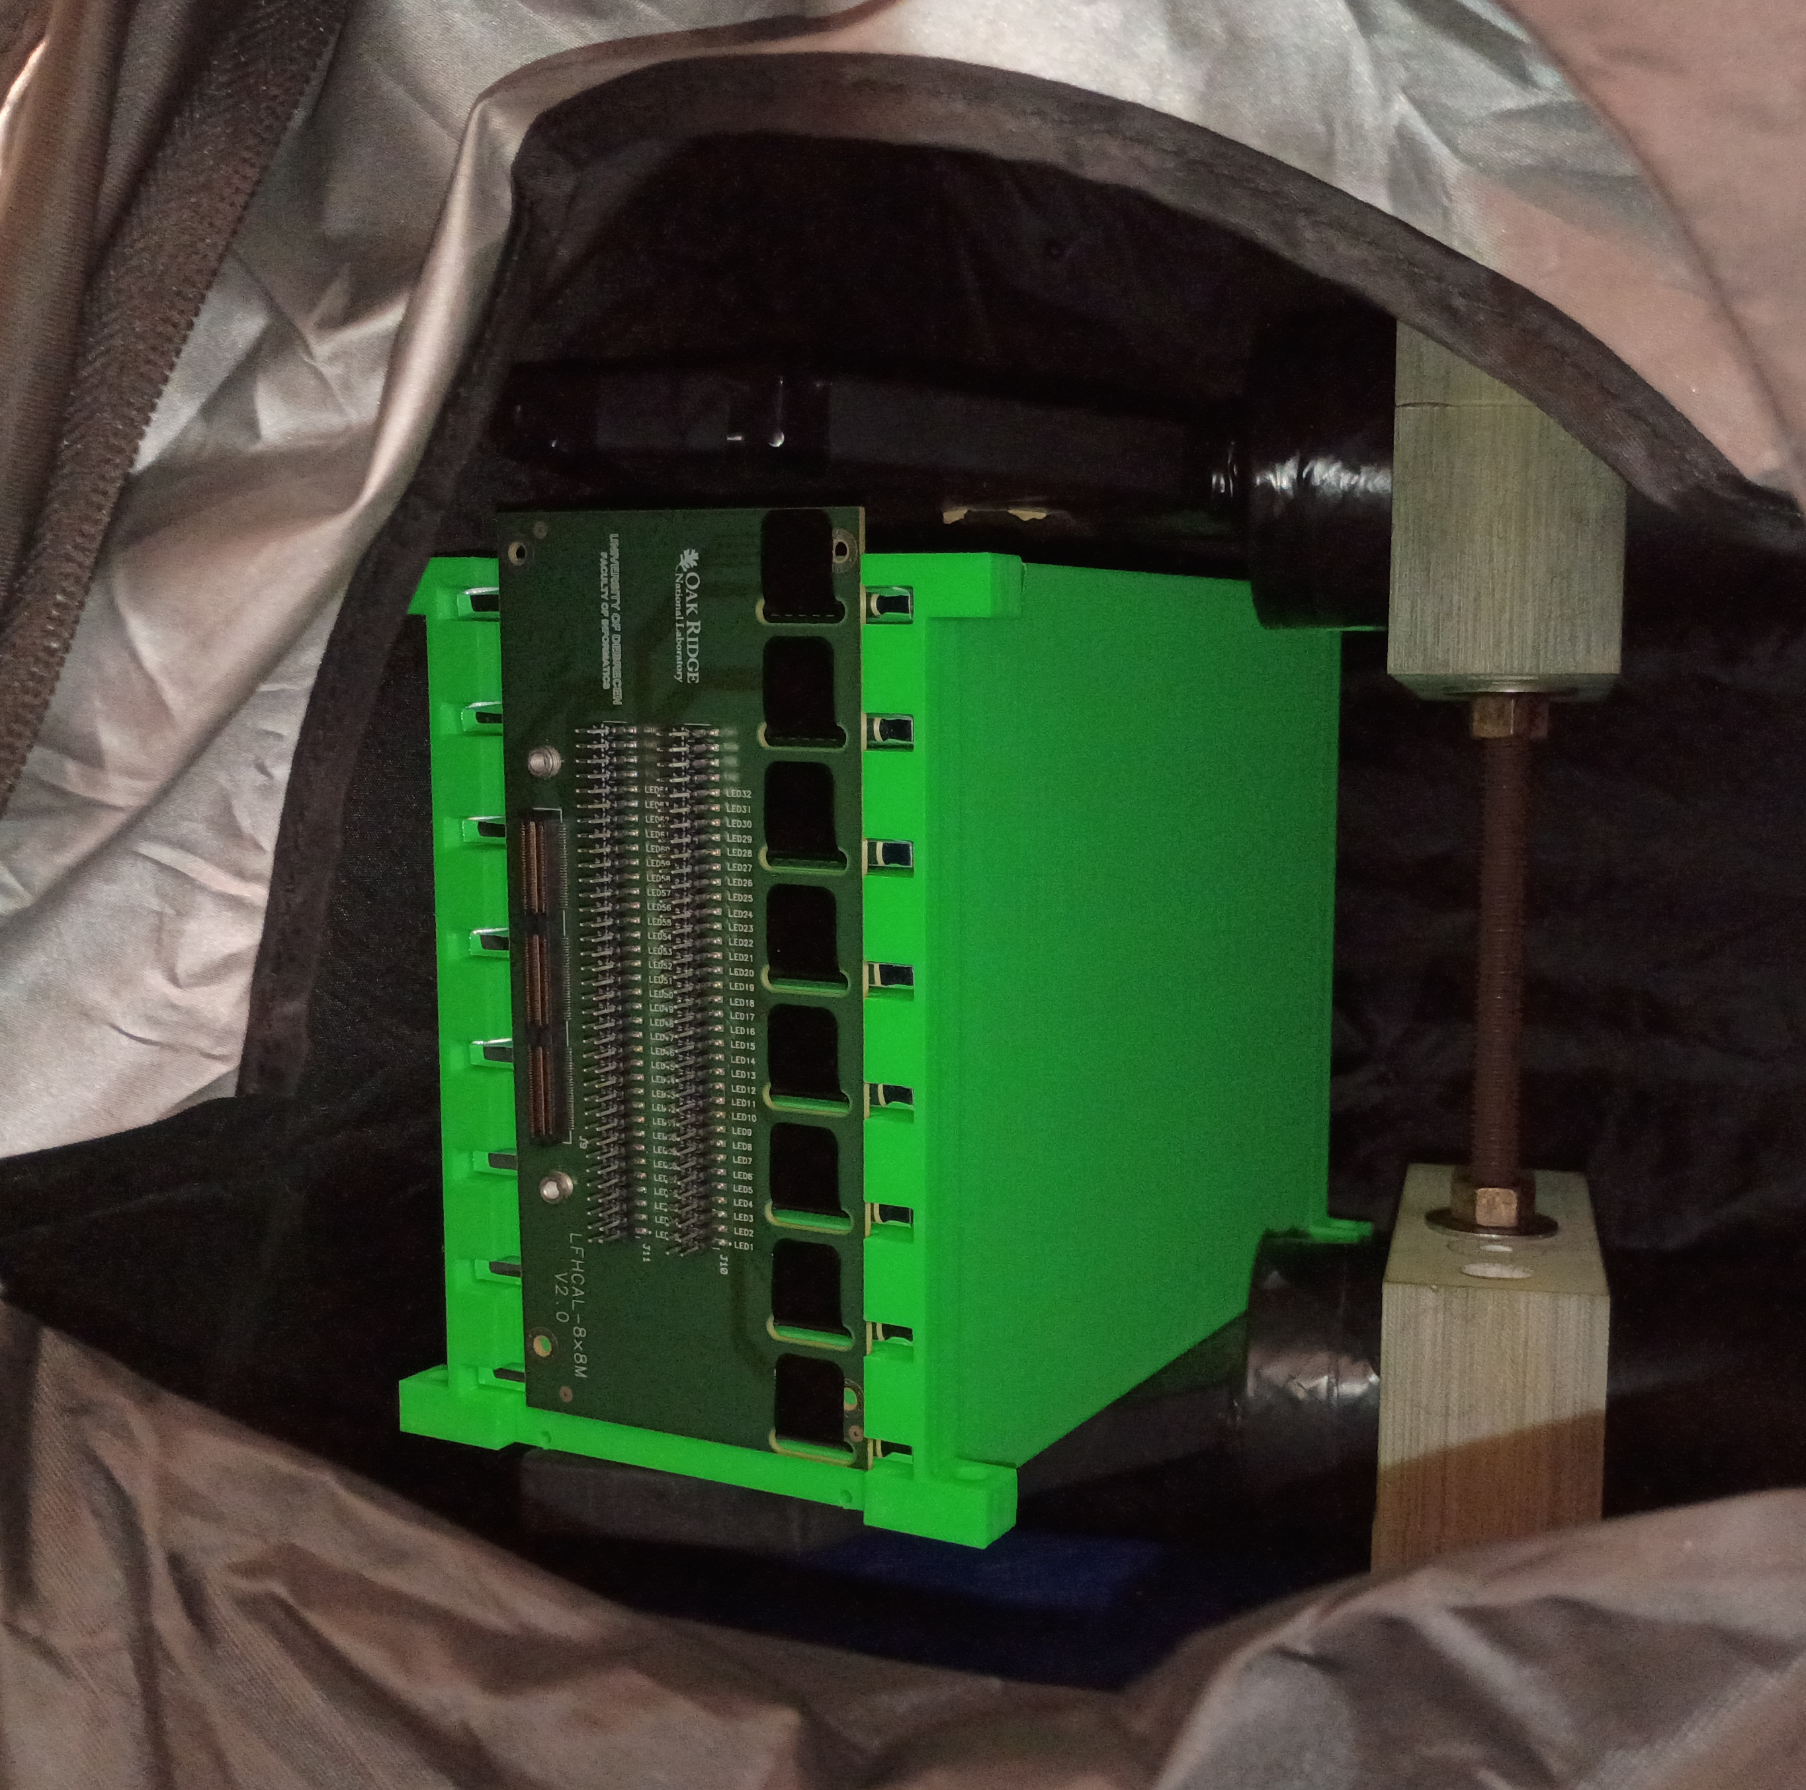
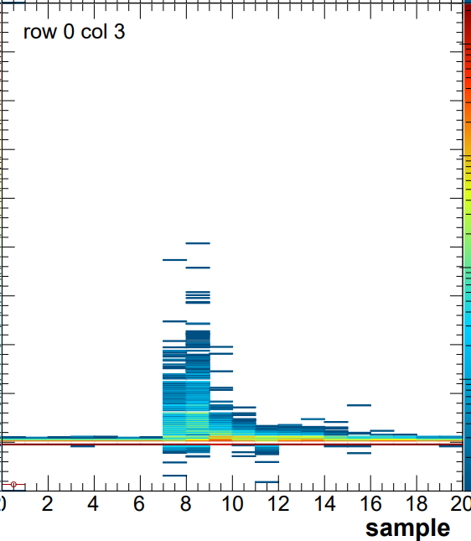
Calorimetry Workfest at ORNL – June 2-6
https://indico.phy.ornl.gov/event/680/
17 participants in-person (+ several remote)
  From UK, Lehigh, OSU, Valpo, UTK, BNL, ANL, ISU, UIUC, ORNL, …
Subgroups working on: ePIC simulation, LFHCAL test beam analysis, HGCROC lab tests
  Onboarding tutorials on ePIC simulations, LFHCAL test beam analysis, HGCROC+rcdaq operation
  nHCAL simulation debugging, HGCROC data model
  Integrating LFHCAL HGCROC beam data into test beam analysis software
  Set up first HGCROC cosmics measurement with LFHCAL tiles at ORNL

Slide 12

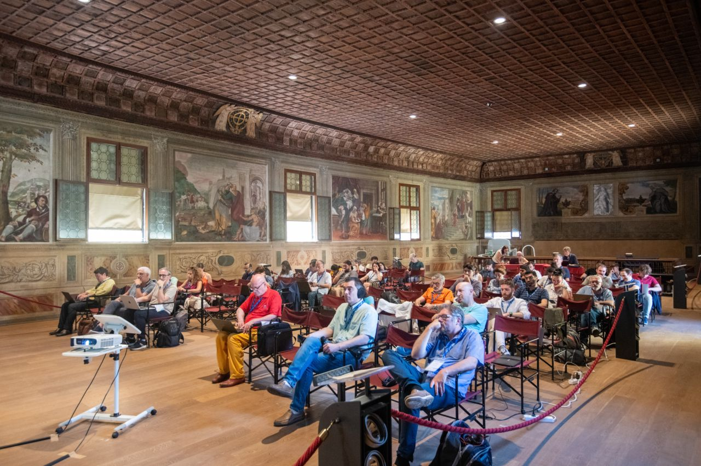
The annual meeting of the Italian ePIC Community
  A well-establish tradition
  16-18 June 2025 (Padova)
  27-28 June 2024 (Bologna)
  22 – 23 June 2023 (Corigliano-Rossano)
  30 June – 1 July 2022 (Catania)
  20 – 21 December 2021 (Torino)
  3 – 4 December 2020 (LNF, online)
  7 – 8 November 2019 (Bari)
A new INFN branch starting to contribute:
TIFPA (Trento) devoted to INFN technological aspects
Highlights
EIC and ePIC update
Focus on INFN activities (detector and physics)
News about the INFN contributions to the accelerators
Report about the solenoid progressing towards the call for tender
An outreach session awarding the 2 best EIC-dedicated videos by Italian high-school students (11 videos received)
66 participants, 90% in person
in a beautiful historical hall

Slide 13

EIC Latin America
EIC Latin America brought together researchers from various countries in the region to discuss the science of the EIC and research opportunities, seeking to expand collaboration in the Americas. This is an event supported by I.ANN QCD, a NSF AccelNet program.
Lots of interest in ePIC!
https://indico.ku.edu/event/478/

Slide 14
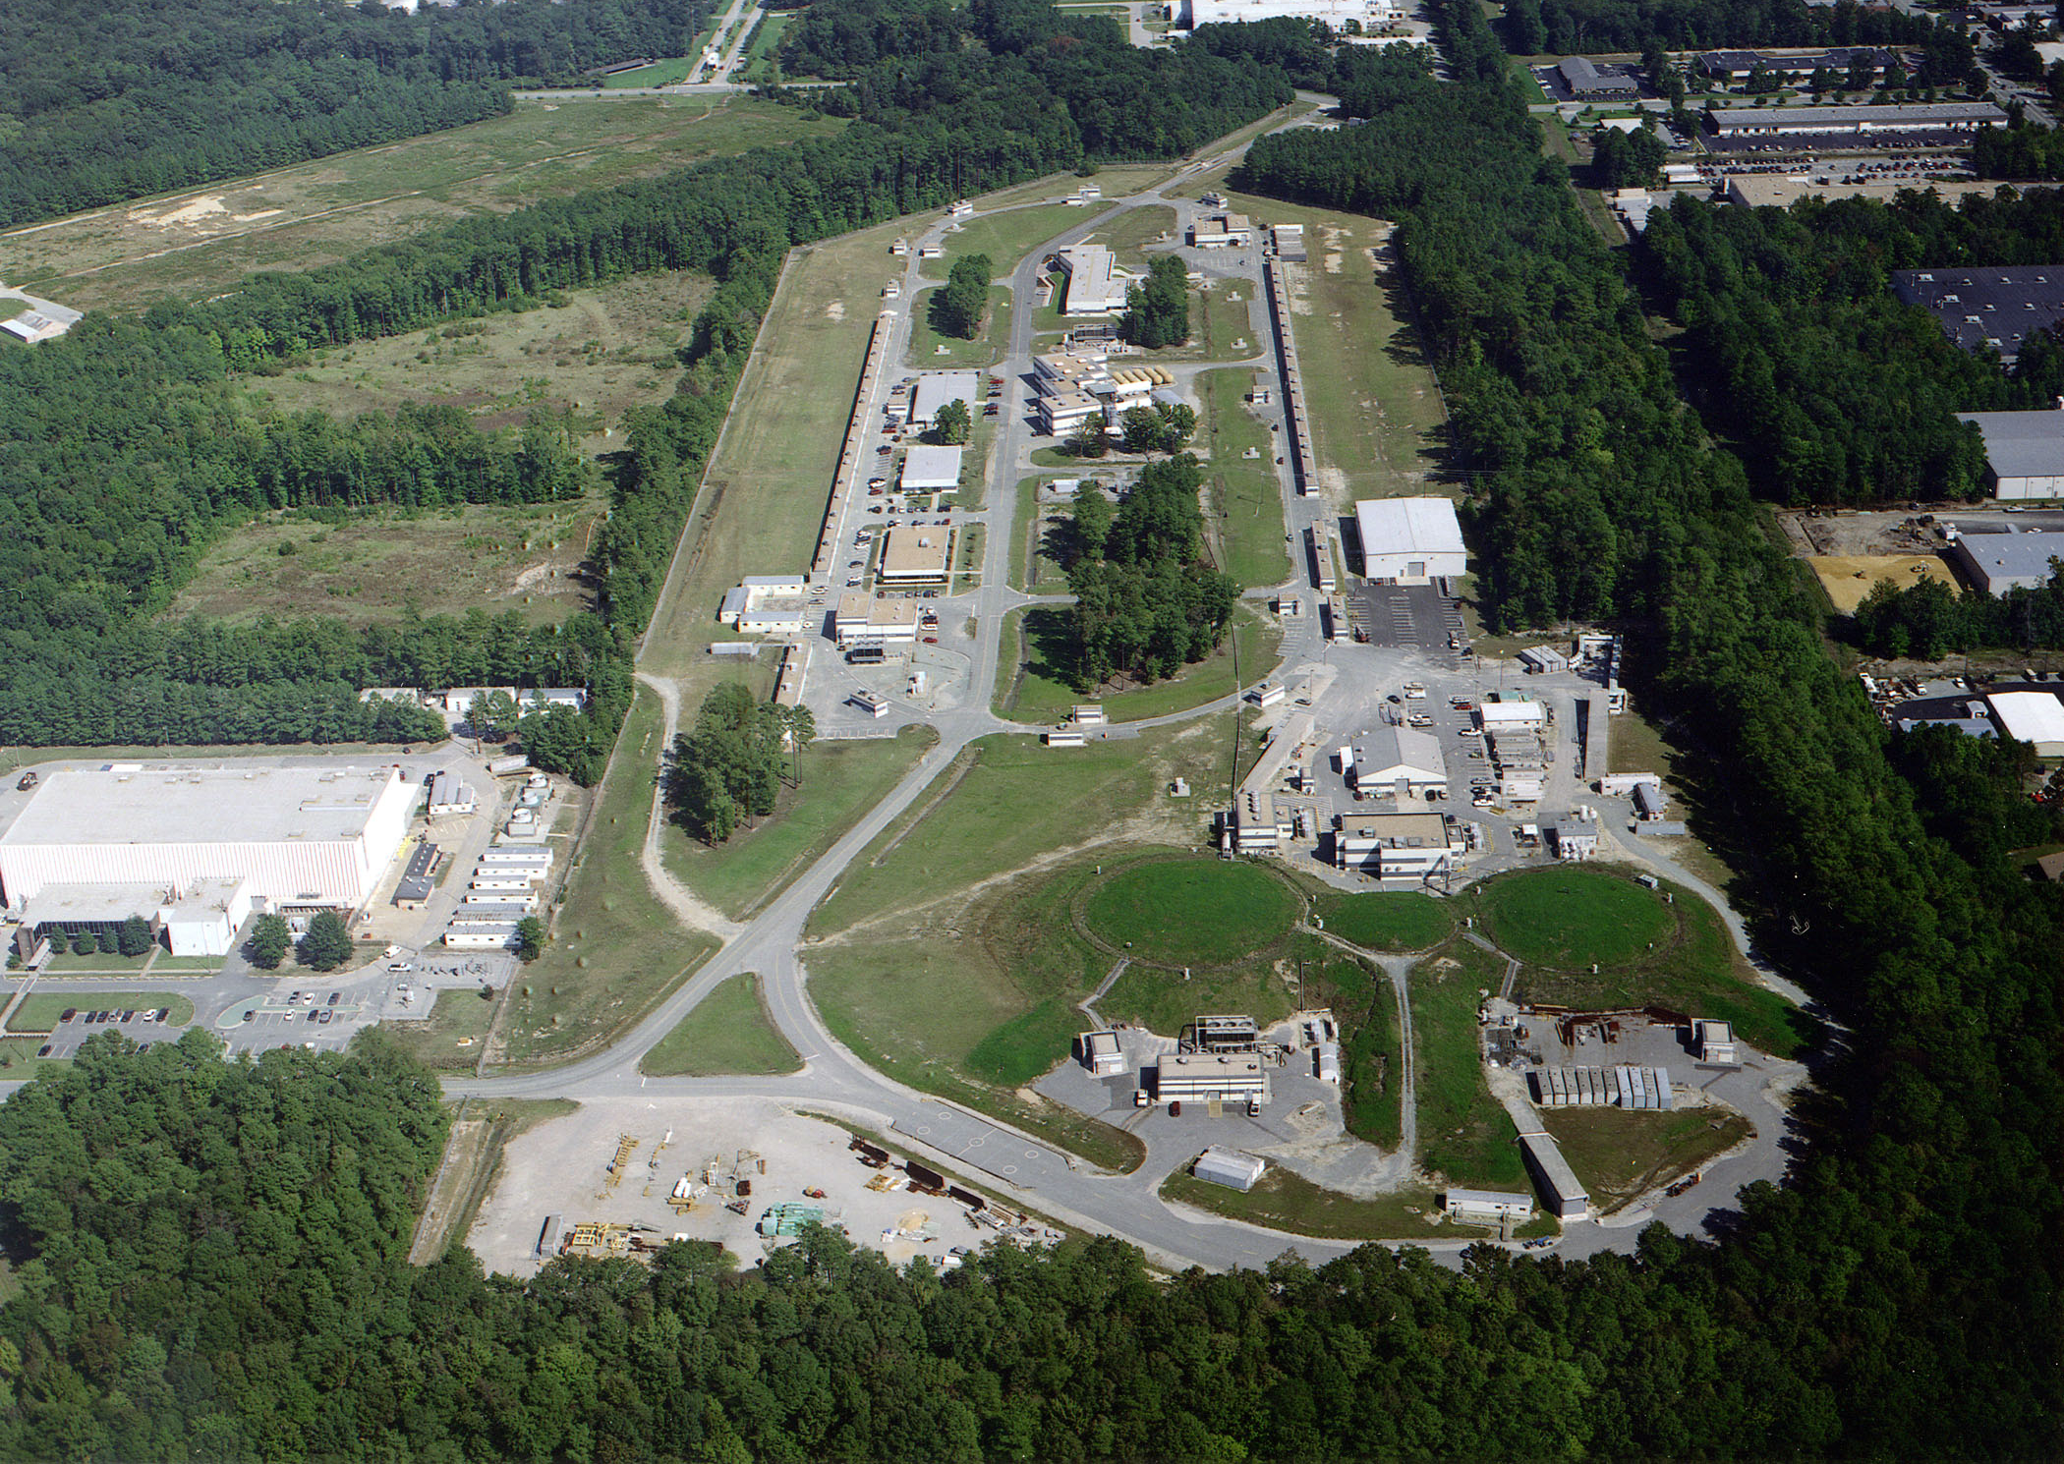
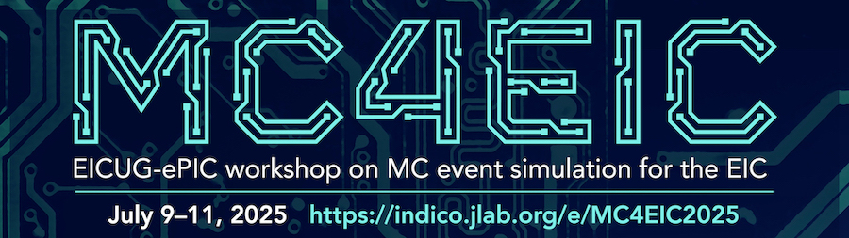
Summer 2025 EICUG/ePIC Collaboration Meeting
July 14-18th at JLab
EICUG Early Career Workshop
July 11-13th
Registration is now open:
https://indico.jlab.org/event/934/
Please register ASAP!
NOTE: Collaboration Meeting follows
MC4EIC July 9-11th
https://indico.jlab.org/event/930/

Slide 15
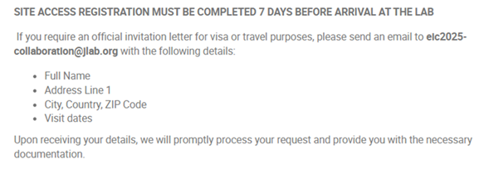
Coming to Jefferson Lab
This meeting at a national lab - please note a REAL ID or passport will be required for visiting the lab.
Apply for site access at least 7 days prior to arrival:
  Apply for Site Access
Invitation letters available on request
Many thanks to Doug Higinbotham!

Slide 16
July 2025 Meeting Block Schedule
Early Career Workshop
Summer 2025 Joint EICUG/ePIC Collaboration Meeting
 | F July 11th | S | S | M July 14th | T | W | Th | F
Morning Sessions | Last part of MC4EIC | 2nd Session | 4th Session | Joint ePIC/ EICUG Plenary | Parallel/ Workfests | Parallel/ Workfests | ePIC CC Meeting | ePIC Closing Plenary
Lunch | Not Provided | Provided | Not Provided | Provided | Provided | Provided | Provided | Not Provided
Afternoon Sessions | 1st Session | 3rd Session | ( free ) | Accelerator/ Physics talks | EICUG/ Awards | Parallel/ Workfests | Parallel/ Workfests | ( free )
Social Event @
Traditions Brewpub

Slide 17
DRAFT Workfest Agenda
Working to finalize workfest agendas and make agendas available to organizers in Indico.
Indico also includes workfest descriptions:
https://indico.jlab.org/event/934/page/513-workfest-descriptions
A huge thanks to the workfest organizers – who, in addition to everything else they do, are taking on the extra burden to organize these important activities.

Slide 18
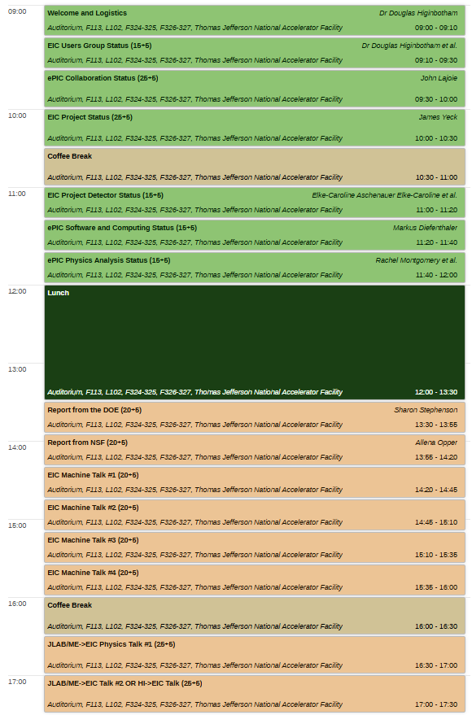
DRAFT Plenary Agenda
Monday, July 14th
Monday’s joint EICUG/ePIC opening session will feature status reports, reports from the funding agencies, talks from EIC machine physicists, and forward looing talks on EIC science.
The Tuesday afternoon EICUG plenary session will have status talks and the EICUG awards.
There will be a CC Meeting Thursday morning.
Friday’s ePIC plenary session will be organized around the theme Priorities and Challenges for the ePIC Technical Design and will focus on the studies that need to be completed to inform the technical design and the preTDR.
https://indico.jlab.org/event/934/timetable/#20250714.detailed

Slide 19
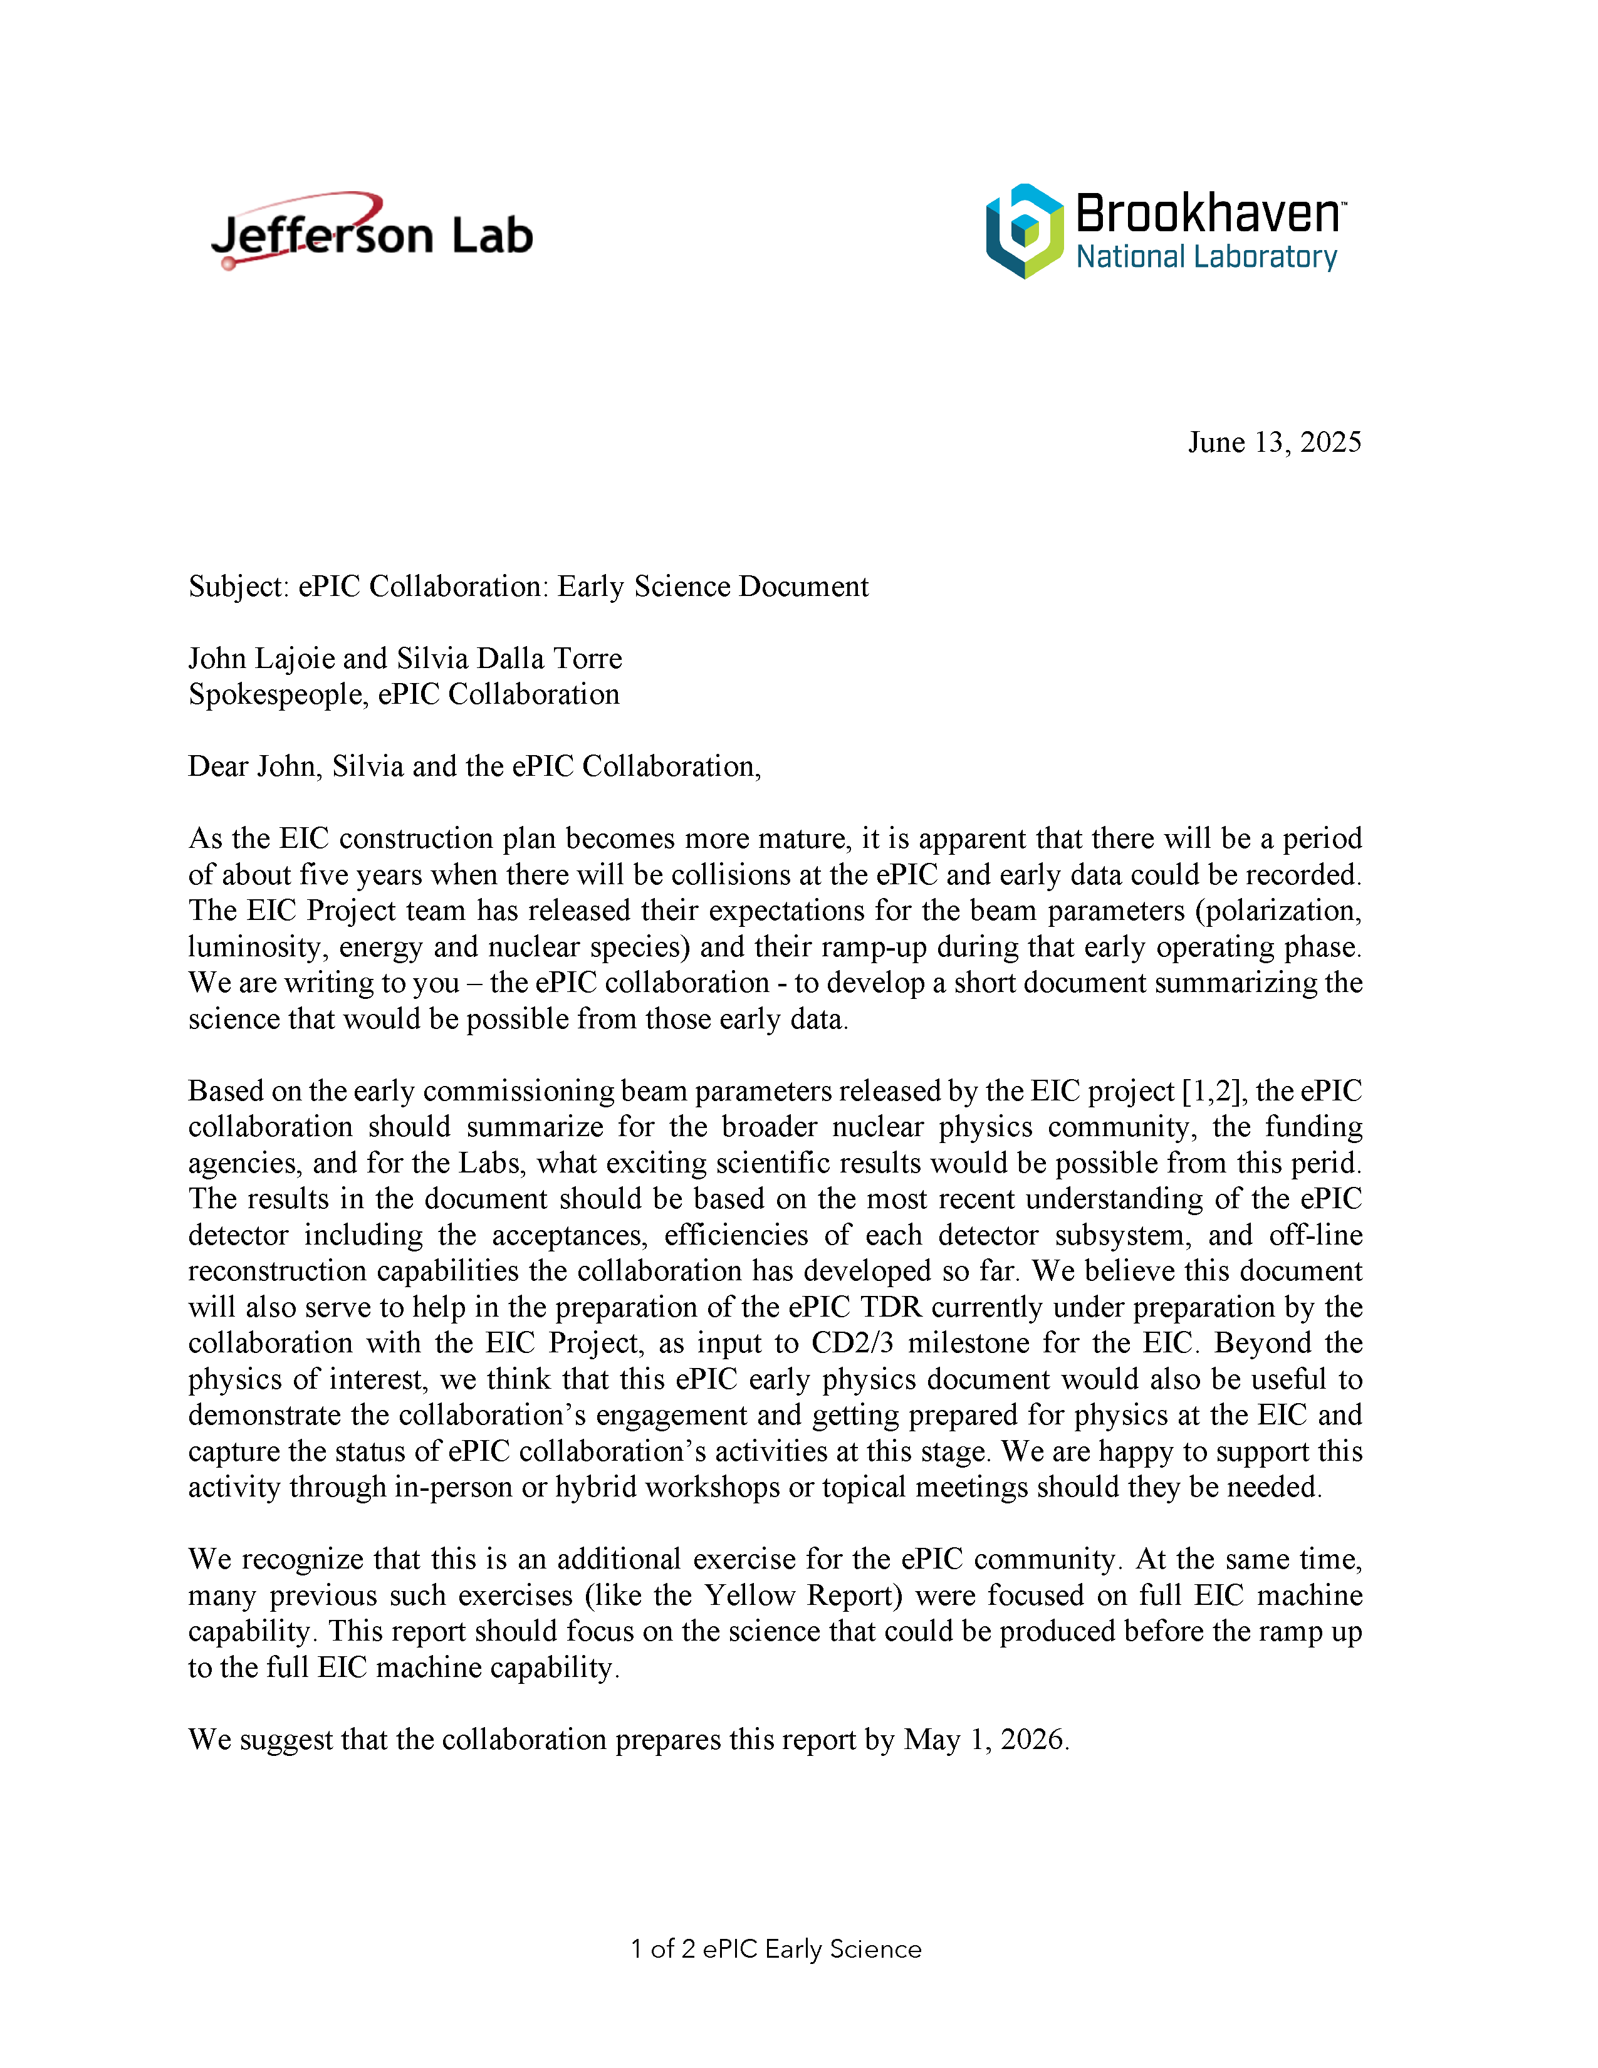
Early Science Charge
The collaboration has received a charge from Abhay Deshpande and David Dean to develop a document that summarizes EIC Early Science.
Supports the EIC project plan
Report requested by May 1, 2026
  Consistent with our publication plan
Next Early Science workshop in early 2026

Slide 20

Call for Speaker Nominations
Spin 2025
ePIC Overview, Future Facility Session, September 22–26, 2025, Qingdao, China
https://indico.ihep.ac.cn/event/22189/
New Horizons with Fixed-Target Proton–Nucleus Experiments at Intermediate Energies
ePIC Detector and Physics Overview, July 10–11, 2025, Stony Brook, USA
https://indico.cfnssbu.physics.sunysb.edu/event/430/
Reminder about ePIC CTC Policies: https://www.epic-eic.org/meetings/conferences.html
Please inform CTC about invited ePIC Talks
Please upload conference materials (abstracts/talks/posters) to Zenodo with proper keyword (see the webpage above) and send for the PWG/DSC to review (to the PWG/DSC mailing list) 8 days before the conference/deadline.
After the approval by your conveners/DSC, materials are to be sent to epic-talks list (subscribe!) 4 days before the deadline for collaboration review and final coordinator approval.
Overview ePIC talks go straight to epic-talks for collaboration review and coordinator approval 7 days before the deadline.
Remember to archive the final version of your slides/poster/abstract on Zenodo.

Slide 21
A couple of initiatives proposed by the
EICUG/ePIC Outreach Working Group
eic-outreach-wg@lists.bnl.gov
Poster contest
Photo contest
Not only fun and people involvement but also way to collect
- images documenting these early years
- material for outreach
Notes:
First of all to whom?

Slide 22
2nd ePIC photo contest
Photos collected through the following form – deadline July 10th https://urldefense.com/v3/__https://forms.gle/hp7D1Hr1Y6udc4t29__;!!P4SdNyxKAPE!FIa1ybIRRr1cVr34iixQoqtgM_tkSf-3MZWWw6U9_YGXHaRiTDEP-LAHHv2e-cnKUTHX1AMKeTiHEubcejGQQrat7TYbKMKu$
During the Collab meeting in JLAB all Collaborators will be able to vote (electronically)
Winners will be announced during the closing plenary of the Collab meeting in JLAB
The detailed rules of the contest are as follows:
- Photographs should be submitted by a member of the ePIC Collaboration.
- A maximum of 3 photographs can be submitted by each member.
- Photographs should be related to ePIC activities (the outreach group reserves the right to reject non-pertinent pictures).
- AI-generated images will not be accepted. Photo-editing is allowed.
- Each photograph should have a caption and a brief description (maximum 5 lines).
- The ePIC collaboration will reserve the right to archive and post the photograph, citing the name of the photographer, unless the person doesn’t want to be cited.
- If there is any identifiable person in the photo, the photographer must collect that person’s permission for posting it on social media.
- Last date of entry is July 10th 2025.
- An online voting form will be available for all ePIC members during the next Collaboration meeting in JLAB, 14-18 July 2025.
- The three best photographs will be selected and prizes will be awarded during the
closing session of Collaboration meeting.
In case of questions/needs please email antonio.paladino@bo.infn.it (Thanks Antonio!)

Slide 23
Poster contest
Deadline July 7th
During the Collab meeting in JLAB all Collaborators will be able to vote (electronically)
Winners will be announced during the closing plenary of the Collab meeting in JLAB
Category 1: A poster on EIC Science or the ePIC detector for high-school students
Category 2: A poster on EIC Science or the ePIC detector for scientists, not experts in ePIC, EIC or DIS
Category 3: Accelerator - posters on the EIC accelerator, for scientists, not experts in accelerators/colliders
If you are interested to participate please enter your information into the following word file PosterContest.docx
https://brookhavenlab.sharepoint.com/:w:/s/EICPublicSharingDocs/Ec0kq7PEzqNCq1CLMZbwDZgBz_fpveRuLlJjaR1u5HYrBA?e=9oeAg8
To submit your poster please post to
Category 1:
https://brookhavenlab.sharepoint.com/:f:/s/EICPublicSharingDocs/EhmXoa-n2j1IgRnDBuh-foEBrd9dD4vr6I9xelI0D3UuvA?e=lSfaQb
Category 2:
https://brookhavenlab.sharepoint.com/:f:/s/EICPublicSharingDocs/EgrUHNNbNT1Cm-iV_8rqVP0BUtKw82qNv03oLJKaFqib7Q?e=htnozO
Category 3:
https://brookhavenlab.sharepoint.com/:f:/s/EICPublicSharingDocs/EjlAVcbPJYpCsisLTVKELtQBJmzV3i-QDWWHV818RHVUVg?e=lvcqLT
The name of the file should please contain your name, the category you want to submit to as well as if it is a
poster on science or the detector.
In case of questions/needs please email elke@bnl.gov

Slide 24
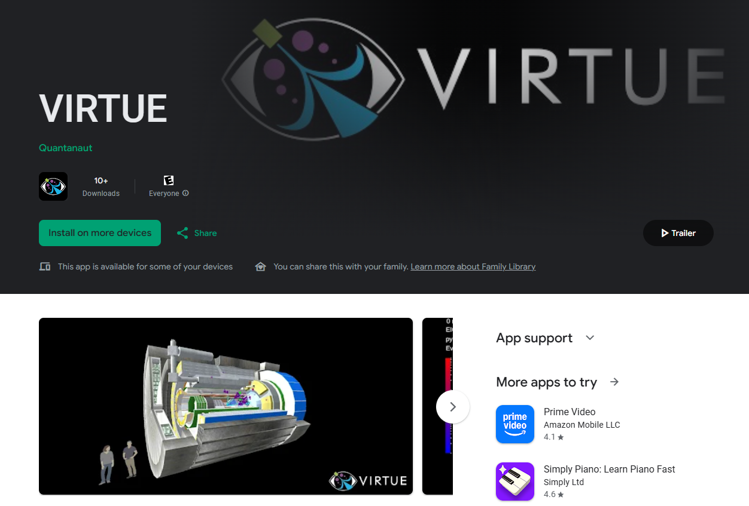
Outreach:
VIRTUE
Now available in the Google Play store!
ePIC application from Sean Preins (UCR)!
A really convenient prop to use when you talk to people about EIC and ePIC!
You can get it here.

Slide 25
Summary
You will hear more in Silvia and the Project’s
talks, but the EIC project and ePIC are moving
forward at a rapid pace.
This is only possible because of the dedication of the individual
members of the ePIC collaboration!
The July collaboration meeting will be critical to setting the path to completing the preTDR by the end of 2025.
  Register! Attend! Participate!

Slide 26


Slide 27


Outreach Activities
Poster Contest:
  Submissions due July 7th
    Category 1: A poster on EIC Science or the ePIC detector for
    high-school students
    Category 2: A poster on EIC Science or the ePIC detector for
    scientists, but not being experts in ePIC, EIC or DIS.
    Category 3: A poster on the EIC Accelerator, for scientists, but
    not being experts in accelerators and colliders
  Contacts: Marta and Elke
    See Marta’s slides from the Frascati collaboration meeting
2nd ePIC Photo Contest:
  Rules and submission form available here
  Contact: Marta and Antonio

Slide 28
ePIC Resources
Public Website - https://www.bnl.gov/eic/epic.php
Mailing Lists – https://lists.bnl.gov/mailman/listinfo
Indico Agenda - https://indico.bnl.gov/category/402/
  ePIC Software and Computing: https://indico.bnl.gov/category/435/
Wiki - https://wiki.bnl.gov/EPIC
ePIC Software Training:
  Landing Page: https://eic.github.io/documentation/landingpage.html
  Tutorials: https://eic.github.io/documentation/tutorials.html
Mattermost: https://chat.epic-eic.org
ePIC Zenodo Community: https://zenodo.org/communities/epic

Slide 29


EICUG Membership
The EICUG is a vital organization to promote the interests of the EIC community!
  Without the EICUG we would never have gotten far enough to form ePIC!
Please register your institution!
Check with your EICUG IB representative to get registered as a member
https://www.eicug.org/content/join.html

Slide 30
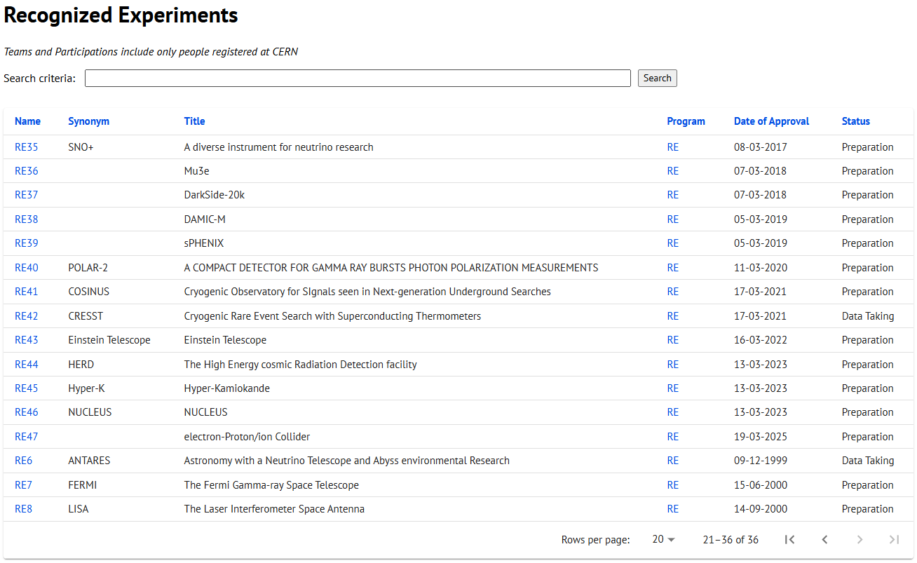
CERN Recognized Experiment Status: RE47
ePIC now appears in the CERN Grey Book database as RE47:
https://greybook.cern.ch/experiment/recognized
Two steps to get ePIC Collaborators registered at CERN:
CC Representative needs to register as team leader with
CERN Users Office:
  https://usersoffice.web.cern.ch/
  https://usersoffice.web.cern.ch/team-leaders-corner
  Users.Office@cern.ch
CC member can then certify registrations of team members
Contact us if you run into problems!

