Slide 1
ePIC Collaboration News
J. Lajoie, S. Dalla Torre
February 20, 2025

Slide 2
Hey John, start the recording….

Slide 3
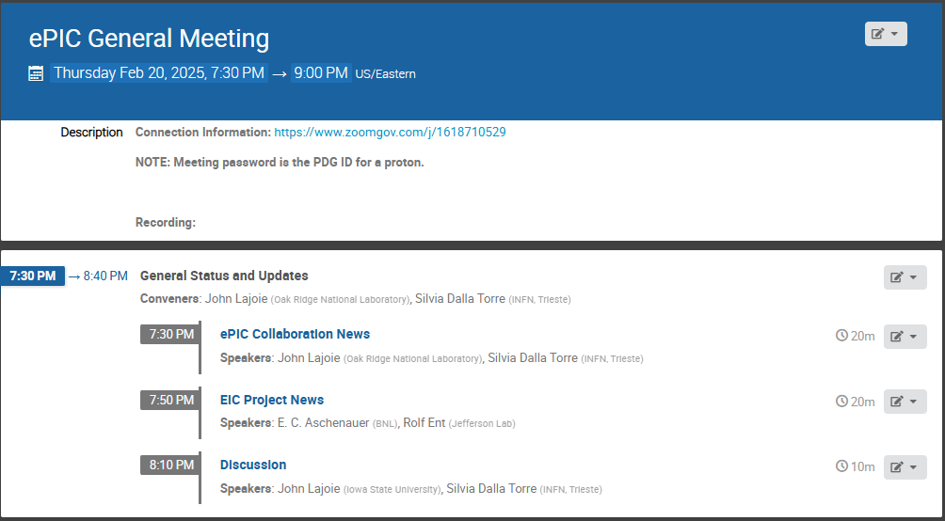
Agenda
Light agenda this evening - news from the collaboration and the project.

Slide 4
2025 -2026
More in the Project News talk…
PDR2: Polarimetry
Sept./Oct 2025
PDR: DAQ/Slow Controls
Nov./Dec. 2025
ePIC Early Physics Workshop April 2025
PDR2: Backwards HCal
~Sept. 2025
ePIC pre-TDR
and publications (goal)
PDR2: Barrel EMCal
~August 2025
5th EIC RRB Meeting
June 2025
ePIC Software and Computing Review ~Oct 2025
ePIC Software and Computing Review Check-in ~May 2025
PDR2: Cerenkov PID
April 1-2, 2025
PDR3: Aux. Det
Nov./Dec. 2025
PDR2: MPGD Detectors
Summer 2025
PDR3: Elec./DAQ
August 2025
PDR: Magnet/Cryo Detectors
Sept./Oct. 2025
2025
2026
Frascati
Jan 20-24,2025
EICUG/ePIC Collab. Mtg. July 14-18
CD-2/3 Review ~2026
FDR: Backward & Forward EM Calorimetry, Barrel & Forward HCAL
May 2025
PDR: Integ. + Installation (outside GST)
Nov/Dec 2025
PDR2: Si Tracking Detectors
Fall 2025
10th Detector Advisory Committee June 2025
Detector R&D Day (ePIC/Project) ~April 2025
PDR2: AC-LGAD Detectors
Fall 2025
6th EIC RRB Meeting Nov 2025
PDR: Integ. + Installation (inside GST)
Nov/Dec 2025

Slide 5
The ePIC Collaboration and Recent Changes
A great deal of concern has been expressed with regards to recent executive orders from the new U.S. administration.
ePIC is an independent, international scientific collaboration
We are united in our goal to realize the EIC science program.
ePIC has a Code of Conduct and a DE&I Committee established by charter.
A Code of Conduct is not “DE&I” – it is a set of expectations for professional conduct in the context of the collaboration.
There have been NO requests from anyone, internal or external to ePIC, to modify our structure or Code of Conduct. Similarly, there have been no requests to remove anything from the ePIC Indico.
The entirety of ePIC Leadership continues in their dedication to maintain a collaboration where everyone is respected and has an opportunity to succeed and grow professionally.
This includes working with collaborators who have constraints due to new policies

Slide 6
Collaboration Tools
We believe that fostering open communication among all members of the ePIC Collaboration, regardless of their background or geographic location, is essential. Additionally, we aim to onboard new members quickly, without delays in user registration:
It is for this reason we operate our own domain registration, Google cloud account, and Mattermost server
S&C team members have done this at their own expense and risk
Some issues came up regarding the Mattermost server prior to last GM.
We cannot/should not mandate how collaboration members interact with these services:
Not using a federal email address will be encouraged but not mandated.
Individuals will have to assess their own risk – unsubscribe from emails, etc.
Keep Mattermost discussions on-topic
Ownership of these accounts will be consolidated within ePIC to members that are comfortable with any risk they may incur.
Long-term might consider a 501c3 or some such entity

Slide 7
Recent TIC Meetings
Implementing one of the priorities identified at the ePIC collaboration meeting
Completing the ePIC collaboration meeting
WORKFEST summaries at the TIC meetings:
Integration Workfest
PID-Near Term and future Workfest
AC-LGAD Detector Workfest
Silicon Vertex Tracker Workfest
MPGD's Workfest
Machine Learning Workflow Hackathon
+ Tracking Projection/resolution@hpDIRC at the General meeting on February 7th
Recordings Available at:
https://indico.bnl.gov/event/26438/
https://indico.bnl.gov/event/26439/
Workfest summaries also at Feb. 7th GM:
https://indico.bnl.gov/event/25847/

Slide 8
Feb. 17th Discussion – Progress Towards TDR
A useful and widely contributed discussion
A good basis for progressing with a more detailed planning
Key outcomes:
PreTDR finalized by the end of 2025
Version 1 (chapter 8) to be reviewed by a small board → Input for Version2
Version 2 must be the LAST preTDR version by DSCs
Then, an Editorial Board for final polishing
Need of starting the production of ePIC Technical Notes
Defining a simple process for approval is urged
Detector publication(s) derived from preTDR
The TDR is a primary focus and tied to many other priorities – details and timeline at next GM.
February 20th, 2025
ePIC General Meeting

Slide 9
EPPSU Documents (TC & AC)
due March 31st
Progressing with the ePIC-detector technology and physics synergy documents for the EPPSU

Slide 10
Common Themes from Priority Discussion
There is a need for better communication within the collaboration, across multiple different entities
Not a single problem with a single solution - something that we need to continually work on. Tailor the communication to collaboration needs (newsletter, minutes of meetings, etc.)
Accelerate development of and transition to the website
Actions Underway:
Discussions underway on future development of ePIC website:
Current version functional not very visually appealing or engaging
Public face of ePIC needs to be dynamic
Need to seek collaboration feedback
Coordinators discussion meeting “best practices”
S&C has meeting minutes for all WG’s
Proposing new time for evening GM (next slide)
Sub-bullets are examples that support the priority but are not exhaustive.
Actions listed not exhaustive.

Slide 11
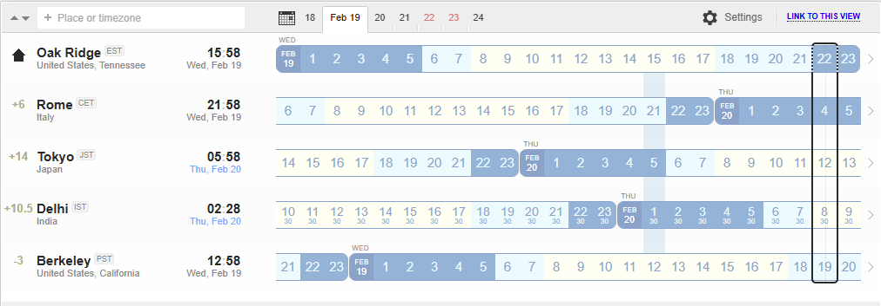
Time for Evening General Meetings
Current Meeting Times:
Fridays:
10:30 AM ET
Thursdays:
7:30 AM ET
Current evening meeting time is not serving its purpose
NOTE: It is not expected that everyone attend all General Meetings!
Feedback and input is welcome.
Proposed New Evening Meeting Time: Thursdays:
10 PM ET

Slide 12
Common Themes from Priority Discussion
Evolve technical coordination into less of a reporting body, with a proactive coordinating effort supporting the DSC’s
Organize and coordinate preTDR effort
Increase the direct engagement of the TC-Office with DSCs and CC WGs, TC Office presence in DSC meetings
Set standards/requirements for DSC internal reviews, assist with organization
Facilitate communication with CAMs and EIC Project
Organize common solutions – cooling, grounding, database,…
Actions Underway:
Increased TC presence in DSC meetings
Individual meetings with DSC leadership (through mid-March)
Coordination effort for CERN test beams in 2025
Sub-bullets are examples that support the priority but are not exhaustive.
Actions listed not exhaustive.

Slide 13
Common Themes from Priority Discussion
Need a better way to grow/onboard analysis efforts
Not just software! Onboard analysis as well
Common reconstruction tools facilitate higher-level analysis efforts
Use Early Science studies as a focus for efforts in analysis and engagement with theory
Actions Underway:
PWG’s working to implement analysis tutorials
AC working with TC Office on performance studies
S&C will be reaching out to DSCs on software plans.
Planning Early Science workshop in late April
Sub-bullets are examples that support this priority but are not exhaustive.
Actions listed not exhaustive.

Slide 14
Common Themes from Priority Discussion
Need to define a set of 2025 milestones for progress in simulations
This includes simulation framework, fidelity to the mechanical design, inclusion of backgrounds, and reconstruction and common tools
Work with DSC’s to set software goals, SCC to support
Define how we work towards simulation reconstruction in timeframes
Actions Underway:
S&C/AC agreed on priorities and people identified
Report at next General Meeting
Workforce and Engagement
Need to increase workforce and support engagement across all three coordination offices
Actions Underway:
Analysis tutorials in preparation ahead of summer students
Analysis of membership survey underway
Actions listed not exhaustive.
Sub-bullets are examples that support this priority but are not exhaustive.

Slide 15
More Information Coming Soon
2025 Statements of Service frozen as of Feb 10th
Analysis of 2025 FTE commitments and projections underway
Concrete strategy/plan for publications in 2025
Next Early Science Workshop to be announced soon
Voting underway to admit University of Seoul
Spokesperson election to start imminently
Planning underway for next CC meeting
Two new institutions ready to petition for membership
Next collaboration meeting – Week of July 14th @ JLab
REMINDER: Call for Jan. 2026 Collab. Meeting Host due March 31st
So far no expressions of interest

Slide 16
Conclusion
A busy 2025 is already underway
We are using the momentum from the Frascati meeting to act on collaboration priorities
In future General Meetings we will continue to report on progress on collaboration priorities established at the Frascati meeting
Next ePIC General Meeting Friday, Mar. 7th, 2025 @ 10:30AM ET

Slide 18
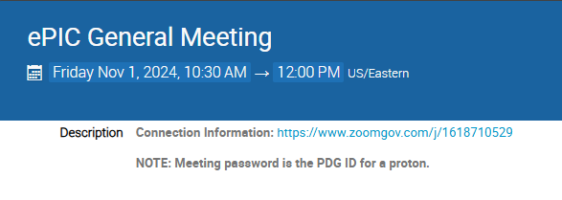
New Zoom Link
The Zoom link for the General Meeting now requires a password
We decided to do this after a TIC meeting was Zoom-bombed
All our Indico pages are public, so this offers another hurdle for a would-be bomber (not a guarantee)
Old link had password embedded to allow one-click access
Hopefully this is not overly cumbersome for our collaborators

Slide 19
ePIC Resources
Public Website - https://www.bnl.gov/eic/epic.php
Mailing Lists – https://lists.bnl.gov/mailman/listinfo
Indico Agenda - https://indico.bnl.gov/category/402/
ePIC Software and Computing: https://indico.bnl.gov/category/435/
Wiki - https://wiki.bnl.gov/EPIC
ePIC Software Training:
Landing Page: https://eic.github.io/documentation/landingpage.html
Tutorials: https://eic.github.io/documentation/tutorials.html
Mattermost: https://chat.epic-eic.org
ePIC Zenodo Community: https://zenodo.org/communities/epic

Slide 20
EICUG Membership
The EICUG is a vital organization to promote the interests of the EIC community!
Without the EICUG we would never have gotten far enough to form ePIC!
Please register your institution!
Check with your EICUG IB representative to get registered as a member
https://www.eicug.org/content/join.html

