Slide 1
EIC Project News
E.C. Aschenauer (BNL), R. Ent (JLab)
Co-Associate Directors for the EIC Experimental Program
ePIC Bi-Weekly General Meeting
March 20th, 2025

Slide 2
Outline
CD-3A Progress
Reviews in 2025
CD-3B Scope
Upcoming Reviews and Meetings
Cooling Requirements
Envelope Updates
Beam Pipe Advanced Design and Subsystem Clearances

Slide 3
Construction is starting: CD-3A
Actively Cooled Beam Screen Material
Cryo Beam Position Monitor (BPM) Buttons and Silicon Dioxide (SiO2) cables
Interaction Region (IR) Super Conducting (SC) Strand for IR SC Magnets
Electron Storage Ring (ESR) 591 MHz 1-Cell Cryomodule First Article
Design and Fabrication of One 2K Satellite Refrigerator Plant
Lead Tungstate Crystals for the Detector Backward Electro-Magnetic (EM) Calorimeter
Scintillating Fibers for the Detector Barrel and Forward EM Calorimeters
Silicon Photomultipliers for the Detector Forward Hadronic Calorimeter
Steel and Tungsten for the Detector Forward Hadronic Calorimeter
Detector Solenoid Magnet Design and Fabrication and Conductor
Unit Substations for Infrastructure
Accelerator
Detector
Approved and Authorized – Procurements In Progress
Awarded: #1-#3, #6-#8, #11. Nearly awarded #10 (conductor)
Infrastructure

Slide 4
Detector Reviews planned for 2025 (all Reviews for 2024 completed)
Preliminary Design Reviews (60% design maturity equivalent, called PDR, PDR2 or PDR3, pending the subsystem)
PDR2: MPGD Tracking Detectors (6.10.03.02) – Summer 2025 – exact timing linked to progress on first engineering test articles
PDR2: Silicon Tracking Detectors (6.10.03.01) – Fall 2025 – After early results of ITS3 ER2
PDR2: Cherenkov-based Particle Identification Detectors (6.10.04; pfRICH, hpDIRC, dRICH) – April 1-2, 2025
PDR2: AC-LGAD-based Particle Identification Detectors (6.10.04; BTOF, FTOF, common systems) – Fall 2025
PDR3: Barrel EM Cal (6.10.05.02) – ~August 2025
PDR2: Backward HCAL (6.10.06.01) – ~September 2025
PDR: Magnet Cryogenics and infrastructure (6.10.07) – September/October 2025
PDR3: Electronics/DAQ-computing (6.10.08. 6.10.09.01) – Late August 2025 – this does not include slow controls
PDR: DAQ-Slow Controls (6.10.09.02) – November/December 2025 – Later to ensure integration DAQ in the collider common platform
PDR: Integration, Infrastructure and Installation (6.10.10) – September/October – everything outside GST, includes cradle, HCAL, etc.
PDR: Integration, Infrastructure and Installation (6.10.10) – November/December 2025 – everything inside GST
PDR3: IR Integration and Auxiliary Detectors (6.10.11) – November/December 2025 – includes 6.10.14 lumi detector
PDR2: Polarimetry (6.10.014) – September/October 2025
Final Design Reviews (FDR):
NEW: FDR: Final Design Review of the BABAR DIRC Bar Refurbishment for the High Performance DIRC Particle Identification Detector – April 1, 2025
FDR: Backward & Forward EM Calorimetry, Barrel & Forward HCAL (6.10.05.01; 6.10.05.03; 6.10.06.02; 6.10.06.03) – May 2025
Project Reviews:
OPA CD-3B Review – January 7-9, 2025
OPA Project Status Review – Summer 2025 (~6 months after CD-3B Review)
Other Meetings:
Detector R&D Day hosted by ePIC and EIC Project – April 16-17, 2025
DAC Meeting – Comprehensive look to design status and readiness for CD-2. June 11-13, 2025.
5th RRB Meeting: June 5-6, 2025 – Prague, Czech
EIC International Computing Organization (EICO) – April 2–4, 2025 @BNL
ePIC Software & Computing review by host labs: ~April/May 2025 for status check

Slide 5
Past 2025 Reviews/Meetings and Upcoming Meetings
Past:
DOE/OPA CD-3B and Status Review – January 7-9, 2025
Jan 2025 ePIC Collaboration Meeting – January 20-24, 2025
Magnet In-Kind Follow-Up w/ INFN and CEA – January 31
EIC, RIKEN, U-Tokyo Collaboration Meeting – February 3
Upcoming:
PDR2: Cherenkov-based Particle Identification Detectors (6.10.04; pfRICH, hpDIRC, dRICH) – April 1-2
Includes FDR of the BABAR DIRC Bar Refurbishment for the High Performance DIRC Particle Identification Detector
EIC International Computing Organization (EICO) meeting – April 2-4 @ BNL
Indico link for the EICO meeting: https://indico.bnl.gov/event/26855/
Discussion on Echelon 0 and 1: https://indico.bnl.gov/event/26856/
ePIC/EIC Project Detector R&D Day – April 16-17 (two half days, from 10 am to 1 pm)
Indico link: https://indico.bnl.gov/event/27200/
5th Resource Review Board meeting – June 5-6 in Prague, Czech
10th Detector Advisory Committee meeting – 3 days in person at BNL, June 11-13
Joint EIC User Group and ePIC Collaboration Meeting – July 14-18 @ Jefferson Lab

Slide 6
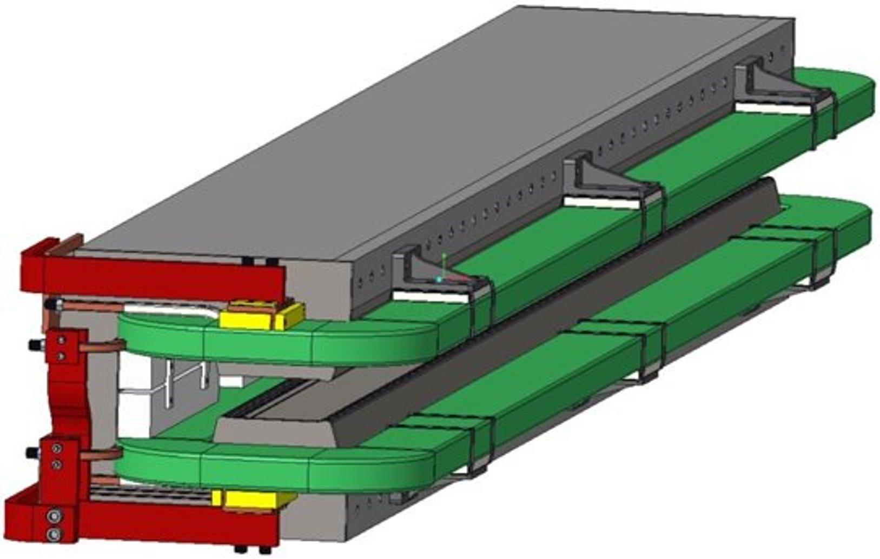
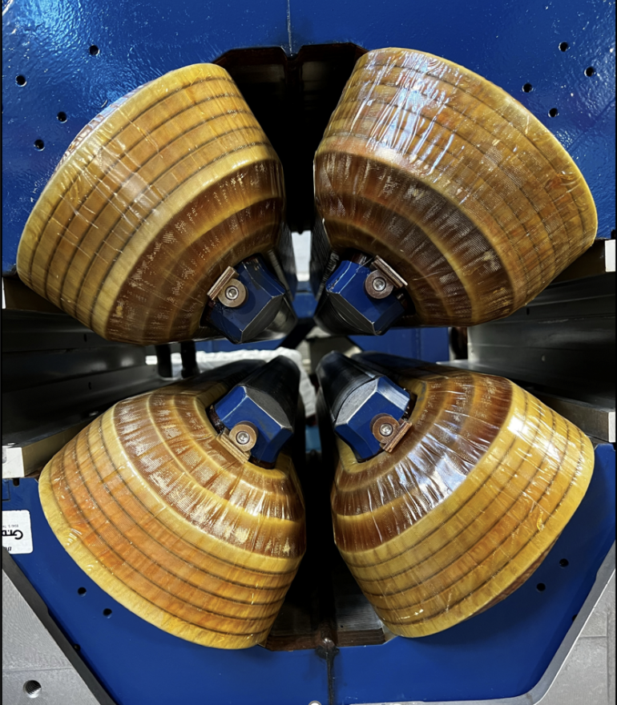
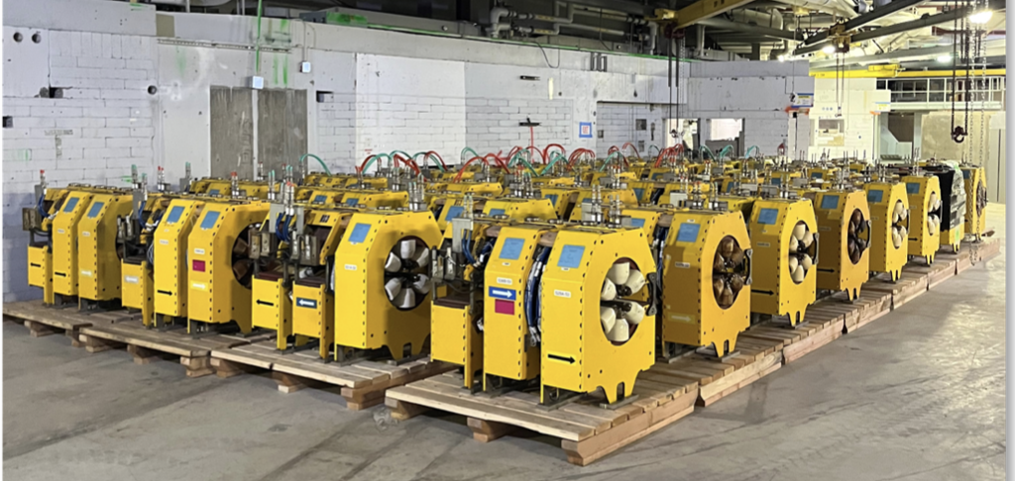
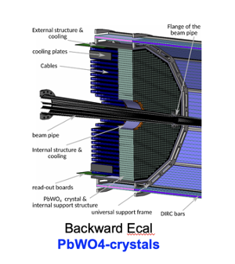
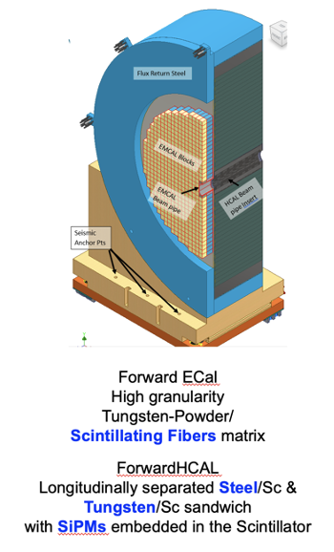
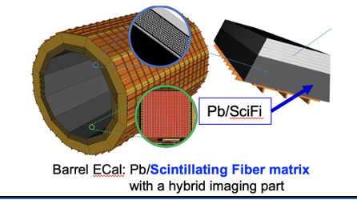
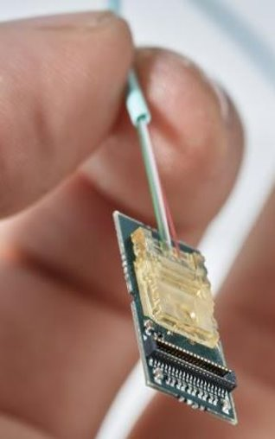
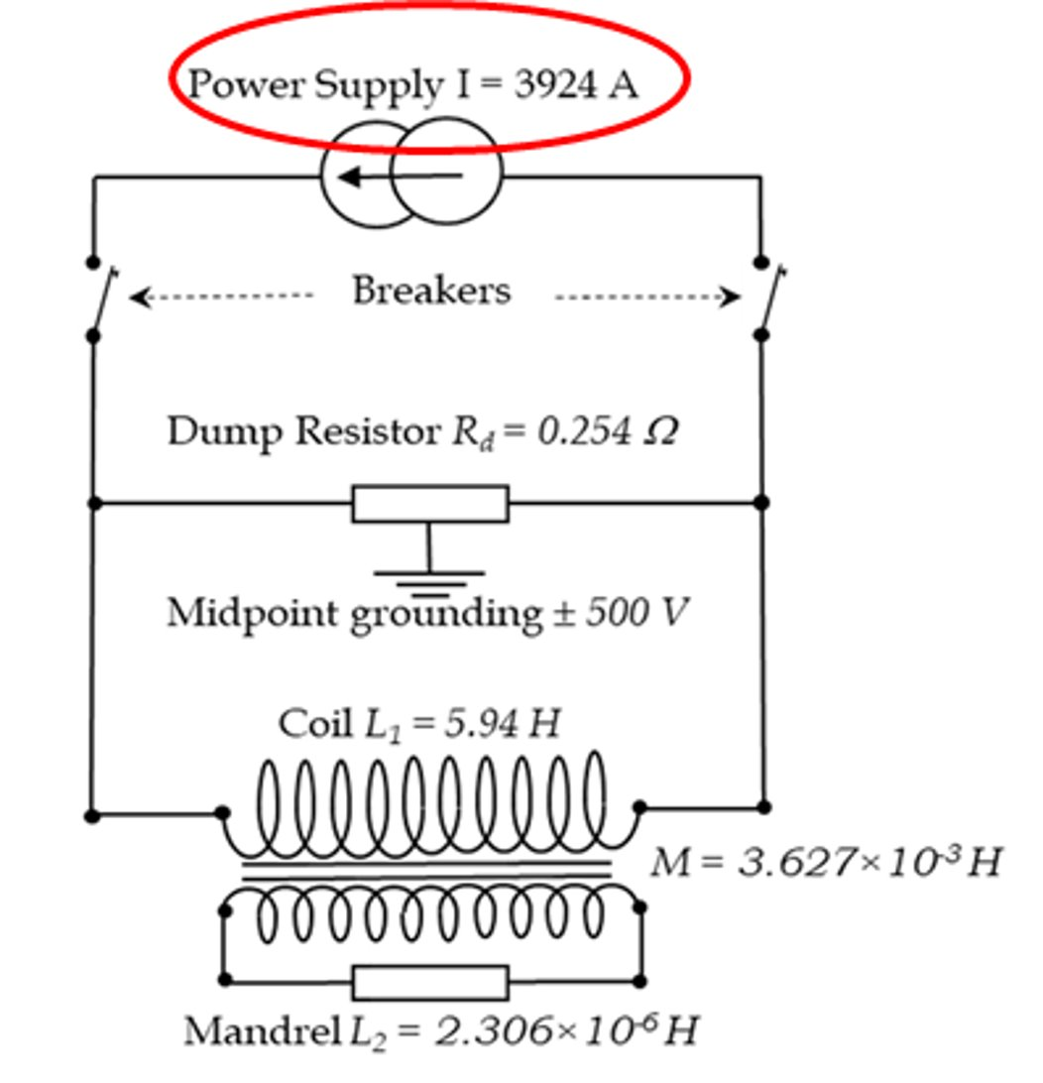
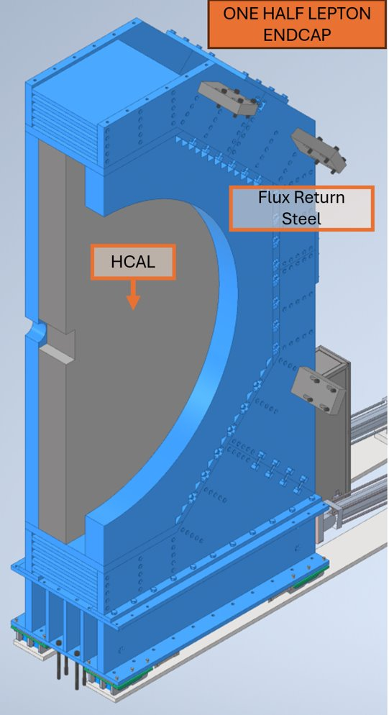
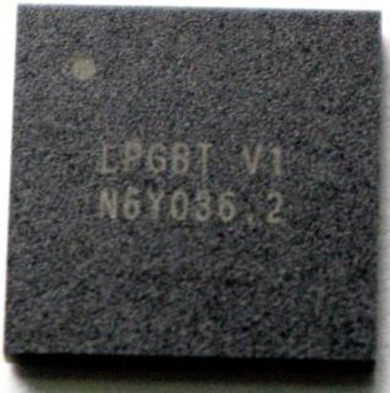
Construction is starting: CD-3B
Accelerator
Electron Storage Ring (ESR) Dipole Magnets
Advanced Photon Source (APS) Sextupole Magnet Refurbishment, Testing, and Measurement
ESR Magnetic Measurement Bench
APS Quadrupole Magnet Refurbishment, Testing, and Measurement
ESR APS Quadrupole Magnetic Measurement Stand
* Lead Tungstate Crystals for the Detector Backward Electromagnetic (EM) Calorimeter - Batch 3 and Batch 4
* Scintillating Fibers for the Detector Barrel - Bath 2 and Forward - Batch 2 EM Calorimeters
* Steel for the Detector Forward Hadronic Calorimeter
Detector Solenoid Magnet Power Supply
Detector Electronics Versatile Link Plus Transceiver (VRTX+) and Low Power Giga-bit Transceiver (lpGBT)
Detector Endcap Structures – Flux Return Steel
Detector
* Continuation of CD-3A contracts
Approved and Waiting for Authorization – Preparing procurements
Latest wrinkle: DOE asked to add DIRC bar refurbishment

Slide 7
PDR of the Cherenkov-based PID detectors (pfRICH, dRICH, hpDIRC) & FDR of the BABAR DIRC Bar Refurbishment for hpDIRC
Dates: April 1-2, 2025
Reviewers: Peter Krizan (U Ljubljana)
Floris Keizer (CERN)
Ana Amelia Machado (UniCamp)
Koji Nakamura (KEK)
Justin Stevens (W&M)
Why the FDR?
The DOE Office of Nuclear Physics decided that the work on the DIRC bar refurbishment, even if we never procure new bars, should be included in the CD-3B request.
Since we know the amount of bars we need, and we know the scope of work we have to do, we have adjusted to fold this in.
Note that the assumption is we can reuse the bars, and if we find we end with not sufficient quality bars for ePIC we carry also a risk-based contingency through the risk registry.

Slide 8
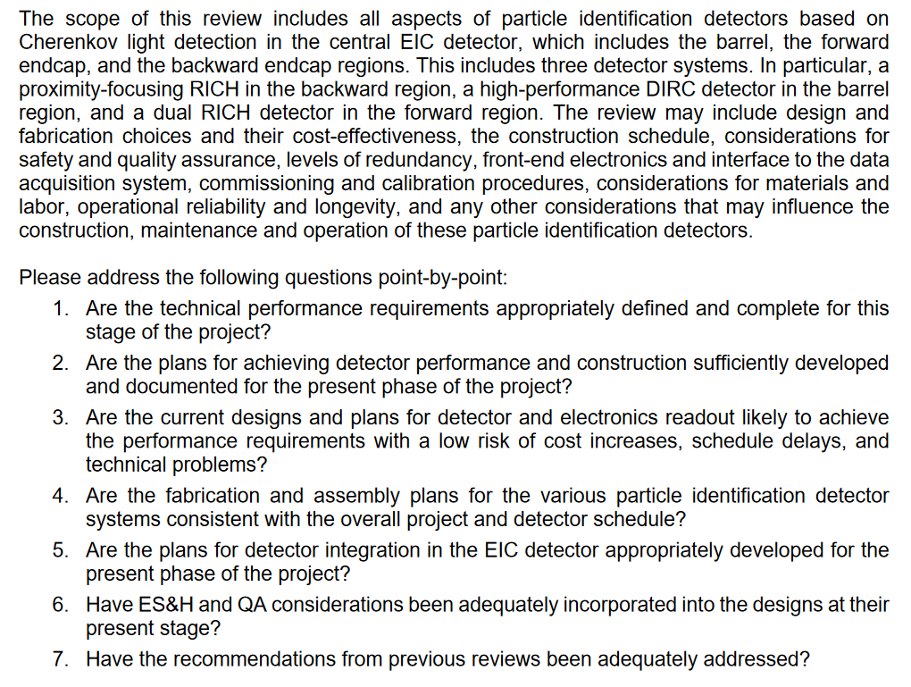
PDR of the Cherenkov-based PID detectors (pfRICH, dRICH, hpDIRC) - Charge

Slide 9
FDR of the BABAR DIRC Bar Refurbishment for hpDIRC - Charge

Slide 10
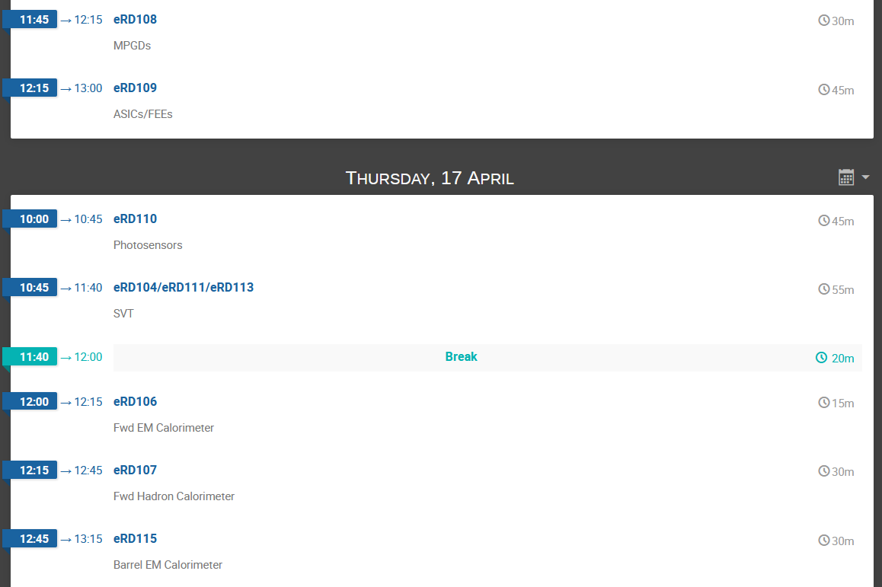
Joint ePIC/EIC Project Detector R&D “Day”
The purpose of the meeting is of course to touch base and discuss the progress and status of the remaining R&D efforts. Some of the programs have finished and their presentation can be a brief show-and-tell to remind everyone what was learned and where things stand. For the ongoing projects we need to hear about where we stand with the milestones/deliverables and what the plan is to retire them.

Slide 11
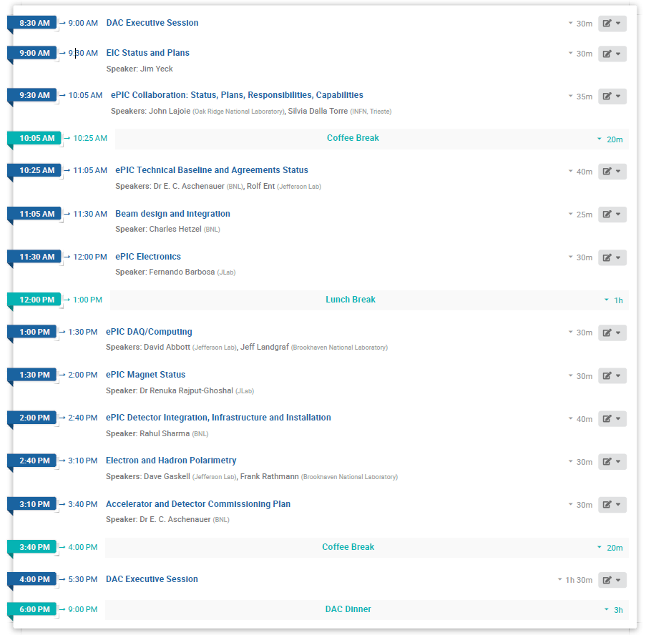
10th DAC Meeting, June 11-13, 2025
Talk added

Slide 12
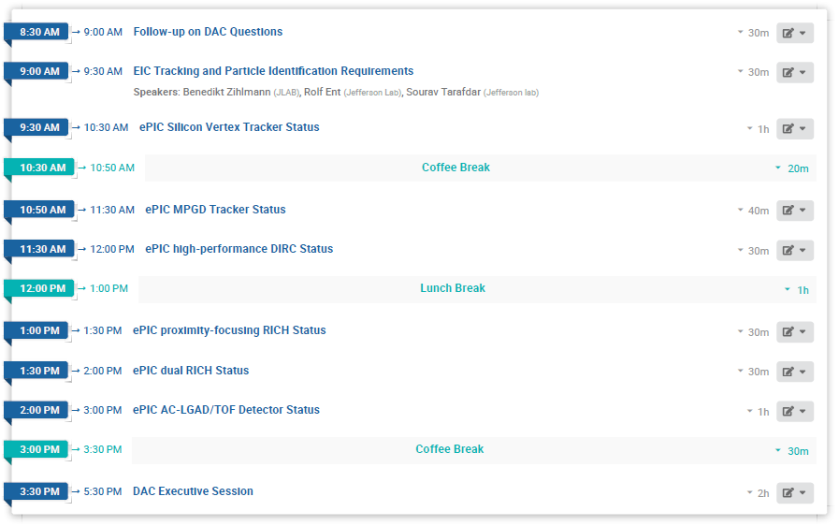
10th DAC Meeting, June 11-13, 2025
Note that in some cases we still need to finalize and indicate the speakers

Slide 13
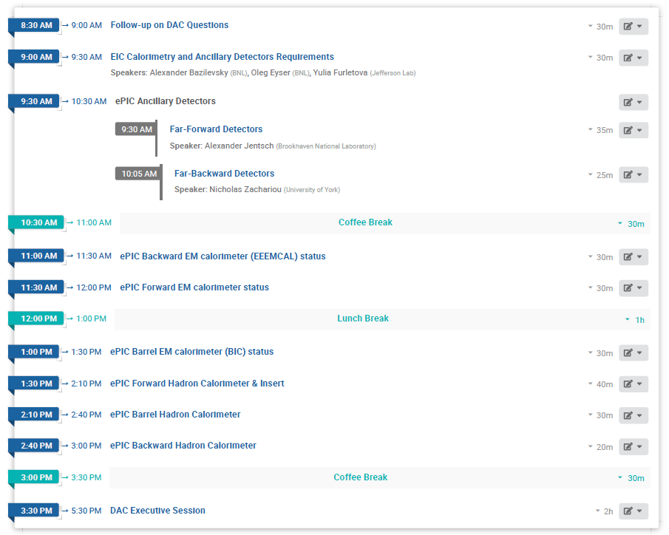
10th DAC Meeting, June 11-13, 2025
Note that in some cases we still need to finalize and indicate the speakers

Slide 14
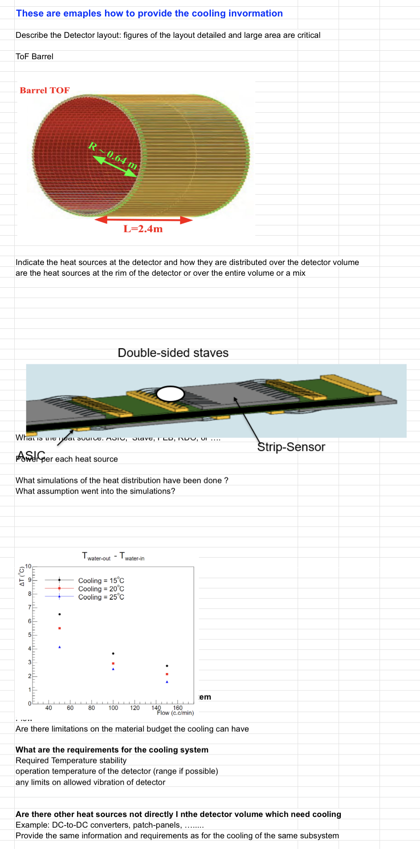
Cooling Requirements – Deadline 03/17/2025
Made an example of what we would like to see for the cooling from each subgroup.
Spreadsheet is here
Some examples of information we would like:
Heat sources and where they are located on your detector
How are the heat sources distributed over your detector?
How many heat sources are there? Are they FEBs, ASICs, RDOs, etc.
What simulations have you done for heat distribution?
What assumptions did you make for these simulations?
What assumptions have you made about your cooling system?
What are your requirements for a cooling?
What is the required temperature stability?
What is the operating temperature?
Any limits on allowed vibration for the detector?
Are there any other heat sources not in the detector volume which need cooling?
Is there any other pertinent information we should know?
We understand there remain unknowns but please fill in what you can such that we can iterate.

Slide 15
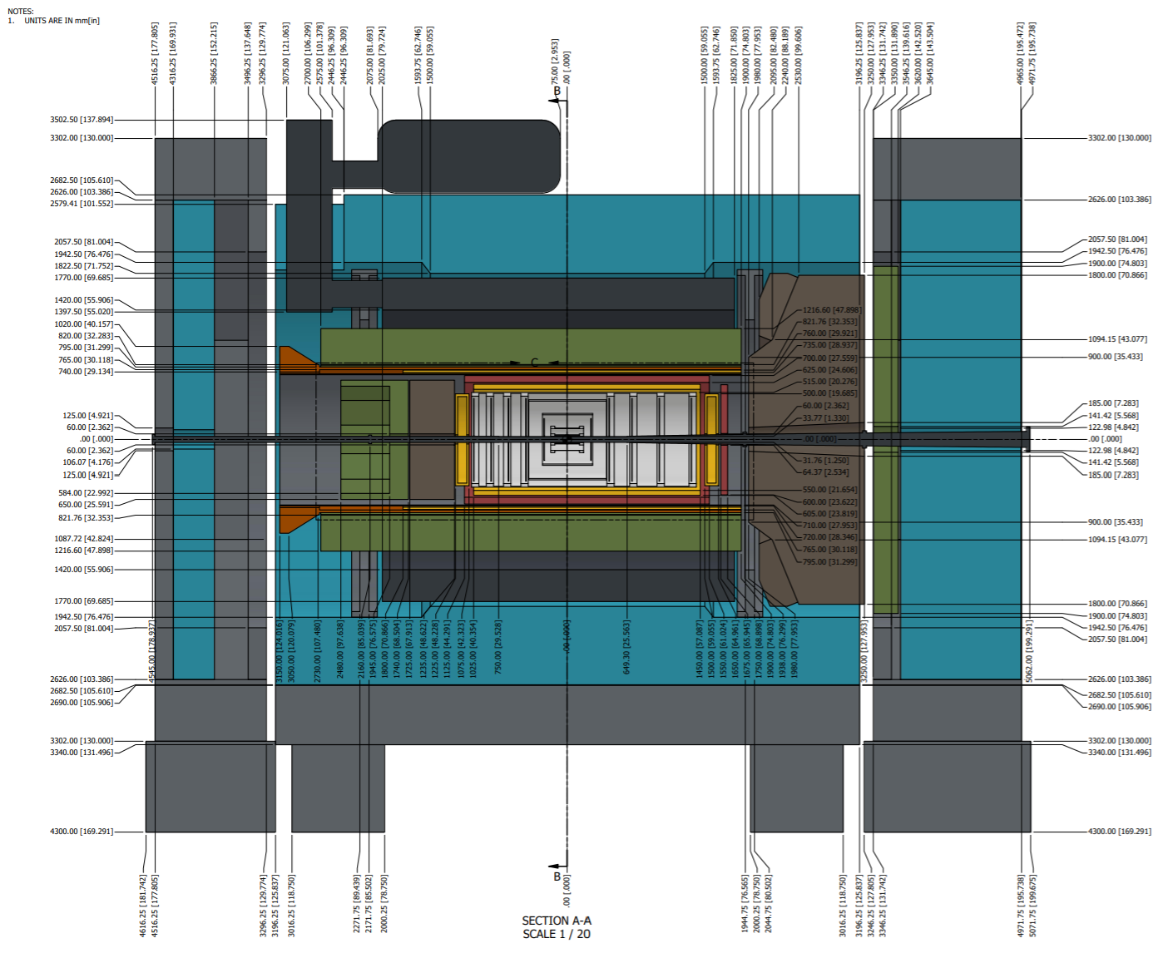
Envelope Updates
The model is current as of beginning of March.
This pdf is in Vault and at https://eic.jlab.org/Geometry/Detector/
Current updates include:
major updates to the beam pipe, flanges remain same size
MPGD disks and barrel slightly shifted
ToF barrel was shortened such that it shares a centerline with the inner MPGD barrel
ToF disk was moved closer to IP
DIRC and oMPGD shifted outward radially
DIRC shifted 3 cm towards electron endcap and shortened spool piece by 2 cm
Pending Updates:
The most backward SVT disk has an interference with the MPGD disks
Will provide also an envelope drawing of active detector areas
We plan to retire the geometry database now → envelopes become too complex for 2d approach

Slide 16
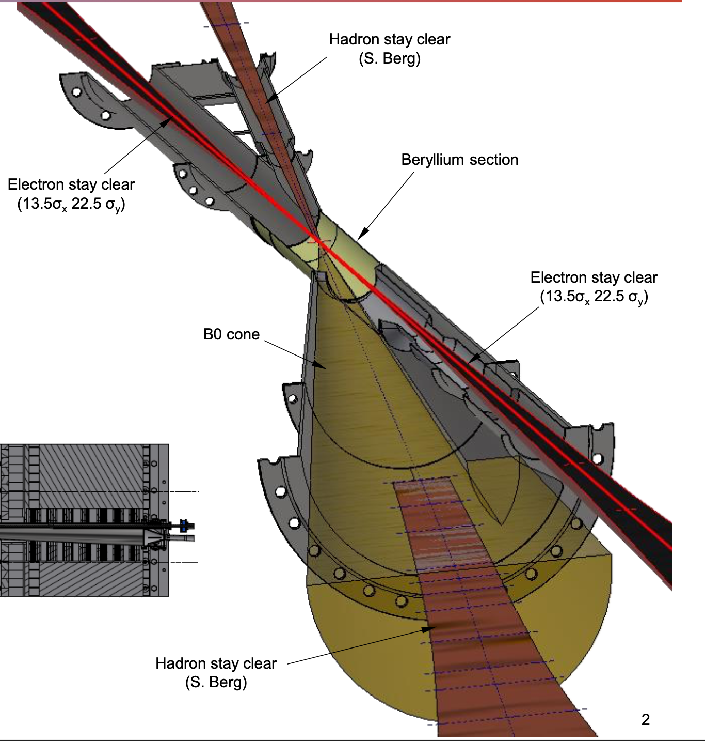
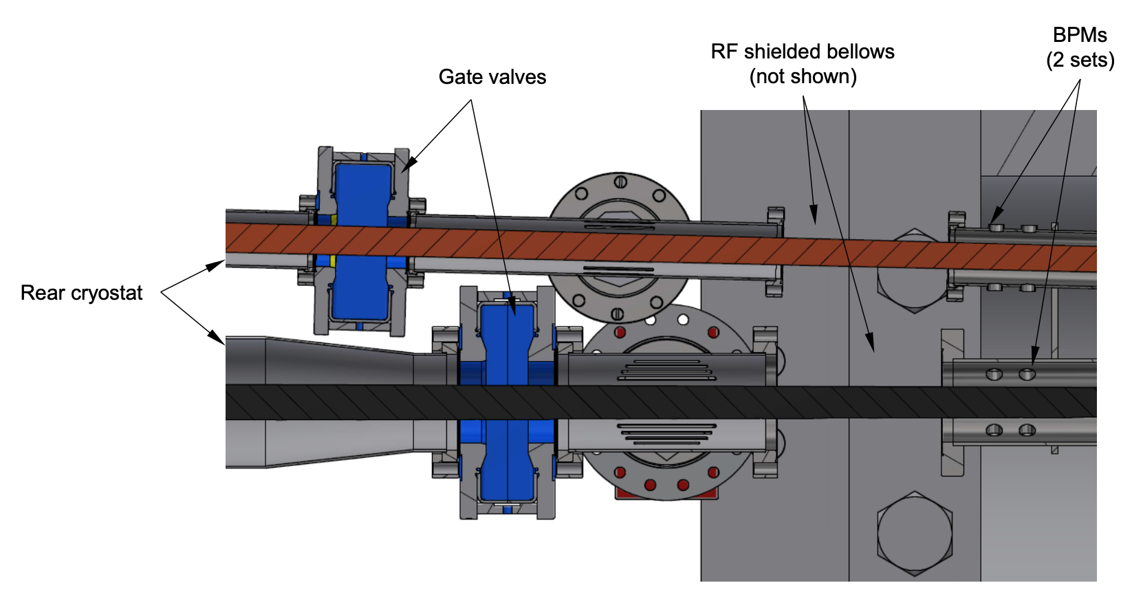
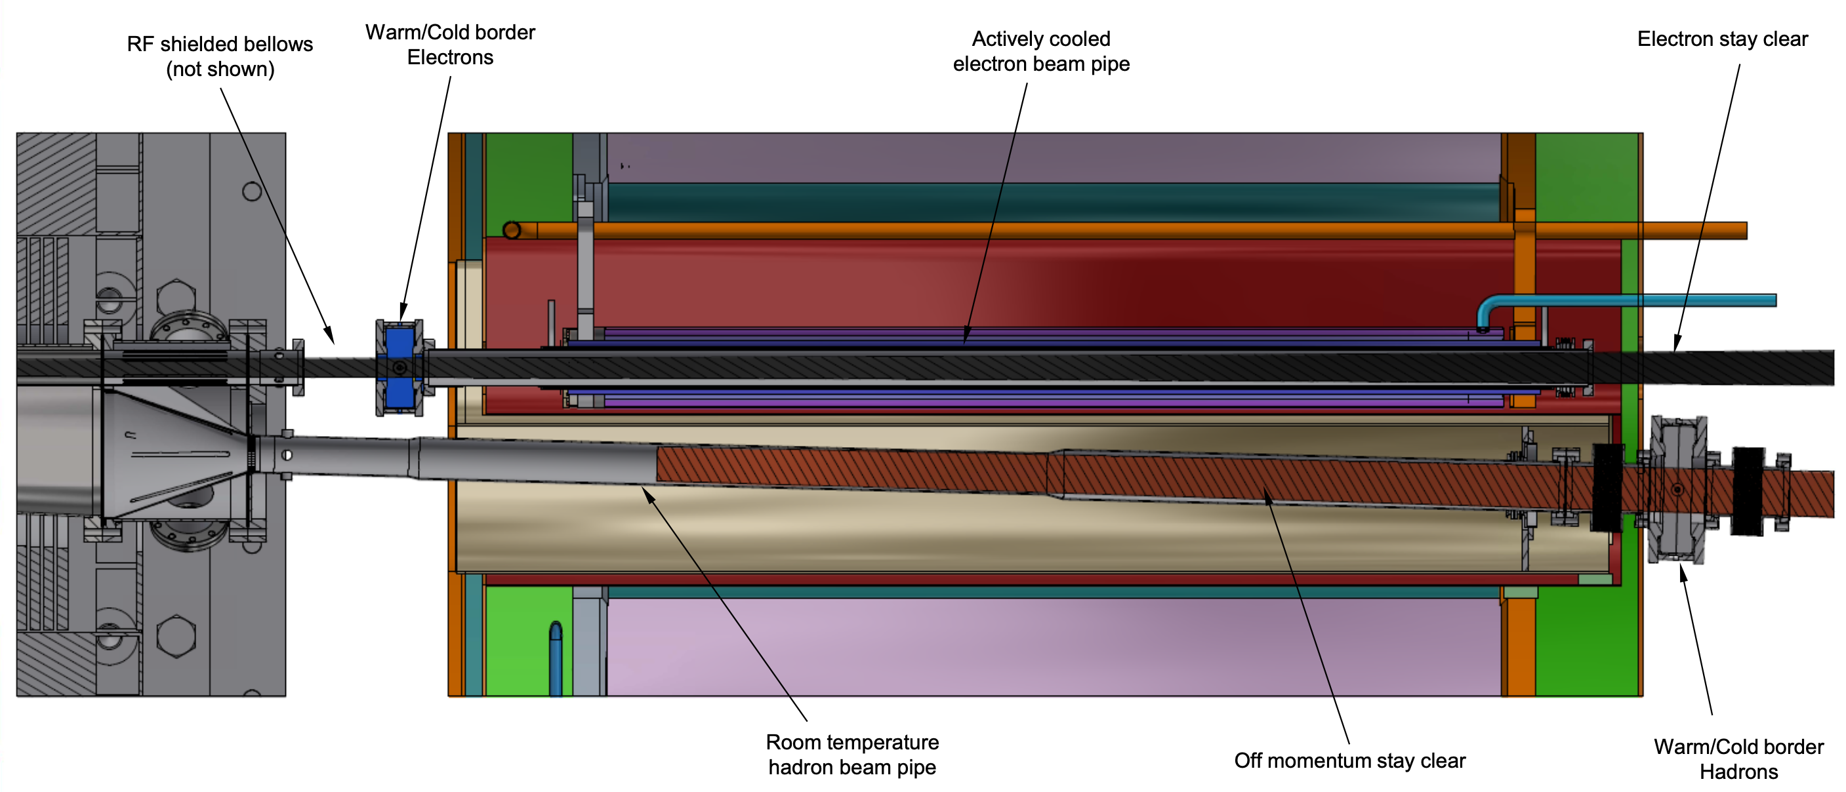
Updates to Beampipe
• Improved electron beam pipe
• Diameter steps down with stay clear envelope
• Collimates scattered photons from upstream
• Better integration with detector
• Optimized flange locations
• Removed flange before DRICH
• Integration of BPMs
• Gate solution for both sides of detector

Slide 17
Subsystem and Beampipe Clearance
All detectors need a minimum 5mm clearance to the beampipe all around.
For the EEEMCAL and pfRICH a 10mm clearance to the beampipe and the flange is preferred
dRICH needs further discussion once we receive the latest model

